Slide 1
The Lymphocyte Detection Project
Team 6
Detection of lymphocytes in histopathology whole-slide images of breast, colon and prostate cancer, stained with immunohistochemistry
Supervisor: Francesco Ciompi
June 4, 2018

Slide 2



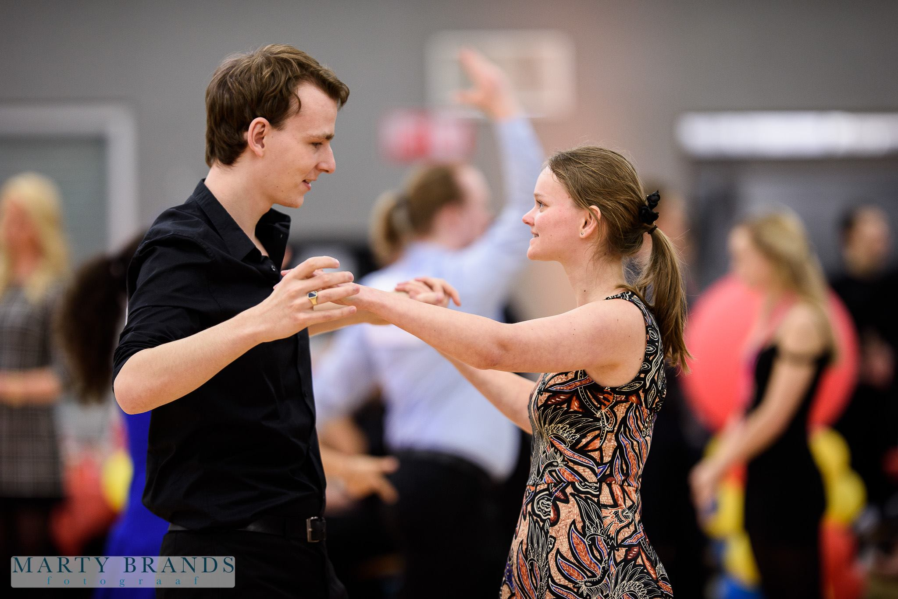
Team Boy Band
Gijsbrecht
..already in a complicated relationship with Numpy
Software Science
Christoph
“The bad boy”
Data Science
Jeffrey
“The Innocent one”
Data Science
Brian
“The hot one”
Data Science

Slide 3
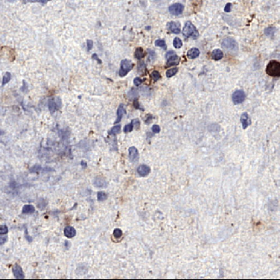
Our Assignment (1)
Scans contain lymphocytes
Breast, colon, and prostate
Strong variations in dimensions
Locations in csv file
Various artifacts

Slide 4
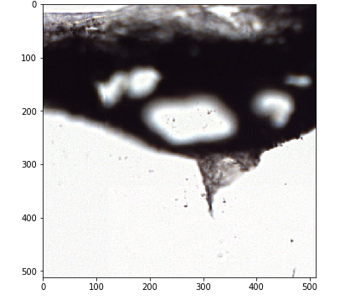
Our Assignment (2)
Strong case for counting lymphocytes because it is related to outcome
And takes long if done manually
Train a model to detect them
Predict and output the coordinates of the centroid of the prediction to a csv file.

Slide 5
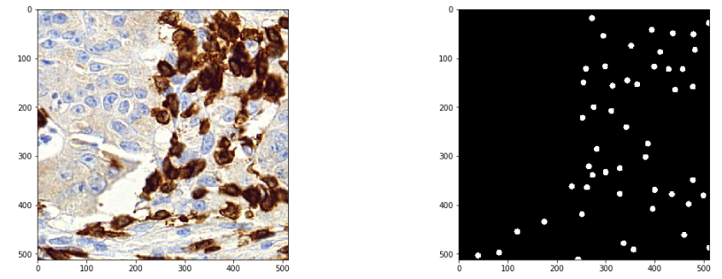

Images And Annotations

Slide 6
Our Approach: Outline
First hunch: Yolo it
“Boxes are stupid anyway though, I’m probably a true believer
in masks except I can’t get YOLO to learn them.”
- Joseph Redmon (on comments received with yolov3)
U-net performed well in literature
Manually annotate images for a mask
Or
Generate masks (saves us work, right?)

Slide 7
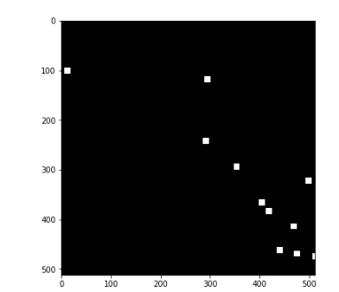
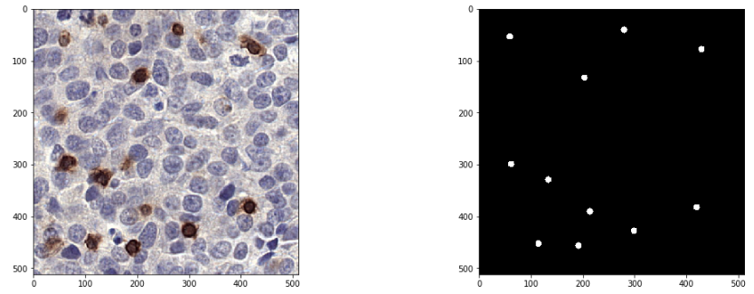
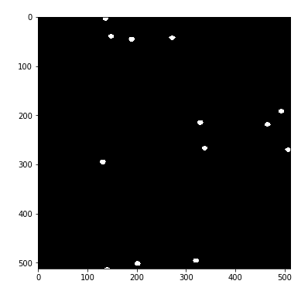
Mask Creation
Square
Circle
Elipsis

Slide 8
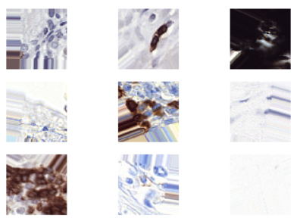

Data Augmentation
The basic stuff
Looking at warping with OpenCV
Shifting wasn’t a great idea ->

Slide 9
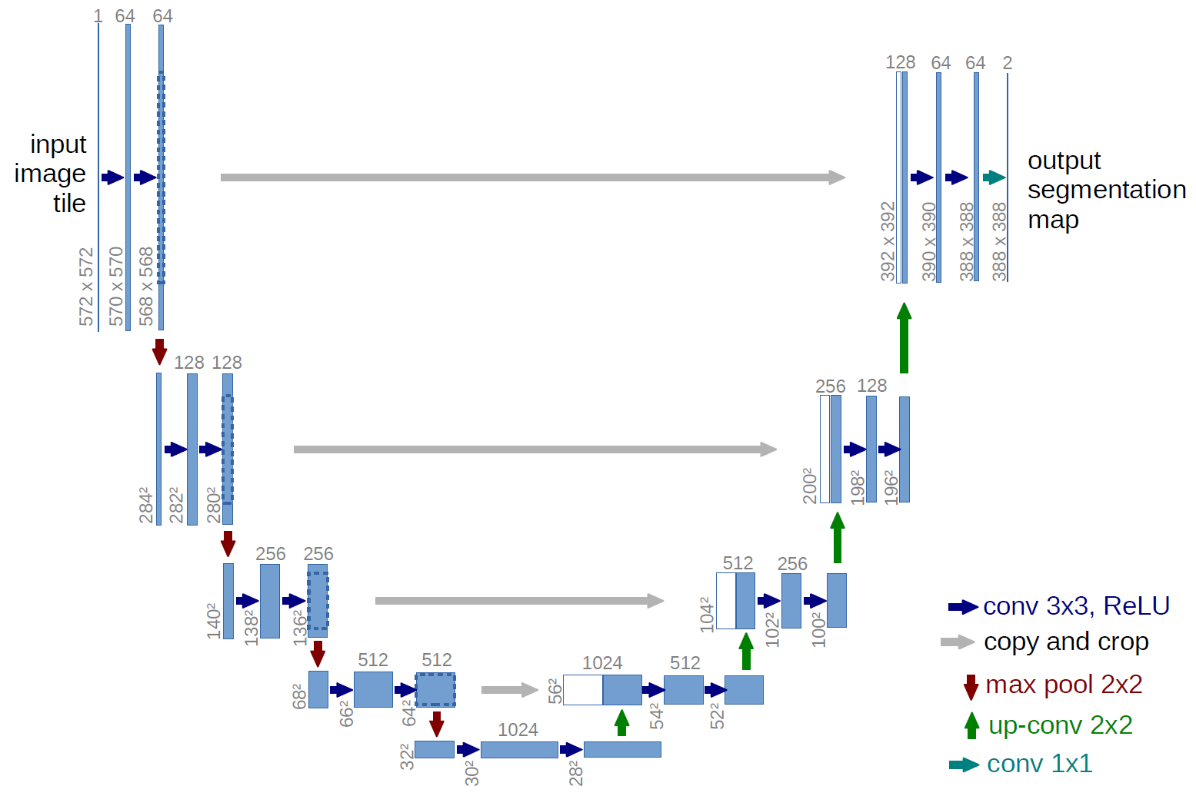
U-Net (1)
2015
Uni of Freiburg

Slide 10
U-Net (2)
Ours only goes to 512, but we experiment with different architectures
We train on patches of 512x512 with 3 channels. Patches need to contain lymphocytes

Slide 11
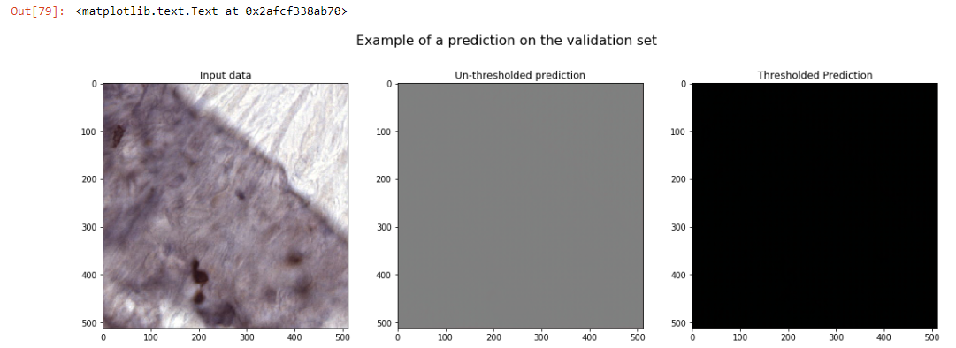
Results So Far
Eh.

Slide 12
Our Plans For The Rest Of The Course
Different augmentations - such as warping
Better sampling techniques
Try + evaluate manual annotation
Customize our functions with better penalties for background

