Slide 1
Rates with Year 8s

Slide 2
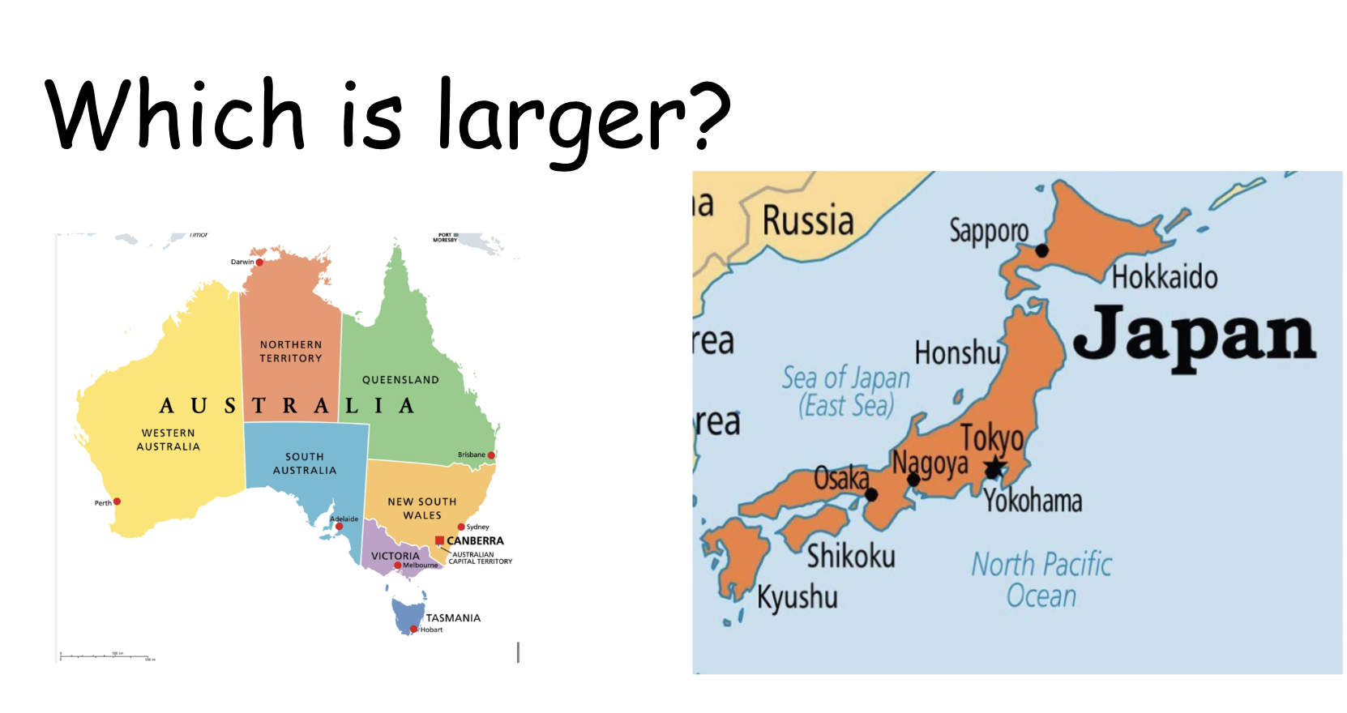

Slide 3
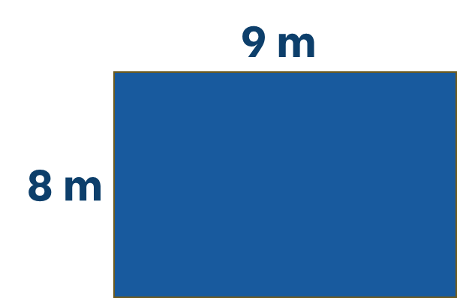

Which is larger?
Or, are they the same?
OR

Slide 4
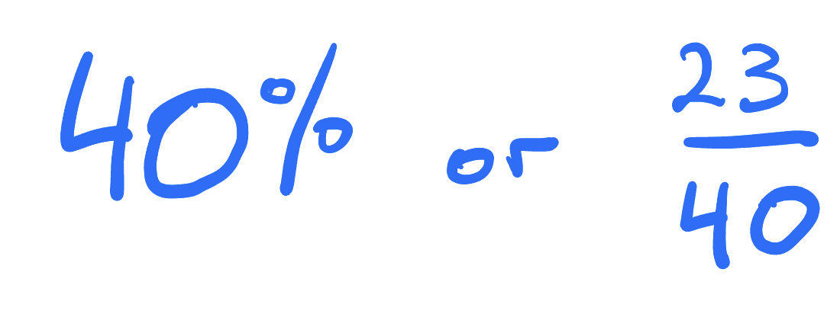
Which is larger?
Or, are they the same?

Slide 5
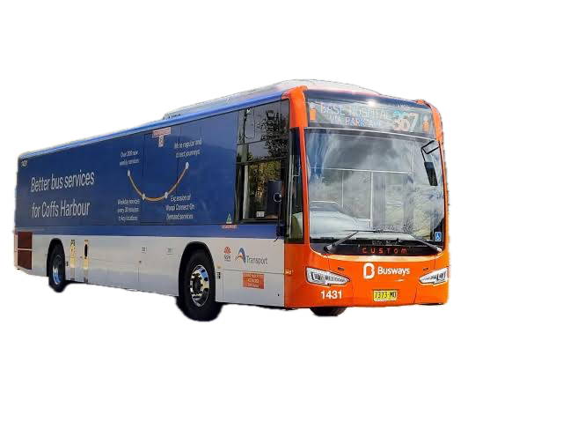
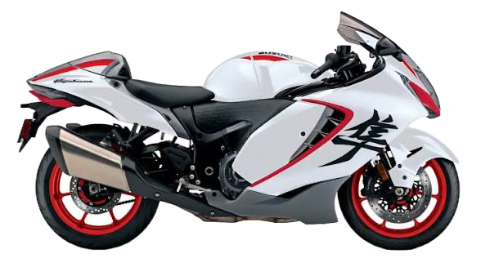
Which is larger?
Or, are they the same?

Slide 6
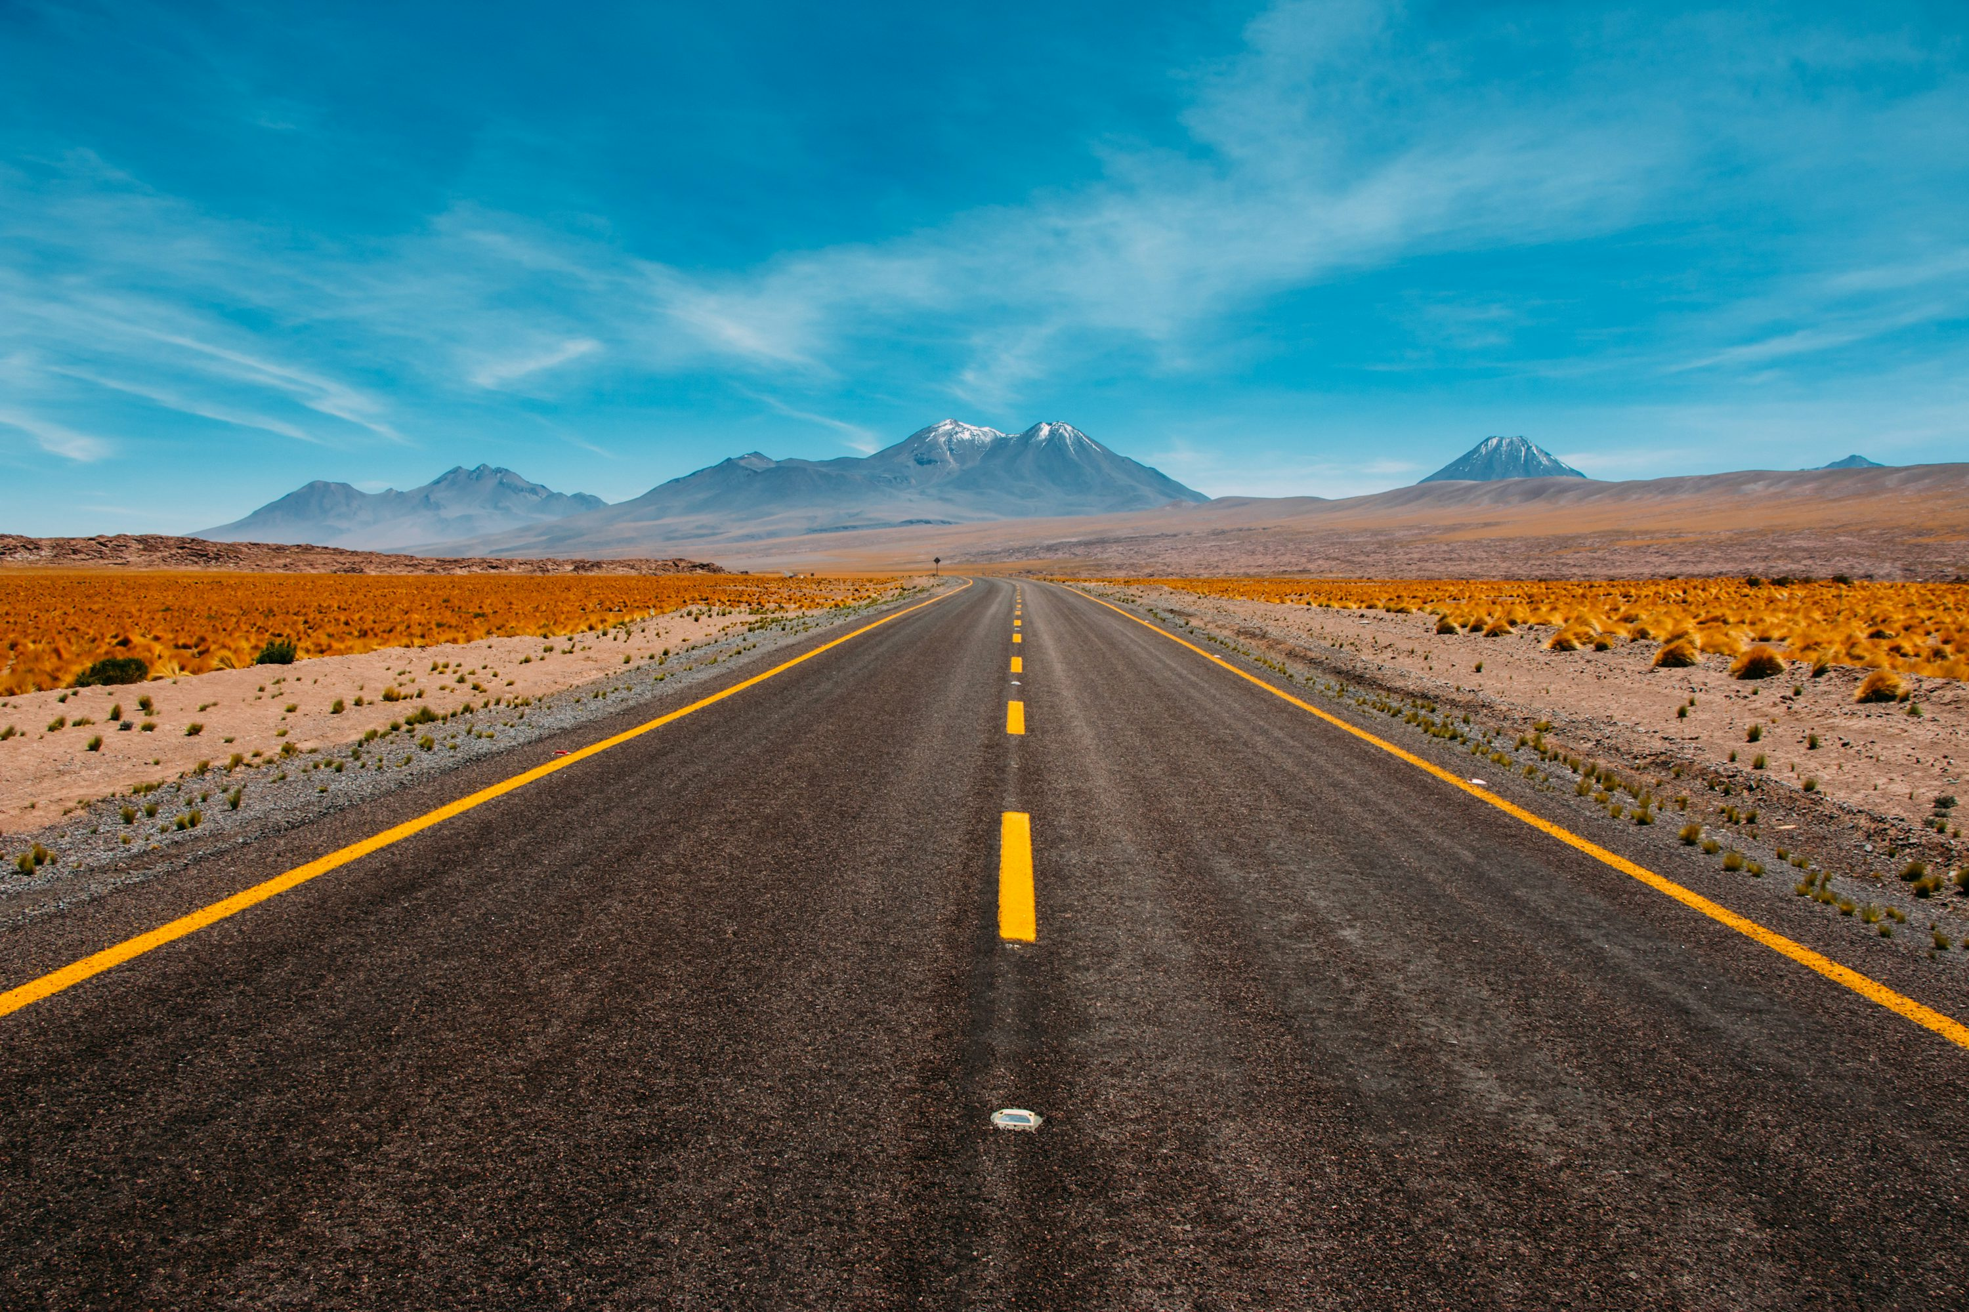
The top speed of a Hayabusa is 300 km/hr

Slide 7
The top speed of a Hayabusa is 300 km/h
What does this mean?!?

Slide 8
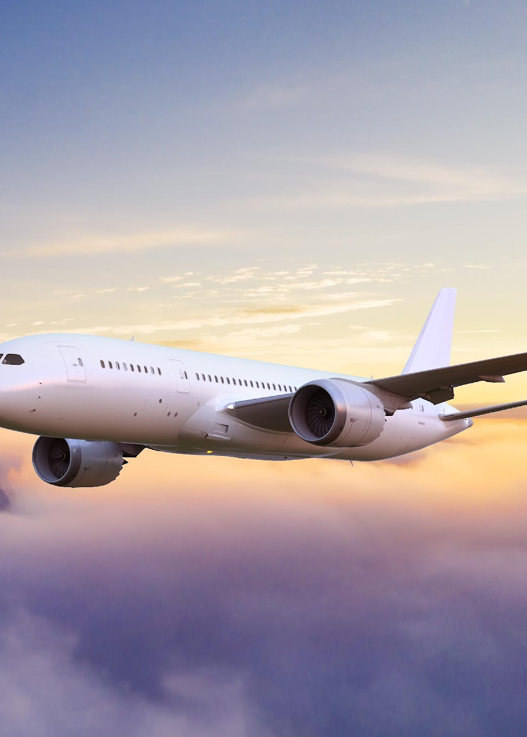
Question 1
An aeroplane travels at 800 km per hour.
What other information can you find?

Slide 9
Question 1
An aeroplane travels at 800 km per hour.
How far has it travelled after 4 hours and 30 minutes?

Slide 10
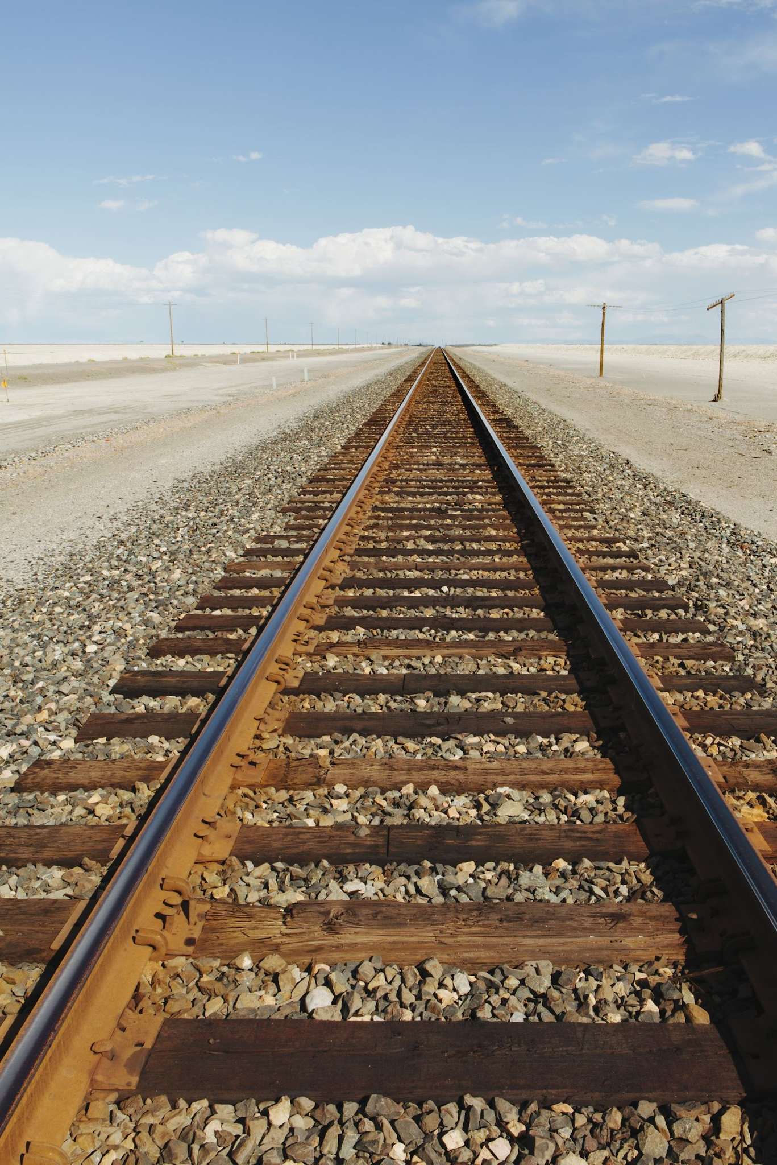
Question 2
A train travels 600km in four hours
What other information can you work out?

Slide 11

Question 2
A train travels 600km in four hours
How far has it travelled after 1 hour and 15 minutes?

Slide 12
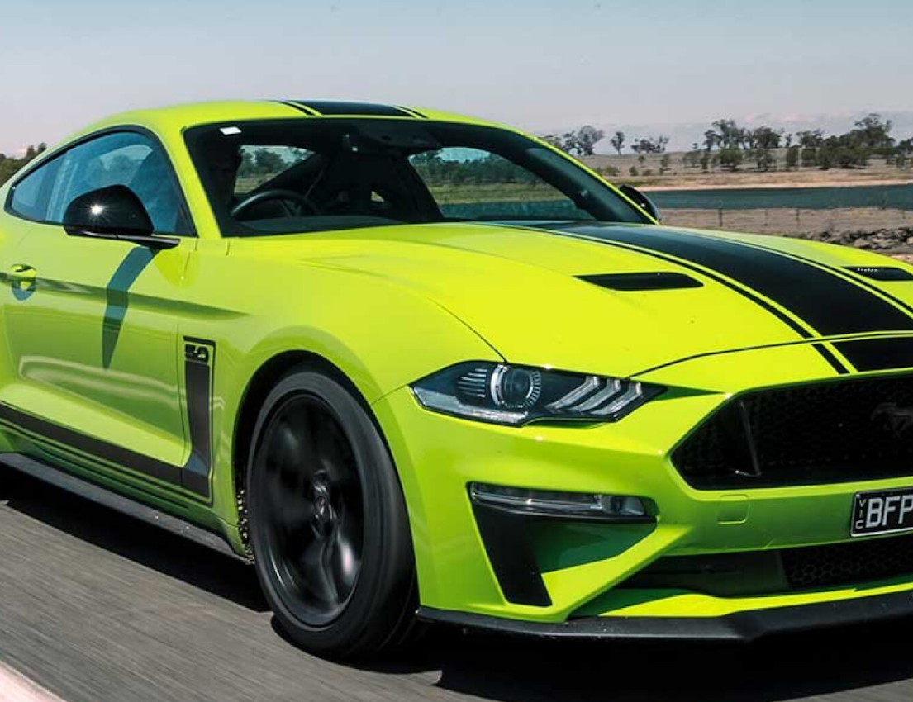
Question 4
A car is travelling at an average speed of 80km/hr
What information can you work out?

Slide 13
Question 4
A car is travelling at an average speed of 80km/hr
How long will it take for the car to travel 240 kilometres?

Slide 14
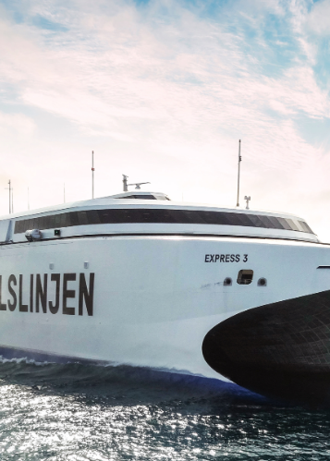
Question 5
A Ferry travelling at 30km/hour leaves a port at 6:00 pm
What information can you work out?

Slide 15
Question 5
A Ferry travelling at 30km/hour leaves a port at 6:00 pm
How far has it travelled when it is 10:30pm?

Slide 16
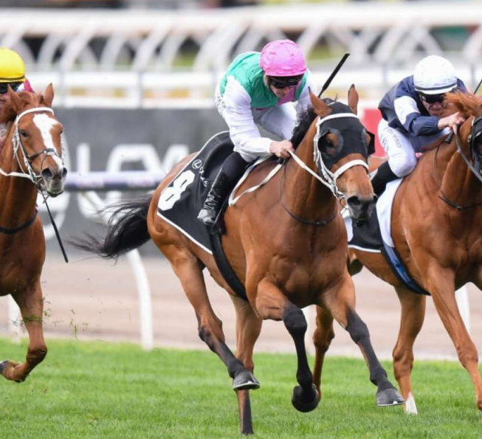
Question 6
A horse can at an average speed of 60km/hour.
What information can you work out?

Slide 17
Question 6
A horse can run at an average speed of 60km/hour.
How long will it take for the horse to complete a 3km race?

