Slide 1
STAGE 3 · TERM 3, WEEK 8
Division Strategies
Three ways to break a number apart.
One of them is going to become your favourite.

Slide 2
Before we start
I teach high school maths.
I'm here to steal your best strategies and take them back to Year 7.
So: show me something good.

Slide 3
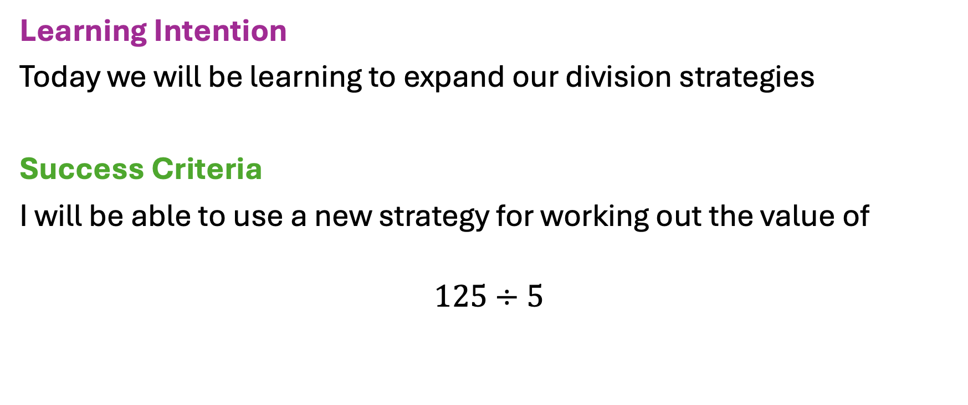
WHERE WE'RE HEADING
Three strategies today. Pick a favourite by the end — and be ready to defend it.

Slide 4
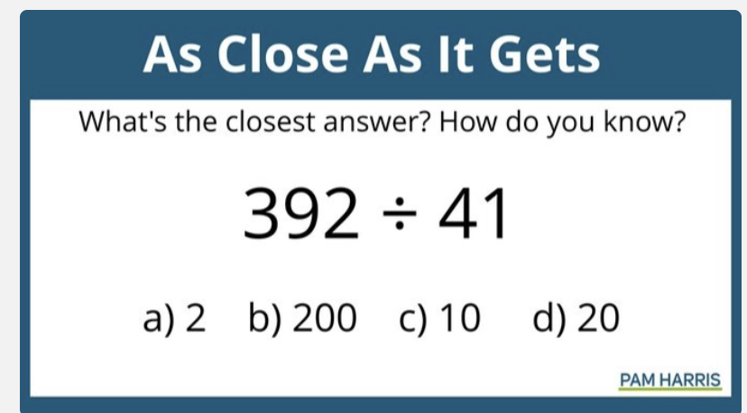
WARM UP
Don't say it.
I can see you wanting to say it. Don't.

Slide 5
WARM UP
Which ones can you rule OUT?
Ruling out is easier than picking. Start there.

Slide 6
WARM UP
Which ones can you rule OUT?
Ruling out is easier than picking. Start there.
How do you know? Convince me.
Nobody needs the exact answer. Nobody.

Slide 7
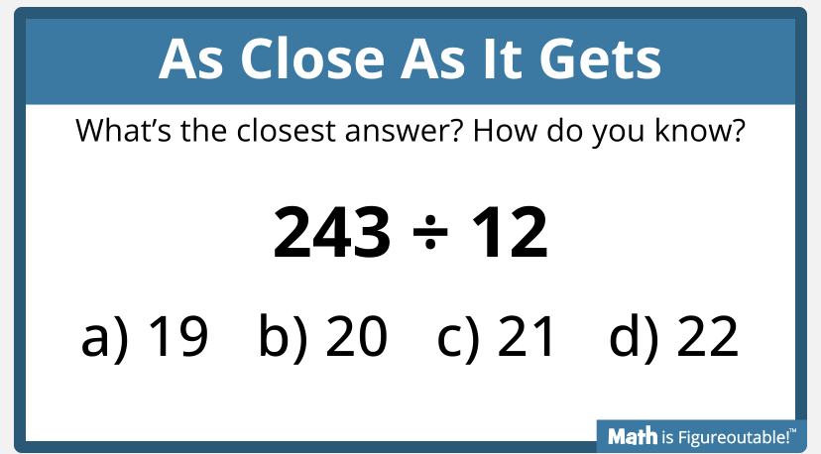
WARM UP · ROUND TWO
Partner first. No hands.
Tell your partner which one. Then tell them why.

Slide 8
WARM UP · ROUND TWO
Did anyone change their mind?
Changing your mind is a maths skill. Own up.
Keep this one.
We come back to it.
Somebody in this room is about to find out this one is sneaky.

Slide 9
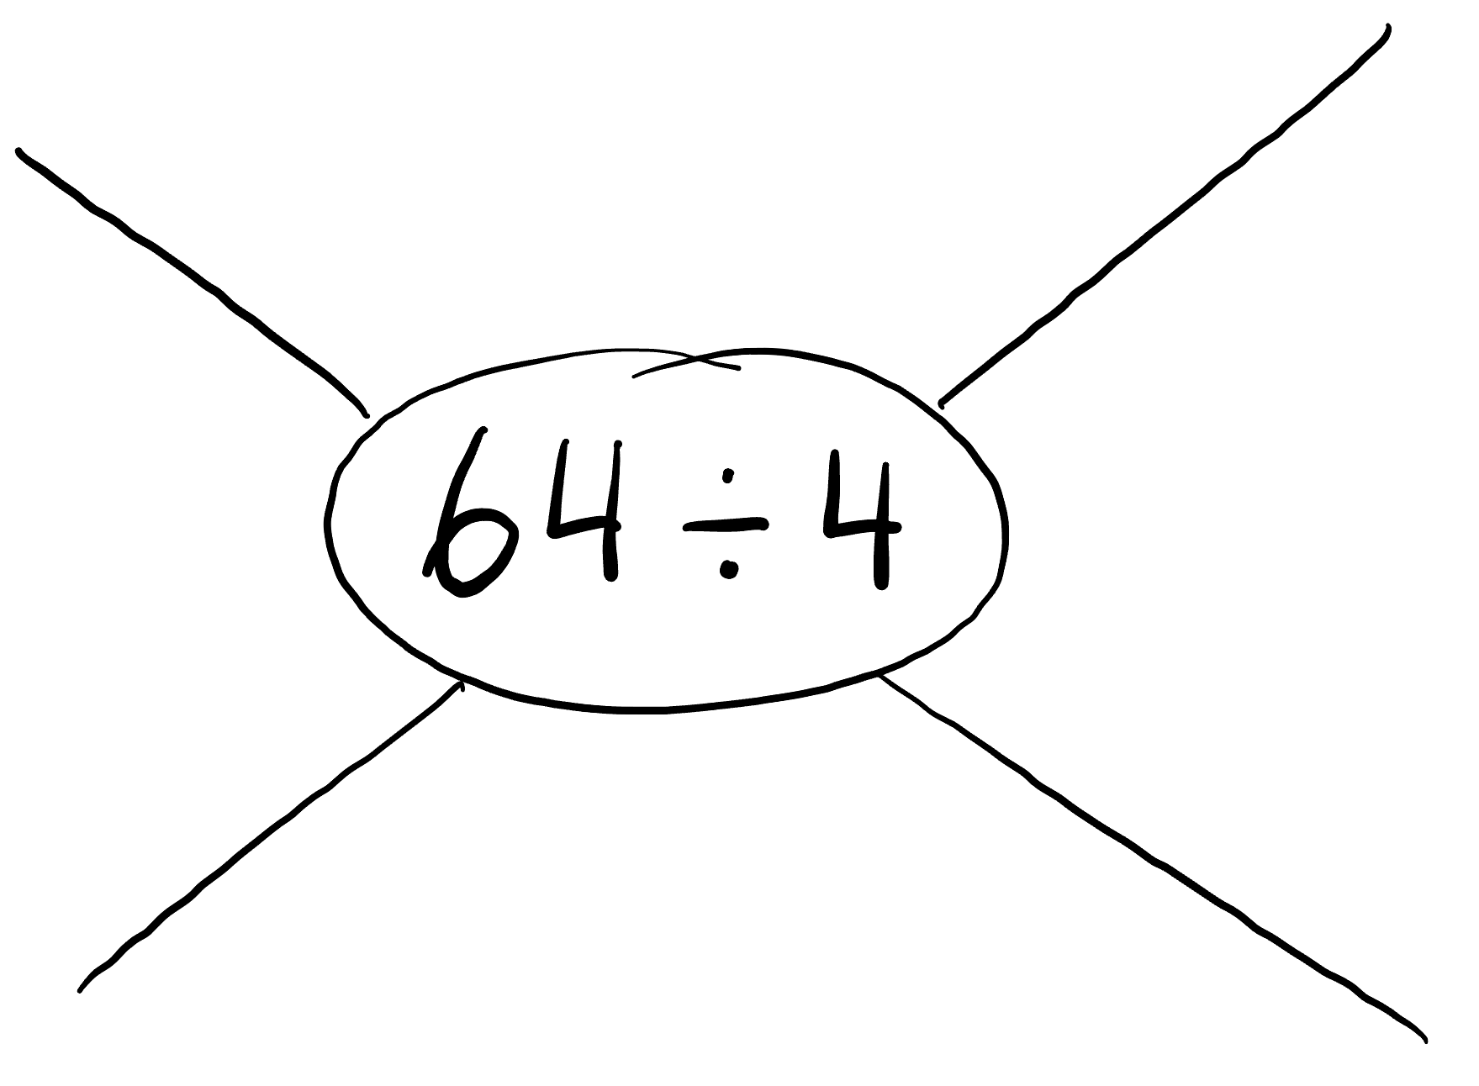
OFF YOU GO
Four ways. Yes, four.
If you find two, that's a win. If you find four, I'm taking a photo.

Slide 10
OFF YOU GO
The small print
Two minutes. Silent. On your own.
Then compare with your partner.
A different way means different thinking — not different handwriting.
Stuck at two? Write the two. That is still an answer.

Slide 11
1
STRATEGY 1 OF 3
Sharing and regrouping
Deal the number out into equal groups.
But not one at a time. We are not animals.

Slide 12
STRATEGY 1 · SHARING AND REGROUPING
64 ÷ 4
four groups, and 64 to hand out
Where do we start?

Slide 13
STRATEGY 1 · SHARING AND REGROUPING
64 ÷ 4
four groups, and 64 to hand out
Everyone gets 10. Why 10?
10
10
10
10

Slide 14
STRATEGY 1 · SHARING AND REGROUPING
64 ÷ 4
four groups, and 64 to hand out
So how much is gone, and how much is left?
10
10
10
10
4 × 10 = 40
handed out so far
64 − 40 = 24 still to share

Slide 15
STRATEGY 1 · SHARING AND REGROUPING
64 ÷ 4
four groups, and 64 to hand out
Now deal out the 24 that's left.
10 + 6
10 + 6
10 + 6
10 + 6
4 × 10 = 40
handed out so far

Slide 16
STRATEGY 1 · SHARING AND REGROUPING
64 ÷ 4
four groups, and 64 to hand out
And that's the lot.
10 + 6
10 + 6
10 + 6
10 + 6
4 × 10 = 40
handed out so far
4 × 6 = 24
and that clears it — 0 left

Slide 17
STRATEGY 1 · SHARING AND REGROUPING
64 ÷ 4
four groups, and 64 to hand out
Add up what one group got.
10 + 6
10 + 6
10 + 6
10 + 6
4 × 10 = 40
handed out so far
4 × 6 = 24
and that clears it — 0 left
64 ÷ 4 = 16

Slide 18
STRATEGY 1 · SHARING AND REGROUPING
64 ÷ 4
four groups, and 64 to hand out
Now prove it.
10 + 6
10 + 6
10 + 6
10 + 6
4 × 10 = 40
handed out so far
4 × 6 = 24
and that clears it — 0 left
64 ÷ 4 = 16
Check it backwards: 16 × 4 = 64

Slide 19
Why 10, and not 1 at a time?
Because we already knew 4 × 10.
Deal in handfuls you already know. That's the whole trick.

Slide 20
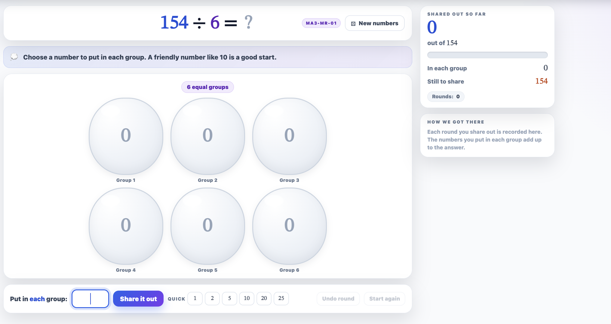
https://millsmathstools.au/interactive-tools/stage-3/number/division-grouping-bubbles/

Slide 21
2
STRATEGY 2 OF 3
Known products
Start from a fact you already know. Build up to the one you want.
Nothing you write down gets wasted.

Slide 22
STRATEGY 2 · KNOWN PRODUCTS
64 ÷ 4
how many 4s make 64?
groups | × 4
How many 4s does it take to make 64?

Slide 23
STRATEGY 2 · KNOWN PRODUCTS
64 ÷ 4
how many 4s make 64?
groups | × 4
1 | 4
Start with one. Always start with something true.

Slide 24
STRATEGY 2 · KNOWN PRODUCTS
64 ÷ 4
how many 4s make 64?
groups | × 4
1 | 4
10 | 40
Ten groups. The easiest jump there is.
← write this row first, every single time

Slide 25
STRATEGY 2 · KNOWN PRODUCTS
64 ÷ 4
how many 4s make 64?
groups | × 4
1 | 4
10 | 40
5 | 20
Half of ten groups is five groups. So half of 40.

Slide 26
STRATEGY 2 · KNOWN PRODUCTS
64 ÷ 4
how many 4s make 64?
groups | × 4
1 | 4
10 | 40
5 | 20
1 | 4
One more group. 40 + 20 + 4 = 64.

Slide 27
STRATEGY 2 · KNOWN PRODUCTS
64 ÷ 4
how many 4s make 64?
groups | × 4
1 | 4
10 | 40
5 | 20
1 | 4
16 | 64
10 + 5 + 1 = 16 groups. Done.
64 ÷ 4 = 16
Same numbers as the bubbles — 40, 20, 4. Different bookkeeping.

Slide 28
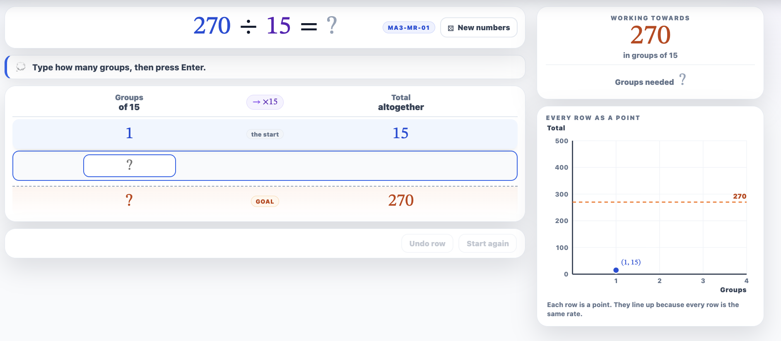
https://millsmathstools.au/interactive-tools/stage-3/number/ratio-table-division/

Slide 29
375 ÷ 15
What strategy is best?

Slide 30
STRATEGY 2 · WHERE BUBBLES GIVE UP
375 ÷ 15
groups | × 15
Fine. Table it is.

Slide 31
STRATEGY 2 · WHERE BUBBLES GIVE UP
375 ÷ 15
groups | × 15
1 | 15
One group is 15. Free information.

Slide 32
STRATEGY 2 · WHERE BUBBLES GIVE UP
375 ÷ 15
groups | × 15
1 | 15
10 | 150
Ten groups is 150. Told you.

Slide 33
STRATEGY 2 · WHERE BUBBLES GIVE UP
375 ÷ 15
groups | × 15
1 | 15
10 | 150
20 | 300
Double that row. 20 groups is 300 — and we didn't start again.

Slide 34
STRATEGY 2 · WHERE BUBBLES GIVE UP
375 ÷ 15
groups | × 15
1 | 15
10 | 150
20 | 300
5 | 75
300 is close. 75 more gets there — and 75 is just half of 150.

Slide 35
STRATEGY 2 · WHERE BUBBLES GIVE UP
375 ÷ 15
groups | × 15
1 | 15
10 | 150
20 | 300
5 | 75
25 | 375
20 + 5 = 25 groups.
375 ÷ 15 = 25
Every row you wrote stayed useful. Nothing wasted.

Slide 36
3
STRATEGY 3 OF 3
5 is half of 10
Dividing by 10 is easy. Dividing by 5 is that answer, doubled.
This one feels like cheating. It isn't.

Slide 37
STRATEGY 3 · ONE AT A TIME
Each one helps you with the next
120 ÷ 10
=
?
No pens. No calculators. Just say it.

Slide 38
STRATEGY 3 · ONE AT A TIME
Each one helps you with the next
120 ÷ 10
120 ÷ 5
=
=
12
?
Don't work it out from scratch. Use the one before it.

Slide 39
STRATEGY 3 · ONE AT A TIME
Each one helps you with the next
120 ÷ 10
120 ÷ 5
240 ÷ 5
=
=
=
12
24
?
Hang on. Dividing by 5 gave a BIGGER answer than dividing by 10?

Slide 40
STRATEGY 3 · ONE AT A TIME
Each one helps you with the next
120 ÷ 10
120 ÷ 5
240 ÷ 5
135 ÷ 5
=
=
=
=
12
24
48
?
Don't work it out from scratch. Use the one before it.

Slide 41
STRATEGY 3 · ONE AT A TIME
Each one helps you with the next
120 ÷ 10
120 ÷ 5
240 ÷ 5
135 ÷ 5
125 ÷ 5
=
=
=
=
=
12
24
48
27
?
Don't work it out from scratch. Use the one before it.

Slide 42
STRATEGY 3 · ONE AT A TIME
Notice anything?
120 ÷ 10
120 ÷ 5
240 ÷ 5
135 ÷ 5
125 ÷ 5
=
=
=
=
=
12
24
48
27
25
Say the rule out loud before I put it up. Someone in here has it.

Slide 43
Halve the divisor,
and the answer doubles.
Extension: 250 ÷ 25. What would you divide by first?

Slide 44
YOUR TURN
Same problem, two ways
You and your partner do the SAME question — with DIFFERENT strategies.
Then you argue about which one was better. Politely. Ish.

Slide 45
YOUR TURN
Same problem, two ways
You and your partner do the SAME question — with DIFFERENT strategies.
PARTNER A
PARTNER B
THEN, TOGETHER
Sharing and regrouping
Known products
Which way was quicker for THIS one — and why?
Bubbles. Deal in handfuls you know.
Ratio table. Write the 10 row first.

Slide 46
YOUR TURN
Same problem, two ways
You and your partner do the SAME question — with DIFFERENT strategies.
PARTNER A
PARTNER B
THEN, TOGETHER
Sharing and regrouping
Known products
Which way was quicker for THIS one — and why?
Bubbles. Deal in handfuls you know.
Ratio table. Write the 10 row first.
Round 1
Round 2
Round 3
96 ÷ 4
168 ÷ 8
245 ÷ 5
Swap over each round. Challenge on page 3: 288 ÷ 12 — how far do bubbles get you?

Slide 47
REMEMBER THIS ONE?
243 ÷ 12
You said “about 20”. Now find it exactly.

Slide 48
REMEMBER THIS ONE?
243 ÷ 12
Try a × 12 table
10 → 120
20 → 240
How much is left?
Is 3 enough for a whole group?
You said “about 20”. Now find it exactly.
Sometimes the answer isn't a whole number. That's not a mistake — that's next lesson.

Slide 49
BEFORE YOU GO
Exit ticket
1
2
290 ÷ 6
Which strategy did you pick, and why that one?
Show your working. Then check it backwards.
“Because it was quick” is not enough. Quick compared to what?

