Slide 1
DO YOU SEE WHAT I’M SAYING:
RELATING LANGUAGE AND VISION TO
CREATE INTERACTION BETWEEN
HUMANS AND ROBOTS
Jeffrey Minton

Slide 2
Topics
Hardware/Software Platform
Image Processing
Communication Framework
Using CF and Image Processing to allow robotic operation

Slide 3
Hardware/Software Platform
Two iterations
First iteration
  created to compete in Trinity College Fire Fighting Home Robot Competition
Second Iteration
  created to accomodate the needs for a class in intelligent robotics

Slide 4
First Iteration Hardware
VEX robotics kit for chassis
VEX Included motors for locomotion
Sonar Rangefinders
Web-cam
Arduino to control motors and sensors
Netbook to control arduino and process images

Slide 5
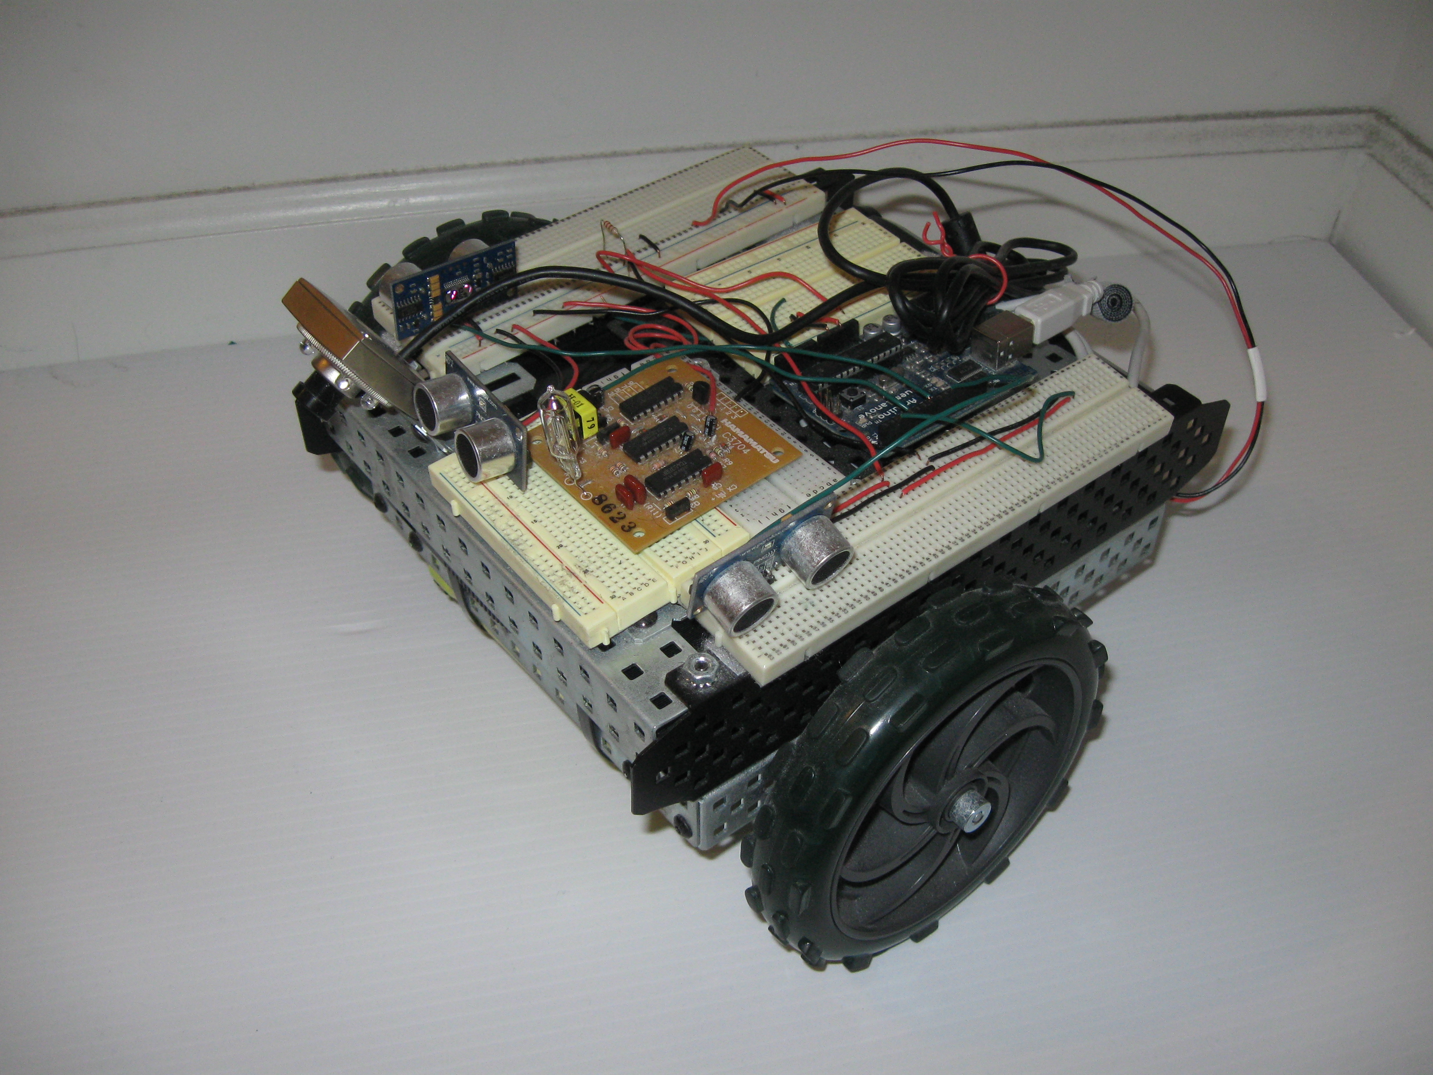
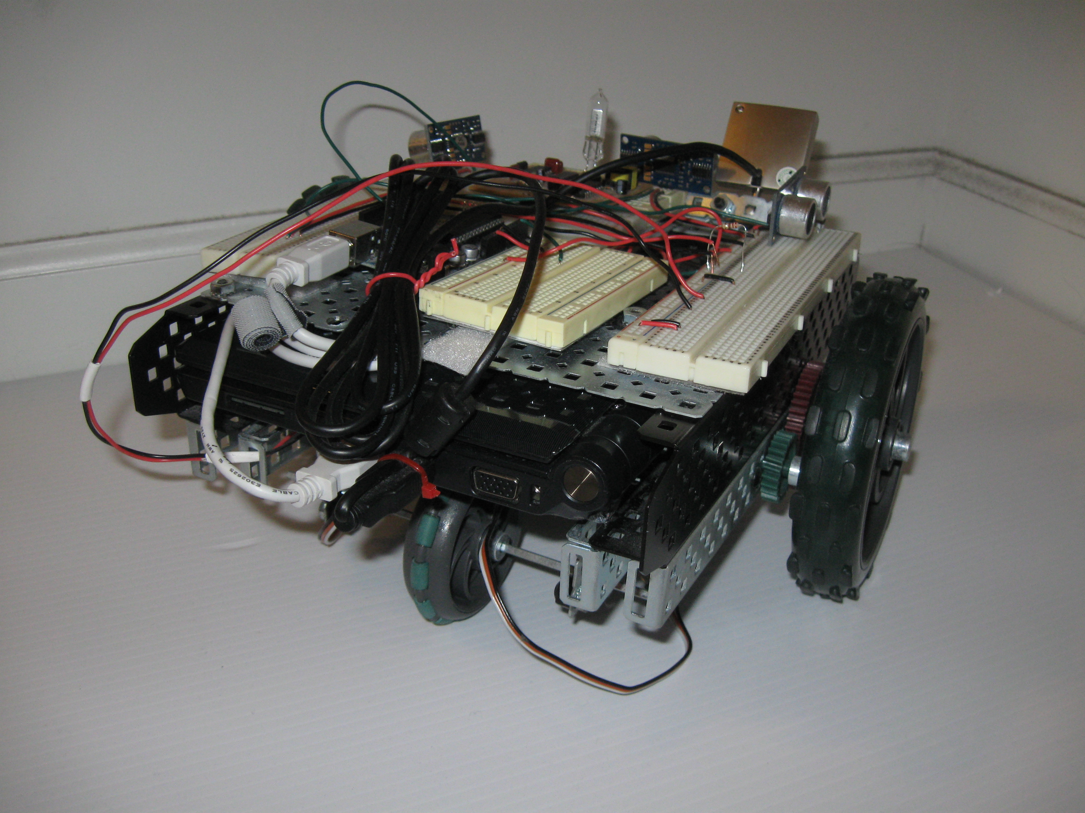
Trinity Robot

Slide 6
First Iteration Software
Windows XP on netbook
OpenCV for image processing
C++ used for writing all robot operation software

Slide 7
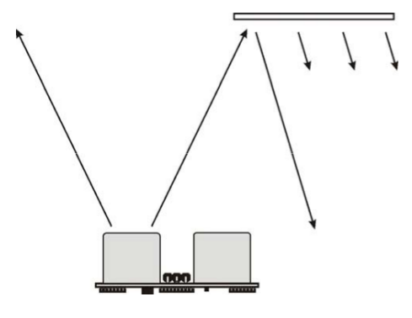
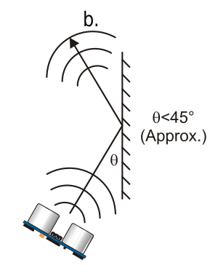
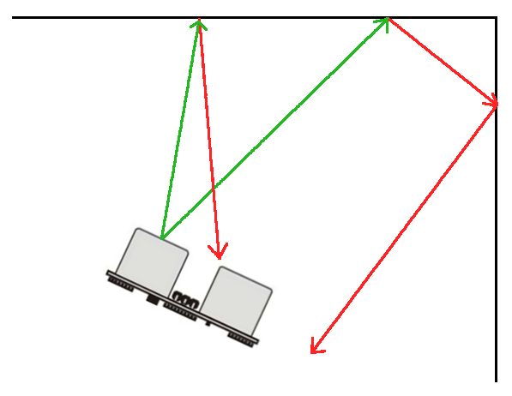
Problems with First Iteration
Inaccurate motor control
Sonar signals bounce inside corners
  provide inaccurate measurements
Web-cam had too small of a viewing angle

Slide 8
Second Iteration Hardware
Create by iRobot
Platform built onto Create cargo bay to accommodate equipment
Web-cam with increased viewing angle
Arduino
Net-book

Slide 9
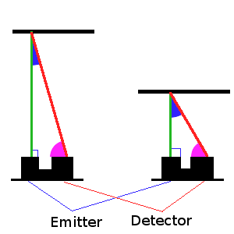
Second Iteration Hardware cont.
IR Rangefinder
  IR light is more focused than sound
  Uses triangulation to measure distance

Slide 10
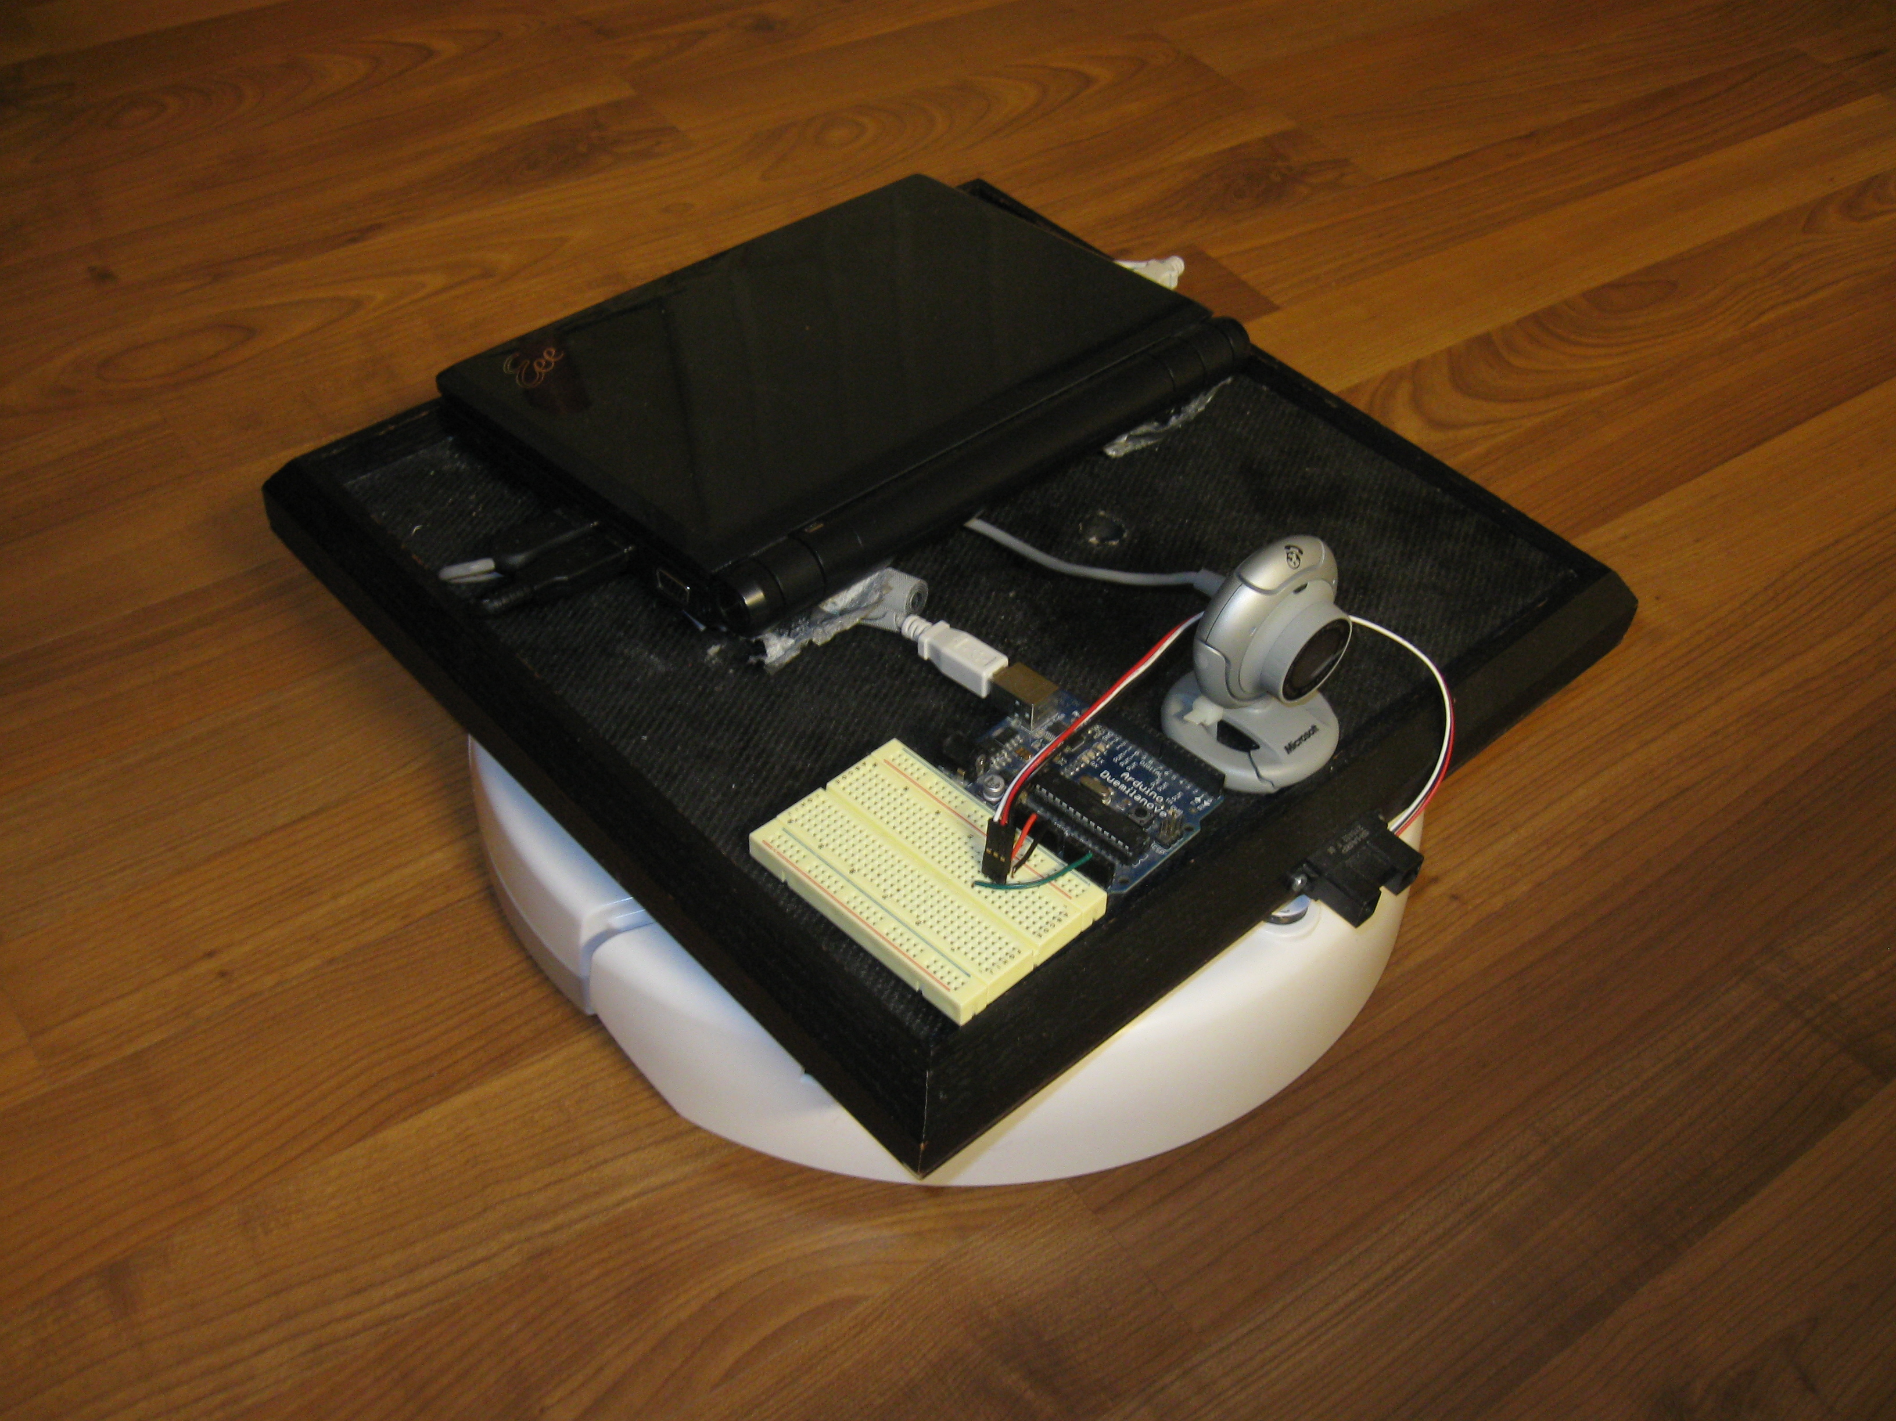
Create

Slide 11
Second Iteration Software
Windows XP on net-book
MATLAB
  Image Acquisition Toolbox
  Image Processing Toolbox
  iRobot Create Toolbox
  Arduino Toolbox

Slide 12
Second Iteration Software cont.
C++ interfacing with MATLAB functions
engine.h
  engine *en;
  en = engOpen(NULL)
  engEvalString(engine *en, char * command);
  engOutputBuffer(engine *en, char *buf, int bufsize);

Slide 13
Image Processing
“A picture is worth a thousand words”
Need to extract discrete objects from images to identify them
Blobbing
K-Means Clustering

Slide 14
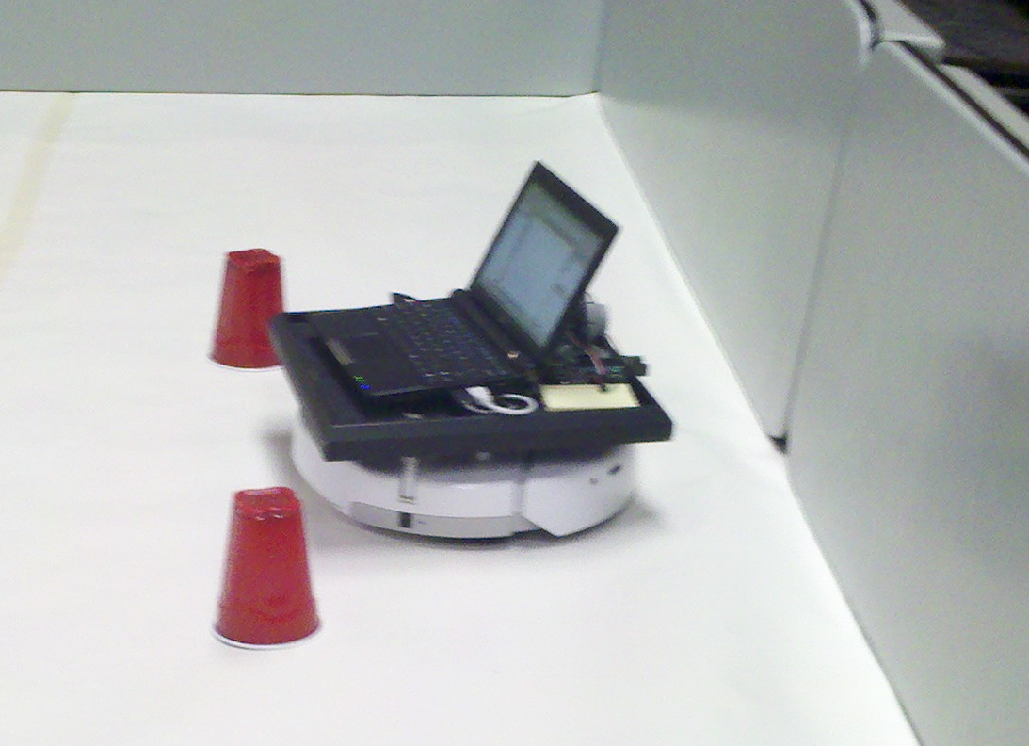
Navigation and Vision

Slide 15
Blobbing
Connected Component Labeling, Blob Labeling
Compare pixels to neighbors
Use threshold to determine if pixels are part of same blob
Often fails to retrieve blobs that are confined to one object, or that contain an entire object

Slide 16
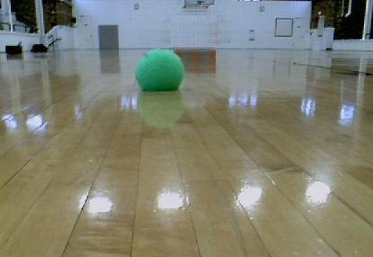

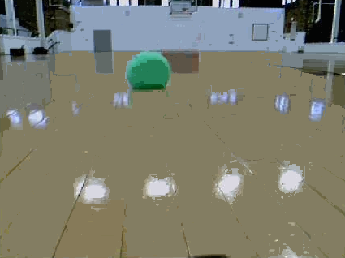
Blobbing Example

Slide 17
K-Means Clustering
Cluster sets of data
  Into user defined number of segments
  Number of segments referred to as K
  Clusters defined by MEAN of all values in cluster
More accurate than blobbing
  Likeness compared to entire cluster not simply adjacent pixels
  Able to reliably retrieve clusters of discrete objects

Slide 18
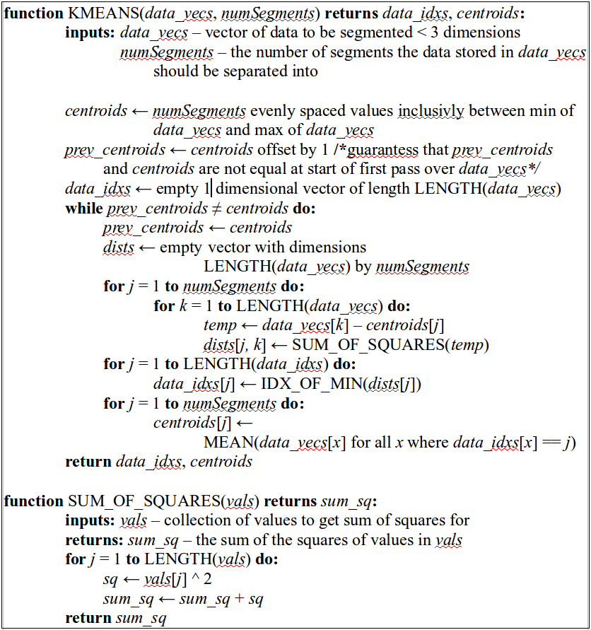
K-Means Algorithm

Slide 19
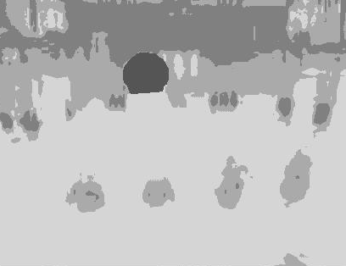


K-Means Example
K-Means using k = 6

Slide 20
Communication Framework
“Go to the green ball”
The meanings behind words must be inferred
“Go,” conceptually can represent many things
  Take a turn in a game
  The Chinese strategy game
  Travel to a location
Determine the concept being referred to
Conceptual Parsing

Slide 21
Conceptual Parsing
Words are mapped to concepts
Concepts
  Rules define set of related concepts
  One concept may have many separate rule sets

Slide 22
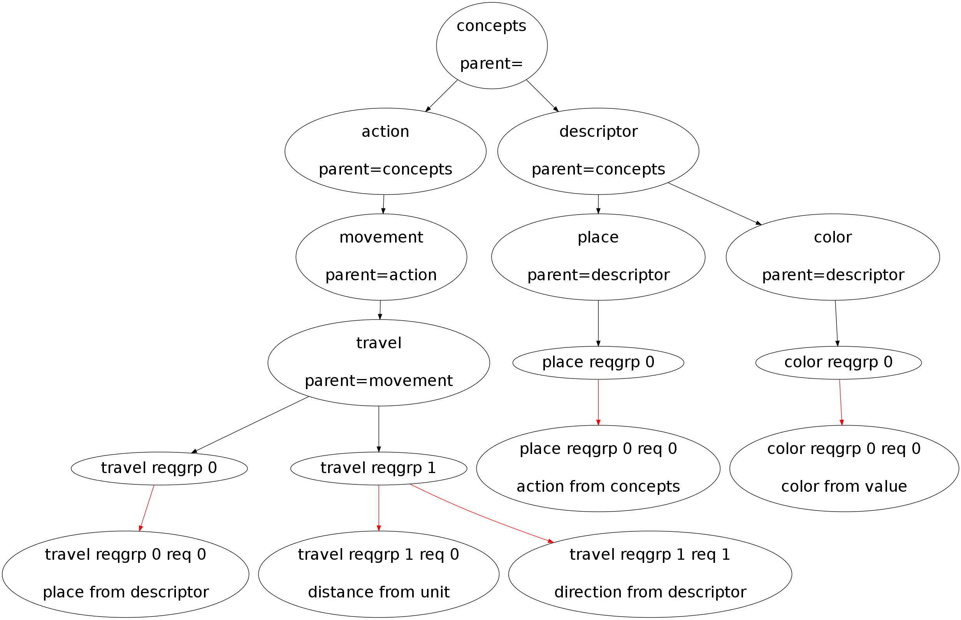
Concept Tree

Slide 23
Relating Language and Vision
Two separate systems have been described
  Image processing
  Communication Framework
Need to tie language concepts to objects in images

Slide 24
Shared Referent Problem
Bob
Harry
Woman
Harry's Wife
Margaret
Sally

Slide 25
Teaching and Learning
Figure based learning is referred to as intensional learning
Explicit instruction
Method used at this point in the robot's operation
ex. Point at a ball and say “this is a red ball”

Slide 26
Demonstration
Go to the green ball
  Understands the word “green”
  Knows values for the color green
Go to the red ball
  Does not understand the word “red”
  Tell robot what concept “red” represents
  Does not know values for the color red
  Show robot what red looks like so it can get values

Slide 27
References
Ahmad. (2010). KMeans Segmentation – MEX. Retrieved from http://www.mathworks.com/matlabcentral/fileexchange/27969-kmeans- segmentation-mex
Cuartielles, D, & Igoe, T, & Mellis, D. A. (2011, January 26). ArduinoDuemilanove. Retrieved from http://www.arduino.cc/en/Main/ArduinoBoardDuemilanove.
Dodds, Z. (2007). pyCreate [software]. Available from http://www.cs.hmc.edu/~dodds/erdos/old.html
Flynn, A. M. (1988). Combining Sonar and Infrared Sensors for Mobile Robot Navigation. The International Journal of Robotics Research, 7(6), 5-14
Fodor, J.A. (1975). The language of thought. New York, NY: Thomas Y. Crowell Company, Inc.
Gurevych, I., & Malaka, R., & Porzel, R., & Zorn, H. (2003). Semantic coherence scoring using an ontology. Proceedings of HLT-NAACL 2003. Edmonton
Image Processing Toolbox: Color-Based Segmentation Using K-Means Clustering. Retrieved from http://www.mathworks.com/products/image/demos.html?file=/products/demos /shipping/images/ipexhistology.html
Kronfeld, A. (1990). Reference and computation: An essay in applied philosophy of language. New York, NY: Press Syndicate of the University of Cambridge
MathWorks, Inc., The. (2001). MATLAB - The Language Of Technical Computing. Retrieved from http://www.mathworks.com/products/matlab/
OpenCVWiki. (n.d.). Retrieved fom the OpenCV Wiki: http://opencv.willowgarage.com/wiki/
Shapiro, L. G., & Stockman, G. C. (2001). Computer Visión. Prentice Hall. Retrieved from http://www.cse.msu.edu/~stockman/Book/.
Sridharan, M., & Stone, P. (2009). Color learning and illumination invariance on mobile robots: A survey. Robotics and Autonomous Systems. 57, 629-644

Slide 28
Questions?

