Slide 1

Human & Modern Machine Interactions
Jeffrey Minton

Slide 2
Topics
Hardware/Software Platform
Image Processing
Natural Language Processing
Using NLP and Image Processing to allow robotic operation

Slide 3
Hardware/Software Platform
Two iterations
First iteration
  created to compete in Trinity College Fire Fighting Home Robot Competition
Second Iteration
  created to accomodate the needs for a class in inteligent robotics

Slide 4
First Iteration Hardware
VEX robotics kit for chassis
VEX Included motors for locomotion
Sonar Rangefinders
Web-cam
Arduino to control motors and sensors
Netbook to control arduino and process images

Slide 5
First Iteration Software
Windows XP on netbook
OpenCV for image processing
C++ used for writing all robot operation software

Slide 6
Problems with First Iteration
Inaccurate motor control
Sonar signals bounce inside corners
  provide inaccurate measurements
Web-cam had too small of a viewing angle

Slide 7
Second Iteration Hardware
Create by iRobot
Platform built onto Create cargo bay to accommodate equipment
Web-cam with increased viewing angle
IR Rangefinder
  IR light doesn't bounce like sound
Arduino
Net-book

Slide 8
Second Iteration Software
Windows XP on net-book
MATLAB
  Image Acquisition Toolbox
  Image Processing Toolbox
  iRobot Create Toolbox
  Arduino Toolbox
C++ interfacing with MATLAB functions

Slide 9
Image Processing
“A picture is worth a thousand words”
Need to extract discrete objects from images to identify them
Blobbing
K-Means Clustering

Slide 10
Blobbing
Connected Component Labeling, Blob Labeling
Compare pixels to neighbors
Use threshold to determine if pixels are part of same blob
Often fails to retrieve blobs that are confined to one object, or that contain an entire object

Slide 11
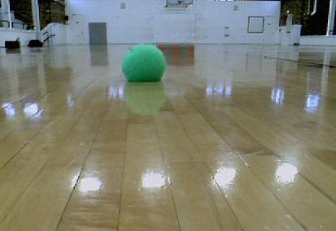

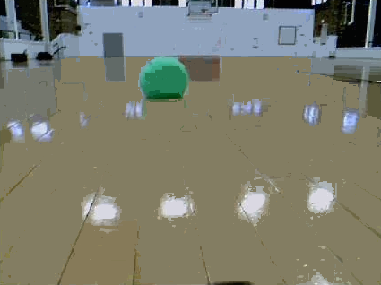
Blobbing Example

Slide 12
K-Means Clustering
Cluster sets of data
  Into user defined number of segments
  Number of segments referred to as K
  Clusters defined by MEAN of all values in cluster
More accurate than blobbing
  Likeness compared to entire cluster not simply adjacent pixels
  Able to reliably retrieve clusters of discrete objects

Slide 13
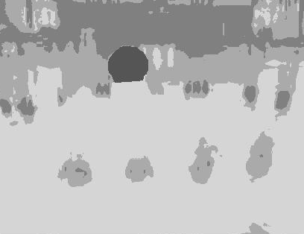


K-Means Example
K-Means using k = 6

Slide 14
Natural Language Processing
“Go to the green ball”
The meanings behind words must be inferred
“Go,” conceptually can represent many things
  Take a turn in a game
  The Chinese strategy game
  Travel to a location
Determine the concept being referred to
Conceptual Parsing

Slide 15
Conceptual Parsing
Words are mapped to concepts
Concepts
  Rules define set of related concepts
  One concept may have many separate rule sets

Slide 16
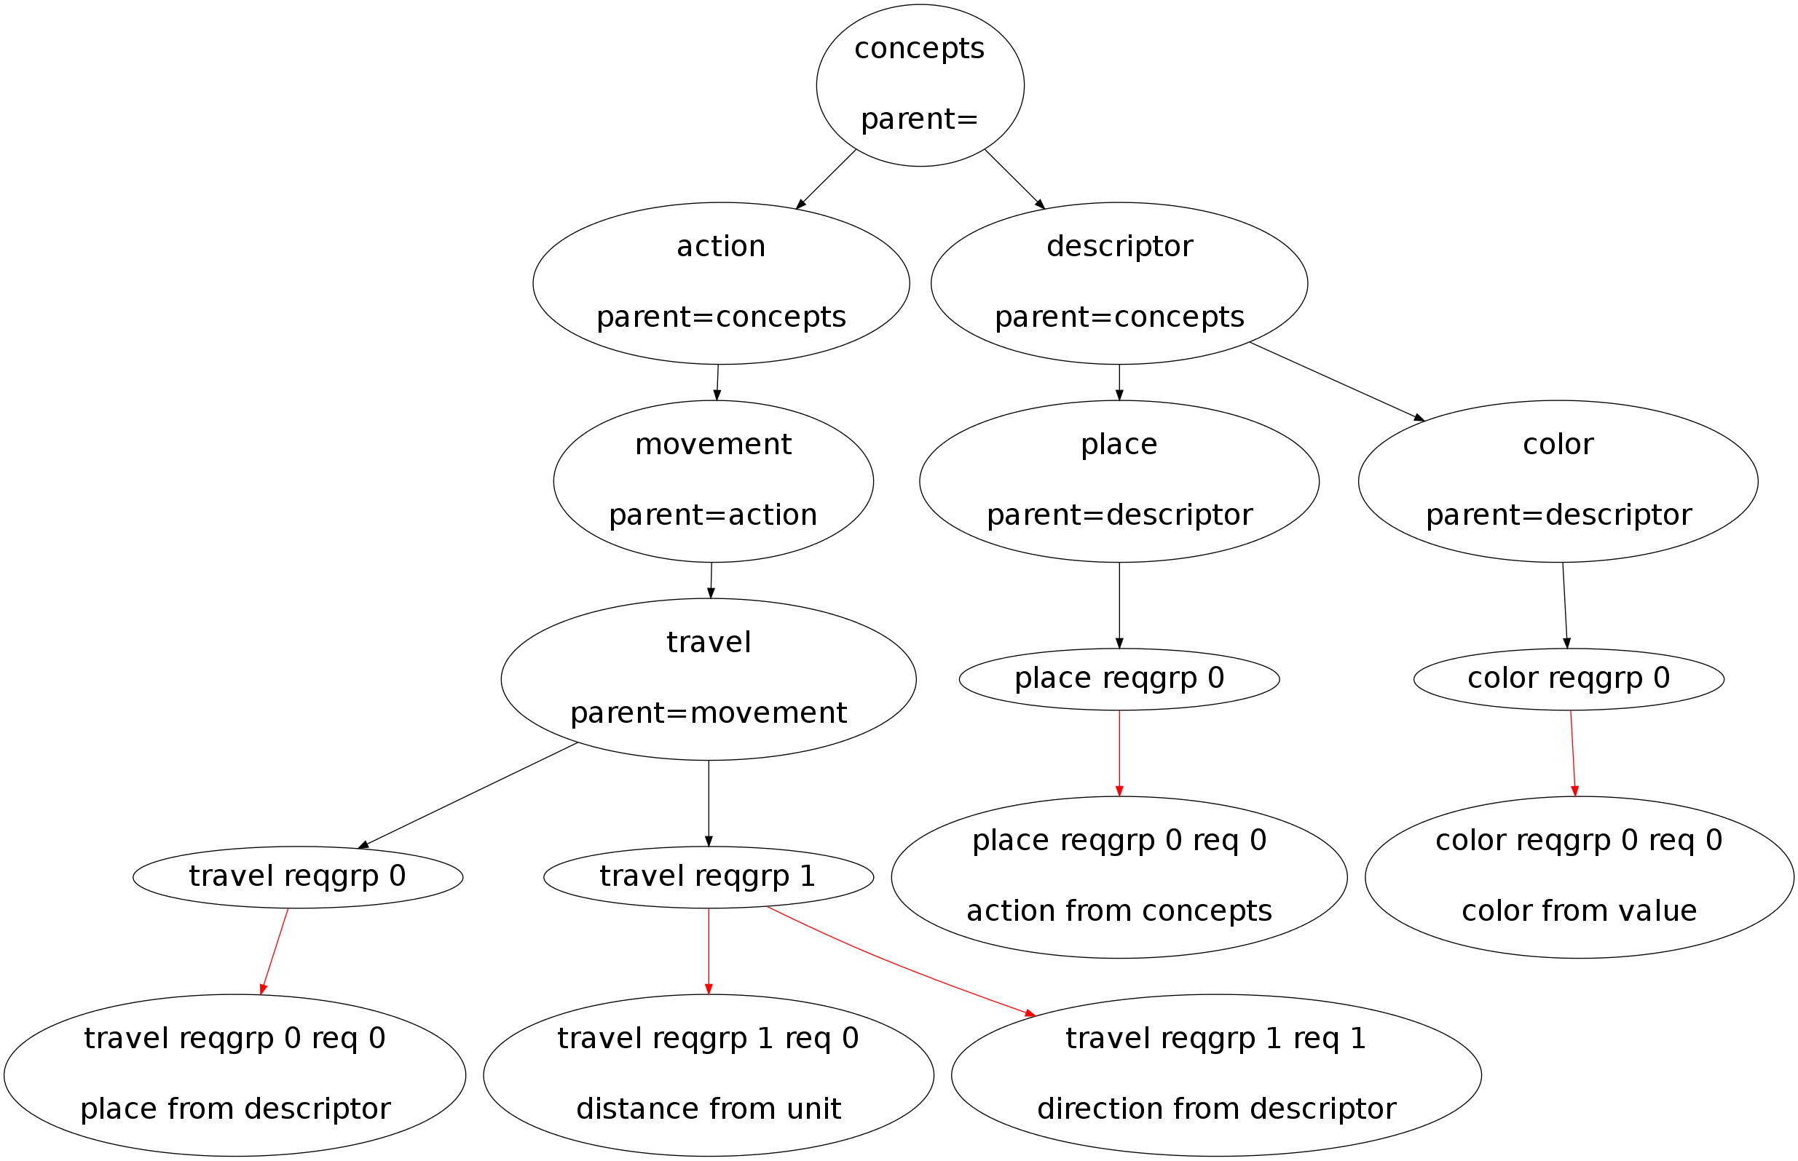
Concept Tree

Slide 17
References
iRobotCreate Toolbox - Vader Laboratory at Lehigh University
K-Means algorithm - KMeans Segmentation – MEX, http://www.mathworks.com/matlabcentral/fileexchange/27969-kmeans-segmentation-mex
Arduino Toolbox - MATLAB Support for Arduino http://www.mathworks.com/academia/arduino-software/arduino-matlab.html

Slide 18
Questions?

Slide 19
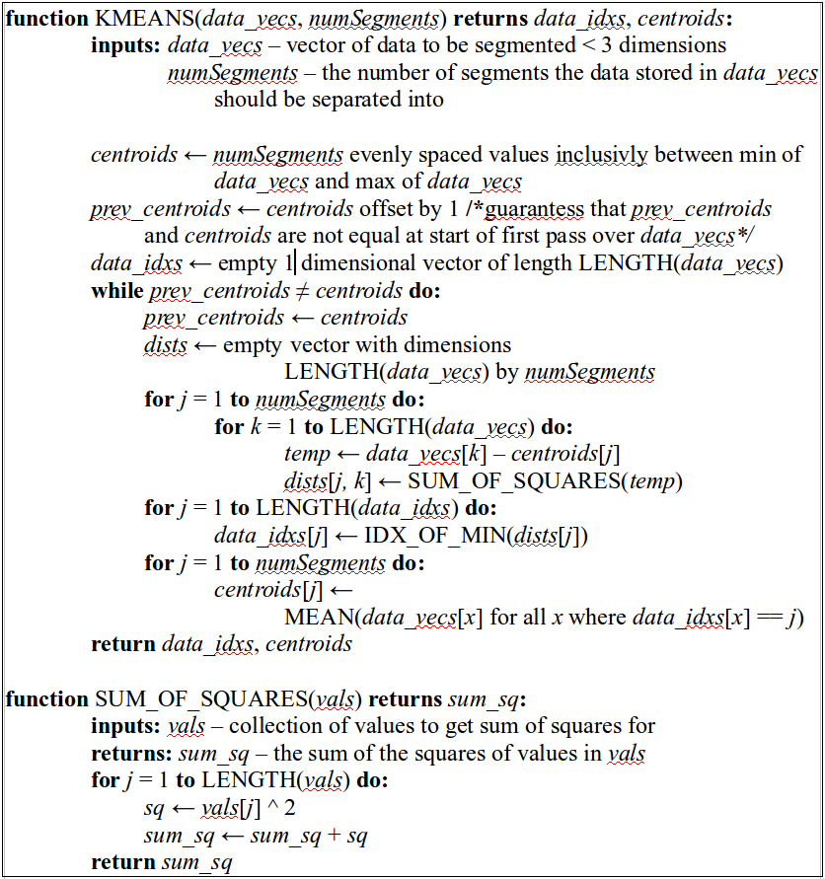
K-Means Algorithm

