Slide 1
Comparative Analysis of Data Ingestion Performance Across Python Libraries

Slide 2
Data Ingestion
Data Science works with massive datasets.
Ingestion can become a bottle neck for algorithms.
Need solutions to mitigate this bottle neck.
Choosing the appropriate ingestion strategy can greatly reduce development time and costs.

Slide 3
Five Python Libraries to Compare
These libraries are primarily for structured data (think excel).
Pandas: most widely used data ingestion library.
Modin: Works on top of Pandas to improve processing speed by allowing parallel computing.
Polars: Written in Rust so its close to the machine = FAST!
  Can handle datasets larger than the RAM available.
Vaex: lazy dataframe manipulation. Works with vast datasets.
  Has built in features like visualization and computing without additional RAM.
Dask: similar to Modin in that it utilizes parallel computing techniques and “larger than memory execution”.

Slide 4
Environment Setup
Environment was created using Anaconda and version 3.10.19 of Python.
  Needed this version for Vaex compatibility.
Please refer to the requirements.txt file in the GitHub repo for additional requirements.
  https://github.com/jeffmoe/CST_605_Week1.git
Highlights of Other Libraries Needed:
import pandas as pd
import numpy as np
import cProfile
import re
import seaborn as sns
import vaex as vx
import modin.pandas as mpd
import ray
import dask.dataframe as dd
import dask.array as da
import dask.bag as db
import polars as pl
import io
import pstats
import matplotlib.pyplot as plt
import time

Slide 5
Data Selection and Setup
Dataset comes from Kaggle: https://www.kaggle.com/datasets/allen-institute-for-ai/CORD-19-research-challenge
Specifically utilized the “cord_19_embeddings_2022-06-02.csv” sized at >15GB.
Created a function that would ingest the dataset based on the given library and then store the time into its own dataframe.
Created read functions for each library to be fed into the function above.
Had to profile Modin separately, as running the ray profiler at the same time as cProfiler did not work.
  Modin ingestion time was captured with the time library instead of cProfile.

Slide 6
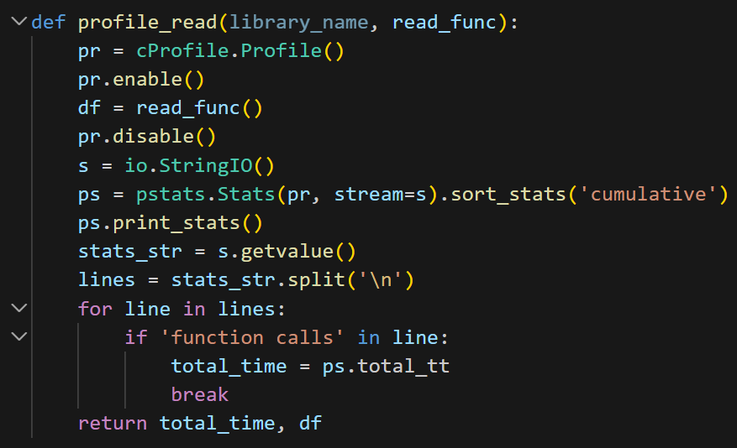
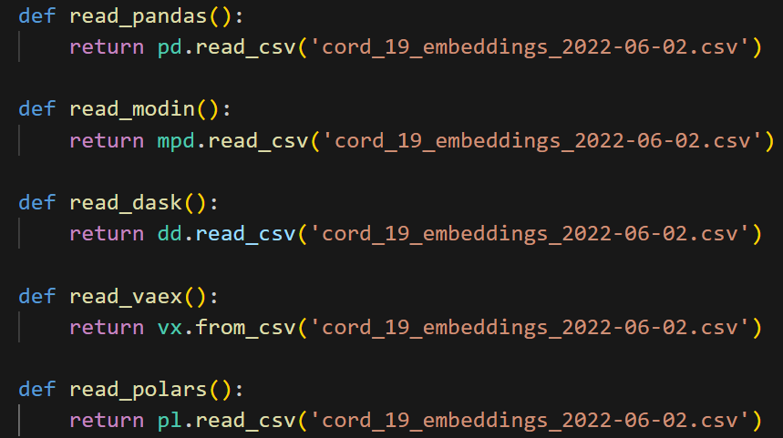
Data Selection and Setup
https://github.com/jeffmoe/CST_605_Week1.git

Slide 7
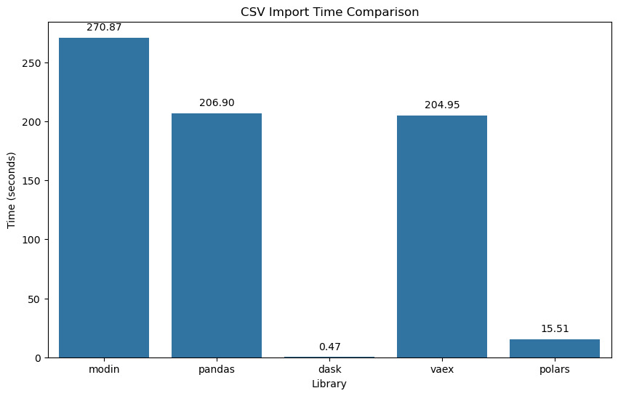
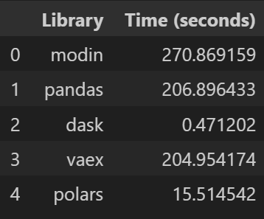
Results
Dask and Polars were the fastest.
Modin, Vaex, and Pandas were roughly the same.

Slide 8
Bibliography
W3Schools. (n.d.). Matplotlib Tutorial. Www.w3schools.com. https://www.w3schools.com/python/matplotlib_intro.asp
Khan, F. (2022, September 2). Easiest Way To Handle Large Datasets in Python. Medium. https://medium.com/@fareedkhandev/handling-large-datasets-in-python-42f57ccbbd1b
Installing Packages — Python Packaging User Guide. (n.d.). Packaging.python.org. https://packaging.python.org/en/latest/tutorials/installing-packages/

Slide 9
Bibliography
Getting started - Polars user guide. (2026). Pola.rs. https://docs.pola.rs/user-guide/getting-started/#reading-writing
The Python Profilers — Python 3.9.4 documentation. (n.d.). Docs.python.org. https://docs.python.org/3/library/profile.html
Scale your pandas workflow by changing a single line of code — Modin 0+untagged.50.gbce3707 documentation. (2018). Readthedocs.io. https://modin.readthedocs.io/en/stable/
Dask — Dask documentation. (2021). Dask.org. https://docs.dask.org/en/stable/

Slide 10
Bibliography
Dask DataFrames — Dask Examples documentation. (n.d.). Examples.dask.org. https://examples.dask.org/dataframe.html
Sowhardh Honnappa. (2020, April 24). Top 100 Open Source Datasets for Data Science. Medium; Analytics Vidhya. https://medium.com/analytics-vidhya/top-100-open-source-datasets-for-data-science-cd5a8d67cc3d?
Optimizing Performance — Ray 2.53.0. (2025). Docs.ray.io. https://docs.ray.io/en/latest/ray-observability/user-guides/debug-apps/optimize-performance.html
Overview of seaborn plotting functions — seaborn 0.12.0 documentation. (n.d.). Seaborn.pydata.org. https://seaborn.pydata.org/tutorial/function_overview.html

