Slide 1

Epoch Optimization in LSTM Models

Slide 2
Agenda
Preparation and Environment Setup
Experiment Setup
Performance Recording and Analysis
Insights and Optimization

Slide 3
Preparation and Environment Setup

Slide 4
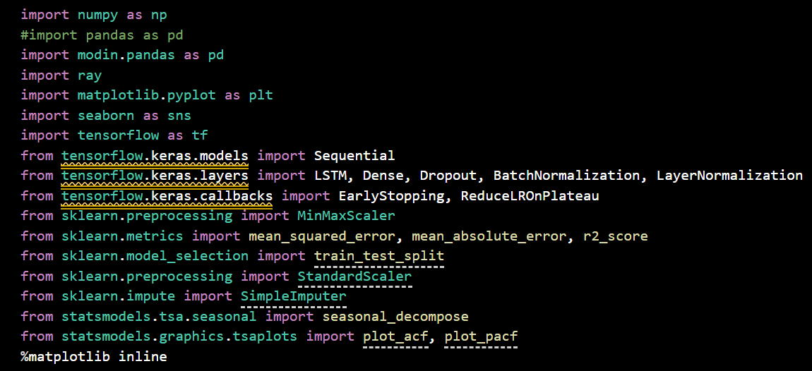
Environment Setup
Project was created using WSL2: Debian
Created a venv using python for this project
  Venv: Week4env
  Python version: 3.10.19 (for compatibility with Tensorflow WSL2)
  Utilized pyenv tool to install specific python version
Github repo: https://github.com/jeffmoe/CST_605_Week4.git
Notes:
This slide goes over the environment setup. WSL2: Debian was used for this project as a way to practice using it. I also created a virtual environment for the project that was in the repo folder, but added to the gitignore file so there were not 1000+ changes on every merge. The requirements.txt file was utilized to show what libraries were used in the jupyter notebook.

Slide 5
Test Plan
Epoch: a full training pass through all the data.
Train the model using 3,4, and 5 epochs.
Fix all other hyperparameters to isolate epochs.
Record common accuracy metrics for each training loop.
  RSME,MSE,MAE,R2
Visualize and store the values for comparison and analysis.
Notes:
This slide goes over the plan for testing the different length training loops.

Slide 6
Experiment Setup

Slide 7
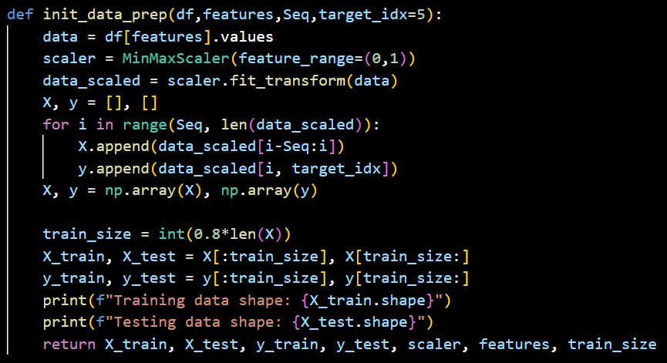
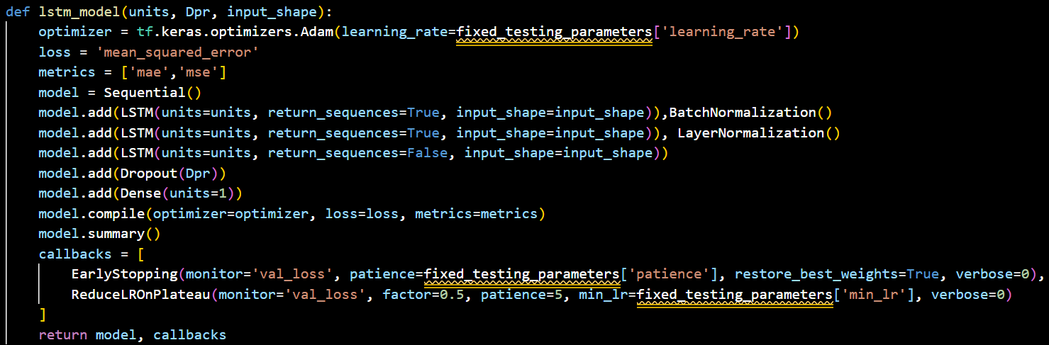
Model Preparation
Created two functions to prep the data and the model for testing.
Init_data_prep:
  scales the values from the df
  Splits the data into training and test sets
Lstm_model:
  Creates the layers for the LSTM and returns it.
Notes:
This slide goes over the initial data prepping function and the function that houses the LSTM model that was created.

Slide 8
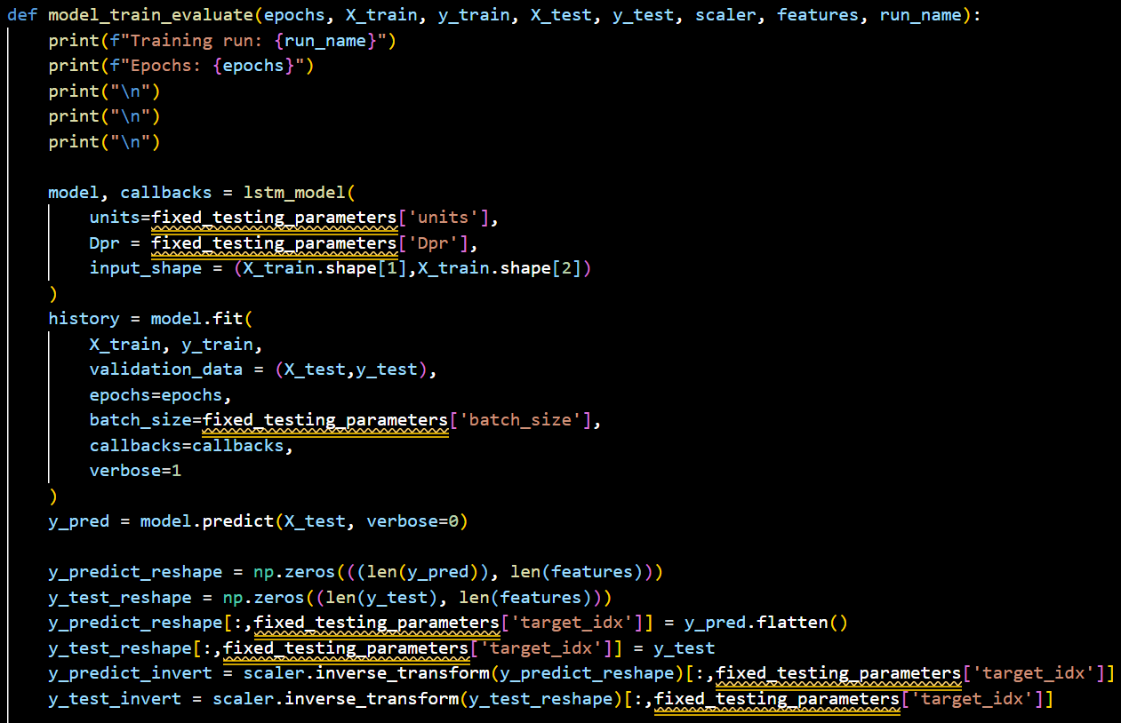
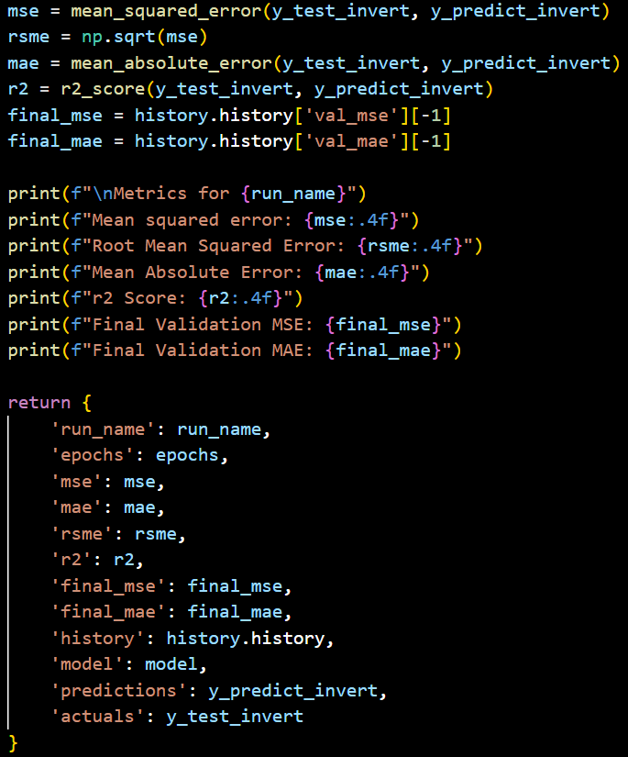
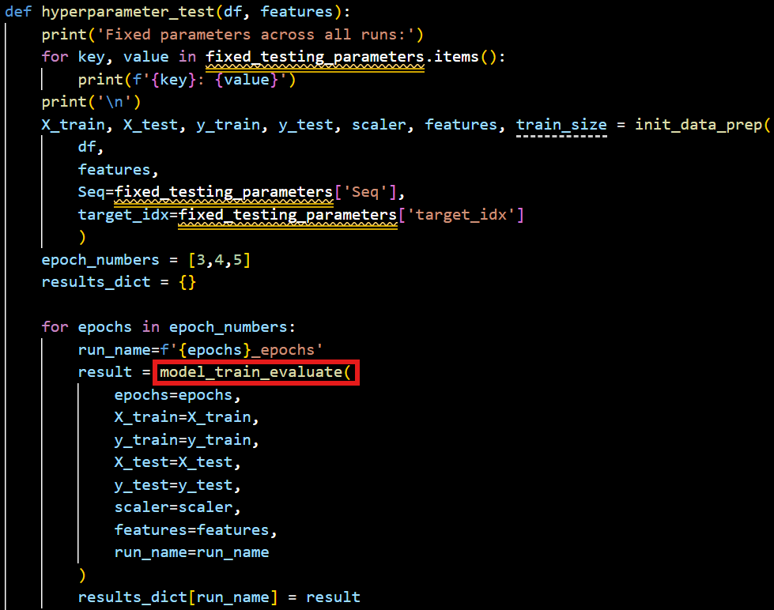
Epoch Selection
Have a training/evaluation function that gets fed into the experiment function.
Experiment function passes the number of epochs to the training/evaluation function.
Notes:
This slide goes over the evaluation and training function, as well as the portion where it was used in the main function.

Slide 9
Performance Recording and Analysis

Slide 10
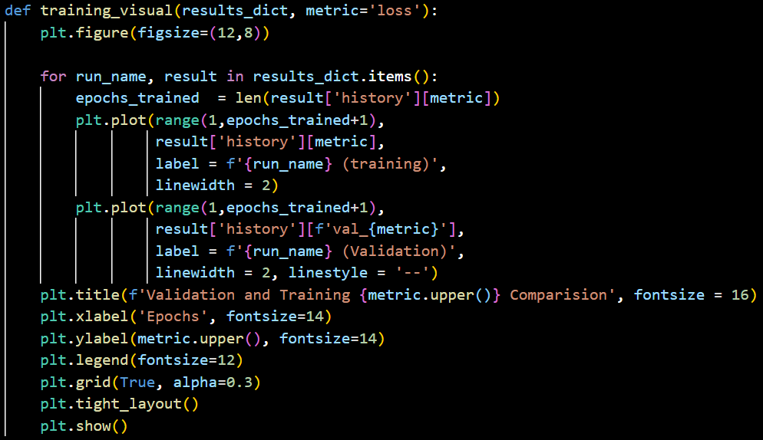
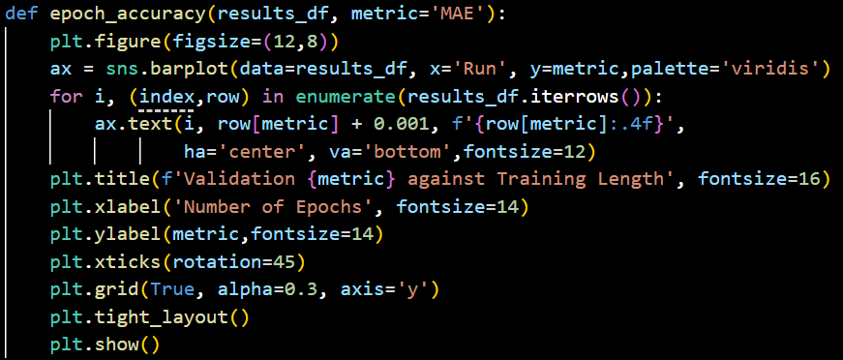
Accuracy Recording
Visuals were created with the epoch_accuracy, training_visual, and hyperparameter_test functions.
Data tables were created with the results_table and hyperparameter_test functions.
Notes:
This slide goes over the functions where the visuals were stored for accuracy values for easier analysis.

Slide 11
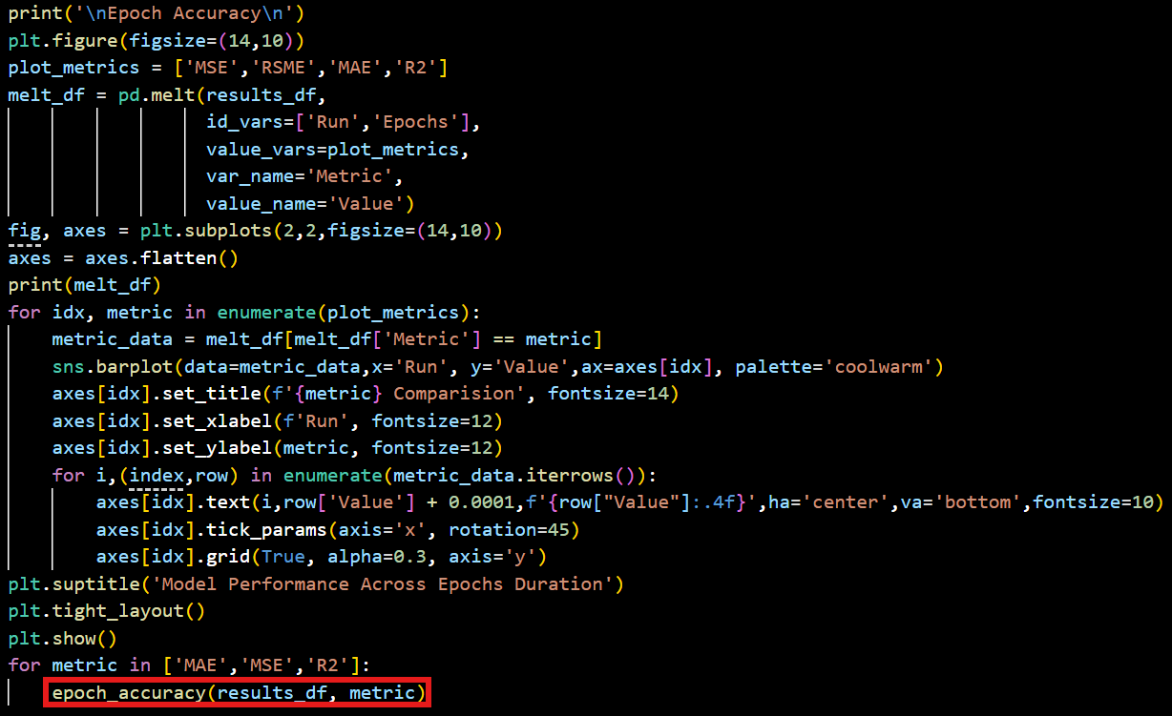
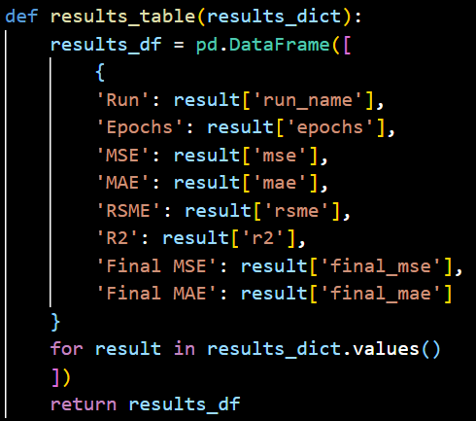
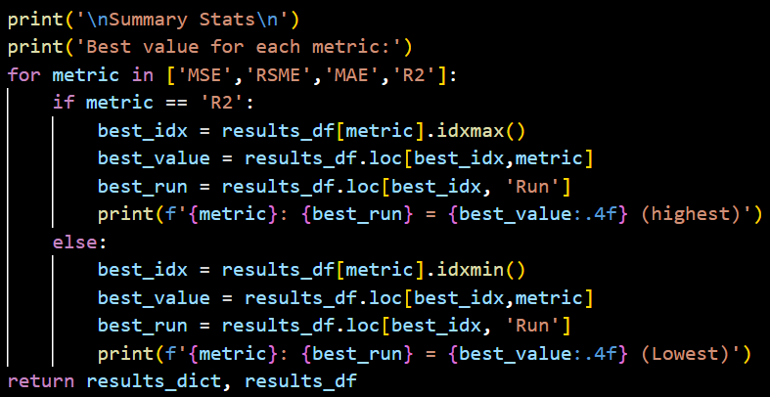
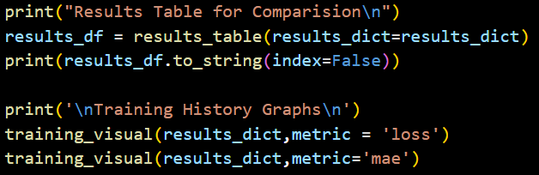
Accuracy Recording
Notes:
This slide goes over where the results dataframe gets created and the functions for compiling the accuracy values that recorded from the training loops.

Slide 12
Insights and Optimization

Slide 13
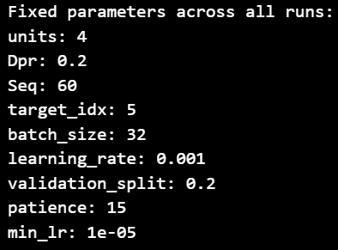
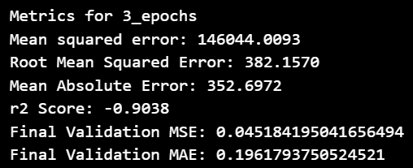
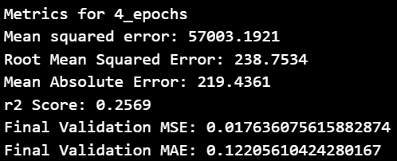

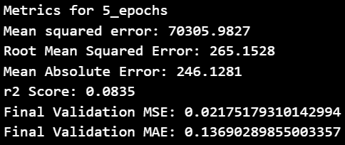
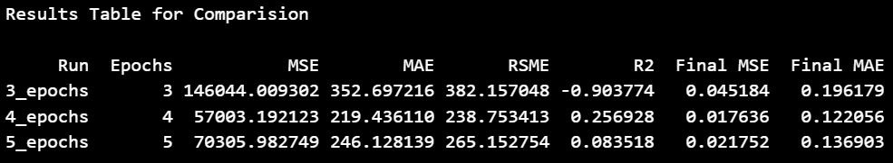
Analysis
MSE,MAE,RSME decreased from 3 to 4 epochs.
MSE,MAE,RSME increased from 4 to 5 epochs.
R2 increased from 3 to 4 epochs.
R2 decreased from 4 to 5 epochs.
Notes:
This slide goes over the outputs from the main function. It shows the values for common regression accuracy metrics such as MSE, RSME, MAE, and R2.

Slide 14
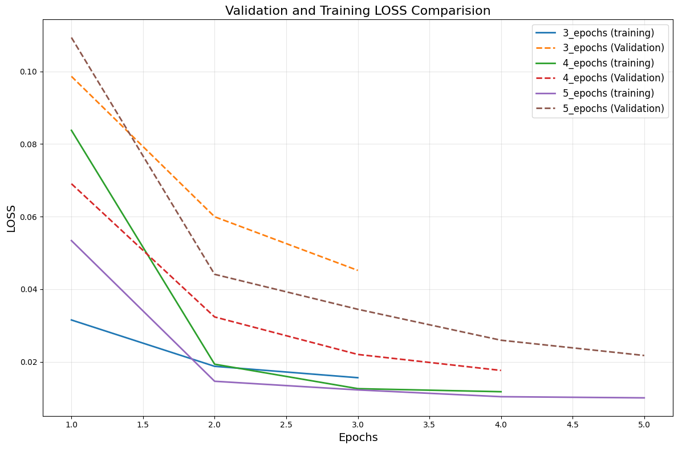
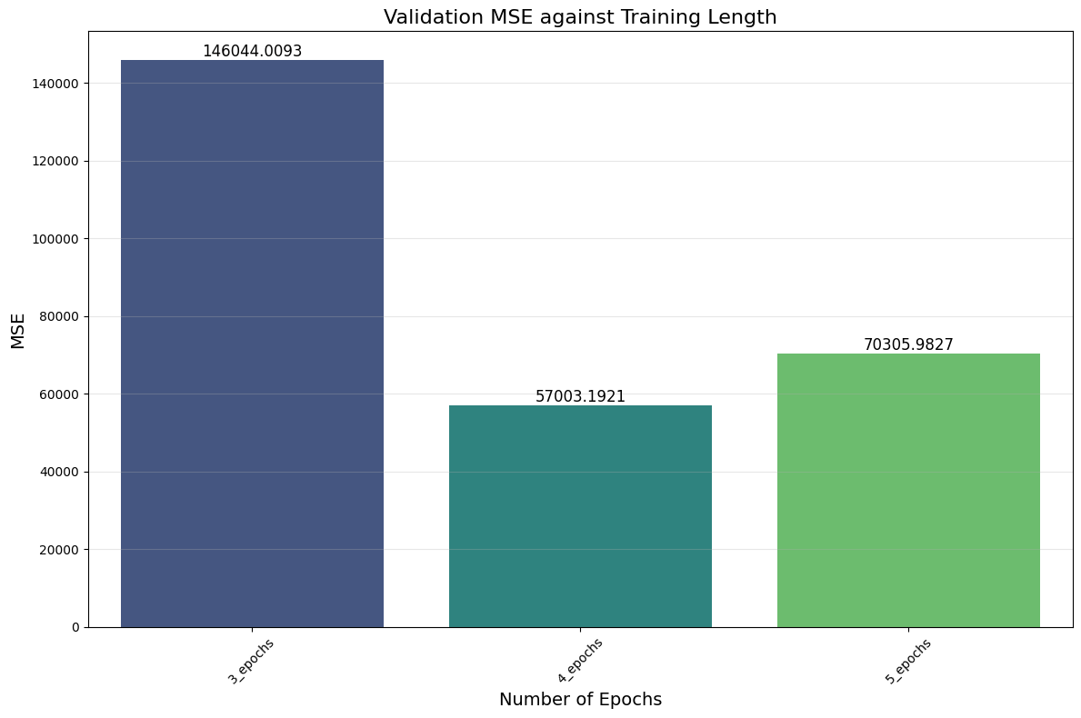
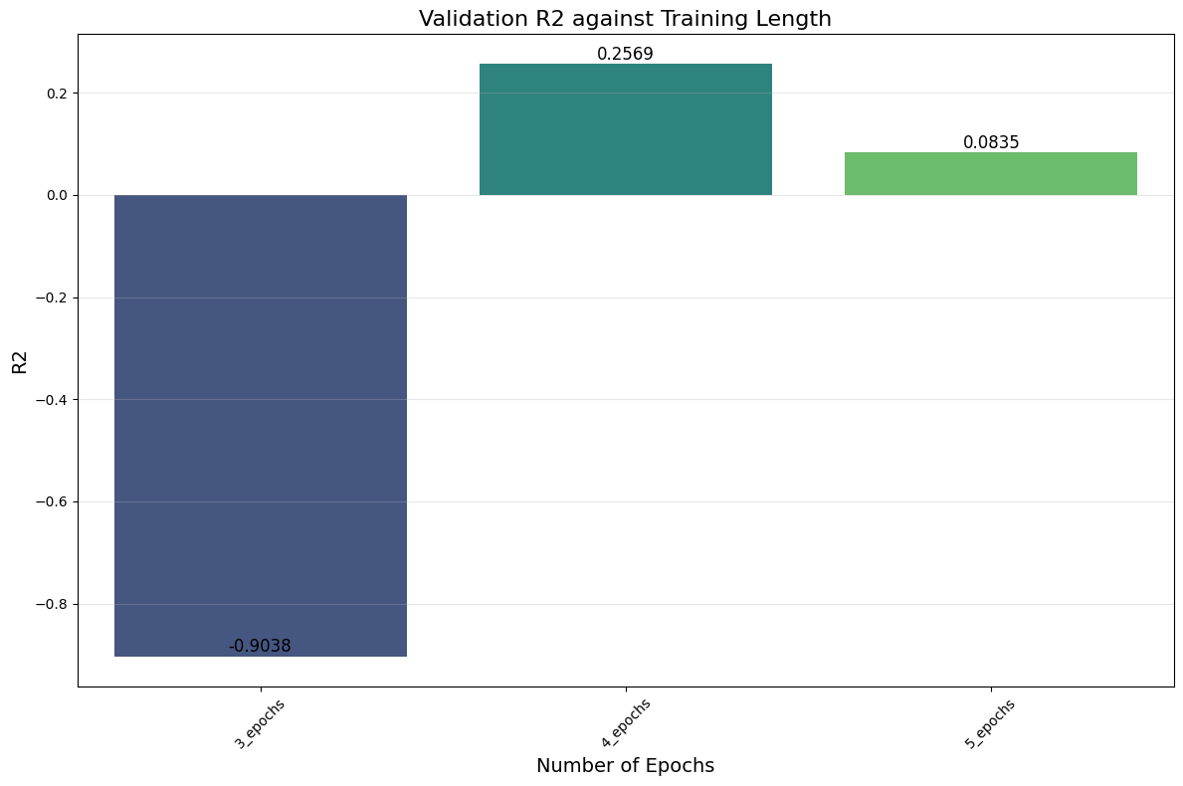
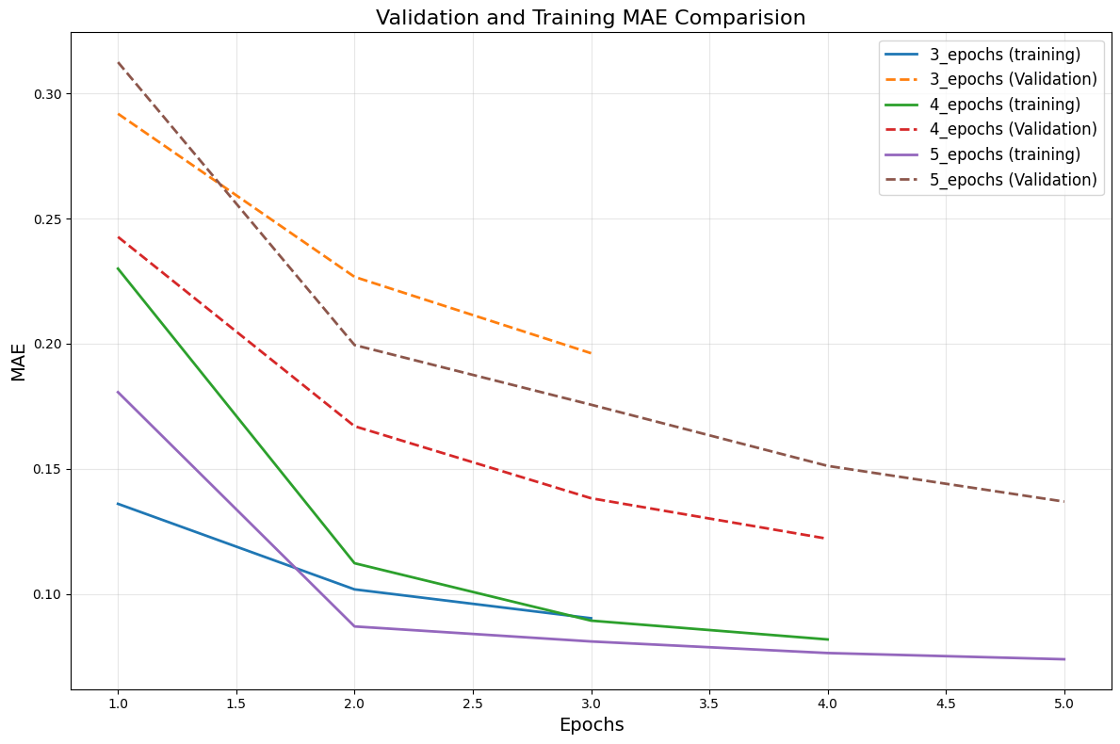
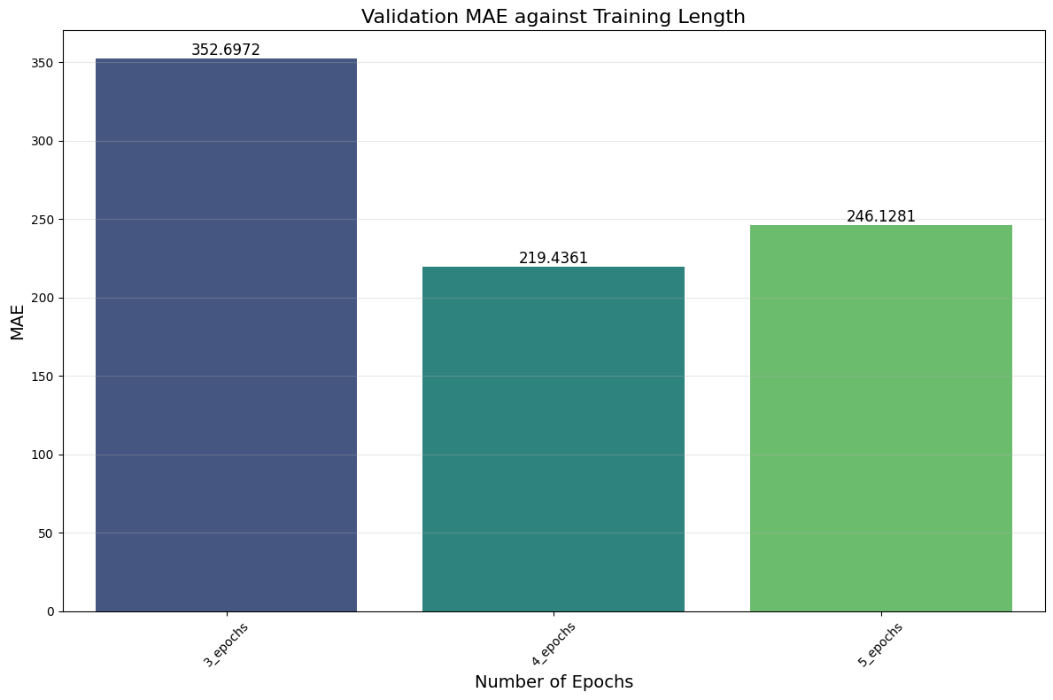
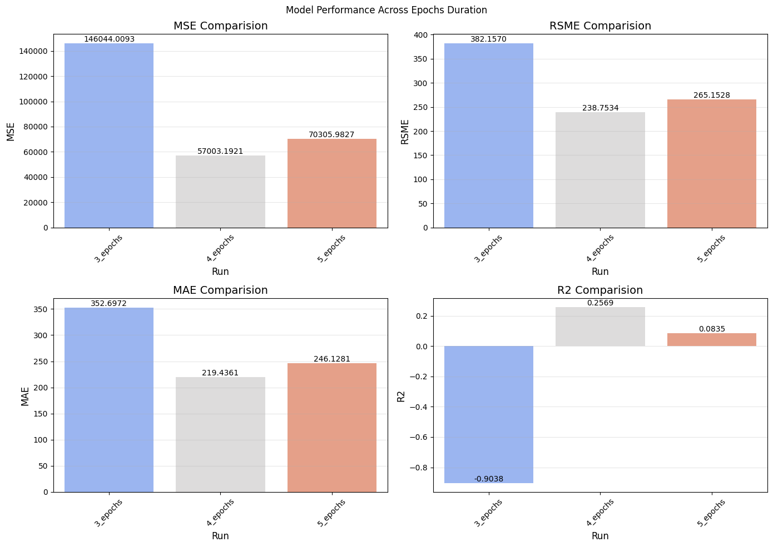
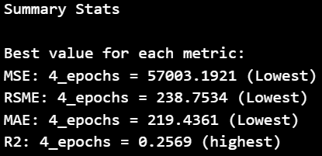
Analysis
Visuals highlighting the accuracy scores across training lengths.
Decrease in accuracy for 5 epochs suggests overfitting.
Recommendation: 4 epochs if max limit is 5.
Notes:
This slide shows the visual outputs of the values that were collected, as well as which number of epochs had the best measurements for each metric.

Slide 15
Bibliography
GeeksforGeeks. (2020, June 6). Choose Optimal Number of Epochs to Train a Neural Network in Keras. GeeksforGeeks. https://www.geeksforgeeks.org/deep-learning/choose-optimal-number-of-epochs-to-train-a-neural-network-in-keras/
Brownlee, J. (2017, April 11). How to Tune LSTM Hyperparameters with Keras for Time Series Forecasting. Machine Learning Mastery. https://machinelearningmastery.com/tune-lstm-hyperparameters-keras-time-series-forecasting/
The Ultimate Guide to Building Your Own LSTM Models. (n.d.). ProjectPro. https://www.projectpro.io/article/lstm-model/832
Hyperparameter Optimization | IBM Cloud Pak for Data as a Service. (n.d.). Dataplatform.cloud.ibm.com. https://dataplatform.cloud.ibm.com/docs/content/wsj/analyze-data/ml_dlaas_hpo.html?context=cpdaas
Pandas. (n.d.). pandas.melt — pandas 1.4.4 documentation. Pandas.pydata.org. https://pandas.pydata.org/docs/reference/api/pandas.melt.html

Slide 16
Bibliography
Bhatt, D. (2025, October 15). How To Develop LSTM Recurrent Neural Networks for Time Series Prediction in Python (TensorFlow 2.0). Medium. https://medium.com/@dbhatt245/how-to-develop-lstm-recurrent-neural-networks-for-time-series-prediction-in-python-tensorflow-2-0-c39c000c84e9
Aurélien Géron. (2019). Hands-On Machine Learning with Scikit-Learn, Keras, and TensorFlow. “O’Reilly Media, Inc.”
GeeksforGeeks. (2019, January 16). What is LSTM Long Short Term Memory? GeeksforGeeks. https://www.geeksforgeeks.org/deep-learning/deep-learning-introduction-to-long-short-term-memory/
Brownlee, J. (2019, April 26). Time Series Prediction with LSTM Recurrent Neural Networks in Python with Keras. Machine Learning Mastery. https://machinelearningmastery.com/time-series-prediction-lstm-recurrent-neural-networks-python-keras/
Securly - Geolocation sharing. (2026). Medium.com. https://medium.com/codex/seasonal-decomposition-and-forecasting-with-statsmodels-92234c6bf3c6

Slide 17
Bibliography
Time Series Forecasting with Yahoo Stock Price. (n.d.). Www.kaggle.com. https://www.kaggle.com/datasets/arashnic/time-series-forecasting-with-yahoo-stock-price
Time series forecasting. (2009). Time series forecasting | TensorFlow Core. TensorFlow. https://www.tensorflow.org/tutorials/structured_data/time_series
PANDYA, V. (2023, May 6). Use Tensorflow LSTM for Time Series Forecasting. Medium. https://medium.com/@vineet.pandya/use-tensorflow-lstm-for-time-series-forecasting-770ec789d2ce
NVIDIA. (2018, August 3). Long Short-Term Memory (LSTM). NVIDIA Developer. https://developer.nvidia.com/discover/lstm
Radečić, D. (2021, July 15). Time Series From Scratch - Decomposing Time Series Data | Towards Data Science. Towards Data Science. https://towardsdatascience.com/time-series-from-scratch-decomposing-time-series-data-7b7ad0c30fe7/

