Slide 1
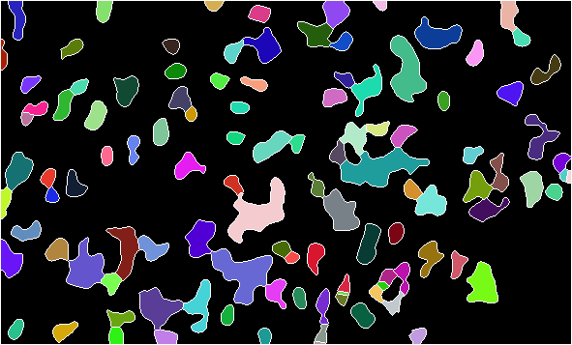
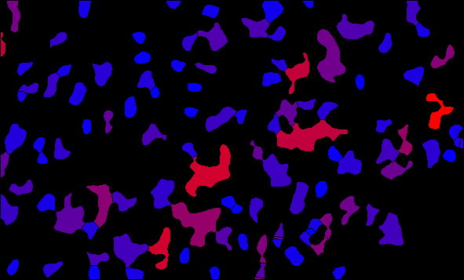

Slide 2
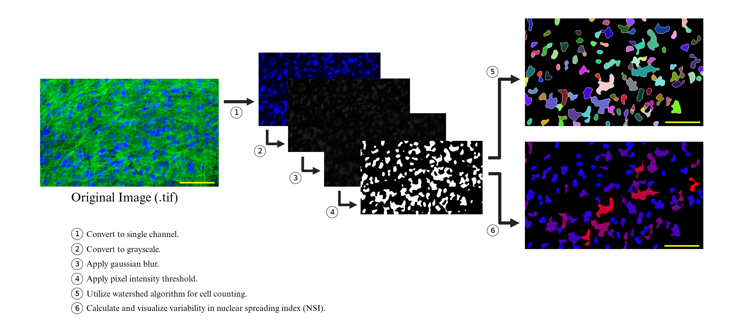
Figure 1. Analysis workflow for cell counting and NSI analysis (bar = 100 µm).

