Slide 1
IBMCloud Kubernetes
https://github.com/jeffpascal/Kubernetes/tree/master/Demo
Cloud is the process of virtualizing resources

Slide 2
Certificari
Kubernetes Services Badge
Domain Driven Design Badge
Developer Bronze BNPP (VM)

Slide 3
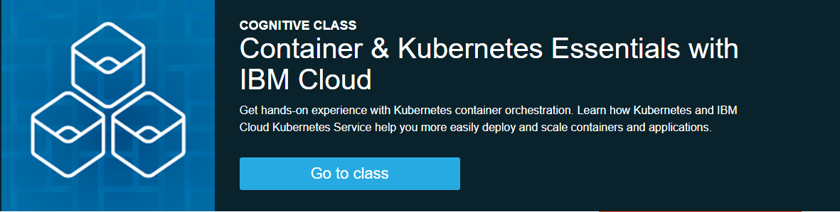
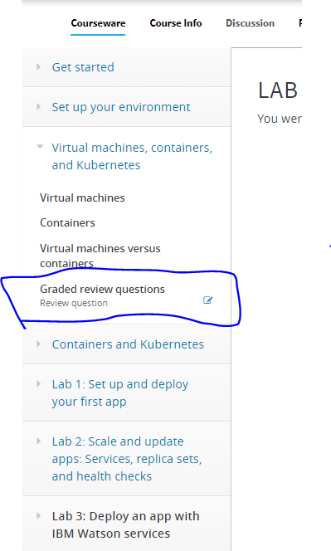

Slide 4
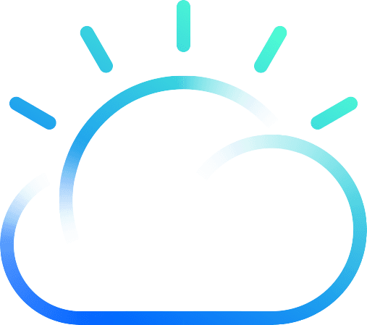


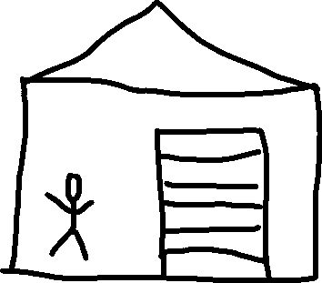
Cloud
Ce este Cloud?
Resurse virtualizate
5000 $ hardware
1000 $ cooling
500 $ electricity/month
??? $ maintanence
15$ / month VM
Free storage up to 20gb

Slide 5

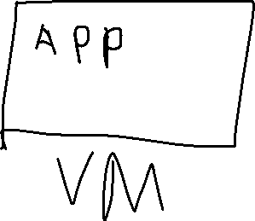

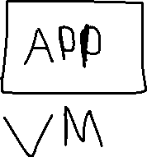
VM
3 VM-uri in Cloud care folosesc strict resursele necesare ca sa rulam aplicatia.
VM-urile au nevoie de resurse care sunt costisitoare
Este ceva mai eficient ca un vm?

Slide 6
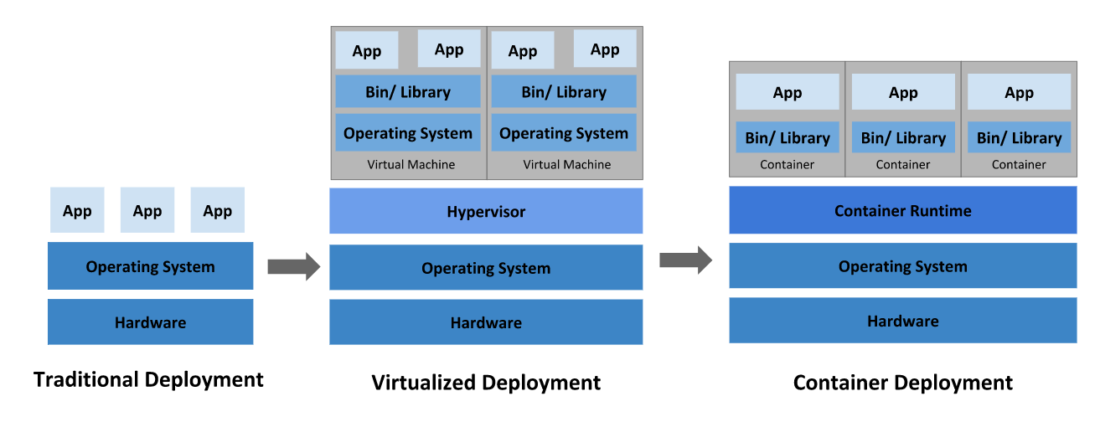
Deployments

Slide 7
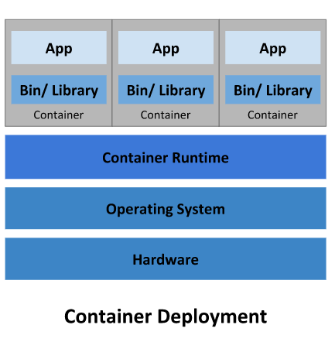
Containers / Docker
Allows a process on Linux to feel like its own environement. You can’t see other processes, or filesystems
An instance of an image is called a container.
Containers allow you to share the host OS, which provides isolation.
Un container, este un set de procese izolate de toate celelalte procese care ruleaza pe OS.
O imagine este definita in Dockerfile [exemplu de creare in demo]

Slide 8
Kubernetes
Kubernetes is a container orchestrator to provision, manage, and scale apps
Like Apache Mesos and Docker Swarm
Kubernetes este declarativ
Noi definim un state, iar Kubernetes incearca sa ajunga la acel state

Slide 9
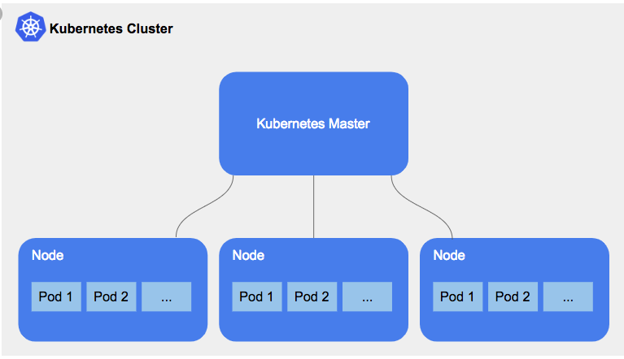
Kubernetes Cluster
Un Node este un VM
Fiecare Node are componentele necesare sa ruleze un Pod
Foarte rar intervenim intr-un Node. Totul este facut de catre Kubernetes
Cea mai mica componenta cu care lucreaza Kubernetes este Pod

Slide 10
Pod
A Kubernetes pod is a group of containers
Un Pod poate avea un singur Container
De obicei contine si alte componente gen Logger sau Monitoring

Slide 11
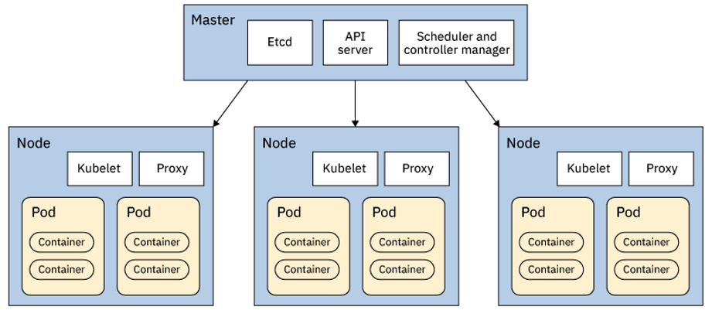
Kubernetes Master
ETCD – unde avem Stateul pe care il vrem din Kubernetes. Este stocat ca si Obiecte
API Server – serverul care se ocupa de requesturi. Poate primii requesturi de la noi si trimite requesturi la Node
Controllerul tot verifica ETCD si daca se inregistreaza o schimbare, se ocupa sa aduca clusterul la Stateul specificat

Slide 12
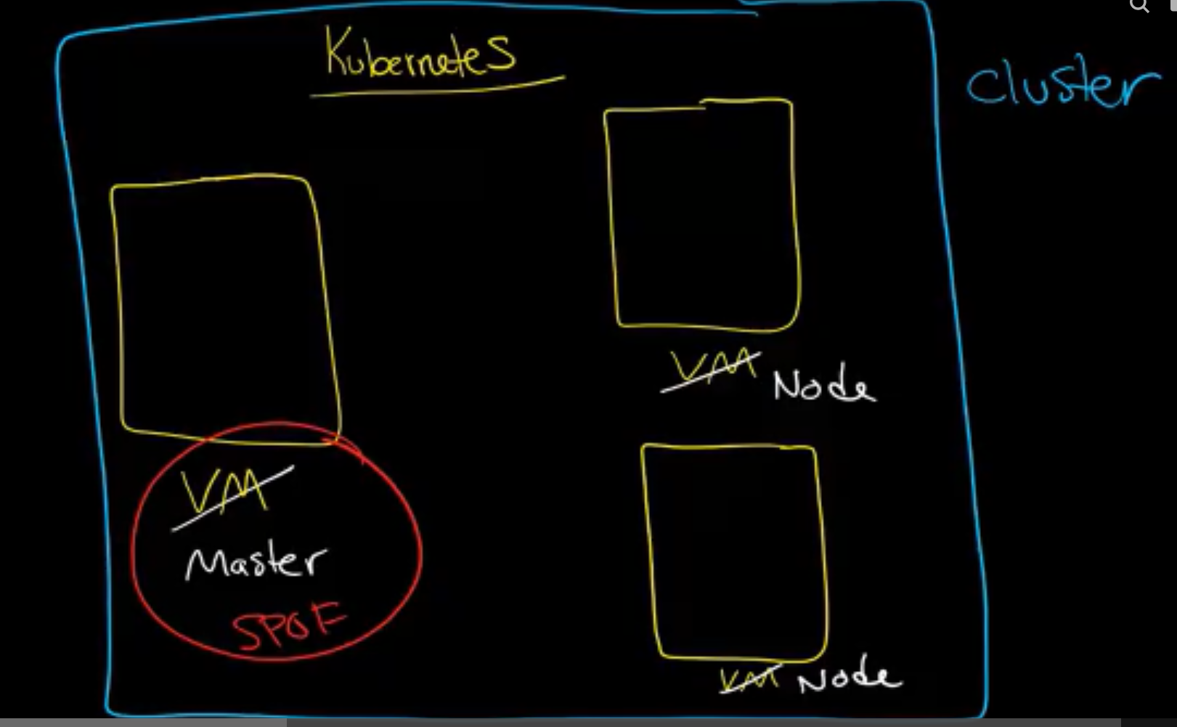
Cluster of containers: A set of compute engine instances called nodes

Slide 13
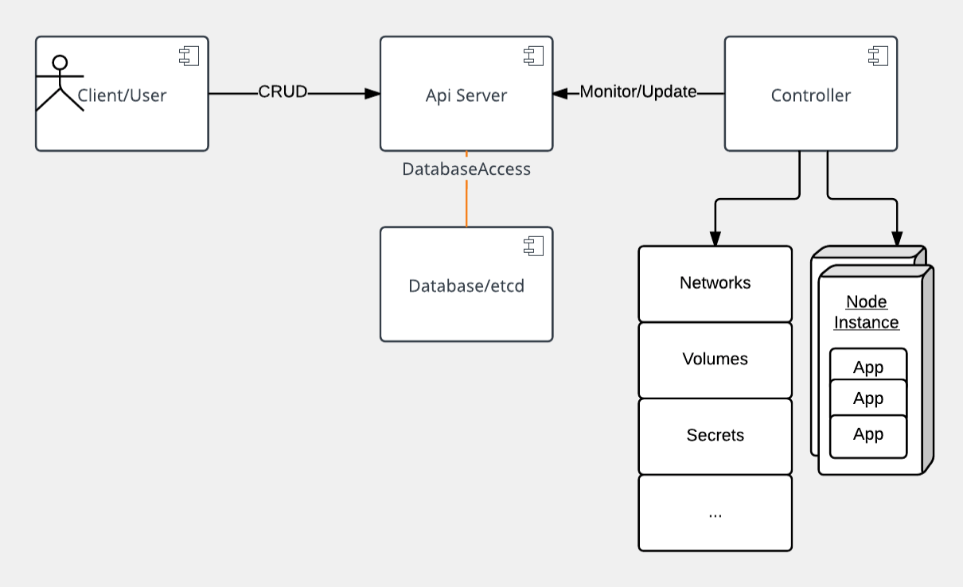
Kubernetes Architecture
API Server care primeste requesturi de la noi
Controllerul monitorizeaza ETCD prin API Server sa identifice daca sunt schimbari
Controllerul identifica schimbarile pe care le vrei, si le aplica

Slide 14
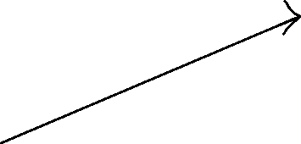
The declarative model is stored in the data store as objects,
and that means when you say you want five instances of a
container, then that request is stored into the data store.
Controllers are responsible for instantiating the actual resource
represented by any Kubernetes resource. These actual resources
are what your app needs to allow it to run successfully.
In the following diagram, an API server is a simple HTTP
server handling create/read/update/delete (CRUD)
operations on the data store.
The Controller identifies the change that you
want and makes that happen.
Contine “stateul pe care il vrei” al aplicatiei

Slide 15
Kubernetes se ocupa numai cu mentinerea stateului

Slide 16
Pod
A pod is the smallest object model that you can create and run.
When you are ready to scale your app, you can use the label to tell Kubernetes which Pod you need to scale
Pods contain at least one container that runs the job and additionally might have other containers in it called sidecars for monitoring, logging, and so on. Essentially, a pod is a group of containers.
An app is typically a group of pods
Although an entire app can be run in a single pod, you usually build multiple pods that talk to each other to make a useful app
- easier for scaling
Kubernetes provides a client interface through the kubectl command-line interface. Kubectl commands allow you to manage your apps and manage cluster and cluster resources by modifying the model in the data store.
You directly manipulate resources through YAML, which is a human-readable serialization language:

Slide 17
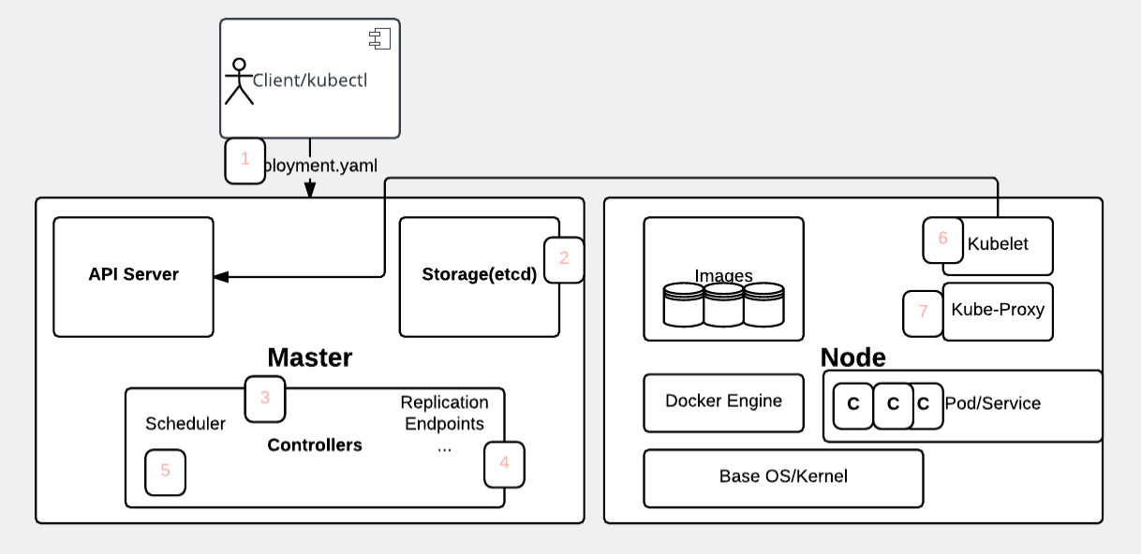
The user deploys a new app by using the kubectl CLI. Kubectl sends the request to the API server.
The API server receives the request and stores it in the data store (etcd). After the request is written to the data store, the API server is done with the request.
Watchers detect the resource changes and send notifications to the Controller to act on those changes.
The Controller detects the new app and creates new pods to match the desired number of instances. Any changes to the stored model will be used to create or delete pods.

Slide 18
5. The Scheduler assigns new pods to a node based on specific criteria. The Scheduler decides on whether to run pods on specific nodes in the cluster. The Scheduler modifies the model with the node information.
6. A Kubelet on a node detects a pod with an assignment to itself and deploys the requested containers through the container runtime, for example, Docker. Each node watches the storage to see what pods it is assigned to run. The node takes necessary actions on the resources assigned to it such as to create or delete pods.
7. Kubeproxy manages network traffic for the pods, including service discovery and load balancing. Kubeproxy is responsible for communication between pods that want to interact.

