Slide 1
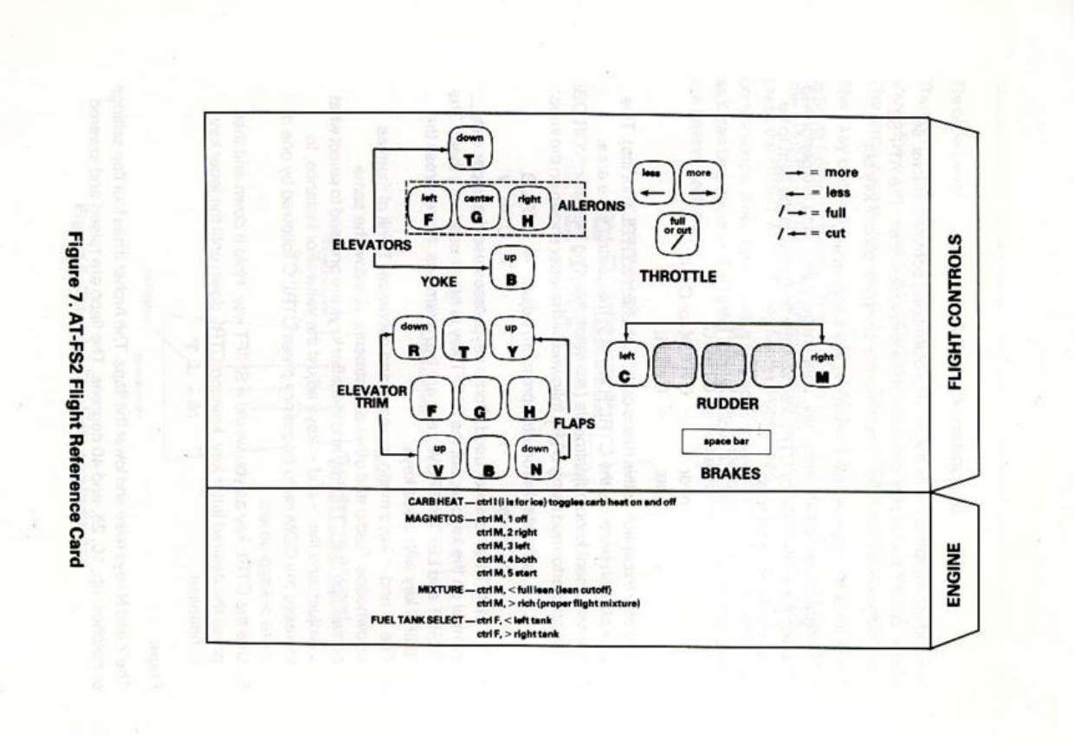
less
<
,
more
>
.
on BBC Micro

