Slide 1
Sentiment Analyzer using DistilBERT
By: Jeffrey Rufus A 23BCE1101
Sadhana Tamilarasi N 23BCE1019
Harini Karthikeyan 23BCE1249
Krithikha N 23BCE1393
Notes:
© Copyright PresentationGO.com – Free Templates & Infographics for PowerPoint and Google Slides

Slide 2
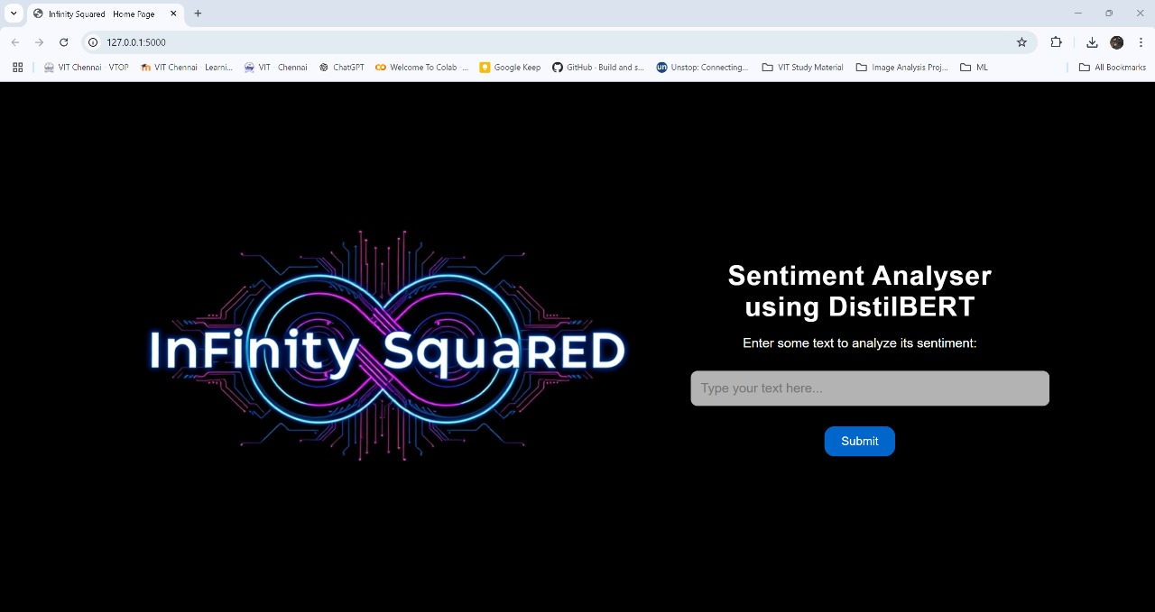
Working Model
Notes:
© Copyright PresentationGO.com – Free Templates & Infographics for PowerPoint and Google Slides

Slide 3
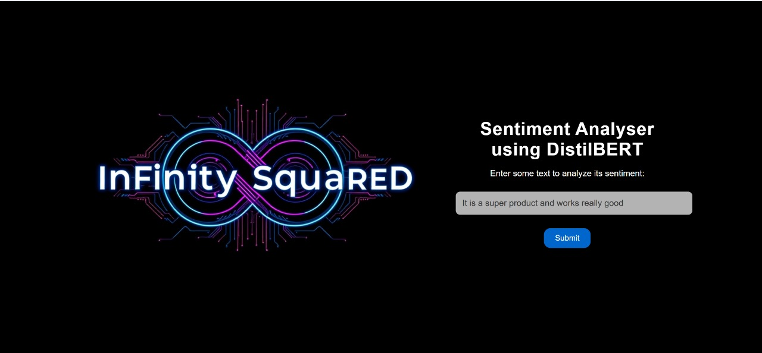
Notes:
© Copyright PresentationGO.com – Free Templates & Infographics for PowerPoint and Google Slides

Slide 4
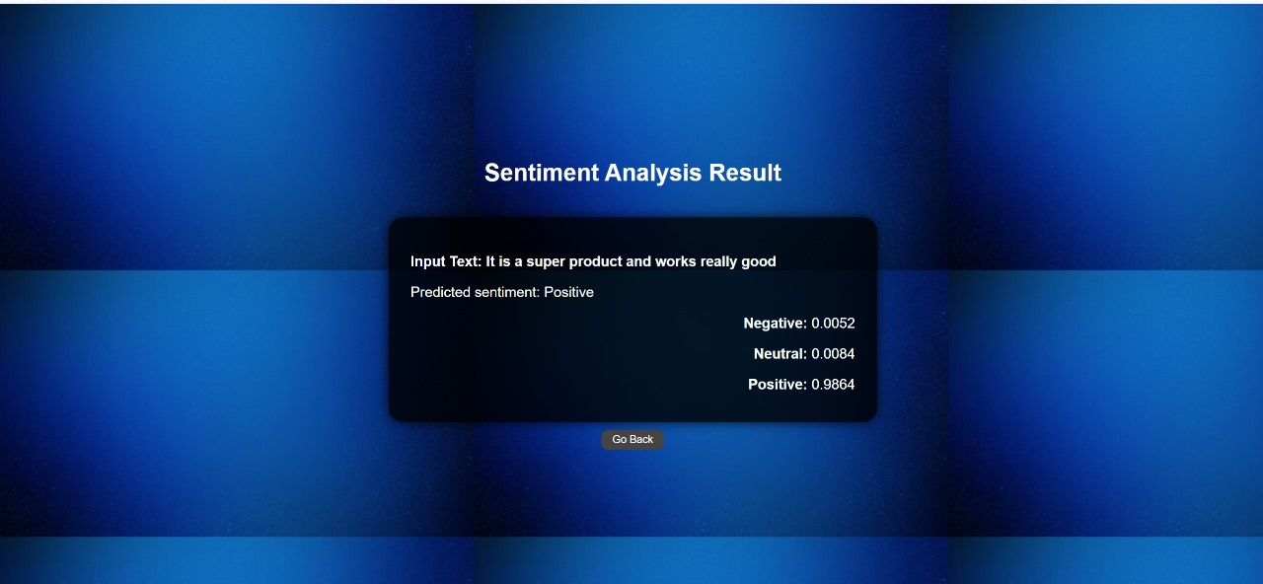

Slide 5
Thank You!
Notes:
© Copyright PresentationGO.com – Free Templates & Infographics for PowerPoint and Google Slides

