Slide 1
Contagion Overview by US State
Jeff Renz, Brian Liberatore

Slide 2
States most impacted by COVID-19
State | Total Cases | Total Deaths
New York | 222,284 | 12,192
New Jersey | 75,317 | 3,518
Massachusetts | 32,181 | 1,245
Michigan | 29,120 | 2,092
Pennsylvania | 28,314 | 940
California | 28,142 | 971
Illinois | 25,738 | 1,080
Florida | 23,332 | 667
Louisiana | 22,532 | 1,156
Texas | 16,927 | 431
Connecticut | 15,884 | 971
Georgia | 15,644 | 611
Washington | 11,152 | 588
Maryland | 10,784 | 372
Indiana | 9,542 | 477

Slide 3
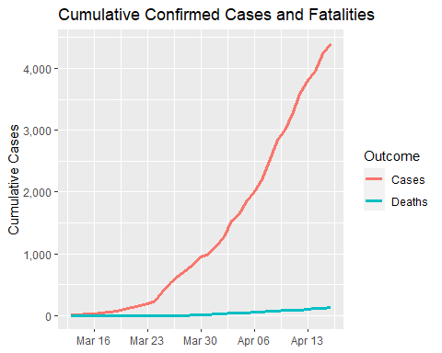
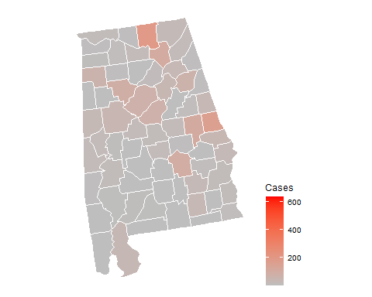
Alabama

Slide 4
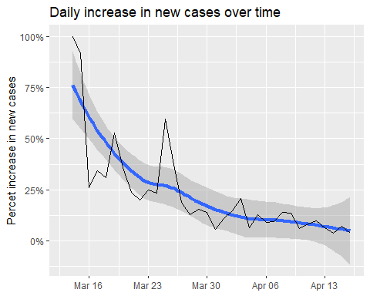
Alabama infection statistics
Date | Cases | Change | Days to double
2020-04-16 | 4,404 | 3.800% | 18
2020-04-15 | 4,241 | 7.300% | 10
2020-04-14 | 3,953 | 3.900% | 18
2020-04-13 | 3,805 | 6.200% | 12
2020-04-12 | 3,583 | 9.800% | 7
2020-04-11 | 3,262 | 8.400% | 9
2020-04-10 | 3,008 | 6.000% | 12
2020-04-09 | 2,838 | 13.600% | 5
2020-04-08 | 2,499 | 13.700% | 5
2020-04-07 | 2,197 | 9.500% | 8
2020-04-06 | 2,006 | 9.000% | 8
2020-04-05 | 1,841 | 12.700% | 6
2020-04-04 | 1,633 | 6.400% | 11
2020-04-03 | 1,535 | 20.900% | 4
2020-04-02 | 1,270 | 14.600% | 5

Slide 5
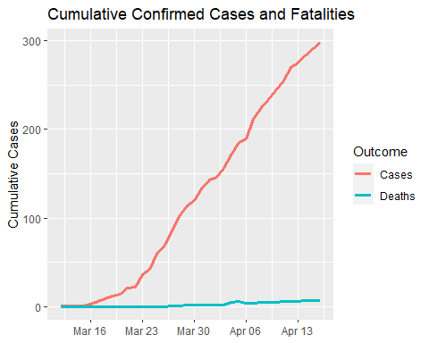
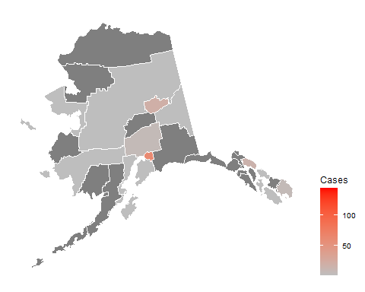
Alaska

Slide 6
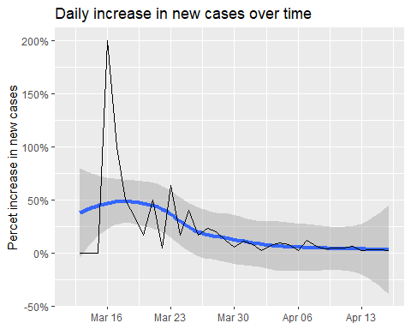
Alaska infection statistics
Date | Cases | Change | Days to double
2020-04-16 | 298.0 | 2.400% | 29
2020-04-15 | 291.0 | 2.800% | 25
2020-04-14 | 283.0 | 2.900% | 24
2020-04-13 | 275.0 | 1.900% | 38
2020-04-12 | 270.0 | 5.900% | 12
2020-04-11 | 255.0 | 4.500% | 16
2020-04-10 | 244.0 | 4.700% | 15
2020-04-09 | 233.0 | 4.000% | 18
2020-04-08 | 224.0 | 6.200% | 12
2020-04-07 | 211.0 | 11.600% | 6
2020-04-06 | 189.0 | 2.200% | 32
2020-04-05 | 185.0 | 8.200% | 9
2020-04-04 | 171.0 | 9.600% | 8
2020-04-03 | 156.0 | 6.800% | 10
2020-04-02 | 146.0 | 2.100% | 33

Slide 7
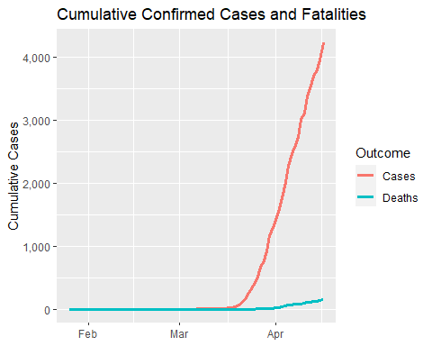
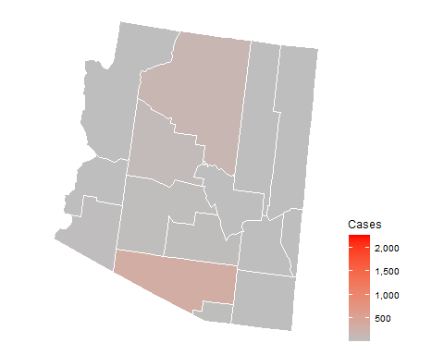
Arizona

Slide 8
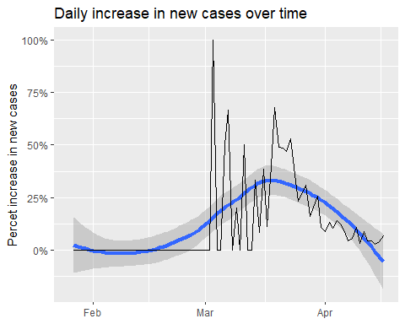
Arizona infection statistics
Date | Cases | Change | Days to double
2020-04-16 | 4,234 | 6.900% | 10
2020-04-15 | 3,962 | 4.100% | 17
2020-04-14 | 3,806 | 2.800% | 25
2020-04-13 | 3,702 | 4.600% | 15
2020-04-12 | 3,539 | 4.300% | 16
2020-04-11 | 3,393 | 9.000% | 8
2020-04-10 | 3,112 | 3.100% | 23
2020-04-09 | 3,018 | 10.700% | 7
2020-04-08 | 2,726 | 5.800% | 12
2020-04-07 | 2,577 | 4.500% | 16
2020-04-06 | 2,466 | 8.700% | 8
2020-04-05 | 2,269 | 12.400% | 6
2020-04-04 | 2,019 | 14.100% | 5
2020-04-03 | 1,769 | 10.600% | 7
2020-04-02 | 1,600 | 13.200% | 6

Slide 9
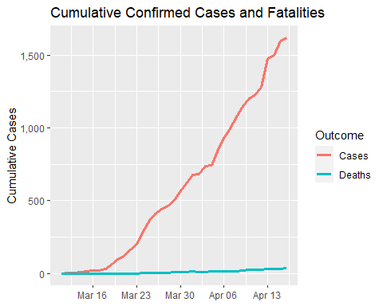
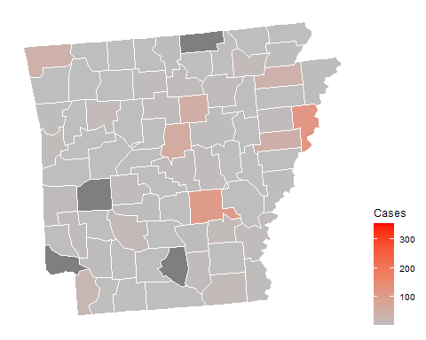
Arkansas

Slide 10
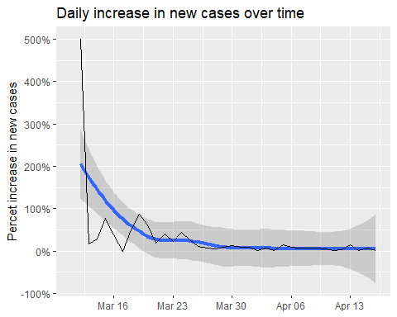
Arkansas infection statistics
Date | Cases | Change | Days to double
2020-04-16 | 1,620.0 | 1.300% | 53
2020-04-15 | 1,599.0 | 6.700% | 11
2020-04-14 | 1,498.0 | 1.600% | 45
2020-04-13 | 1,475.0 | 15.200% | 5
2020-04-12 | 1,280.0 | 4.200% | 17
2020-04-11 | 1,228.0 | 2.200% | 32
2020-04-10 | 1,202.0 | 4.900% | 15
2020-04-09 | 1,146.0 | 6.400% | 11
2020-04-08 | 1,077.0 | 8.000% | 9
2020-04-07 | 997.0 | 7.600% | 10
2020-04-06 | 927.0 | 8.700% | 8
2020-04-05 | 853.0 | 14.800% | 5
2020-04-04 | 743.0 | 0.700% | 103
2020-04-03 | 738.0 | 8.100% | 9
2020-04-02 | 683.0 | 0.600% | 118

Slide 11
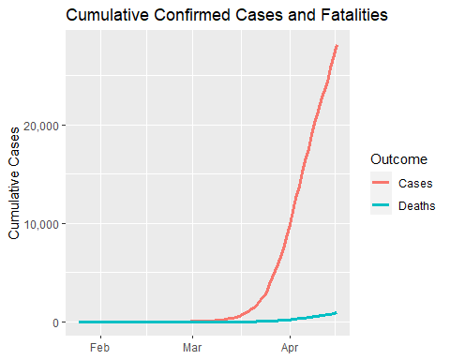
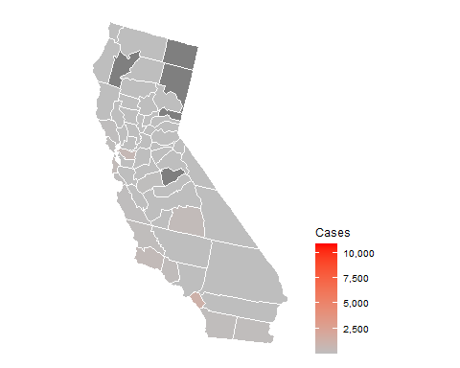
California

Slide 12
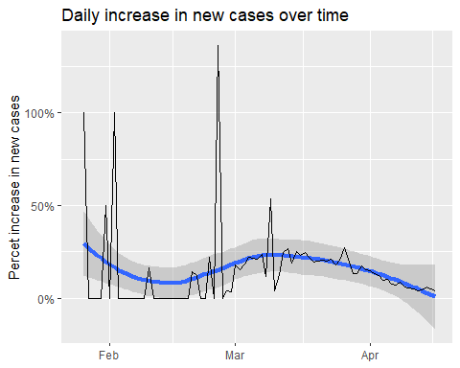
California infection statistics
Date | Cases | Change | Days to double
2020-04-16 | 28,142 | 3.800% | 18
2020-04-15 | 27,107 | 5.200% | 14
2020-04-14 | 25,758 | 5.900% | 12
2020-04-13 | 24,334 | 4.300% | 16
2020-04-12 | 23,323 | 4.000% | 18
2020-04-11 | 22,421 | 4.900% | 14
2020-04-10 | 21,366 | 5.800% | 12
2020-04-09 | 20,191 | 6.000% | 12
2020-04-08 | 19,043 | 8.600% | 8
2020-04-07 | 17,539 | 7.200% | 10
2020-04-06 | 16,361 | 7.600% | 9
2020-04-05 | 15,202 | 10.200% | 7
2020-04-04 | 13,796 | 9.800% | 7
2020-04-03 | 12,568 | 12.300% | 6
2020-04-02 | 11,190 | 13.500% | 5

Slide 13
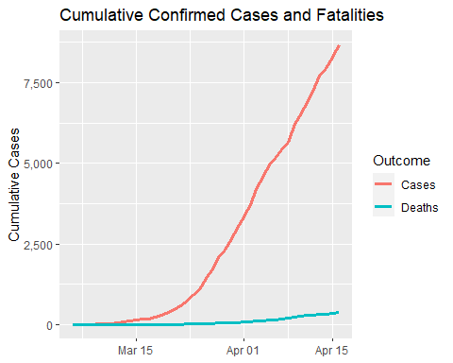
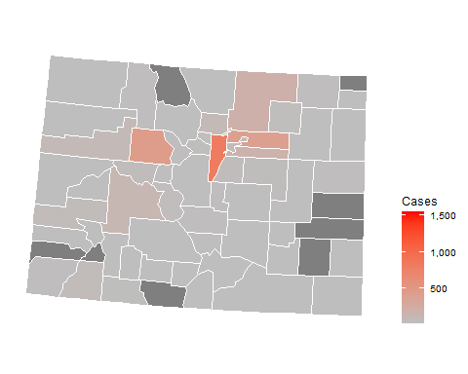
Colorado

Slide 14
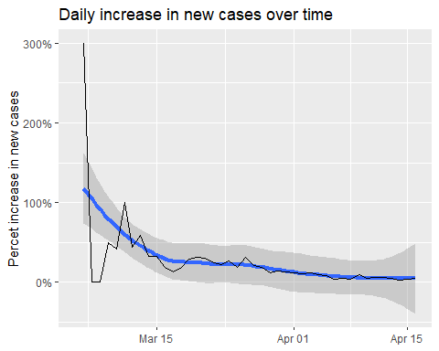
Colorado infection statistics
Date | Cases | Change | Days to double
2020-04-16 | 8,675 | 5% | 15
2020-04-15 | 8,280 | 4% | 17
2020-04-14 | 7,941 | 3% | 22
2020-04-13 | 7,691 | 5% | 13
2020-04-12 | 7,303 | 6% | 12
2020-04-11 | 6,893 | 6% | 12
2020-04-10 | 6,510 | 5% | 14
2020-04-09 | 6,202 | 10% | 8
2020-04-08 | 5,656 | 4% | 17
2020-04-07 | 5,429 | 5% | 14
2020-04-06 | 5,175 | 4% | 16
2020-04-05 | 4,962 | 8% | 9
2020-04-04 | 4,574 | 9% | 8
2020-04-03 | 4,182 | 12% | 6
2020-04-02 | 3,730 | 11% | 6

Slide 15
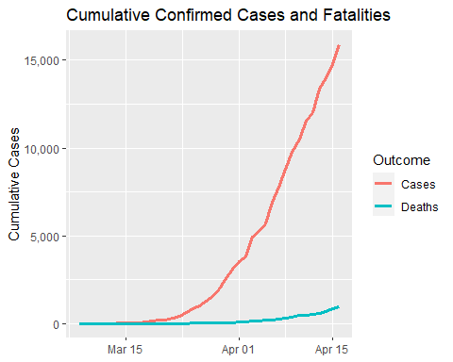
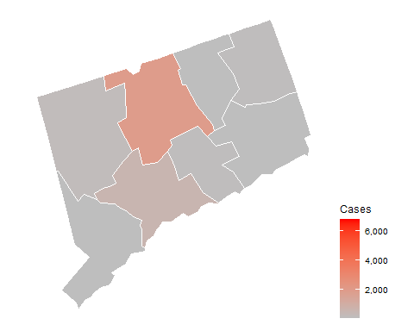
Connecticut

Slide 16
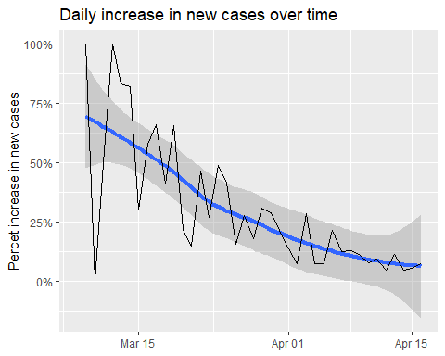
Connecticut infection statistics
Date | Cases | Change | Days to double
2020-04-16 | 15,884 | 8% | 9
2020-04-15 | 14,755 | 6% | 13
2020-04-14 | 13,989 | 4% | 16
2020-04-13 | 13,381 | 11% | 7
2020-04-12 | 12,035 | 5% | 16
2020-04-11 | 11,510 | 9% | 8
2020-04-10 | 10,538 | 8% | 9
2020-04-09 | 9,784 | 11% | 6
2020-04-08 | 8,781 | 13% | 6
2020-04-07 | 7,781 | 13% | 6
2020-04-06 | 6,906 | 22% | 4
2020-04-05 | 5,675 | 8% | 10
2020-04-04 | 5,276 | 7% | 10
2020-04-03 | 4,915 | 28% | 3
2020-04-02 | 3,824 | 8% | 10

Slide 17
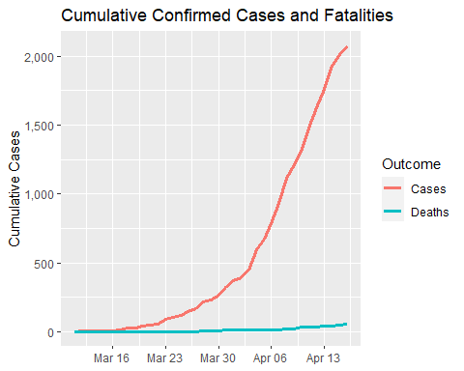
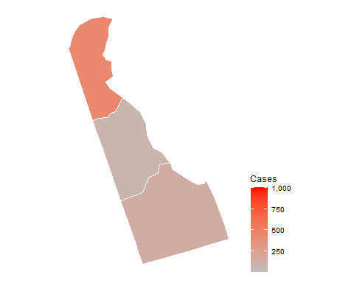
Delaware

Slide 18
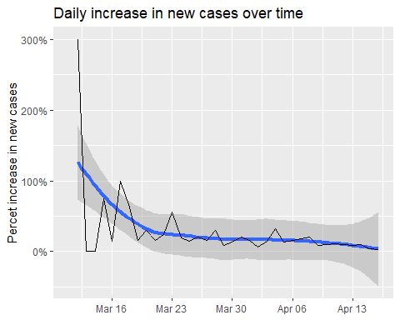
Delaware infection statistics
Date | Cases | Change | Days to double
2020-04-16 | 2,075 | 3.000% | 23
2020-04-15 | 2,014 | 4.600% | 16
2020-04-14 | 1,926 | 9.400% | 8
2020-04-13 | 1,761 | 8.400% | 9
2020-04-12 | 1,625 | 9.900% | 7
2020-04-11 | 1,479 | 11.500% | 6
2020-04-10 | 1,326 | 9.700% | 8
2020-04-09 | 1,209 | 8.300% | 9
2020-04-08 | 1,116 | 20.300% | 4
2020-04-07 | 928 | 18.500% | 4
2020-04-06 | 783 | 16.300% | 5
2020-04-05 | 673 | 13.500% | 5
2020-04-04 | 593 | 31.800% | 3
2020-04-03 | 450 | 14.500% | 5
2020-04-02 | 393 | 6.800% | 11

Slide 19
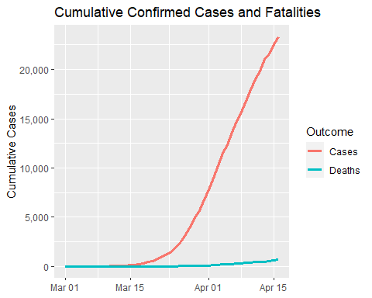
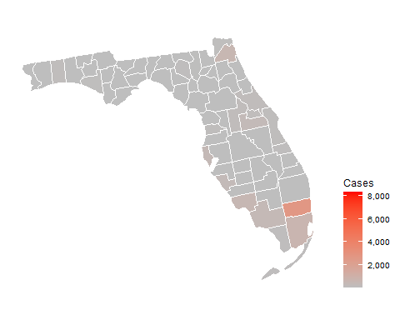
Florida

Slide 20
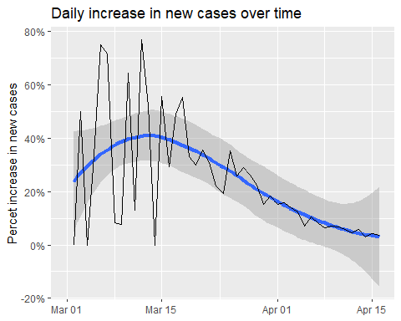
Florida infection statistics
Date | Cases | Change | Days to double
2020-04-16 | 23,332 | 3.60% | 20
2020-04-15 | 22,526 | 4.20% | 17
2020-04-14 | 21,620 | 2.90% | 24
2020-04-13 | 21,011 | 5.80% | 12
2020-04-12 | 19,855 | 4.60% | 15
2020-04-11 | 18,978 | 5.70% | 13
2020-04-10 | 17,960 | 6.80% | 11
2020-04-09 | 16,819 | 7.20% | 10
2020-04-08 | 15,690 | 6.50% | 11
2020-04-07 | 14,739 | 8.20% | 9
2020-04-06 | 13,621 | 10.40% | 7
2020-04-05 | 12,342 | 7.00% | 10
2020-04-04 | 11,537 | 12.40% | 6
2020-04-03 | 10,260 | 14.00% | 5
2020-04-02 | 9,000 | 15.80% | 5

Slide 21
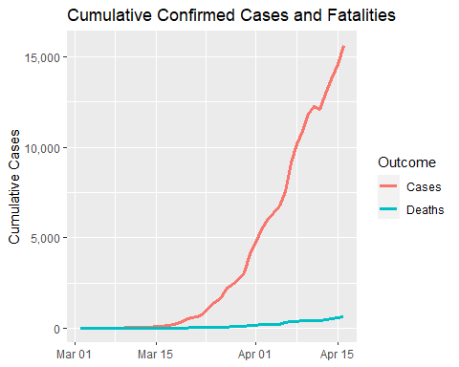
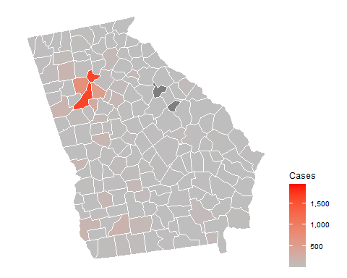
Georgia

Slide 22
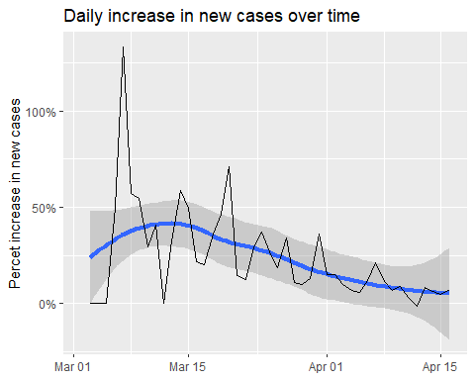
Georgia infection statistics
Date | Cases | Change | Days to double
2020-04-16 | 15,644 | 7.30% | 10
2020-04-15 | 14,583 | 4.80% | 15
2020-04-14 | 13,913 | 6.00% | 12
2020-04-13 | 13,125 | 8.40% | 9
2020-04-12 | 12,103 | -1.30% | -53
2020-04-11 | 12,261 | 3.40% | 21
2020-04-10 | 11,859 | 8.90% | 8
2020-04-09 | 10,885 | 6.70% | 11
2020-04-08 | 10,204 | 11.40% | 6
2020-04-07 | 9,156 | 21.10% | 4
2020-04-06 | 7,558 | 12.10% | 6
2020-04-05 | 6,742 | 5.60% | 13
2020-04-04 | 6,383 | 7.00% | 10
2020-04-03 | 5,967 | 9.60% | 8
2020-04-02 | 5,444 | 14.80% | 5

Slide 23
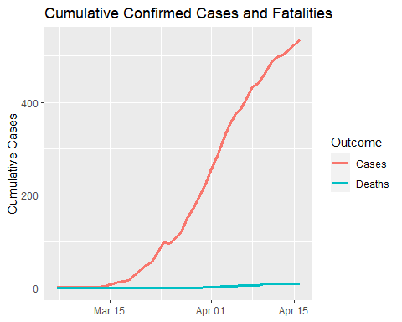
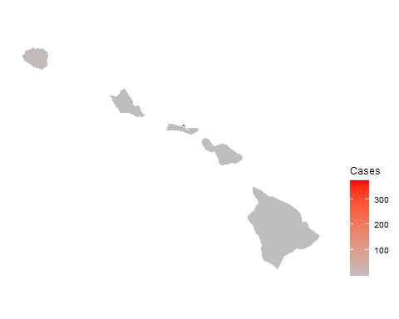
Hawaii

Slide 24
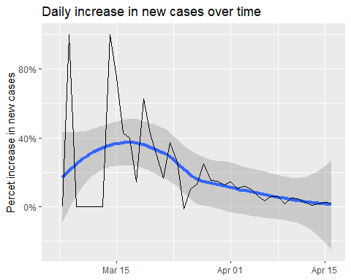
Hawaii infection statistics
Date | Cases | Change | Days to double
2020-04-16 | 535.0 | 2.100% | 33
2020-04-15 | 524.0 | 2.500% | 28
2020-04-14 | 511.0 | 1.800% | 39
2020-04-13 | 502.0 | 1.000% | 69
2020-04-12 | 497.0 | 2.700% | 26
2020-04-11 | 484.0 | 4.500% | 16
2020-04-10 | 463.0 | 5.200% | 14
2020-04-09 | 440.0 | 1.600% | 43
2020-04-08 | 433.0 | 6.100% | 12
2020-04-07 | 408.0 | 6.000% | 12
2020-04-06 | 385.0 | 3.500% | 20
2020-04-05 | 372.0 | 6.600% | 11
2020-04-04 | 349.0 | 10.100% | 7
2020-04-03 | 317.0 | 12.000% | 6
2020-04-02 | 283.0 | 10.500% | 7

Slide 25
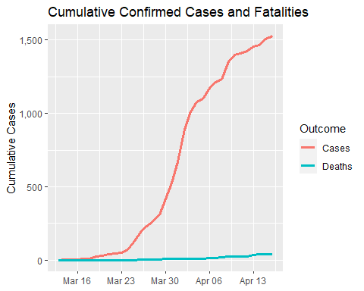
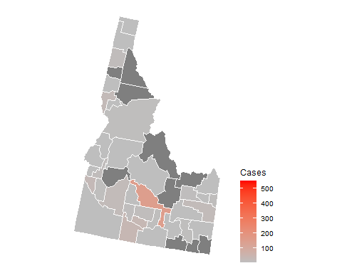
Idaho

Slide 26
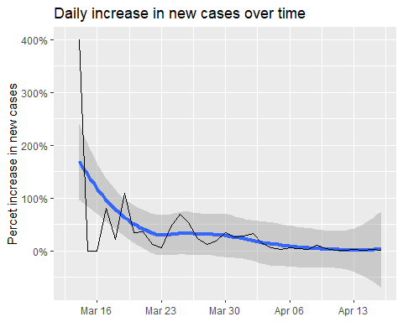
Idaho infection statistics
Date | Cases | Change | Days to double
2020-04-16 | 1,528.0 | 1% | 50
2020-04-15 | 1,507.0 | 3% | 24
2020-04-14 | 1,464.0 | 1% | 92
2020-04-13 | 1,453.0 | 2% | 37
2020-04-12 | 1,426.0 | 1% | 52
2020-04-11 | 1,407.0 | 0% | 139
2020-04-10 | 1,400.0 | 4% | 20
2020-04-09 | 1,353.0 | 10% | 7
2020-04-08 | 1,232.0 | 2% | 38
2020-04-07 | 1,210.0 | 3% | 21
2020-04-06 | 1,170.0 | 6% | 11
2020-04-05 | 1,101.0 | 2% | 31
2020-04-04 | 1,077.0 | 6% | 11
2020-04-03 | 1,013.0 | 14% | 5
2020-04-02 | 892.0 | 33% | 2

Slide 27
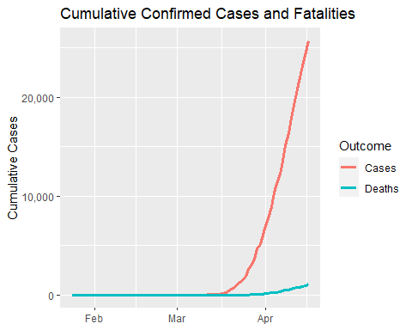
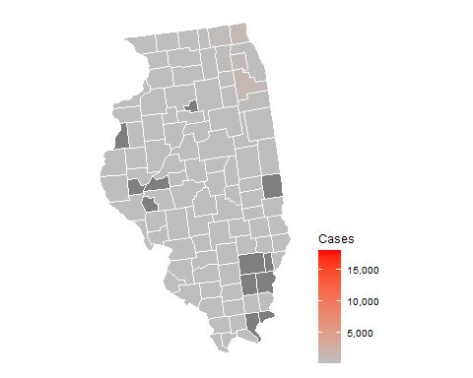
Illinois

Slide 28
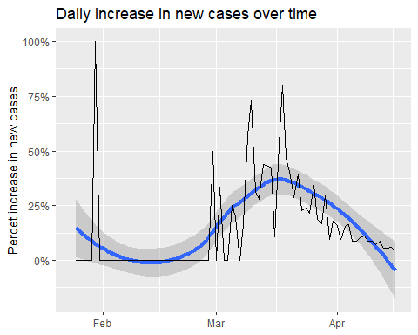
Illinois infection statistics
Date | Cases | Change | Days to double
2020-04-16 | 25,738 | 5% | 15
2020-04-15 | 24,604 | 6% | 12
2020-04-14 | 23,247 | 6% | 13
2020-04-13 | 22,028 | 6% | 13
2020-04-12 | 20,855 | 9% | 8
2020-04-11 | 19,183 | 7% | 10
2020-04-10 | 17,892 | 9% | 8
2020-04-09 | 16,432 | 9% | 8
2020-04-08 | 15,078 | 11% | 6
2020-04-07 | 13,549 | 10% | 7
2020-04-06 | 12,262 | 9% | 8
2020-04-05 | 11,277 | 9% | 8
2020-04-04 | 10,358 | 16% | 5
2020-04-03 | 8,904 | 16% | 5
2020-04-02 | 7,695 | 10% | 8

Slide 29
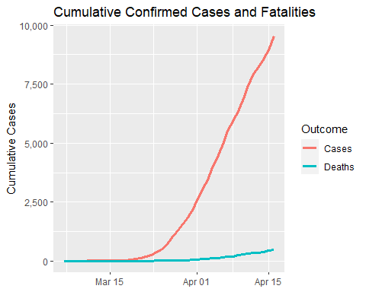
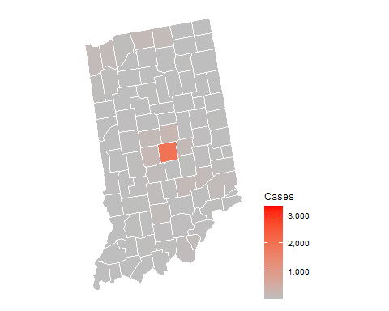
Indiana

Slide 30
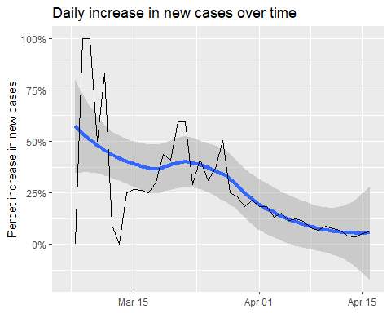
Indiana infection statistics
Date | Cases | Change | Days to double
2020-04-16 | 9,542 | 7% | 11
2020-04-15 | 8,955 | 5% | 14
2020-04-14 | 8,527 | 4% | 20
2020-04-13 | 8,236 | 4% | 18
2020-04-12 | 7,928 | 7% | 11
2020-04-11 | 7,435 | 8% | 9
2020-04-10 | 6,907 | 9% | 8
2020-04-09 | 6,351 | 7% | 10
2020-04-08 | 5,943 | 8% | 9
2020-04-07 | 5,509 | 11% | 7
2020-04-06 | 4,956 | 12% | 6
2020-04-05 | 4,409 | 12% | 6
2020-04-04 | 3,951 | 15% | 5
2020-04-03 | 3,435 | 13% | 6
2020-04-02 | 3,038 | 18% | 4

Slide 31
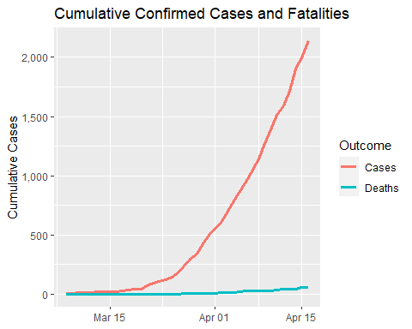
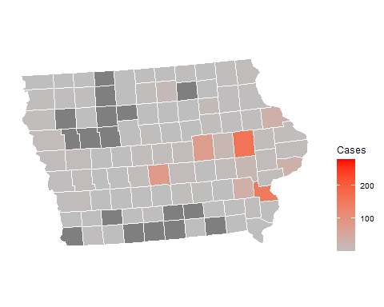
Iowa

Slide 32
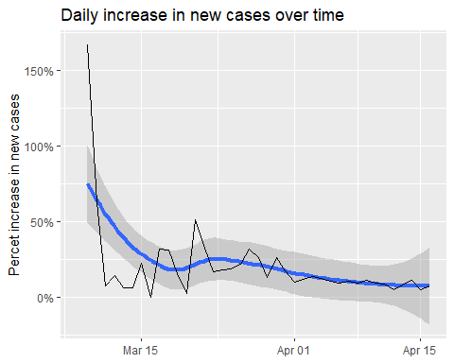
Iowa infection statistics
Date | Cases | Change | Days to double
2020-04-16 | 2,141 | 7% | 10
2020-04-15 | 1,995 | 5% | 14
2020-04-14 | 1,899 | 11% | 7
2020-04-13 | 1,710 | 8% | 9
2020-04-12 | 1,587 | 5% | 14
2020-04-11 | 1,510 | 9% | 8
2020-04-10 | 1,388 | 9% | 8
2020-04-09 | 1,270 | 11% | 7
2020-04-08 | 1,145 | 9% | 8
2020-04-07 | 1,048 | 11% | 7
2020-04-06 | 946 | 9% | 8
2020-04-05 | 868 | 10% | 7
2020-04-04 | 786 | 12% | 6
2020-04-03 | 699 | 14% | 5
2020-04-02 | 614 | 12% | 6

Slide 33
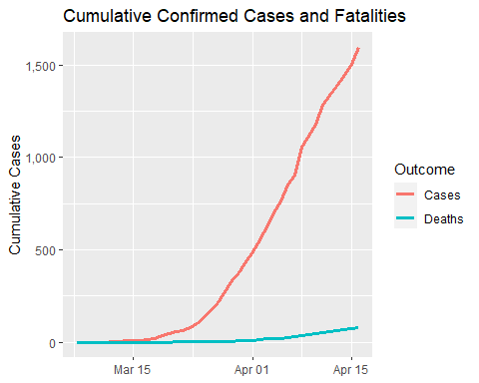
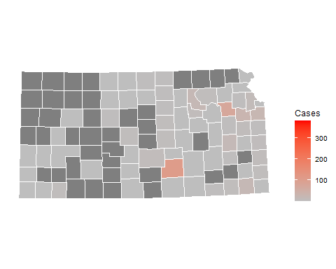
Kansas

Slide 34
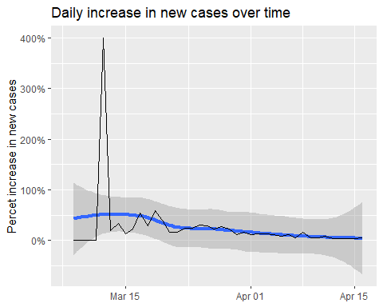
Kansas infection statistics
Date | Cases | Change | Days to double
2020-04-16 | 1,596 | 6% | 12
2020-04-15 | 1,504 | 4% | 16
2020-04-14 | 1,441 | 4% | 17
2020-04-13 | 1,385 | 4% | 20
2020-04-12 | 1,338 | 4% | 17
2020-04-11 | 1,283 | 9% | 8
2020-04-10 | 1,180 | 6% | 12
2020-04-09 | 1,116 | 6% | 12
2020-04-08 | 1,055 | 17% | 5
2020-04-07 | 905 | 6% | 12
2020-04-06 | 853 | 12% | 6
2020-04-05 | 765 | 9% | 8
2020-04-04 | 701 | 12% | 6
2020-04-03 | 625 | 13% | 6
2020-04-02 | 554 | 13% | 6

Slide 35
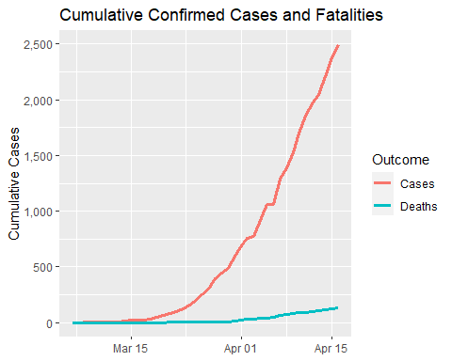
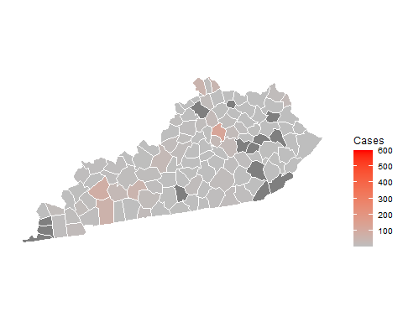
Kentucky

Slide 36

Kentucky infection statistics
Date | Cases | Change | Days to double
2020-04-16 | 2,494 | 5.10% | 14
2020-04-15 | 2,372 | 7.30% | 10
2020-04-14 | 2,210 | 7.90% | 9
2020-04-13 | 2,048 | 4.30% | 16
2020-04-12 | 1,963 | 6.10% | 12
2020-04-11 | 1,851 | 8.80% | 8
2020-04-10 | 1,702 | 11.60% | 6
2020-04-09 | 1,525 | 9.50% | 8
2020-04-08 | 1,393 | 8.10% | 9
2020-04-07 | 1,289 | 21.90% | 3
2020-04-06 | 1,057 | 0.00% | Inf
2020-04-05 | 1,057 | 15.30% | 5
2020-04-04 | 917 | 19.10% | 4
2020-04-03 | 770 | 2.00% | 35
2020-04-02 | 755 | 9.30% | 8

Slide 37


Louisiana

Slide 38

Louisiana infection statistics
Date | Cases | Change | Days to double
2020-04-16 | 22,532 | 3% | 27
2020-04-15 | 21,951 | 2% | 35
2020-04-14 | 21,518 | 2% | 29
2020-04-13 | 21,016 | 2% | 34
2020-04-12 | 20,595 | 3% | 24
2020-04-11 | 20,014 | 4% | 18
2020-04-10 | 19,253 | 5% | 13
2020-04-09 | 18,283 | 7% | 10
2020-04-08 | 17,030 | 5% | 15
2020-04-07 | 16,284 | 10% | 8
2020-04-06 | 14,867 | 14% | 5
2020-04-05 | 13,006 | 4% | 17
2020-04-04 | 12,492 | 21% | 4
2020-04-03 | 10,295 | 12% | 6
2020-04-02 | 9,148 | 42% | 2

Slide 39


Maine

Slide 40

Maine infection statistics
Date | Cases | Change | Days to double
2020-04-16 | 796 | 3.40% | 21
2020-04-15 | 770 | 4.90% | 14
2020-04-14 | 734 | 5.20% | 14
2020-04-13 | 698 | 10.30% | 7
2020-04-12 | 633 | 2.80% | 25
2020-04-11 | 616 | 5.10% | 14
2020-04-10 | 586 | 4.60% | 15
2020-04-09 | 560 | 4.30% | 17
2020-04-08 | 537 | 3.50% | 20
2020-04-07 | 519 | 4.00% | 18
2020-04-06 | 499 | 6.20% | 12
2020-04-05 | 470 | 3.10% | 23
2020-04-04 | 456 | 5.60% | 13
2020-04-03 | 432 | 14.90% | 5
2020-04-02 | 376 | 9.30% | 8

Slide 41


Maryland

Slide 42

Maryland infection statistics
Date | Cases | Change | Days to double
2020-04-16 | 10,784 | 7.50% | 10
2020-04-15 | 10,032 | 5.90% | 12
2020-04-14 | 9,472 | 6.00% | 12
2020-04-13 | 8,936 | 8.60% | 8
2020-04-12 | 8,225 | 6.90% | 10
2020-04-11 | 7,694 | 10.40% | 7
2020-04-10 | 6,968 | 12.70% | 6
2020-04-09 | 6,185 | 11.90% | 6
2020-04-08 | 5,529 | 26.50% | 3
2020-04-07 | 4,371 | 8.10% | 9
2020-04-06 | 4,045 | 12.10% | 6
2020-04-05 | 3,609 | 15.50% | 5
2020-04-04 | 3,125 | 13.30% | 6
2020-04-03 | 2,758 | 18.30% | 4
2020-04-02 | 2,331 | 19.50% | 4

Slide 43


Massachusetts

Slide 44

Massachusetts infection statistics
Date | Cases | Change | Days to double
2020-04-16 | 32,181 | 8% | 10
2020-04-15 | 29,918 | 6% | 11
2020-04-14 | 28,163 | 5% | 15
2020-04-13 | 26,867 | 6% | 13
2020-04-12 | 25,475 | 11% | 6
2020-04-11 | 22,860 | 9% | 8
2020-04-10 | 20,974 | 11% | 7
2020-04-09 | 18,941 | 13% | 6
2020-04-08 | 16,790 | 10% | 7
2020-04-07 | 15,202 | 10% | 7
2020-04-06 | 13,837 | 11% | 7
2020-04-05 | 12,500 | 6% | 11
2020-04-04 | 11,736 | 13% | 6
2020-04-03 | 10,402 | 16% | 5
2020-04-02 | 8,966 | 15% | 5

Slide 45


Michigan

Slide 46

Michigan infection statistics
Date | Cases | Change | Days to double
2020-04-16 | 29,120 | 4% | 16
2020-04-15 | 27,894 | 4% | 18
2020-04-14 | 26,845 | 5% | 13
2020-04-13 | 25,490 | 4% | 17
2020-04-12 | 24,496 | 3% | 26
2020-04-11 | 23,855 | 5% | 13
2020-04-10 | 22,646 | 6% | 12
2020-04-09 | 21,375 | 6% | 12
2020-04-08 | 20,220 | 7% | 10
2020-04-07 | 18,852 | 10% | 7
2020-04-06 | 17,130 | 10% | 8
2020-04-05 | 15,635 | 10% | 7
2020-04-04 | 14,225 | 12% | 6
2020-04-03 | 12,670 | 17% | 4
2020-04-02 | 10,791 | 16% | 5

Slide 47


Minnesota

Slide 48

Minnesota infection statistics
Date | Cases | Change | Days to double
2020-04-16 | 1,917 | 5.700% | 12
2020-04-15 | 1,813 | 7.000% | 10
2020-04-14 | 1,695 | 2.700% | 26
2020-04-13 | 1,650 | 1.800% | 39
2020-04-12 | 1,621 | 13.600% | 5
2020-04-11 | 1,427 | 6.900% | 10
2020-04-10 | 1,335 | 7.700% | 9
2020-04-09 | 1,240 | 7.800% | 9
2020-04-08 | 1,150 | 8.100% | 9
2020-04-07 | 1,064 | 8.600% | 8
2020-04-06 | 980 | 5.600% | 13
2020-04-05 | 928 | 7.300% | 10
2020-04-04 | 865 | 9.600% | 8
2020-04-03 | 789 | 6.300% | 11
2020-04-02 | 742 | 7.500% | 10

Slide 49


Mississippi

Slide 50

Mississippi infection statistics
Date | Cases | Change | Days to double
2020-04-16 | 3,624 | 7.900% | 9
2020-04-15 | 3,360 | 8.800% | 8
2020-04-14 | 3,087 | 4.900% | 14
2020-04-13 | 2,942 | 5.800% | 12
2020-04-12 | 2,781 | 5.300% | 14
2020-04-11 | 2,642 | 7.000% | 10
2020-04-10 | 2,469 | 9.200% | 8
2020-04-09 | 2,260 | 12.800% | 6
2020-04-08 | 2,003 | 4.600% | 15
2020-04-07 | 1,915 | 10.200% | 7
2020-04-06 | 1,738 | 6.100% | 12
2020-04-05 | 1,638 | 12.600% | 6
2020-04-04 | 1,455 | 7.100% | 10
2020-04-03 | 1,358 | 15.400% | 5
2020-04-02 | 1,177 | 9.300% | 8

Slide 51


Missouri

Slide 52

Missouri infection statistics
Date | Cases | Change | Days to double
2020-04-16 | 5,111 | 4% | 16
2020-04-15 | 4,896 | 4% | 16
2020-04-14 | 4,686 | 7% | 11
2020-04-13 | 4,389 | 6% | 13
2020-04-12 | 4,156 | 3% | 21
2020-04-11 | 4,021 | 6% | 12
2020-04-10 | 3,795 | 7% | 10
2020-04-09 | 3,538 | 6% | 11
2020-04-08 | 3,325 | 10% | 8
2020-04-07 | 3,035 | 12% | 6
2020-04-06 | 2,721 | 15% | 5
2020-04-05 | 2,365 | 4% | 20
2020-04-04 | 2,285 | 8% | 9
2020-04-03 | 2,113 | 15% | 5
2020-04-02 | 1,835 | 28% | 3

Slide 53


Montana

Slide 54

Montana infection statistics
Date | Cases | Change | Days to double
2020-04-16 | 415 | 3% | 26
2020-04-15 | 404 | 1% | 56
2020-04-14 | 399 | 1% | 55
2020-04-13 | 394 | 2% | 39
2020-04-12 | 387 | 3% | 26
2020-04-11 | 377 | 3% | 21
2020-04-10 | 365 | 3% | 23
2020-04-09 | 354 | 7% | 11
2020-04-08 | 332 | 4% | 17
2020-04-07 | 319 | 0% | Inf
2020-04-06 | 319 | 7% | 10
2020-04-05 | 298 | 6% | 12
2020-04-04 | 281 | 7% | 10
2020-04-03 | 262 | 9% | 8
2020-04-02 | 241 | 10% | 7

Slide 55


Nebraska

Slide 56

Nebraska infection statistics
Date | Cases | Change | Days to double
2020-04-16 | 1,094 | 10% | 7
2020-04-15 | 995 | 7% | 10
2020-04-14 | 931 | 7% | 10
2020-04-13 | 871 | 8% | 9
2020-04-12 | 806 | 12% | 6
2020-04-11 | 719 | 6% | 12
2020-04-10 | 679 | 14% | 5
2020-04-09 | 594 | 10% | 7
2020-04-08 | 538 | 10% | 8
2020-04-07 | 491 | 12% | 6
2020-04-06 | 439 | 16% | 5
2020-04-05 | 378 | 12% | 6
2020-04-04 | 339 | 14% | 5
2020-04-03 | 297 | 10% | 7
2020-04-02 | 269 | 19% | 4

Slide 57


Nevada

Slide 58

Nevada infection statistics
Date | Cases | Change | Days to double
2020-04-16 | 3,321 | 3% | 21
2020-04-15 | 3,212 | 2% | 29
2020-04-14 | 3,137 | 3% | 21
2020-04-13 | 3,036 | 6% | 12
2020-04-12 | 2,860 | 5% | 14
2020-04-11 | 2,720 | 4% | 16
2020-04-10 | 2,606 | 6% | 12
2020-04-09 | 2,456 | 6% | 12
2020-04-08 | 2,318 | 10% | 7
2020-04-07 | 2,101 | 7% | 11
2020-04-06 | 1,971 | 5% | 15
2020-04-05 | 1,880 | 7% | 10
2020-04-04 | 1,758 | 14% | 5
2020-04-03 | 1,549 | 6% | 11
2020-04-02 | 1,458 | 14% | 5

Slide 59


New Hampshire

Slide 60

New Hampshire infection statistics
Date | Cases | Change | Days to double
2020-04-16 | 1,211 | 6.30% | 11
2020-04-15 | 1,139 | 4.40% | 16
2020-04-14 | 1,091 | 7.00% | 10
2020-04-13 | 1,020 | 3.60% | 20
2020-04-12 | 985 | 6.00% | 12
2020-04-11 | 929 | 5.00% | 14
2020-04-10 | 885 | 8.10% | 9
2020-04-09 | 819 | 3.90% | 18
2020-04-08 | 788 | 5.50% | 13
2020-04-07 | 747 | 4.60% | 15
2020-04-06 | 714 | 6.70% | 11
2020-04-05 | 669 | 7.90% | 9
2020-04-04 | 620 | 14.80% | 5
2020-04-03 | 540 | 12.70% | 6
2020-04-02 | 479 | 15.40% | 5

Slide 61


New Jersey

Slide 62

New Jersey infection statistics
Date | Cases | Change | Days to double
2020-04-16 | 75,317 | 6.000% | 12
2020-04-15 | 71,030 | 3.200% | 22
2020-04-14 | 68,824 | 6.600% | 11
2020-04-13 | 64,584 | 4.400% | 16
2020-04-12 | 61,850 | 6.400% | 11
2020-04-11 | 58,151 | 6.500% | 11
2020-04-10 | 54,588 | 7.000% | 10
2020-04-09 | 51,027 | 7.600% | 10
2020-04-08 | 47,437 | 6.800% | 11
2020-04-07 | 44,416 | 8.100% | 9
2020-04-06 | 41,090 | 9.600% | 8
2020-04-05 | 37,505 | 9.900% | 7
2020-04-04 | 34,124 | 14.100% | 5
2020-04-03 | 29,895 | 16.800% | 4
2020-04-02 | 25,590 | 15.000% | 5

Slide 63


New Mexico

Slide 64

New Mexico infection statistics
Date | Cases | Change | Days to double
2020-04-16 | 1,597 | 8% | 9
2020-04-15 | 1,484 | 6% | 13
2020-04-14 | 1,407 | 5% | 15
2020-04-13 | 1,345 | 8% | 9
2020-04-12 | 1,245 | 6% | 12
2020-04-11 | 1,174 | 8% | 9
2020-04-10 | 1,091 | 10% | 7
2020-04-09 | 989 | 14% | 5
2020-04-08 | 865 | 9% | 8
2020-04-07 | 794 | 16% | 5
2020-04-06 | 686 | 10% | 7
2020-04-05 | 624 | 14% | 5
2020-04-04 | 546 | 10% | 7
2020-04-03 | 495 | 23% | 3
2020-04-02 | 403 | 11% | 7

Slide 65


New York

Slide 66

New York infection statistics
Date | Cases | Change | Days to double
2020-04-16 | 222,284 | 4.000% | 18
2020-04-15 | 213,779 | 5.700% | 12
2020-04-14 | 202,208 | 3.700% | 19
2020-04-13 | 195,031 | 3.400% | 21
2020-04-12 | 188,694 | 4.600% | 16
2020-04-11 | 180,458 | 5.800% | 12
2020-04-10 | 170,512 | 6.600% | 11
2020-04-09 | 159,937 | 7.100% | 10
2020-04-08 | 149,401 | 6.700% | 11
2020-04-07 | 140,081 | 7.200% | 10
2020-04-06 | 130,703 | 6.300% | 11
2020-04-05 | 122,911 | 6.900% | 10
2020-04-04 | 114,996 | 11.700% | 6
2020-04-03 | 102,945 | 11.000% | 7
2020-04-02 | 92,770 | 10.600% | 7

Slide 67


North Carolina

Slide 68

North Carolina infection statistics
Date | Cases | Change | Days to double
2020-04-16 | 5,463 | 6.600% | 11
2020-04-15 | 5,123 | 2.600% | 27
2020-04-14 | 4,992 | 4.300% | 17
2020-04-13 | 4,788 | 5.900% | 12
2020-04-12 | 4,520 | 4.900% | 15
2020-04-11 | 4,310 | 10.300% | 7
2020-04-10 | 3,906 | 7.000% | 10
2020-04-09 | 3,651 | 6.700% | 11
2020-04-08 | 3,423 | 6.300% | 11
2020-04-07 | 3,220 | 12.200% | 6
2020-04-06 | 2,870 | 11.000% | 7
2020-04-05 | 2,585 | 7.600% | 9
2020-04-04 | 2,402 | 14.800% | 5
2020-04-03 | 2,093 | 12.600% | 6
2020-04-02 | 1,858 | 16.600% | 5

Slide 69


North Dakota

Slide 70

North Dakota infection statistics
Date | Cases | Change | Days to double
2020-04-16 | 394.0 | 8% | 9
2020-04-15 | 366.0 | 7% | 10
2020-04-14 | 341.0 | 3% | 23
2020-04-13 | 331.0 | 8% | 10
2020-04-12 | 308.0 | 5% | 14
2020-04-11 | 293.0 | 5% | 13
2020-04-10 | 278.0 | 3% | 21
2020-04-09 | 269.0 | 7% | 10
2020-04-08 | 251.0 | 6% | 12
2020-04-07 | 237.0 | 5% | 13
2020-04-06 | 225.0 | 9% | 8
2020-04-05 | 207.0 | 11% | 6
2020-04-04 | 186.0 | 8% | 10
2020-04-03 | 173.0 | 9% | 8
2020-04-02 | 159.0 | 8% | 9

Slide 71


Ohio

Slide 72

Ohio infection statistics
Date | Cases | Change | Days to double
2020-04-16 | 8,414 | 8.000% | 9
2020-04-15 | 7,791 | 7.000% | 10
2020-04-14 | 7,280 | 4.400% | 16
2020-04-13 | 6,975 | 5.600% | 13
2020-04-12 | 6,604 | 5.700% | 13
2020-04-11 | 6,250 | 6.300% | 11
2020-04-10 | 5,878 | 6.600% | 11
2020-04-09 | 5,512 | 7.100% | 10
2020-04-08 | 5,148 | 7.700% | 9
2020-04-07 | 4,782 | 7.500% | 10
2020-04-06 | 4,450 | 10.100% | 7
2020-04-05 | 4,043 | 8.100% | 9
2020-04-04 | 3,739 | 12.900% | 6
2020-04-03 | 3,312 | 14.100% | 5
2020-04-02 | 2,903 | 13.900% | 5

Slide 73


Oklahoma

Slide 74

Oklahoma infection statistics
Date | Cases | Change | Days to double
2020-04-16 | 2,357 | 4.200% | 17
2020-04-15 | 2,263 | 3.600% | 20
2020-04-14 | 2,184 | 5.600% | 13
2020-04-13 | 2,069 | 5.000% | 14
2020-04-12 | 1,970 | 5.500% | 13
2020-04-11 | 1,868 | 4.100% | 17
2020-04-10 | 1,794 | 6.500% | 11
2020-04-09 | 1,684 | 10.500% | 7
2020-04-08 | 1,524 | 3.500% | 20
2020-04-07 | 1,472 | 10.900% | 7
2020-04-06 | 1,327 | 6.000% | 12
2020-04-05 | 1,252 | 8.000% | 9
2020-04-04 | 1,159 | 17.100% | 4
2020-04-03 | 990 | 12.600% | 6
2020-04-02 | 879 | 22.300% | 3

Slide 75


Oregon

Slide 76

Oregon infection statistics
Date | Cases | Change | Days to double
2020-04-16 | 1,736 | 4% | 16
2020-04-15 | 1,663 | 2% | 38
2020-04-14 | 1,633 | 3% | 23
2020-04-13 | 1,584 | 4% | 19
2020-04-12 | 1,527 | 6% | 13
2020-04-11 | 1,447 | 6% | 13
2020-04-10 | 1,371 | 4% | 19
2020-04-09 | 1,321 | 7% | 11
2020-04-08 | 1,239 | 5% | 14
2020-04-07 | 1,181 | 4% | 16
2020-04-06 | 1,132 | 6% | 12
2020-04-05 | 1,068 | 7% | 11
2020-04-04 | 1,000 | 11% | 7
2020-04-03 | 899 | 9% | 8
2020-04-02 | 827 | 12% | 6

Slide 77


Pennsylvania

Slide 78

Pennsylvania infection statistics
Date | Cases | Change | Days to double
2020-04-16 | 28,314 | 5.60% | 13
2020-04-15 | 26,804 | 4.70% | 15
2020-04-14 | 25,591 | 5.30% | 13
2020-04-13 | 24,295 | 5.80% | 12
2020-04-12 | 22,955 | 5.40% | 13
2020-04-11 | 21,774 | 8.20% | 9
2020-04-10 | 20,128 | 9.50% | 8
2020-04-09 | 18,379 | 12.00% | 6
2020-04-08 | 16,414 | 12.60% | 6
2020-04-07 | 14,582 | 11.50% | 6
2020-04-06 | 13,075 | 12.80% | 6
2020-04-05 | 11,590 | 14.60% | 5
2020-04-04 | 10,110 | 20.30% | 4
2020-04-03 | 8,402 | 19.70% | 4
2020-04-02 | 7,021 | 20.90% | 4

Slide 79


Rhode Island

Slide 80

Rhode Island infection statistics
Date | Cases | Change | Days to double
2020-04-16 | 3,838 | 18.100% | 4
2020-04-15 | 3,251 | 0.000% | Inf
2020-04-14 | 3,251 | 9.200% | 8
2020-04-13 | 2,976 | 11.700% | 6
2020-04-12 | 2,665 | 13.500% | 5
2020-04-11 | 2,349 | 16.600% | 5
2020-04-10 | 2,015 | 16.700% | 4
2020-04-09 | 1,727 | 19.100% | 4
2020-04-08 | 1,450 | 18.000% | 4
2020-04-07 | 1,229 | 13.600% | 5
2020-04-06 | 1,082 | 9.500% | 8
2020-04-05 | 988 | 22.600% | 3
2020-04-04 | 806 | 11.300% | 6
2020-04-03 | 724 | 8.100% | 9
2020-04-02 | 670 | -5.400% | -13

Slide 81


South Carolina

Slide 82

South Carolina infection statistics
Date | Cases | Change | Days to double
2020-04-16 | 3,931 | 8% | 10
2020-04-15 | 3,656 | 3% | 24
2020-04-14 | 3,553 | 3% | 21
2020-04-13 | 3,439 | 4% | 20
2020-04-12 | 3,319 | 4% | 20
2020-04-11 | 3,207 | 5% | 15
2020-04-10 | 3,065 | 10% | 7
2020-04-09 | 2,792 | 9% | 8
2020-04-08 | 2,552 | 6% | 13
2020-04-07 | 2,417 | 8% | 9
2020-04-06 | 2,232 | 9% | 8
2020-04-05 | 2,049 | 7% | 10
2020-04-04 | 1,917 | 13% | 6
2020-04-03 | 1,700 | 9% | 8
2020-04-02 | 1,554 | 20% | 4

Slide 83


South Dakota

Slide 84

South Dakota infection statistics
Date | Cases | Change | Days to double
2020-04-16 | 1,312 | 12.200% | 6
2020-04-15 | 1,169 | 18.300% | 4
2020-04-14 | 988 | 13.800% | 5
2020-04-13 | 868 | 18.900% | 4
2020-04-12 | 730 | 16.600% | 5
2020-04-11 | 626 | 16.800% | 4
2020-04-10 | 536 | 19.900% | 4
2020-04-09 | 447 | 13.700% | 5
2020-04-08 | 393 | 22.800% | 3
2020-04-07 | 320 | 11.100% | 7
2020-04-06 | 288 | 20.000% | 4
2020-04-05 | 240 | 13.200% | 6
2020-04-04 | 212 | 13.400% | 6
2020-04-03 | 187 | 13.300% | 6
2020-04-02 | 165 | 26.900% | 3

Slide 85


Tennessee

Slide 86

Tennessee infection statistics
Date | Cases | Change | Days to double
2020-04-16 | 6,090 | 4% | 20
2020-04-15 | 5,878 | 4% | 18
2020-04-14 | 5,654 | 3% | 23
2020-04-13 | 5,483 | 7% | 11
2020-04-12 | 5,144 | 3% | 22
2020-04-11 | 4,983 | 4% | 18
2020-04-10 | 4,793 | 8% | 10
2020-04-09 | 4,456 | 5% | 14
2020-04-08 | 4,246 | 6% | 12
2020-04-07 | 4,010 | 7% | 10
2020-04-06 | 3,753 | 6% | 12
2020-04-05 | 3,538 | 8% | 9
2020-04-04 | 3,265 | 8% | 9
2020-04-03 | 3,034 | 6% | 13
2020-04-02 | 2,871 | 7% | 11

Slide 87


Texas

Slide 88

Texas infection statistics
Date | Cases | Change | Days to double
2020-04-16 | 16,927 | 5% | 14
2020-04-15 | 16,104 | 5% | 14
2020-04-14 | 15,304 | 6% | 13
2020-04-13 | 14,488 | 5% | 14
2020-04-12 | 13,774 | 4% | 16
2020-04-11 | 13,206 | 8% | 10
2020-04-10 | 12,289 | 8% | 9
2020-04-09 | 11,372 | 15% | 5
2020-04-08 | 9,900 | 10% | 7
2020-04-07 | 8,974 | 10% | 7
2020-04-06 | 8,161 | 15% | 5
2020-04-05 | 7,120 | 8% | 9
2020-04-04 | 6,566 | 14% | 5
2020-04-03 | 5,773 | 17% | 5
2020-04-02 | 4,952 | 12% | 6

Slide 89


Utah

Slide 90

Utah infection statistics
Date | Cases | Change | Days to double
2020-04-16 | 2,683 | 5% | 14
2020-04-15 | 2,549 | 5% | 13
2020-04-14 | 2,418 | 1% | 88
2020-04-13 | 2,399 | 4% | 17
2020-04-12 | 2,303 | 4% | 19
2020-04-11 | 2,221 | 6% | 13
2020-04-10 | 2,103 | 6% | 12
2020-04-09 | 1,980 | 6% | 13
2020-04-08 | 1,875 | 7% | 10
2020-04-07 | 1,752 | 5% | 15
2020-04-06 | 1,675 | 4% | 16
2020-04-05 | 1,605 | 12% | 6
2020-04-04 | 1,428 | 13% | 6
2020-04-03 | 1,260 | 17% | 4
2020-04-02 | 1,074 | 8% | 9

Slide 91


Vermont

Slide 92

Vermont infection statistics
Date | Cases | Change | Days to double
2020-04-16 | 768.0 | 1.20% | 59
2020-04-15 | 759.0 | 0.90% | 75
2020-04-14 | 752.0 | 0.50% | 130
2020-04-13 | 748.0 | 2.30% | 30
2020-04-12 | 731.0 | 2.80% | 25
2020-04-11 | 711.0 | 4.70% | 15
2020-04-10 | 679.0 | 8.10% | 9
2020-04-09 | 628.0 | 3.80% | 19
2020-04-08 | 605.0 | 5.20% | 14
2020-04-07 | 575.0 | 5.90% | 12
2020-04-06 | 543.0 | 6.10% | 12
2020-04-05 | 512.0 | 11.10% | 7
2020-04-04 | 461.0 | 18.50% | 4
2020-04-03 | 389.0 | 15.10% | 5
2020-04-02 | 338.0 | 2.40% | 29

Slide 93


Virginia

Slide 94

Virginia infection statistics
Date | Cases | Change | Days to double
2020-04-16 | 6,892 | 6.000% | 12
2020-04-15 | 6,503 | 5.300% | 13
2020-04-14 | 6,174 | 7.400% | 10
2020-04-13 | 5,749 | 9.000% | 8
2020-04-12 | 5,272 | 3.800% | 18
2020-04-11 | 5,077 | 12.600% | 6
2020-04-10 | 4,510 | 11.600% | 6
2020-04-09 | 4,040 | 10.900% | 7
2020-04-08 | 3,644 | 9.300% | 8
2020-04-07 | 3,333 | 15.800% | 5
2020-04-06 | 2,878 | 8.400% | 9
2020-04-05 | 2,655 | 9.400% | 8
2020-04-04 | 2,427 | 20.600% | 4
2020-04-03 | 2,012 | 17.900% | 4
2020-04-02 | 1,707 | 15.000% | 5

Slide 95


Washington

Slide 96

Washington infection statistics
Date | Cases | Change | Days to double
2020-04-16 | 11,152 | 3% | 21
2020-04-15 | 10,783 | 1% | 84
2020-04-14 | 10,694 | 2% | 47
2020-04-13 | 10,538 | 1% | 57
2020-04-12 | 10,411 | 2% | 38
2020-04-11 | 10,224 | 3% | 21
2020-04-10 | 9,887 | 3% | 24
2020-04-09 | 9,608 | 6% | 13
2020-04-08 | 9,097 | 5% | 15
2020-04-07 | 8,682 | 4% | 20
2020-04-06 | 8,384 | 14% | 5
2020-04-05 | 7,369 | 9% | 8
2020-04-04 | 6,788 | 5% | 15
2020-04-03 | 6,490 | 7% | 10
2020-04-02 | 6,075 | 9% | 8

Slide 97


West Virginia

Slide 98

West Virginia infection statistics
Date | Cases | Change | Days to double
2020-04-16 | 739 | 2% | 36
2020-04-15 | 725 | 4% | 18
2020-04-14 | 697 | 9% | 8
2020-04-13 | 638 | 4% | 19
2020-04-12 | 615 | 4% | 19
2020-04-11 | 593 | 10% | 7
2020-04-10 | 537 | 2% | 28
2020-04-09 | 524 | 8% | 9
2020-04-08 | 483 | 17% | 4
2020-04-07 | 413 | 19% | 4
2020-04-06 | 347 | 7% | 11
2020-04-05 | 325 | 15% | 5
2020-04-04 | 282 | 16% | 5
2020-04-03 | 242 | 12% | 6
2020-04-02 | 217 | 14% | 5

Slide 99


Wisconsin

Slide 100

Wisconsin infection statistics
Date | Cases | Change | Days to double
2020-04-16 | 3,875 | 4% | 17
2020-04-15 | 3,721 | 5% | 15
2020-04-14 | 3,555 | 4% | 19
2020-04-13 | 3,428 | 3% | 27
2020-04-12 | 3,341 | 4% | 18
2020-04-11 | 3,213 | 5% | 15
2020-04-10 | 3,068 | 6% | 11
2020-04-09 | 2,885 | 5% | 15
2020-04-08 | 2,756 | 7% | 10
2020-04-07 | 2,578 | 6% | 13
2020-04-06 | 2,440 | 8% | 9
2020-04-05 | 2,267 | 7% | 10
2020-04-04 | 2,112 | 10% | 7
2020-04-03 | 1,916 | 11% | 7
2020-04-02 | 1,730 | 12% | 6

Slide 101


Wyoming

Slide 102

Wyoming infection statistics
Date | Cases | Change | Days to double
2020-04-16 | 295 | 2.400% | 29
2020-04-15 | 288 | 2.100% | 33
2020-04-14 | 282 | 2.500% | 28
2020-04-13 | 275 | 1.900% | 38
2020-04-12 | 270 | 3.400% | 20
2020-04-11 | 261 | 9.200% | 8
2020-04-10 | 239 | 0.000% | Inf
2020-04-09 | 239 | 19.500% | 4
2020-04-08 | 200 | -9.500% | -7
2020-04-07 | 221 | 3.800% | 19
2020-04-06 | 213 | 6.500% | 11
2020-04-05 | 200 | 6.400% | 11
2020-04-04 | 188 | 12.600% | 6
2020-04-03 | 167 | 8.400% | 9
2020-04-02 | 154 | 11.600% | 6

