Slide 1
Contagion Overview by US State
Jeff Renz, Brian Liberatore

Slide 2
States most impacted by COVID-19
State | Total Cases | Total Deaths
New York | 222,284 | 12,192
New Jersey | 75,317 | 3,518
Massachusetts | 32,181 | 1,245
Michigan | 29,120 | 2,092
Pennsylvania | 28,314 | 940
California | 28,142 | 971
Illinois | 25,738 | 1,080
Florida | 23,332 | 667
Louisiana | 22,532 | 1,156
Texas | 16,927 | 431
Connecticut | 15,884 | 971
Georgia | 15,644 | 611
Washington | 11,152 | 588
Maryland | 10,784 | 372
Indiana | 9,542 | 477

Slide 3
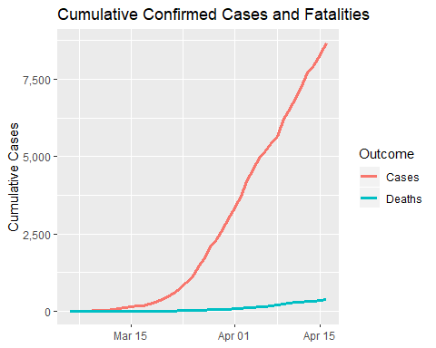
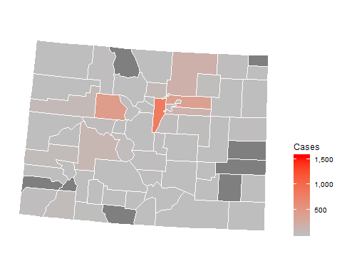
Colorado

Slide 4
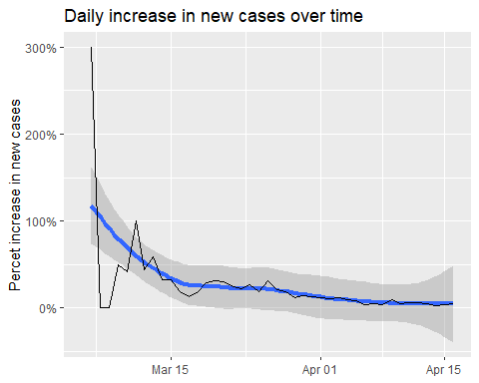
Colorado infection statistics
Date | Cases | Change | Days to double
2020-04-16 | 8,675 | 5% | 15
2020-04-15 | 8,280 | 4% | 17
2020-04-14 | 7,941 | 3% | 22
2020-04-13 | 7,691 | 5% | 13
2020-04-12 | 7,303 | 6% | 12
2020-04-11 | 6,893 | 6% | 12
2020-04-10 | 6,510 | 5% | 14
2020-04-09 | 6,202 | 10% | 8
2020-04-08 | 5,656 | 4% | 17
2020-04-07 | 5,429 | 5% | 14
2020-04-06 | 5,175 | 4% | 16
2020-04-05 | 4,962 | 8% | 9
2020-04-04 | 4,574 | 9% | 8
2020-04-03 | 4,182 | 12% | 6
2020-04-02 | 3,730 | 11% | 6

