Slide 1
Contagion Overview by US State
Jeff Renz, Brian Liberatore

Slide 2
States most impacted by COVID-19
State | Total Cases | Total Deaths
New York | 222,284 | 12,192
New Jersey | 75,317 | 3,518
Massachusetts | 32,181 | 1,245
Michigan | 29,120 | 2,092
Pennsylvania | 28,314 | 940
California | 28,142 | 971
Illinois | 25,738 | 1,080
Florida | 23,332 | 667
Louisiana | 22,532 | 1,156
Texas | 16,927 | 431
Connecticut | 15,884 | 971
Georgia | 15,644 | 611
Washington | 11,152 | 588
Maryland | 10,784 | 372
Indiana | 9,542 | 477

Slide 3
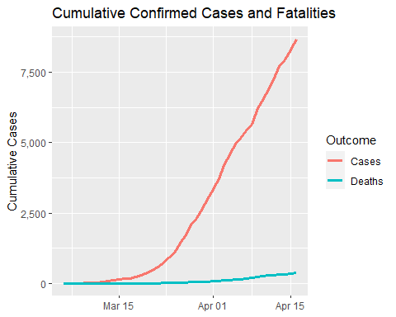
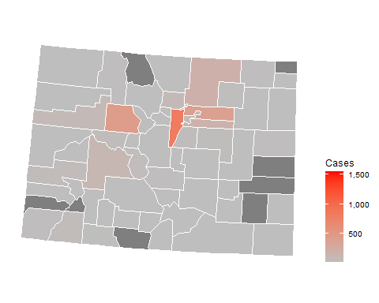
Colorado

Slide 4
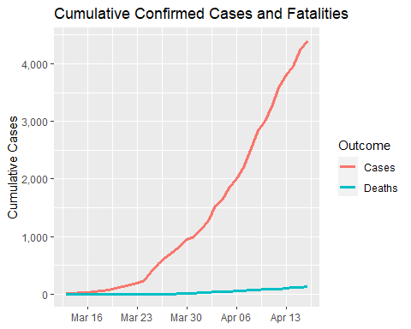
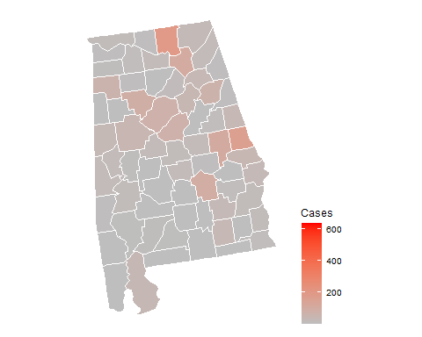
Alabama

Slide 5
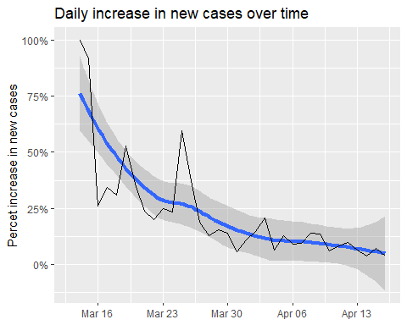
Alabama infection statistics
Date | Cases | Change | Days to double
2020-04-16 | 4404 | 3.800% | 18
2020-04-15 | 4241 | 7.300% | 10
2020-04-14 | 3953 | 3.900% | 18
2020-04-13 | 3805 | 6.200% | 12
2020-04-12 | 3583 | 9.800% | 7
2020-04-11 | 3262 | 8.400% | 9
2020-04-10 | 3008 | 6.000% | 12
2020-04-09 | 2838 | 13.600% | 5
2020-04-08 | 2499 | 13.700% | 5
2020-04-07 | 2197 | 9.500% | 8
2020-04-06 | 2006 | 9.000% | 8
2020-04-05 | 1841 | 12.700% | 6
2020-04-04 | 1633 | 6.400% | 11
2020-04-03 | 1535 | 20.900% | 4
2020-04-02 | 1270 | 14.600% | 5

Slide 6
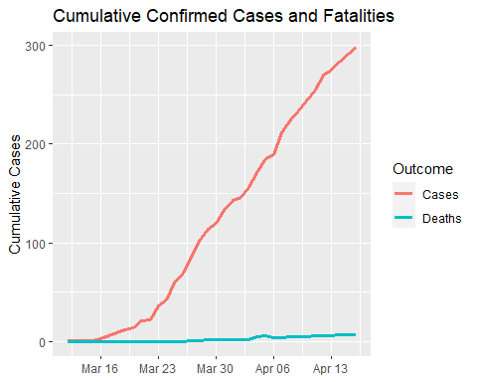
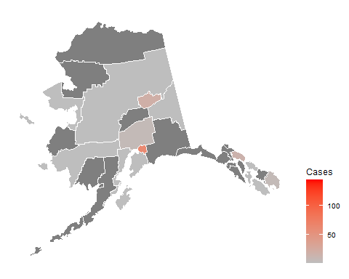
Alaska

Slide 7
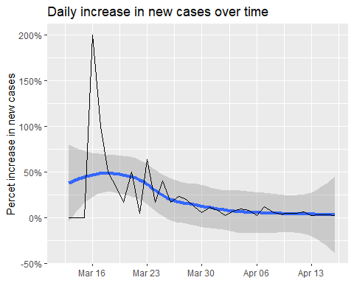
Alaska infection statistics
Date | Cases | Change | Days to double
2020-04-16 | 298 | 2.400% | 29
2020-04-15 | 291 | 2.800% | 25
2020-04-14 | 283 | 2.900% | 24
2020-04-13 | 275 | 1.900% | 38
2020-04-12 | 270 | 5.900% | 12
2020-04-11 | 255 | 4.500% | 16
2020-04-10 | 244 | 4.700% | 15
2020-04-09 | 233 | 4.000% | 18
2020-04-08 | 224 | 6.200% | 12
2020-04-07 | 211 | 11.600% | 6
2020-04-06 | 189 | 2.200% | 32
2020-04-05 | 185 | 8.200% | 9
2020-04-04 | 171 | 9.600% | 8
2020-04-03 | 156 | 6.800% | 10
2020-04-02 | 146 | 2.100% | 33

Slide 8
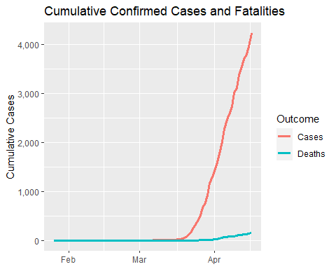
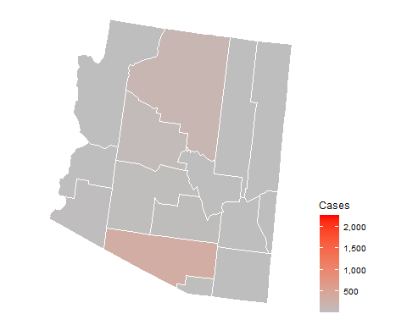
Arizona

Slide 9
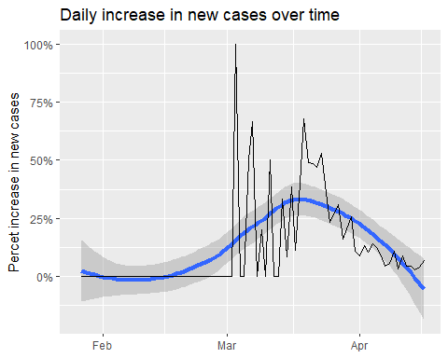
Arizona infection statistics
Date | Cases | Change | Days to double
2020-04-16 | 4234 | 6.900% | 10
2020-04-15 | 3962 | 4.100% | 17
2020-04-14 | 3806 | 2.800% | 25
2020-04-13 | 3702 | 4.600% | 15
2020-04-12 | 3539 | 4.300% | 16
2020-04-11 | 3393 | 9.000% | 8
2020-04-10 | 3112 | 3.100% | 23
2020-04-09 | 3018 | 10.700% | 7
2020-04-08 | 2726 | 5.800% | 12
2020-04-07 | 2577 | 4.500% | 16
2020-04-06 | 2466 | 8.700% | 8
2020-04-05 | 2269 | 12.400% | 6
2020-04-04 | 2019 | 14.100% | 5
2020-04-03 | 1769 | 10.600% | 7
2020-04-02 | 1600 | 13.200% | 6

Slide 10
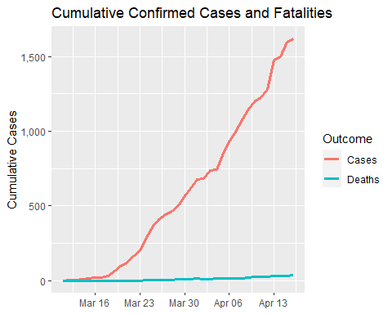
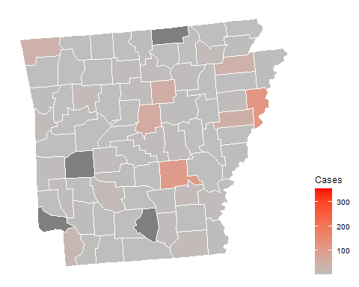
Arkansas

Slide 11
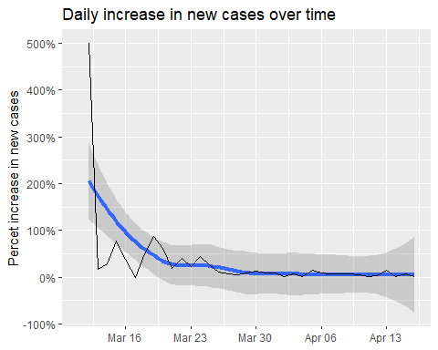
Arkansas infection statistics
Date | Cases | Change | Days to double
2020-04-16 | 1620 | 1.300% | 53
2020-04-15 | 1599 | 6.700% | 11
2020-04-14 | 1498 | 1.600% | 45
2020-04-13 | 1475 | 15.200% | 5
2020-04-12 | 1280 | 4.200% | 17
2020-04-11 | 1228 | 2.200% | 32
2020-04-10 | 1202 | 4.900% | 15
2020-04-09 | 1146 | 6.400% | 11
2020-04-08 | 1077 | 8.000% | 9
2020-04-07 | 997 | 7.600% | 10
2020-04-06 | 927 | 8.700% | 8
2020-04-05 | 853 | 14.800% | 5
2020-04-04 | 743 | 0.700% | 103
2020-04-03 | 738 | 8.100% | 9
2020-04-02 | 683 | 0.600% | 118

Slide 12
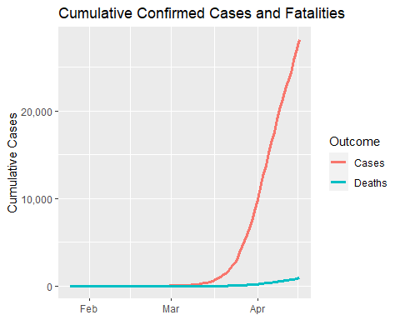
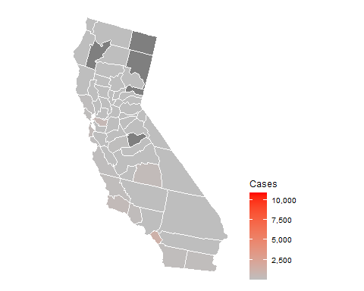
California

Slide 13
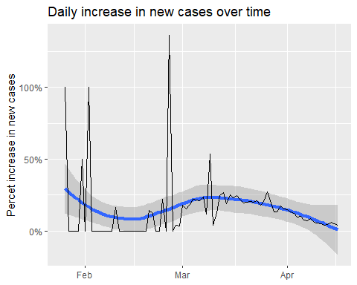
California infection statistics
Date | Cases | Change | Days to double
2020-04-16 | 28142 | 3.800% | 18
2020-04-15 | 27107 | 5.200% | 14
2020-04-14 | 25758 | 5.900% | 12
2020-04-13 | 24334 | 4.300% | 16
2020-04-12 | 23323 | 4.000% | 18
2020-04-11 | 22421 | 4.900% | 14
2020-04-10 | 21366 | 5.800% | 12
2020-04-09 | 20191 | 6.000% | 12
2020-04-08 | 19043 | 8.600% | 8
2020-04-07 | 17539 | 7.200% | 10
2020-04-06 | 16361 | 7.600% | 9
2020-04-05 | 15202 | 10.200% | 7
2020-04-04 | 13796 | 9.800% | 7
2020-04-03 | 12568 | 12.300% | 6
2020-04-02 | 11190 | 13.500% | 5

Slide 14
Colorado

Slide 15
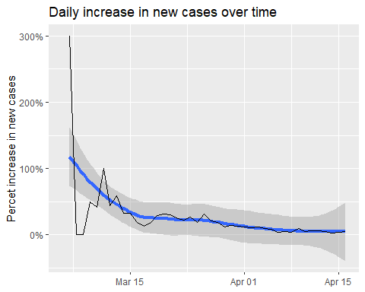
Colorado infection statistics
Date | Cases | Change | Days to double
2020-04-16 | 8675 | 5% | 15
2020-04-15 | 8280 | 4% | 17
2020-04-14 | 7941 | 3% | 22
2020-04-13 | 7691 | 5% | 13
2020-04-12 | 7303 | 6% | 12
2020-04-11 | 6893 | 6% | 12
2020-04-10 | 6510 | 5% | 14
2020-04-09 | 6202 | 10% | 8
2020-04-08 | 5656 | 4% | 17
2020-04-07 | 5429 | 5% | 14
2020-04-06 | 5175 | 4% | 16
2020-04-05 | 4962 | 8% | 9
2020-04-04 | 4574 | 9% | 8
2020-04-03 | 4182 | 12% | 6
2020-04-02 | 3730 | 11% | 6

Slide 16
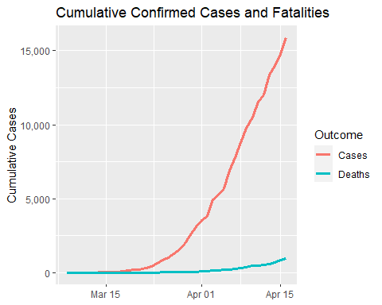
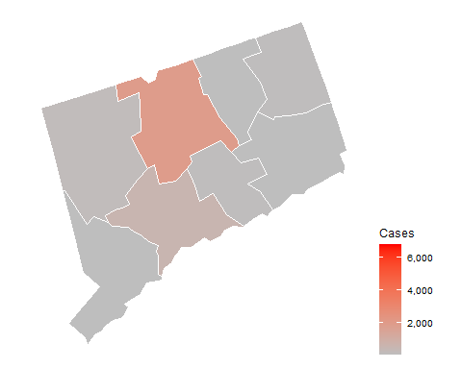
Connecticut

Slide 17
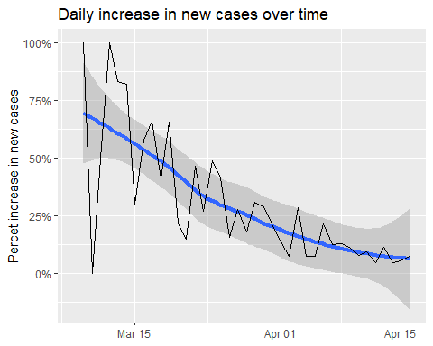
Connecticut infection statistics
Date | Cases | Change | Days to double
2020-04-16 | 15884 | 8% | 9
2020-04-15 | 14755 | 6% | 13
2020-04-14 | 13989 | 4% | 16
2020-04-13 | 13381 | 11% | 7
2020-04-12 | 12035 | 5% | 16
2020-04-11 | 11510 | 9% | 8
2020-04-10 | 10538 | 8% | 9
2020-04-09 | 9784 | 11% | 6
2020-04-08 | 8781 | 13% | 6
2020-04-07 | 7781 | 13% | 6
2020-04-06 | 6906 | 22% | 4
2020-04-05 | 5675 | 8% | 10
2020-04-04 | 5276 | 7% | 10
2020-04-03 | 4915 | 28% | 3
2020-04-02 | 3824 | 8% | 10

Slide 18
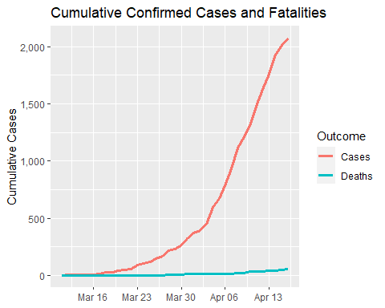
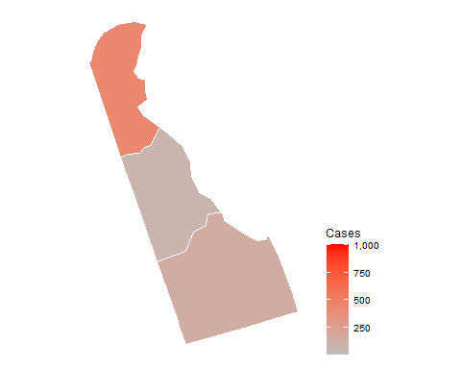
Delaware

Slide 19
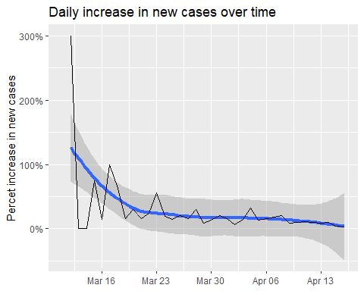
Delaware infection statistics
Date | Cases | Change | Days to double
2020-04-16 | 2075 | 3.000% | 23
2020-04-15 | 2014 | 4.600% | 16
2020-04-14 | 1926 | 9.400% | 8
2020-04-13 | 1761 | 8.400% | 9
2020-04-12 | 1625 | 9.900% | 7
2020-04-11 | 1479 | 11.500% | 6
2020-04-10 | 1326 | 9.700% | 8
2020-04-09 | 1209 | 8.300% | 9
2020-04-08 | 1116 | 20.300% | 4
2020-04-07 | 928 | 18.500% | 4
2020-04-06 | 783 | 16.300% | 5
2020-04-05 | 673 | 13.500% | 5
2020-04-04 | 593 | 31.800% | 3
2020-04-03 | 450 | 14.500% | 5
2020-04-02 | 393 | 6.800% | 11

Slide 20
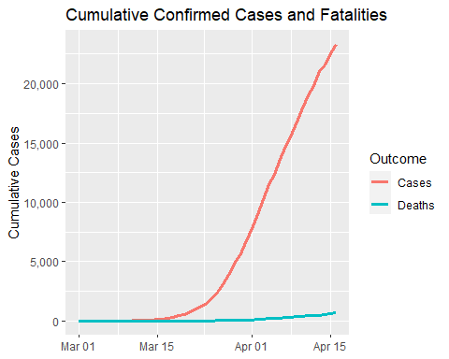
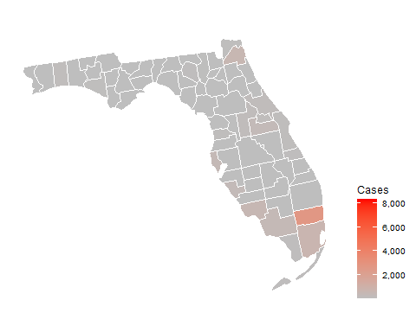
Florida

Slide 21
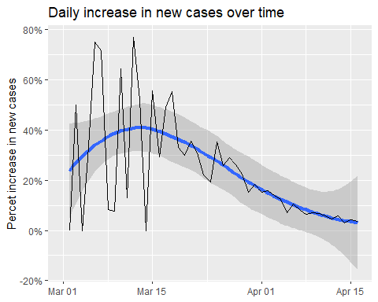
Florida infection statistics
Date | Cases | Change | Days to double
2020-04-16 | 23332 | 3.60% | 20
2020-04-15 | 22526 | 4.20% | 17
2020-04-14 | 21620 | 2.90% | 24
2020-04-13 | 21011 | 5.80% | 12
2020-04-12 | 19855 | 4.60% | 15
2020-04-11 | 18978 | 5.70% | 13
2020-04-10 | 17960 | 6.80% | 11
2020-04-09 | 16819 | 7.20% | 10
2020-04-08 | 15690 | 6.50% | 11
2020-04-07 | 14739 | 8.20% | 9
2020-04-06 | 13621 | 10.40% | 7
2020-04-05 | 12342 | 7.00% | 10
2020-04-04 | 11537 | 12.40% | 6
2020-04-03 | 10260 | 14.00% | 5
2020-04-02 | 9000 | 15.80% | 5

Slide 22
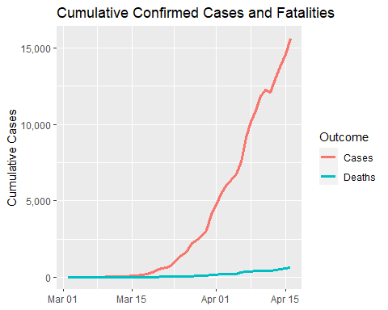
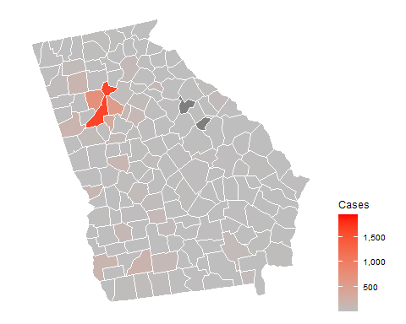
Georgia

Slide 23
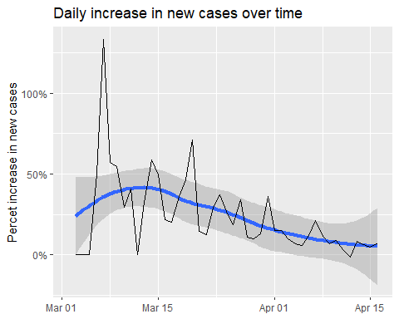
Georgia infection statistics
Date | Cases | Change | Days to double
2020-04-16 | 15644 | 7.30% | 10
2020-04-15 | 14583 | 4.80% | 15
2020-04-14 | 13913 | 6.00% | 12
2020-04-13 | 13125 | 8.40% | 9
2020-04-12 | 12103 | -1.30% | -53
2020-04-11 | 12261 | 3.40% | 21
2020-04-10 | 11859 | 8.90% | 8
2020-04-09 | 10885 | 6.70% | 11
2020-04-08 | 10204 | 11.40% | 6
2020-04-07 | 9156 | 21.10% | 4
2020-04-06 | 7558 | 12.10% | 6
2020-04-05 | 6742 | 5.60% | 13
2020-04-04 | 6383 | 7.00% | 10
2020-04-03 | 5967 | 9.60% | 8
2020-04-02 | 5444 | 14.80% | 5

Slide 24
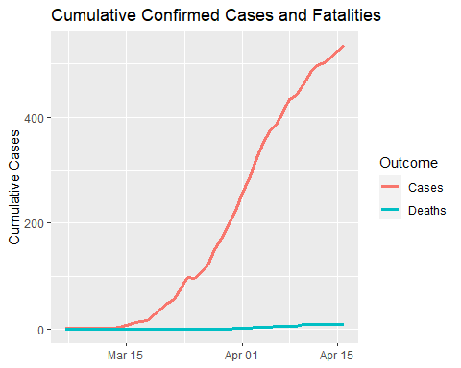
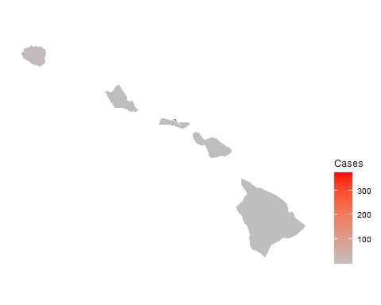
Hawaii

Slide 25
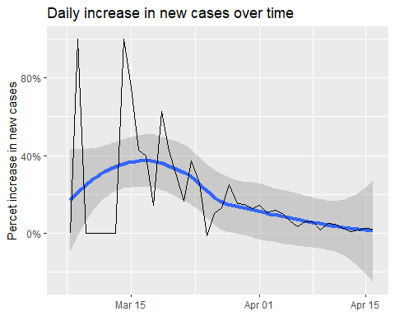
Hawaii infection statistics
Date | Cases | Change | Days to double
2020-04-16 | 535 | 2.100% | 33
2020-04-15 | 524 | 2.500% | 28
2020-04-14 | 511 | 1.800% | 39
2020-04-13 | 502 | 1.000% | 69
2020-04-12 | 497 | 2.700% | 26
2020-04-11 | 484 | 4.500% | 16
2020-04-10 | 463 | 5.200% | 14
2020-04-09 | 440 | 1.600% | 43
2020-04-08 | 433 | 6.100% | 12
2020-04-07 | 408 | 6.000% | 12
2020-04-06 | 385 | 3.500% | 20
2020-04-05 | 372 | 6.600% | 11
2020-04-04 | 349 | 10.100% | 7
2020-04-03 | 317 | 12.000% | 6
2020-04-02 | 283 | 10.500% | 7

Slide 26
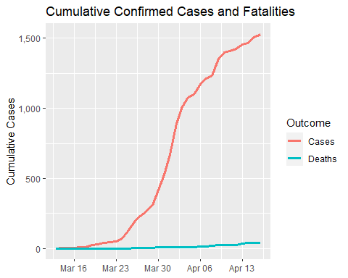
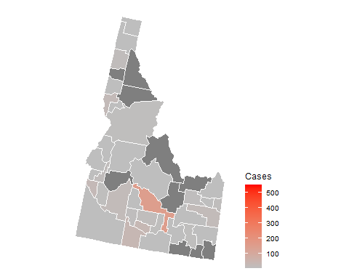
Idaho

Slide 27
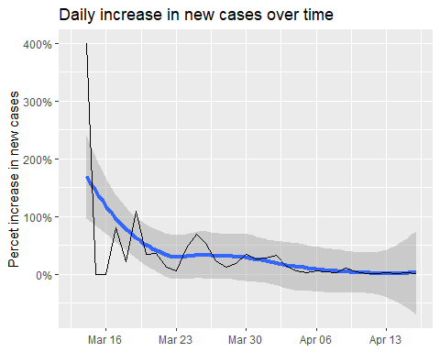
Idaho infection statistics
Date | Cases | Change | Days to double
2020-04-16 | 1528 | 1% | 50
2020-04-15 | 1507 | 3% | 24
2020-04-14 | 1464 | 1% | 92
2020-04-13 | 1453 | 2% | 37
2020-04-12 | 1426 | 1% | 52
2020-04-11 | 1407 | 0% | 139
2020-04-10 | 1400 | 4% | 20
2020-04-09 | 1353 | 10% | 7
2020-04-08 | 1232 | 2% | 38
2020-04-07 | 1210 | 3% | 21
2020-04-06 | 1170 | 6% | 11
2020-04-05 | 1101 | 2% | 31
2020-04-04 | 1077 | 6% | 11
2020-04-03 | 1013 | 14% | 5
2020-04-02 | 892 | 33% | 2

Slide 28
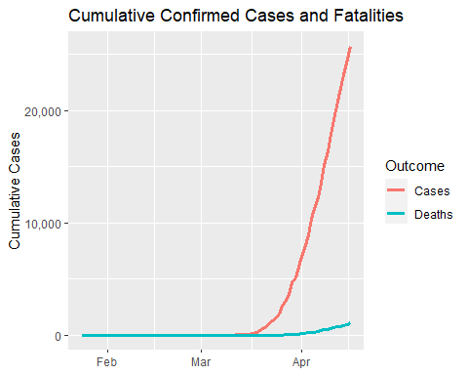
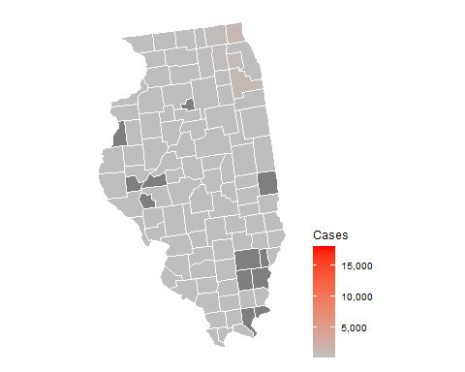
Illinois

Slide 29
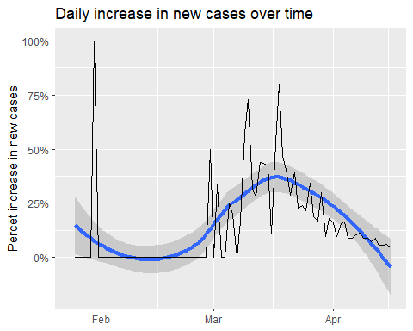
Illinois infection statistics
Date | Cases | Change | Days to double
2020-04-16 | 25738 | 5% | 15
2020-04-15 | 24604 | 6% | 12
2020-04-14 | 23247 | 6% | 13
2020-04-13 | 22028 | 6% | 13
2020-04-12 | 20855 | 9% | 8
2020-04-11 | 19183 | 7% | 10
2020-04-10 | 17892 | 9% | 8
2020-04-09 | 16432 | 9% | 8
2020-04-08 | 15078 | 11% | 6
2020-04-07 | 13549 | 10% | 7
2020-04-06 | 12262 | 9% | 8
2020-04-05 | 11277 | 9% | 8
2020-04-04 | 10358 | 16% | 5
2020-04-03 | 8904 | 16% | 5
2020-04-02 | 7695 | 10% | 8

Slide 30
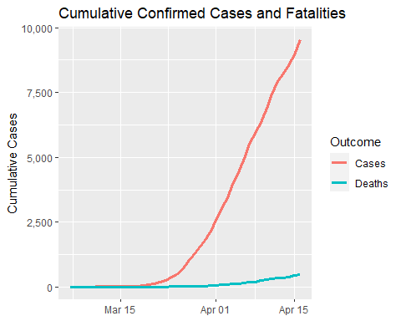
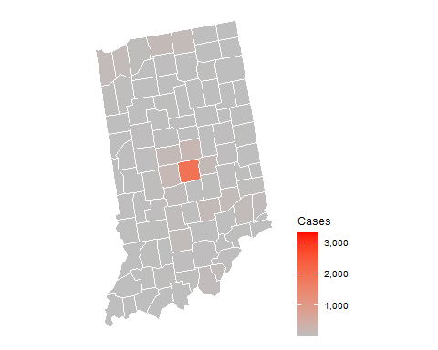
Indiana

Slide 31
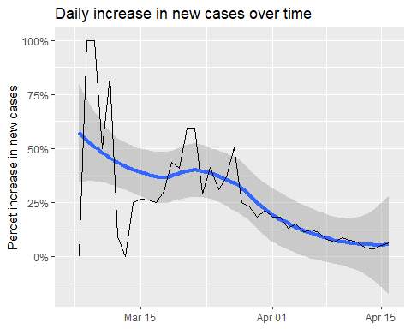
Indiana infection statistics
Date | Cases | Change | Days to double
2020-04-16 | 9542 | 7% | 11
2020-04-15 | 8955 | 5% | 14
2020-04-14 | 8527 | 4% | 20
2020-04-13 | 8236 | 4% | 18
2020-04-12 | 7928 | 7% | 11
2020-04-11 | 7435 | 8% | 9
2020-04-10 | 6907 | 9% | 8
2020-04-09 | 6351 | 7% | 10
2020-04-08 | 5943 | 8% | 9
2020-04-07 | 5509 | 11% | 7
2020-04-06 | 4956 | 12% | 6
2020-04-05 | 4409 | 12% | 6
2020-04-04 | 3951 | 15% | 5
2020-04-03 | 3435 | 13% | 6
2020-04-02 | 3038 | 18% | 4

Slide 32
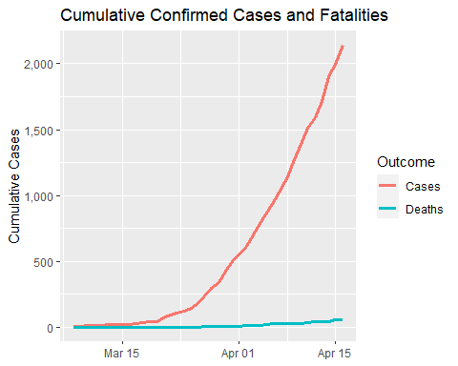
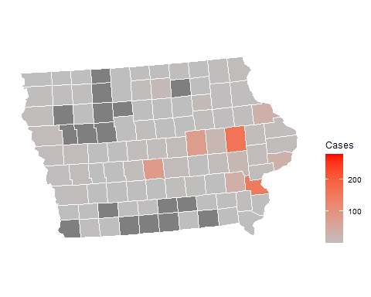
Iowa

Slide 33
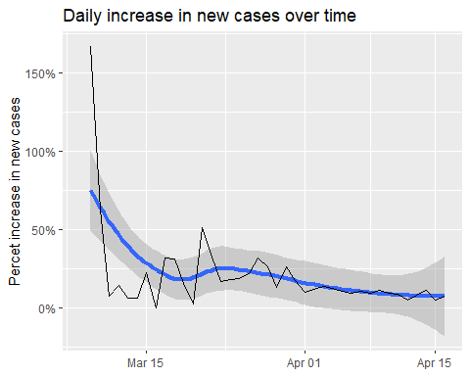
Iowa infection statistics
Date | Cases | Change | Days to double
2020-04-16 | 2141 | 7% | 10
2020-04-15 | 1995 | 5% | 14
2020-04-14 | 1899 | 11% | 7
2020-04-13 | 1710 | 8% | 9
2020-04-12 | 1587 | 5% | 14
2020-04-11 | 1510 | 9% | 8
2020-04-10 | 1388 | 9% | 8
2020-04-09 | 1270 | 11% | 7
2020-04-08 | 1145 | 9% | 8
2020-04-07 | 1048 | 11% | 7
2020-04-06 | 946 | 9% | 8
2020-04-05 | 868 | 10% | 7
2020-04-04 | 786 | 12% | 6
2020-04-03 | 699 | 14% | 5
2020-04-02 | 614 | 12% | 6

Slide 34
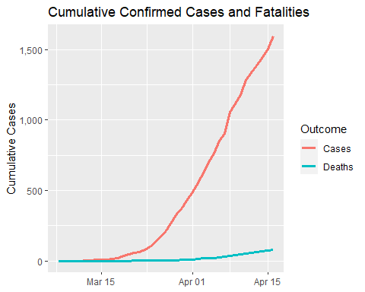
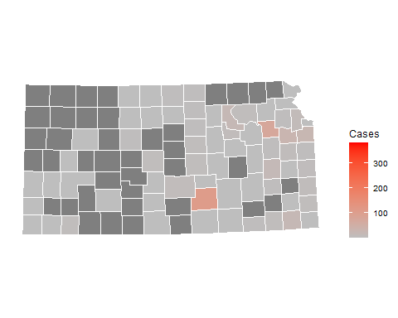
Kansas

Slide 35
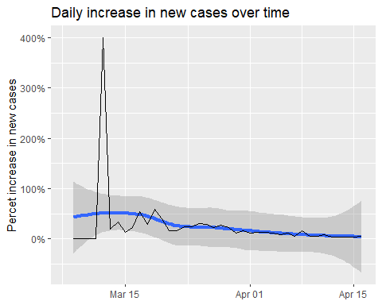
Kansas infection statistics
Date | Cases | Change | Days to double
2020-04-16 | 1596 | 6% | 12
2020-04-15 | 1504 | 4% | 16
2020-04-14 | 1441 | 4% | 17
2020-04-13 | 1385 | 4% | 20
2020-04-12 | 1338 | 4% | 17
2020-04-11 | 1283 | 9% | 8
2020-04-10 | 1180 | 6% | 12
2020-04-09 | 1116 | 6% | 12
2020-04-08 | 1055 | 17% | 5
2020-04-07 | 905 | 6% | 12
2020-04-06 | 853 | 12% | 6
2020-04-05 | 765 | 9% | 8
2020-04-04 | 701 | 12% | 6
2020-04-03 | 625 | 13% | 6
2020-04-02 | 554 | 13% | 6

Slide 36
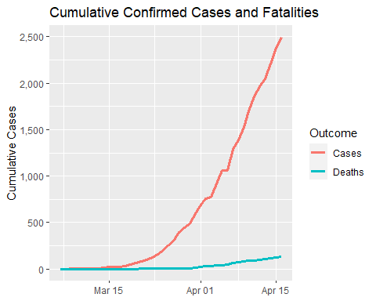
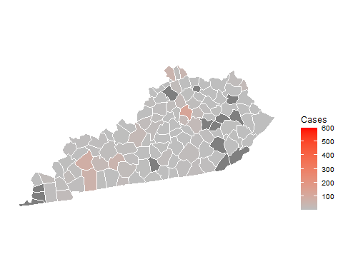
Kentucky

Slide 37

Kentucky infection statistics
Date | Cases | Change | Days to double
2020-04-16 | 2494 | 5.10% | 14
2020-04-15 | 2372 | 7.30% | 10
2020-04-14 | 2210 | 7.90% | 9
2020-04-13 | 2048 | 4.30% | 16
2020-04-12 | 1963 | 6.10% | 12
2020-04-11 | 1851 | 8.80% | 8
2020-04-10 | 1702 | 11.60% | 6
2020-04-09 | 1525 | 9.50% | 8
2020-04-08 | 1393 | 8.10% | 9
2020-04-07 | 1289 | 21.90% | 3
2020-04-06 | 1057 | 0.00% | Inf
2020-04-05 | 1057 | 15.30% | 5
2020-04-04 | 917 | 19.10% | 4
2020-04-03 | 770 | 2.00% | 35
2020-04-02 | 755 | 9.30% | 8

Slide 38


Louisiana

Slide 39

Louisiana infection statistics
Date | Cases | Change | Days to double
2020-04-16 | 22532 | 3% | 27
2020-04-15 | 21951 | 2% | 35
2020-04-14 | 21518 | 2% | 29
2020-04-13 | 21016 | 2% | 34
2020-04-12 | 20595 | 3% | 24
2020-04-11 | 20014 | 4% | 18
2020-04-10 | 19253 | 5% | 13
2020-04-09 | 18283 | 7% | 10
2020-04-08 | 17030 | 5% | 15
2020-04-07 | 16284 | 10% | 8
2020-04-06 | 14867 | 14% | 5
2020-04-05 | 13006 | 4% | 17
2020-04-04 | 12492 | 21% | 4
2020-04-03 | 10295 | 12% | 6
2020-04-02 | 9148 | 42% | 2

Slide 40


Maine

Slide 41

Maine infection statistics
Date | Cases | Change | Days to double
2020-04-16 | 796 | 3.40% | 21
2020-04-15 | 770 | 4.90% | 14
2020-04-14 | 734 | 5.20% | 14
2020-04-13 | 698 | 10.30% | 7
2020-04-12 | 633 | 2.80% | 25
2020-04-11 | 616 | 5.10% | 14
2020-04-10 | 586 | 4.60% | 15
2020-04-09 | 560 | 4.30% | 17
2020-04-08 | 537 | 3.50% | 20
2020-04-07 | 519 | 4.00% | 18
2020-04-06 | 499 | 6.20% | 12
2020-04-05 | 470 | 3.10% | 23
2020-04-04 | 456 | 5.60% | 13
2020-04-03 | 432 | 14.90% | 5
2020-04-02 | 376 | 9.30% | 8

Slide 42


Maryland

Slide 43

Maryland infection statistics
Date | Cases | Change | Days to double
2020-04-16 | 10784 | 7.50% | 10
2020-04-15 | 10032 | 5.90% | 12
2020-04-14 | 9472 | 6.00% | 12
2020-04-13 | 8936 | 8.60% | 8
2020-04-12 | 8225 | 6.90% | 10
2020-04-11 | 7694 | 10.40% | 7
2020-04-10 | 6968 | 12.70% | 6
2020-04-09 | 6185 | 11.90% | 6
2020-04-08 | 5529 | 26.50% | 3
2020-04-07 | 4371 | 8.10% | 9
2020-04-06 | 4045 | 12.10% | 6
2020-04-05 | 3609 | 15.50% | 5
2020-04-04 | 3125 | 13.30% | 6
2020-04-03 | 2758 | 18.30% | 4
2020-04-02 | 2331 | 19.50% | 4

Slide 44


Massachusetts

Slide 45

Massachusetts infection statistics
Date | Cases | Change | Days to double
2020-04-16 | 32181 | 8% | 10
2020-04-15 | 29918 | 6% | 11
2020-04-14 | 28163 | 5% | 15
2020-04-13 | 26867 | 6% | 13
2020-04-12 | 25475 | 11% | 6
2020-04-11 | 22860 | 9% | 8
2020-04-10 | 20974 | 11% | 7
2020-04-09 | 18941 | 13% | 6
2020-04-08 | 16790 | 10% | 7
2020-04-07 | 15202 | 10% | 7
2020-04-06 | 13837 | 11% | 7
2020-04-05 | 12500 | 6% | 11
2020-04-04 | 11736 | 13% | 6
2020-04-03 | 10402 | 16% | 5
2020-04-02 | 8966 | 15% | 5

Slide 46


Michigan

Slide 47

Michigan infection statistics
Date | Cases | Change | Days to double
2020-04-16 | 29120 | 4% | 16
2020-04-15 | 27894 | 4% | 18
2020-04-14 | 26845 | 5% | 13
2020-04-13 | 25490 | 4% | 17
2020-04-12 | 24496 | 3% | 26
2020-04-11 | 23855 | 5% | 13
2020-04-10 | 22646 | 6% | 12
2020-04-09 | 21375 | 6% | 12
2020-04-08 | 20220 | 7% | 10
2020-04-07 | 18852 | 10% | 7
2020-04-06 | 17130 | 10% | 8
2020-04-05 | 15635 | 10% | 7
2020-04-04 | 14225 | 12% | 6
2020-04-03 | 12670 | 17% | 4
2020-04-02 | 10791 | 16% | 5

Slide 48


Minnesota

Slide 49

Minnesota infection statistics
Date | Cases | Change | Days to double
2020-04-16 | 1917 | 5.700% | 12
2020-04-15 | 1813 | 7.000% | 10
2020-04-14 | 1695 | 2.700% | 26
2020-04-13 | 1650 | 1.800% | 39
2020-04-12 | 1621 | 13.600% | 5
2020-04-11 | 1427 | 6.900% | 10
2020-04-10 | 1335 | 7.700% | 9
2020-04-09 | 1240 | 7.800% | 9
2020-04-08 | 1150 | 8.100% | 9
2020-04-07 | 1064 | 8.600% | 8
2020-04-06 | 980 | 5.600% | 13
2020-04-05 | 928 | 7.300% | 10
2020-04-04 | 865 | 9.600% | 8
2020-04-03 | 789 | 6.300% | 11
2020-04-02 | 742 | 7.500% | 10

Slide 50


Mississippi

Slide 51

Mississippi infection statistics
Date | Cases | Change | Days to double
2020-04-16 | 3624 | 7.900% | 9
2020-04-15 | 3360 | 8.800% | 8
2020-04-14 | 3087 | 4.900% | 14
2020-04-13 | 2942 | 5.800% | 12
2020-04-12 | 2781 | 5.300% | 14
2020-04-11 | 2642 | 7.000% | 10
2020-04-10 | 2469 | 9.200% | 8
2020-04-09 | 2260 | 12.800% | 6
2020-04-08 | 2003 | 4.600% | 15
2020-04-07 | 1915 | 10.200% | 7
2020-04-06 | 1738 | 6.100% | 12
2020-04-05 | 1638 | 12.600% | 6
2020-04-04 | 1455 | 7.100% | 10
2020-04-03 | 1358 | 15.400% | 5
2020-04-02 | 1177 | 9.300% | 8

Slide 52


Missouri

Slide 53

Missouri infection statistics
Date | Cases | Change | Days to double
2020-04-16 | 5111 | 4% | 16
2020-04-15 | 4896 | 4% | 16
2020-04-14 | 4686 | 7% | 11
2020-04-13 | 4389 | 6% | 13
2020-04-12 | 4156 | 3% | 21
2020-04-11 | 4021 | 6% | 12
2020-04-10 | 3795 | 7% | 10
2020-04-09 | 3538 | 6% | 11
2020-04-08 | 3325 | 10% | 8
2020-04-07 | 3035 | 12% | 6
2020-04-06 | 2721 | 15% | 5
2020-04-05 | 2365 | 4% | 20
2020-04-04 | 2285 | 8% | 9
2020-04-03 | 2113 | 15% | 5
2020-04-02 | 1835 | 28% | 3

Slide 54


Montana

Slide 55

Montana infection statistics
Date | Cases | Change | Days to double
2020-04-16 | 415 | 3% | 26
2020-04-15 | 404 | 1% | 56
2020-04-14 | 399 | 1% | 55
2020-04-13 | 394 | 2% | 39
2020-04-12 | 387 | 3% | 26
2020-04-11 | 377 | 3% | 21
2020-04-10 | 365 | 3% | 23
2020-04-09 | 354 | 7% | 11
2020-04-08 | 332 | 4% | 17
2020-04-07 | 319 | 0% | Inf
2020-04-06 | 319 | 7% | 10
2020-04-05 | 298 | 6% | 12
2020-04-04 | 281 | 7% | 10
2020-04-03 | 262 | 9% | 8
2020-04-02 | 241 | 10% | 7

Slide 56


Nebraska

Slide 57

Nebraska infection statistics
Date | Cases | Change | Days to double
2020-04-16 | 1094 | 10% | 7
2020-04-15 | 995 | 7% | 10
2020-04-14 | 931 | 7% | 10
2020-04-13 | 871 | 8% | 9
2020-04-12 | 806 | 12% | 6
2020-04-11 | 719 | 6% | 12
2020-04-10 | 679 | 14% | 5
2020-04-09 | 594 | 10% | 7
2020-04-08 | 538 | 10% | 8
2020-04-07 | 491 | 12% | 6
2020-04-06 | 439 | 16% | 5
2020-04-05 | 378 | 12% | 6
2020-04-04 | 339 | 14% | 5
2020-04-03 | 297 | 10% | 7
2020-04-02 | 269 | 19% | 4

Slide 58


Nevada

Slide 59

Nevada infection statistics
Date | Cases | Change | Days to double
2020-04-16 | 3321 | 3% | 21
2020-04-15 | 3212 | 2% | 29
2020-04-14 | 3137 | 3% | 21
2020-04-13 | 3036 | 6% | 12
2020-04-12 | 2860 | 5% | 14
2020-04-11 | 2720 | 4% | 16
2020-04-10 | 2606 | 6% | 12
2020-04-09 | 2456 | 6% | 12
2020-04-08 | 2318 | 10% | 7
2020-04-07 | 2101 | 7% | 11
2020-04-06 | 1971 | 5% | 15
2020-04-05 | 1880 | 7% | 10
2020-04-04 | 1758 | 14% | 5
2020-04-03 | 1549 | 6% | 11
2020-04-02 | 1458 | 14% | 5

Slide 60


New Hampshire

Slide 61

New Hampshire infection statistics
Date | Cases | Change | Days to double
2020-04-16 | 1211 | 6.30% | 11
2020-04-15 | 1139 | 4.40% | 16
2020-04-14 | 1091 | 7.00% | 10
2020-04-13 | 1020 | 3.60% | 20
2020-04-12 | 985 | 6.00% | 12
2020-04-11 | 929 | 5.00% | 14
2020-04-10 | 885 | 8.10% | 9
2020-04-09 | 819 | 3.90% | 18
2020-04-08 | 788 | 5.50% | 13
2020-04-07 | 747 | 4.60% | 15
2020-04-06 | 714 | 6.70% | 11
2020-04-05 | 669 | 7.90% | 9
2020-04-04 | 620 | 14.80% | 5
2020-04-03 | 540 | 12.70% | 6
2020-04-02 | 479 | 15.40% | 5

Slide 62


New Jersey

Slide 63

New Jersey infection statistics
Date | Cases | Change | Days to double
2020-04-16 | 75317 | 6.000% | 12
2020-04-15 | 71030 | 3.200% | 22
2020-04-14 | 68824 | 6.600% | 11
2020-04-13 | 64584 | 4.400% | 16
2020-04-12 | 61850 | 6.400% | 11
2020-04-11 | 58151 | 6.500% | 11
2020-04-10 | 54588 | 7.000% | 10
2020-04-09 | 51027 | 7.600% | 10
2020-04-08 | 47437 | 6.800% | 11
2020-04-07 | 44416 | 8.100% | 9
2020-04-06 | 41090 | 9.600% | 8
2020-04-05 | 37505 | 9.900% | 7
2020-04-04 | 34124 | 14.100% | 5
2020-04-03 | 29895 | 16.800% | 4
2020-04-02 | 25590 | 15.000% | 5

Slide 64


New Mexico

Slide 65

New Mexico infection statistics
Date | Cases | Change | Days to double
2020-04-16 | 1597 | 8% | 9
2020-04-15 | 1484 | 6% | 13
2020-04-14 | 1407 | 5% | 15
2020-04-13 | 1345 | 8% | 9
2020-04-12 | 1245 | 6% | 12
2020-04-11 | 1174 | 8% | 9
2020-04-10 | 1091 | 10% | 7
2020-04-09 | 989 | 14% | 5
2020-04-08 | 865 | 9% | 8
2020-04-07 | 794 | 16% | 5
2020-04-06 | 686 | 10% | 7
2020-04-05 | 624 | 14% | 5
2020-04-04 | 546 | 10% | 7
2020-04-03 | 495 | 23% | 3
2020-04-02 | 403 | 11% | 7

Slide 66


New York

Slide 67

New York infection statistics
Date | Cases | Change | Days to double
2020-04-16 | 222284 | 4.000% | 18
2020-04-15 | 213779 | 5.700% | 12
2020-04-14 | 202208 | 3.700% | 19
2020-04-13 | 195031 | 3.400% | 21
2020-04-12 | 188694 | 4.600% | 16
2020-04-11 | 180458 | 5.800% | 12
2020-04-10 | 170512 | 6.600% | 11
2020-04-09 | 159937 | 7.100% | 10
2020-04-08 | 149401 | 6.700% | 11
2020-04-07 | 140081 | 7.200% | 10
2020-04-06 | 130703 | 6.300% | 11
2020-04-05 | 122911 | 6.900% | 10
2020-04-04 | 114996 | 11.700% | 6
2020-04-03 | 102945 | 11.000% | 7
2020-04-02 | 92770 | 10.600% | 7

Slide 68


North Carolina

Slide 69

North Carolina infection statistics
Date | Cases | Change | Days to double
2020-04-16 | 5463 | 6.600% | 11
2020-04-15 | 5123 | 2.600% | 27
2020-04-14 | 4992 | 4.300% | 17
2020-04-13 | 4788 | 5.900% | 12
2020-04-12 | 4520 | 4.900% | 15
2020-04-11 | 4310 | 10.300% | 7
2020-04-10 | 3906 | 7.000% | 10
2020-04-09 | 3651 | 6.700% | 11
2020-04-08 | 3423 | 6.300% | 11
2020-04-07 | 3220 | 12.200% | 6
2020-04-06 | 2870 | 11.000% | 7
2020-04-05 | 2585 | 7.600% | 9
2020-04-04 | 2402 | 14.800% | 5
2020-04-03 | 2093 | 12.600% | 6
2020-04-02 | 1858 | 16.600% | 5

Slide 70


North Dakota

Slide 71

North Dakota infection statistics
Date | Cases | Change | Days to double
2020-04-16 | 394 | 8% | 9
2020-04-15 | 366 | 7% | 10
2020-04-14 | 341 | 3% | 23
2020-04-13 | 331 | 8% | 10
2020-04-12 | 308 | 5% | 14
2020-04-11 | 293 | 5% | 13
2020-04-10 | 278 | 3% | 21
2020-04-09 | 269 | 7% | 10
2020-04-08 | 251 | 6% | 12
2020-04-07 | 237 | 5% | 13
2020-04-06 | 225 | 9% | 8
2020-04-05 | 207 | 11% | 6
2020-04-04 | 186 | 8% | 10
2020-04-03 | 173 | 9% | 8
2020-04-02 | 159 | 8% | 9

Slide 72


Ohio

Slide 73

Ohio infection statistics
Date | Cases | Change | Days to double
2020-04-16 | 8414 | 8.000% | 9
2020-04-15 | 7791 | 7.000% | 10
2020-04-14 | 7280 | 4.400% | 16
2020-04-13 | 6975 | 5.600% | 13
2020-04-12 | 6604 | 5.700% | 13
2020-04-11 | 6250 | 6.300% | 11
2020-04-10 | 5878 | 6.600% | 11
2020-04-09 | 5512 | 7.100% | 10
2020-04-08 | 5148 | 7.700% | 9
2020-04-07 | 4782 | 7.500% | 10
2020-04-06 | 4450 | 10.100% | 7
2020-04-05 | 4043 | 8.100% | 9
2020-04-04 | 3739 | 12.900% | 6
2020-04-03 | 3312 | 14.100% | 5
2020-04-02 | 2903 | 13.900% | 5

Slide 74


Oklahoma

Slide 75

Oklahoma infection statistics
Date | Cases | Change | Days to double
2020-04-16 | 2357 | 4.200% | 17
2020-04-15 | 2263 | 3.600% | 20
2020-04-14 | 2184 | 5.600% | 13
2020-04-13 | 2069 | 5.000% | 14
2020-04-12 | 1970 | 5.500% | 13
2020-04-11 | 1868 | 4.100% | 17
2020-04-10 | 1794 | 6.500% | 11
2020-04-09 | 1684 | 10.500% | 7
2020-04-08 | 1524 | 3.500% | 20
2020-04-07 | 1472 | 10.900% | 7
2020-04-06 | 1327 | 6.000% | 12
2020-04-05 | 1252 | 8.000% | 9
2020-04-04 | 1159 | 17.100% | 4
2020-04-03 | 990 | 12.600% | 6
2020-04-02 | 879 | 22.300% | 3

Slide 76


Oregon

Slide 77

Oregon infection statistics
Date | Cases | Change | Days to double
2020-04-16 | 1736 | 4% | 16
2020-04-15 | 1663 | 2% | 38
2020-04-14 | 1633 | 3% | 23
2020-04-13 | 1584 | 4% | 19
2020-04-12 | 1527 | 6% | 13
2020-04-11 | 1447 | 6% | 13
2020-04-10 | 1371 | 4% | 19
2020-04-09 | 1321 | 7% | 11
2020-04-08 | 1239 | 5% | 14
2020-04-07 | 1181 | 4% | 16
2020-04-06 | 1132 | 6% | 12
2020-04-05 | 1068 | 7% | 11
2020-04-04 | 1000 | 11% | 7
2020-04-03 | 899 | 9% | 8
2020-04-02 | 827 | 12% | 6

Slide 78


Pennsylvania

Slide 79

Pennsylvania infection statistics
Date | Cases | Change | Days to double
2020-04-16 | 28314 | 5.60% | 13
2020-04-15 | 26804 | 4.70% | 15
2020-04-14 | 25591 | 5.30% | 13
2020-04-13 | 24295 | 5.80% | 12
2020-04-12 | 22955 | 5.40% | 13
2020-04-11 | 21774 | 8.20% | 9
2020-04-10 | 20128 | 9.50% | 8
2020-04-09 | 18379 | 12.00% | 6
2020-04-08 | 16414 | 12.60% | 6
2020-04-07 | 14582 | 11.50% | 6
2020-04-06 | 13075 | 12.80% | 6
2020-04-05 | 11590 | 14.60% | 5
2020-04-04 | 10110 | 20.30% | 4
2020-04-03 | 8402 | 19.70% | 4
2020-04-02 | 7021 | 20.90% | 4

Slide 80


Rhode Island

Slide 81

Rhode Island infection statistics
Date | Cases | Change | Days to double
2020-04-16 | 3838 | 18.100% | 4
2020-04-15 | 3251 | 0.000% | Inf
2020-04-14 | 3251 | 9.200% | 8
2020-04-13 | 2976 | 11.700% | 6
2020-04-12 | 2665 | 13.500% | 5
2020-04-11 | 2349 | 16.600% | 5
2020-04-10 | 2015 | 16.700% | 4
2020-04-09 | 1727 | 19.100% | 4
2020-04-08 | 1450 | 18.000% | 4
2020-04-07 | 1229 | 13.600% | 5
2020-04-06 | 1082 | 9.500% | 8
2020-04-05 | 988 | 22.600% | 3
2020-04-04 | 806 | 11.300% | 6
2020-04-03 | 724 | 8.100% | 9
2020-04-02 | 670 | -5.400% | -13

Slide 82


South Carolina

Slide 83

South Carolina infection statistics
Date | Cases | Change | Days to double
2020-04-16 | 3931 | 8% | 10
2020-04-15 | 3656 | 3% | 24
2020-04-14 | 3553 | 3% | 21
2020-04-13 | 3439 | 4% | 20
2020-04-12 | 3319 | 4% | 20
2020-04-11 | 3207 | 5% | 15
2020-04-10 | 3065 | 10% | 7
2020-04-09 | 2792 | 9% | 8
2020-04-08 | 2552 | 6% | 13
2020-04-07 | 2417 | 8% | 9
2020-04-06 | 2232 | 9% | 8
2020-04-05 | 2049 | 7% | 10
2020-04-04 | 1917 | 13% | 6
2020-04-03 | 1700 | 9% | 8
2020-04-02 | 1554 | 20% | 4

Slide 84


South Dakota

Slide 85

South Dakota infection statistics
Date | Cases | Change | Days to double
2020-04-16 | 1312 | 12.200% | 6
2020-04-15 | 1169 | 18.300% | 4
2020-04-14 | 988 | 13.800% | 5
2020-04-13 | 868 | 18.900% | 4
2020-04-12 | 730 | 16.600% | 5
2020-04-11 | 626 | 16.800% | 4
2020-04-10 | 536 | 19.900% | 4
2020-04-09 | 447 | 13.700% | 5
2020-04-08 | 393 | 22.800% | 3
2020-04-07 | 320 | 11.100% | 7
2020-04-06 | 288 | 20.000% | 4
2020-04-05 | 240 | 13.200% | 6
2020-04-04 | 212 | 13.400% | 6
2020-04-03 | 187 | 13.300% | 6
2020-04-02 | 165 | 26.900% | 3

Slide 86


Tennessee

Slide 87

Tennessee infection statistics
Date | Cases | Change | Days to double
2020-04-16 | 6090 | 4% | 20
2020-04-15 | 5878 | 4% | 18
2020-04-14 | 5654 | 3% | 23
2020-04-13 | 5483 | 7% | 11
2020-04-12 | 5144 | 3% | 22
2020-04-11 | 4983 | 4% | 18
2020-04-10 | 4793 | 8% | 10
2020-04-09 | 4456 | 5% | 14
2020-04-08 | 4246 | 6% | 12
2020-04-07 | 4010 | 7% | 10
2020-04-06 | 3753 | 6% | 12
2020-04-05 | 3538 | 8% | 9
2020-04-04 | 3265 | 8% | 9
2020-04-03 | 3034 | 6% | 13
2020-04-02 | 2871 | 7% | 11

Slide 88


Texas

Slide 89

Texas infection statistics
Date | Cases | Change | Days to double
2020-04-16 | 16927 | 5% | 14
2020-04-15 | 16104 | 5% | 14
2020-04-14 | 15304 | 6% | 13
2020-04-13 | 14488 | 5% | 14
2020-04-12 | 13774 | 4% | 16
2020-04-11 | 13206 | 8% | 10
2020-04-10 | 12289 | 8% | 9
2020-04-09 | 11372 | 15% | 5
2020-04-08 | 9900 | 10% | 7
2020-04-07 | 8974 | 10% | 7
2020-04-06 | 8161 | 15% | 5
2020-04-05 | 7120 | 8% | 9
2020-04-04 | 6566 | 14% | 5
2020-04-03 | 5773 | 17% | 5
2020-04-02 | 4952 | 12% | 6

Slide 90


Utah

Slide 91

Utah infection statistics
Date | Cases | Change | Days to double
2020-04-16 | 2683 | 5% | 14
2020-04-15 | 2549 | 5% | 13
2020-04-14 | 2418 | 1% | 88
2020-04-13 | 2399 | 4% | 17
2020-04-12 | 2303 | 4% | 19
2020-04-11 | 2221 | 6% | 13
2020-04-10 | 2103 | 6% | 12
2020-04-09 | 1980 | 6% | 13
2020-04-08 | 1875 | 7% | 10
2020-04-07 | 1752 | 5% | 15
2020-04-06 | 1675 | 4% | 16
2020-04-05 | 1605 | 12% | 6
2020-04-04 | 1428 | 13% | 6
2020-04-03 | 1260 | 17% | 4
2020-04-02 | 1074 | 8% | 9

Slide 92


Vermont

Slide 93

Vermont infection statistics
Date | Cases | Change | Days to double
2020-04-16 | 768 | 1.20% | 59
2020-04-15 | 759 | 0.90% | 75
2020-04-14 | 752 | 0.50% | 130
2020-04-13 | 748 | 2.30% | 30
2020-04-12 | 731 | 2.80% | 25
2020-04-11 | 711 | 4.70% | 15
2020-04-10 | 679 | 8.10% | 9
2020-04-09 | 628 | 3.80% | 19
2020-04-08 | 605 | 5.20% | 14
2020-04-07 | 575 | 5.90% | 12
2020-04-06 | 543 | 6.10% | 12
2020-04-05 | 512 | 11.10% | 7
2020-04-04 | 461 | 18.50% | 4
2020-04-03 | 389 | 15.10% | 5
2020-04-02 | 338 | 2.40% | 29

Slide 94


Virginia

Slide 95

Virginia infection statistics
Date | Cases | Change | Days to double
2020-04-16 | 6892 | 6.000% | 12
2020-04-15 | 6503 | 5.300% | 13
2020-04-14 | 6174 | 7.400% | 10
2020-04-13 | 5749 | 9.000% | 8
2020-04-12 | 5272 | 3.800% | 18
2020-04-11 | 5077 | 12.600% | 6
2020-04-10 | 4510 | 11.600% | 6
2020-04-09 | 4040 | 10.900% | 7
2020-04-08 | 3644 | 9.300% | 8
2020-04-07 | 3333 | 15.800% | 5
2020-04-06 | 2878 | 8.400% | 9
2020-04-05 | 2655 | 9.400% | 8
2020-04-04 | 2427 | 20.600% | 4
2020-04-03 | 2012 | 17.900% | 4
2020-04-02 | 1707 | 15.000% | 5

Slide 96


Washington

Slide 97

Washington infection statistics
Date | Cases | Change | Days to double
2020-04-16 | 11152 | 3% | 21
2020-04-15 | 10783 | 1% | 84
2020-04-14 | 10694 | 2% | 47
2020-04-13 | 10538 | 1% | 57
2020-04-12 | 10411 | 2% | 38
2020-04-11 | 10224 | 3% | 21
2020-04-10 | 9887 | 3% | 24
2020-04-09 | 9608 | 6% | 13
2020-04-08 | 9097 | 5% | 15
2020-04-07 | 8682 | 4% | 20
2020-04-06 | 8384 | 14% | 5
2020-04-05 | 7369 | 9% | 8
2020-04-04 | 6788 | 5% | 15
2020-04-03 | 6490 | 7% | 10
2020-04-02 | 6075 | 9% | 8

Slide 98


West Virginia

Slide 99

West Virginia infection statistics
Date | Cases | Change | Days to double
2020-04-16 | 739 | 2% | 36
2020-04-15 | 725 | 4% | 18
2020-04-14 | 697 | 9% | 8
2020-04-13 | 638 | 4% | 19
2020-04-12 | 615 | 4% | 19
2020-04-11 | 593 | 10% | 7
2020-04-10 | 537 | 2% | 28
2020-04-09 | 524 | 8% | 9
2020-04-08 | 483 | 17% | 4
2020-04-07 | 413 | 19% | 4
2020-04-06 | 347 | 7% | 11
2020-04-05 | 325 | 15% | 5
2020-04-04 | 282 | 16% | 5
2020-04-03 | 242 | 12% | 6
2020-04-02 | 217 | 14% | 5

Slide 100


Wisconsin

Slide 101

Wisconsin infection statistics
Date | Cases | Change | Days to double
2020-04-16 | 3875 | 4% | 17
2020-04-15 | 3721 | 5% | 15
2020-04-14 | 3555 | 4% | 19
2020-04-13 | 3428 | 3% | 27
2020-04-12 | 3341 | 4% | 18
2020-04-11 | 3213 | 5% | 15
2020-04-10 | 3068 | 6% | 11
2020-04-09 | 2885 | 5% | 15
2020-04-08 | 2756 | 7% | 10
2020-04-07 | 2578 | 6% | 13
2020-04-06 | 2440 | 8% | 9
2020-04-05 | 2267 | 7% | 10
2020-04-04 | 2112 | 10% | 7
2020-04-03 | 1916 | 11% | 7
2020-04-02 | 1730 | 12% | 6

Slide 102


Wyoming

Slide 103

Wyoming infection statistics
Date | Cases | Change | Days to double
2020-04-16 | 295 | 2.400% | 29
2020-04-15 | 288 | 2.100% | 33
2020-04-14 | 282 | 2.500% | 28
2020-04-13 | 275 | 1.900% | 38
2020-04-12 | 270 | 3.400% | 20
2020-04-11 | 261 | 9.200% | 8
2020-04-10 | 239 | 0.000% | Inf
2020-04-09 | 239 | 19.500% | 4
2020-04-08 | 200 | -9.500% | -7
2020-04-07 | 221 | 3.800% | 19
2020-04-06 | 213 | 6.500% | 11
2020-04-05 | 200 | 6.400% | 11
2020-04-04 | 188 | 12.600% | 6
2020-04-03 | 167 | 8.400% | 9
2020-04-02 | 154 | 11.600% | 6

