Slide 1
Double Resonance Experiments

Slide 2
Spin Decoupling
It is often advantageous to reverse or remove the splitting caused by spin-spin coupling
This is called spin decoupling
Spin decoupling (or just “decoupling) can be used for several reasons
- to simplify spectra
- to assist in identification of coupling between nuclei
to improve signal-to-noise
How do we decouple spins from one another?
Remember, coupling occurs because the transitions of one spin (α to β or β to α) ensue
when the other (coupled) spin is in either the α or β state
thus, to observe the coupling of one spin to another, the lifetime of the coupled spin
in a given state must be long enough for the transitions of the other to occur
this lifetime (τ₁) must be greater than 1/J (J is the scalar coupling constant)
τ₁ > 1/J
if this lifetime is significantly shortened, the coupling (splitting of the signal) will not
be observed
Two main types of decoupling: selective and broad-band

Slide 3
Selective Decoupling
selective decoupling
- selective excitation is accomplished by a very long pulse centered at the
Larmor frequency of the signal of interest (remember, the bandwidth is
proportional to 1/τ_{p}, so a long pulse is highly selective)
- the long pulse causes rapid α → β and β → α transitions such that the lifetime
of any particular spin in any given state is short (i.e. τ₁ < 1/J)
selective excitation of one signal (spin) in an NMR spectrum leads to multiplet
collapse and simplification of the spin-spin splitting patterns of the signals from
the nuclei to which the spin is coupled
low-power long pulse (frequency selective)
¹H
90
¹H
d₁

Slide 4
Broad-Band Decoupling
broad-band decoupling (or composite pulse decoupling, cpd)
- excitation of a large frequency range using a train of short pulses (short pulses
excite a large bandwidth) applied in rapid succession
- the rapid succession of pulses causes rapid α → β and β → α transitions such
that the lifetime of any particular spin in any given state is short (i.e. τ₁ < 1/J)
broadband excitation of all frequencies corresponding to a particular nucleus
type (i.e. all hydrogens) leads to multiplet collapse and simplification of the
spin-spin splitting patterns of the signals from coupled nuclei
often it is useful to remove all coupling of a given type
for instance, it is often useful in ¹³C NMR/spectra to remove all coupling from ¹H
broad-band or “cpd” sequence
¹H
90
¹³C
d₁

Slide 5
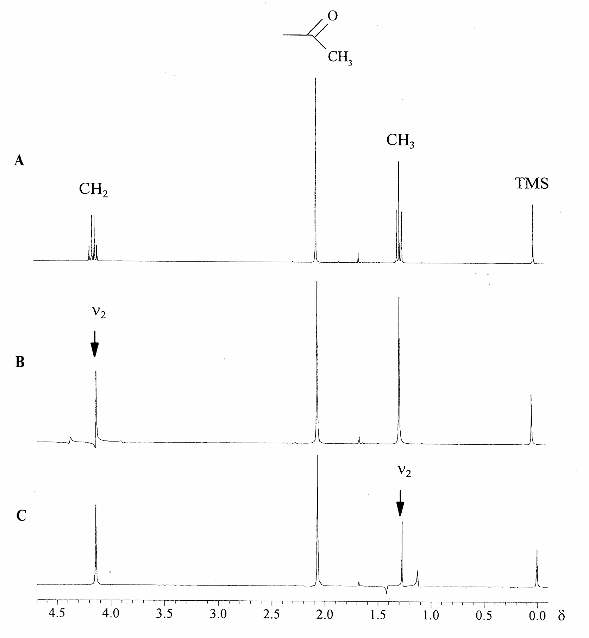
Selective Spin Decoupling
trivial example
- selective decoupling of methyl hydrogens from
methylene hydrogens in the ethyl moiety of
ethyl acetate
O
||
CH₃-C-O-CH₂-CH₃
ethyl acetate

Slide 6
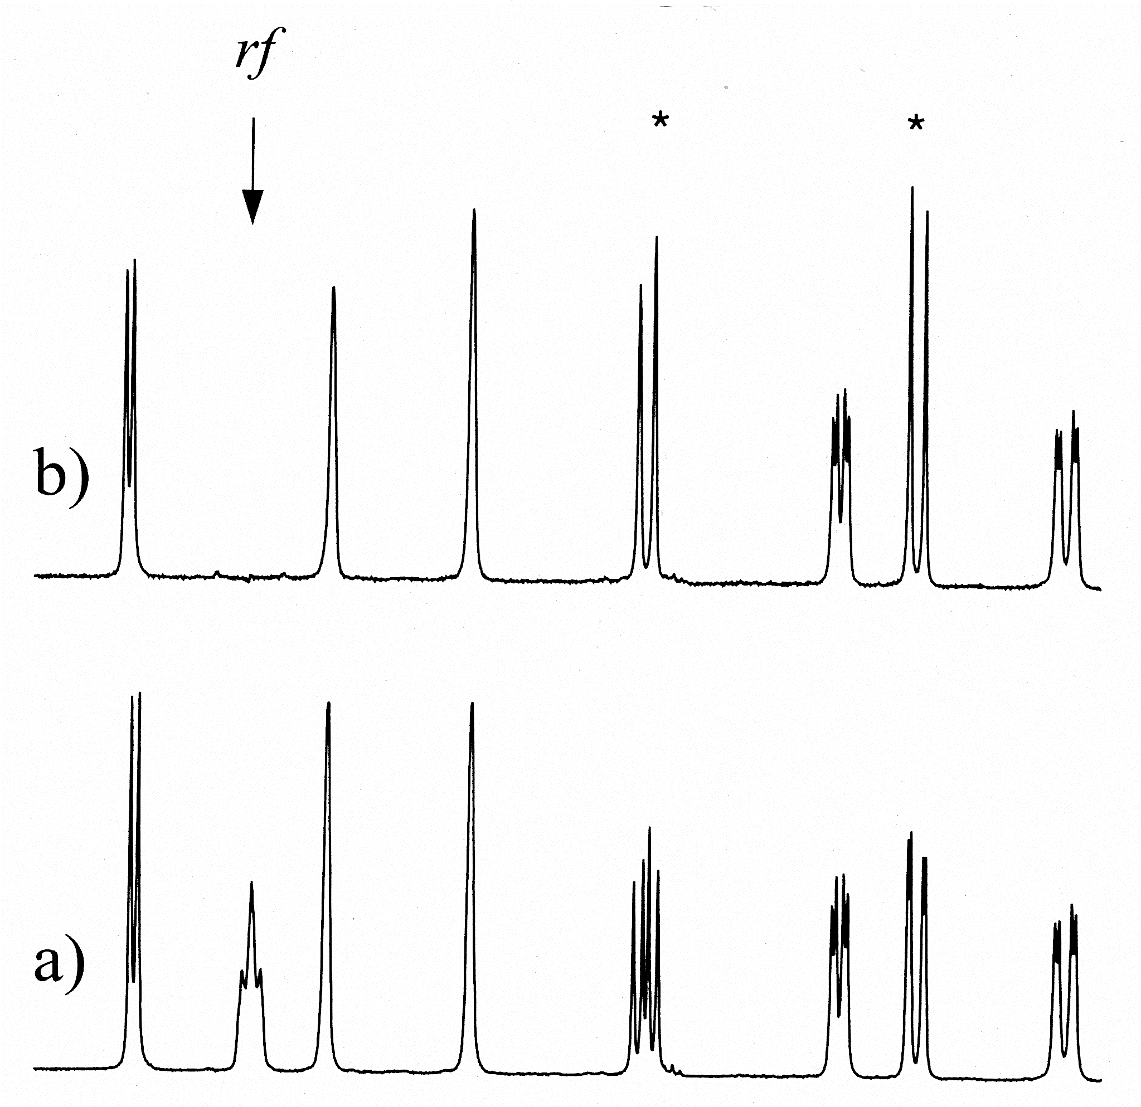
Selective Spin Decoupling
selective decoupling can identify signals from coupled nuclei, thus assisting to
establish connectivity/structure
intensities of signals from coupled nuclei are improved (due to multiplet collapse)
- integrals are unchanged for signals from coupled nuclei
selective decoupling
no decoupling

Slide 7
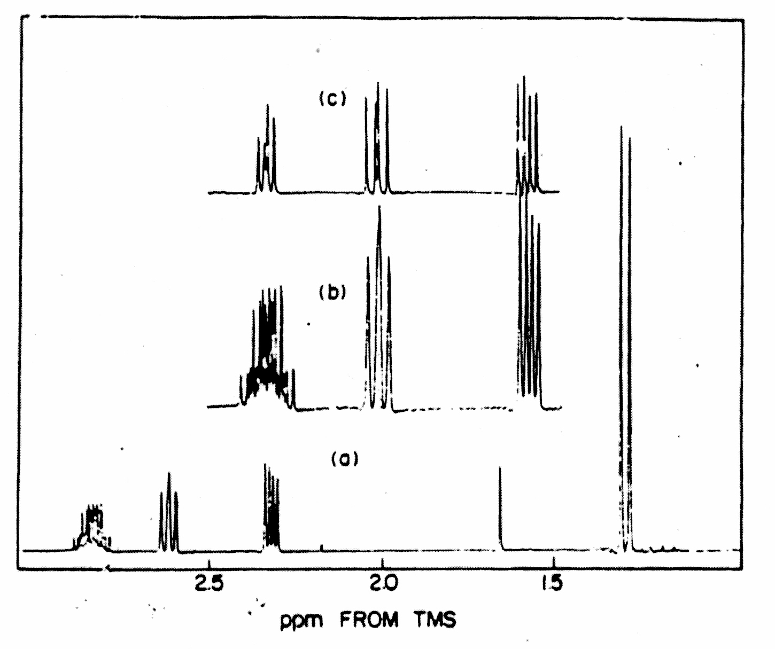
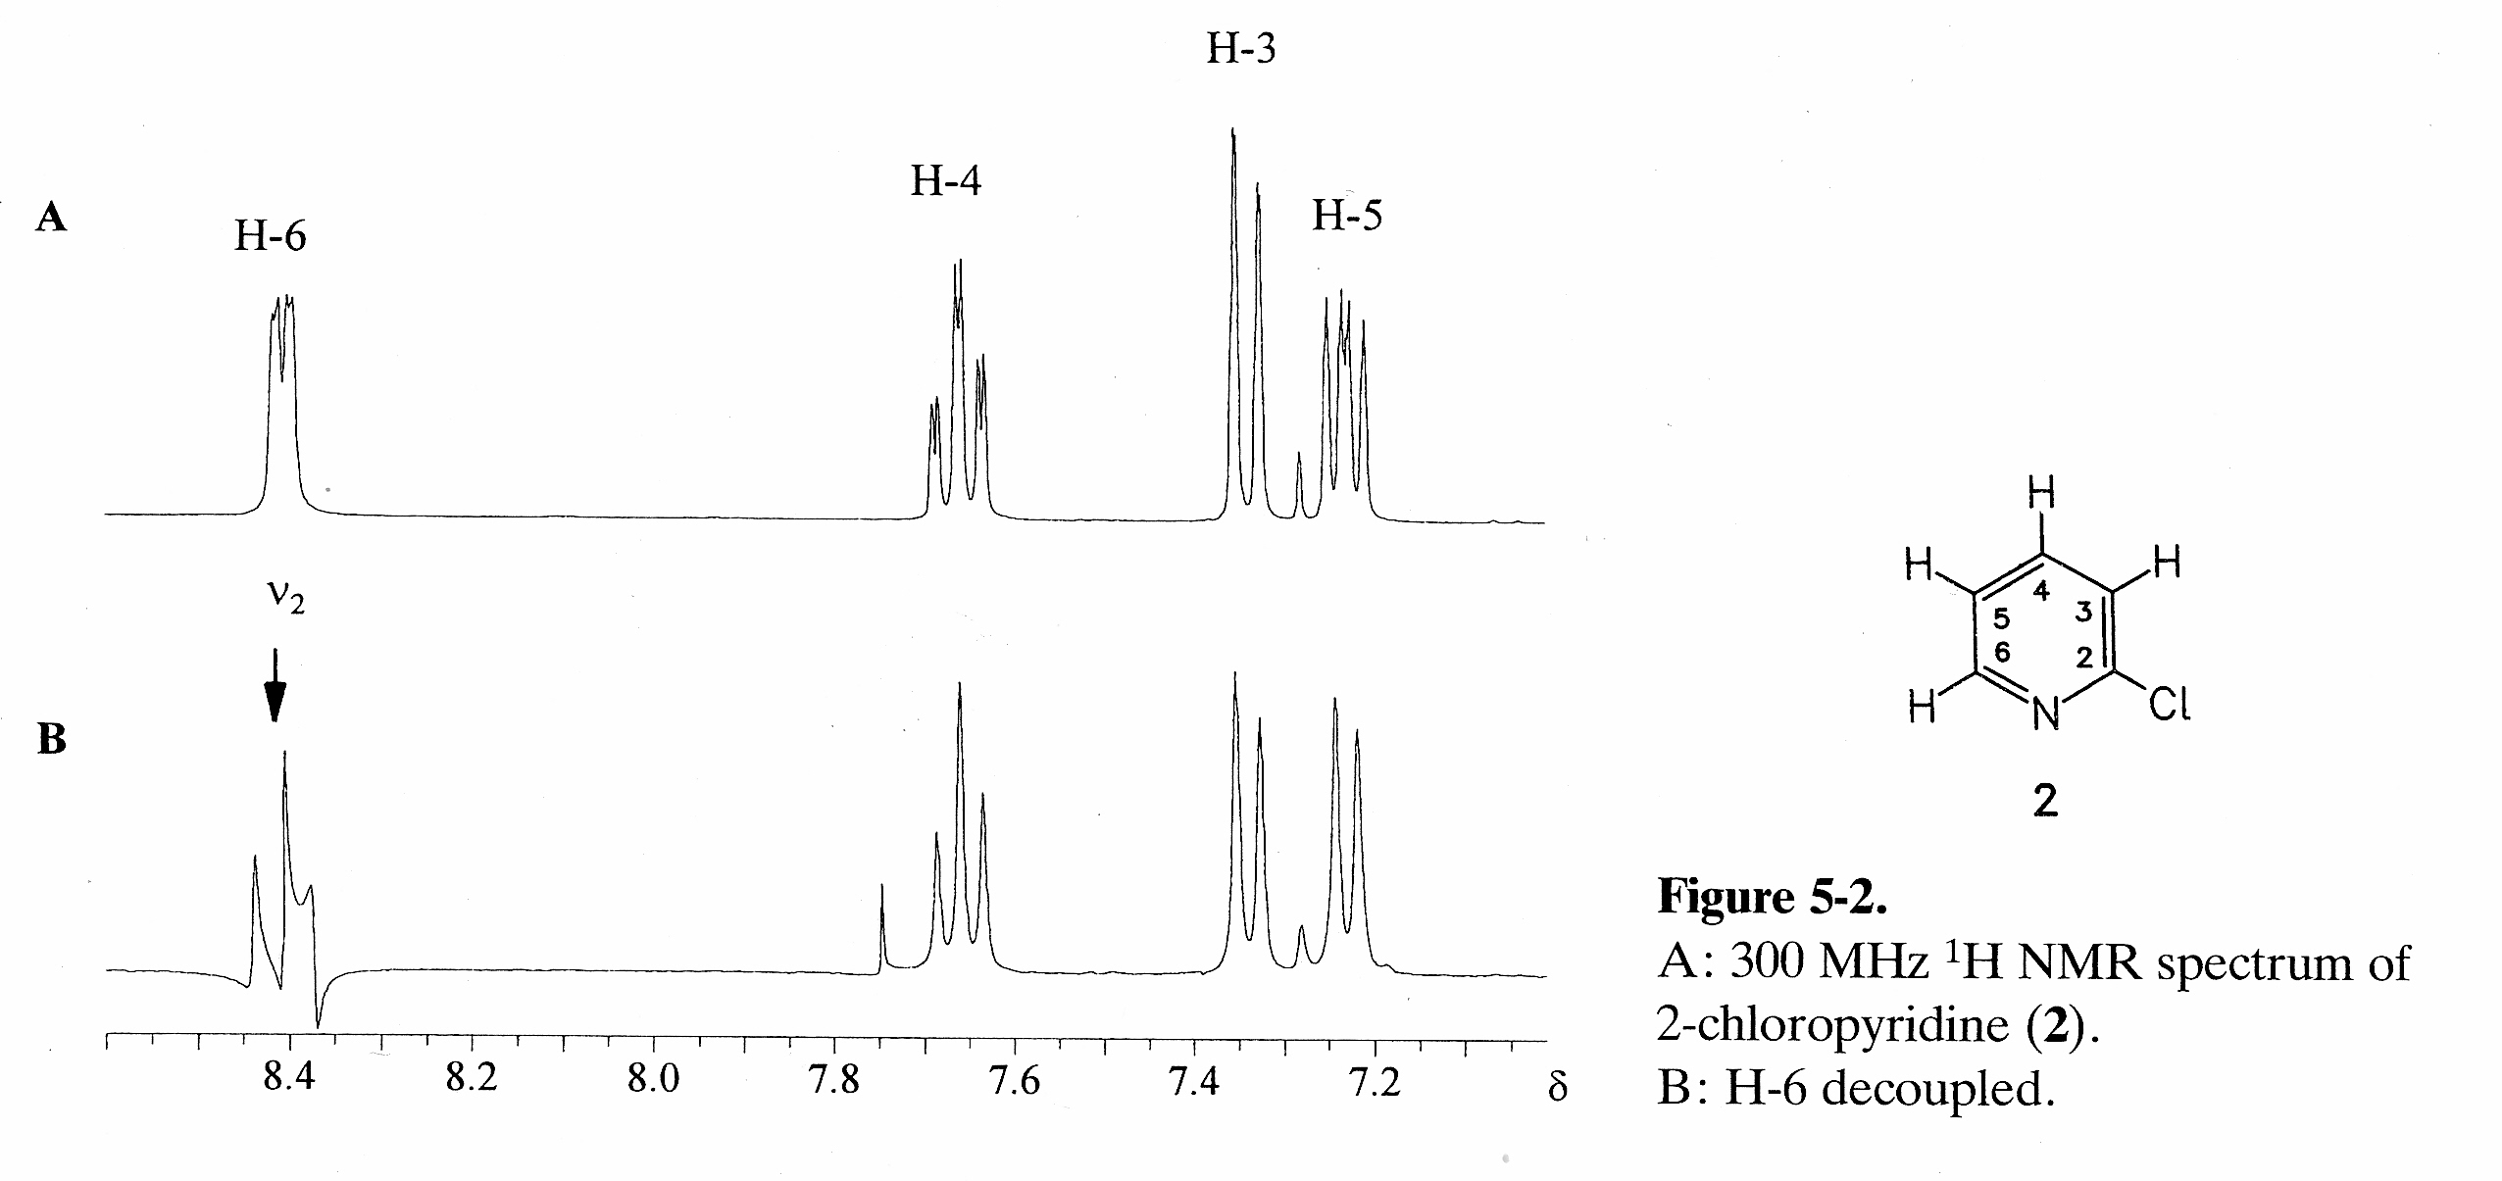
Selective Spin Decoupling
(right) selective decoupling of the methyl
hydrogens (1.3 ppm) of propylene oxide
confirms identity of signal
from methine H (2.8 ppm)
CH₃
H
H
H
O
propylene oxide
(left) selective decoupling of H-6 of
2-chloropyridine leads to assignment
of signals from H-3, H-4 and H-5
2-chloropyridine

Slide 8
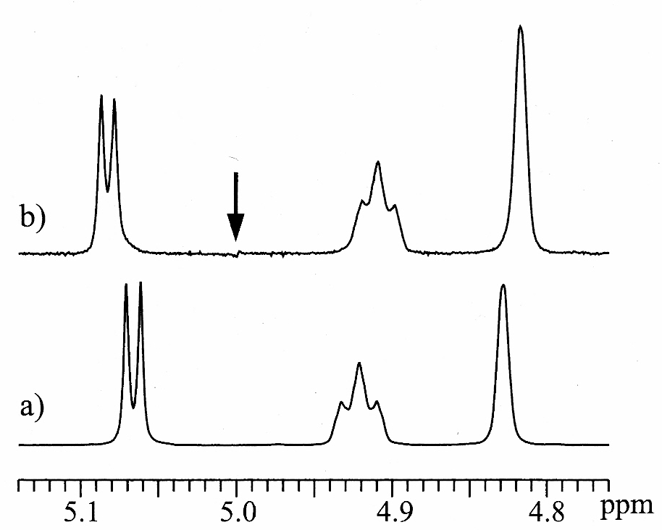
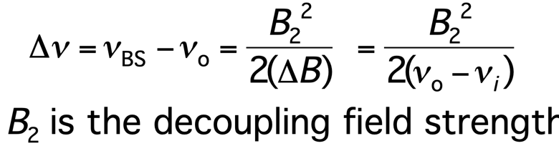
Bloch-Siegert Effect
In selective homonuclear decoupling experiments, if the decoupling field is applied during
the acquisition of the FID, signals in the spectrum (‘b’, below) can move relative to their
positions in the control spectrum (‘a’, below) where no decoupling field is applied
This is demonstrated in the spectra shown (below), where the arrow indicates the
frequency at which the decoupling field was applied for spectrum ‘b’
This effect is known as the Bloch-Siegert effect. The shifts in positions of signals are known
as Bloch-Siegert shifts
The effective field experienced by a nucleus is altered by the presence of the decoupling
field, thus causing the frequency changes
It is not observed if the decoupling field is turned off prior to acquisition
If the decoupling field is not too strong
(if B₂ << (ν_{o} – ν_{i})), then the Bloch-Siegert
shifts can be easily calculated:
In many homonuclear (selective) decoupling
experiments, the requirement for selectivity
keeps B₂ small, but if B₂ is large and is not
turned off during acquisition, Bloch-Siegert
shifts can be very large
Δν
ν_{BS}
ν_{o}
irradiation
frequency
ν_{i}

Slide 9
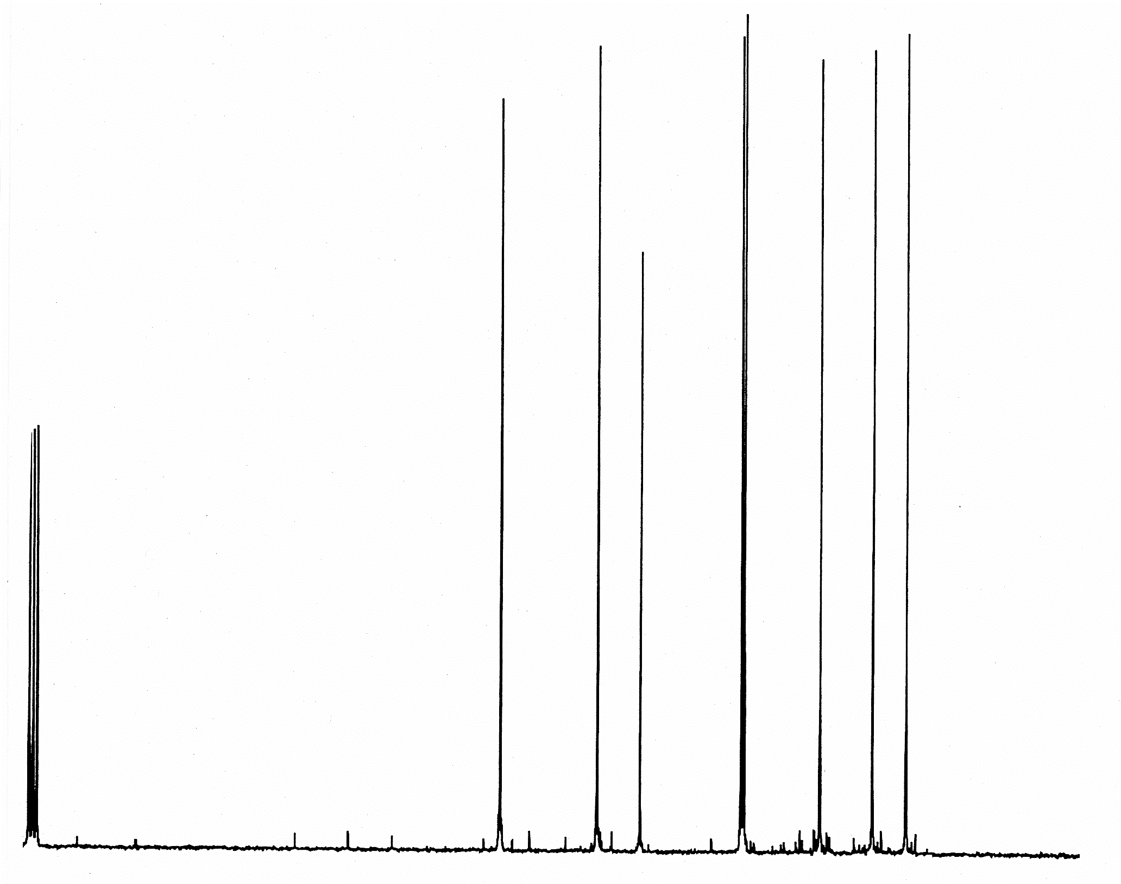
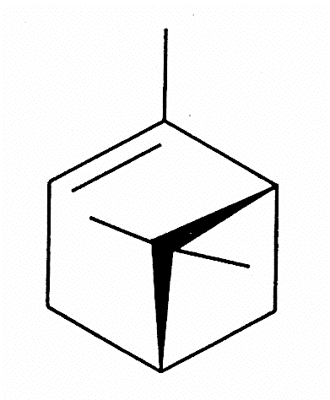
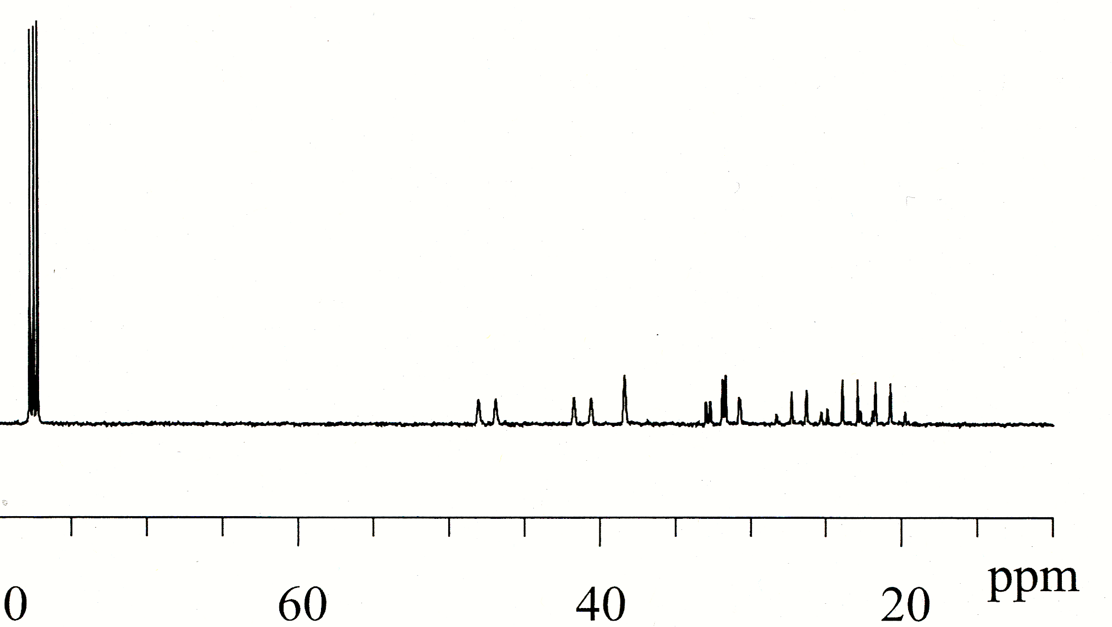
Broad-Band Decoupling
Substantial spectral simplification (multiplets collapse to singlets)
Substantial signal-to-noise gains
Signal-to-noise gains arise from two sources:
- collapse of the multiplet into a singlet
- nuclear Overhauser effect (NOE)
The signal-to-noise enhancement by the NOE is not uniform,
so quantitative information is lost
solvent
example: acquisition of ¹³C
spectrum of alpha pinene with
broad-band ¹H decoupling
- broad-band
¹H decoupling
- no decoupling

Slide 10
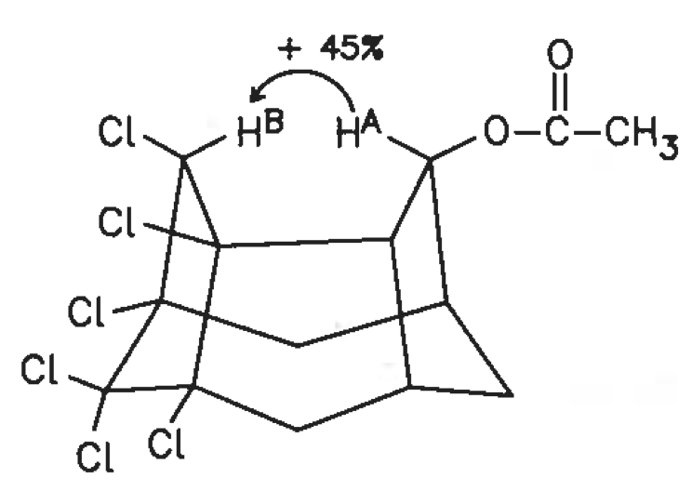
Broad-Band Decoupling:
Introduction to the Nuclear Overhauser Effect
The nuclear Overhauser effect (NOE) is the change in intensity of the NMR signal from a
nucleus when the spin populations of a nearby nucleus are changed (for instance, by an
electromagnetic pulse)
This is a through space effect (independent of the presence
of a chemical bond)
The effect is distance dependent (upper internuclear
distance limit of 5-6 A); shorter distance, larger effect
The effect is time dependent: it does not develop
instantaneously
The effect is closely tied to relaxation (much more later
in semester)
For broadband decoupling of ¹H from ¹³C:
the effect (signal-to-noise-enhancement) is proportional to number of ¹H nuclei
attached to a given ¹³C nucleus
effect is proportional to density of ¹H nuclei (attached or not attached) surrounding
a given ¹³C nucleus
¹³C signal may be increased up to 200% by nuclear Overhauser effect
quantitative information lost because relative integral values are dependent on
the signal-to-noise enhancement by the NOE which is not uniform for all ¹³C nuclei

Slide 11
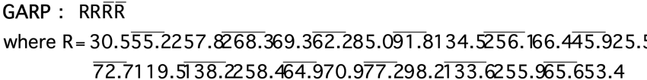
Broad-Band Decoupling
broad-band or “cpd” sequence
The broadband decoupling or “cpd” sequence can
be as simple as a series of 90 or 180 degree pulses,
or quite sophisticated, employing multiple pulse
angles, multiple pulse phases, and “shaped” pulses
(non-rectangular pulse profiles)
A goal of cpd (composite pulse decoupling) sequence development is to minimize the
effects of pulse imperfections, maximize the exitation bandwith and minimize pulse
power (decoupling pulse strength, or B₂ field strength) to avoid problems such as sample
heating
These sequences have “interesting” names, such as MLEV-16 (“Malcolm Levitt”),
WALTZ-16 (“1-2-3, 1-2-3”), GARP (“Globally Optimized Alternating Phase
Rectangular Pulse”), DIPSI-2, SEDUCE, FLOPSY-8, etc.
Examples: MLEV-16, WALTZ-16 and GARP
¹H
90
¹³C
d₁

Slide 12
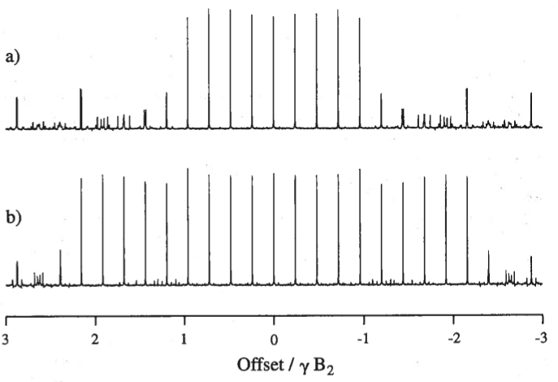
Broad-Band Decoupling
“Decoupling offset profiles” indicate the effective decoupling bandwidth (γB₂)
Example: note the bandwidth of GARP is nearly twice that of WALTZ-16
WALTZ-16
GARP

Slide 13
Broad-Band Decoupling:
Gated Broad-Band Decoupling
The gated broad-band decoupling experiment is designed to:
improve signal-to-noise via the NOE (or nOe)
retain coupling information (retain signal multiplets)
The NOE develops during the time that decoupling
is performed (during the d₁ delay time)
¹H-¹³C coupling returns instantaneously when
decoupling is ceased (just before acquisition), so
coupling information (¹³C signal splitting due to
attached hydrogens) is present in the spectra
The signal enhancement from the NOE begins to be
lost after decoupling ceases, but the loss depends on
T₁ relaxation times, which are generally long for ¹³C
in small molecules, so losses are minimal
Signal-to-noise enhancement by the NOE is not
uniform for all ¹³C nuclei, so quantitative
information is lost
gated broad-band decoupling sequence
¹H
90
¹³C
d₁
So, the gated broad-band decoupling sequence is useful when both high signal-to-noise
(from the NOE) and coupling information (signal splitting) are desired or required

Slide 14
BROAD-BAND DECOUPLING:
INVERSE (“QUANTITATIVE”) GATED BROAD-BAND DECOUPLING
The inverse gated broad-band decoupling experiment is designed to:
minimize signal-to-noise enhancement by the NOE
remove signal splitting (thereby improving signal-to-noise due to multiplet collapse)
The NOE does not develop during d₁ because
broad-band decoupling is not applied during this time
¹H-¹³C decoupling commences when acquisition
begins), so there is no signal splitting from ¹H-¹³C
coupling
Acquisition times are kept short to minimize
development of signal-to-noise enhancement from the
NOE that can develop when decoupling is on (i.e.
during acquisition)
Because signal-to-noise enhancement by the NOE is
minimized, quantitative information is available from
integrals of the signals
inverse gated broad-band
decoupling sequence
¹H
90
¹³C
d₁
So, overall, coupling information (signal splitting) is lost, signal-to-noise is improved due
to multiplet collapse, and integration can give reliable quantitative information

Slide 15
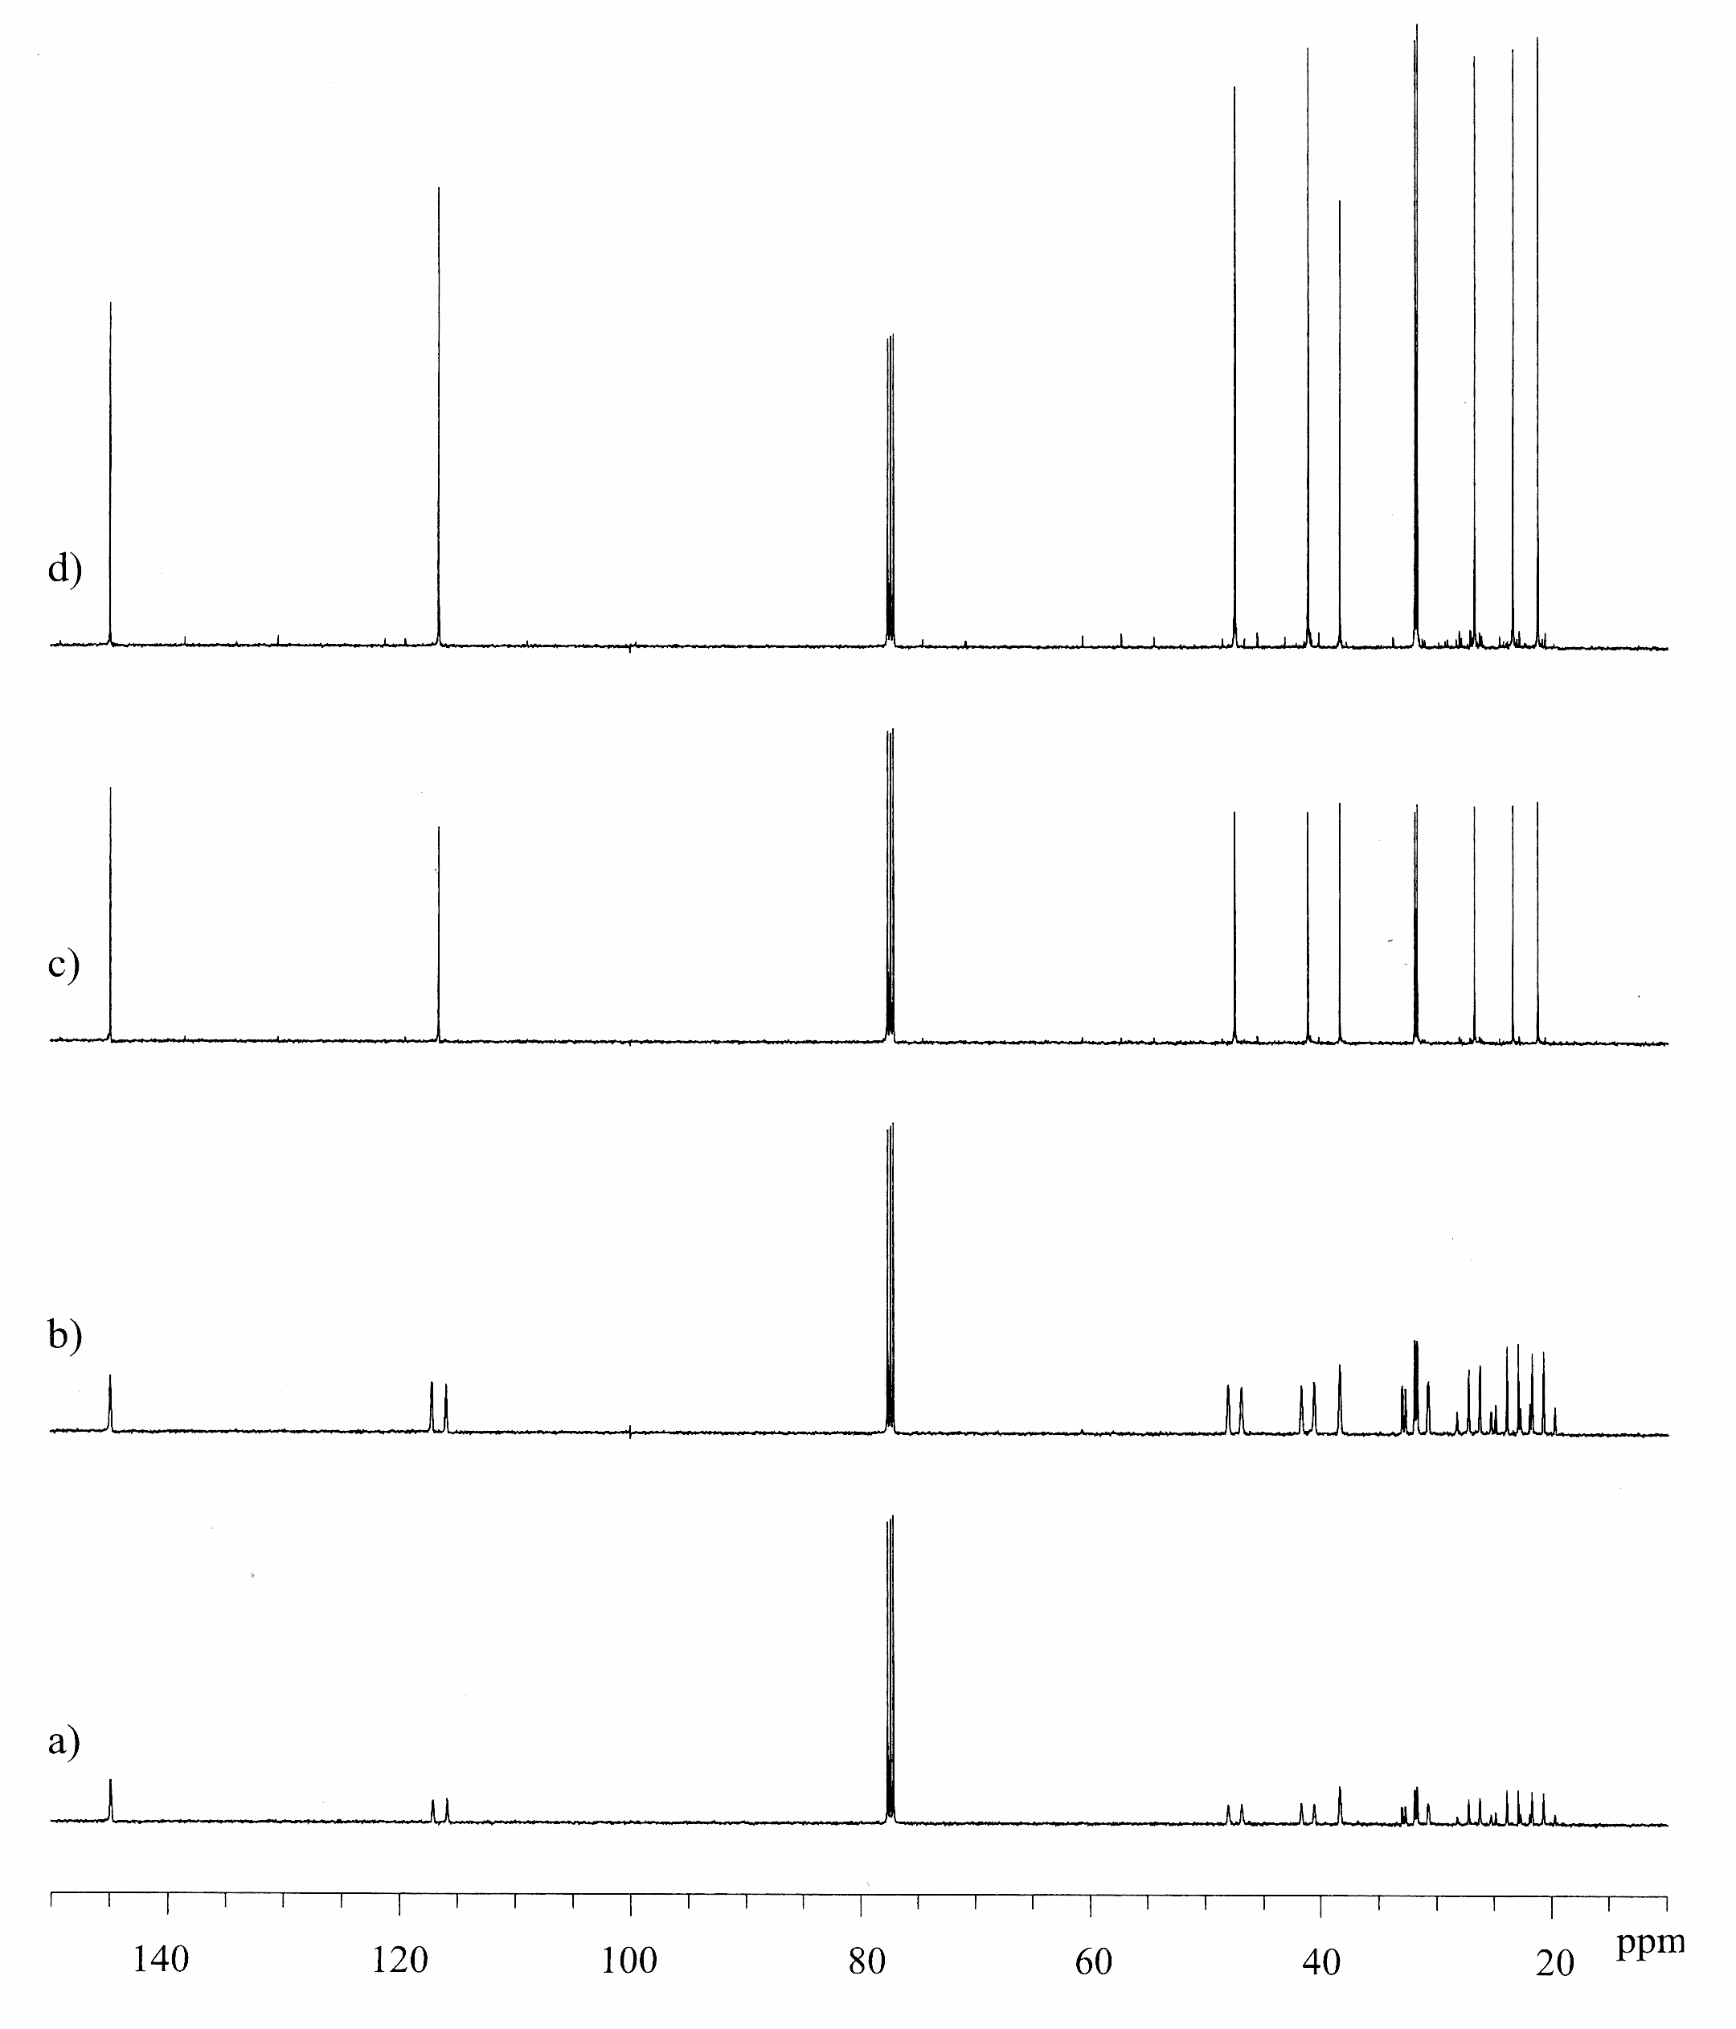
Broad-Band Decoupling: Examples
broad-band decoupling
-decoupled spectrum, with NOE
inverse gated broad-band decoupling
-decoupled spectrum, no NOE
gated broad-band decoupling
-coupled spectrum, with NOE
no decoupling
-coupled spectrum, no NOE

Slide 16
Other Decoupling: Off-Resonance Decoupling
¹³C spectra are routinely subjected to ¹H broad-band decoupling in order to improve
signal-to-noise via the NOE and resolve overlapped signals
This often allows unambiguous identification of individual signals and their chemical shifts
at the expense of loss of coupling information (multiplet structure) useful for identification
of -CH, -CH₂, and -CH₃ groups
There is a compromise method, “off-resonance” ¹H decoupling of ¹³C spectra. The utility of
this method stems from the following attributes:
it permits some signal to-noise enhancement via the NOE
it permits some coupling information to remain in order to assist in identification of
CH, -CH₂, and -CH₃ groups
it also reduces heteronuclear (¹H-¹³C) coupling constants so as to reduce overlap of
multiplets and thus help resolve individual signals
In this off-resonance decoupling method, a low power
(but not too low) ¹H “pulse” is applied at some
frequency in the ¹H spectral window where there are
no signals (hence, “off” resonance)
Often this is at one edge of the spectrum
In the ¹³C spectrum, some NOE enhancement is
observed, ¹H-¹³C couplings are reduced, multiplet
structures are (normally) preserved but spectral
overlap (multiplet overlap) is reduced
“off-resonance” heteronuclear decoupling
¹H
90
¹³C
d₁

Slide 17
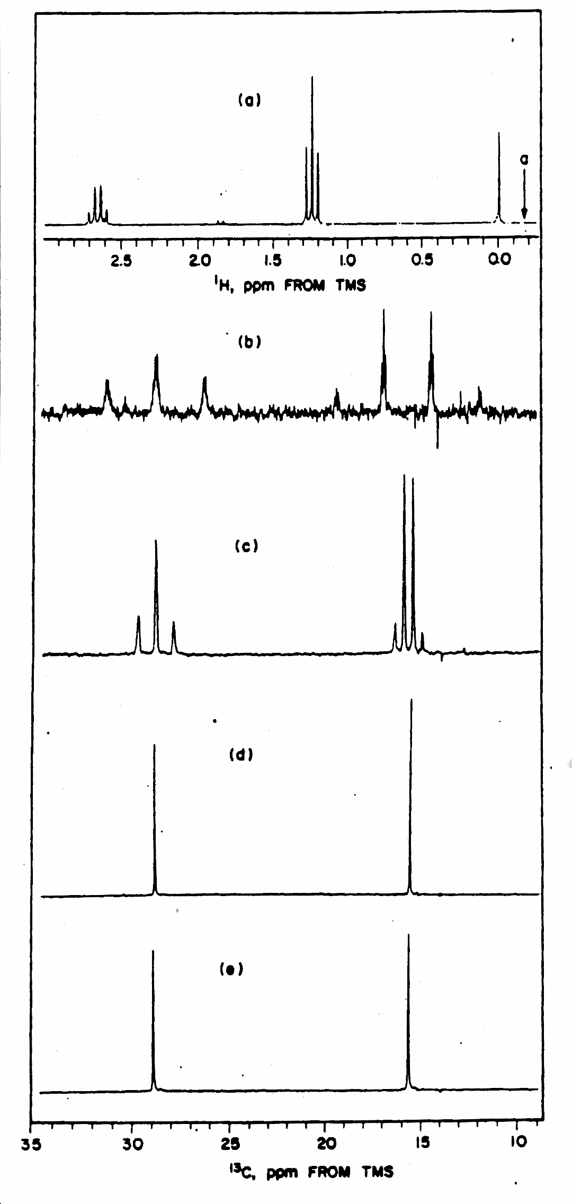
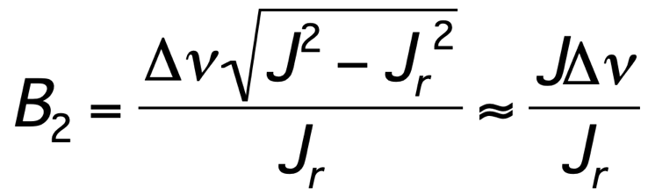
Other Decoupling: Off-Resonance Decoupling
¹H (‘a’), and ¹³C (‘b’, ‘c’, and ‘d’) spectra of the ethyl group
of ethylbenzene are shown
As indicated in the ¹H spectrum ‘a’, a low power pulse is
applied at approximately -0.2 ppm (indicated in the
spectrum) during the entire experiment
In ‘b’ is shown the normal (no decoupling) ¹³C spectrum
(note the large ¹H-¹³C couplings in the triplet and quartet)
In ‘c’ is shown the off-resonance decoupled spectrum
note the decreased ¹H-¹³C coupling constants, and
how this could be important for spectra where
multiplets are overlapped
note the improvement in signal-to-noise from the NOE
In ‘d’ is shown the broad-band decoupled ¹³C spectrum
The magnitude of the observed ¹H-¹³C coupling constant (J_{r},
r for “reduced”) in an off-resonance decoupled spectrum is
related to the actual coupling constant (J), the decoupler
field strength (B₂, in Hz) and the frequency offset between
the decoupler field and the ¹H signal of interest (Δν, Hz):
the approximation holds only when B₂ >> Δν

Slide 18
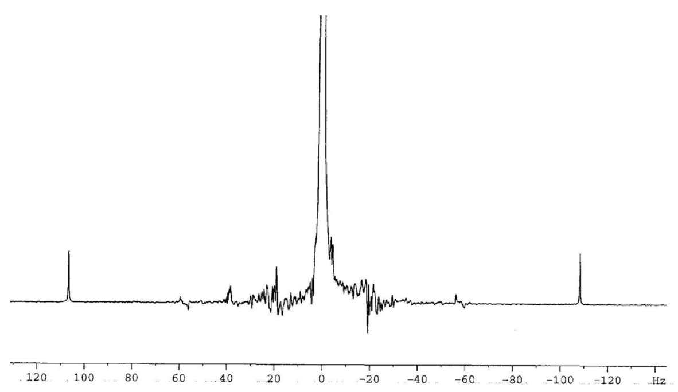
Other Decoupling: Selective Heteronuclear Decoupling
Decoupling ¹H from ¹³C can also be performed selectively
The frequency of a selected signal in the ¹H spectrum is saturated, and the ¹³C signal of the
¹³C bound to that hydrogen collapses to a singlet
This is very useful for correlating the signals in the ¹H and ¹³C spectra (deciding which
hydrogens are bound to which ¹³C nuclei
This is done in a manner very similar to “off-resonance” decoupling, except the decoupling
pulse frequency is “on” some resonance (signal), and the power level generally is lower
It is important that the signal(s) in the ¹H spectrum corresponding to ¹H bound to ¹³C are
those that are saturated with the low power ¹H pulse (not the ¹H-¹²C signal/peak)
The signal corresponding to ¹H-¹³C is split by ¹J_{1H-13C} coupling constant, and the peaks lie
on either side of the ¹H-¹²C peak
These peaks are sometimes called the
“satellite” peaks or “¹³C-satellite” peaks
¹H spectrum
of CHCl₃
¹H-¹²C (~99%)
“selective” heteronuclear decoupling
¹H-¹³C (~0.5 %)
¹H-¹³C (~0.5 %)
¹H
90
¹³C
d₁

Slide 19
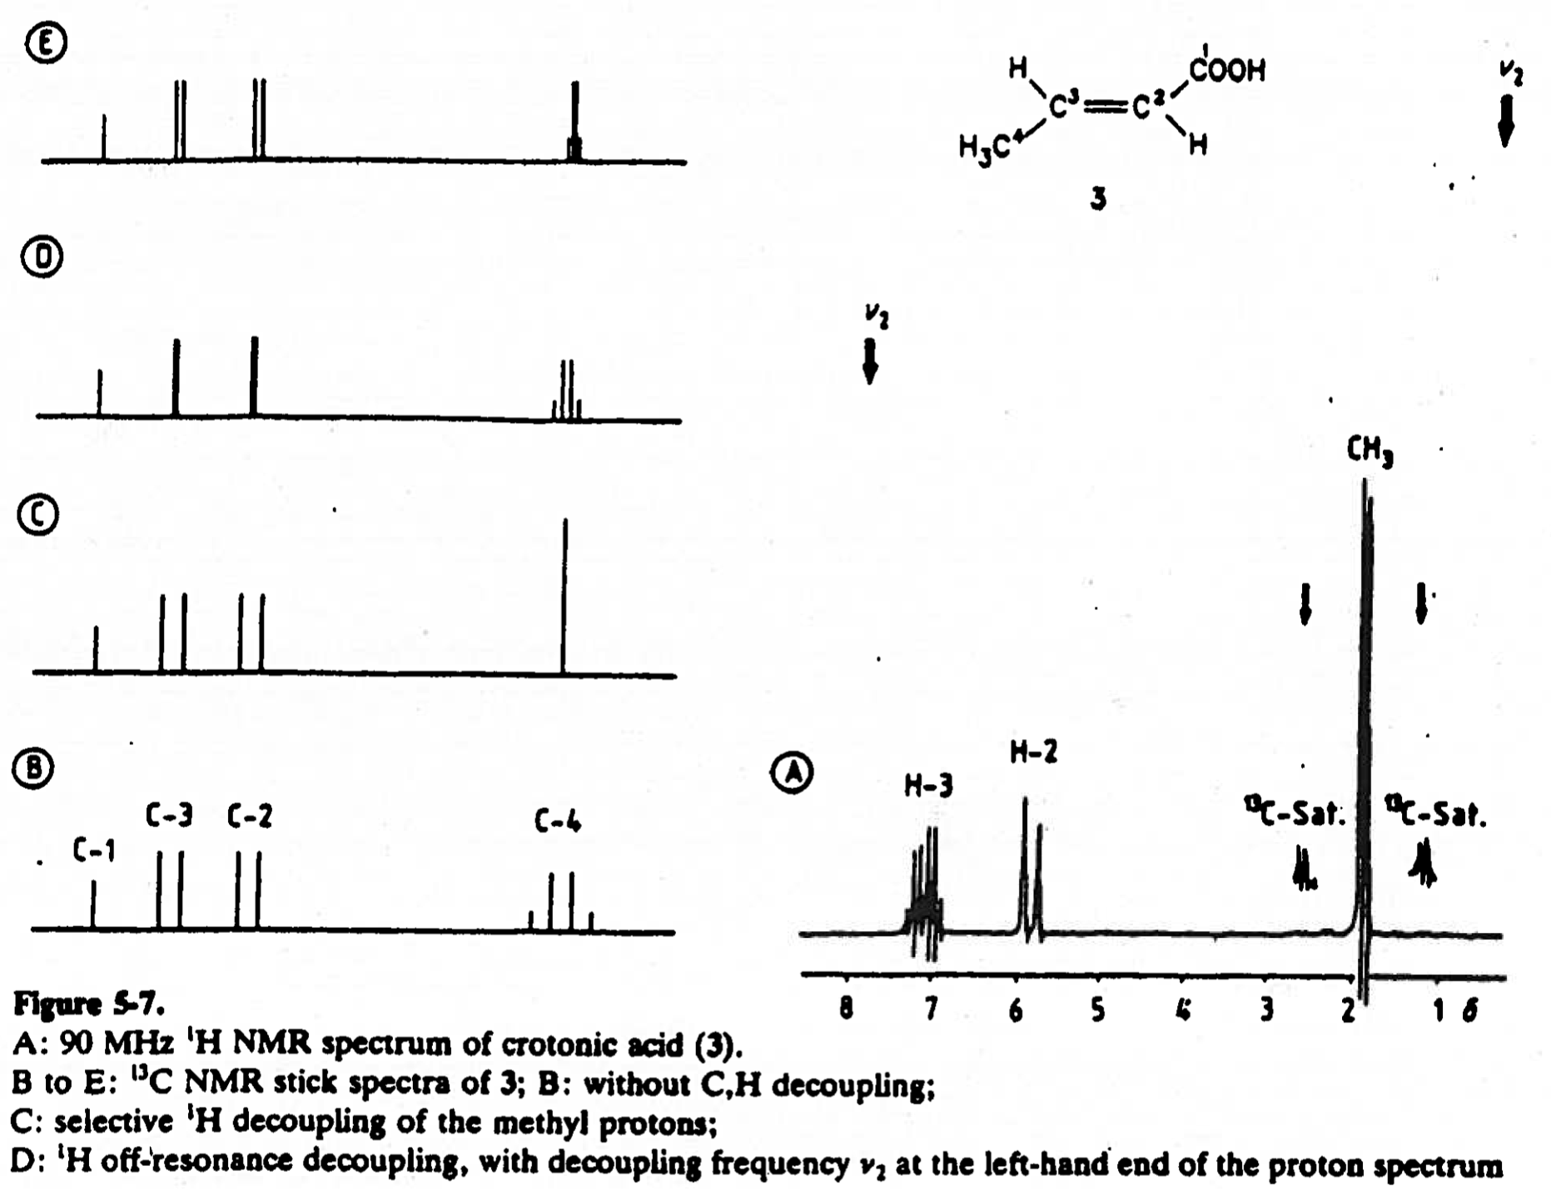
Other Decoupling: Selective Heteronuclear Decoupling
In ‘A’ is shown the ¹H spectrum of crotonic acid, and the ¹³C spectrum is shown in ‘B’
If the ¹³C satellites in ‘A’ corresponding to the methy group are saturated, the upfield
quartet in ‘B’ collapses to a singlet
off-resonance decoupling
(¹H decoupling frequency
ν₂ at 0 ppm as in figure)
off-resonance decoupling
(¹H decoupling frequency
ν₂ at 7.5 ppm as in figure)
selective heteronuclear
decoupling of ¹H from
¹³C in methyl group
¹³C spectrum (no decoupling)

Slide 20
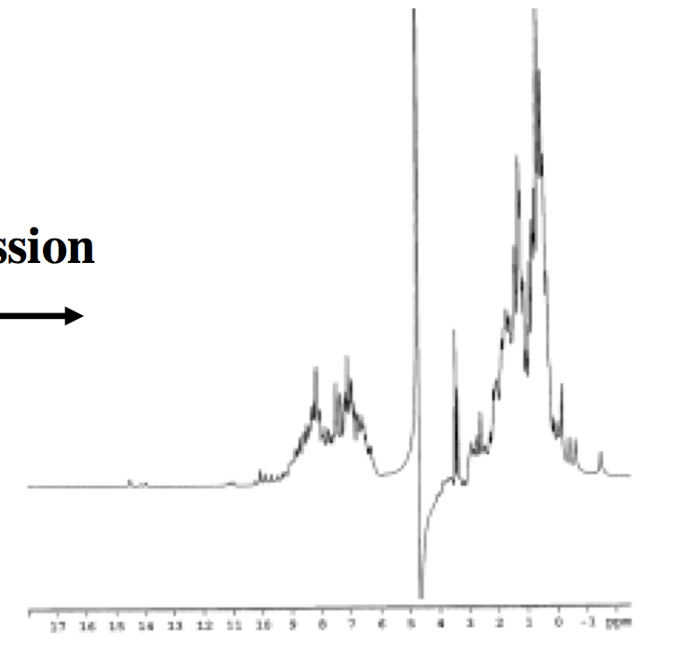
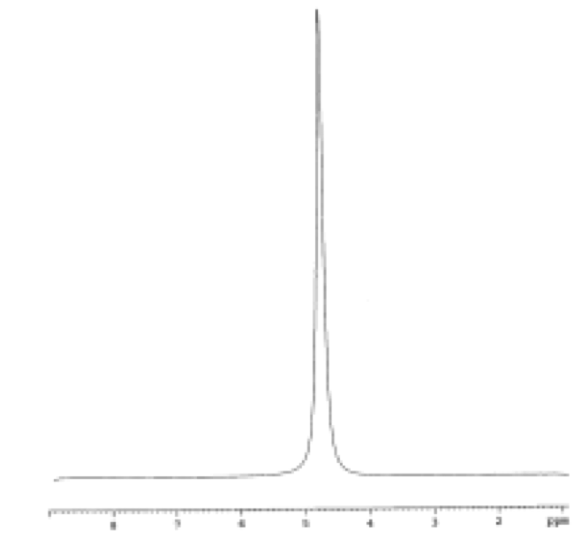
OTHER DECOUPLING: SOLVENT (H₂O) SUPPRESSION
¹H NMR in protonated solvents is problematic
The concentration of H₂O in H₂O is ~55 M (¹H concentration ~110 M)
Signals from other molecules are obscured by the large H₂O signal
One way to attenuate the H₂O signal is by “decoupling”,
or saturating the resonance (called solvent
suppression by “saturation” or “presaturation”)
A long, selective, low power pulse is used to saturate
selectively the H₂O frequency, which
greatly attenuates the signal in the spectrum
solvent (H₂O) suppression
¹H (H₂O)
90
¹H
d₁
¹H NMR spectrum of a 1 mM
solution of a protein molecule
no water suppression
with water suppression➔

