Slide 1
PHUSE poster
Jeff Dickinson

Slide 2
Abstract
Population Pharmacokinetic modeling is an important tool for drug development. The CDISC ADaM Population PK Implementation Guide was released on October 6, 2023. Population PK models generally make use of nonlinear mixed effects models that require numeric variables. The data used in the models will include both dosing and concentration records, relative time variables, and numeric covariate variables. {admiral} is an open-source R package for creating CDISC ADaM data. It can be used effectively to create Population PK analysis data (ADPPK). Additional tools from other Pharmaverse packages such as {metacore}, {metatools} and {xportr} can be used to simplify the workflow. I will discuss some of the challenges of Population Pharmacokinetic analysis data programming and show some of the solutions developed in {admiral} and the Pharmaverse.

Slide 3
Agenda
What is PK data
Types of PK analysis data
Brief overview of {admiral} and the Pharmaverse
Programming Workflow
Some Additional Pharmaverse tools
Pharmaverse Website Example

Slide 4

Pharmacokinetics Overview

Slide 5
Pharmacokinetics is the interaction of a drug with the body
Samples collected at regular time intervals after dosing
Metrics calculated from concentrations over time

Slide 6
Two Main Types of Modelling
Non-Compartmental Analysis (NCA)
Population PK (PopPK)

Slide 7
Population PK (PopPK) – ADPPK
Population Based
Less Intensive Sampling
Can Detect Variations based on Covariates

Slide 8
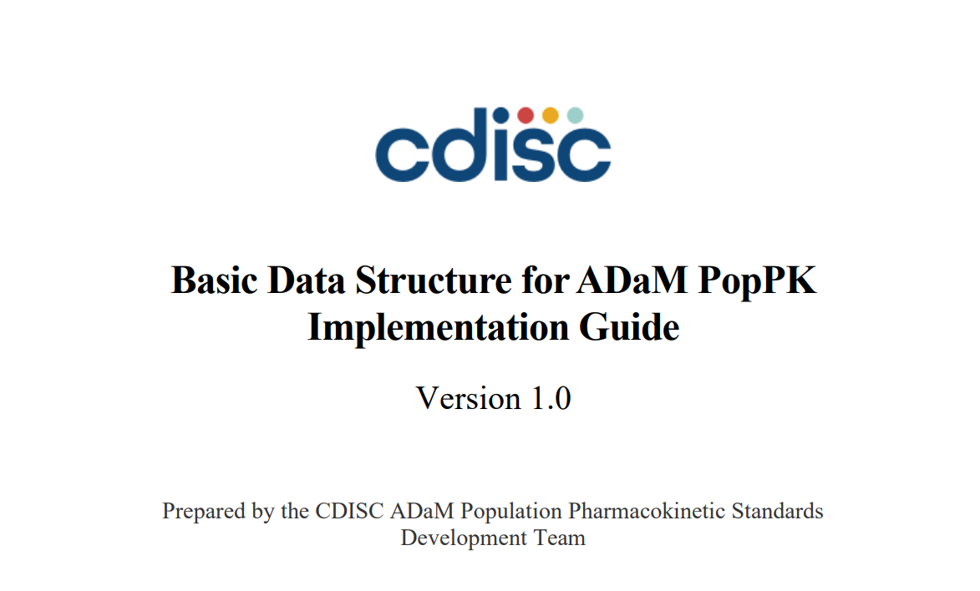
CDISC Standards for Population PK Analysis

Slide 9
Published October 6, 2023!
https://www.cdisc.org/standards/foundational/adam/basic-data-structure-adam-poppk-implementation-guide-v1-0

Slide 10
CDISC ADaM PK Standards
ADNCA (NCA) – released November 2021
ADPPK (PopPK) – released October 2023
ADPP (PK Parameters) – coming in 2024

Slide 11
Characteristics of PK Analysis Data
Includes both exposure (EX) and concentration data (PC)
Includes nominal and actual relative time variables
Duplicated Records for Analysis (ADNCA)
Numeric Covariates for Modelling (ADPPK)
May need to expand dosing records

Slide 12
Time Variables (ADPPK)
Variable | Variable Label
NFRLT | Nominal Rel Time from First Dose
AFRLT | Actual Rel Time from First Dose
NPRLT | Nominal Rel Time from Previous Dose
APRLT | Actual Rel Time from Previous Dose

Slide 13
ADPPK Expected Variables
EVID Event ID
DV Dependent Variable
MDV Missing Dependent Variable
BLQ Below Limit of Quantitation

Slide 14
ADPPK Covariates
<COV>BL for baseline covariate, (e.g., WTBL, BMIBL)
<COV>N for numerical version of categorical covariate (e.g., SEXN, RACEN)
<COV>I for any covariates with imputed values (e.g., WTI, BMII)
<COV>GRy for grouping covariates (e.g. AGEGR1)

Slide 15

{admiral}

Slide 16
ADaM in R Asset Library
{admiral} is Open Source and Collaborative
{admiral} is Modular
{admiral} is Part of Pharmaverse
https://github.com/pharmaverse/admiral

Slide 17
{admiral} Functions Used
derive_vars_dtm()
derive_vars_dtm_to_dt()
derive_vars_dtm_to_tm()
derive_vars_dy()
derive_vars_duration()
create_single_dose_dataset()

Slide 18
{admiral} Functions Used (continued)
derive_vars_merged()
derive_vars_joined()
derive_vars_transposed()
compute_bmi()
compute_bsa()
compute_egfr()

Slide 19
Other Pharmaverse Packages in ADPPK Workflow
{pharmaversesdtm} CDISC pilot SDTM data
{metacore} Store metadata
{metatools} Work with metadata and perform checks
{xportr} Perform checks and export transport files (XPT)

Slide 20
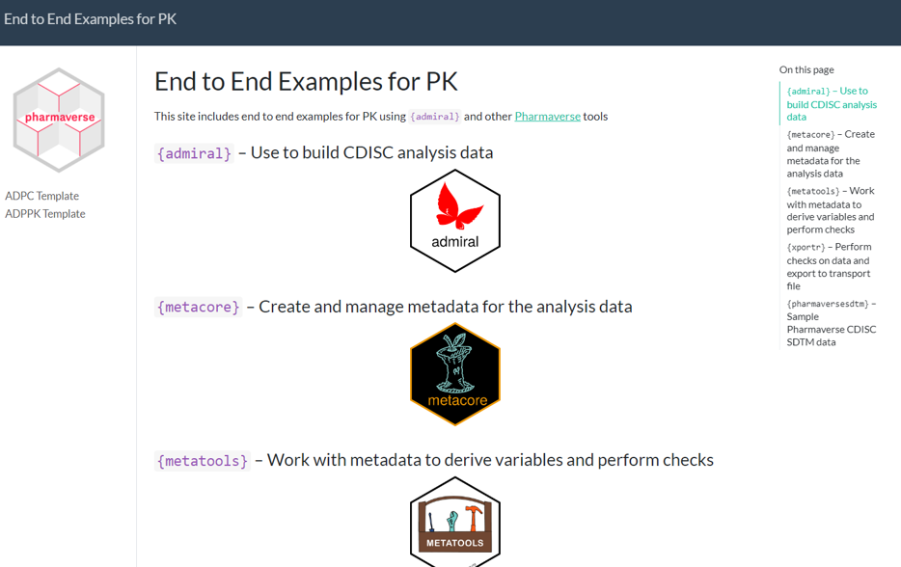
End to End Example Site

Slide 21
https://pharmaverse.github.io/examples/
Will focus on ADPPK example

Slide 22
Coding Highlights
Load Specs with {metacore}
Derive PC Dates
Expand Dosing Records
Find First Dose
Find Previous Dose
Find Previous Nominal Dose
Derive Covariates Using {metacore}
{metacore} Checks
{xportr} Steps

Slide 23
Load Specs with {metacore}
# ---- Load Specs for Metacore ----
metacore <- spec_to_metacore("pk_spec.xlsx") %>%
select_dataset("ADPPK")

Slide 24
Derive PC Dates
pc_dates <- pc %>%
# Join ADSL with PC (need TRTSDT for ADY derivation)
derive_vars_merged(
dataset_add = adsl,
new_vars = adsl_vars,
by_vars = exprs(STUDYID, USUBJID)
) %>%
# Derive analysis date/time
# Impute missing time to 00:00:00
derive_vars_dtm(
new_vars_prefix = "A",
dtc = PCDTC,
time_imputation = "00:00:00"
) %>%
# Derive dates and times from date/times
derive_vars_dtm_to_dt(exprs(ADTM)) %>%
derive_vars_dtm_to_tm(exprs(ADTM)) %>%
# Derive event ID and nominal relative time from first dose (NFRLT)
mutate(
EVID = 0,
DRUG = PCTEST,
NFRLT = if_else(PCTPTNUM < 0, 0, PCTPTNUM), .after = USUBJID
)

Slide 25
Expand Dosing Records
ex_vars <- exprs(
STUDYID, USUBJID, EVID, EXDOSFRQ, EXDOSFRM,
NFRLT, EXDOSE, EXDOSU, EXTRT, ASTDT, ASTDTM, AENDT, AENDTM,
VISIT, VISITNUM, VISITDY, TRT01A, TRT01P, DOMAIN, EXSEQ,
!!!adsl_vars
)
ex_exp <- ex_dates %>%
create_single_dose_dataset(
dose_freq = EXDOSFRQ,
start_date = ASTDT,
start_datetime = ASTDTM,
end_date = AENDT,
end_datetime = AENDTM,
nominal_time = NFRLT,
lookup_table = dose_freq_lookup,
lookup_column = CDISC_VALUE,
keep_source_vars = ex_vars
) %>%
# Derive AVISIT based on nominal relative time
# Derive AVISITN to nominal time in whole days using integer division
# Define AVISIT based on nominal day
mutate(
AVISITN = NFRLT %/% 24 + 1,
AVISIT = paste("Day", AVISITN),
ADTM = ASTDTM,
DRUG = EXTRT
) %>%
# Derive dates and times from datetimes
derive_vars_dtm_to_dt(exprs(ADTM)) %>%
derive_vars_dtm_to_tm(exprs(ADTM)) %>%
derive_vars_dtm_to_tm(exprs(ASTDTM)) %>%
derive_vars_dtm_to_tm(exprs(AENDTM))

Slide 26
Find First Dose
adppk_first_dose <- pc_dates %>%
derive_vars_merged(
dataset_add = ex_exp,
filter_add = (!is.na(ADTM)),
new_vars = exprs(FANLDTM = ADTM, EXDOSE_first = EXDOSE),
order = exprs(ADTM, EXSEQ),
mode = "first",
by_vars = exprs(STUDYID, USUBJID, DRUG)
) %>%
filter(!is.na(FANLDTM)) %>%
# Derive AVISIT based on nominal relative time
# Derive AVISITN to nominal time in whole days using integer division
# Define AVISIT based on nominal day
mutate(
AVISITN = NFRLT %/% 24 + 1,
AVISIT = paste("Day", AVISITN),
)

Slide 27
Find Previous Dose
adppk_prev <- adppk_first_dose %>%
derive_vars_joined(
dataset_add = ex_exp,
by_vars = exprs(USUBJID),
order = exprs(ADTM),
new_vars = exprs(
ADTM_prev = ADTM,
EXDOSE_prev = EXDOSE,
AVISIT_prev = AVISIT,
AENDTM_prev = AENDTM
),
join_vars = exprs(ADTM),
join_type = "all",
filter_add = NULL,
filter_join = ADTM > ADTM.join,
mode = "last",
check_type = "none"
)

Slide 28
Find Previous Nominal Dose
adppk_nom_prev <- adppk_prev %>%
derive_vars_joined(
dataset_add = ex_exp,
by_vars = exprs(USUBJID),
order = exprs(NFRLT),
new_vars = exprs(NFRLT_prev = NFRLT),
join_vars = exprs(NFRLT),
join_type = "all",
filter_add = NULL,
filter_join = NFRLT > NFRLT.join,
mode = "last",
check_type = "none"
)

Slide 29
Derive Covariates Using Metacore
Use metatools::create_var_from_codelist()
#---- Derive Covariates ----
covar <- adsl %>%
create_var_from_codelist(metacore, input_var = STUDYID, out_var = STUDYIDN) %>%
create_var_from_codelist(metacore, input_var = SEX, out_var = SEXN) %>%
create_var_from_codelist(metacore, input_var = RACE, out_var = RACEN) %>%
create_var_from_codelist(metacore, input_var = ETHNIC, out_var = AETHNIC) %>%
create_var_from_codelist(metacore, input_var = AETHNIC, out_var = AETHNICN) %>%
create_var_from_codelist(metacore, input_var = ARMCD, out_var = COHORT) %>%
create_var_from_codelist(metacore, input_var = ARMCD, out_var = COHORTC) %>%
create_var_from_codelist(metacore, input_var = COUNTRY, out_var = COUNTRYN) %>%
create_var_from_codelist(metacore, input_var = COUNTRY, out_var = COUNTRYL) %>%
mutate(
STUDYIDN = as.numeric(word(USUBJID, 1, sep = fixed("-"))),
SITEIDN = as.numeric(word(USUBJID, 2, sep = fixed("-"))),
USUBJIDN = as.numeric(word(USUBJID, 3, sep = fixed("-"))),
SUBJIDN = as.numeric(SUBJID),
ROUTE = unique(ex$EXROUTE),
FORM = unique(ex$EXDOSFRM),
REGION1 = COUNTRY,
REGION1N = COUNTRYN,
SUBJTYPC = "Volunteer",
) %>%
create_var_from_codelist(metacore, input_var = FORM, out_var = FORMN) %>%
create_var_from_codelist(metacore, input_var = ROUTE, out_var = ROUTEN) %>%
create_var_from_codelist(metacore, input_var = SUBJTYPC, out_var = SUBJTYP)

Slide 30
Calculate Additional Covariates from Vital Signs and Labs
covar_vslb <- covar %>%
derive_vars_merged(
dataset_add = vs,
filter_add = VSTESTCD == "HEIGHT",
by_vars = exprs(STUDYID, USUBJID),
new_vars = exprs(HTBL = VSSTRESN)
) %>%
derive_vars_merged(
dataset_add = vs,
filter_add = VSTESTCD == "WEIGHT" & VSBLFL == "Y",
by_vars = exprs(STUDYID, USUBJID),
new_vars = exprs(WTBL = VSSTRESN)
) %>%
derive_vars_transposed(
dataset_merge = labsbl,
by_vars = exprs(STUDYID, USUBJID),
key_var = LBTESTCDB,
value_var = LBSTRESN
) %>%
mutate(
BMIBL = compute_bmi(height = HTBL, weight = WTBL),
BSABL = compute_bsa(
height = HTBL,
weight = HTBL,
method = "Mosteller"
),
CRCLBL = compute_egfr(
creat = CREATBL, creatu = "SI", age = AGE, weight = WTBL, sex = SEX,
method = "CRCL"
),
EGFRBL = compute_egfr(
creat = CREATBL, creatu = "SI", age = AGE, weight = WTBL, sex = SEX,
method = "CKD-EPI"
)
) %>%
rename(TBILBL = BILIBL)

Slide 31
{metacore} Checks
adppk <- adppk_prefinal %>%
drop_unspec_vars(metacore) %>% # Drop unspecified variables from specs
check_variables(metacore) %>% # Check all variables specified are present and no more
check_ct_data(metacore) %>% # Checks all variables with CT only contain values within the CT
order_cols(metacore) %>% # Orders the columns according to the spec
sort_by_key(metacore) # Sorts the rows by the sort keys

Slide 32
{xportr} Steps
adppk_xpt <- adppk %>%
xportr_type(metacore) %>% # Coerce variable type to match spec
xportr_length(metacore) %>% # Assigns SAS length from a variable level metadata
xportr_label(metacore) %>% # Assigns variable label from metacore specifications
xportr_format(metacore) %>% # Assigns variable format from metacore specifications
xportr_df_label(metacore) %>% # Assigns dataset label from metacore specifications
xportr_write(file.path(dir, "adppk.xpt")) # Write xpt v5 transport file

Slide 33
ADPPK_XPT
USUBJID EVID NFRLT NPRLT AFRLT APRLT DV
1 01-701-1028 0 0.00 0.00 -0.50000000 -0.50000000 0.00000000
2 01-701-1028 1 0.00 0.00 0.00000000 0.00000000 NA
3 01-701-1028 0 0.08 0.08 0.08333333 0.08333333 0.10156622
4 01-701-1028 0 0.50 0.50 0.50000000 0.50000000 0.54690177
5 01-701-1028 0 1.00 1.00 1.00000000 1.00000000 0.92546539
6 01-701-1028 0 1.50 1.50 1.50000000 1.50000000 1.18750588
7 01-701-1028 0 2.00 2.00 2.00000000 2.00000000 1.36888945
8 01-701-1028 0 4.00 4.00 4.00000000 4.00000000 1.68314758
9 01-701-1028 0 6.00 6.00 6.00000000 6.00000000 1.75529232
10 01-701-1028 0 8.00 8.00 8.00000000 8.00000000 1.77185470
11 01-701-1028 0 12.00 12.00 12.00000000 12.00000000 0.49503585
12 01-701-1028 0 16.00 16.00 16.00000000 16.00000000 0.13792316
13 01-701-1028 0 24.00 24.00 24.00000000 24.00000000 0.01070627
14 01-701-1028 1 24.00 0.00 24.00000000 0.00000000 NA
15 01-701-1028 0 36.00 12.00 36.00000000 12.00000000 NA
16 01-701-1028 0 48.00 24.00 48.00000000 24.00000000 NA
17 01-701-1028 1 48.00 0.00 48.00000000 0.00000000 NA
18 01-701-1033 0 0.00 0.00 -0.50000000 -0.50000000 0.00000000
19 01-701-1033 1 0.00 0.00 0.00000000 0.00000000 NA
20 01-701-1033 0 0.08 0.08 0.08333333 0.08333333 0.10052550

Slide 34
Summary
CDISC ADaM Implementation guides for ADNCA and ADPPK available
{admiral} template programs exist for these
Pharmaverse tools can streamline the workflow
Examples Website https://pharmaverse.github.io/examples/

Slide 35
Thank You!
{admiral} Core Team
Slack Pharmaverse PK Working Group
Luke Reinbolt
Ben Straub

