Slide 1
California Community Colleges Salary Study
Jeffrey Bergamini
Cabrillo College Federation of Teachers
jebergam@cabrillo.edu
2018-06-04
https://jeff.cis.cabrillo.edu/ccc-salary-study/

Slide 2
Purpose
Empirically determine Cabrillo's statewide rankings in:
Full-Time Salaries
Full-Time Salaries vs. Cost of Living
Part-Time Rates
PT/FT Pro Rata
Why?
To inform decisions like today's
So we can approach the Board with concrete data

Slide 3
Data
Salary reports from Joanna Valentine, Administrative Assistant for Research, CFT Sacramento:
2016–2017 salary schedules
PT rates and FT salaries @ 5 different class/step combinations
Some information on office hour inclusion in PT hourly rates
I filled in missing data on compensation for PT office hours
Zillow Home Value Index:
Median single-family home price per ZIP code
District ZIP codes:
ZIP codes of all campuses in all districts
All data and source code available on GitHub.

Slide 4
Cabrillo's Full-Time Salary Ranking (1 is highest, 72 is lowest)
Average FT Ranking:
51/72
29th percentile
(lower third quartile)
Master's Degree, Step 1: 43/72 → 40th percentile
Master's Degree, Step 6: 38/72 → 47th percentile
Master's Degree + 30 units, Step 11: 47/72 → 35th percentile
Master's Degree + 60 units, Step 21: 59/72 → 18th percentile
PhD, Maximum Step: 54/72 → 25th percentile

Slide 5
Cabrillo's Full-Time Salary Ranking Relative to Cost of Living
Average FT Ranking:
4.61 FT salaries
to qualify for loan
1.6/72
98th percentile
Master's Degree, Step 1: 6.15 salaries → 97th percentile
Master's Degree, Step 6: 5.03 salaries → 97th percentile
Master's Degree + 30 units, Step 11: 4.13 salaries → 97th percentile
Master's Degree + 60 units, Step 21: 3.46 salaries → 99th percentile
PhD, Maximum Step: 3.15 salaries → 99th percentile
Methodology:
Number of FT salaries required to qualify for median single-family home loan within 70 km, using National Association of Realtors guidelines.

Slide 6
Cabrillo's Full-Time Salary Ranking Relative to Cost of Living
Average FT Ranking:
4.61 FT salaries
to qualify for loan
1.6/72
98th percentile
Master's Degree, Step 1: 6.15 salaries → 97th percentile
Master's Degree, Step 6: 5.03 salaries → 97th percentile
Master's Degree + 30 units, Step 11: 4.13 salaries → 97th percentile
Master's Degree + 60 units, Step 21: 3.46 salaries → 99th percentile
PhD, Maximum Step: 3.15 salaries → 99th percentile
Methodology:
Number of FT salaries required to qualify for median single-family home loan within 70 km, using National Association of Realtors guidelines.

Slide 7
Cabrillo's Part-Time Rates Ranking (1 is highest, 72 is lowest)
Average PT Ranking:
16/72
78th percentile
(lower first quartile)
Master's Degree, Step 1: 24/72 → 67th percentile
Master's Degree, Step 5: 17/72 → 76th percentile
Master's Degree + 30 units, Step 10: 13/72 → 82nd percentile
Maximum Without PhD: 16/72 → 78th percentile
Maximum With PhD: 15/72 → 79th percentile

Slide 8
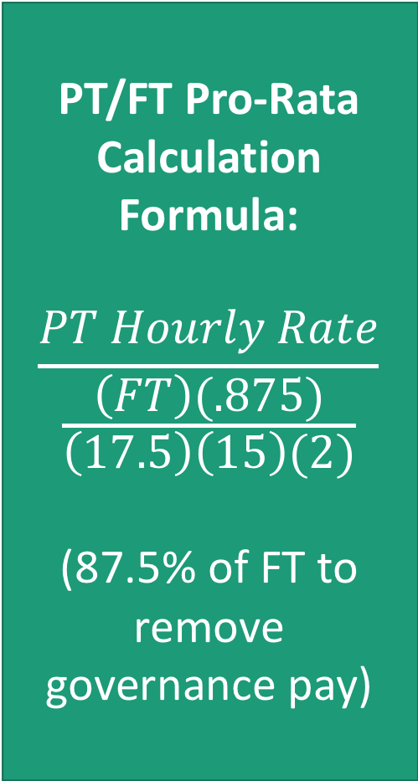
Cabrillo's Pro-Rata Ranking
Background
(per CFT and contracts)
All full-time salaries include office-hour and governance pay, usually specified in contracts as 12.5% each.
Some part-time rates include office-hour pay. Some districts instead pay extra for 1-2 hours at a flat rate (usually $20–50/hr), very few pay on an instructional schedule, a few on a non-instructional (lab) schedule. 20 districts pay nothing. Many districts require at least 40% load for any office-hour pay.
I increased PT rates at other districts to include per-unit compensation at maximum PT load for required office hours, i.e. to opt for highest hourly rates in other districts.
CFT data compares several PT rates at one step lower than FT rates, lowering the actual ratio.
PT/FT Pro-Rata Calculation Formula:
$$\frac{PT Hourly Rate}{\frac{\left(FT\right)(.875)}{\left(17.5\right)\left(15\right)(2)}}$$
(87.5% of FT to remove governance pay)

Slide 9
Cabrillo's Pro-Rata Ranking (1 is highest, 72 is lowest)
Average Pro-Rata Ranking:
15/72
79th percentile
(lower first quartile)
Master's Degree, Step 1: 21/72 → 71st percentile
Master's Degree, Step 5(PT)/6(FT)*: 16/72 → 78th percentile
Master's Degree + 30 units, Step 10(PT)/11(FT)*: 10/72 → 86th percentile
Maximum With PhD: 13/72 → 82nd percentile
*Ratios are slightly lower than actual, due to CFT's use of different steps.

Slide 10
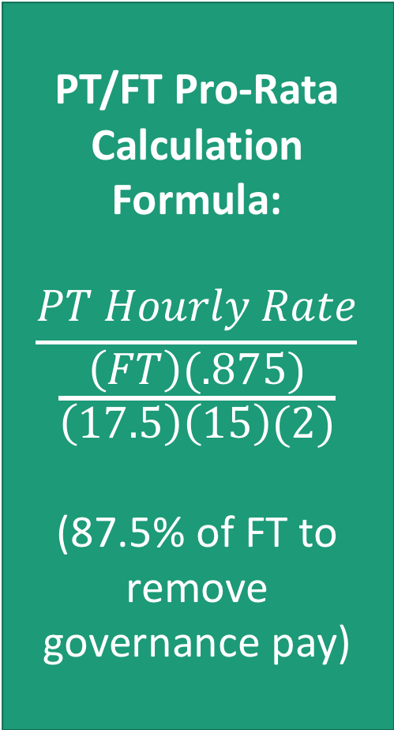
Cabrillo 2017–2018 Pro Rata
Cabrillo PT/FT Pro Rata 2017–2018
Step↓ / Class→ | 1 | 2 | 3 | 4 | 5 | 6
1 | 74.69% | 74.68% | 74.72% | 74.70% | 74.68% | 74.72%
2 | 74.68% | 74.69% | 74.70% | 74.70% | 74.71% | 74.72%
3 | 74.69% | 74.70% | 74.70% | 74.71% | 74.71% | 74.72%
4 | 74.70% | 74.70% | 74.71% | 74.71% | 74.72% | 74.68%
5 | 74.70% | 74.71% | 74.71% | 74.72% | 74.67% | 74.68%
6 | 74.71% | 74.71% | 74.72% | 74.72% | 74.68% | 74.69%
7 | 74.71% | 74.72% | 74.68% | 74.68% | 74.69% | 74.69%
8 | 74.72% | 74.68% | 74.68% | 74.69% | 74.69% | 74.70%
9 | 74.68% | 74.69% | 74.69% | 74.69% | 74.69% | 74.70%
10 | 74.68% | 74.69% | 74.69% | 74.70% | 74.70% | 74.71%
11 | 74.68% | 74.69% | 74.69% | 74.71% | 74.69% | 74.71%
12 | 74.68% | 74.69% | 74.69% | 74.68% | 74.71% | 74.71%
PT/FT Pro-Rata Calculation Formula:
$$\frac{PT Hourly Rate}{\frac{\left(FT\right)(.875)}{\left(17.5\right)\left(15\right)(2)}}$$
(87.5% of FT to remove governance pay)

Slide 11
Comparative Rankings, Cabrillo College, 2016-2017
Average FT Ranking:
51/72
29th percentile
(lower third quartile)
Average PT Ranking:
16/72
78th percentile
(lower first quartile)
Average Pro-Rata Ranking:
15/72
79th percentile
(lower first quartile)

Slide 12
Average FT Ranking:
51/72
29th percentile
(lower third quartile)
Average PT Ranking:
16/72
78th percentile
(lower first quartile)
Average Pro-Rata Ranking:
15/72
79th percentile
(lower first quartile)
If we dedicate funds toward further increasing PT/FT pro rata:
Cabrillo part-time rates move higher in the first quartile in both overall pay and pro rata, toward the top 15% of districts.
We actively compete with some of the highest-funded districts in the state for highest PT rates and highest pro rata.
FT ranking decreases, lower into the third or fourth quartile; we voluntarily aim toward lowest-paid district for full-time teaching career WRT cost of living.

Slide 13
From Jo-Ann Panzardi, Engineering Chair
I am speaking on behalf for the newer hired full-time faculty, (not for me as a long time faculty).....
The f-t salary is causing newer full-time faculty to leave ... Damian and Joe in Math; Beth in Anthro
I fully support all the salary increase to go to newer full-time faculty.
Or, if this is too non-conventional, I support the full amount going to full-time faculty in the hopes that this will supoprt [sic] us keeping newer faculty and enticing new faculty recruits.
You can voice my concern that we need to attract new faculty and keep new faculty, so my support is to pay any full-time faculty hired in the last ten years more.

