Slide 1
Pairs Trading
Evaluation of Selection Methods
Jeff Darling
Willy Lai

Slide 2
What is pairs trading?

Slide 3
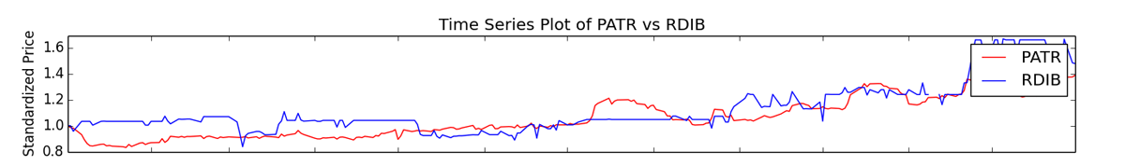
Brief Overview of Pairs Trading
Pairs trading is a method of trading two stocks with related prices. When one stock outperforms the other, you sell the higher stock and buy the lower stock, betting on a reversion to mean.
Begin Trade
End Trade

Slide 4
How do you select stocks?
There are several widely used methods to select stocks to pairs trade: Correlation, Distance, and Cointegration.
Anecdotally, the stocks should be related in some known fashion. A traditional example is Coke and Pepsi.
Our research attempts to answer two questions:
Which method has the best predictive value?
Is it important to know that the two stocks are related beyond numerical tests?
We evaluate the “best” 5 pairs for each method, and then plot the top 100.
Training Data: 2011-2012 NASDAQ
Test Data: 2013 NASDAQ

Slide 5
Correlation

Slide 6
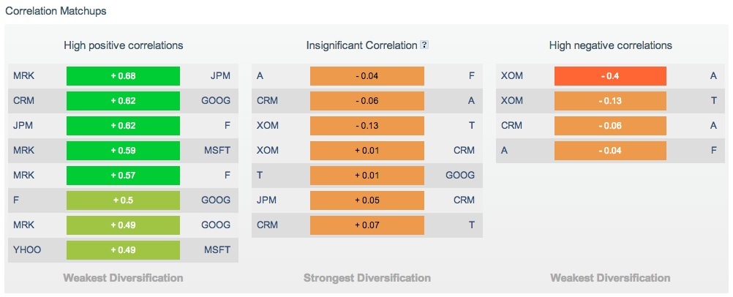
Websites Make It Easy
But what is the value of this correlation info?

Slide 7
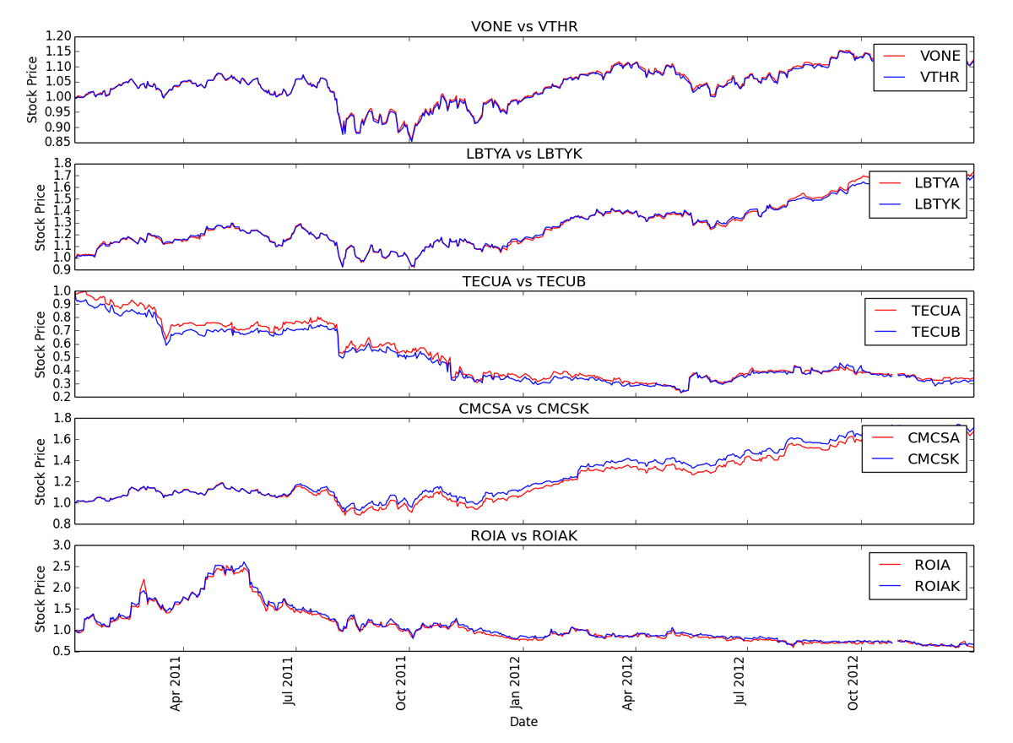
Training Data: Five most correlated stocks

Slide 8
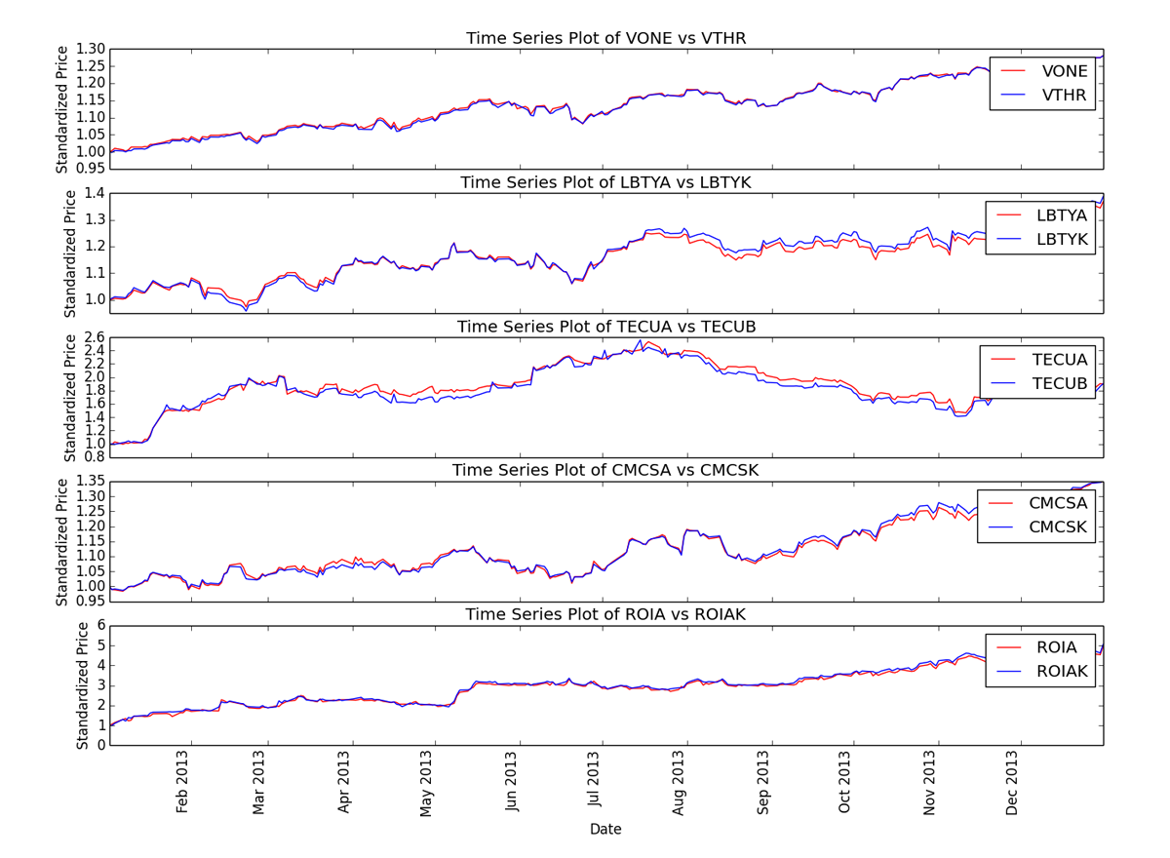
Test Data: Higher spread as test window lengthens

Slide 9
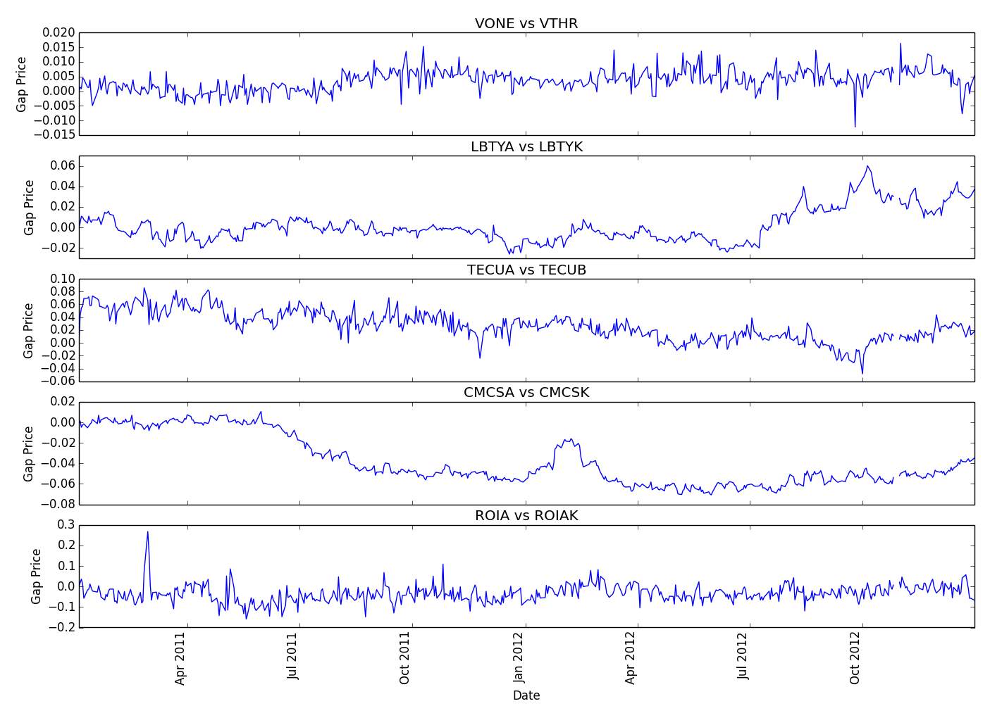
Training Data: No/Small trends in price differential

Slide 10
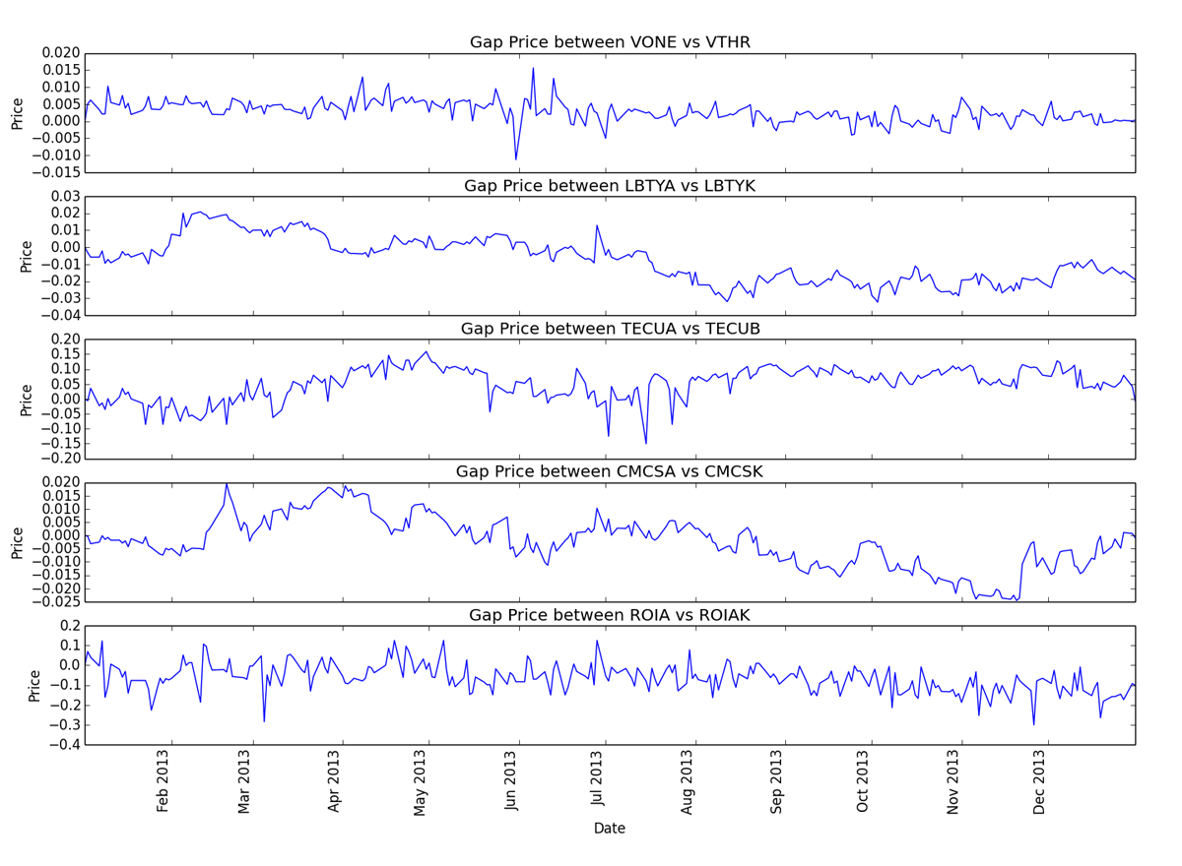
Test Data: No/Small trends in price differential

Slide 11
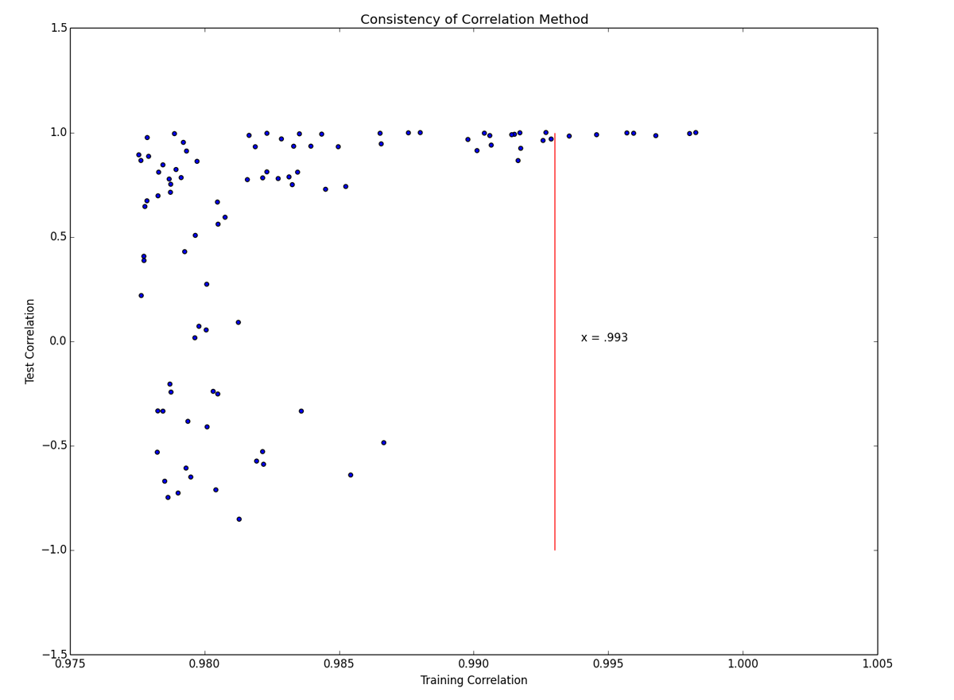
Correlation Training vs Test: Highly heteroscedastic – danger!

Slide 12
Least sum-squares

Slide 13
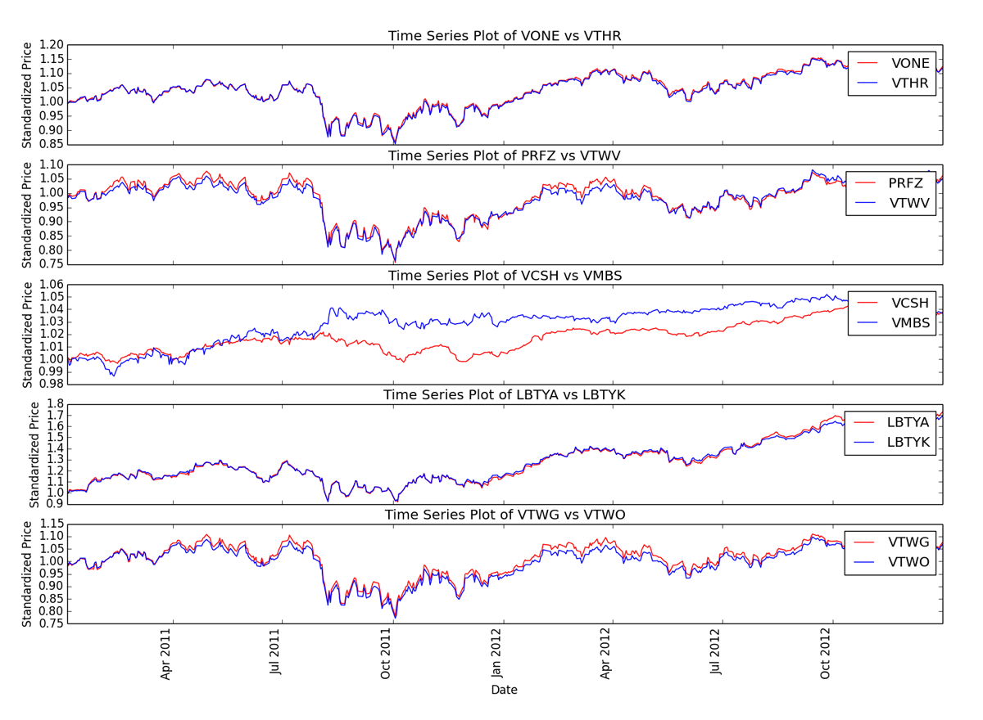
Training Data: Five smallest sum-square distance pairs

Slide 14
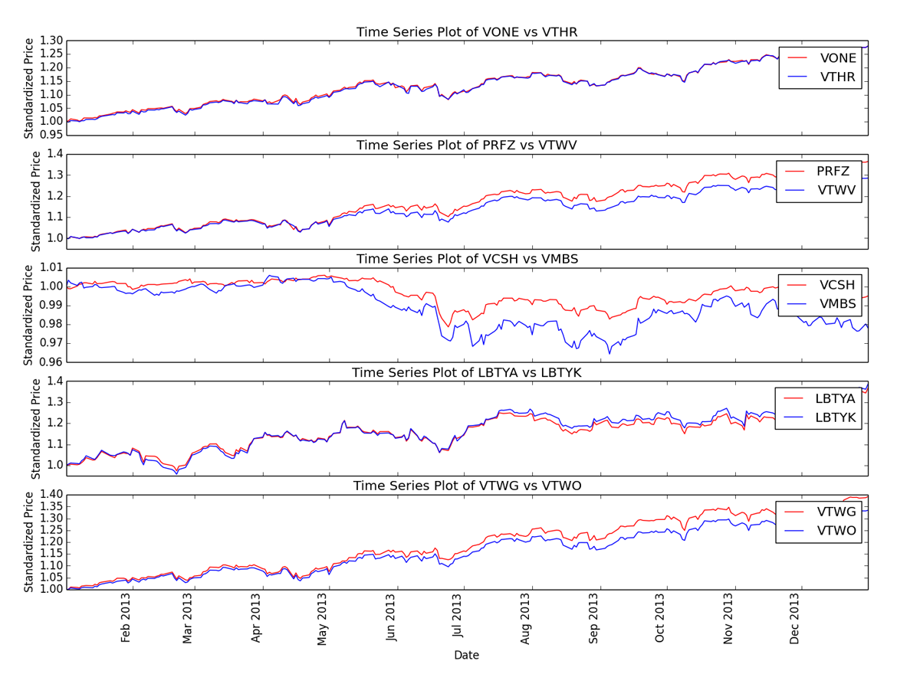
Test Data: Much larger deviation as time passes

Slide 15
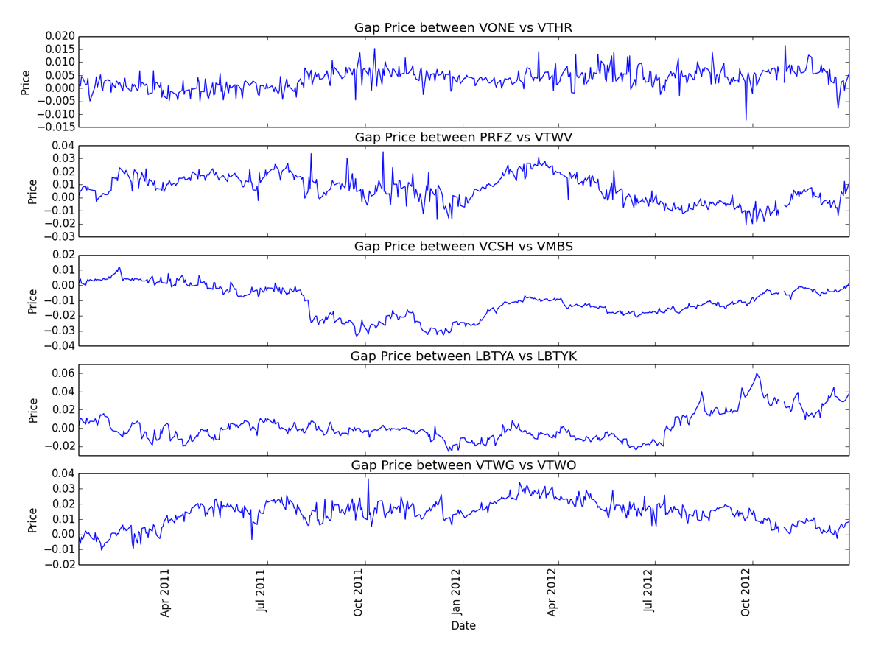
Training Data: No/Small trends in price differential

Slide 16
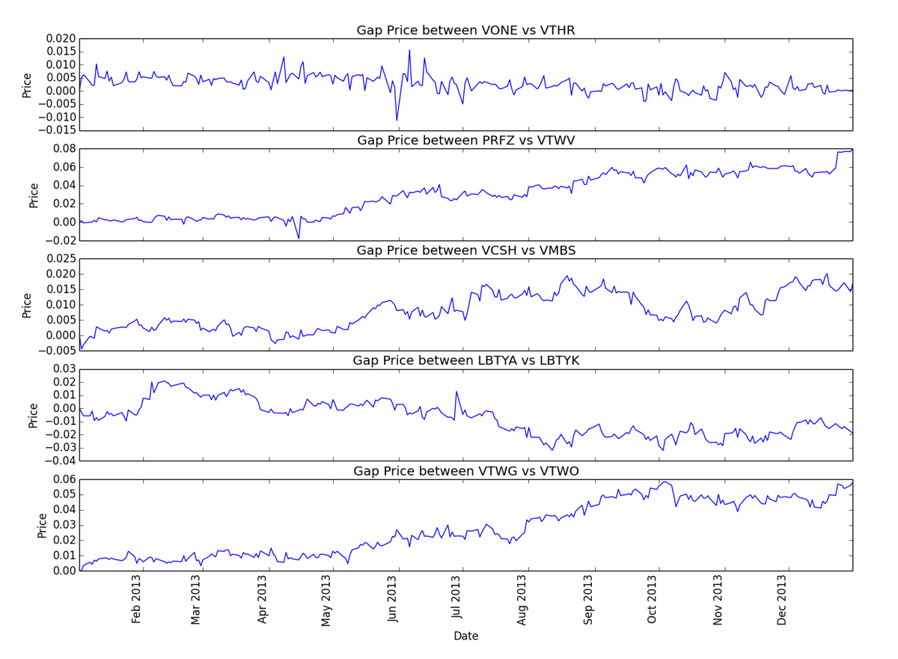
Training Data: Much larger trends in price differential

Slide 17
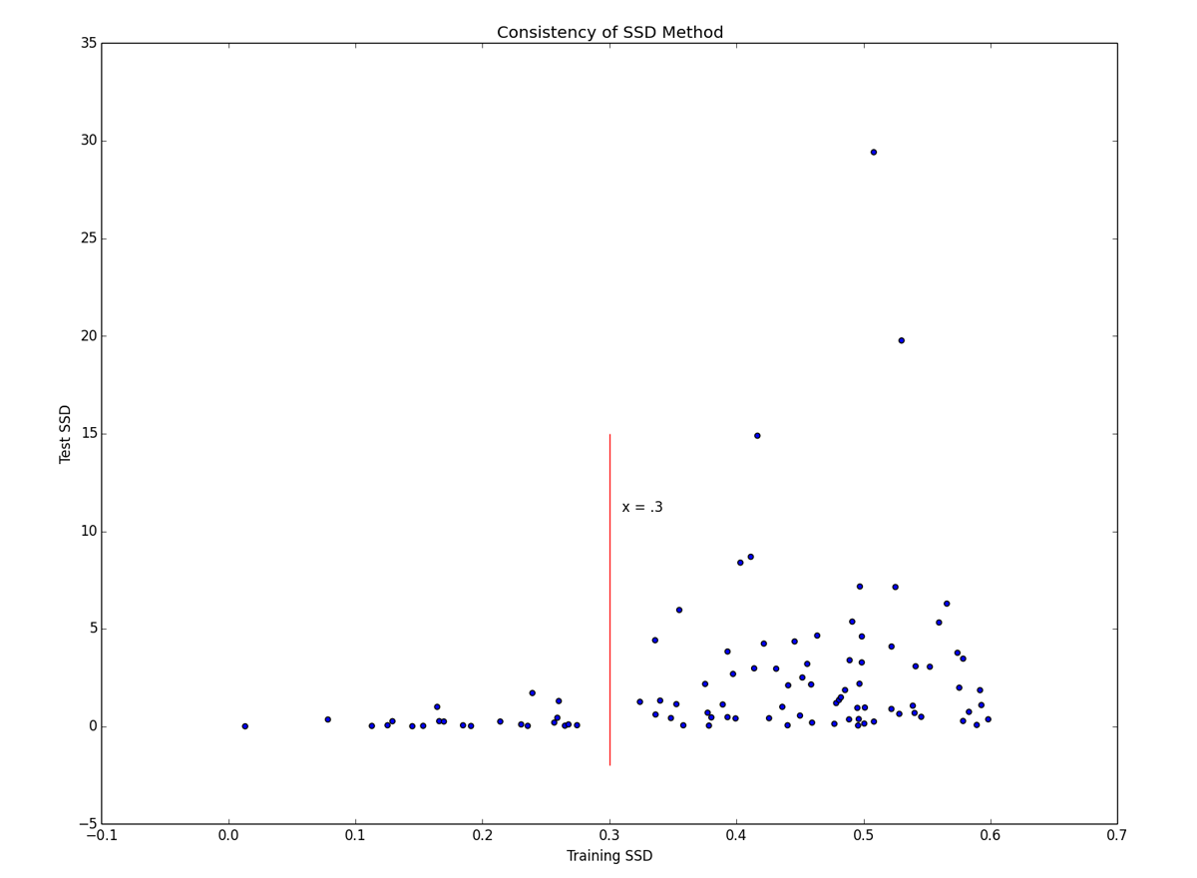
Distance Training vs Test: Highly heteroscedastic – danger!

Slide 18
Cointegration
An approachable explanation of cointegration can be found here:
http://www.uta.edu/faculty/crowder/papers/drunk%20and%20dog.pdf

Slide 19
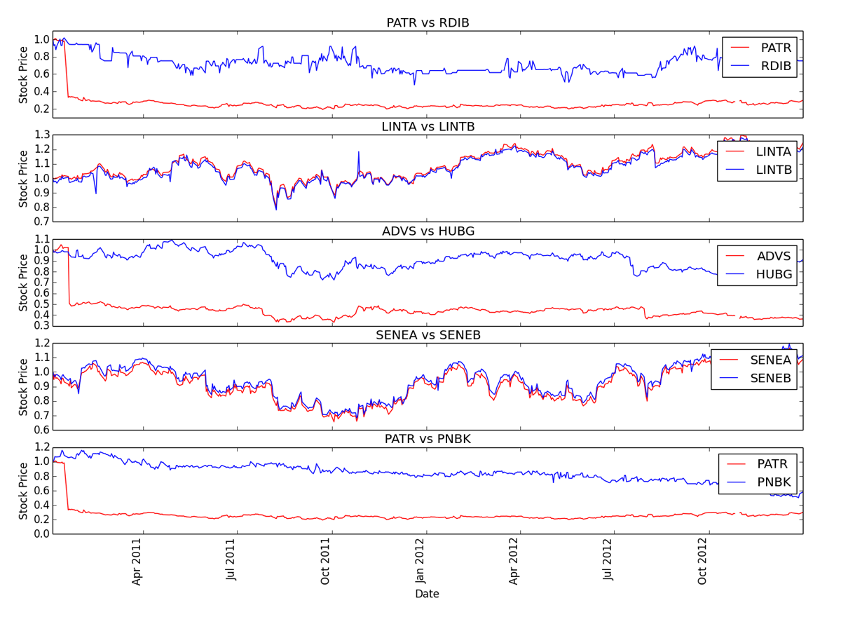
Training Data: Five smallest cointegration p-values

Slide 20
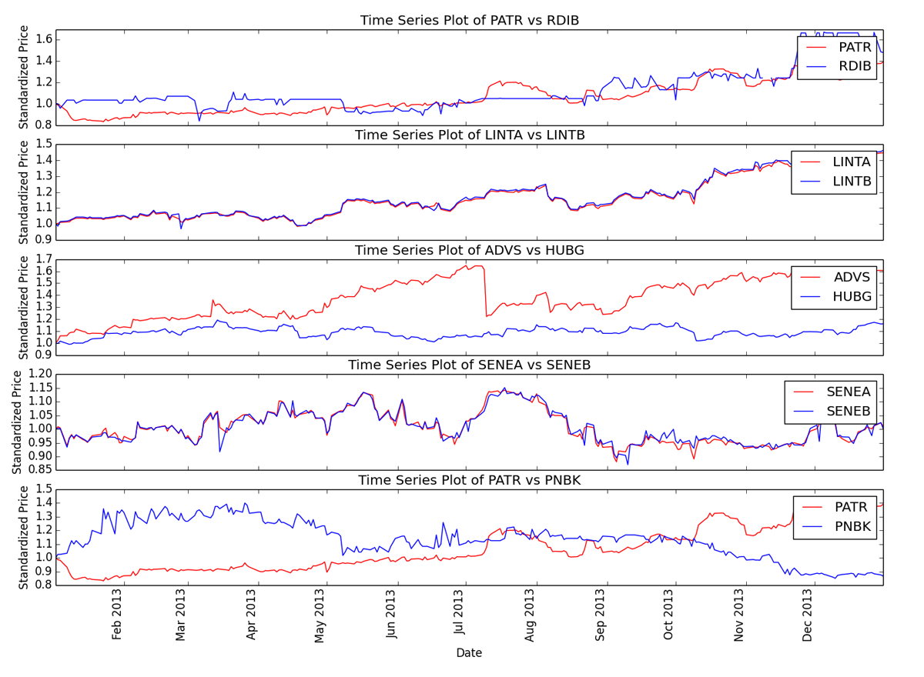
Test Data: Related stocks maintain their relationship
Note: related stocks

Slide 21
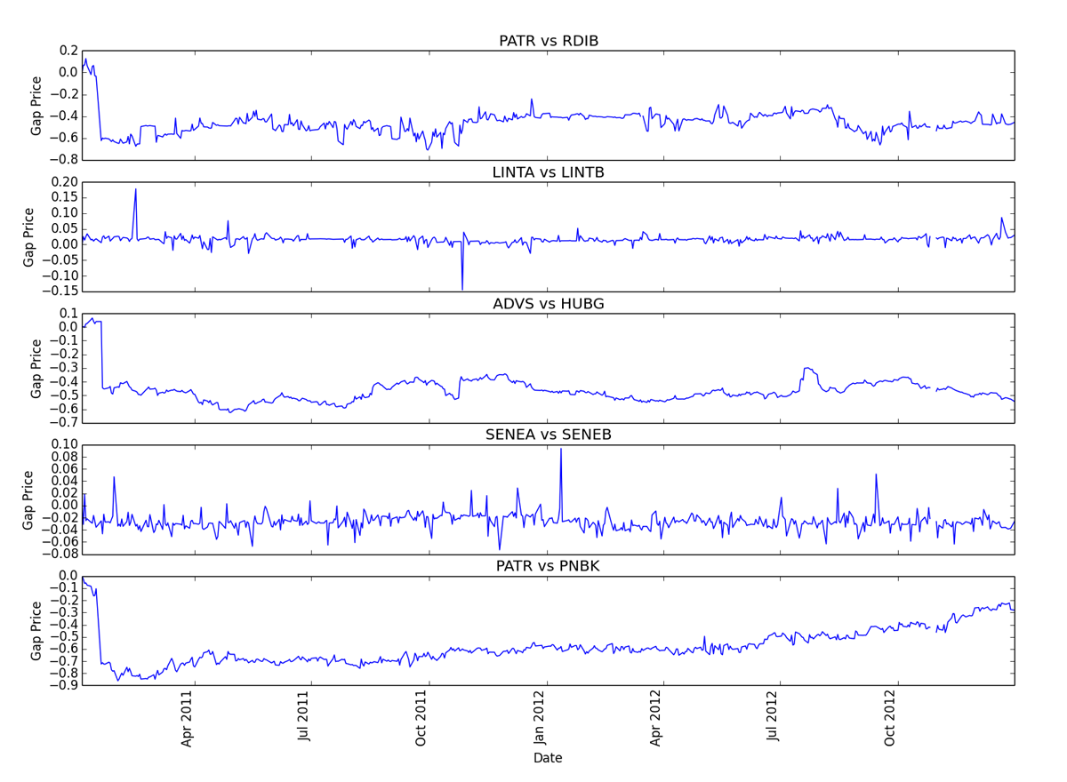
Training Data: Some almost zero slope!

Slide 22
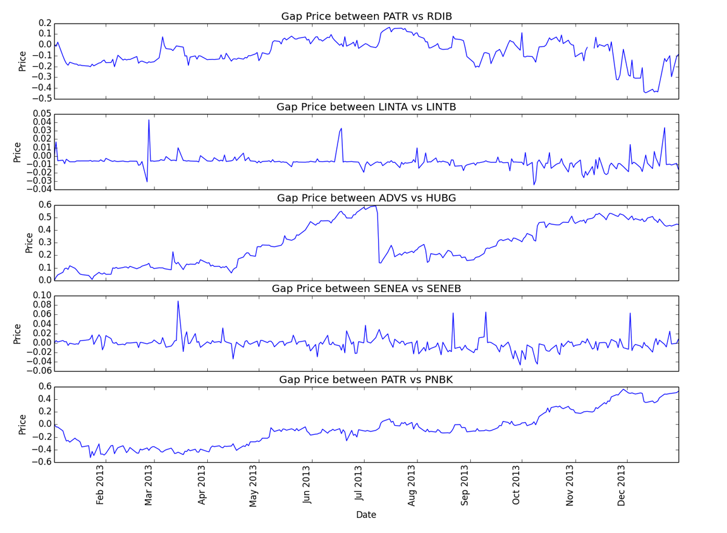
Training Data: Much larger deviation in price differential

Slide 23
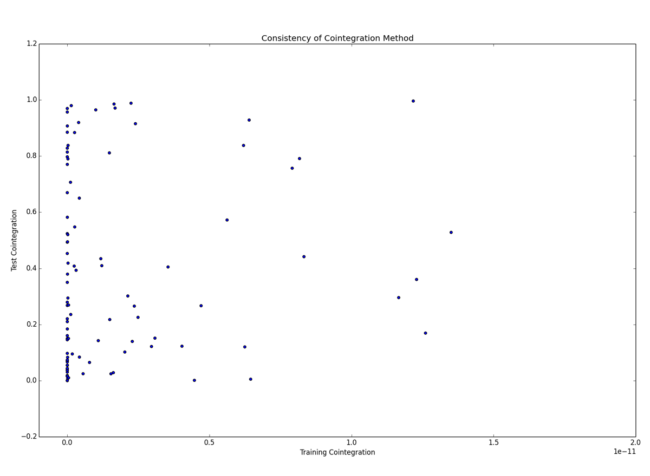
Distance Training vs Test: Overall, no useful relationship

Slide 24
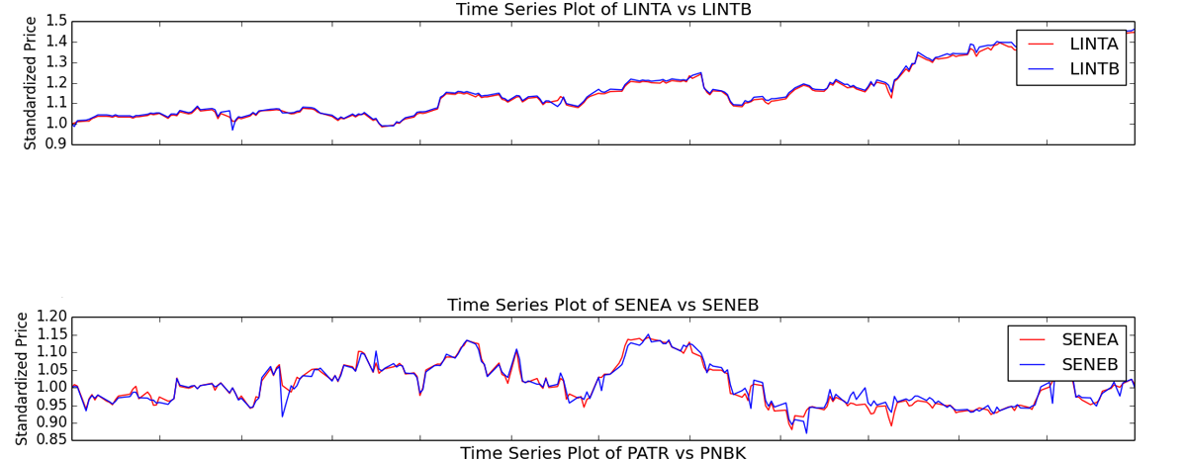
Test Data: Related stocks had lowest p-value
Of the pairs with the smallest five p-values on the training data, the two closely related pairs had the smallest test data p-values. None of the other five tested significant.
LINTA vs LINTB: 1.23e-26
SENEA vs SENEB: 1.25e-08

