Slide 1
Pairs Trading
Evaluation of Selection Methods
Jeff Darling
Willy Lai

Slide 2
Correlation

Slide 3
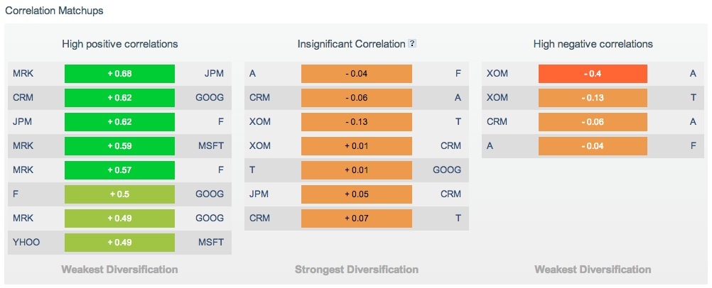
Websites Make It Easy
But what is the value of this correlation info?

Slide 4
Least sum-squares

Slide 5
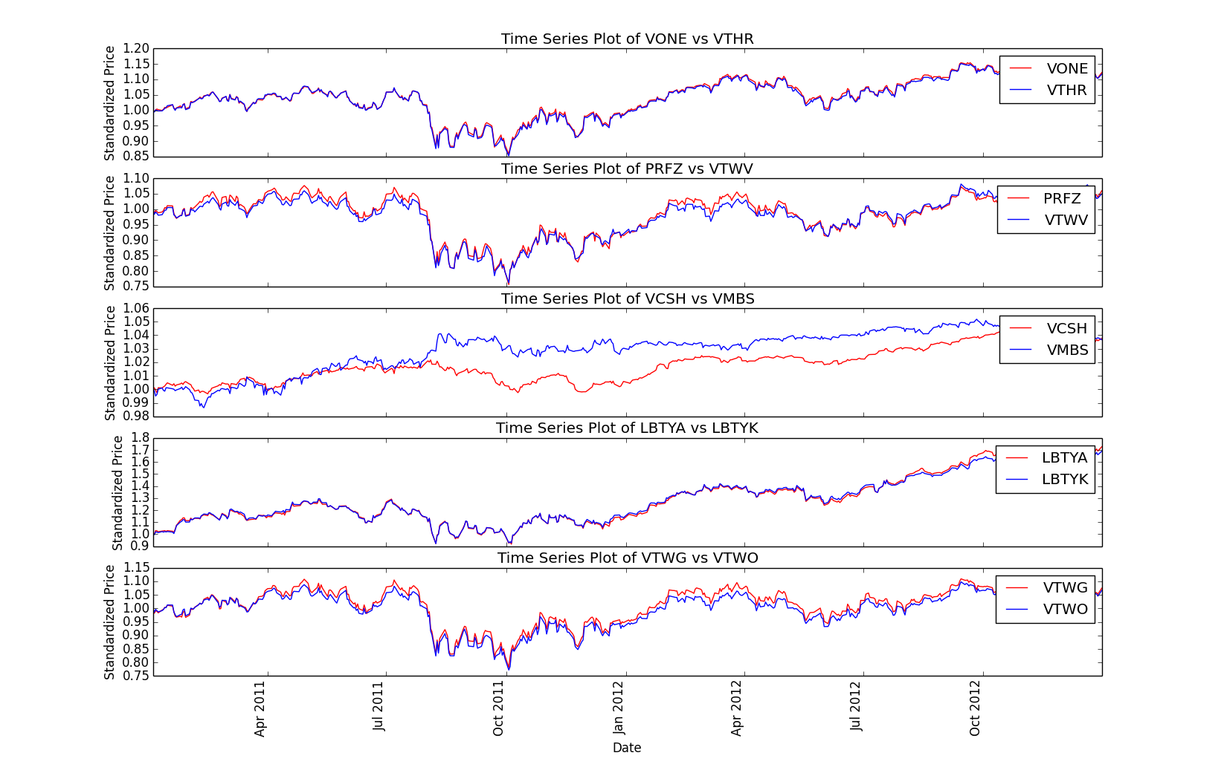
Training Data Min. Distance

