Slide 1
Pairs Trading
Evaluation of Selection Methods
Jeff Darling
Willy Lai

Slide 2
What is pairs trading?

Slide 3
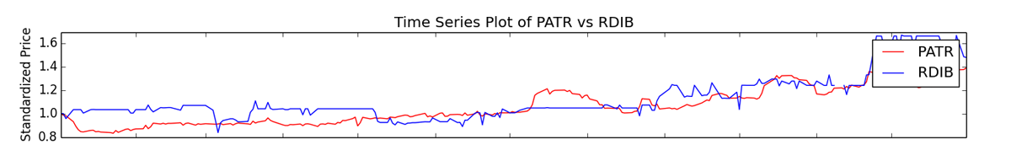
Brief Overview of Pairs Trading
Pairs trading is a method of trading two stocks with related prices. When one stock outperforms the other, you sell the higher stock and buy the lower stock, betting on a reversion to mean.
Begin Trade
End Trade
Notes:
Pairs trading is a method of trading two stocks with related prices. When one stock outperforms the other, you sell the higher stock and buy the lower stock, betting on a reversion to mean.
Show example plot.

Slide 4
How do you select stocks?
There are several widely used methods to select stocks to pairs trade: Correlation, Distance, and Cointegration.
Anecdotally, the stocks should be related in some known fashion. A traditional example is Coke and Pepsi.
Our research attempts to answer two questions:
Which method has the best predictive value?
Is it important to know that the two stocks are related beyond numerical tests?
We evaluate the “best” 5 pairs for each method, and then plot the top 100.
Training Data: 2011-2012 NASDAQ
Test Data: 2013 NASDAQ
Notes:
There are several widely used methods to select stocks to pairs trade: Correlation, Distance, and Cointegration.
Anecdotally, the stocks should be related in some known fashion. A traditional example is Coke and Pepsi.
Our research attempts to answer two questions:
Which method has the best predictive value?
Is it important to know that the two stocks are related beyond numerical tests?
We evaluate the “best” 5 pairs for each method, and then plot the top 100.
Training Data: 2011-2012 NASDAQ
Test Data: 2013 NASDAQ

Slide 5
Correlation

Slide 6
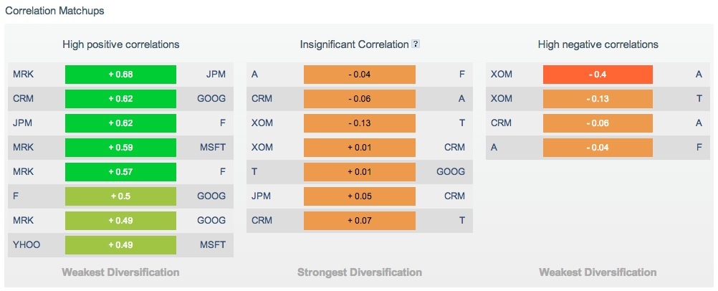
Websites Make It Easy
But what is the value of this correlation info?

Slide 7
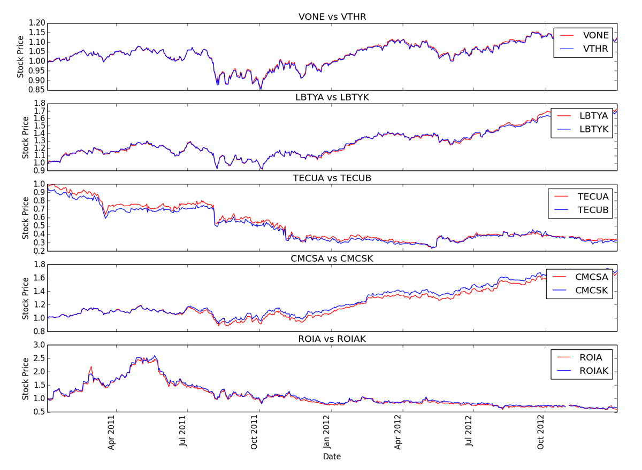
Training Data: Five most correlated stocks

Slide 8
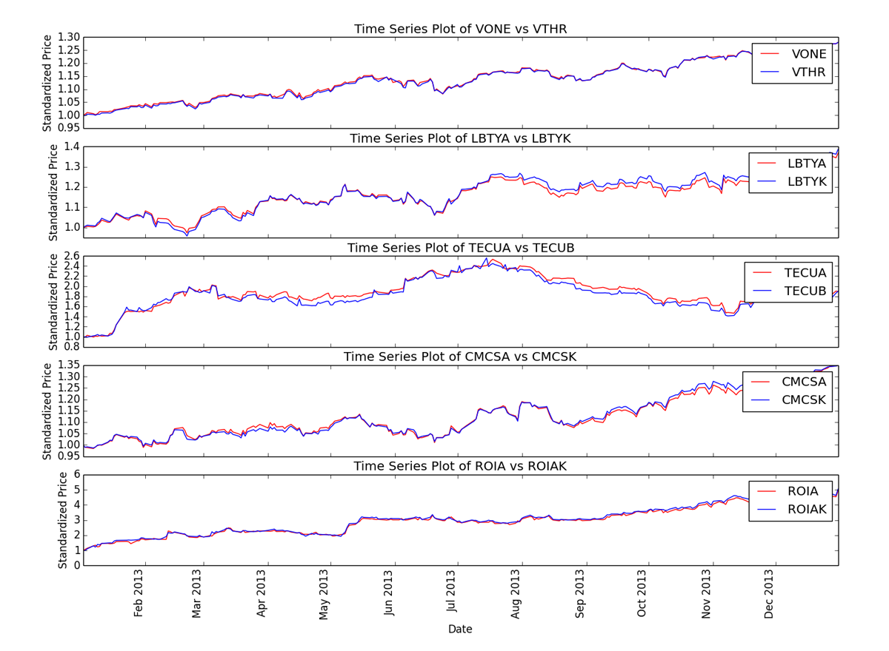
Test Data: Higher spread as test window lengthens

Slide 9
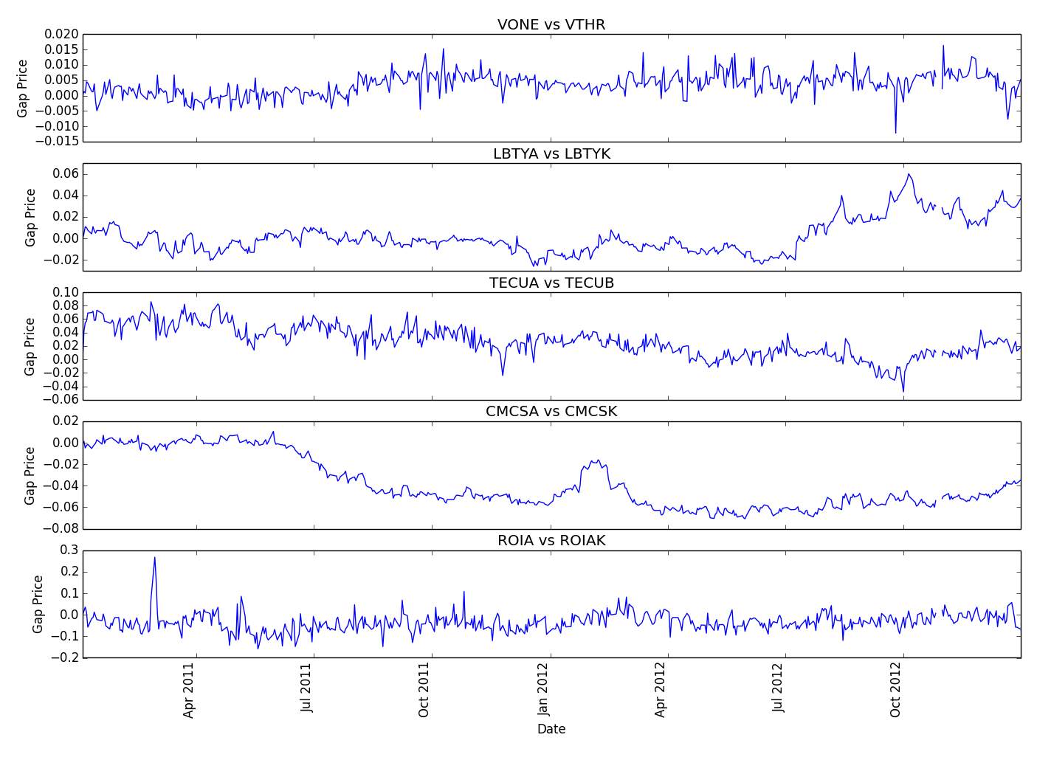
Training Data: No/Small trends in price differential

Slide 10
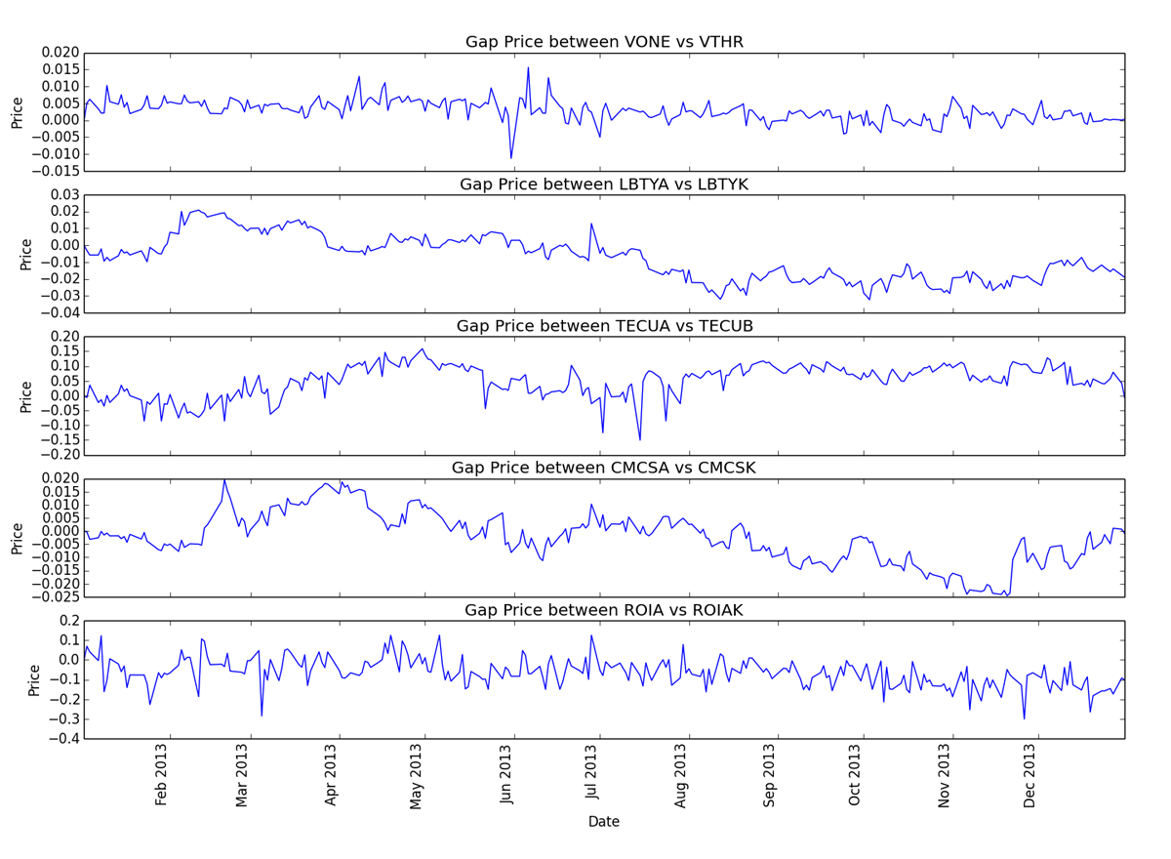
Test Data: No/Small trends in price differential

Slide 11
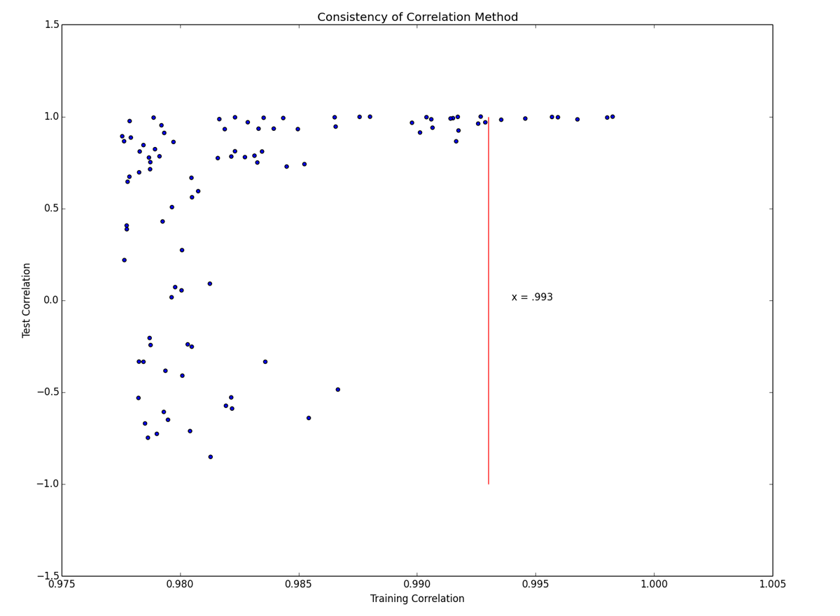
Correlation Training vs Test: Highly heteroscedastic – danger!

Slide 12
Least sum-squares

Slide 13
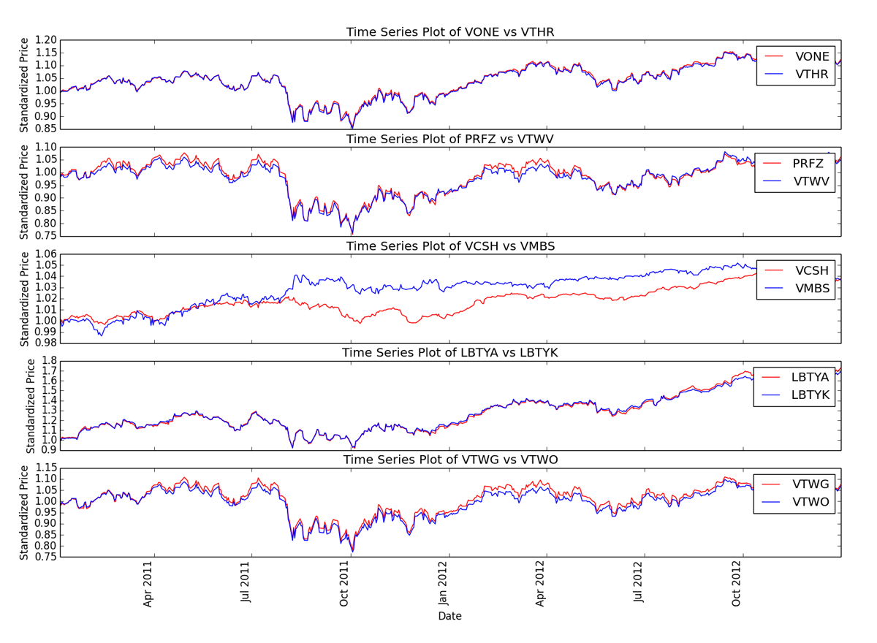
Training Data: Five smallest sum-square distance pairs

Slide 14
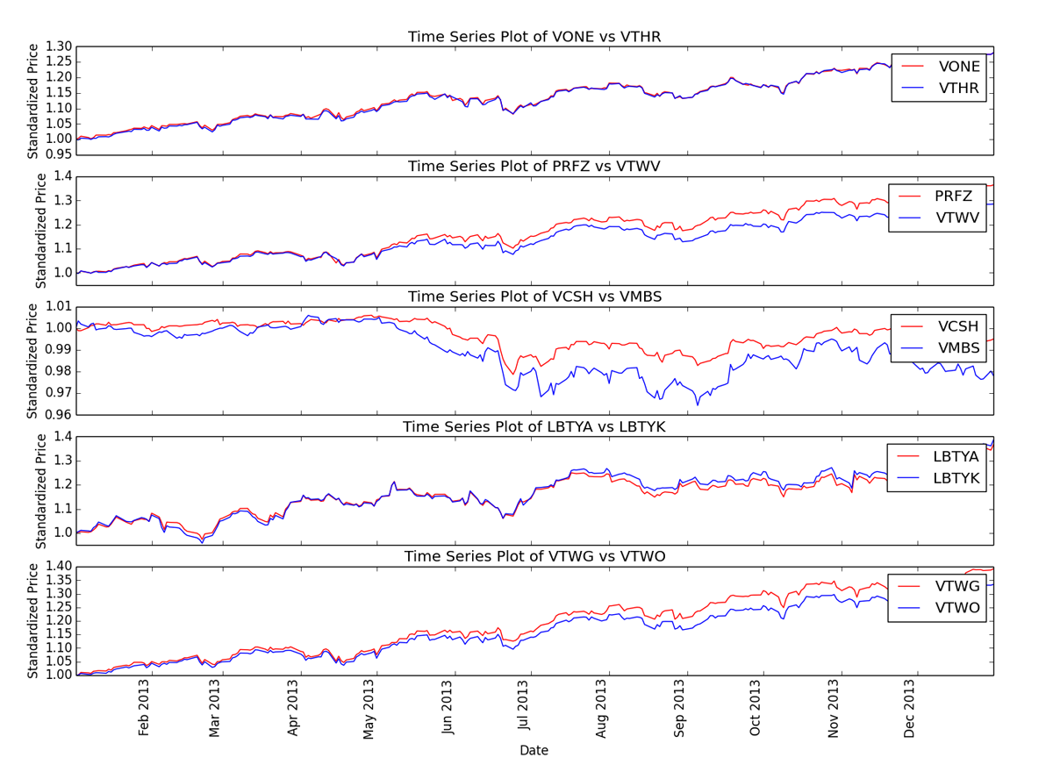
Test Data: Much larger deviation as time passes

Slide 15
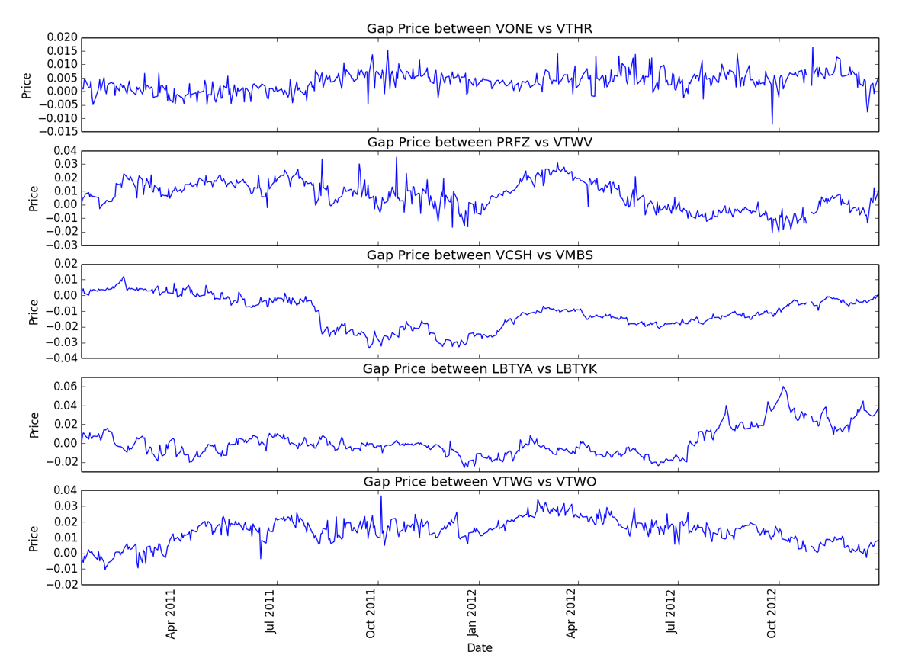
Training Data: No/Small trends in price differential

Slide 16
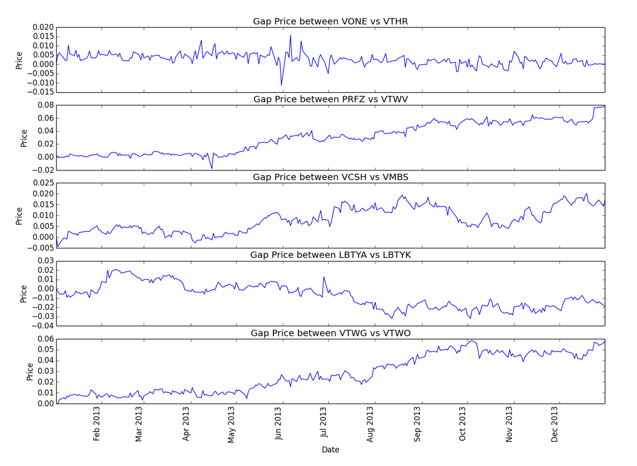
Training Data: Much larger trends in price differential

Slide 17
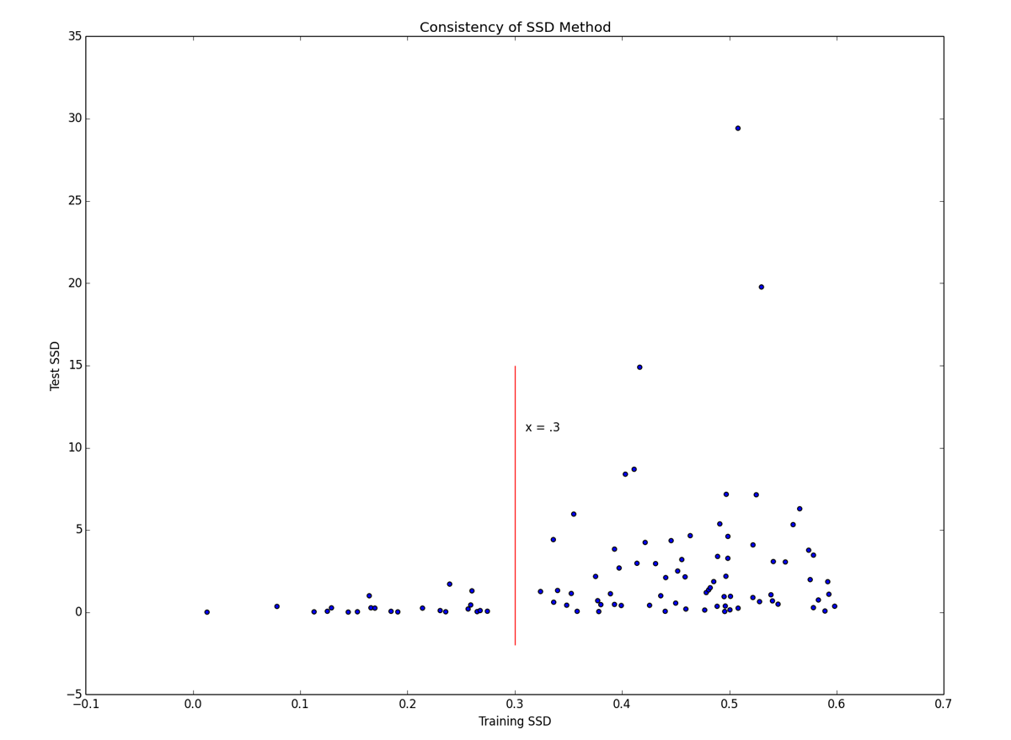
Distance Training vs Test: Highly heteroscedastic – danger!

Slide 18
Cointegration
An approachable explanation of cointegration can be found here:
http://www.uta.edu/faculty/crowder/papers/drunk%20and%20dog.pdf
Notes:
A classic example of cointegration is two constrained random walks. For example, a drunk and their dog.
The drunk makes a random walk, while their dog is on a random walk around them but constrained by the length of the leash.

Slide 19
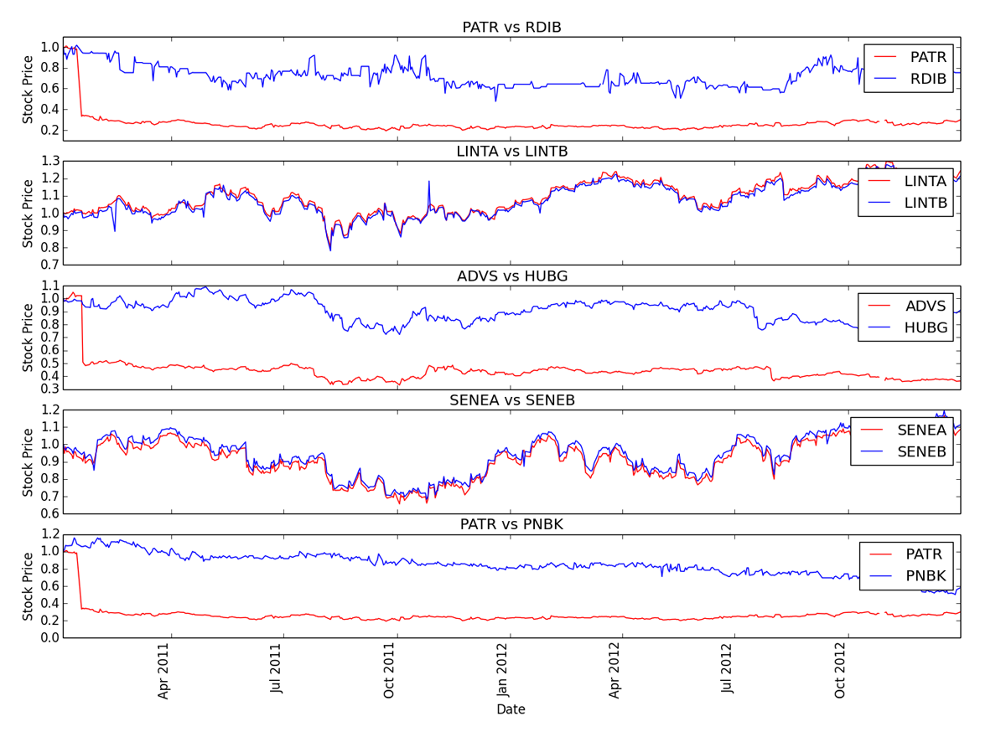
Training Data: Five smallest cointegration p-values
Notes:
These are the five stock pairs with the smallest p-values from the cointegration test
We can see that cointegration selects stocks differently than correlation and distance and does not rely on matched prices

Slide 20
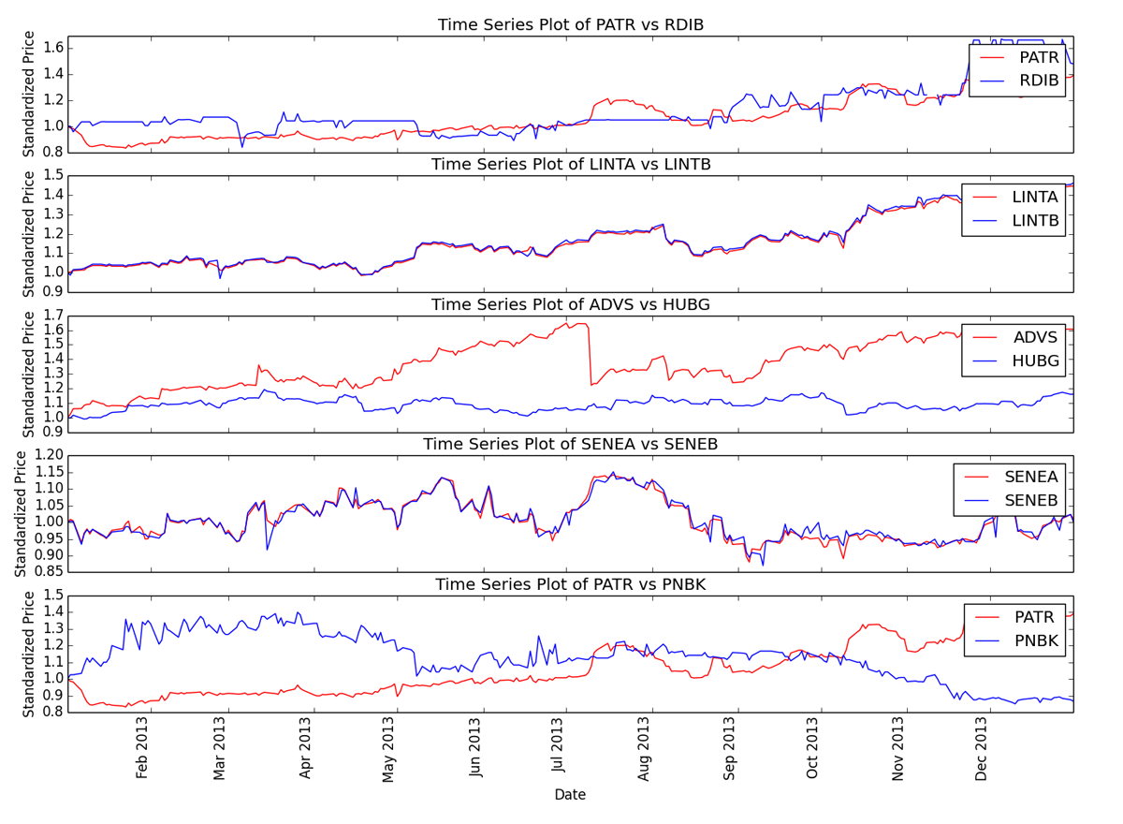
Test Data: Related stocks maintain their relationship
Note: related stocks
Notes:
The five pairs selected in the training data do not maintain cointegration in the test data. Only two of the five have significant p-values for cointegration.
These two pairs are A and B stocks, which are two classes of stock from the same company, so it is easy to see why they might better maintain a relationship.

Slide 21
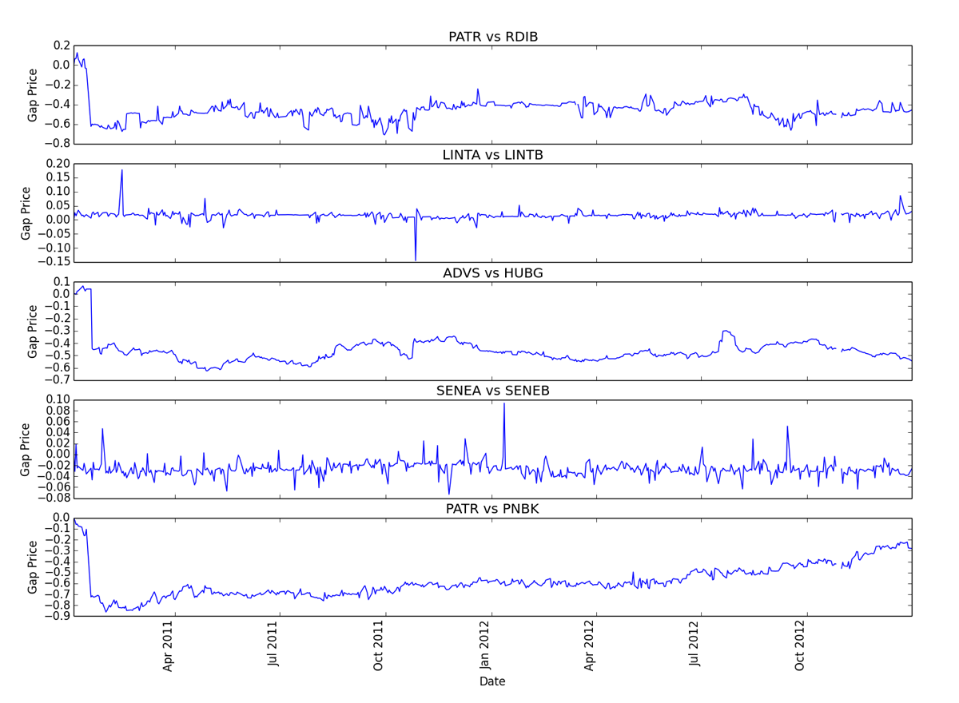
Training Data: Some almost zero slope!
Notes:
Cointegration testing on the training data does produce pairs with very even price differentials, but still with areas that could allow pairs trading.

Slide 22
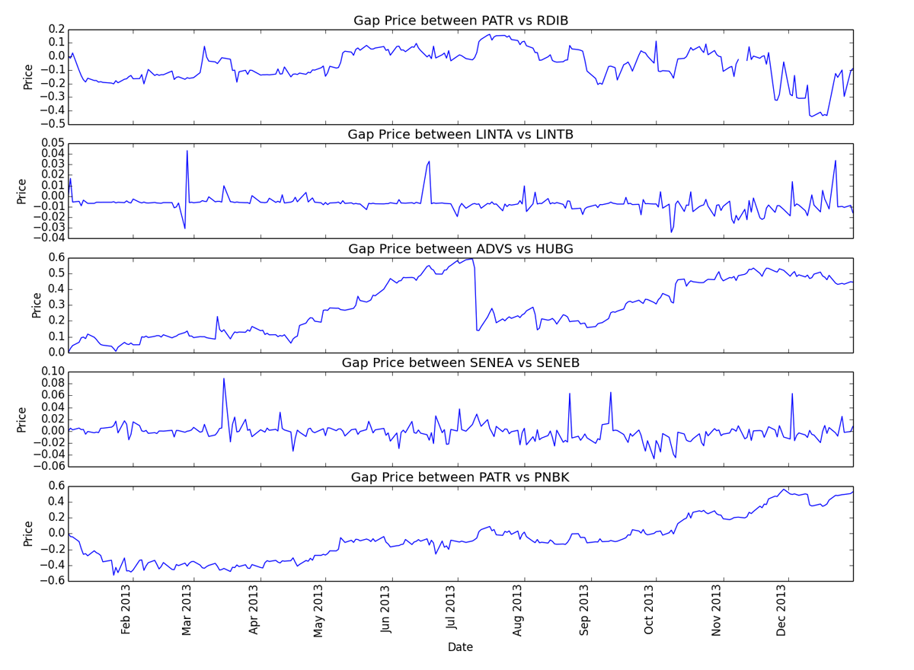
Training Data: Much larger deviation in price differential
Notes:
However, we can see that the test data does not maintain the flat slope – the pairs drift apart – except for the two pairs that are more strongly related.

Slide 23
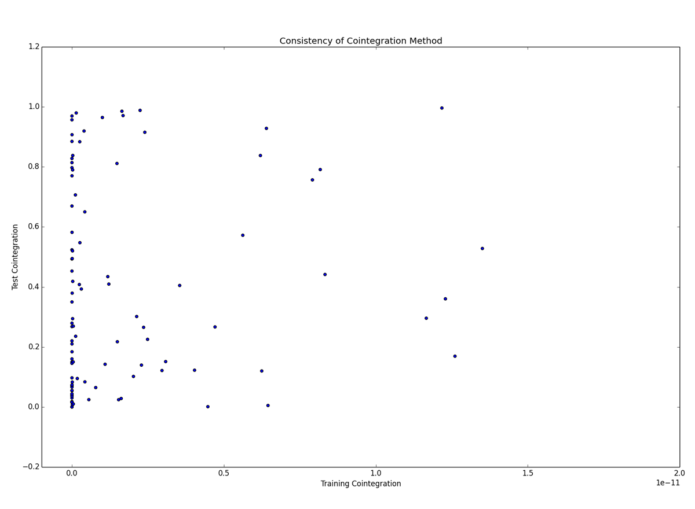
Distance Training vs Test: Overall, no useful relationship
Notes:
Note: the x-axis ranges from ~0 to 2e-11 – these are very small training p-values
Looking at a scatter plot of the p-values between training and test data, even minute training p-values are almost uniformly distributed between 0 and 1 – no relationship.

Slide 24
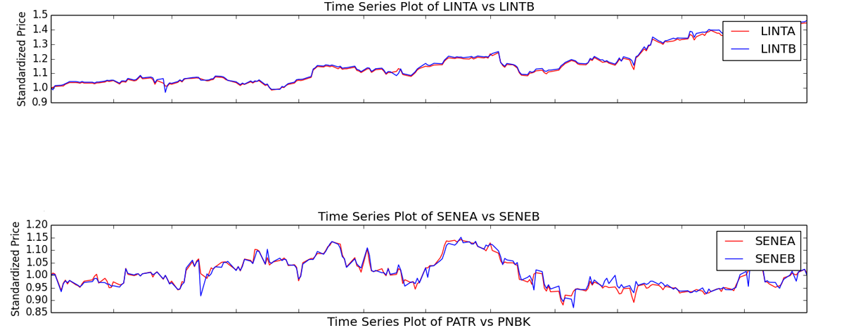
Test Data: Related stocks had lowest p-value
Of the pairs with the smallest five p-values on the training data, the two closely related pairs had the smallest test data p-values. None of the other five tested significant.
LINTA vs LINTB: 1.23e-26
SENEA vs SENEB: 1.25e-08
Notes:
The related stocks, however, still have significant p-values. It would be worth evaluating other related or A/B class stocks to see if they also behave in this way.

Slide 25
Conclusion

Slide 26
Summary of Methods
Correlation:
While correlation selected stocks that seemed to remain near, the scatter plot showed a dangerous variability in results.
Distance:
Of the three methods, distance performed the worst, with the largest movement away from the mean.
In addition, scatter plot shows dangerous variability in results.
Cointegration:
Overall, cointegration cannot be used to mine pairs to trade
However, there is some indication that related stock pairs selected by cointegration might outperform the other methods and be viable pairs to trade
Notes:
Correlation:
While correlation selected stocks that seemed to remain near, the scatter plot showed a dangerous variability in results.
Distance:
Of the three methods, distance performed the worst, with the largest movement away from the mean.
In addition, scatter plot shows dangerous variability in results.
Cointegration:
Overall, cointegration cannot be used to mine pairs to trade
However, there is some indication that related stock pairs selected by cointegration might outperform the other methods and be viable pairs to trade

Slide 27
Conclusion
Overall, there is no evidence to refute anecdotal advice to only evaluate stock pairs with a known relationship.
Suggest further evaluation of cointegration as a method of selecting related stock pairs.
Correlation and distance methods see larger spreads over time even for related stock pairs. Use of these methods is not recommended.
Notes:
Overall, there is no evidence to refute anecdotal advice to only evaluate stock pairs with a known relationship.
Suggest further evaluation of cointegration as a method of selecting related stock pairs.
Correlation and distance methods see larger spreads over time even for related stock pairs. Use of these methods is not recommended.

