Slide 1
Pairs Trading
Evaluation of Selection Methods
Jeff Darling
Willy Lai

Slide 2
What is pairs trading?

Slide 3
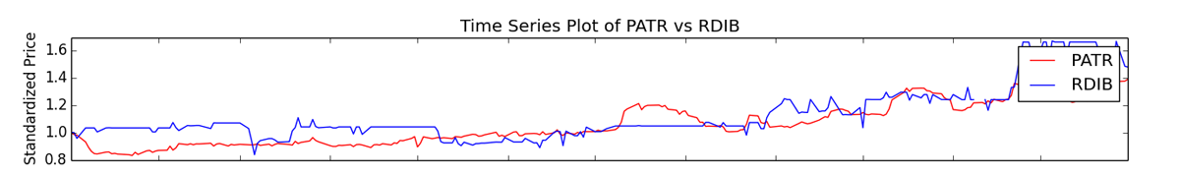
Brief Overview of Pairs Trading
Pairs trading is a method of trading two stocks with related prices. When one stock outperforms the other, you sell the higher stock and buy the lower stock, betting on a reversion to mean.
Begin Trade
End Trade

Slide 4
How do you select stocks?
There are several widely used methods to select stocks to pairs trade: Correlation, Distance, and Cointegration.
Anecdotally, the stocks should be related in some known fashion. A traditional example is Coke and Pepsi.
Our research attempts to answer two questions:
Which method has the best predictive value?
Is it important to know that the two stocks are related beyond numerical tests?
We evaluate the “best” 5 pairs for each method, and then plot the top 100.
Training Data: 2011-2012 NASDAQ
Test Data: 2013 NASDAQ

Slide 5
Correlation

Slide 6
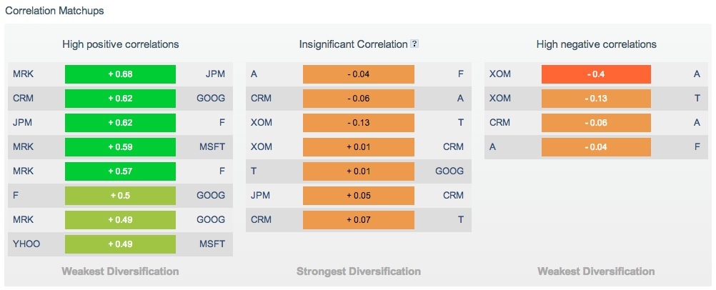
Websites Make It Easy
But what is the value of this correlation info?

Slide 7
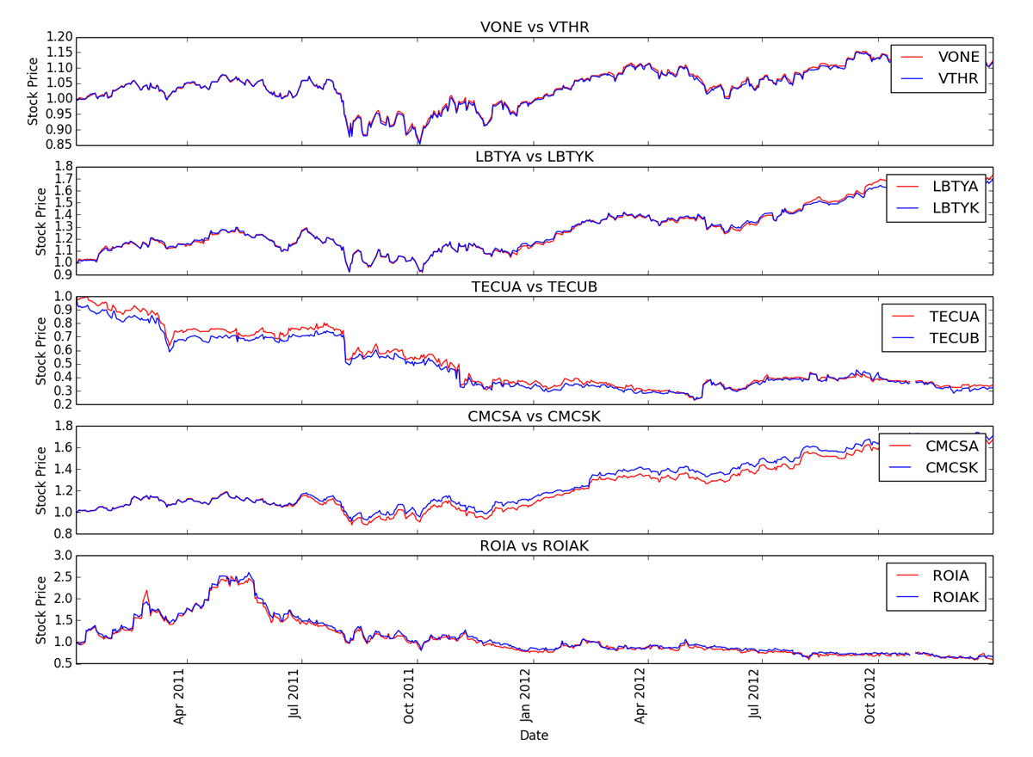
Training Data: Five most correlated stocks

Slide 8
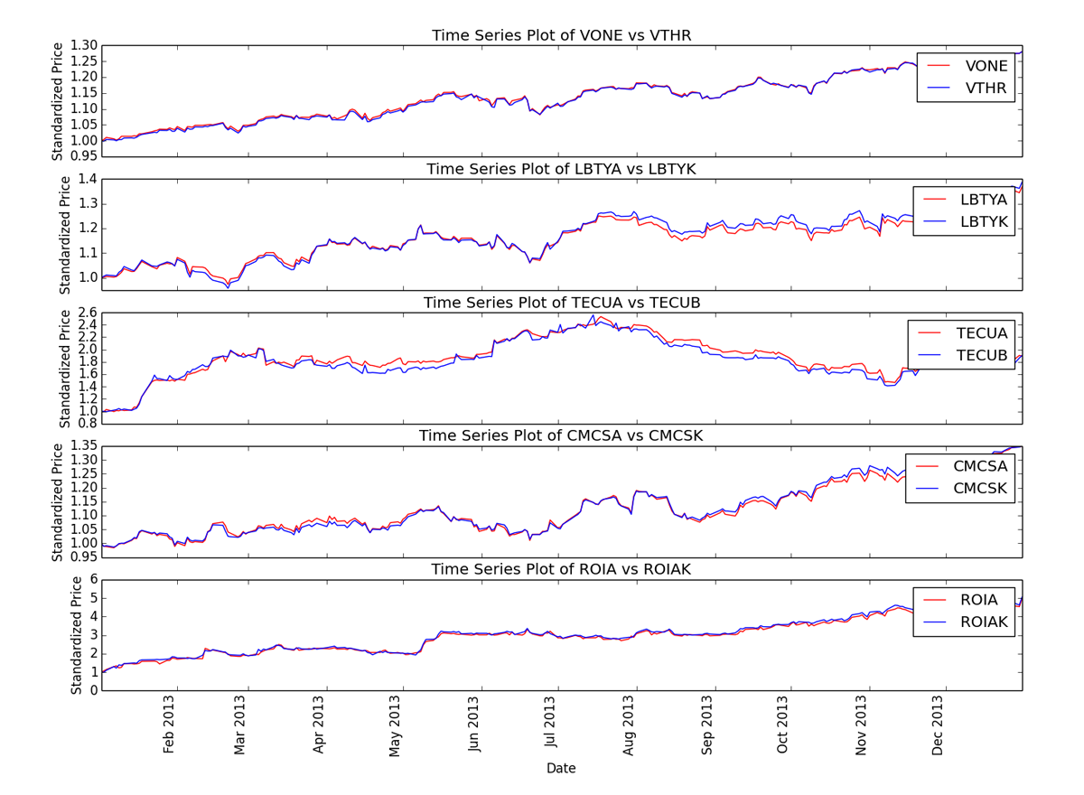
Test Data: Higher spread as test window lengthens

Slide 9
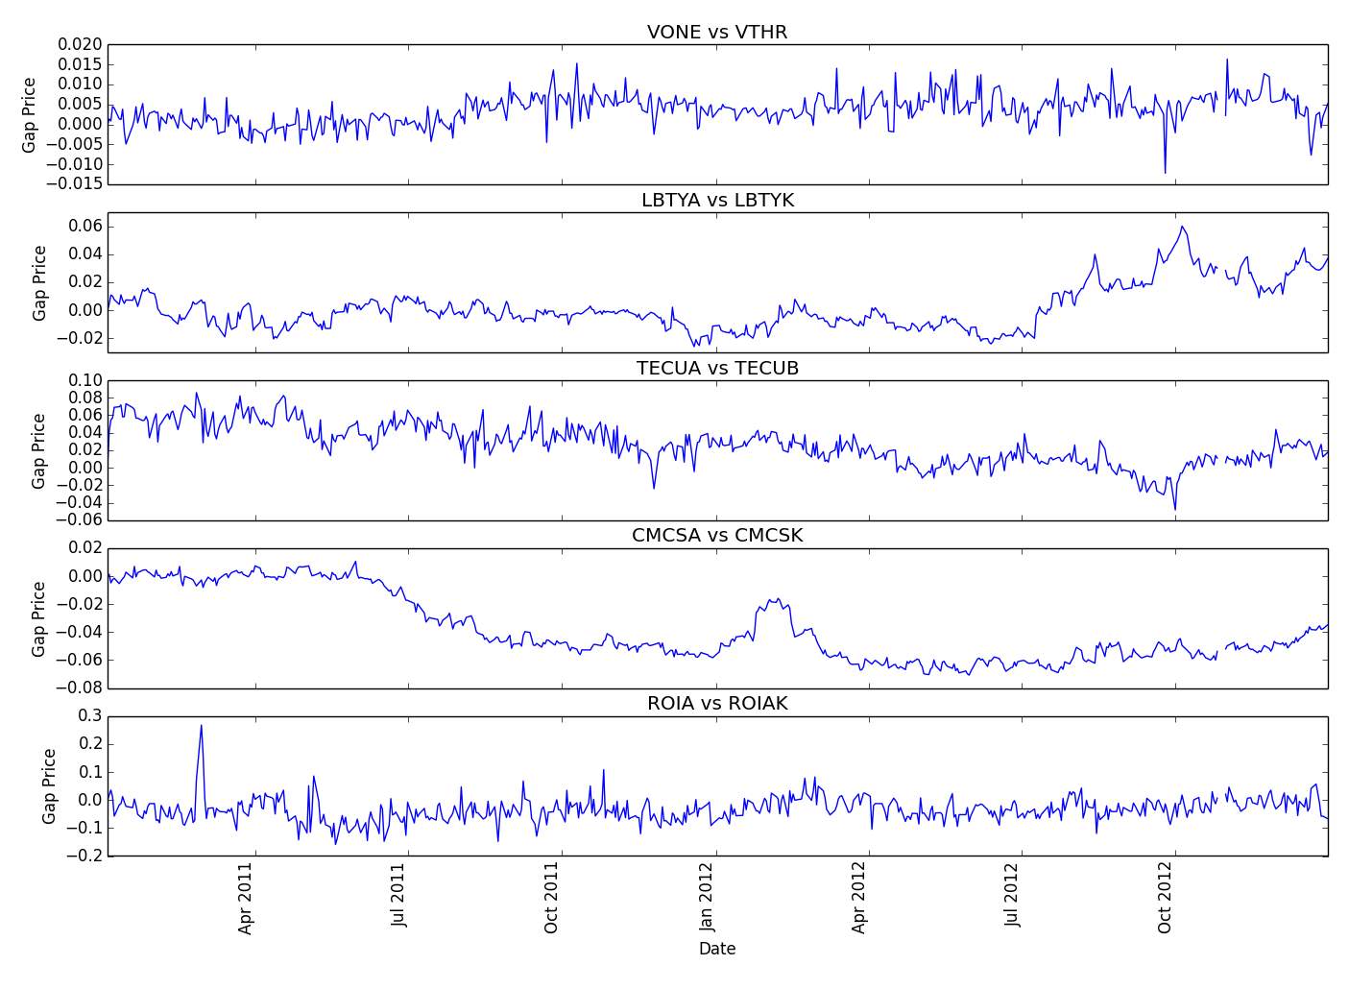
Training Data: No/Small trends in price differential

Slide 10
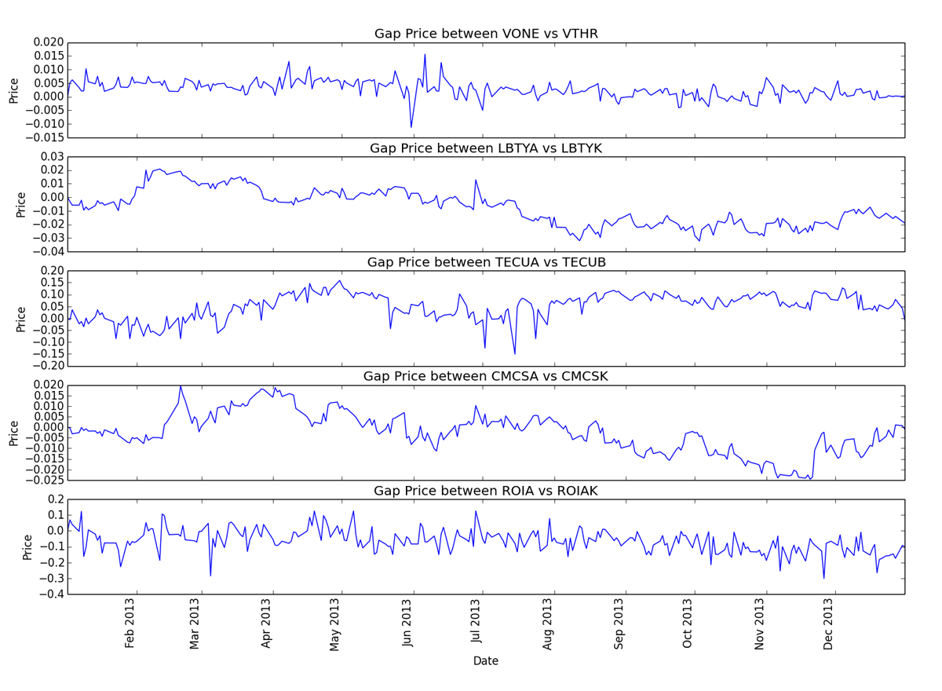
Test Data: No/Small trends in price differential

Slide 11
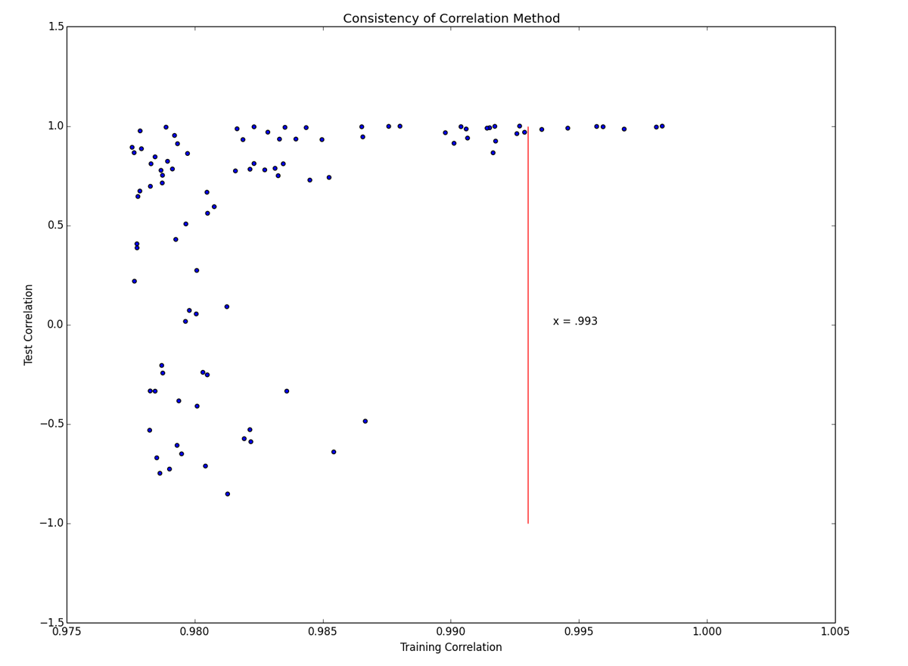
Correlation Training vs Test: Highly heteroscedastic – danger!

Slide 12
Least sum-squares

Slide 13
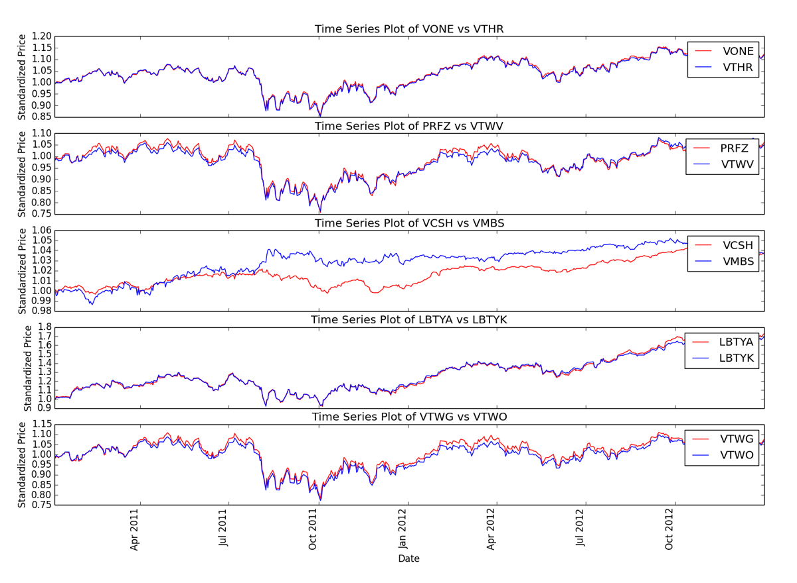
Training Data: Five smallest sum-square distance pairs

Slide 14
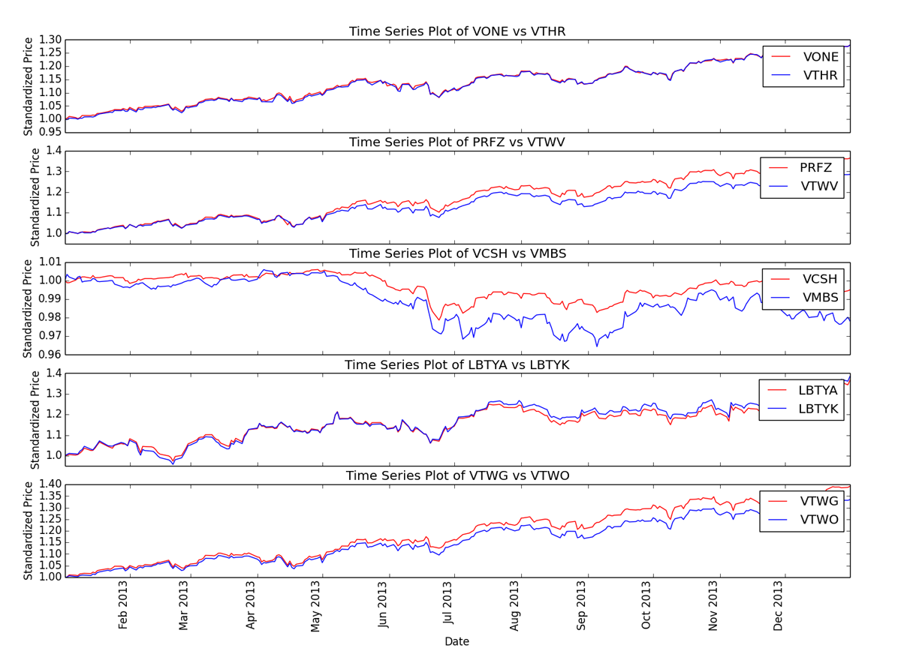
Test Data: Much larger deviation as time passes

Slide 15
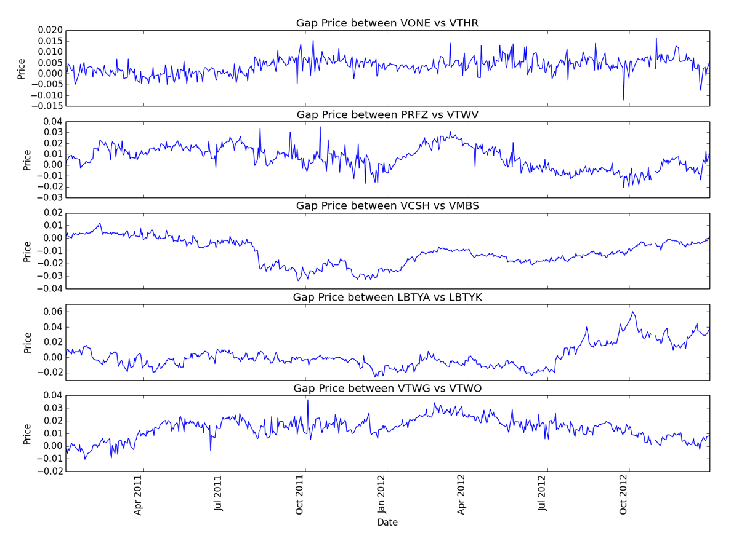
Training Data: No/Small trends in price differential

Slide 16
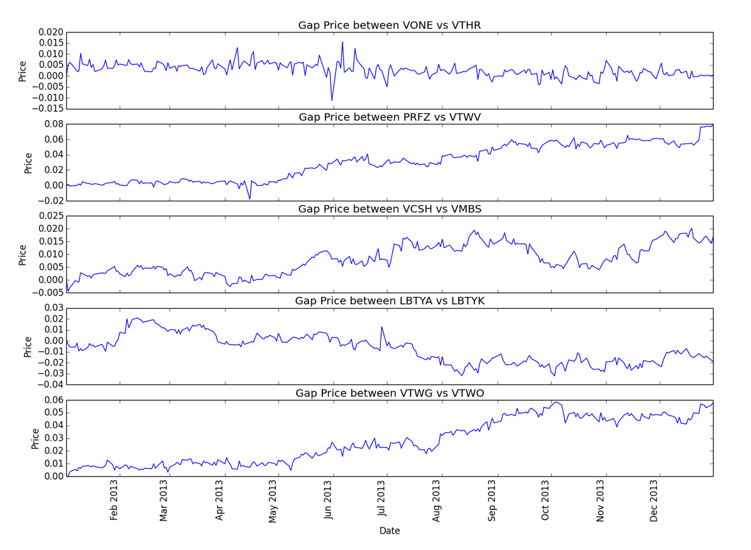
Training Data: Much larger trends in price differential

Slide 17
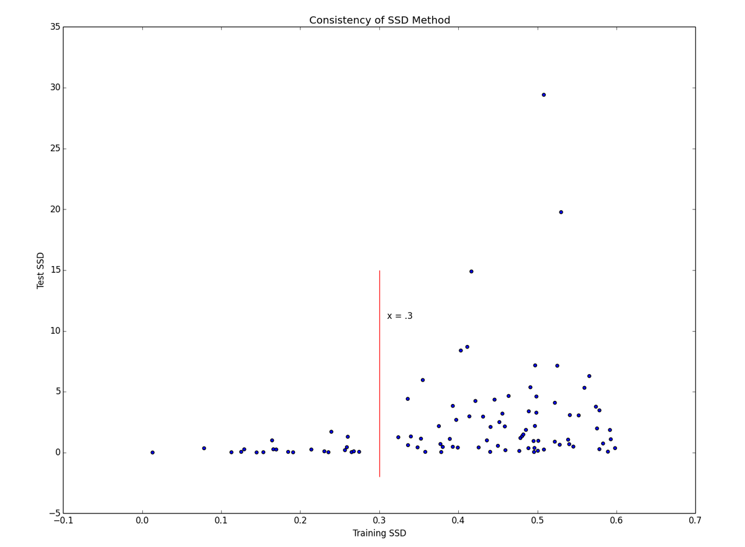
Distance Training vs Test: Highly heteroscedastic – danger!

Slide 18
Cointegration
An approachable explanation of cointegration can be found here:
http://www.uta.edu/faculty/crowder/papers/drunk%20and%20dog.pdf

Slide 19
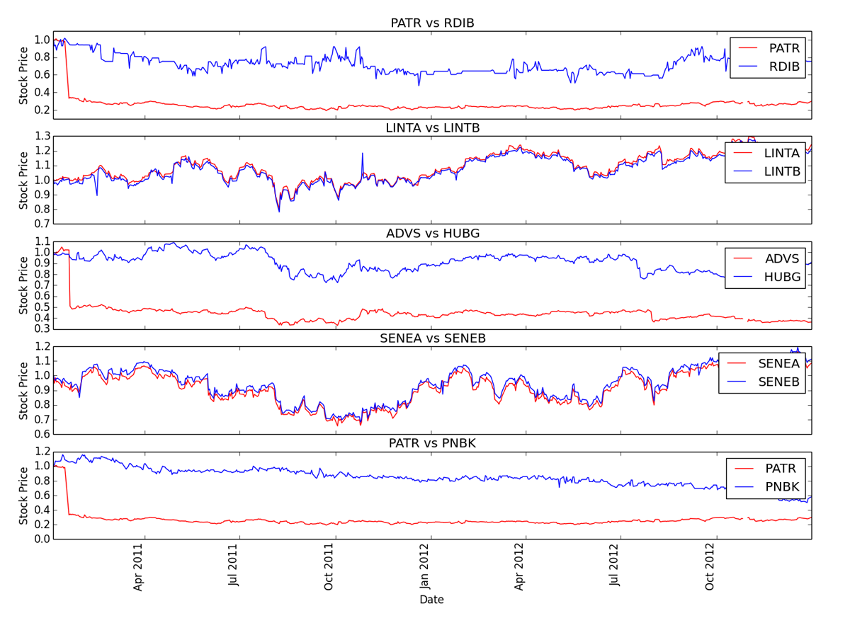
Training Data: Five smallest cointegration p-values

Slide 20
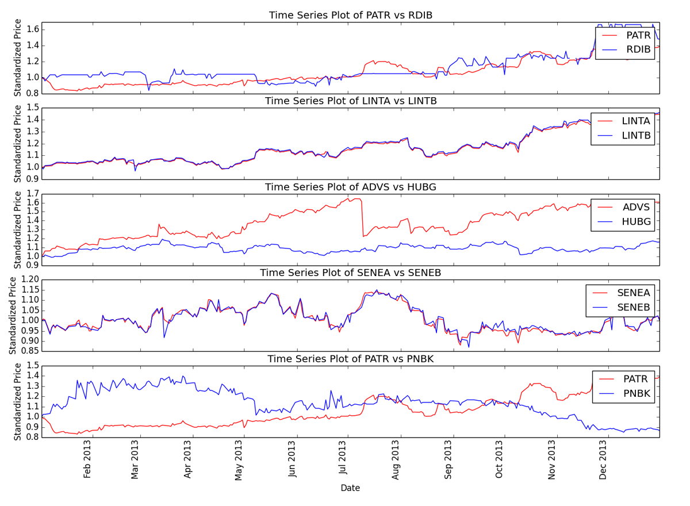
Test Data: Related stocks maintain their relationship
Note: related stocks

Slide 21
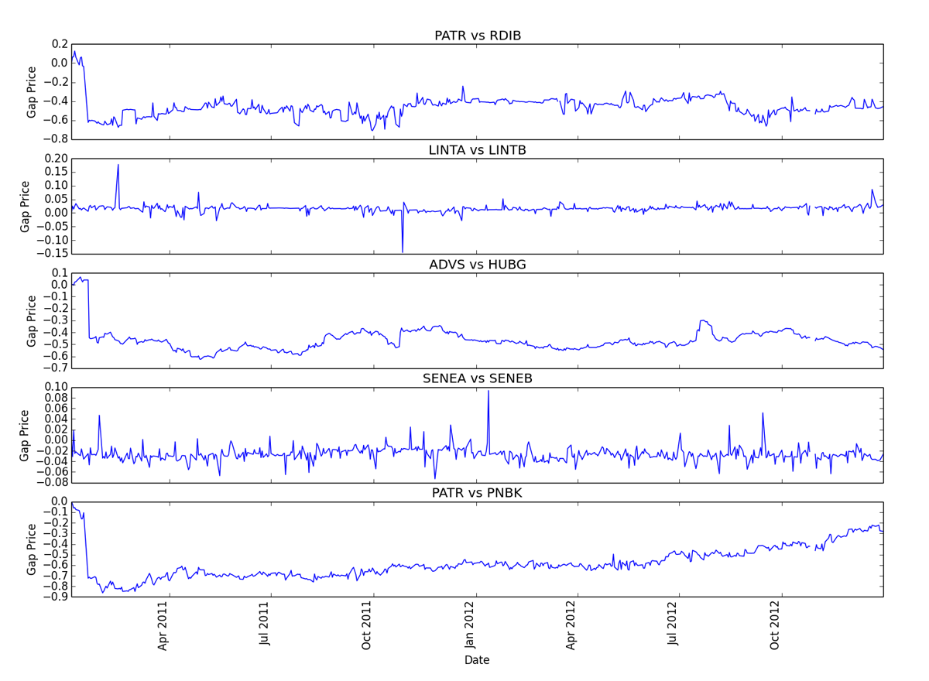
Training Data: Some almost zero slope!

Slide 22
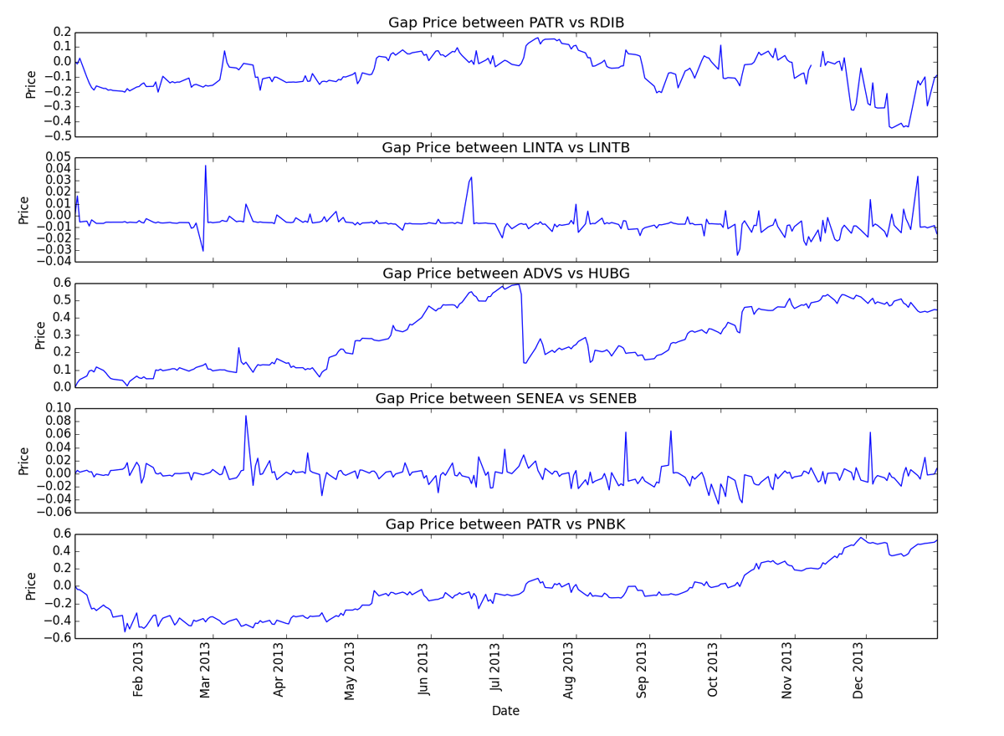
Training Data: Much larger deviation in price differential

Slide 23
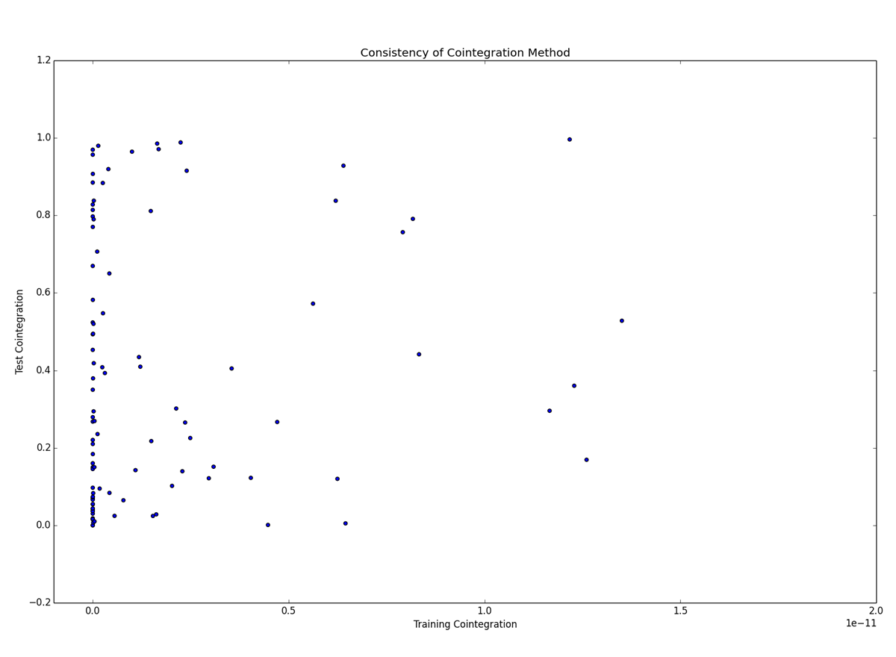
Distance Training vs Test: Overall, no useful relationship

Slide 24
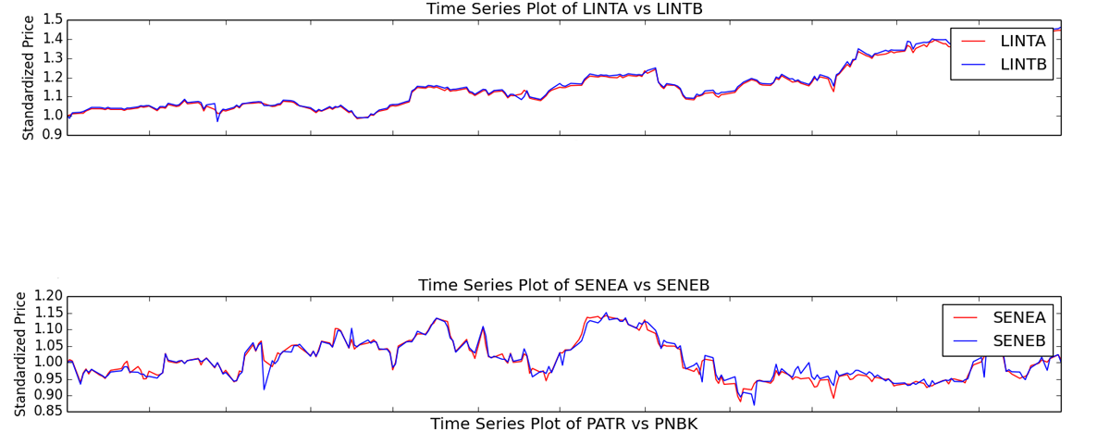
Test Data: Related stocks had lowest p-value
Of the pairs with the smallest five p-values on the training data, the two closely related pairs had the smallest test data p-values. None of the other five tested significant.
LINTA vs LINTB: 1.23e-26
SENEA vs SENEB: 1.25e-08

Slide 25
Conclusion

Slide 26
Summary of Methods
Correlation:
While correlation selected stocks that seemed to remain near, the scatter plot showed a dangerous variability in results.
Distance:
Of the three methods, distance performed the worst, with the largest movement away from the mean.
In addition, scatter plot shows dangerous variability in results.
Cointegration:
Overall, cointegration cannot be used to mine pairs to trade
However, there is some indication that related stock pairs selected by cointegration might outperform the other methods and be viable pairs to trade

Slide 27
Conclusion
Overall, there is no evidence to refute anecdotal advice to only evaluate stock pairs with a known relationship.
Suggest further evaluation of cointegration as a method of selecting related stock pairs.
Correlation and distance methods see larger spreads over time even for related stock pairs. Use of these methods is not recommended.

