Slide 1
Pairs Trading
Evaluation of Selection Methods
Jeff Darling
Willy Lai
https://github.com/jeffreydarling/222project

Slide 2
What is pairs trading?

Slide 3
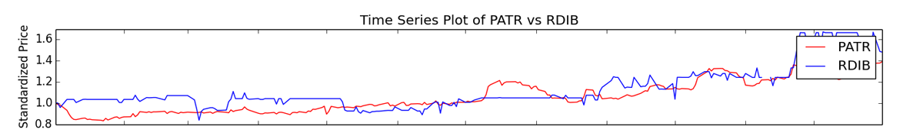
Brief Overview of Pairs Trading
Pairs trading is a method of trading two stocks with related prices. When one stock outperforms the other, you sell the higher stock and buy the lower stock, betting on a reversion to mean.
Begin Trade
End Trade
Notes:
Pairs trading is a method of trading two stocks with related prices. When one stock outperforms the other, you sell the higher stock and buy the lower stock, betting on a reversion to mean.
Show example plot.

Slide 4
How do you select stocks?
There are several widely used methods to select stocks to pairs trade: Correlation, Distance, and Cointegration.
Anecdotally, the stocks should be related in some known fashion. A traditional example is Coke and Pepsi.
Our research attempts to answer two questions:
Which method has the best predictive value?
Is it important to know that the two stocks are related beyond numerical tests?
We evaluate the “best” 5 pairs for each method, and then plot the top 100.
Training Data: 2011-2012 NASDAQ
Test Data: 2013 NASDAQ
Notes:
There are several widely used methods to select stocks to pairs trade: Correlation, Distance, and Cointegration.
Anecdotally, the stocks should be related in some known fashion. A traditional example is Coke and Pepsi.
Our research attempts to answer two questions:
Which method has the best predictive value?
Is it important to know that the two stocks are related beyond numerical tests?
We evaluate the “best” 5 pairs for each method, and then plot the top 100.
Training Data: 2011-2012 NASDAQ
Test Data: 2013 NASDAQ

Slide 5
Correlation

Slide 6
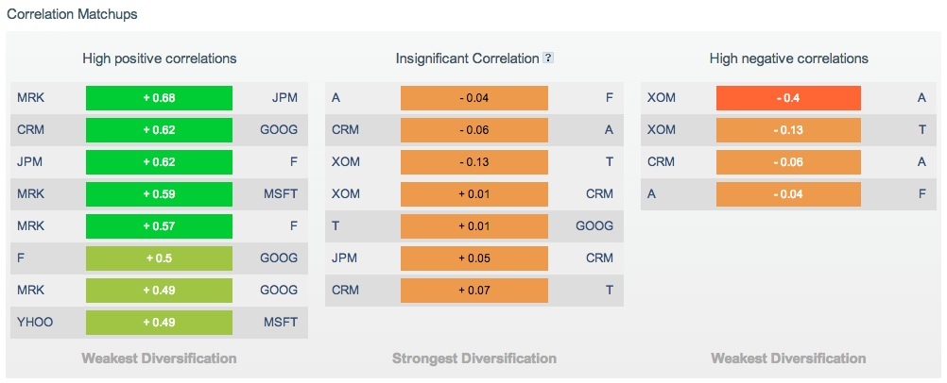
Websites Make It Easy
But what is the value of this correlation info?
Notes:
Correlation is the most basic approach for the pairs trading strategy. It makes sense to pick two stocks whose prices are highly correlated, since this indicates that the two stocks are closely related. But the question is, how valuable is this approach? Anyone can easily calculate the correlation between 2 historical stock prices, and even if one does not want to calculate it themselves, there are websites that will display the correlation between different stocks, such as this one.

Slide 7
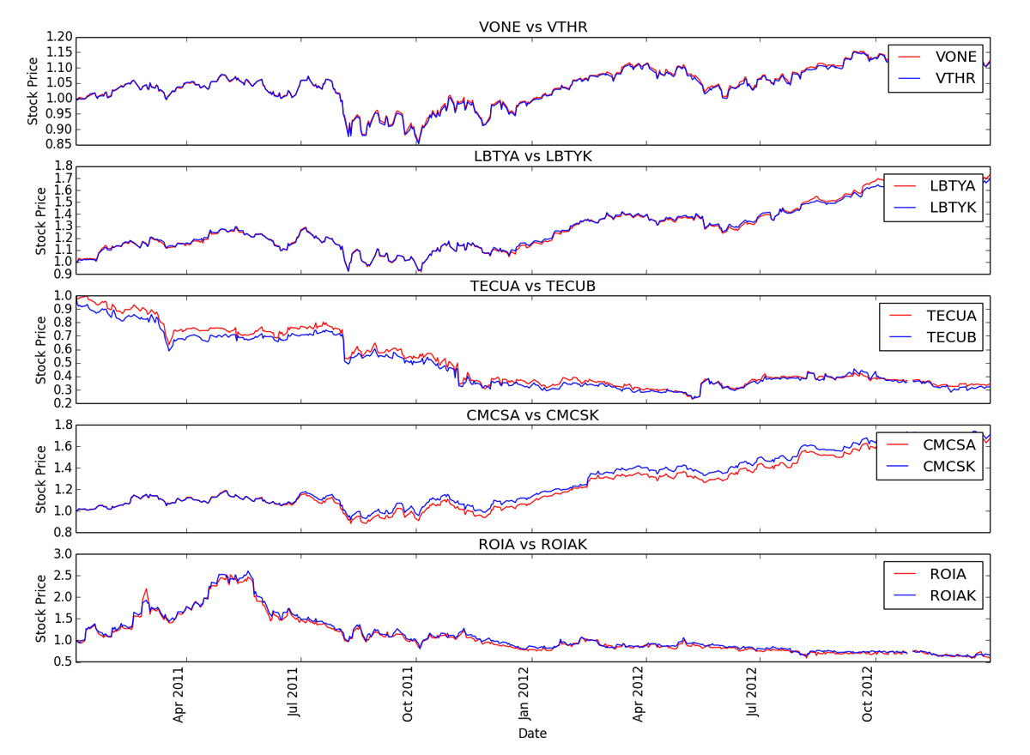
Training Data: Five most correlated stocks
Notes:
In 2011-2012, these are the five pairs of stocks with the highest correlation.
We can see that the stock prices are VERY CLOSE to each other with these stock pairs.

Slide 8
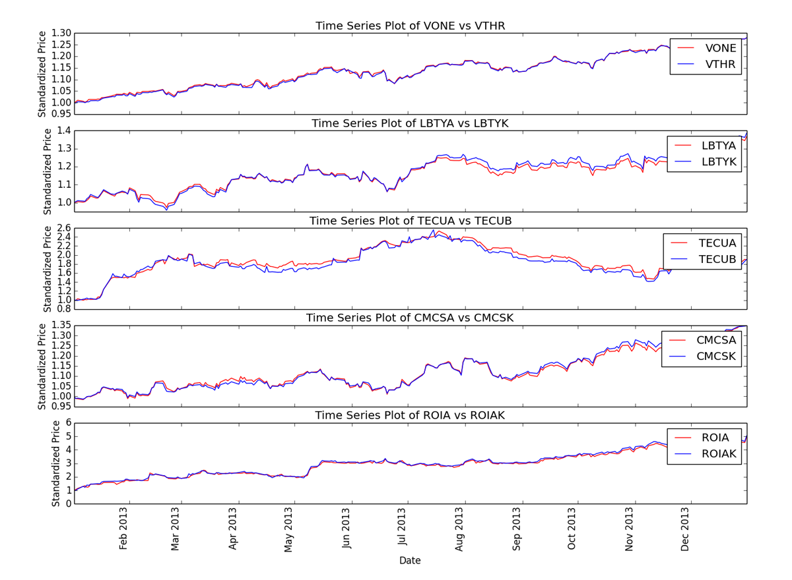
Test Data: Higher spread as test window lengthens
Notes:
In 2013, we see that the same pairs of stocks from the previous two years to be very highly correlated with one another. This makes us wonder if the correlation really is a valuable measure for pairs trading, but before we decide that, let’s examine a few more plots.

Slide 9
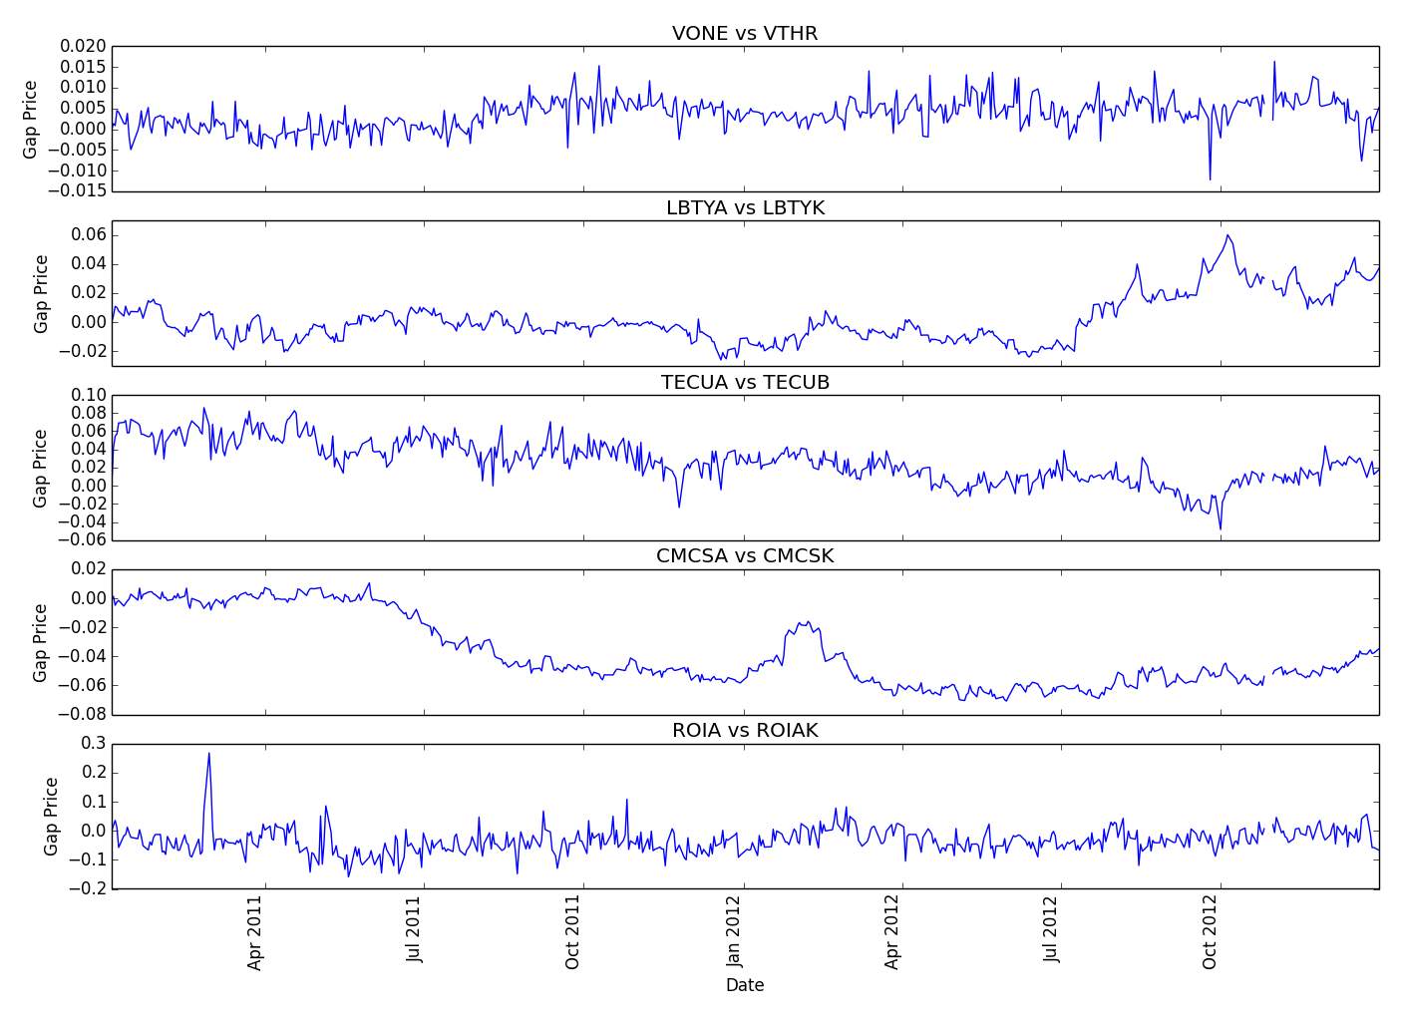
Training Data: No/Small trends in price differential
Notes:
Next, we look at the gap in stock prices for the stock prices in 2011 and 2012. There are very small to no trends in the price differentials.

Slide 10
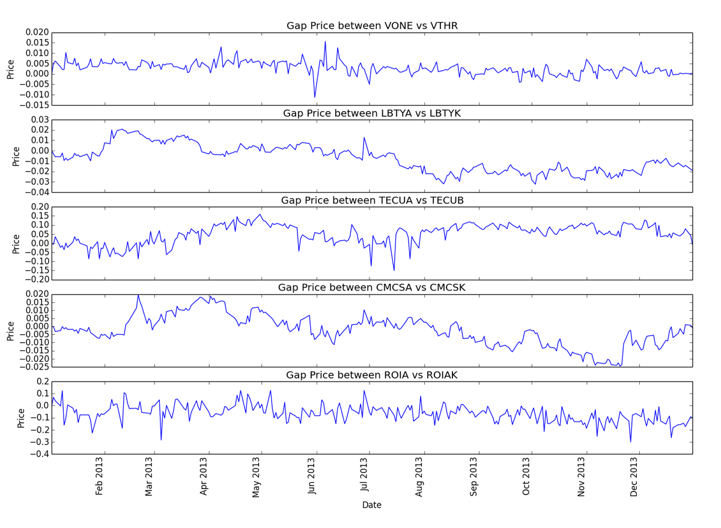
Test Data: No/Small trends in price differential
Notes:
The 2013 data also shows very little to no trends in the price differentials of the highly correlated stock prices.

Slide 11
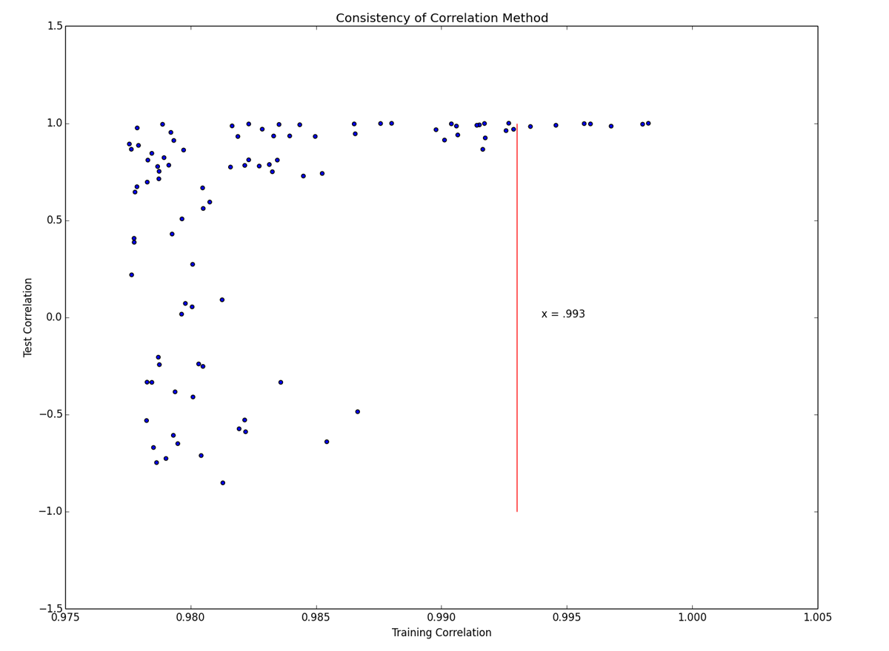
Correlation Training vs Test: Highly heteroscedastic – danger!
Notes:
Now we explore a scatterplot of the correlations of the 100 most highly correlated stock pairs in the training and test data sets and how see how consistent the correlation method is for many stocks. This plot is highly heteroscedastic and shows many inconsistencies, such as having many stock pairs in 2011-2012 having high correlation and then having much lower correlation in 2013. This implies that correlation may not be the best method to use.

Slide 12
Least sum-squares
Notes:
Next, we have the least sum-squares method, otherwise known as the distance method, which calculates the sum of squares difference between two series of stock prices. The lower the SSD is, the better it is for pairs trading.

Slide 13
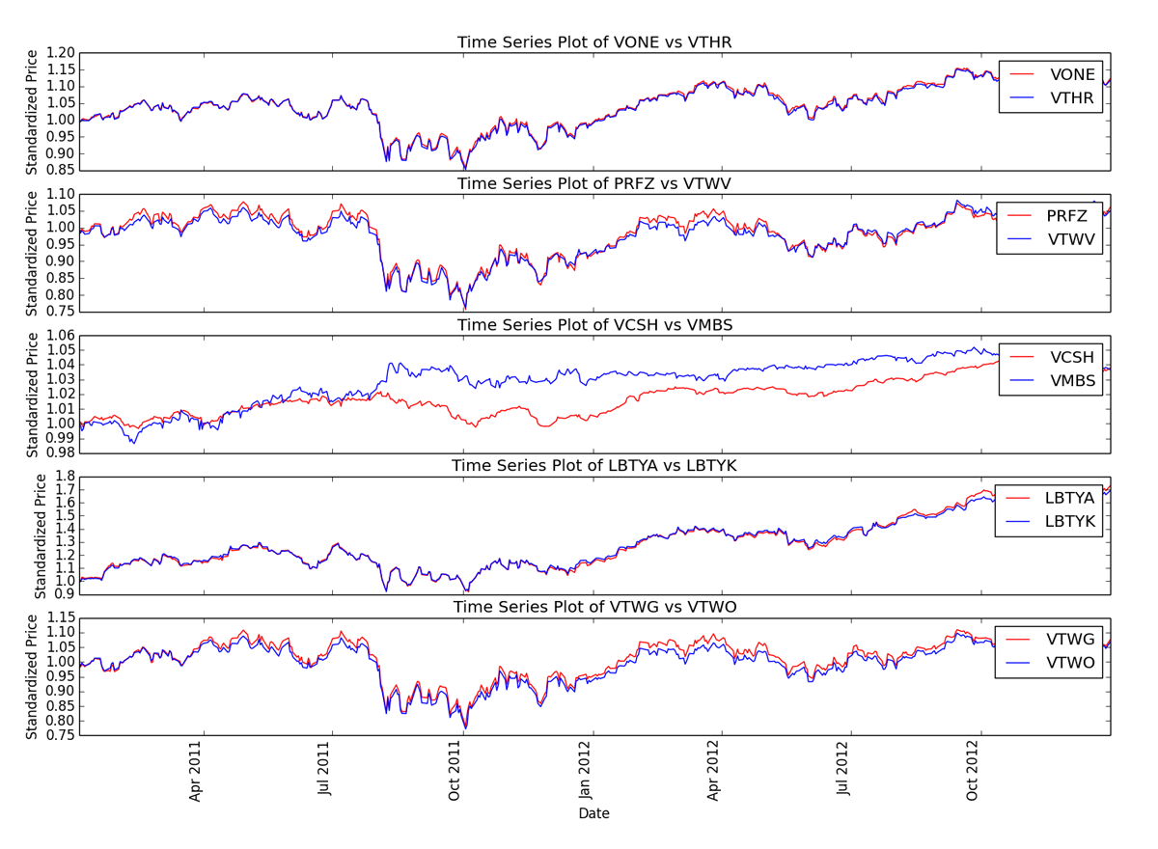
Training Data: Five smallest sum-square distance pairs
Notes:
This plot shows the 5 pairs with the smallest sum of squares distance. Like the correlation method, the stock prices of each pair are still very close to each other for the most part.

Slide 14
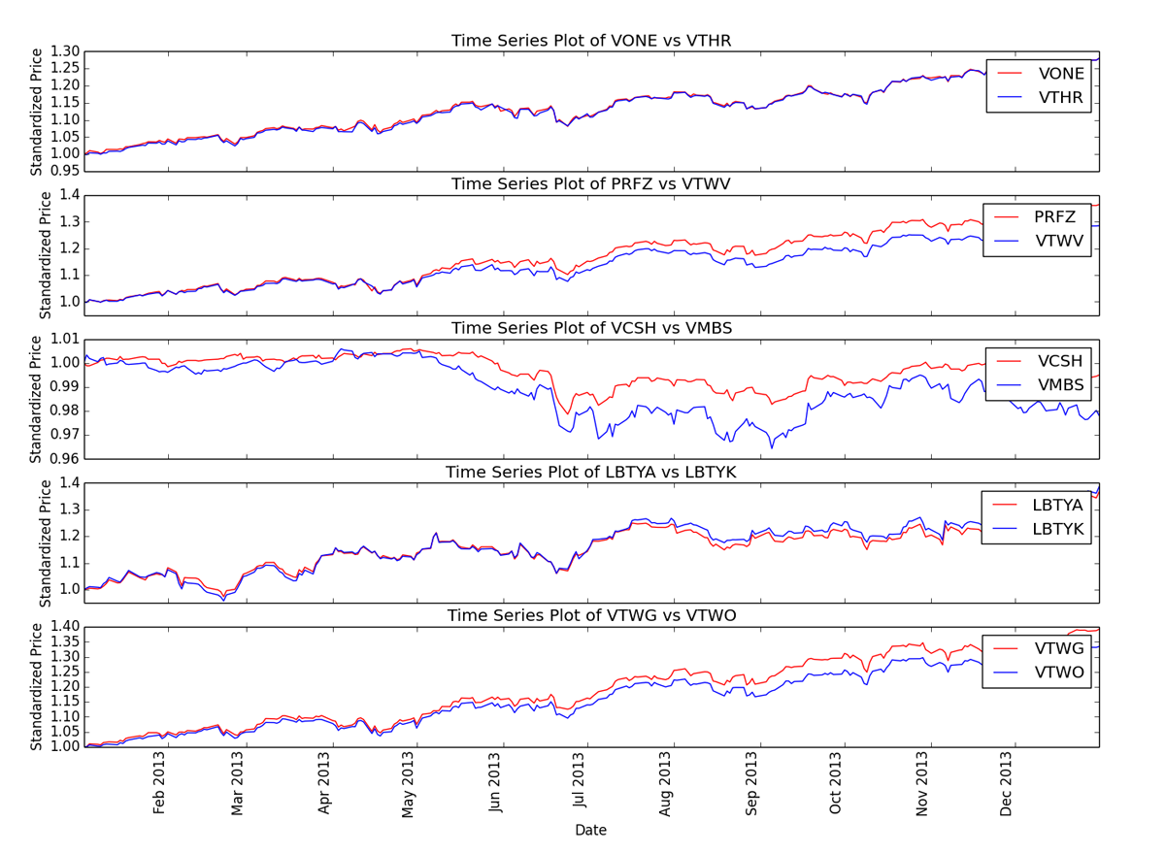
Test Data: Much larger deviation as time passes
Notes:
However, unlike the correlation method, we can see a much larger deviation of stock prices over time in the year 2013, which means pairs trading may not be a good idea if these deviations do not decrease.

Slide 15
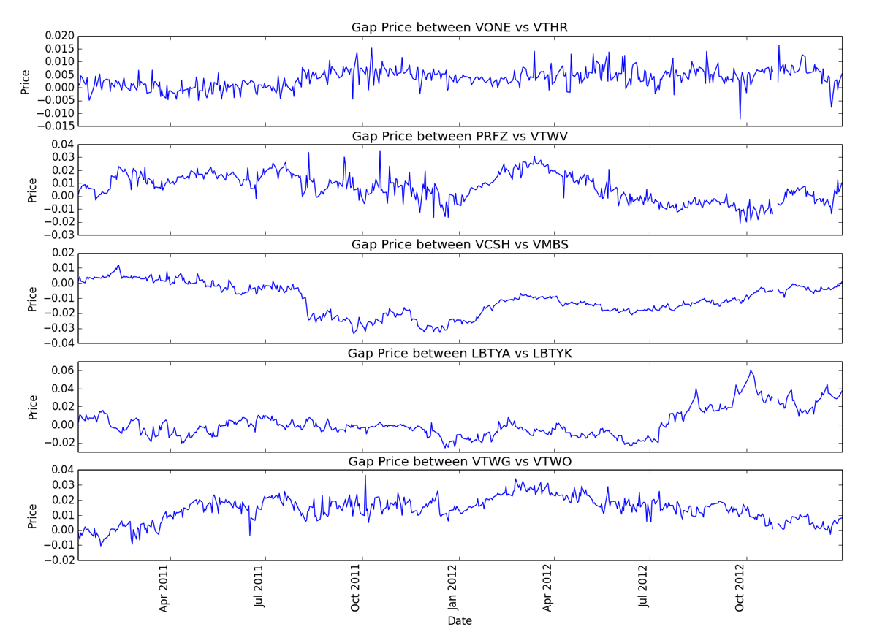
Training Data: No/Small trends in price differential
Notes:
There are very small, if any, trends in price differentials in the training data set.

Slide 16
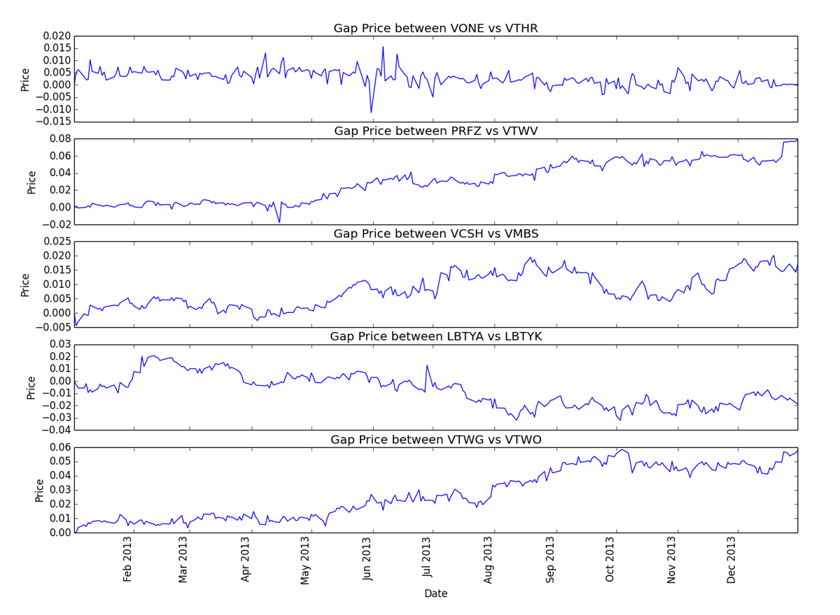
Test Data: Much larger trends in price differential
Notes:
Again, we see much larger trends in the price differential, unlike the gap prices we say in the training data set. It appears that some pairs have their differences continue to increase or decrease well towards the end of 2013, which puts into doubt whether using SSD is even viable.

Slide 17
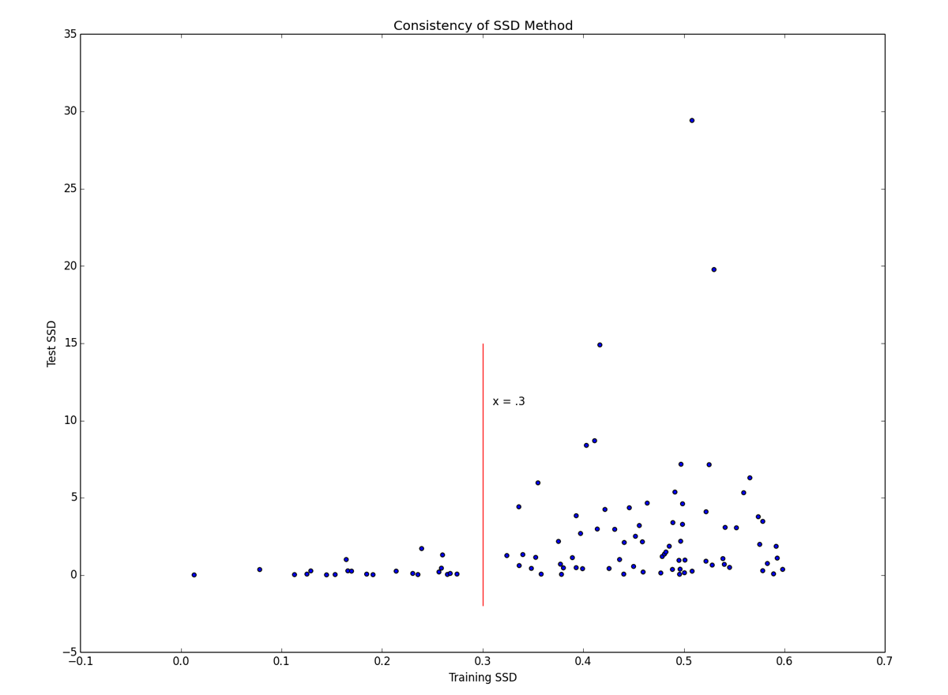
Distance Training vs Test: Highly heteroscedastic – danger!
Notes:
The scatterplot of the sum of squared distances between training and test data sets for 100 pairs shows a highly heteroscedastic plot, which indicates inconsistency in the SSD method. Judging by the scale of the x and y axis, most stock pairs with low distances in 2011-2012 had much higher distances in 2013. This implies that the prices of these pairs are not going to converge any time soon, which means pairs trading these stocks would create huge loss in profit.

Slide 18
Cointegration
An approachable explanation of cointegration can be found here:
http://www.uta.edu/faculty/crowder/papers/drunk%20and%20dog.pdf
Notes:
A classic example of cointegration is two constrained random walks. For example, a drunk and their dog.
The drunk makes a random walk, while their dog is on a random walk around them but constrained by the length of the leash.

Slide 19
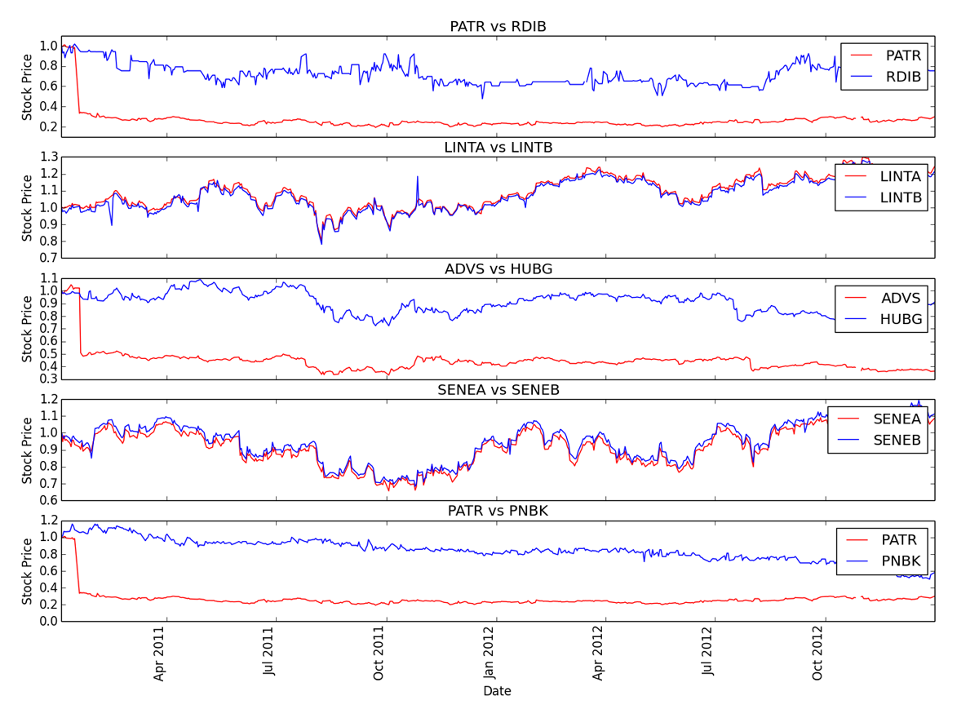
Training Data: Five smallest cointegration p-values
Notes:
These are the five stock pairs with the smallest p-values from the cointegration test
We can see that cointegration selects stocks differently than correlation and distance and does not rely on matched prices

Slide 20
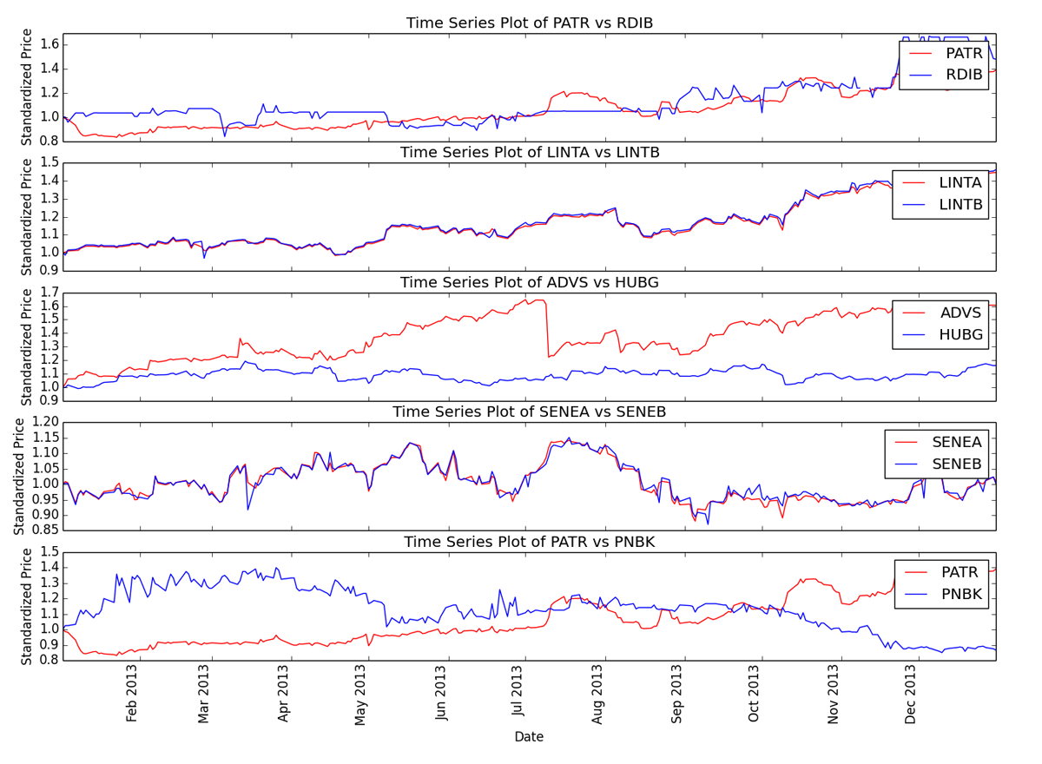
Test Data: Related stocks maintain their relationship
Note: related stocks
Notes:
The five pairs selected in the training data do not maintain cointegration in the test data. Only two of the five have significant p-values for cointegration.
These two pairs are A and B stocks, which are two classes of stock from the same company, so it is easy to see why they might better maintain a relationship.

Slide 21
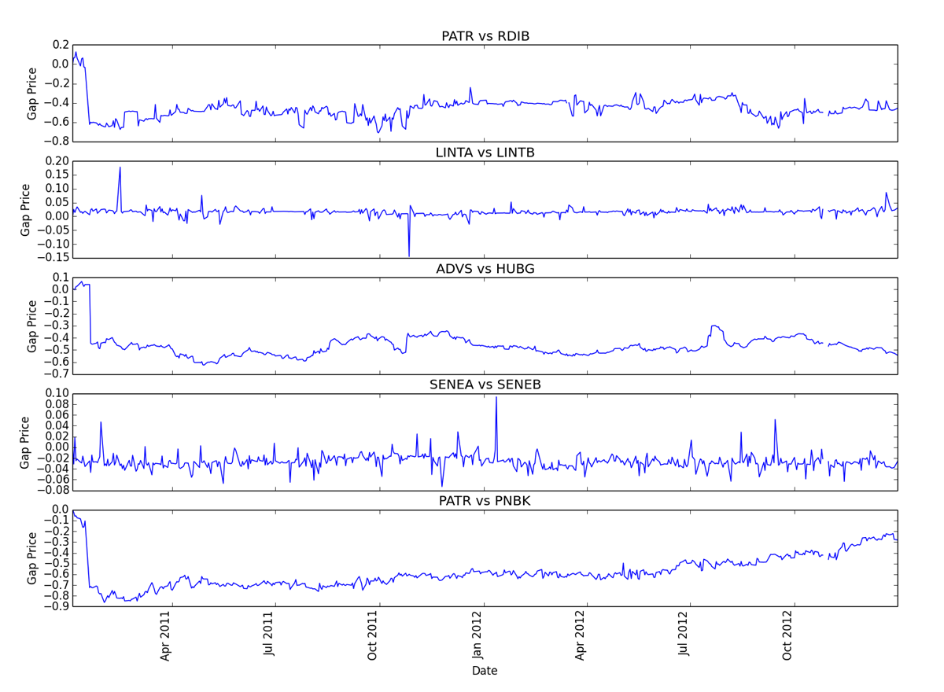
Training Data: Some almost zero slope!
Notes:
Cointegration testing on the training data does produce pairs with very even price differentials, but still with areas that could allow pairs trading.

Slide 22
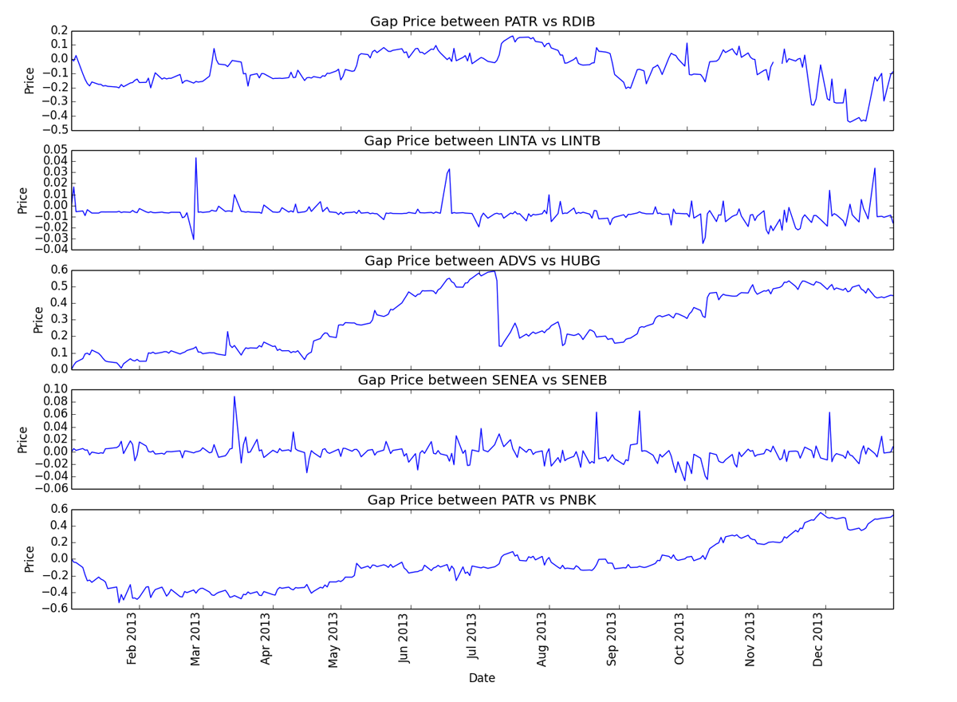
Test Data: Much larger deviation in price differential
Notes:
However, we can see that the test data does not maintain the flat slope – the pairs drift apart – except for the two pairs that are more strongly related.

Slide 23
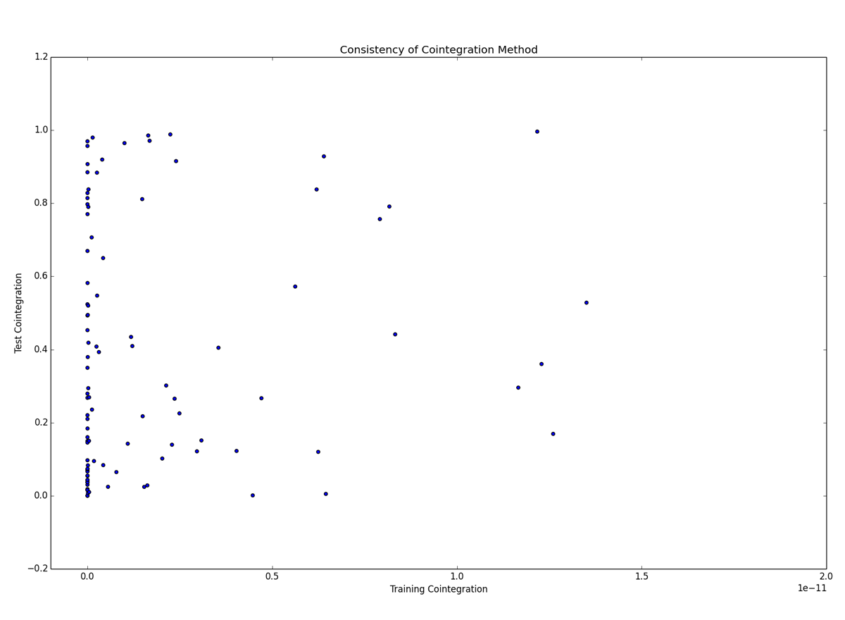
Distance Training vs Test: Overall, no useful relationship
Notes:
Note: the x-axis ranges from ~0 to 2e-11 – these are very small training p-values
Looking at a scatter plot of the p-values between training and test data, even minute training p-values are almost uniformly distributed between 0 and 1 – no relationship.

Slide 24
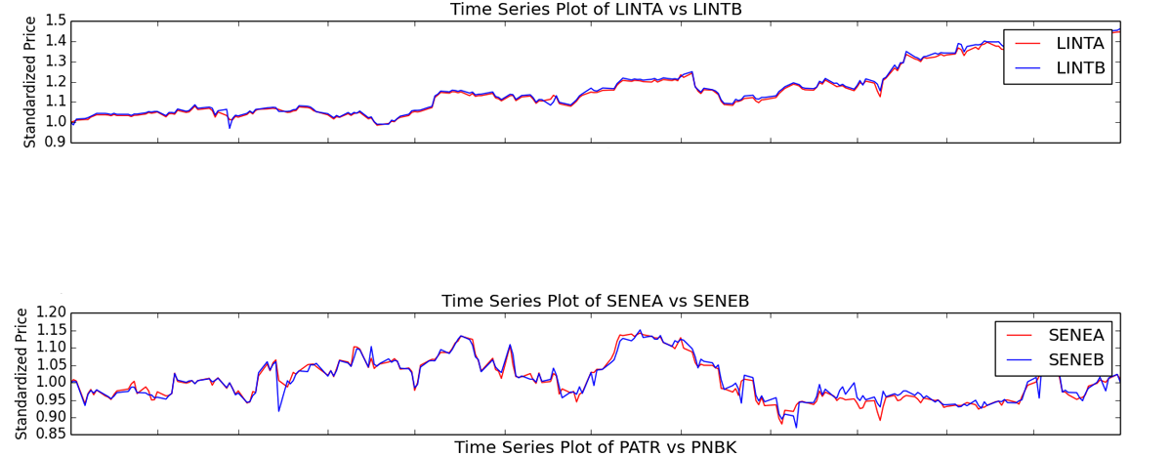
Test Data: Related stocks had lowest p-value
Of the pairs with the smallest five p-values on the training data, the two closely related pairs had the smallest test data p-values. None of the other five tested significant.
LINTA vs LINTB: 1.23e-26
SENEA vs SENEB: 1.25e-08
Notes:
The related stocks, however, still have significant p-values. It would be worth evaluating other related or A/B class stocks to see if they also behave in this way.

Slide 25
Conclusion

Slide 26
Summary of Methods
Correlation:
While correlation selected stocks that seemed to remain near, the scatter plot showed a dangerous variability in results.
Distance:
Of the three methods, distance performed the worst, with the largest movement away from the mean.
In addition, scatter plot shows dangerous variability in results.
Cointegration:
Overall, cointegration cannot be used to mine pairs to trade
However, there is some indication that related stock pairs selected by cointegration might outperform the other methods and be viable pairs to trade
Notes:
Correlation:
While correlation selected stocks that seemed to remain near, the scatter plot showed a dangerous variability in results.
Distance:
Of the three methods, distance performed the worst, with the largest movement away from the mean.
In addition, scatter plot shows dangerous variability in results.
Cointegration:
Overall, cointegration cannot be used to mine pairs to trade
However, there is some indication that related stock pairs selected by cointegration might outperform the other methods and be viable pairs to trade

Slide 27
Conclusion
Overall, there is no evidence to refute anecdotal advice to only evaluate stock pairs with a known relationship.
Suggest further evaluation of cointegration as a method of selecting related stock pairs.
Correlation and distance methods see larger spreads over time even for related stock pairs. Use of these methods is not recommended.
Notes:
Overall, there is no evidence to refute anecdotal advice to only evaluate stock pairs with a known relationship.
Suggest further evaluation of cointegration as a method of selecting related stock pairs.
Correlation and distance methods see larger spreads over time even for related stock pairs. Use of these methods is not recommended.

