Slide 1
Machine Learning Classification of Sarcoma Types using Gene Expression Data
Jeffrey DeLong

Slide 2
Introduction
Soft tissue sarcomas are a diverse family of mesenchymal malignancies.
There are more than 50 types of soft tissue sarcoma, and they are generally classified based on the connective tissue they most resemble.
Diagnosis based on histology can be difficult
Goal of study is to classify 6 different types of sarcoma using gene expression (RNA transcriptome) data

Slide 3
Background - References
Huang, S, Cai, N, et al. Applications of Support Vector Machine (SVM) Learning in Cancer Genomics. Cancer Genomics & Proteomics 15: 41-51. 2018. doi:10.21873/cgp.20063.
Weinstein, John N., et al. The Cancer Genome Atlas Pan-Cancer Analysis Project. Nature Genetics. 2013. 45(10): 1113-1120. https://doi.org/10.1038/ng.2764.
Karim, Md Rezaul. Java Deep Learning Projects: Implement 10 real-world deep learning applications using Deeplearning4j and open source APIs. Packt Publishing. 2018.
Abeshouse A, Adebamowo C, Adebamowo SN, Akbani R, Akeredolu T, Ally A, et al. Comprehensive and Integrated Genomic Characterization of Adult Soft Tissue Sarcomas. The Cancer Genome Research Network, Cell 171, 950-965. 2017. https://doi.org/10.1016/j.cell.2017.10.014
van IJzendoorn DGP, Szuhai K, Briaire-de Bruijn IH, Kostine M, Bovee JVMG. Machine learning analysis of gene expression data reveals novel diagnostic and prognostic biomarkers and identifies therapeutic targets for soft tissue sarcomas. PLoS Computational Biology 15(2): e10006826. 2019. https://doi.org/10.1371/journal.pcbi.1006826.

Slide 4
Materials and Methods: Sarcoma Types
Sarcoma Type | Sample Count
LMS (ULMS and STLMS) | 80
DDLPS | 50
UPS | 44
MFS | 17
SS | 10
MPNST | 5
Total Cases | 206

Slide 5
Materials and Methods
Hardware and Software environment
MacBook Pro with 2.2 GHz Intel Core i7 processor, 32GB RAM, and Radeon Pro 560X GPU.
Data pre-processing and standardization performed with Knime Analytics Platform.
Machine learning models performed using Python, scikit-learn, and Keras.

Slide 6
Materials and Methods
Data Selection, Setup, and Pre-processing
206 (of 261) TCGA-SARC project cases found at https://portal.gdc.cancer.gov/
Clinical data
FPKM mRNA Sequencing files
Used Knime to
Remove features where the genes expression values are 0 in more than 90% of the cases.
Perform z score standardization

Slide 7
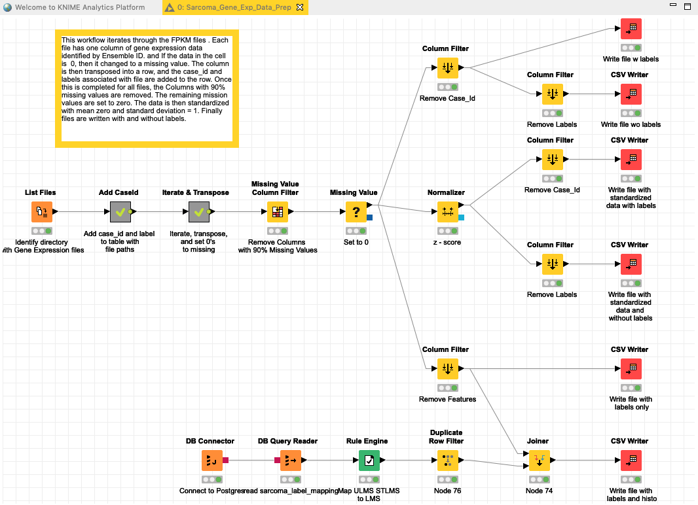

Slide 8
Materials and Methods
Descriptive Analysis / Unsupervised Learning
Chi Squared analysis (best 200 features).
Hierarchical and K-means clustering (identity 6 clusters).
Principal Component Analysis (explain 95% of variance).
t-Stochastic Neighbor Embedding (2 dimensions).

Slide 9
Materials and Methods
Machine Learning Algorithms
K Nearest Neighbor, Support Vector Machine, Random Forest, and Logistic Regression.
Performed on Chi Square 200 best features, PCA components, PCA plus cluster, and t-SNE features using Python.
Split data 60/20/20 training/validation/test.
Kfold Cross Validation to split training with k -= 4
Ran each model with default parameters.
Performed Grid Search with each model.

Slide 10
Materials and Methods
Multi-layer Perceptron deep learning model in Python with Keras and PlaidML
Input layer, two 5000 neuron hidden layers with ReLU activation function, and output layer with Softmax activation function and Multiclass Cross Entropy as the loss function.
Stochastic Gradient Descent optimizer with Learning Rate of 0.01.
Batch size of 32, 10 Epochs.
Experimented with both hold out validation and bootstrapping.
Hyperparameters tuning with Talos: l1 and l2 regularization, dropout, learning rate.
Experimented with Voting, Bagging, and Adaboost and SMOTE for unbalanced data.

Slide 11
Results
Clustering
Hierarchical better than k-means with purity of .73
Similar clusters as with reference 4
PCA components (167)
Logistic Regression with C=1; test accuracy: 83%
SVM with C=1, Gamma=0.0001, RBF kernel; test accuracy: 79%.

Slide 12
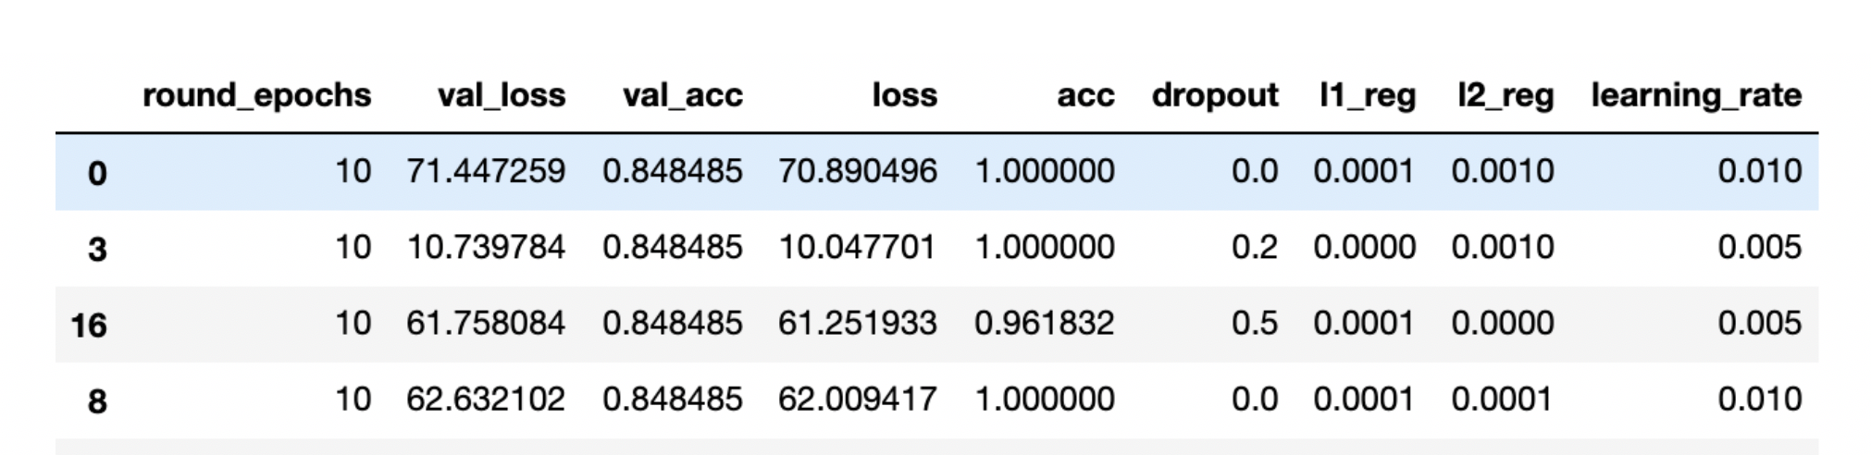
Results – Multilayer Perceptron
Best Models test accuracy: 74%.

Slide 13
Discussion
Best Models: LR, SVM, MLP.
All models misclassified MFS.
Removed MFS samples and re-ran tests; improved accuracy of LR model to 88%.
Evaluated BaggingClassifier with Logistic Regression: 92% accuracy.
Used SMOTE to increase number of minority training samples, ran model on Test data with BaggingClassifier / Logistic Regression with result of 97% accuracy.

Slide 14
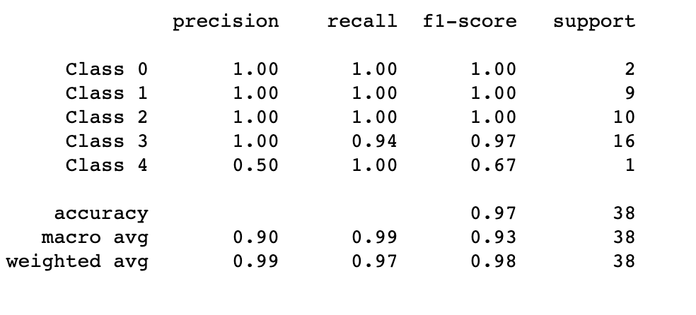
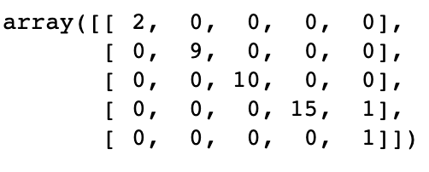
Bagging Classifier (Logistic Regression) with SMOTE synthetic samples

Slide 15
Conclusions
Machine Learning models can classify sarcoma types using gene expression data.
With the caveat that MFS cannot be distinguished from UPS
Small number of TCGA sarcoma samples makes classification more difficult.
Future plans to predict outcomes based on gene expression data.

Slide 16
Questions?

