Slide 1
OSCoffee meeting
A gentle introduction to Git and GitHub
Jeffrey Durieux
01-04-2021

Slide 2
Overview
What is Git and GitHub?
Basic Git commands to ‘git’ you started
How to use Git together with GitHub?

Slide 3

Sources
Everything you need to know can be found here:
https://git-scm.com/
Or just use:

Slide 4

What is Git?
Git is a version control software
Can be used for working on group projects
See it as a complex version of Google Docs…

Slide 5
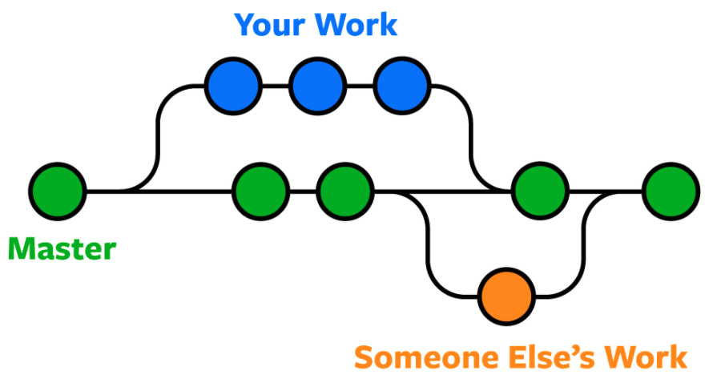
Project flowchart
https://www.nobledesktop.com/blog/what-is-git-and-why-should-you-use-it#:~:text=Git%20is%20the%20most%20commonly,be%20merged%20into%20one%20source.
Notes:
Color’s refer to so called ‘branches’

Slide 6
What is GitHub?
Internet hosting for software development and version control using Git
You can have multiple online repositories (Open Science)
Will first discuss Git and then GitHub

Slide 7
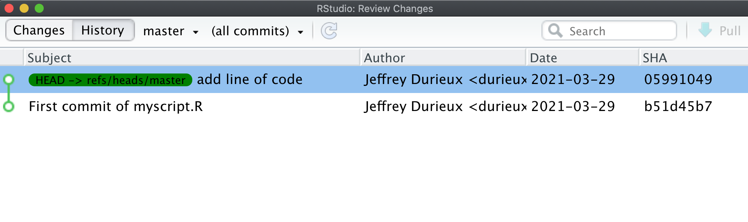
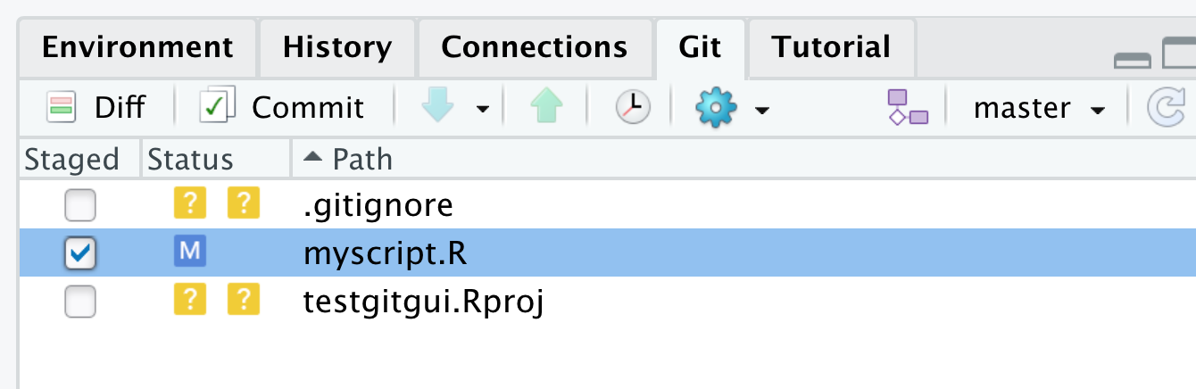
A comment about RStudio
Other GUI’s exist of course: base version git-gui or for example Gitkraken
I’ll use a terminal (linux/mac). On windows you can you use git bash
Notes:
Nice video link for windows users: https://www.youtube.com/watch?v=2j7fD92g-gE

Slide 8
Basic Git commands https://dzone.com/articles/top-20-git-commands-with-examples
git config
git init
git status
git add
git commit
git log
git diff
git reset
git branch
git merge
git checkout
git clone
git push
git pull
git pull request

Slide 9
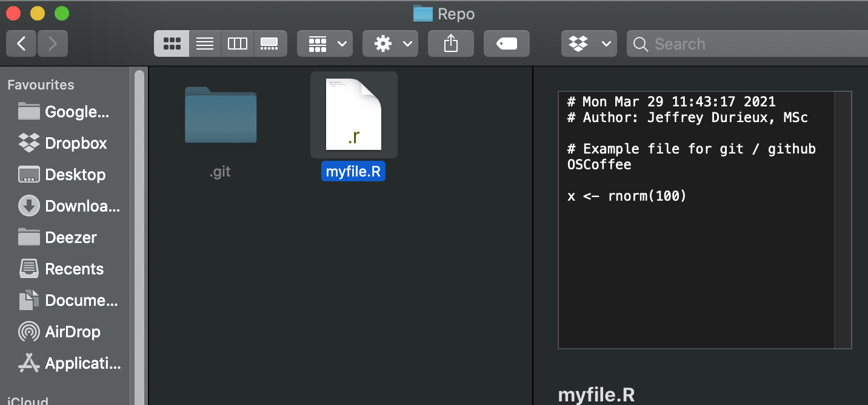
Working example

Slide 10
Git config
Set author and email address

Slide 11
Git init
Start a local repo somewhere on your computer

Slide 12
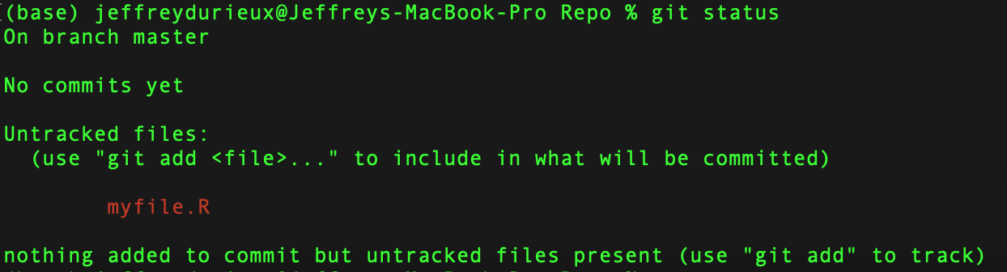
Git status
Three stages of version control:
Untracked file
Staged file
Committed
Check info about your git repo

Slide 13
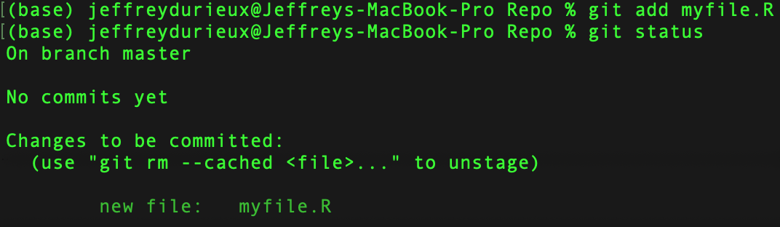
Git add
Three stages of version control:
Untracked file
Staged file
Committed
Add a file to the staging area

Slide 14
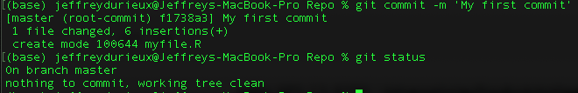
Git commit
Three stages of version control:
Untracked file
Staged file
Committed
Commit file: snapshot of the file add to version history.

Slide 15

Git log
Summary:
we initialized a git repo
Added and committed a file (in order to track the version history of that file)

Slide 16
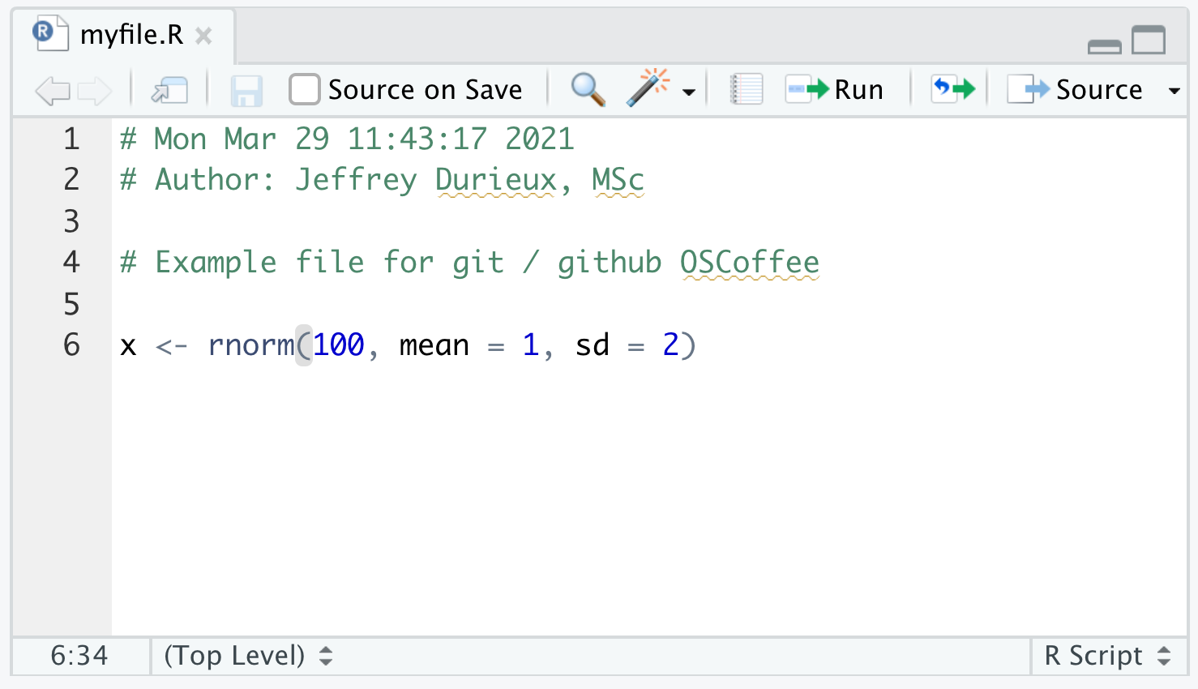
Example: Changes made to the file

Slide 17
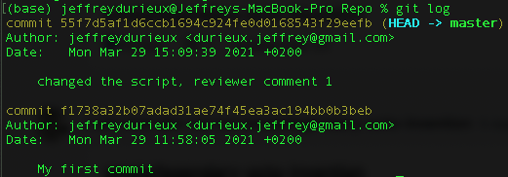
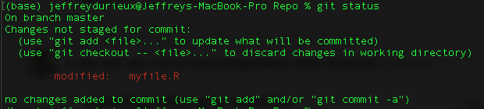
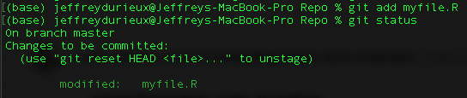

Example: Changes to the file
Instead of making a myfile_v2.R → repeat the three stages of git version control
Keep in mind: I have only 1 file (myfile.R) → not myfile_v1.R and myfile_v2.R

Slide 18
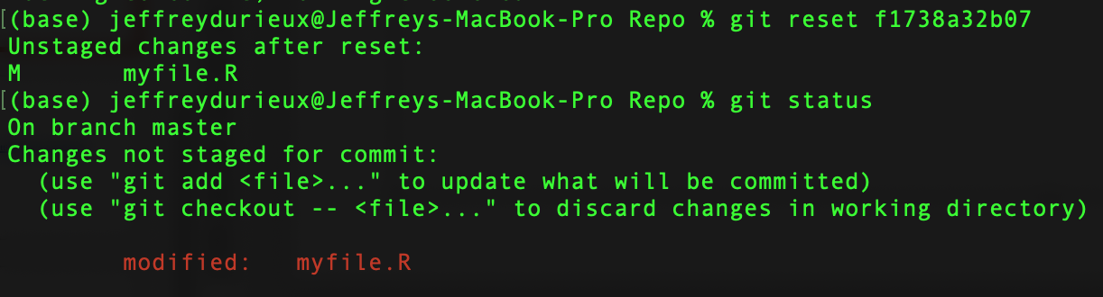
Git reset
git reset SHA → undo all commits after the specified commit

Slide 19
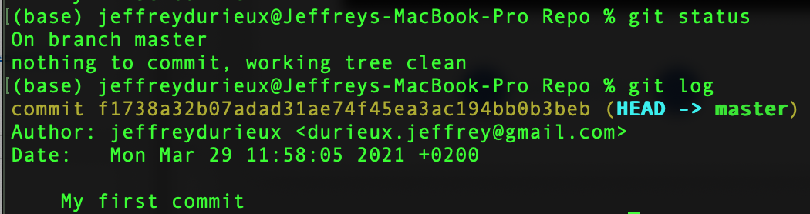
Git reset --hard
git reset --hard SHA → undo all commits after the specified commit and change the contents of the file

Slide 20
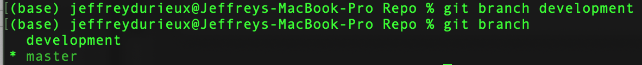
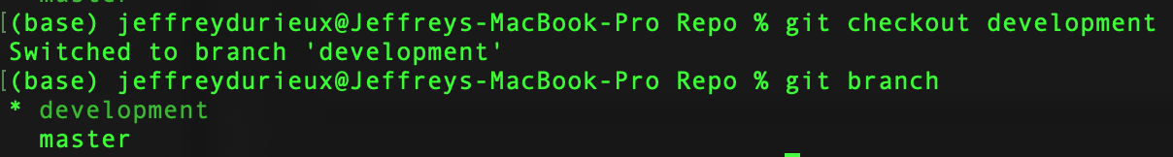
Git branch and checkout

Slide 21
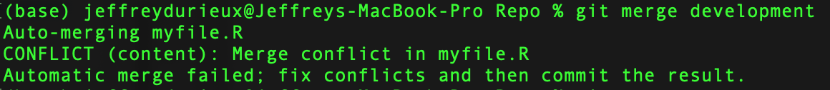
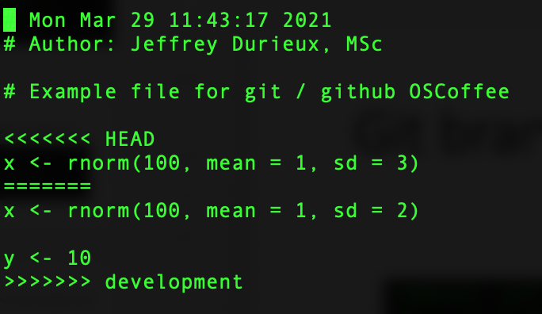
Git merge
Warning: merge conflicts!

Slide 22
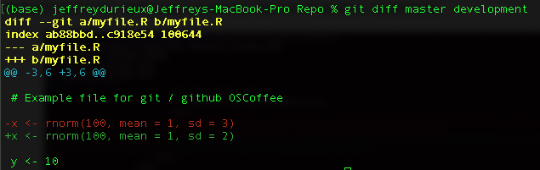
Git diff
Check differences between commits or branches

Slide 23
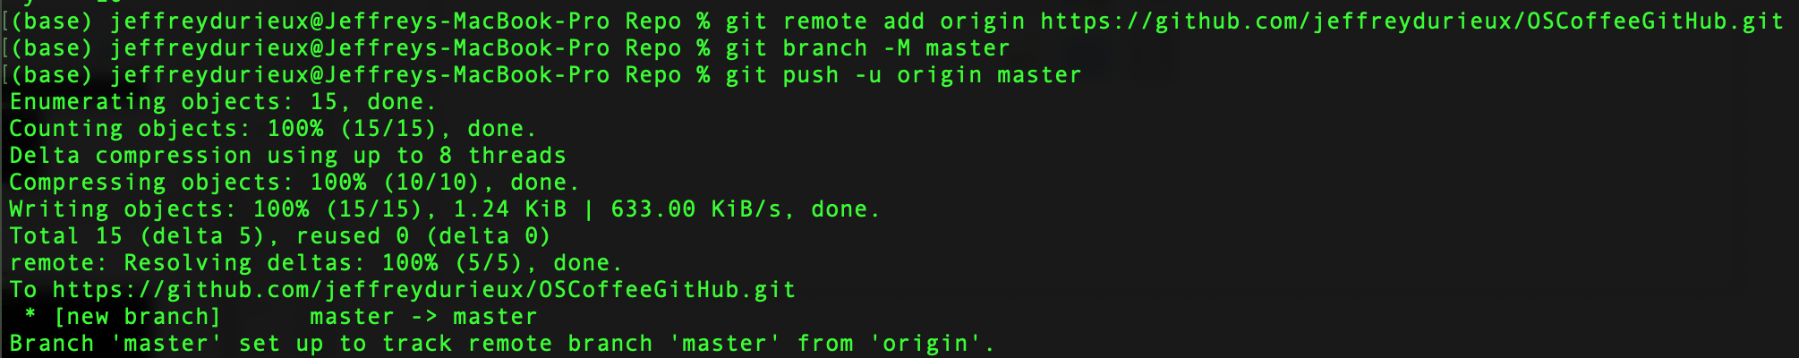
GitHub → git push
First make a repo on GitHub
Git remote add origin url

Slide 24
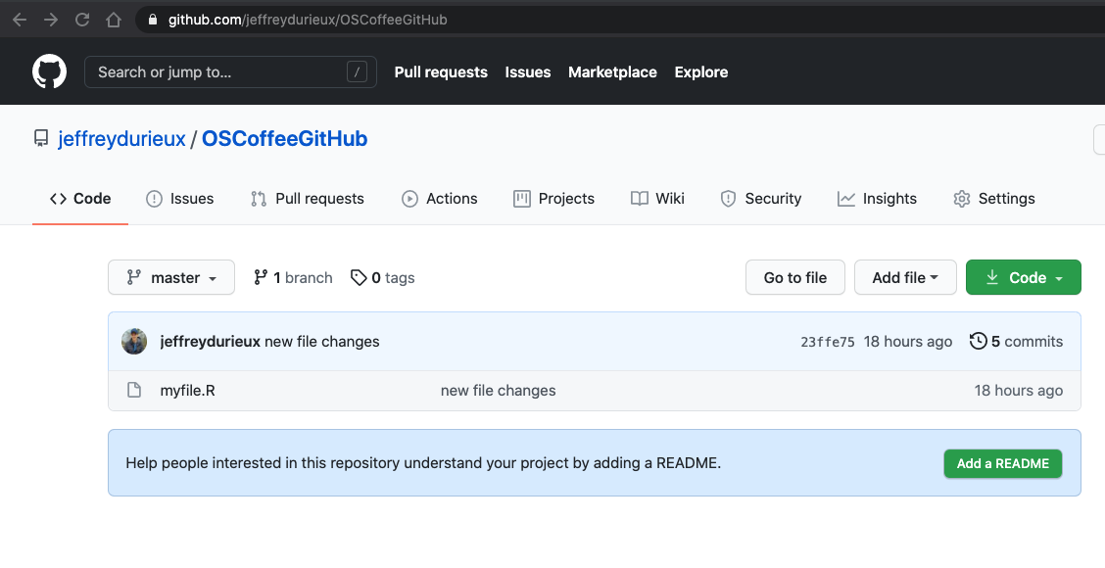
GitHub

Slide 25
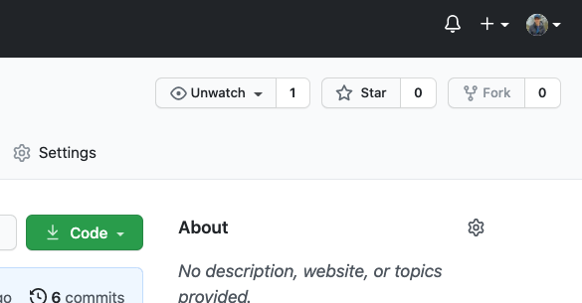
GitHub
If you don’t have write permissions to a repo → fork the repo

Slide 26
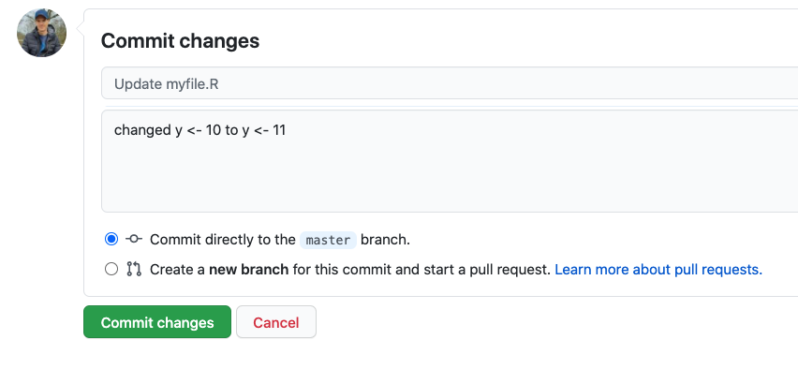
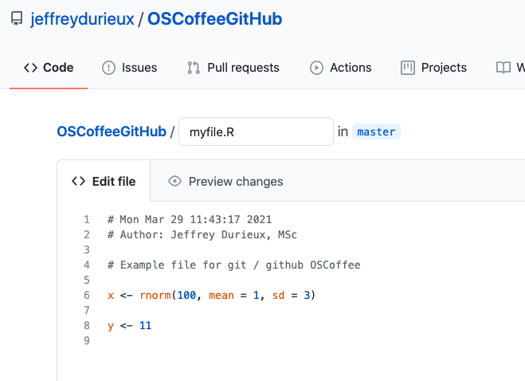
GitHub → git pull
Git pull: download changes from remote repo

Slide 27
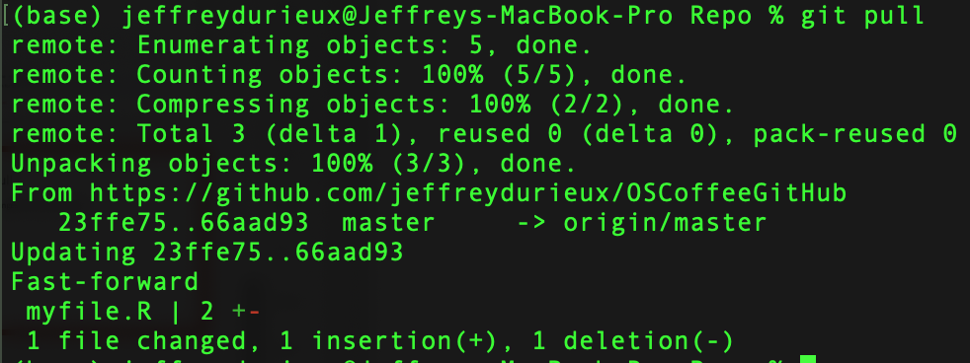
GitHub → git pull
Git pull: download changes from remote repo

Slide 28
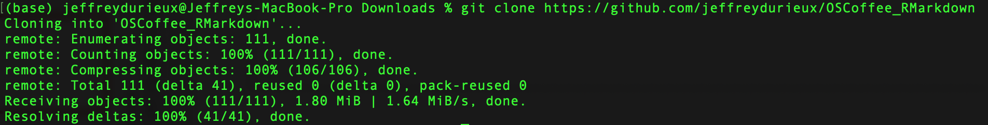
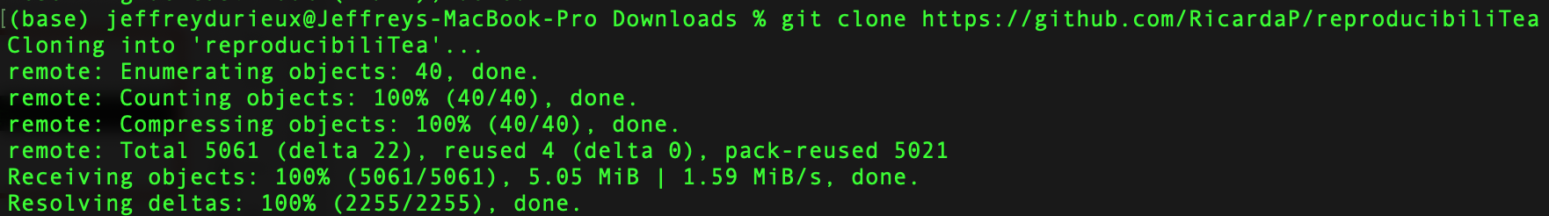
Git clone
Download a repo from an existing URL
29-04-2021: OSCoffee RMarkdown

Slide 29
Pull request
https://docs.github.com/en/github/collaborating-with-issues-and-pull-requests/creating-a-pull-request
(Fork and) clone a repo
Do some changes to files (and stash, commit and push)

Slide 30
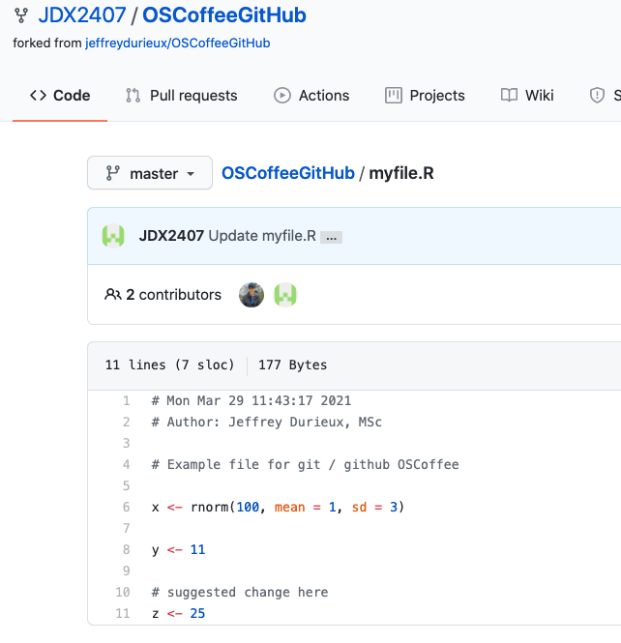

Slide 31
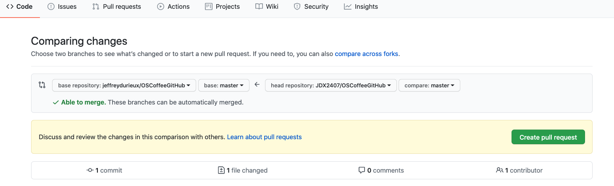

Slide 32
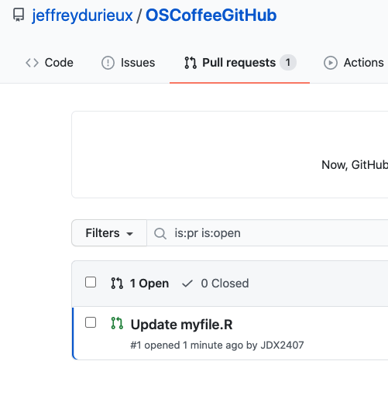

Slide 33
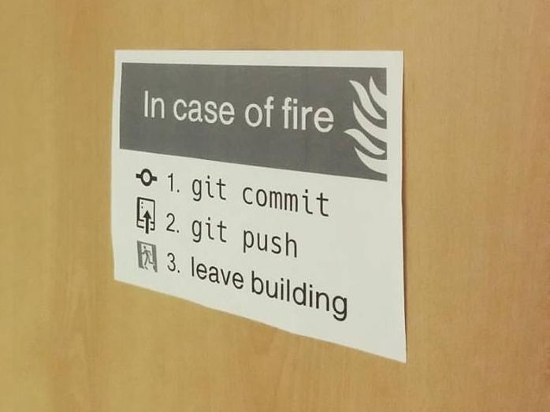
Links
https://git-scm.com/
https://git-scm.com/book/en/v2/Getting-Started-Installing-Git
https://www.toolsqa.com/git/difference-between-git-clone-and-git-fork/#:~:text=When%20you%20fork%20a%20repository,with%20the%20help%20of%20Git.

