Slide 1


Spatial Analysis in R: An introduction to data manipulation, spatial data analysis and statistical modeling Day 1 Vector topology operators, raster integration and distance/proximity analysis
Jeffrey S. Evans, Ph.D.,
Senior Landscape Ecologist & Biometrician
The Nature Conservancy | Protected Lands Science
Visiting Professor | University of Wyoming | Zoology & Physiology
Laramie, WY | jeffrey_evans@tnc.org | (970) 672-6766

Slide 2
Vector operations

Slide 3
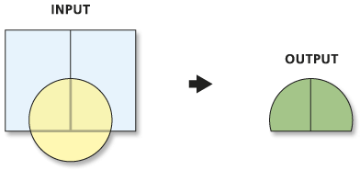
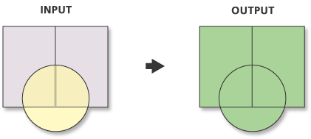
Overlay (historic topology predicates)
Intersection
Combines features into a unique combination of features based on the common intersection of the input features geometry.
Identity
Identity is used to assign attributes from an intersect feature (eg., point in polygon).
Union
Combines features into all combinations of features based on the common intersection of the input features geometry. Attribution represents all possible combinations of input features that intersect.

Slide 4

Overlay (DE-9IM GEOS topology predicates)
Where; dim is the dimension of the intersection (∩) of the interior (I), boundary (B), and exterior (E) of geometries a and b.
Intersect(s) | Union (also dissolve)
Touches | Equals
Covers | Proximity
Contains | Distance (within)
Overlaps | Crosses
Within | Contingency
Difference | Join
Resulting operators
DE-9IM definition: https://en.wikipedia.org/wiki/DE-9IM
sf implementations: https://www.r-spatial.org/r/2017/06/22/spatial-index.html

Slide 5
Overlay
Buffer
Creates unique polygon(s), for each; point, polygon or line, based on a fixed or variable distance criteria.
Fixed point; d = x
Fixed polygon; d = x
Variable point; d_{i} = x_{i}…n_{i}

Slide 6
Raster-vector integration
Attribution
Assigns attributes from one feature class to another. Where point in polygon “Identity” is a form of attribution, assignment of raster values to a vector feature class is more the definition of attribution.
If you extent polygon attribution to derive an explicit statistical or functional summary then you have zonal analysis.
Point sample locations
Raster
(cell values)
1 | 5 | 5
1 | 10 | 10
1 | 1 | 10
1
10
1
10
Point attribution
1 | 5 | 5
1 | 10 | 10
1 | 1 | 10
p_{i}=c(1,5,1,10)
Polygon attribution

Slide 7
Raster-vector integration
Zonal
Assigns a function or statistical summary of underlying raster values to each discrete zonal unit (“polygon”).
Percent of “1” in zonal unit
1 | 5 | 5
1 | 10 | 10
1 | 1 | 10
p_{i}=c(1,5,1,10)
pct = function(x, i) {
length(x[x==i]) / length(x)
}
p = pct(poly, 1)
p_{i}=0.5
Zonal polygon attribution

Slide 8
Overlay, intersection and raster integration functions
sp library – over function provides overlay functions for all feature class types. However, functions listed below depreciate over.
spatialEco library – point.in.poly() for overlay and attribution for points in polygons and spatial.select for spatial joins.
rgeos and sf libraries –
gIntersect, st_intersects - intersection of feature topology
gUnion, st_union - union of feature topology
gBuffer, st_buffer - buffer functionality.
st_join - spatial join functionality.
Among many other functions for overlay and intersection identity
raster library – intersect function nice wrapper for the rgeos gIntersects functions and returns SpatialDataFrame objects.
extract() provides extraction of raster values associated with vector feature classes.
exactextractr library – very fast raster extraction

Slide 9
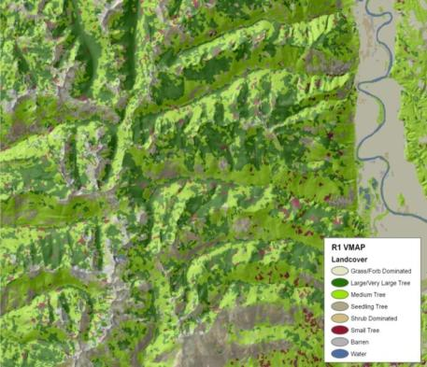
Custom peripheral zonal function
Peripheral
percent

Slide 10
Distance and
Neighbor Relationships

Slide 11
Distance and Neighbor relationships
Distance is the geographic distance to a neighbor, set of neighbors or feature.
Distance can also be defined as the scaled multivariate distance to observations in the same data.
A neighbor can be defined by distance or contingency where, contingency relates to polygons that are directly touching (1st order), touching neighbors (2nd order) or touching neighbors of neighbors (3rd order), etc…
The W_{ij} matrix is a binary or distance weights matrix representing neighbor relationships

Slide 12
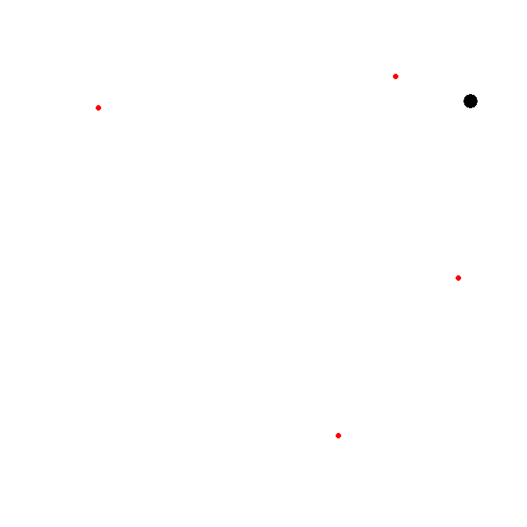
Distance and Neighbor analysis (distance matrix)
d₃
d₁
Distance matrix of all pair-wise distances
d₂
 | 1 | 2 | 3 | 4 | 5
1 | 0 | 1005.783 | 1731.18 | 1417.95 | 379.47
2 | 1005.78 | 0 | 942.02 | 1892.14 | 842.14
3 | 1731.18 | 942.02 | 0 | 1932.14 | 1710.26
4 | 1417.95 | 1892.14 | 1932.15 | 0 | 1770.25
5 | 379.47 | 842.14 | 1710.26 | 1770.25 | 0
d₄
Distance

Slide 13
Distance and Neighbor analysis (distance weighted)
d₃
d₁
value to be estimated
d₂
value z_{i ,} location x_{i}
weight w_{i} distance d_{i}
d₄
The estimate is a weighted average
Weights decline with distance
Distance

Slide 14
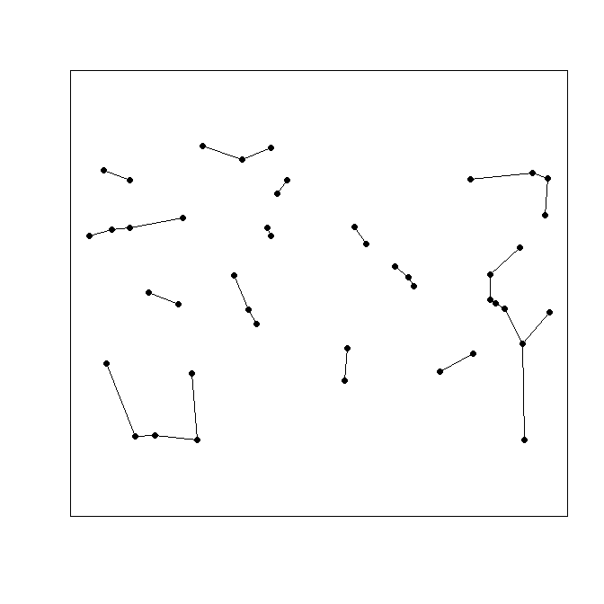
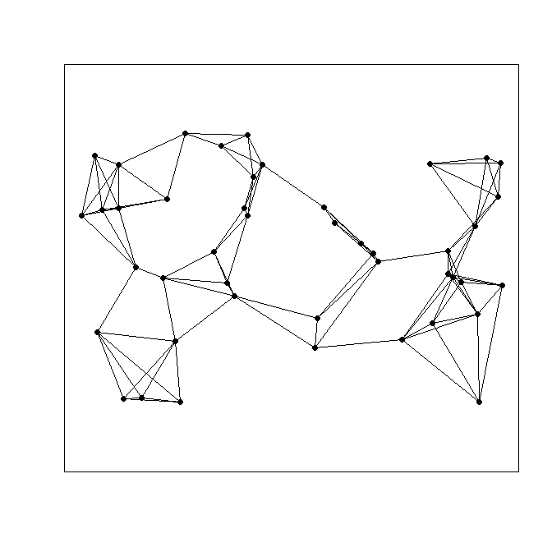
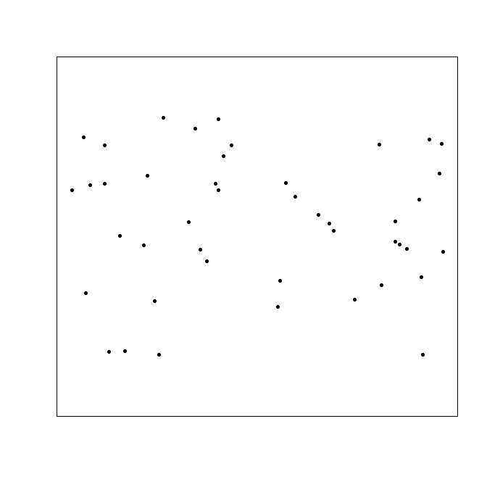
Distance and Neighbor analysis (contingency)
Neighbor contingency kNN=1
Neighbor contingency kNN=4

Slide 15
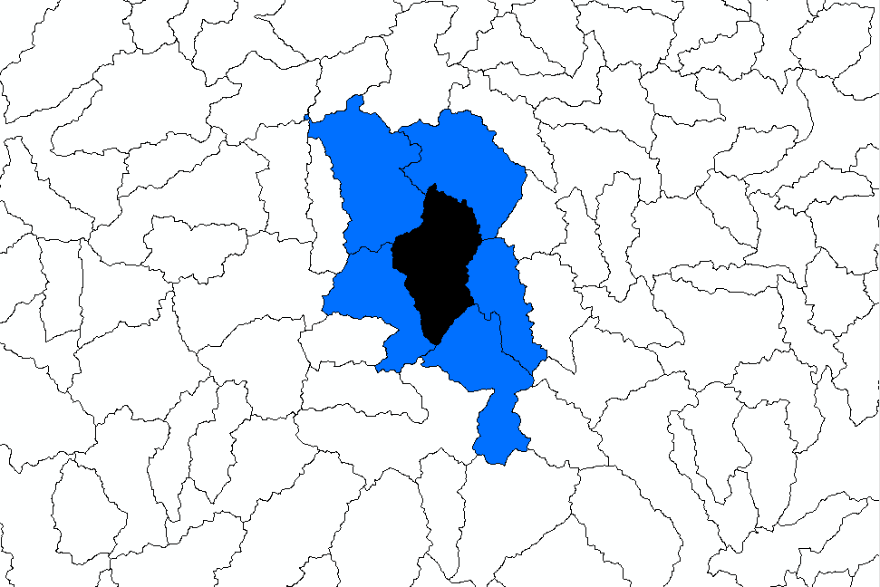
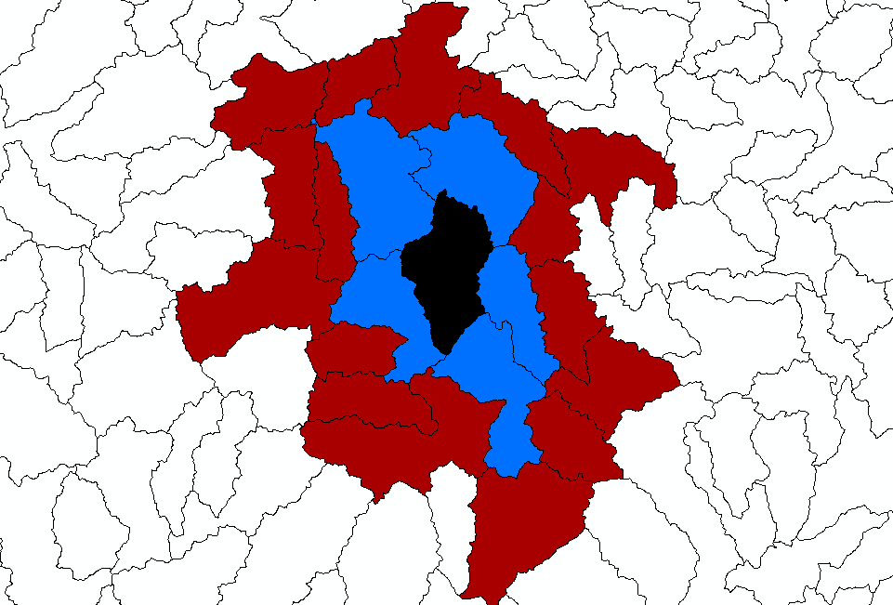
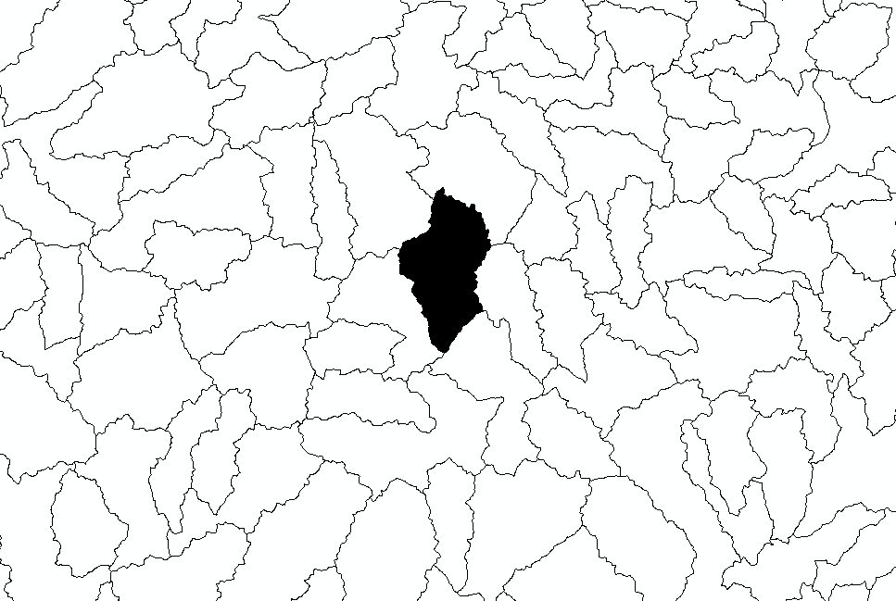
Distance and Neighbor analysis
Second order neighbors
First order neighbors
Neighbor contingency

