Slide 1


Spatial Analysis in R: An introduction to data manipulation, spatial data analysis and statistical modeling Day 2 Raster analysis
Jeffrey S. Evans, Ph.D.,
Senior Landscape Ecologist & Biometrician
The Nature Conservancy | Protected Lands Science
Visiting Professor | University of Wyoming | Zoology & Physiology
Laramie, WY | jeffrey_evans@tnc.org | (970) 672-6766

Slide 2
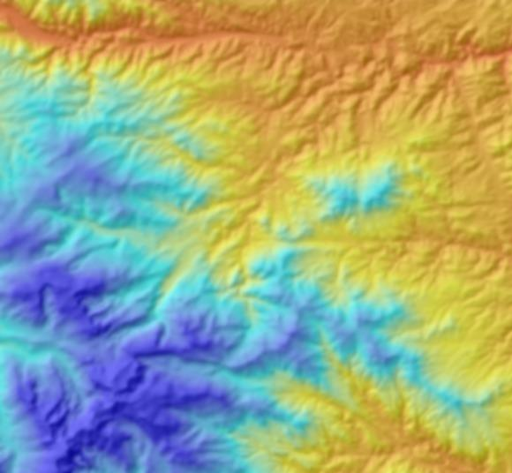
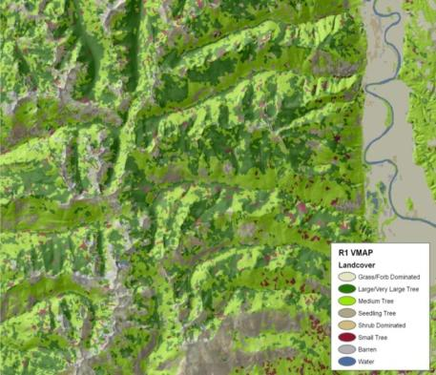
Data type
Continuous
Nominal
Characterization of vegetation
discrete schema

Slide 3
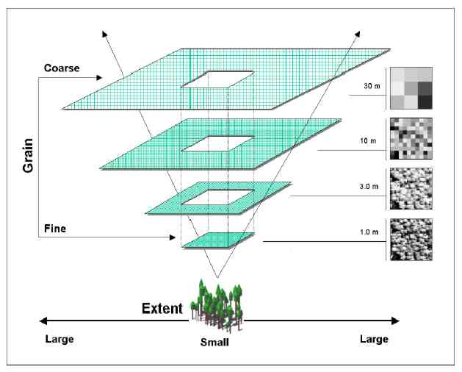
Scale

Slide 4
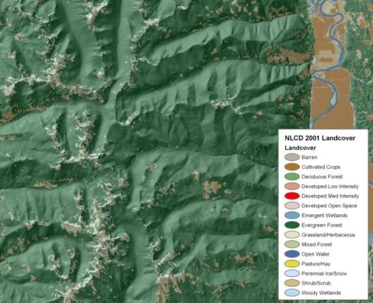
Scale
USFS R1 VMAP
USGS NLCD
Characterization of vegetation
discrete schema
Classification Scale

Slide 5
Gradient hierarchy
Binary level
Two class
Broad scale
Multi-class level
Nominal measurement scale
Mid-scale
Gradient level
Fine scale
Continuous measurement scale

Slide 6
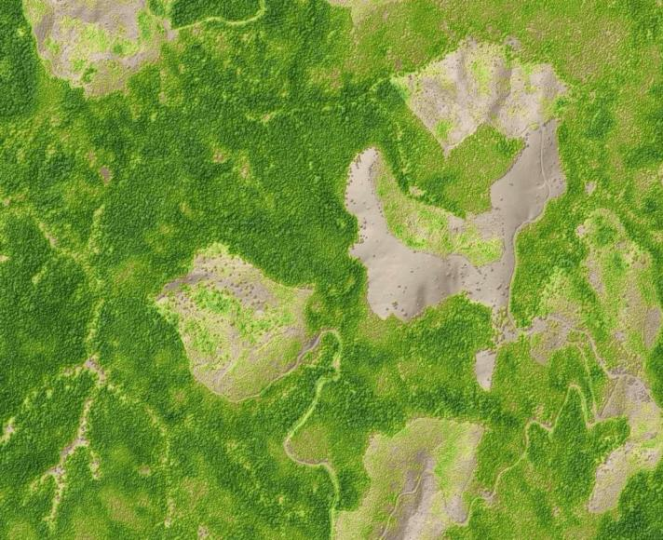
Raster operations - univariate
Entire raster
δ(x)

Slide 7
Raster operations - overlay
Multiple rasters

Slide 8
Raster operations - focal
Moving windows
δ(x,y_{n…i})

Slide 9
Raster operations - focal
Multi-scale moving windows
δ(Z_{ij})(d_{s})

Slide 10
Raster operations - focal
δ(x,y_{n…i})
Multiple rasters moving windows

Slide 11
Rasters in R – sp library
sp raster objects are similar to other feature classes and are just stored as a systematic point array or grid mesh.
Slots for a “SpatialPixelsDataFrame“ are generally: @data, @grid, @coords, @bbox, @proj4string
Can be imported using “readGDAL” in “rgdal” library but, not memory safe
Useful for multi-attributed rasters (eg., landcover, soil, etc..)

Slide 12
Rasters in R – raster library
Raster class objects are similar to S4 sp objects with slots but with some similarities to list objects.
Unlike slots, that can be called directly, you have to use specific functions to return object attributes.
Can process data out-of-memory making large raster processing memory safe.

Slide 13
Rasters in R – raster library
Imports all formats that GDAL can read in addition to netCCF and HDF 4/5
Single raster – raster()
Multiple rasters – stack() or brick()
Requires matching origin, extent, cell resolution, rows, columns
Can be used to combine individual rasters.

Slide 14
Rasters in R – raster library
Large number of functions for providing capacity, comparable to a GIS, along with considerably more customization.
Vector extraction
Resampling and aggregation
Focal
Overlay
Projection and transformation
Coercion (matrix, vector, class)
Prediction
Out-of-memory operation
Block exchange

