Slide 1
Global versus local autocorrelation
Can identify clustering
Can identify specific clusters (significant local clusters in the absence of global autocorrelation)
Can distinguish between homogeneity and heterogeneity (e.g., spatial outliers - highs surrounded by lows, and vice versa)
Can identify hot/cold spots
Can quantify nonstationarity (local deviations from global pattern of spatial autocorrelation)

Slide 2
LISA (Local Indicators of Spatial Association

Slide 3
LISA (Local Indicators of Spatial Association - Randomization

Slide 4
Getis-Ord G_{i}
contiguity based upon distance band defined by d_{r}
d_{r} may be obtained from a semivariogram plot
one statistic for each observation
G_{i}(d_{r}) > 0 signifies clustering of high values
G_{i}(d_{r}) < 0 signifies clustering of lows values
LISA fails to make this particular distinction

Slide 5
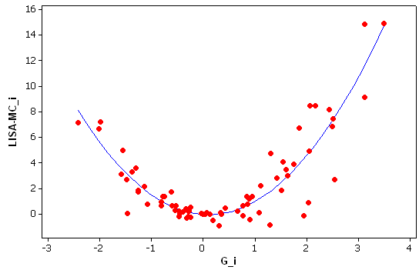
Relationship between LISA and G_{i}
The quadratic trend is why LISA cannot reliably distinguish between HH and LL clusters, while G_{i} can.

