Slide 1


Spatial Analysis in R: An introduction to data manipulation, spatial data analysis and statistical modeling Raster analysis
Jeffrey S. Evans, Ph.D.,
Senior Landscape Ecologist & Biometrician
The Nature Conservancy | Protected Lands Science
Visiting Professor | University of Wyoming | Zoology & Physiology
Laramie, WY | jeffrey_evans@tnc.org | (970) 672-6766

Slide 2
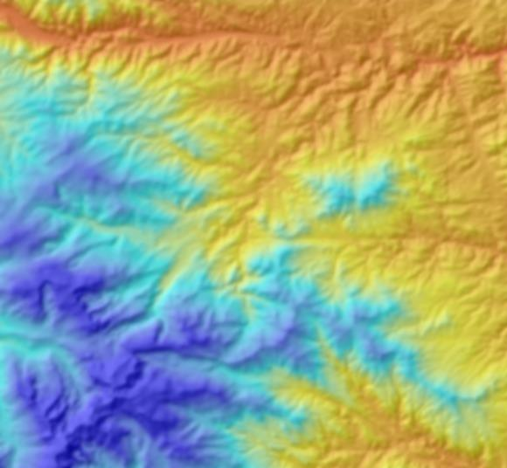
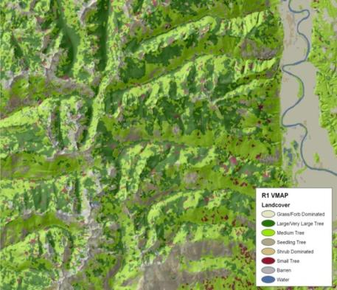
Data type
Continuous
Nominal
Characterization of vegetation
discrete schema

Slide 3
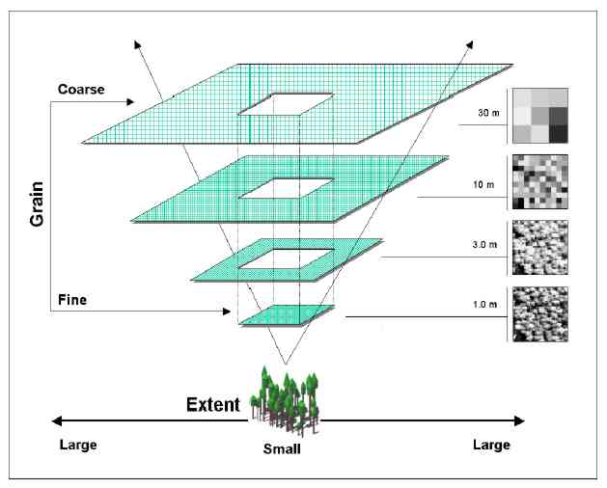
Scale

Slide 4
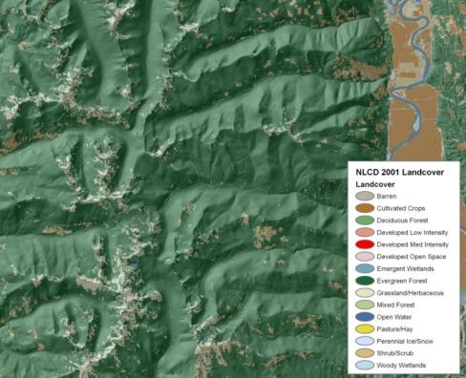
Scale
USFS R1 VMAP
USGS NLCD
Characterization of vegetation
discrete schema
Classification (domain)
Scale

Slide 5
Gradient hierarchy
Binary level
Two class
Broad scale
Multi-class level
Nominal measurement scale
Mid-scale
Gradient level
Fine scale
Continuous measurement scale

Slide 6
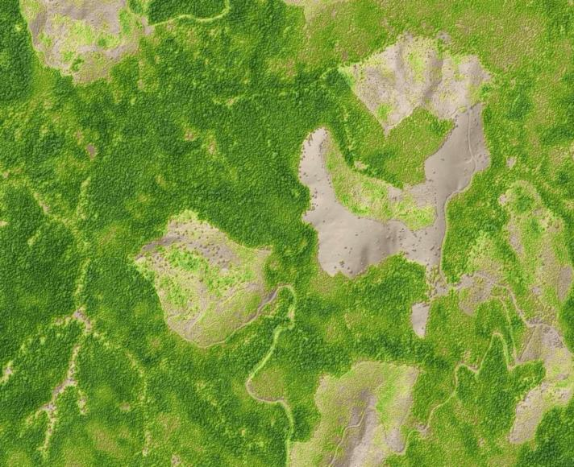
Raster operations - univariate
Entire raster
δ(x)

Slide 7
Raster operations - overlay
Multiple rasters

Slide 8
Raster operations - focal
Moving windows
δ(x,y_{n…i})

Slide 9
Raster operations - focal
Multi-scale moving windows
δ(Z_{ij})(d_{s})

Slide 10
Raster operations - focal
δ(x,y_{n…i})
Multiple rasters moving windows

Slide 11
Rasters in R – terra library
Large number of functions for providing capacity, comparable to a GIS, along with considerably more customization.
Vector extraction
Resampling and aggregation
Focal
Overlay
Projection and transformation
Coercion (matrix, vector, class)
Prediction
Out-of-memory operation
Block exchange

