Slide 1



rapr: representative and adequate prioritisations in R
Jeffrey Hanson
PhD supervisors: Richard Fuller & Jonathon Rhodes
jeffrey.hanson@uqconnect.edu.au
jeffrey-hanson.com

Slide 2
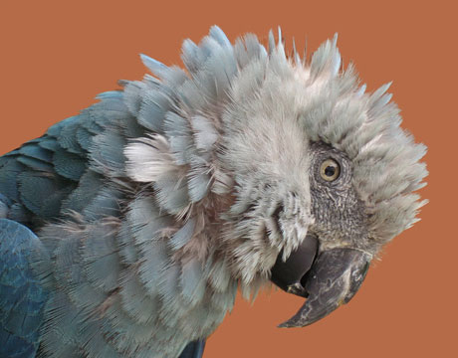
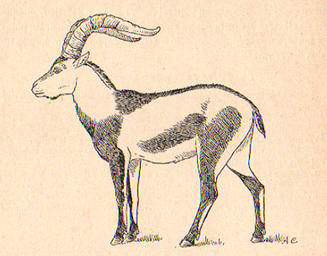
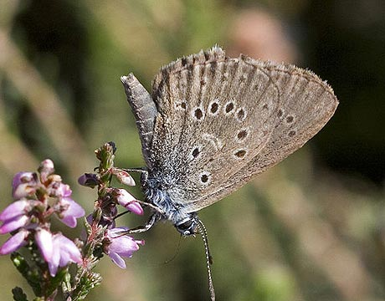
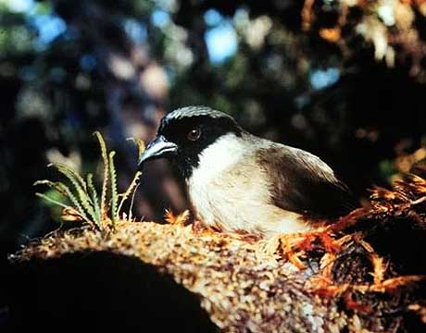
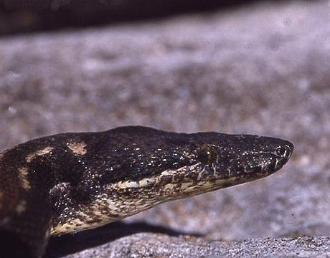
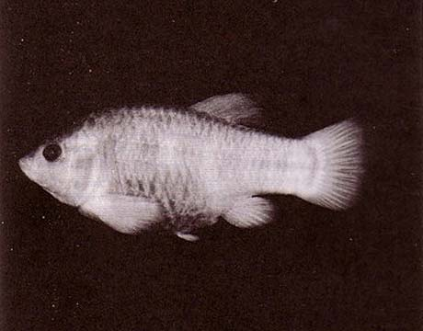
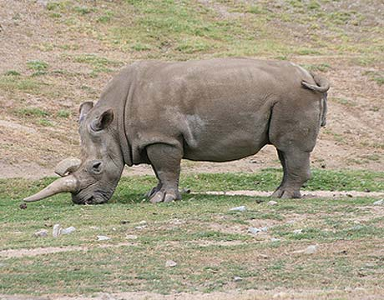
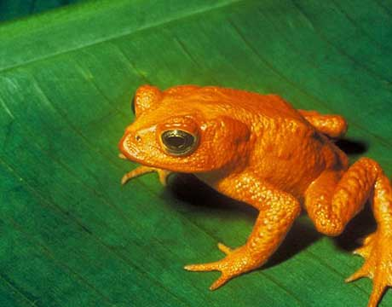
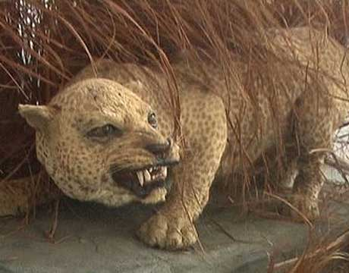
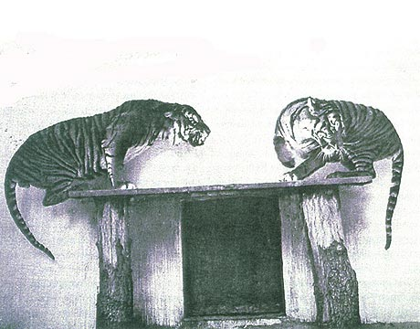
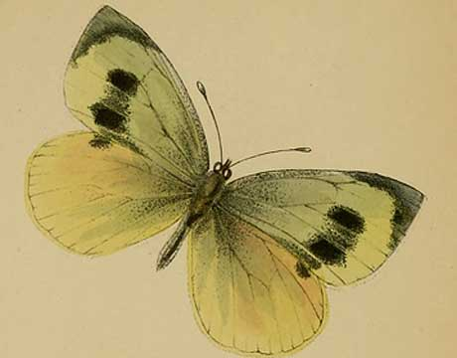
Global Biodiversity Crisis
Notes:
- high extinction rate
- conservation aims to maintain existing patterns of biodiversity and the processes that sustain them
- areas set aside to preserve biodiversity, and spearhead direct management actions

Slide 3
Reserve Selection
Notes:
- not all remaining habitat can be preserved
- achieve conservation objectives for minimal cost
- modern systematic conservation planning primarily focusses on representing species
- however, this ignores intra-specific biodiversity

Slide 4
Reserve Selection

Slide 5
Reserve Selection

Slide 6
Criteria: Adequacy
Notes:
- not all remaining habitat can be preserved
- achieve conservation objectives for minimal cost
- modern systematic conservation planning primarily focusses on representing species
- however, this ignores intra-specific biodiversity

Slide 7
But what about biodiversity processes?
Species range
Population
Geographic
separation
Time +
other factors
Dispersal barriers

Slide 8
But what about biodiversity processes?
Species range
Population
Geographic
separation
Dispersal
barriers
Time +
other factors

Slide 9
But what about biodiversity processes?
Species range
Population
Geographic
separation
Obtain a representative sample of each species
Dispersal
barriers
Time +
other factors

Slide 10
Criteria: Adequacy & Representativeness
Notes:
- not all remaining habitat can be preserved
- achieve conservation objectives for minimal cost
- modern systematic conservation planning primarily focusses on representing species
- however, this ignores intra-specific biodiversity

Slide 11
Aims
Formulate unified reserve selection problem to identify adequate and representative networks
2. Explore the behaviour of the problem

Slide 12
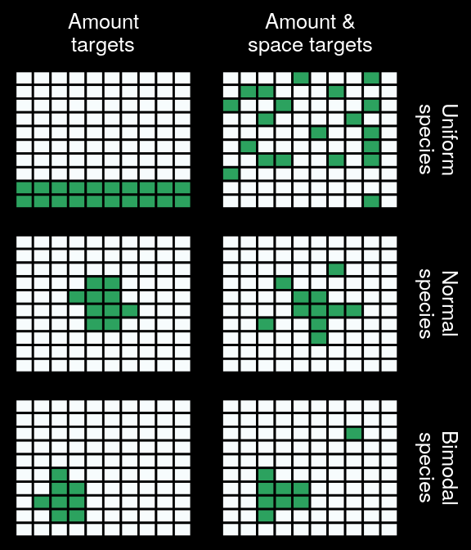
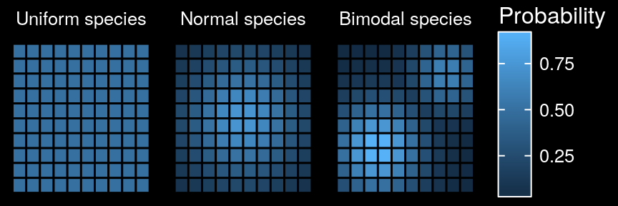
Uniform simulated species
Amount
target
Amount &
space targets
Distribution

Slide 13
Normal simulated species
Amount
target
Amount &
space targets
Distribution

Slide 14
Bimodal simulated species
Amount
target
Amount &
space targets
Distribution
Amount &
space targets
Distribution
Amount targets

Slide 15
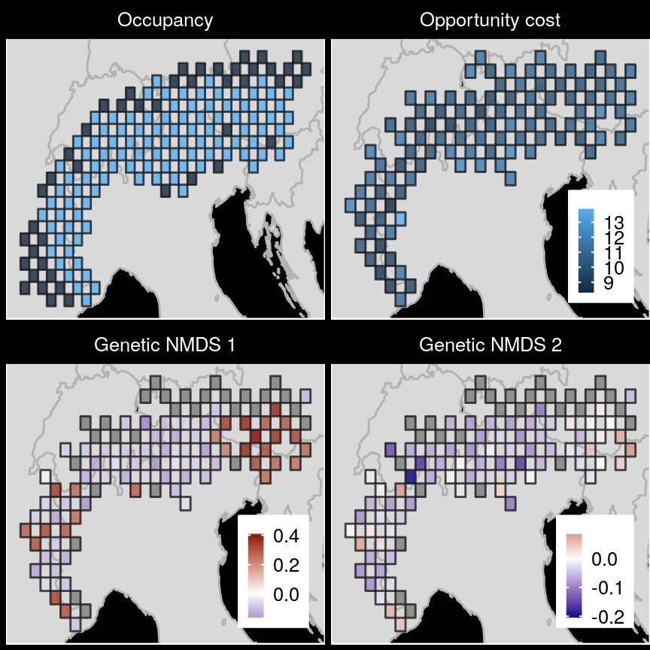
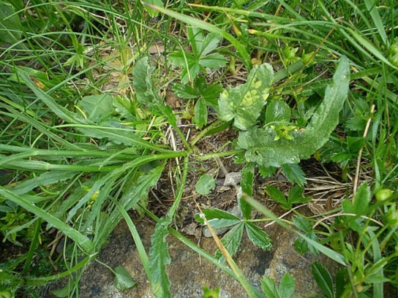
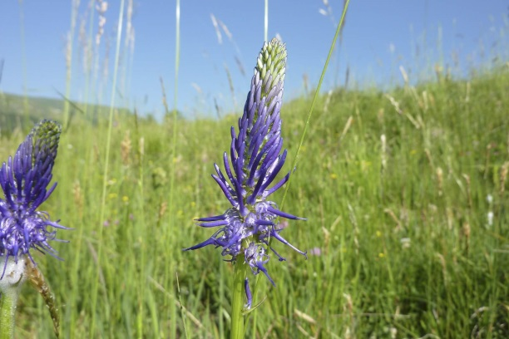
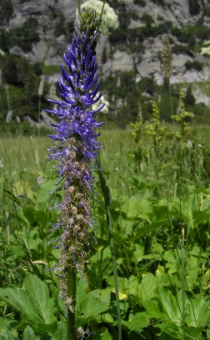
Case study

Slide 16
Case study

Slide 17
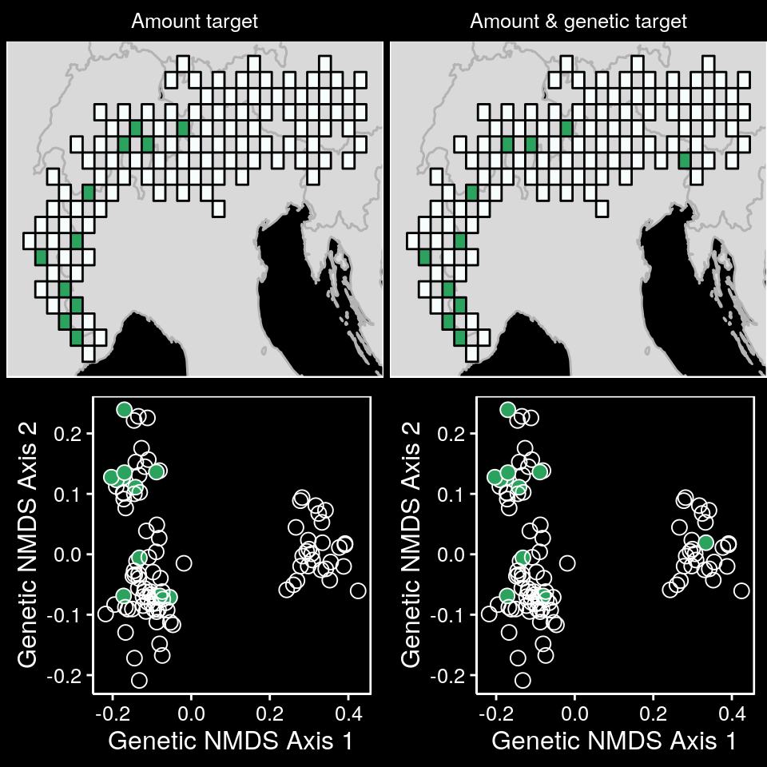
Case study

Slide 18
Case study

Slide 19
Case study

Slide 20
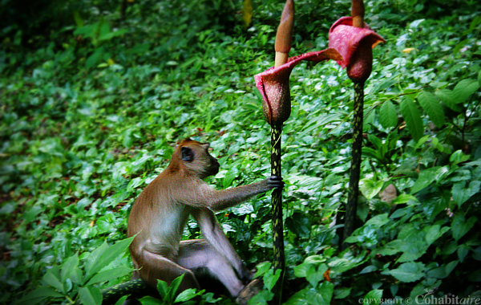
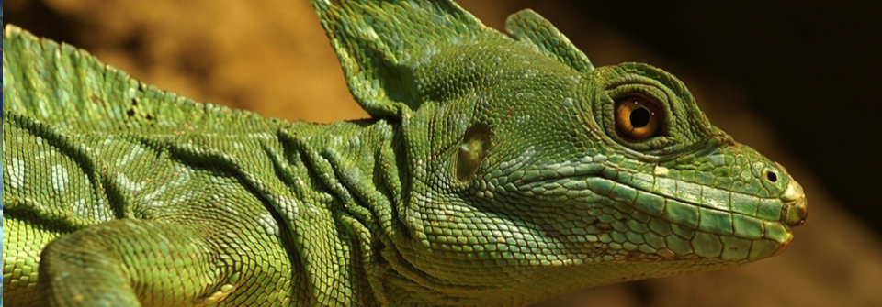
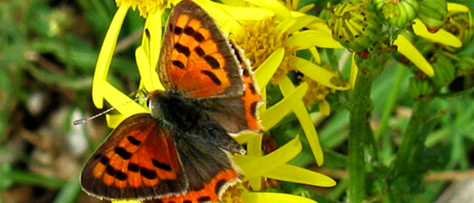
Unified reserve selection problem
explicitly accommodates the three criteria
applied to any system
secure any variation
biodiversity processes

Slide 21
Acknowledgements
Richard Fuller and the Fuller Lab
Jonathan Rhodes and the
Landscape Ecology and Conservation Group
Centre of Excellence for Environmental Decisions

Slide 22


jeffrey.hanson@uqconnect.edu.au
jeffrey-hanson.com
paleo13

