Slide 1


Effective surrogates for genetic variation in conservation planning
Jeffrey Hanson, Jonathan Rhodes
Cynthia Riginos, Richard Fuller
jeffrey.hanson@uqconnect.edu.au
jeffrey-hanson.com

Slide 2
Evolutionary processes
Species range
Population

Slide 3
Evolutionary processes
Species range
Population

Slide 4
Evolutionary processes
Species range
Population

Slide 5
Evolutionary processes
Species range
Population

Slide 6
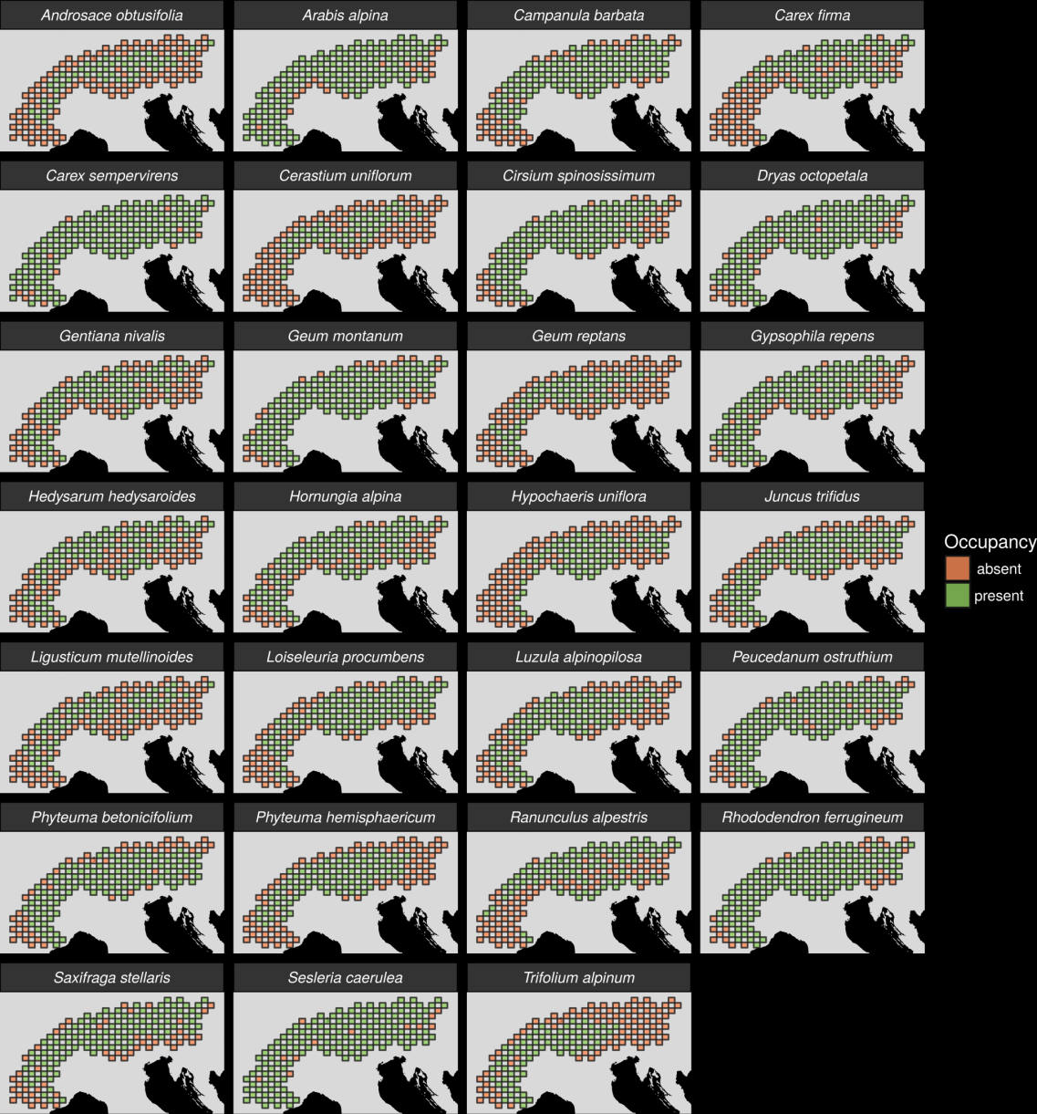
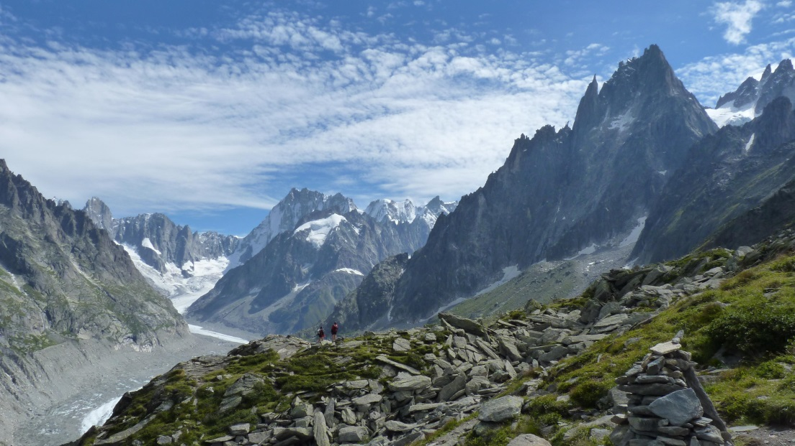
Study area and species
European alps
Data from IntraBioDiv project

Slide 7
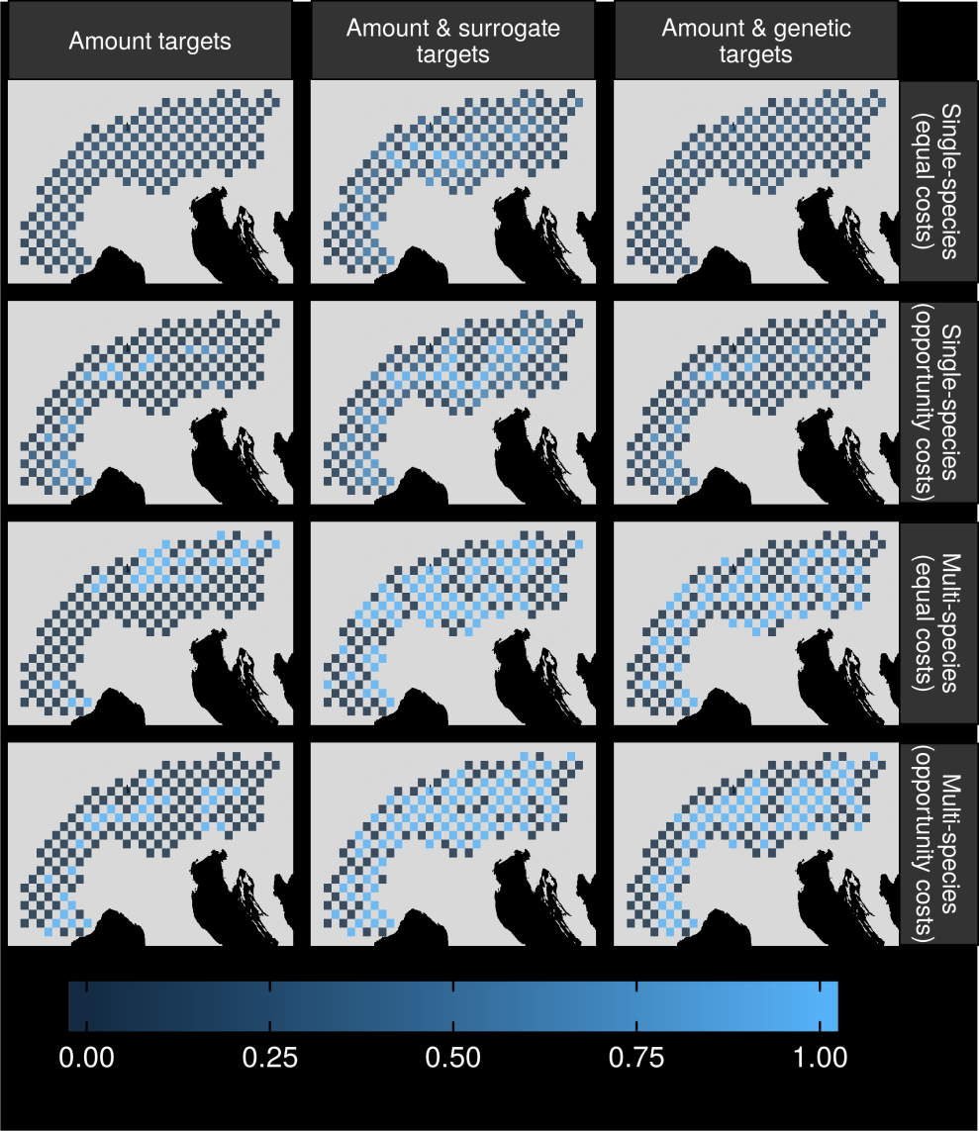
Can we make better decisions using surrogates?

Slide 8
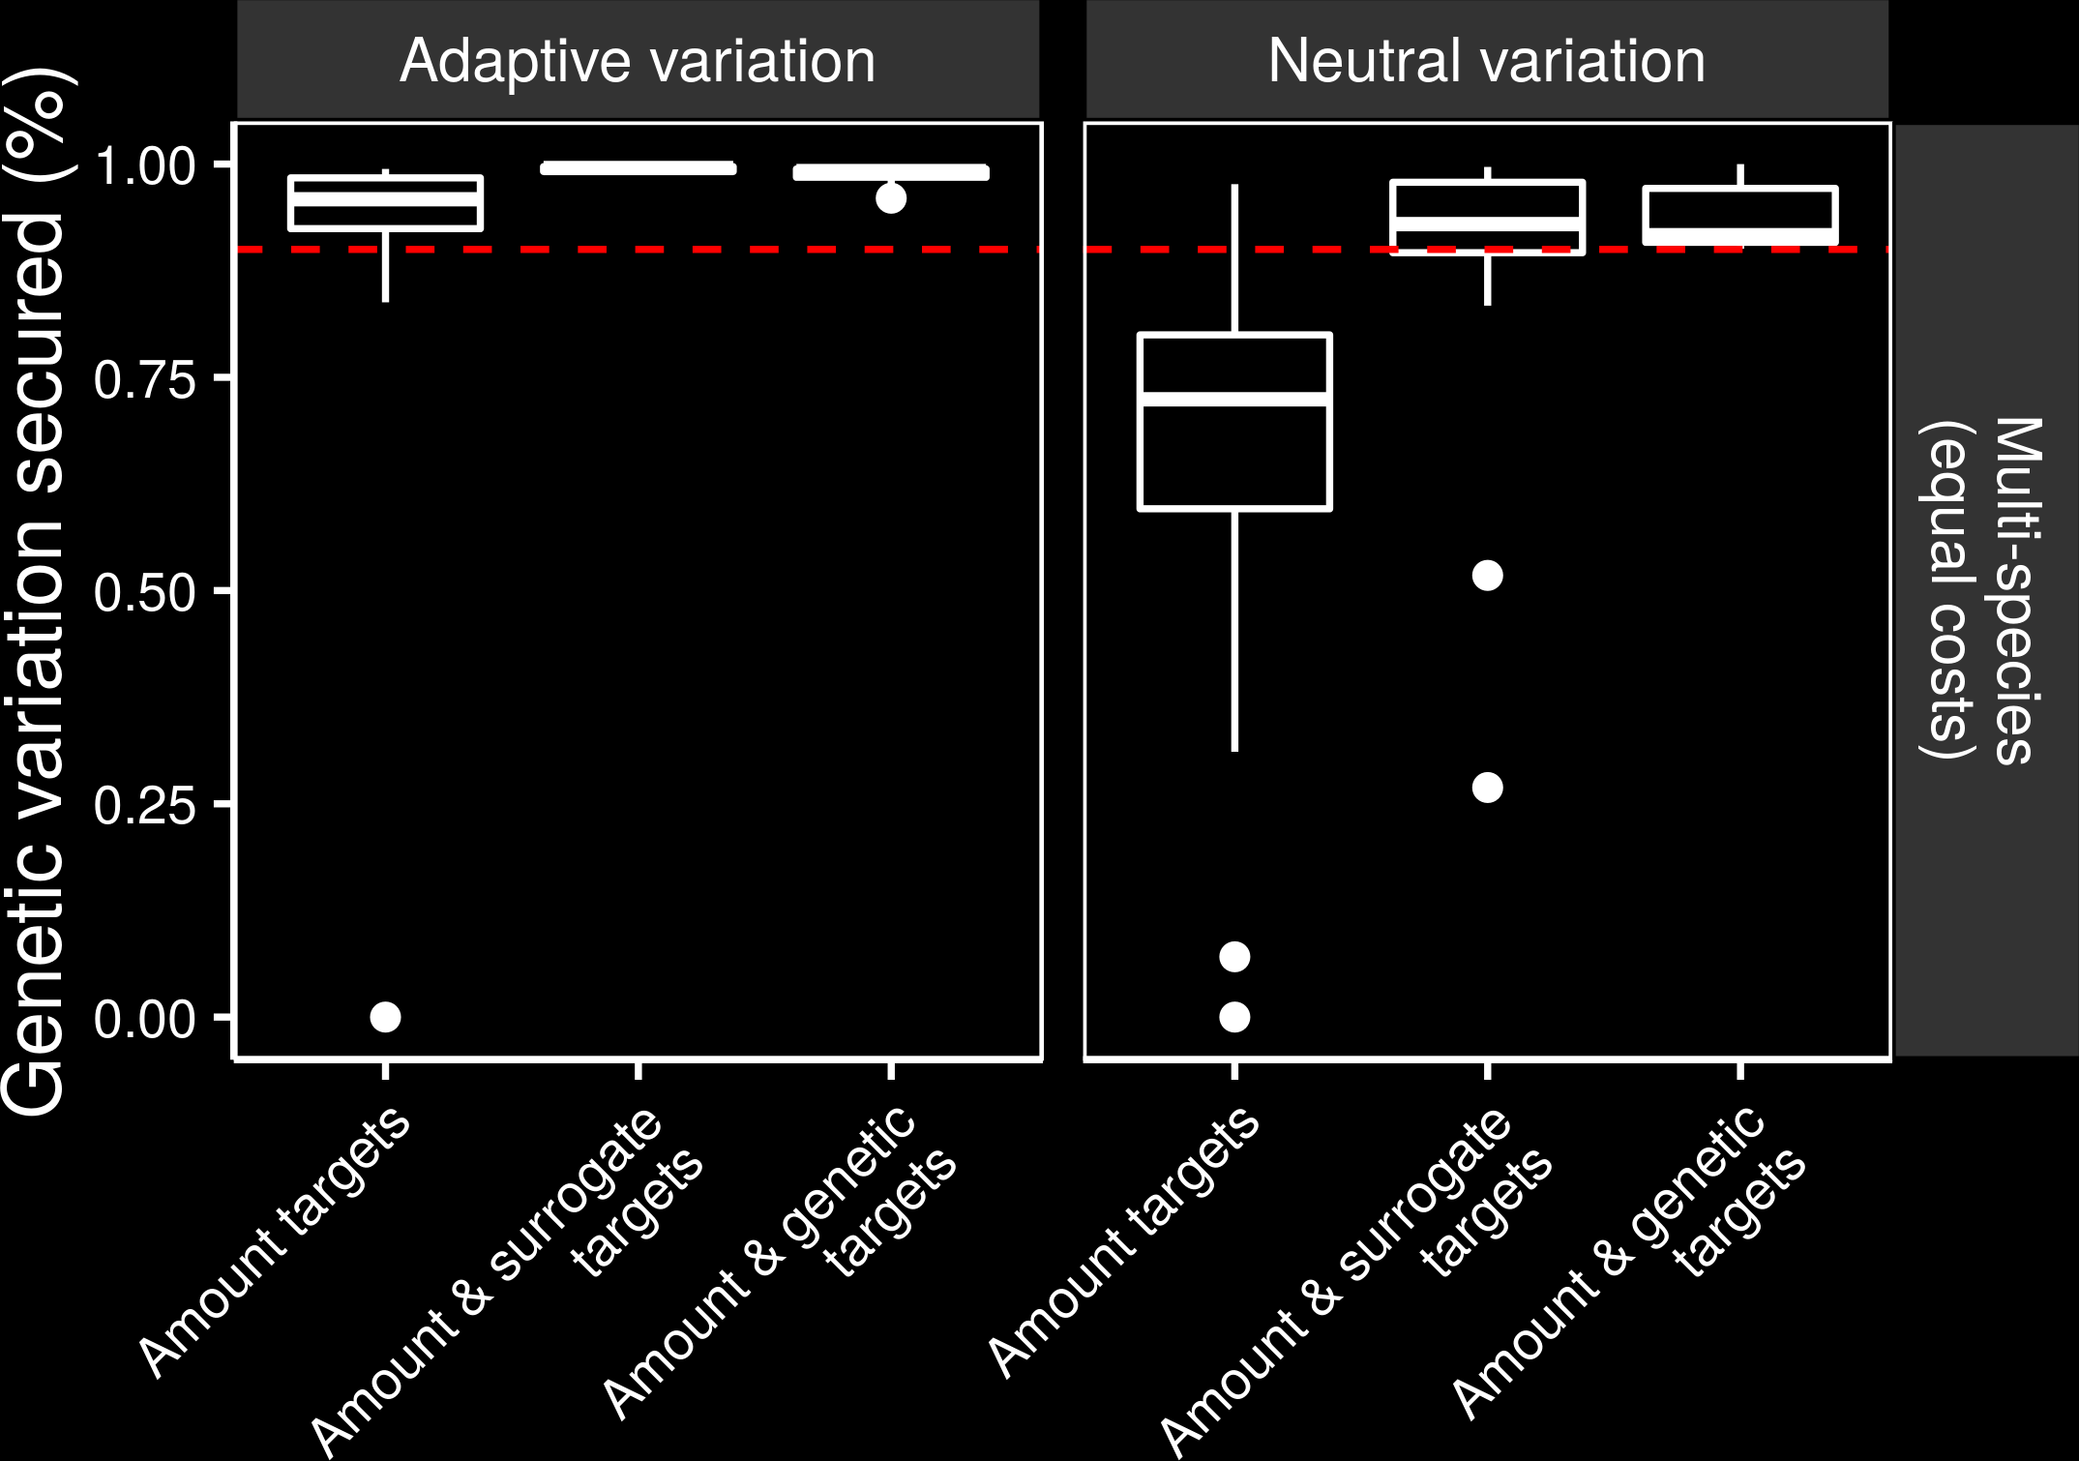
Can we make better decisions using surrogates?

Slide 9
Can we make better decisions using surrogates?

Slide 10
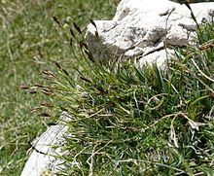
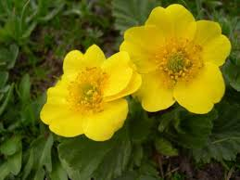
Surrogate performance
Effective for most species
Conventional methods may capture adaptive variation
Performance of geographic distances may depend on dispersal mechanisms

Slide 11



jeffrey.hanson@uqconnect.edu.au
github.com/jeffreyhanson
jeffrey-hanson.com

