Slide 1



Optimally allocating resources for gathering evidence and managing biodiversity
Jeffrey Hanson
jeffrey.hanson@uqconnect.edu.au
jeffrey-hanson.com

Slide 2

Acknowledgements
Jenny McCune
Iadine Chadès
Caitlyn Proctor
Joseph Bennett

Slide 3
Do something?
Biodiversity
Do nothing?
2000
2050
2100

Slide 4



Ecological surveys
Distribution maps
Prioritization
Biodiversity
2000
2100
Data
Information
Action
Outcome
Objectives
Constraints

Slide 5
Ecological surveys
Distribution maps
Prioritization
Biodiversity
?
?
?
?
?
?
2000
2100
Data
Information
Action
Outcome
More
data
Better
synthesis,
modelling
Better
management
Better
outcome
Objectives
Constraints

Slide 6
Ecological surveys
Distribution maps
Prioritization
Biodiversity
?
?
?
?
?
?
?
?
?
?
?
?
2000
2100
Data
Information
Action
Outcome
More
data
Better
synthesis,
modelling
Poorer
management
Worse
outcome
Objectives
Constraints
Less funding

Slide 7
How to design ecological surveys to gather more evidence?
Geographic
Coverage?
Environmental
conditions?
Cheapest places for
conservation actions?
Places where we think threatened species
might occur?
Places where we are uncertain if threatened species occur there?
No where?
Just use existing data
Can’t we just maximize
return on investment?

Slide 8
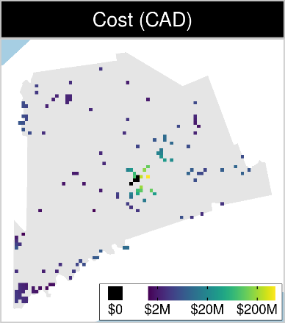
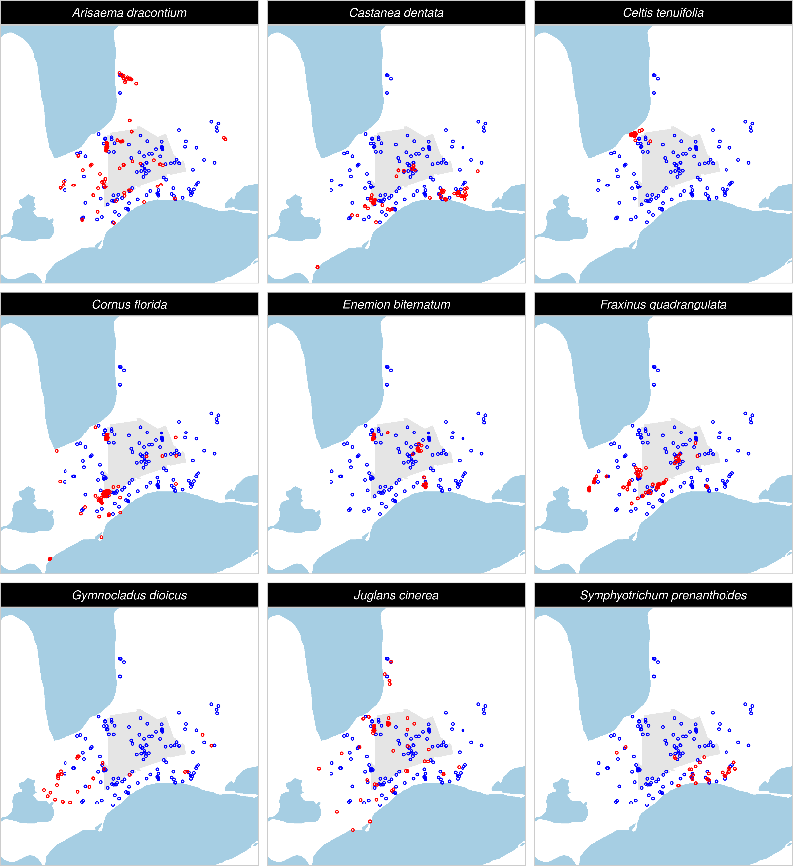
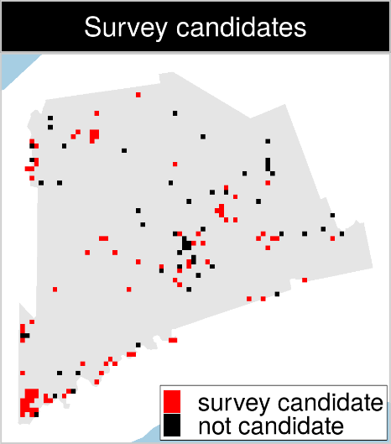
Case study: Middlesex county, Canada
XXX places potential
places for protected
area establishment
144 places that could potentially be surveyed to
improve existing data
9 imperilled plant species

Slide 9
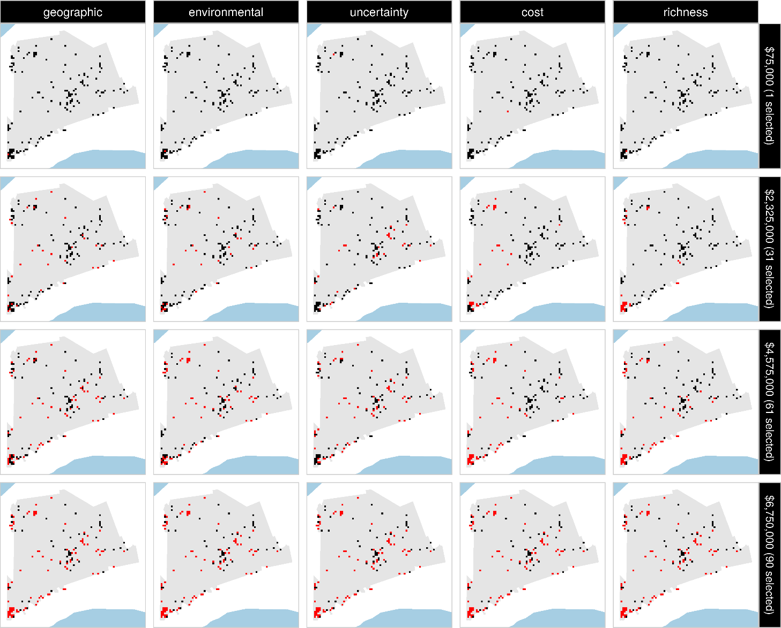

Slide 10
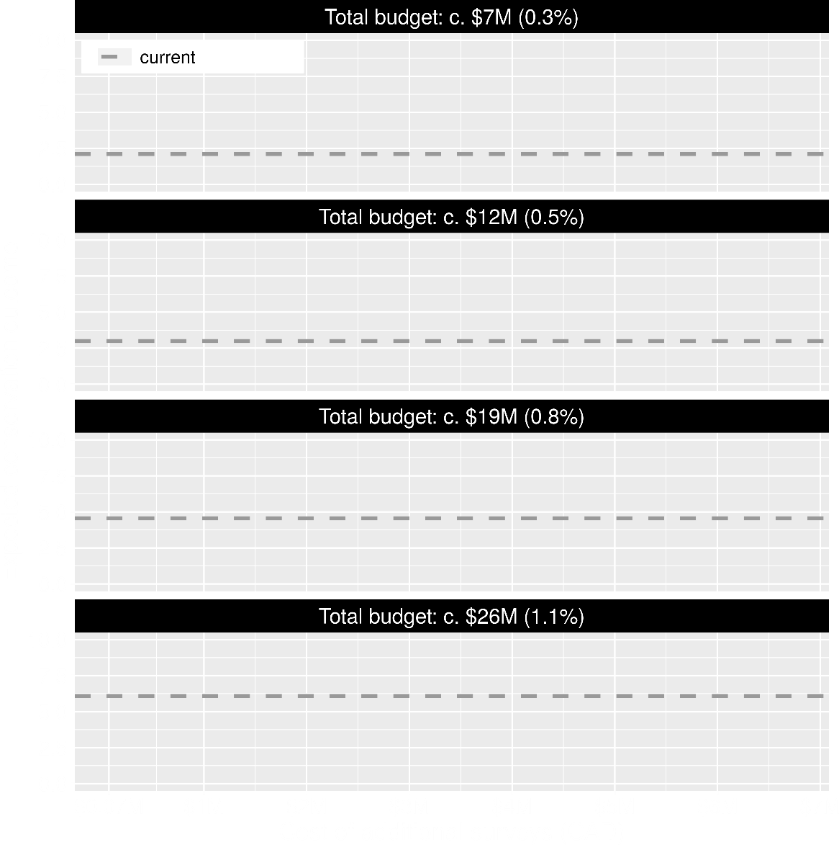
Value of information
Existing evidence leads to positive outcomes
More budget means better outcomes

Slide 11
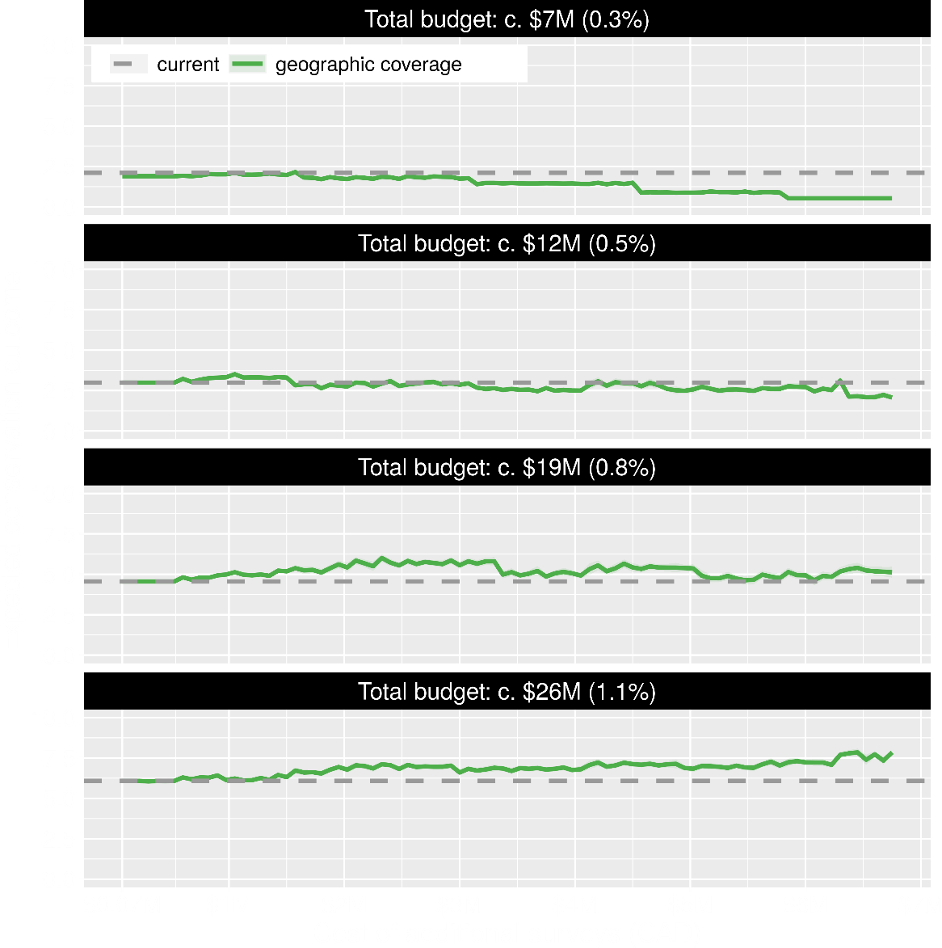
Value of information
Spending funds on gathering additional evidence can mean worse outcomes
Spending funds on gathering additional evidence can mean better outcomes too

Slide 12
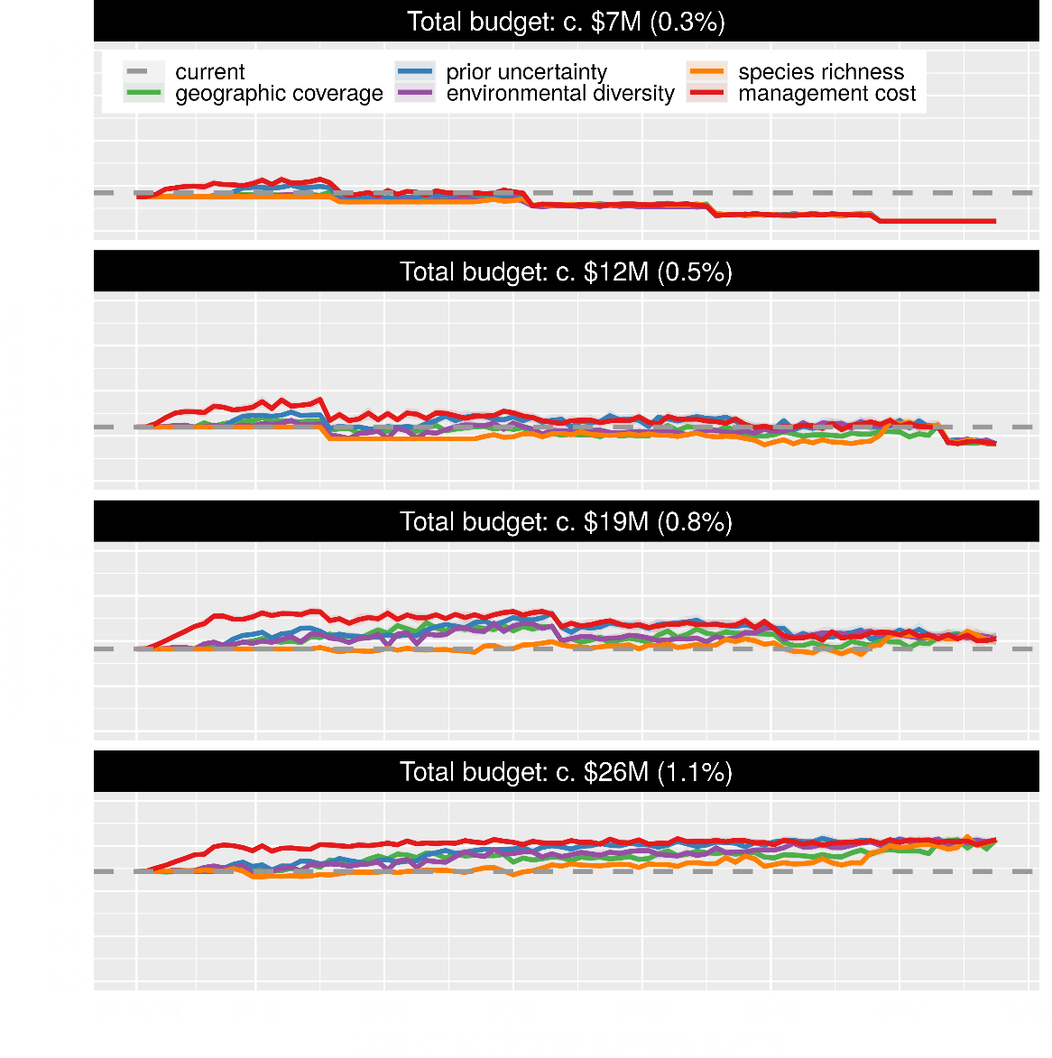
Value of information
Conventional approaches for gathering additional evidence have different performance
Performance of these approaches depends on available funds
All of them could lead to lead to worse outcomes

Slide 13
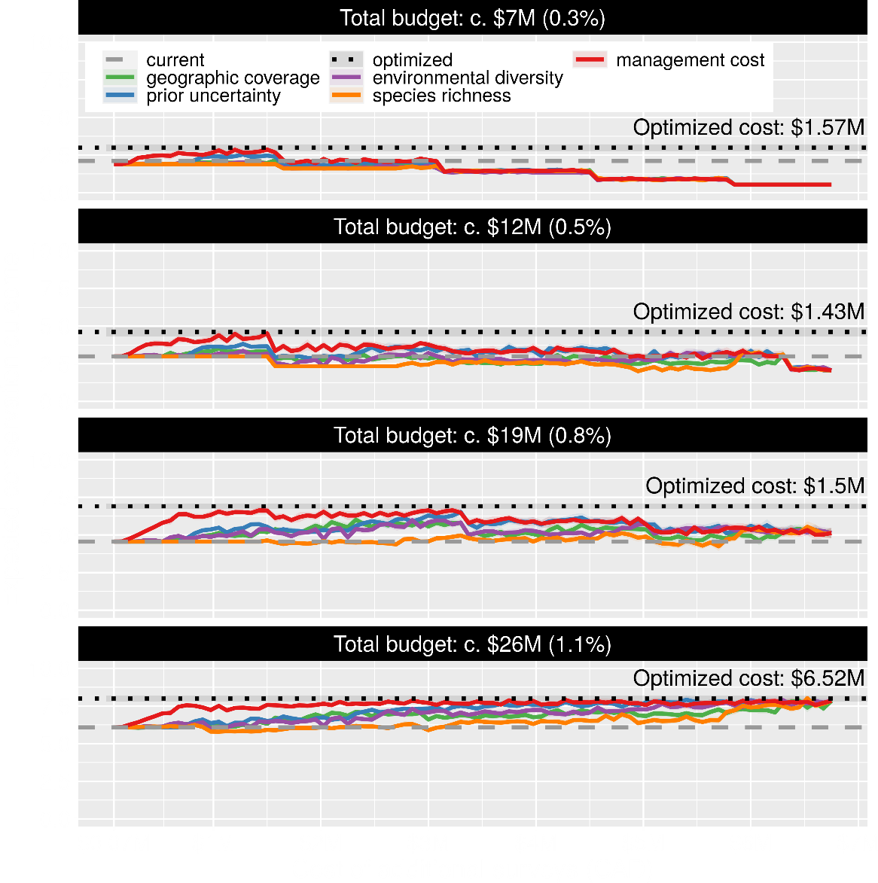
Value of information
Directly maximizing return on investment is best method for gathering evidence
This considers objectives and constraints that underpin conservation plans and their success

Slide 14
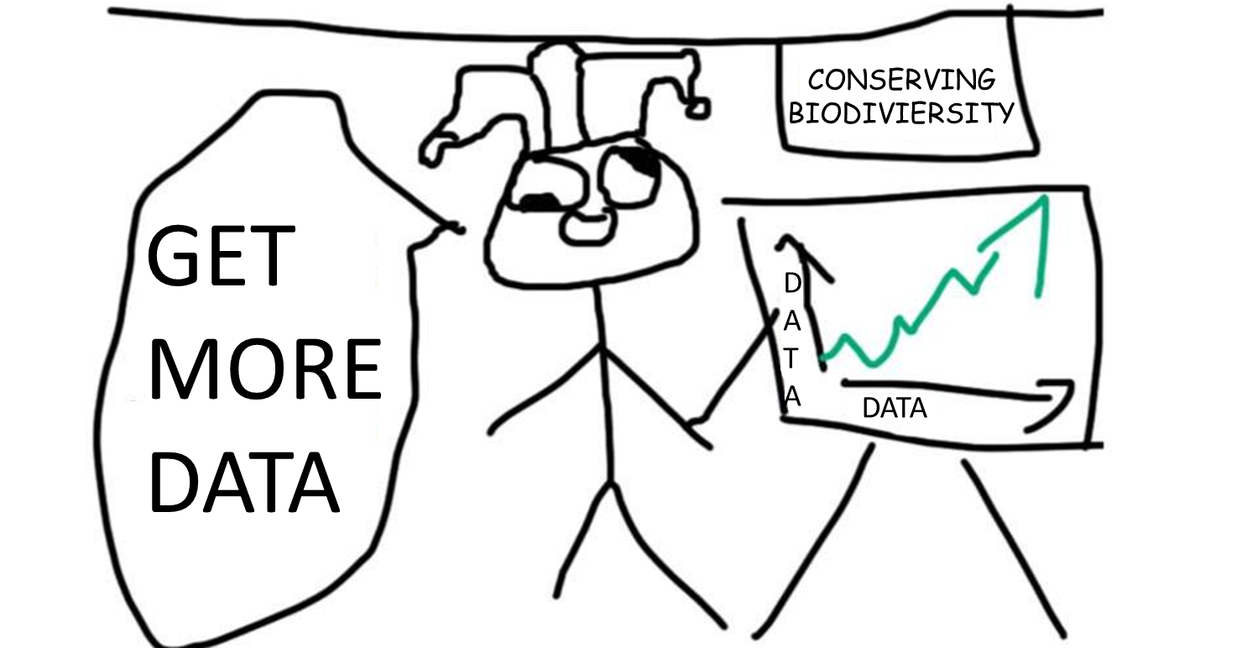
More evidence not always better

Slide 15



jeffrey.hanson@uqconnect.edu.au
github.com/jeffreyhanson
jeffrey-hanson.com

Slide 16
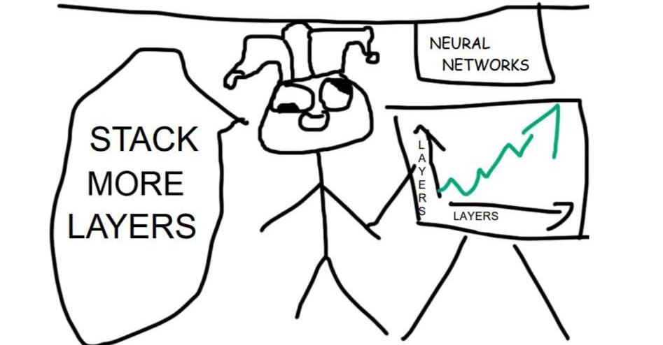
CONSERVING BIODIVIERSITY
GET
MORE
DATA
D
A
T
A
DATA

Slide 17
Appendix

Slide 18
Ecological surveys for
threatened spp.
Biodiversity
Detection
Non-detection
2000
2100
?
Data
Outcome

Slide 19
Ecological surveys for
threatened spp.
Spatial distribution of
threatened spp.
Detection
Non-detection
Data
Information
?
Outcome

Slide 20
Spatial distribution of
threatened spp.
Priorities for
protected areas
Information
Plan?
?
Data
Outcome

Slide 21
Ecological surveys
Distribution maps
Prioritization
Biodiversity
?
?
?
?
?
?
?
?
?
?
?
?
2000
2100
Objectives
Data
Information
Plan
Action
Outcome
More
data
Better
synthesis,
modelling
Poorer
management
Worse
outcome
Constraints
Less funding

