Slide 1
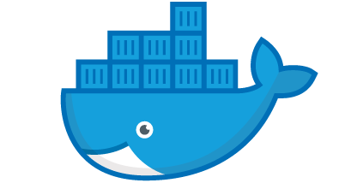

Introduction to Docker
Jeffrey Hanson
jeffrey.hanson@uqconnect.edu.au

Slide 2
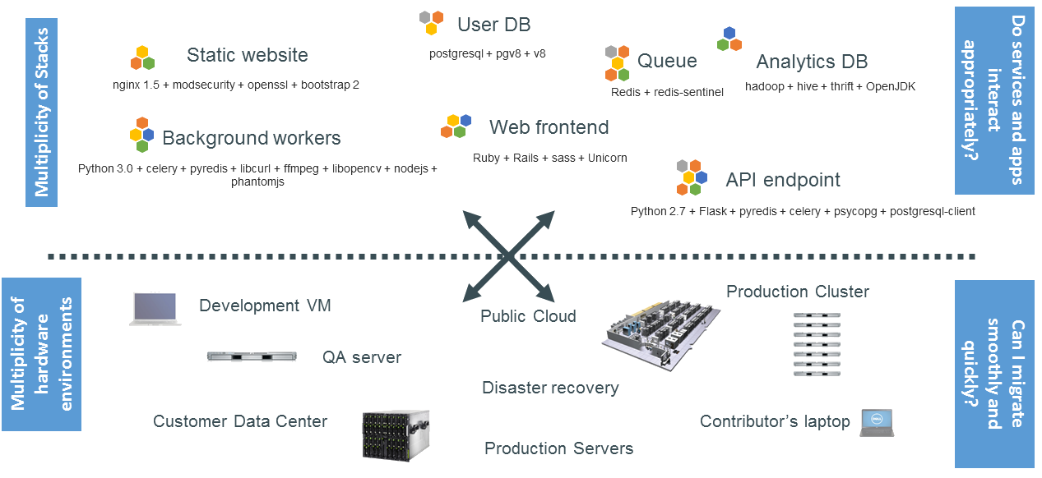
The problem…

Slide 3
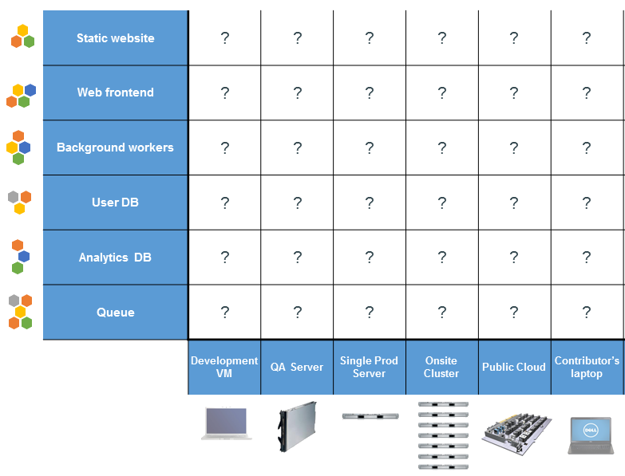
Nightmare matrix

Slide 4
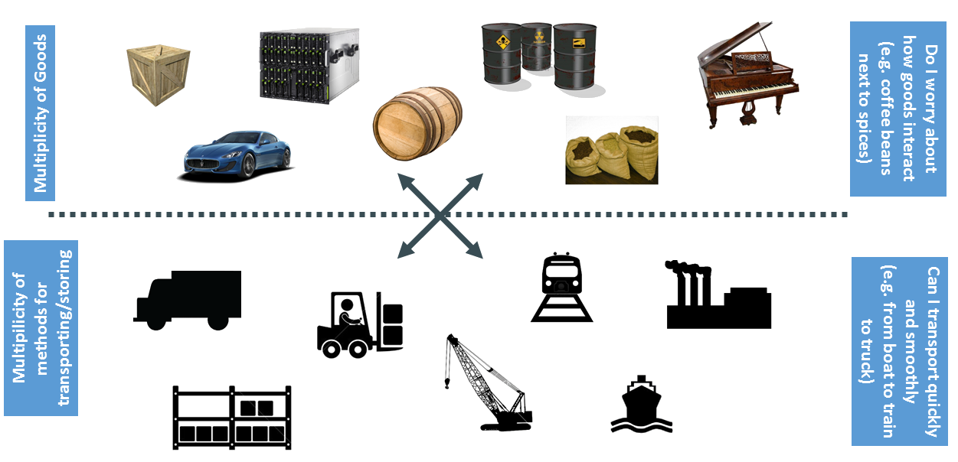
Cargo Transport Pre-1960

Slide 5
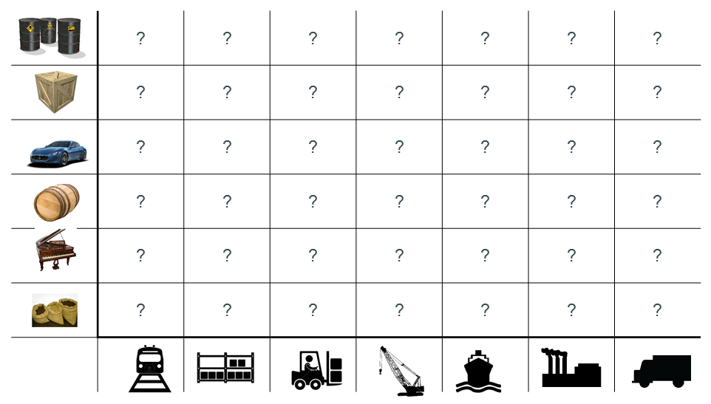
Also a nightmare matrix

Slide 6
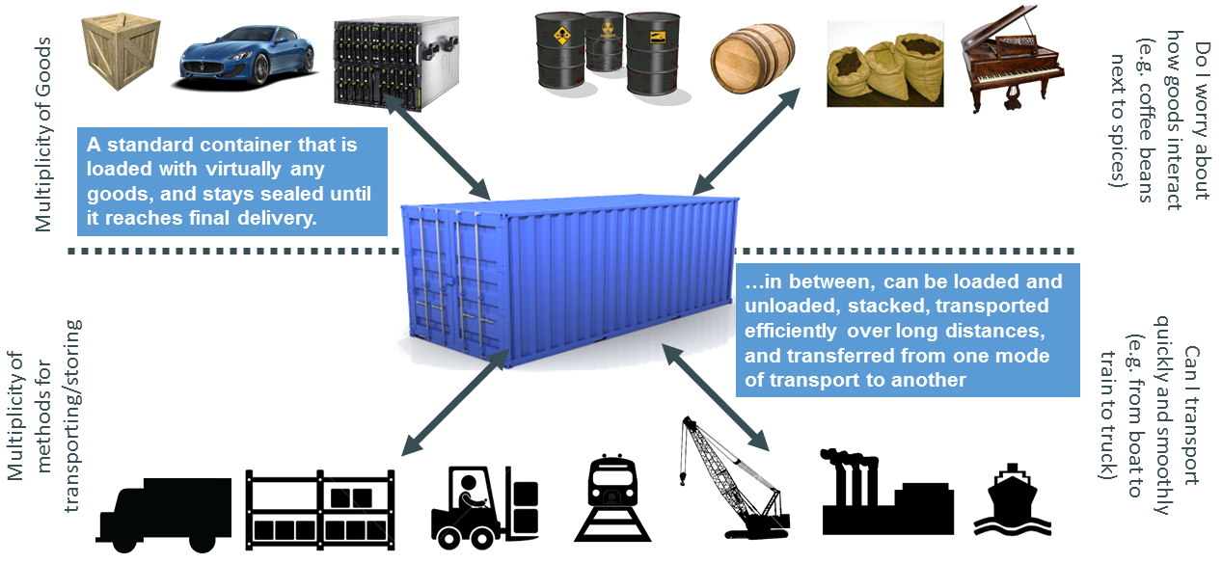
Solution: Intermodal shipping container

Slide 7
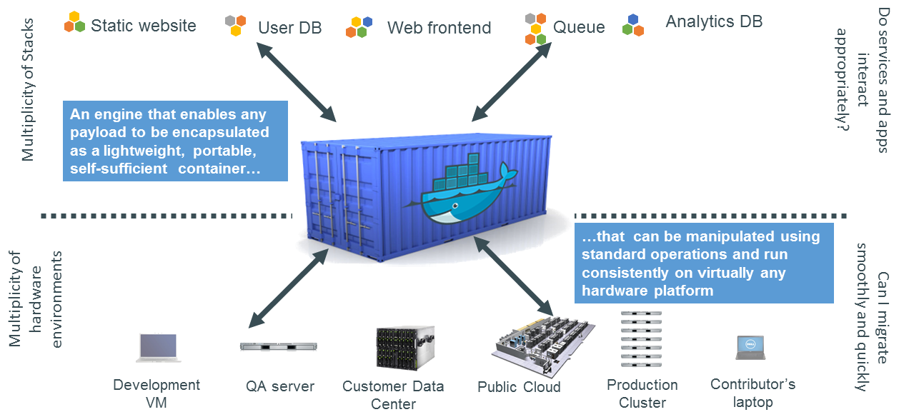
Docker is a container system for code
sort of like a virtual machine system, but more light weight and customizable

Slide 8
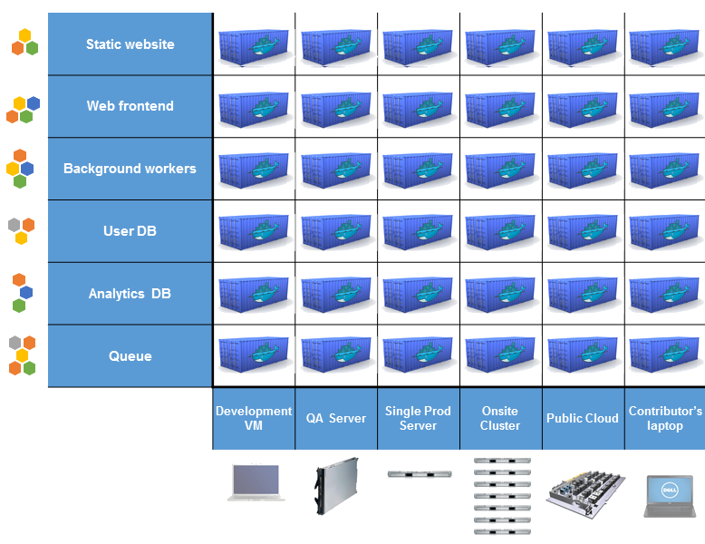
Docker eliminates the nightmare matrix

Slide 9


We want to get the app online
Where To Work app
R + shiny + cbc +
>20 R packages

Slide 10
Docker helps us do this
Where To Work app
R + shiny + cbc +
>20 R packages

Slide 11
It makes our lives easier
Developers
Build once, run anywhere
Clean, safe, portable runtime environment
No worries about missing dependencies
Automate testing, integration, packaging
Eliminate concerns about different platforms
Ops people / administrators
Configure once, run anything
Make the lifecycle more efficient, consistent, and repeatable
Eliminate inconsistencies between development and production
Improve speed and reliability of deployment and updates

Slide 12
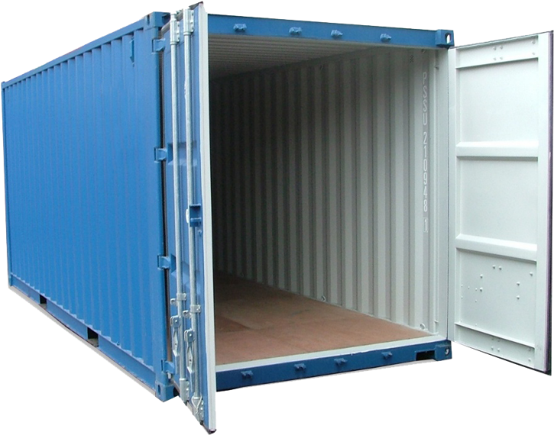
Why it works: separation of concerns
Developer
Ops Person / Admin
Worry about the
“inside” of the
container:
Code
Libraries
Package manager
Installation of dependencies
Worry about the “outside” of the container:
Logging
Access
Monitoring
Network configuration

Slide 13
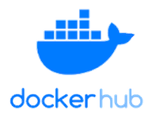
Workflow
Developer
Ops person
creates
configures
Code
Production server
Docker file
pull image to
Docker image
User
builds
runs instance
Docker image
Docker container
push to
accesses web app

Slide 14
Demo

Slide 15
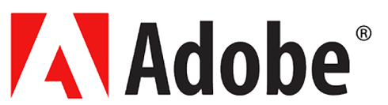







Who uses Docker?
11+ million developers
7+ million applications
13+ billion monthly image downloads

Slide 16
Where to find out more?
Docker website (www.docker.com)
Documentation (https://docs.docker.com/)
Getting started (https://www.docker.com/get-started)
Tutorials (https://www.docker.com/101-tutorial)
Other presentations (https://www.slideshare.net/dotCloud)
Many thanks to these other presentations for providing diagrams used in this presentation

Slide 17
Appendix

Slide 18
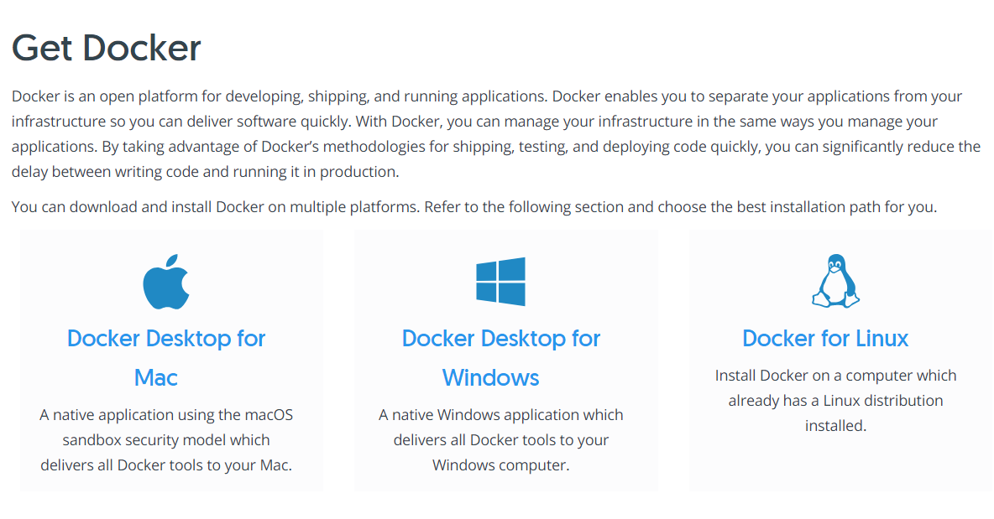
Installing Docker

Slide 19
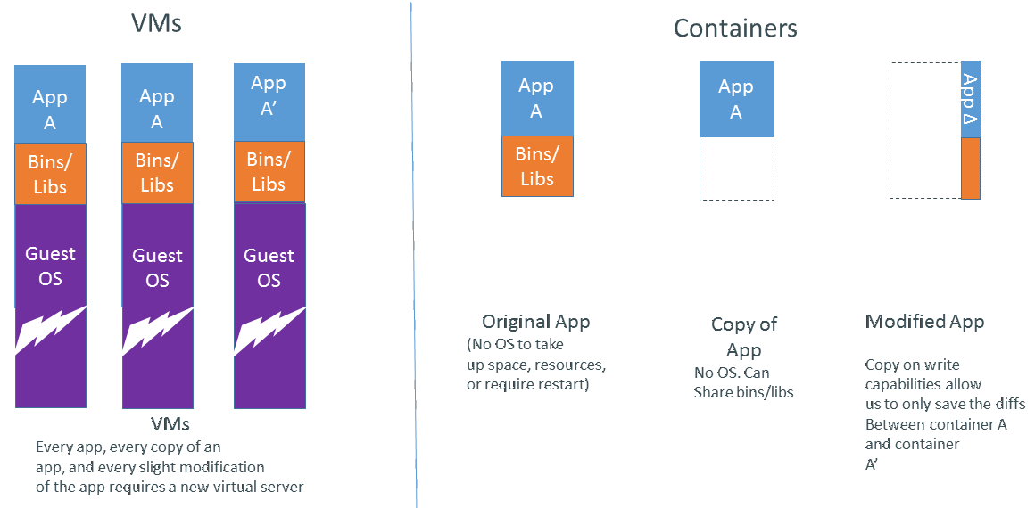
Virtual machines vs. containers

Slide 20


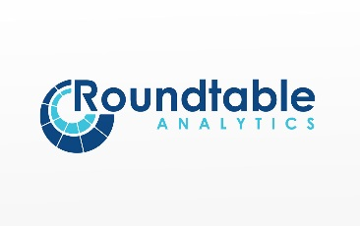












Yes, R is used in the industry
https://www.rstudio.com/about/customer-stories

