Slide 1



Open-source spatial planning
and optimization
Jeffrey Hanson (Carleton University)
jeffrey.hanson@uqconnect.edu.au
jeffrey-hanson.com

Slide 2
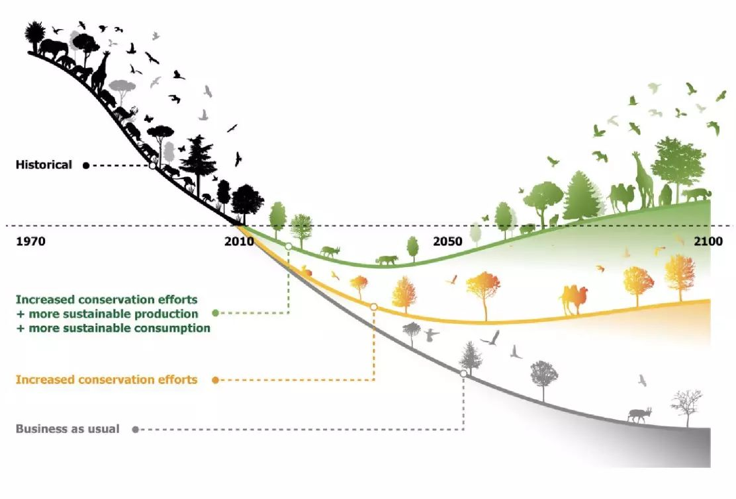
Conservation decision making

Slide 3
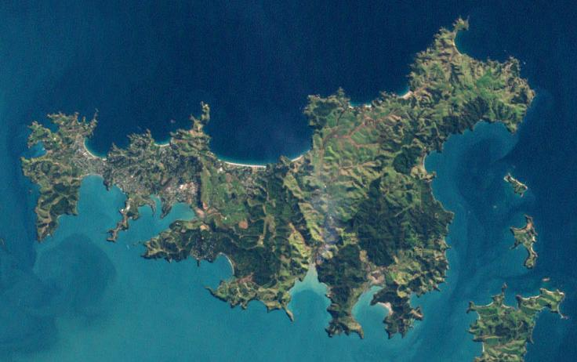
Conservation decision making is hard
Conservation is actions in places
Many facets of biodiversity need attention (e.g., species, habitats, ecosystem services)
Limited resources for implementing actions
Uncertainty in possible outcomes
Need to find compromises among different stakeholders’ values
versus
Lots of potential options for conservation efforts

Slide 4
Spatial optimization
Planning units
Discrete places for conservation management
Each planning unit is managed separately
Commonly include land parcels, islands, spatial grid cells
Notes:
- not all remaining habitat can be preserved
- achieve conservation objectives for minimal cost
- modern systematic conservation planning primarily focusses on representing species
- however, this ignores intra-specific biodiversity

Slide 5





Spatial optimization
Features
Map-able elements that we want to persist
Commonly include species, ecosystem types, ecosystem services (e.g., water provisioning, carbon sequestration)
Target thresholds denote minimum desired amount (e.g., ≥3 crab populations)
Notes:
- not all remaining habitat can be preserved
- achieve conservation objectives for minimal cost
- modern systematic conservation planning primarily focusses on representing species
- however, this ignores intra-specific biodiversity

Slide 6
Spatial optimization
Which planning units should we manage for conservation?
Notes:
- not all remaining habitat can be preserved
- achieve conservation objectives for minimal cost
- modern systematic conservation planning primarily focusses on representing species
- however, this ignores intra-specific biodiversity

Slide 7
Spatial optimization
Minimum set formulation
Objective: min. total cost
Constraints: meet all goals
Cost: each island costs $1
Targets: protect ≥1 population for each species
$1
$1
$1
$1
$1
$1
$1
$1
$1

Slide 8
Spatial optimization
Objective: min. total cost
Constraints: meet all goals
Targets: protect ≥1 population for each species
$1
$1
$1
$1
$1
$1
$1
Optimal objective value = $3
$1
$1

Slide 9

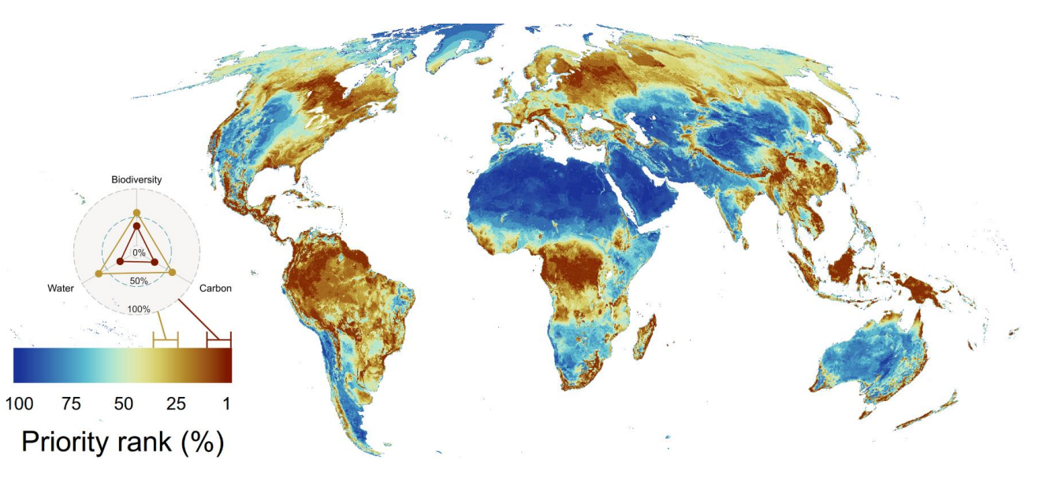
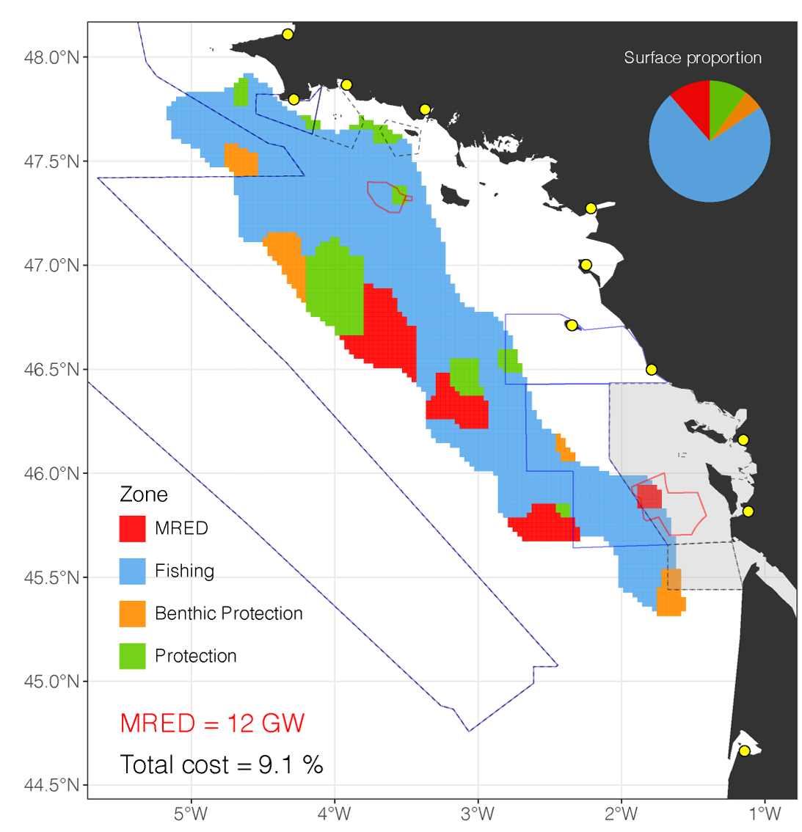
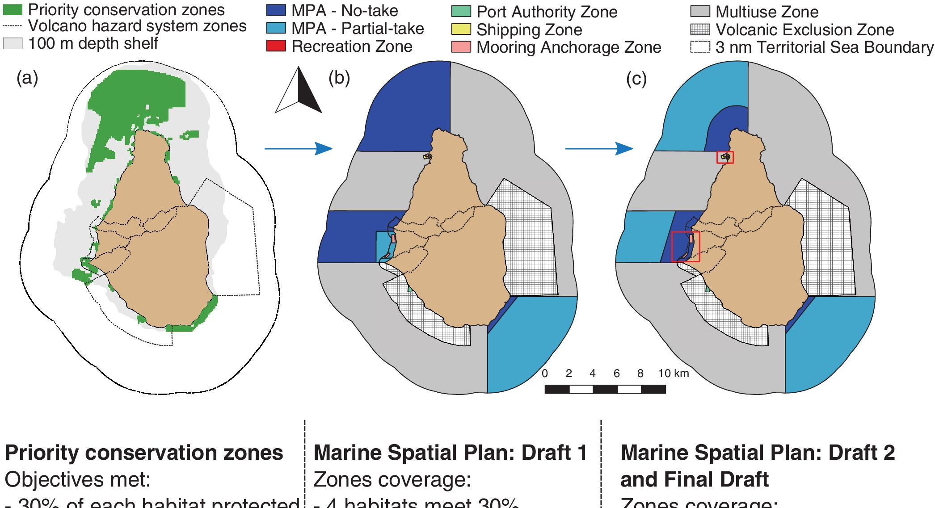
prioritizr
Jung et al.
2021
Highly flexible
Works with broad range of spatial and non-spatial data
Leverages exact algorithm solvers for optimization
Supports multiple actions and zones
Boussarie
et al. 2023
Flower et al.
2020
Hanson et al. 2025, https://prioritizr.net

Slide 10

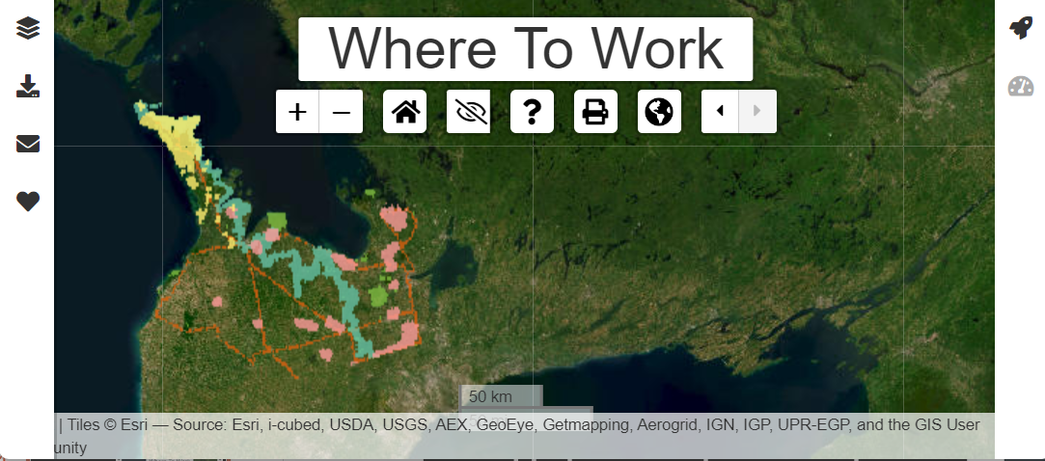
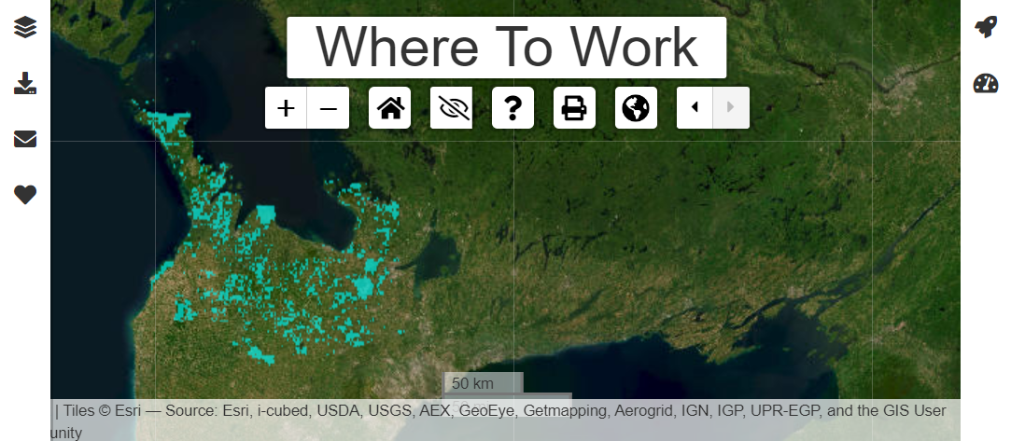
Where to Work
Identifies priority areas for conservation
Explore and resolve trade-offs between objectives
Accessible user interface
Developed in partnership by Nature Conservancy Canada and Carleton University
Data
Priorities
Free at https://ncc.carleton.ca

Slide 11

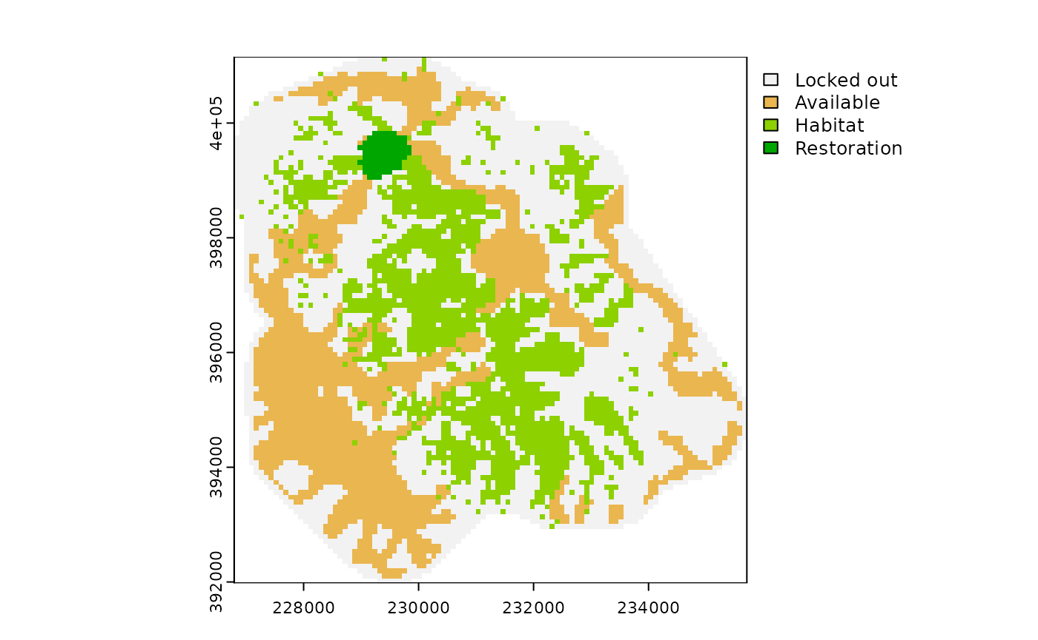
restoptr
Identifies priority areas to restore habitat for improving connectivity
Purpose-built for connectivity (e.g., does not support targets for multiple features)
Supports multiple different connectivity metrics
Prioritizations are generated based on a budget
Justeau-Allaire et al. 2023, https://dimitri-justeau.github.io/restoptr

Slide 12
Strategies to account for global change
Let’s consider a simple example…
We have two species
All islands cost the same to manage
We want to protect at least two populations of each species
$1
$1
$1
$1
$1
$1
$1
$1
$1
Buenafe et al. 2024, 2025

Slide 13
Prioritize selection of locations with low exposure
Useful when conservation action does NOT abate threat (e.g., climate change)
Set cost values according to exposure (e.g., climate velocity)
Doesn’t account for species-specific sensitivities to change
Present day
+2°C
+10°C
+12°C
Climate velocity
+5°C
+9°C
+7°C
+1°C
+4°C
+2°C
Total cost of priority areas = +8°C
+5°C
+1°C
+2°C

Slide 14
Prioritize selection of refugia for species
Useful when conservation action does NOT abate threat (e.g., climate change)
Mask feature values according to exposure thresholds
Requires threshold calibration
Present day
+2°C
+10°C
+12°C
Climate velocity
+5°C
+9°C
+7°C
+1°C
+4°C
+2°C
Refugial populations
≤ +3°C
≤ +9°C

Slide 15
Prioritize selection of locations based on future predictions
Useful when conservation action does NOT abate threat (e.g., climate change)
Set feature values according to future predictions (e.g., per statistical models)
High data requirements
Present day
Predicted future
Priorities for present and future populations

Slide 16

Integrated spatial planning
Useful when conservation action does abate threat (e.g., land use change)
Prioritize multiple land use types with zones
Requires objectives for each land use types
Very high data requirements
Present day
Future land use scenario
Priorities for conservation
Priorities for agriculture

Slide 17




jeffrey.hanson@uqconnect.edu.au
github.com/jeffreyhanson
jeffrey-hanson.com

Slide 18




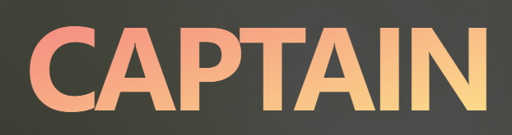
Open source tools
Dependency
Under development
CLUZ
Marxan
Marxan Connect
Marxan with Zones
Marxan MaPP
Marxan with Probability
prioritizr
Where to Work
Captain
restoptr
Zonation

