Slide 1




Conserving evolutionary processes for three amphibian species in the Iberian Peninsula
Jeffrey O. Hanson, Miguel Camacho-Sanchez, Adam Marques, Íñigo Martínez-Solano, Guillermo Velo-Antón, Ana Veríssimo, Silvia B. Carvalho
jeffrey.hanson@uqconnect.edu.au
jeffrey-hanson.com

Slide 2
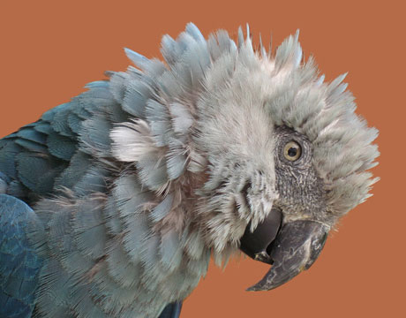
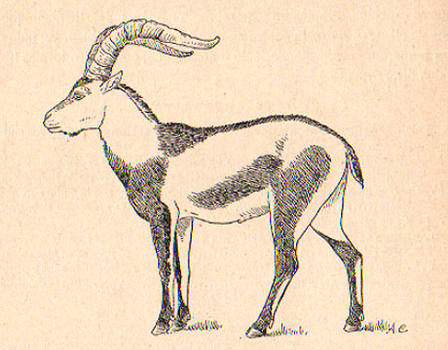
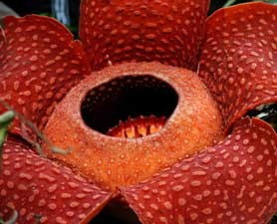
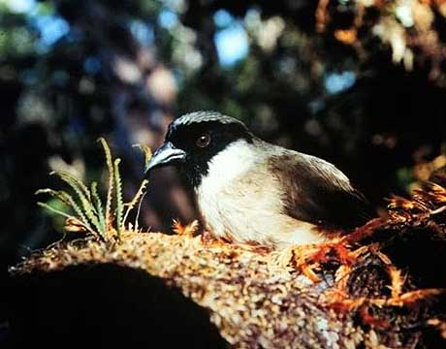
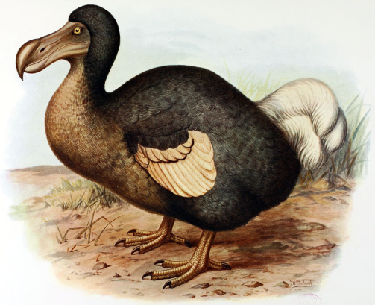
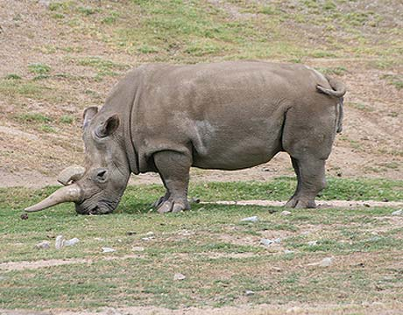
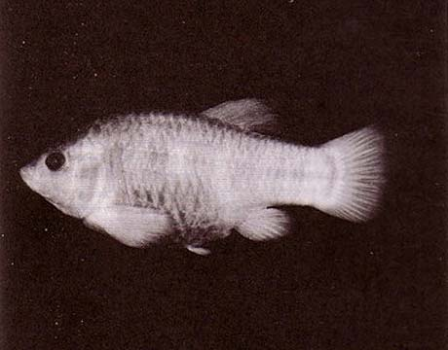
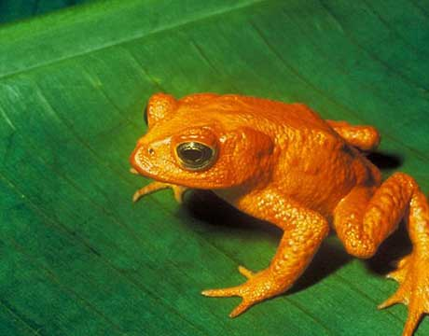
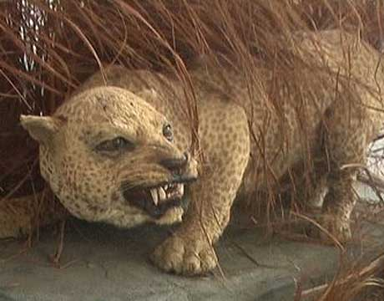
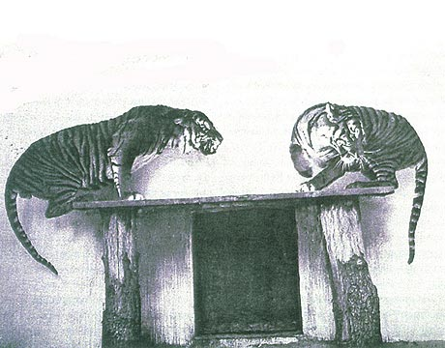
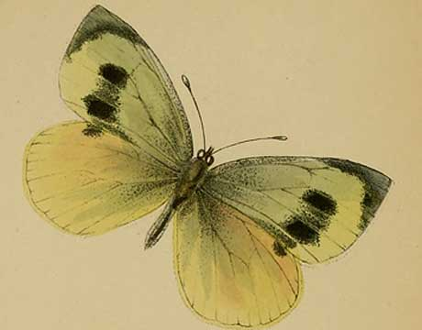
Global biodiversity crisis
Notes:
- high extinction rate
- conservation aims to maintain existing patterns of biodiversity and the processes that sustain them
- areas set aside to preserve biodiversity, and spearhead direct management actions

Slide 3
(i) how well are existing protected areas covering important places for evolutionary processes?
Aims
(ii) where are priority areas for conserving evolutionary processes?

Slide 4
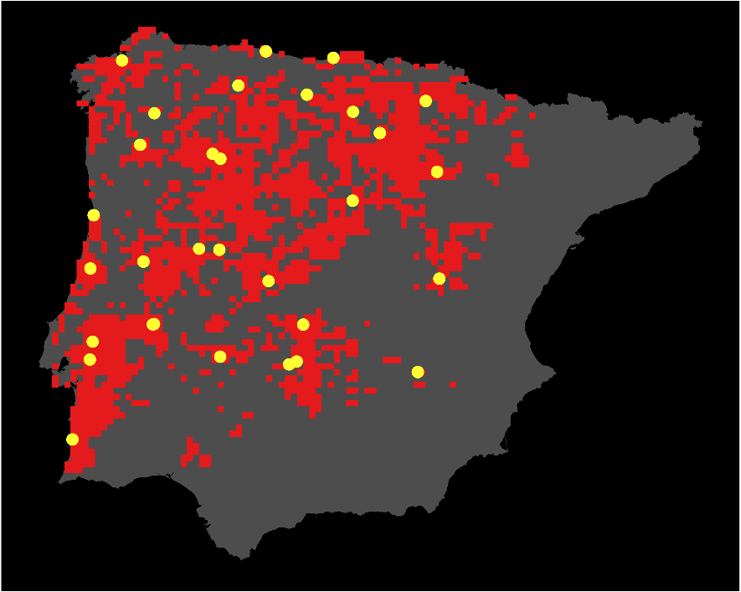
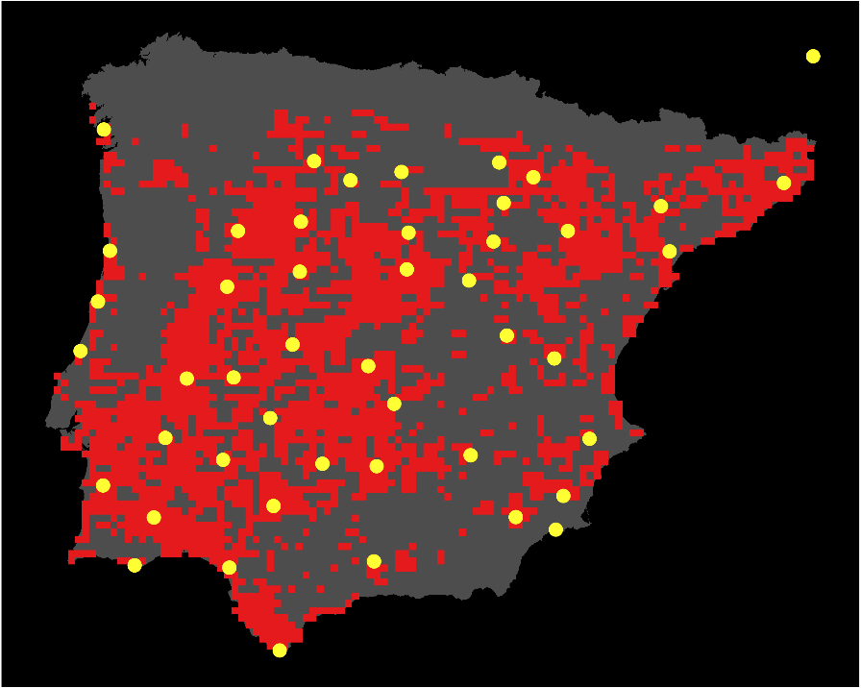
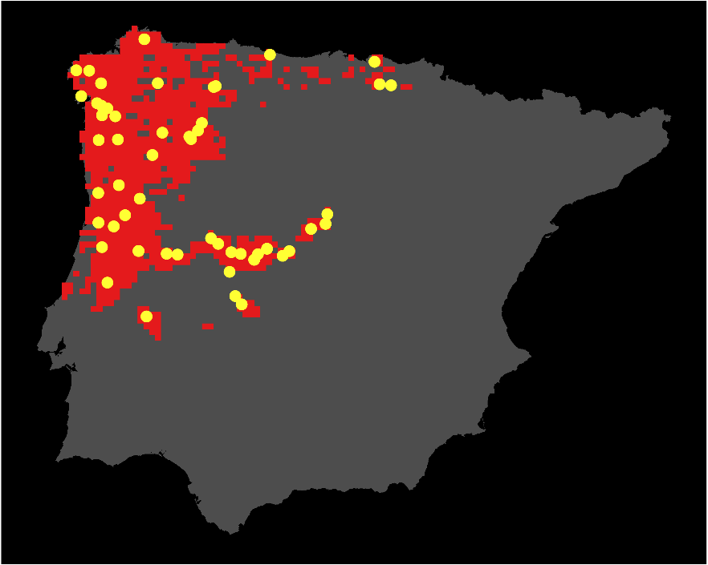

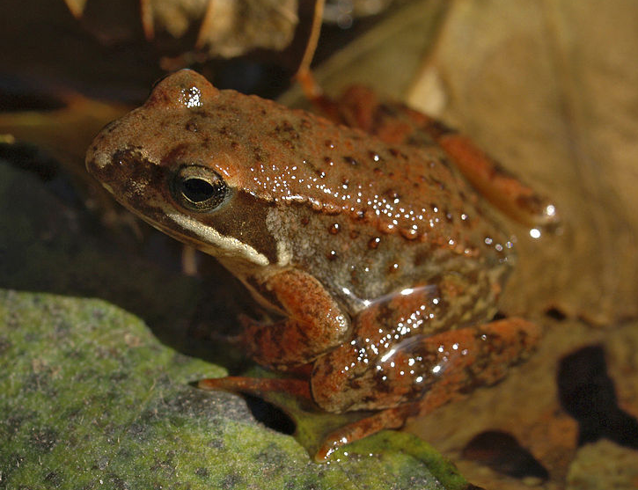
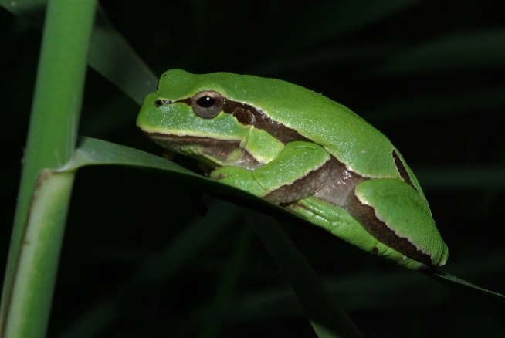
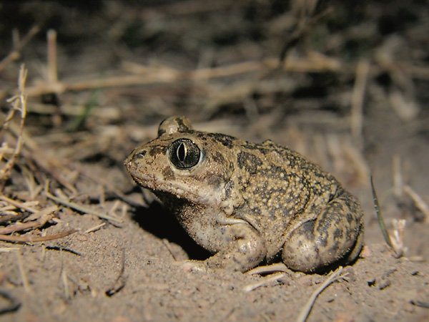
Case study
Hyla molleri
Pelobates cultripes
Rana iberica

Slide 5
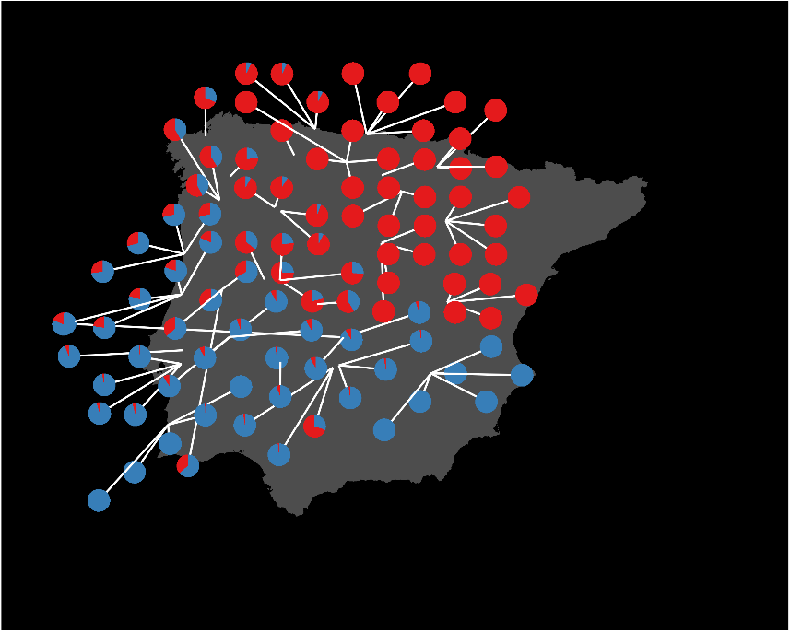
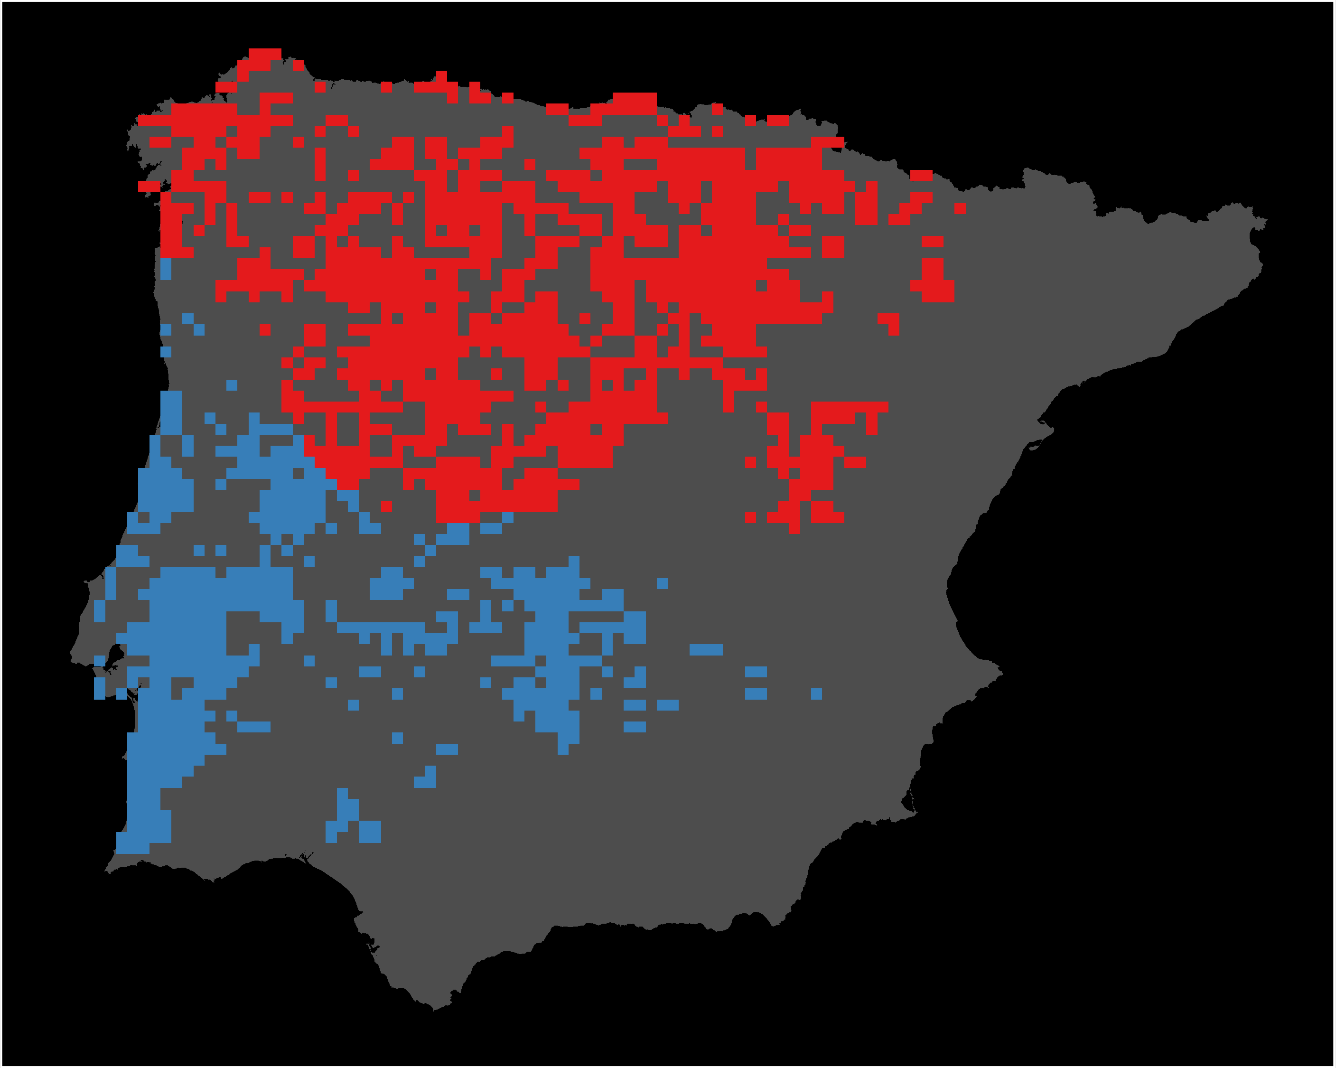

Mapping components of evolution: genetic lineages
STRUCTURE &
CLUMPP
PHYLIN
Genetic data
Data shown for Hyla molleri

Slide 6
Mapping components of evolution: identifying natural selection
Neutral
BAYESCAN
Genetic data
PCADAPT
Adaptive
Loci
SELESTIM

Slide 7
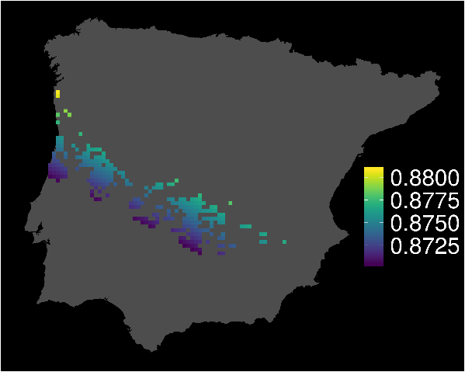
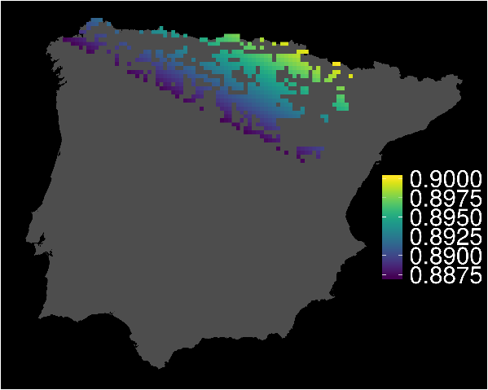
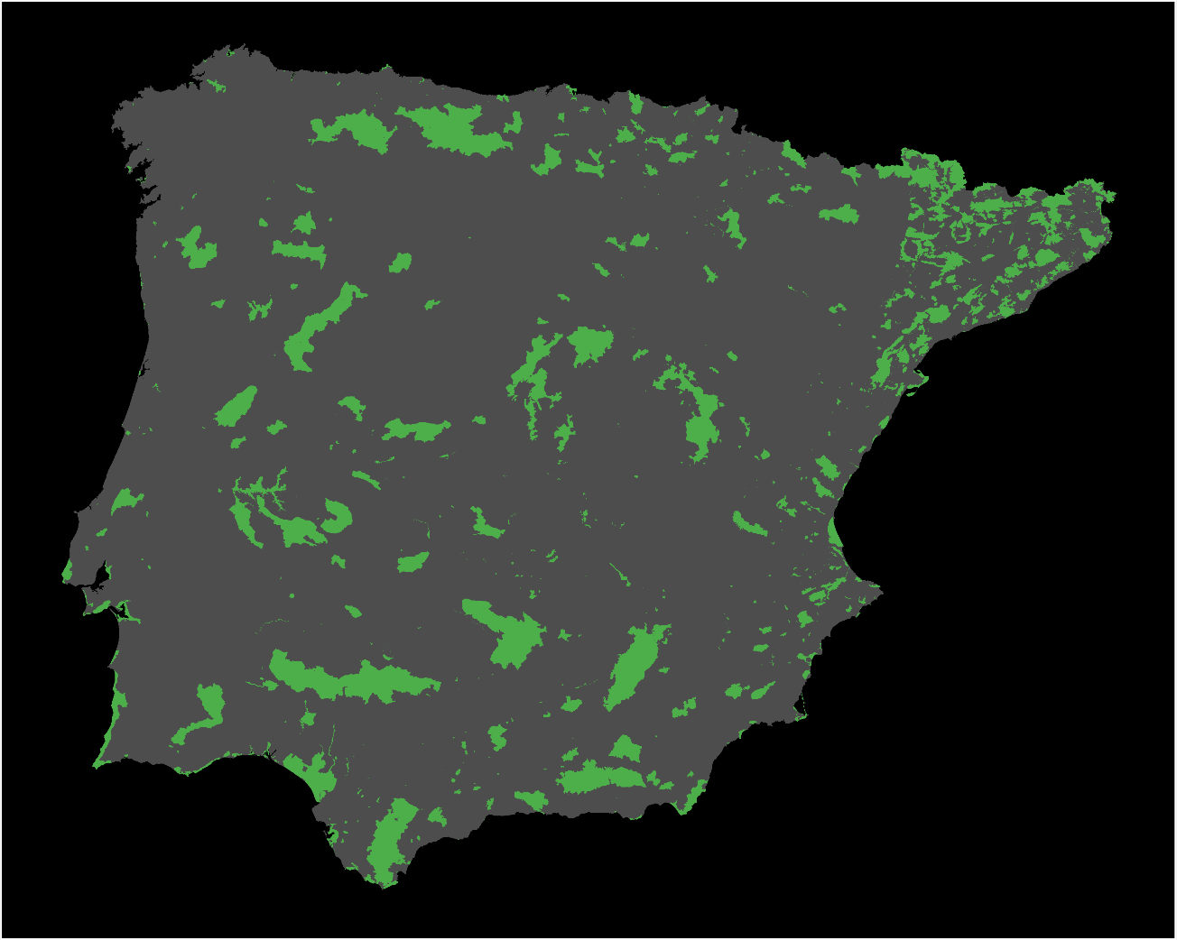
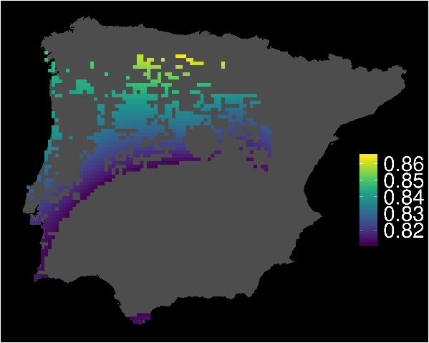
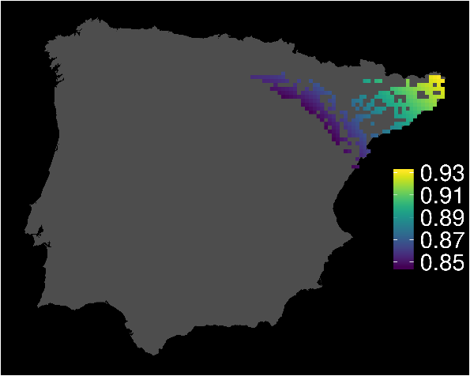
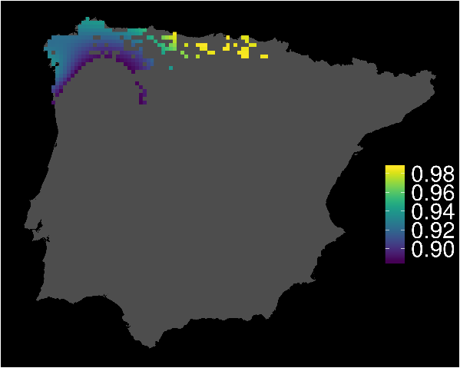
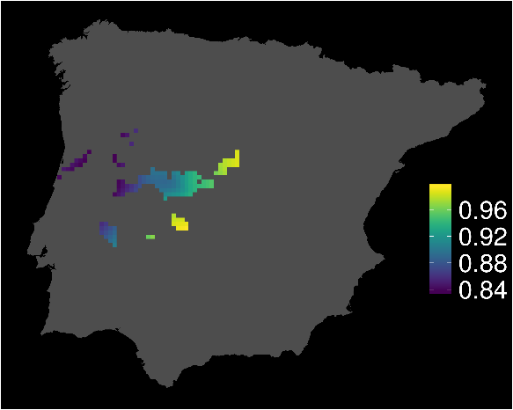
Protection of individual heterozygosity (“genetic fitness”)
H. molleri
P. cultripes
R. iberica
Existing protected areas

Slide 8
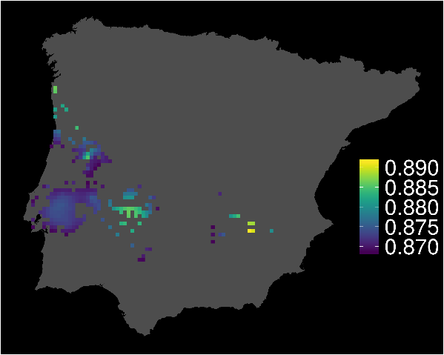
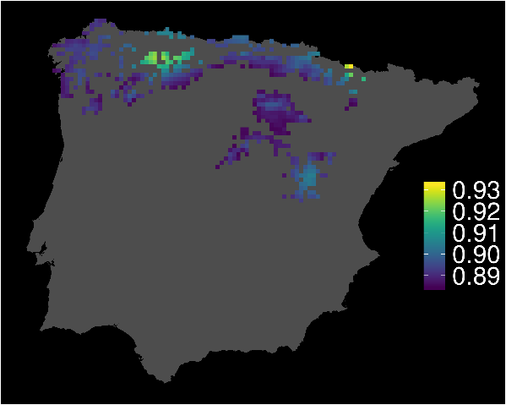
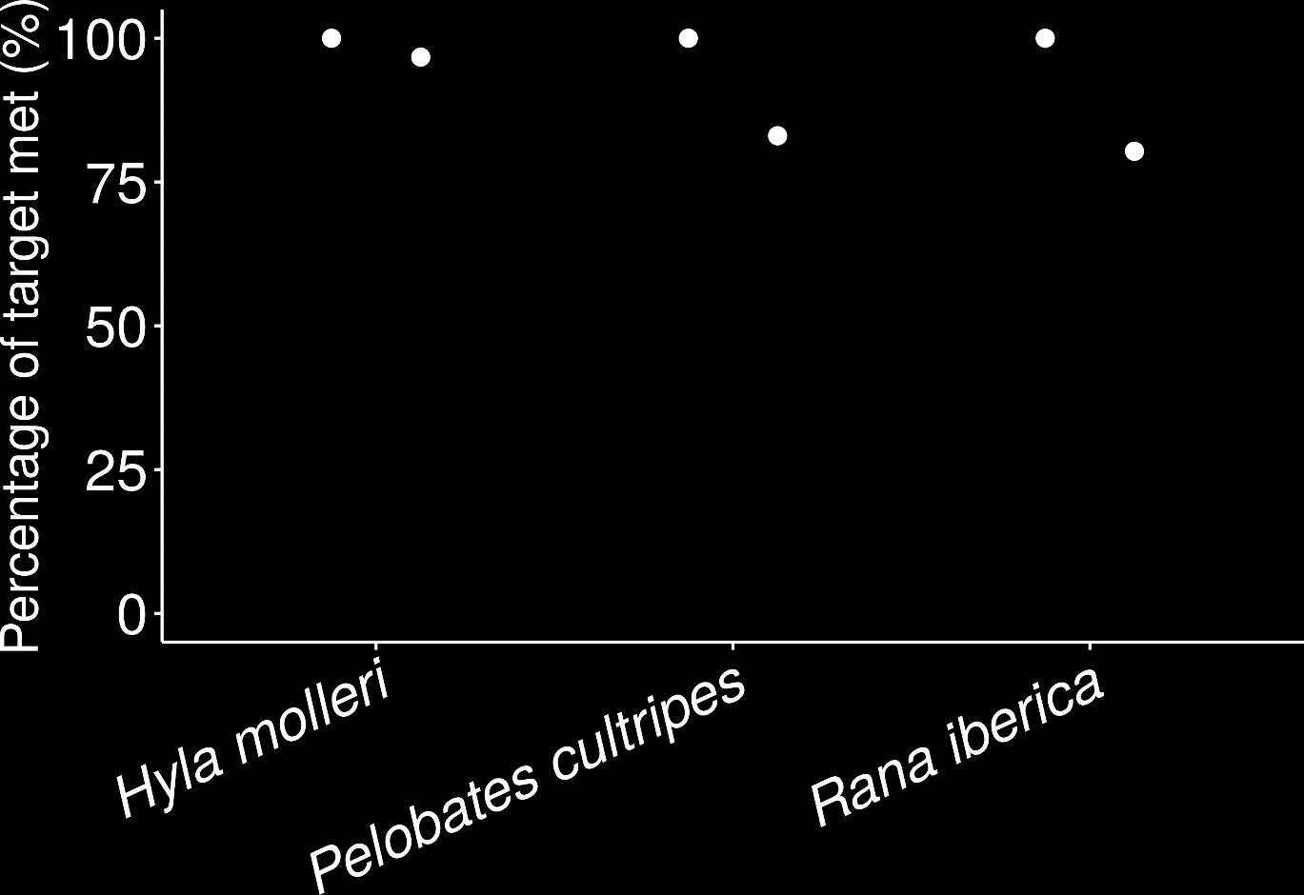
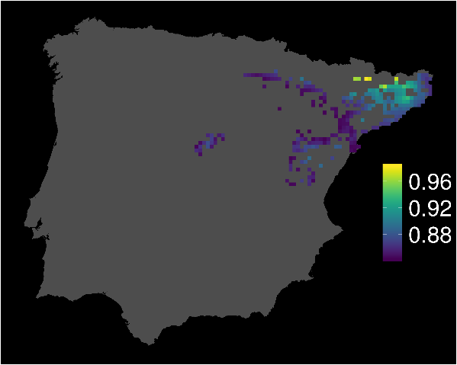
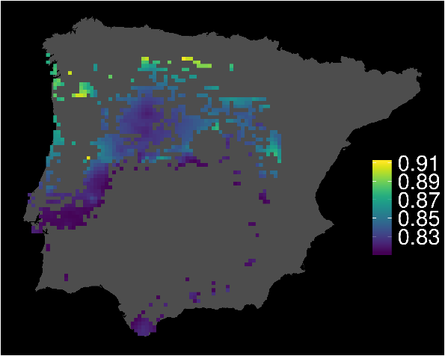
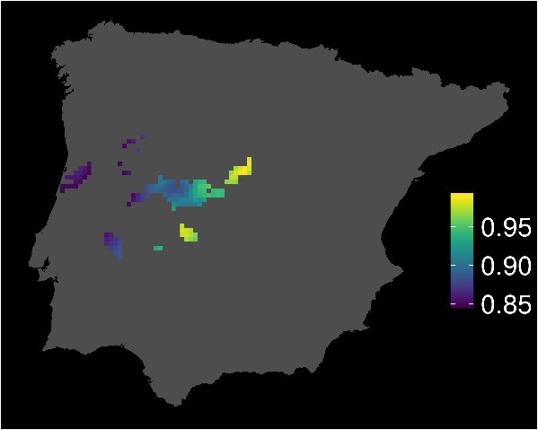
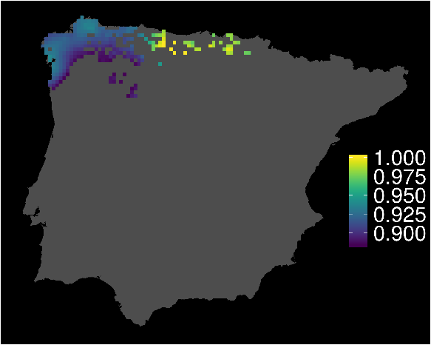
Protection of individual heterozygosity (“genetic fitness”)
H. molleri
P. cultripes
R. iberica

Slide 9
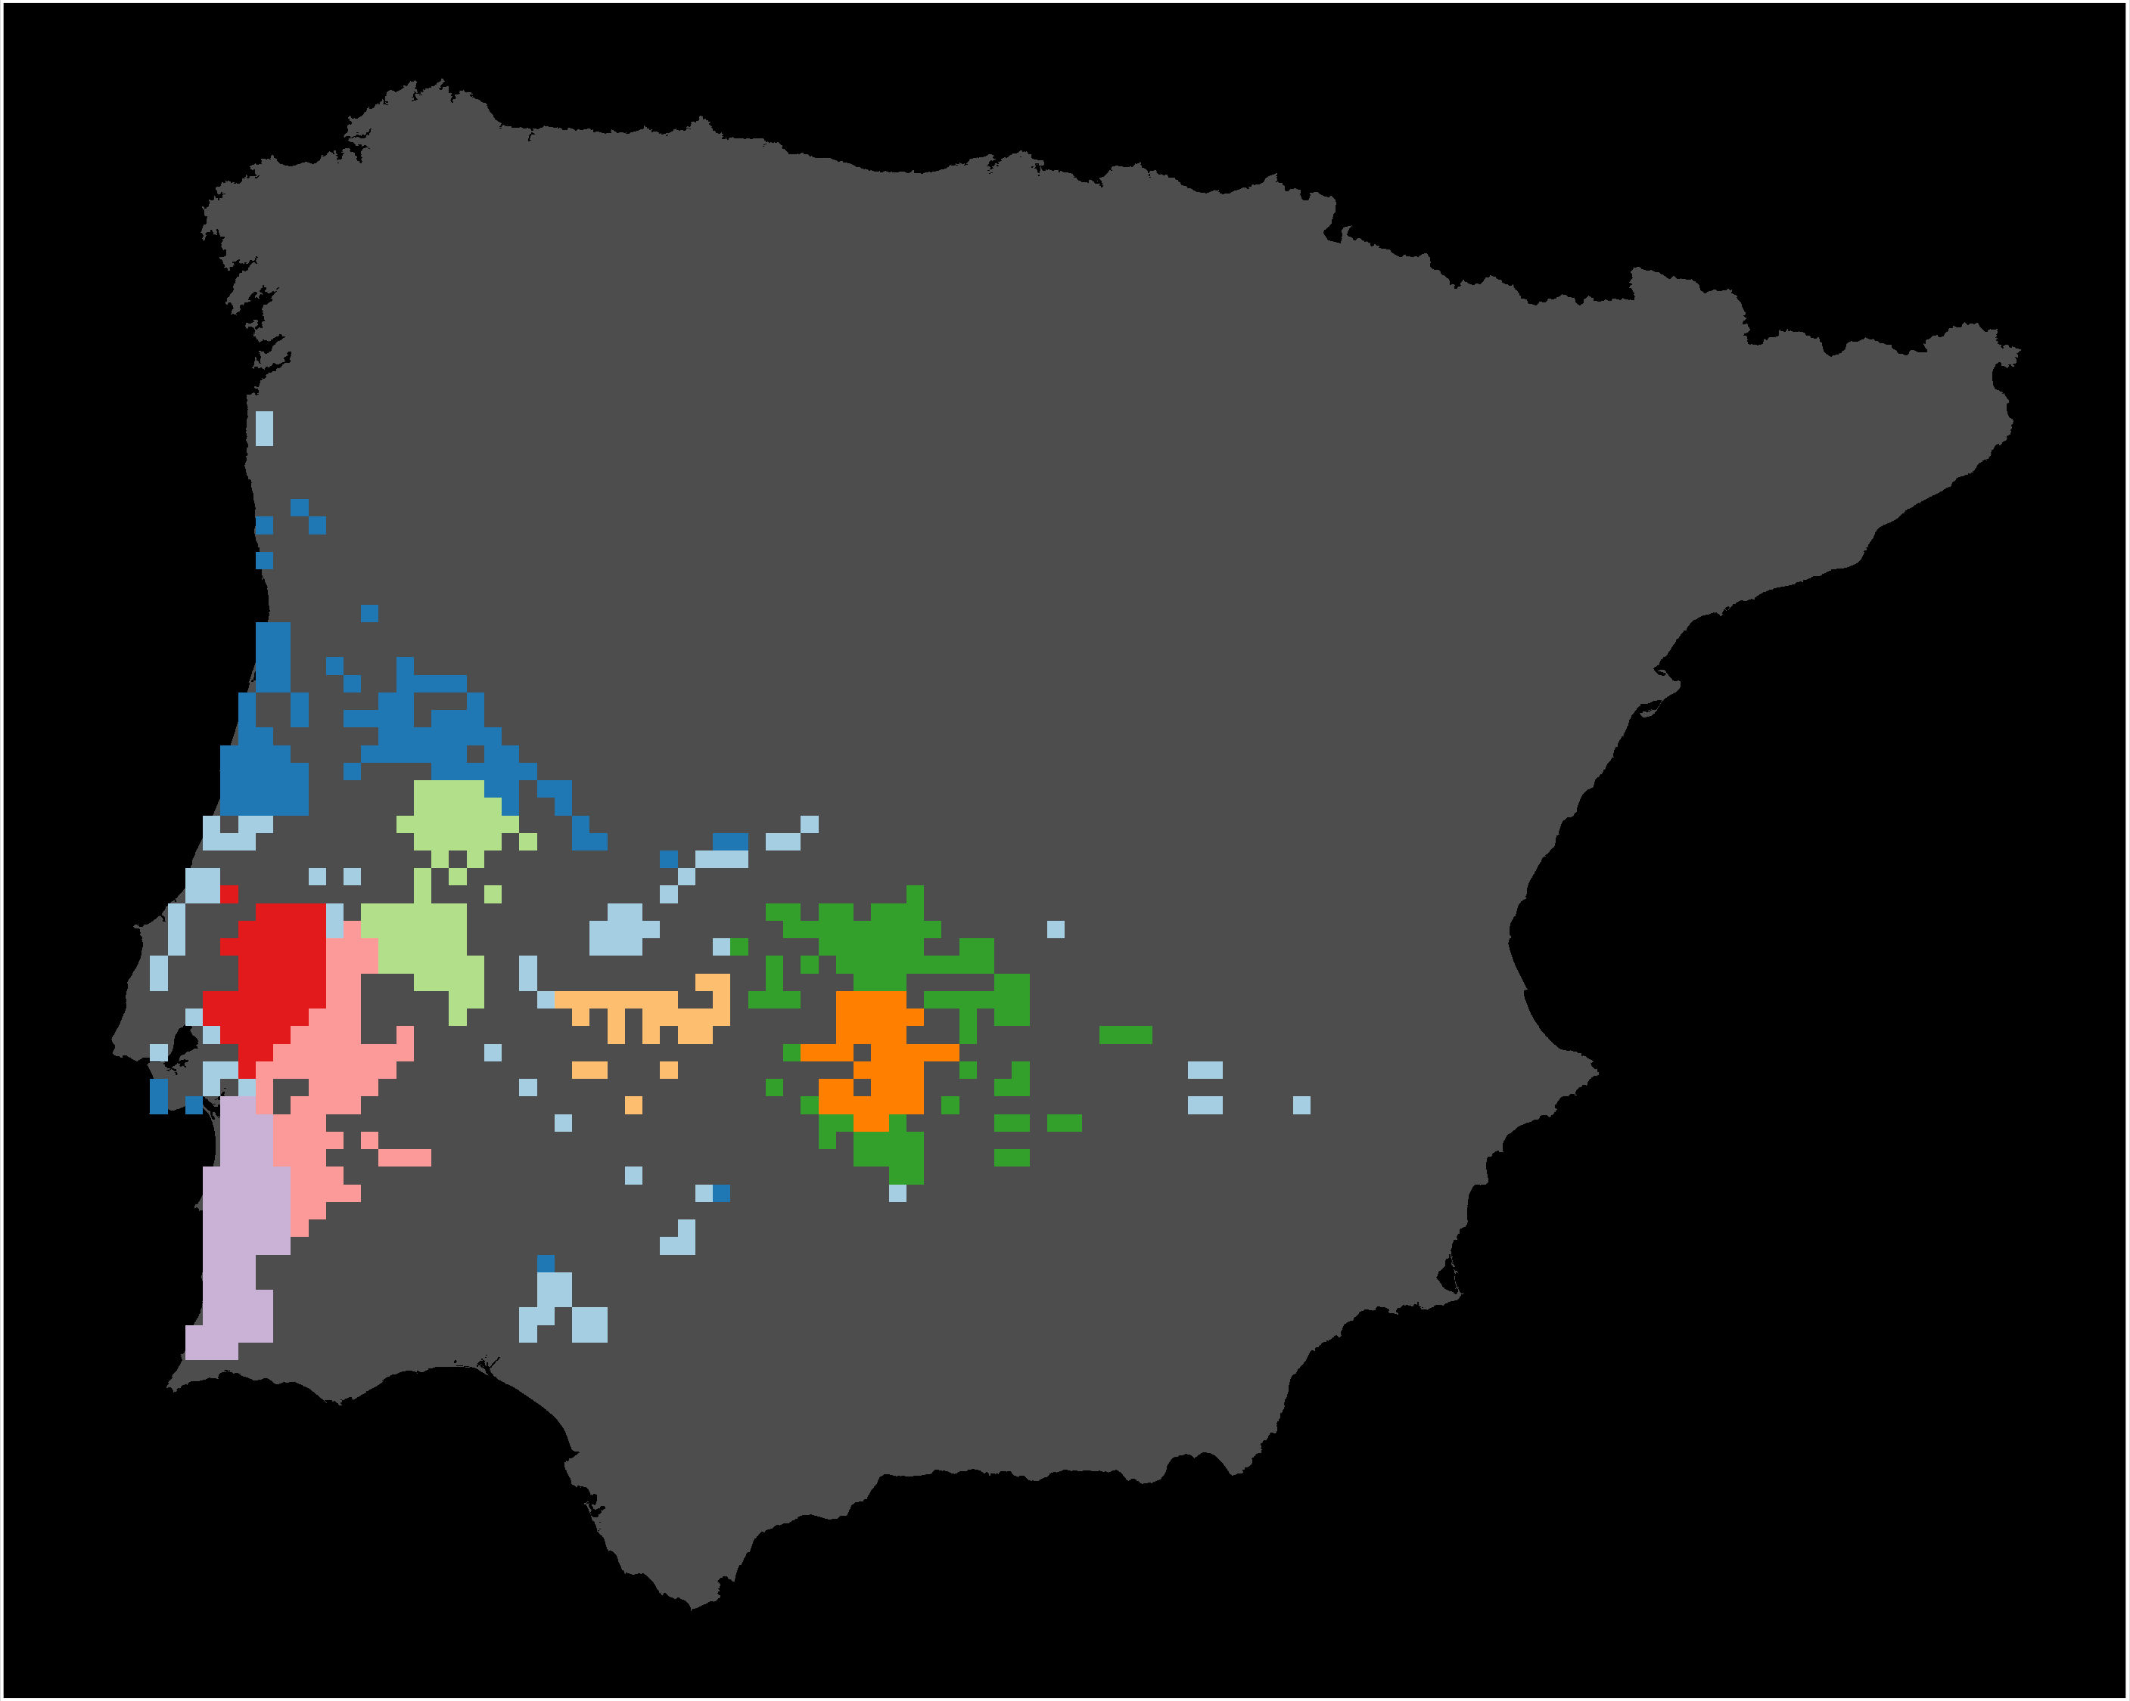
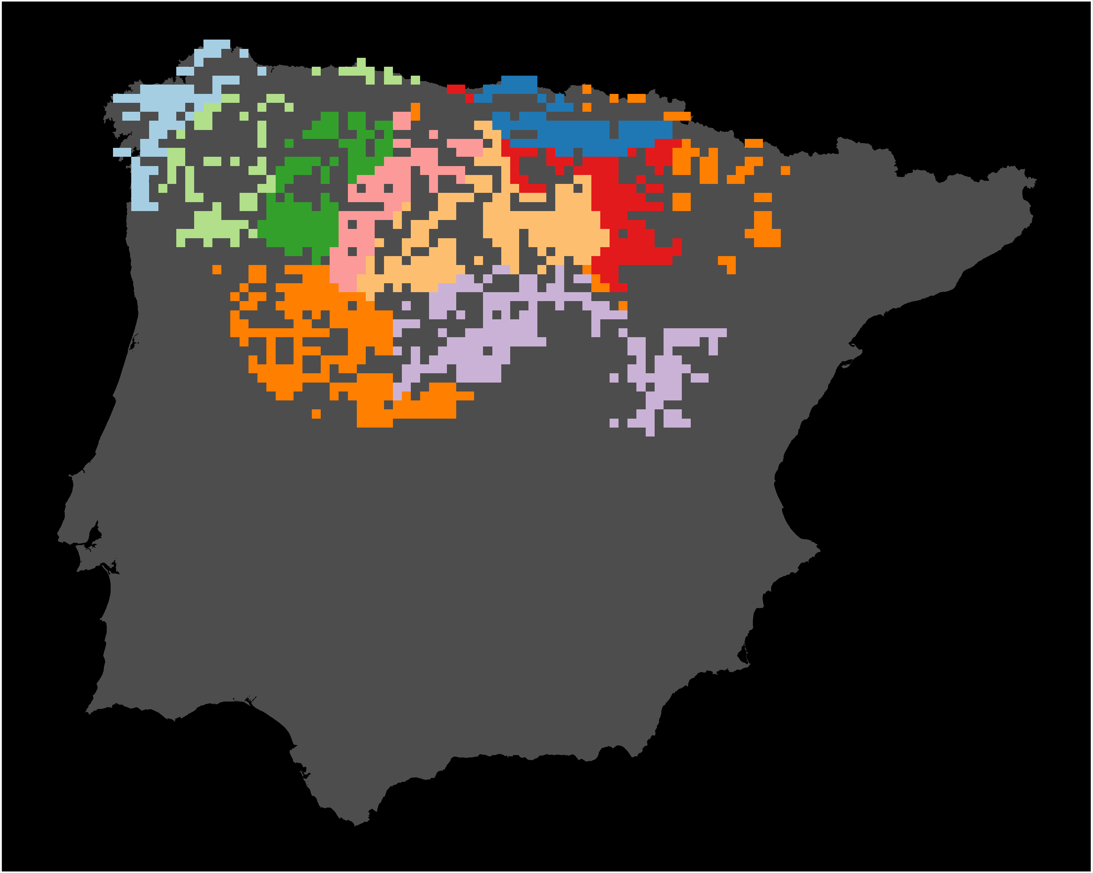
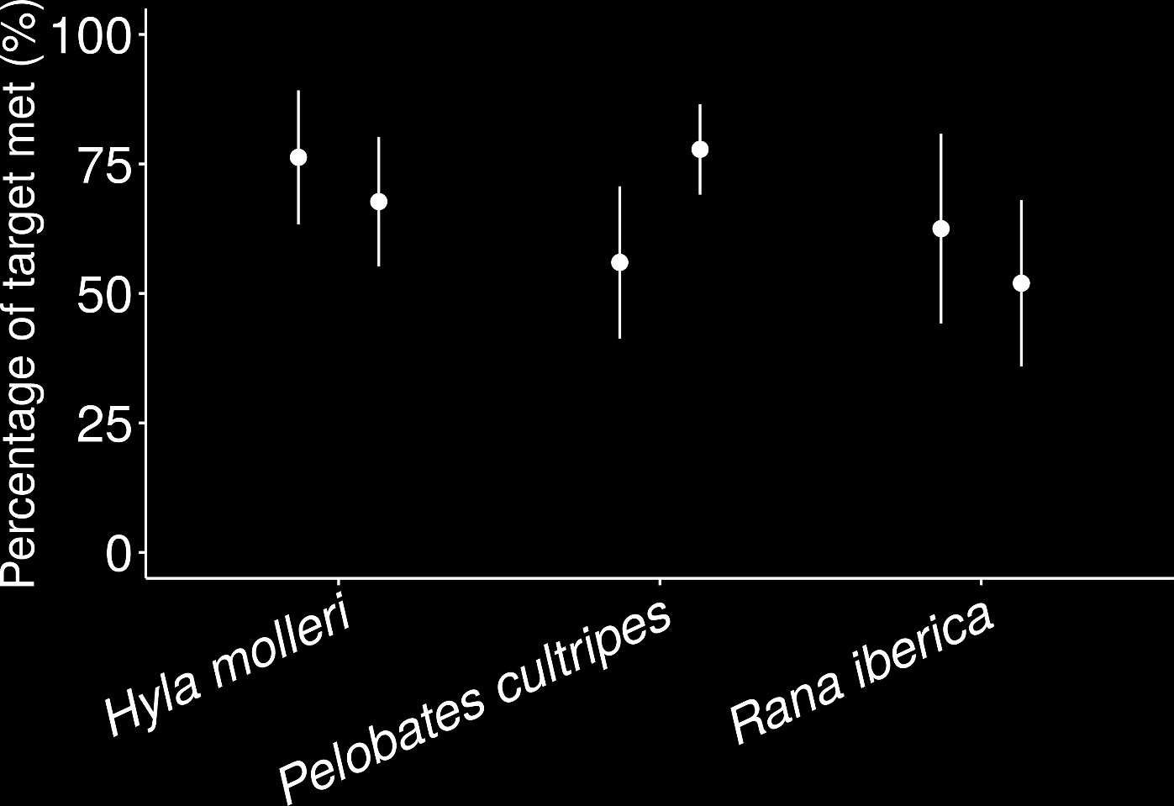
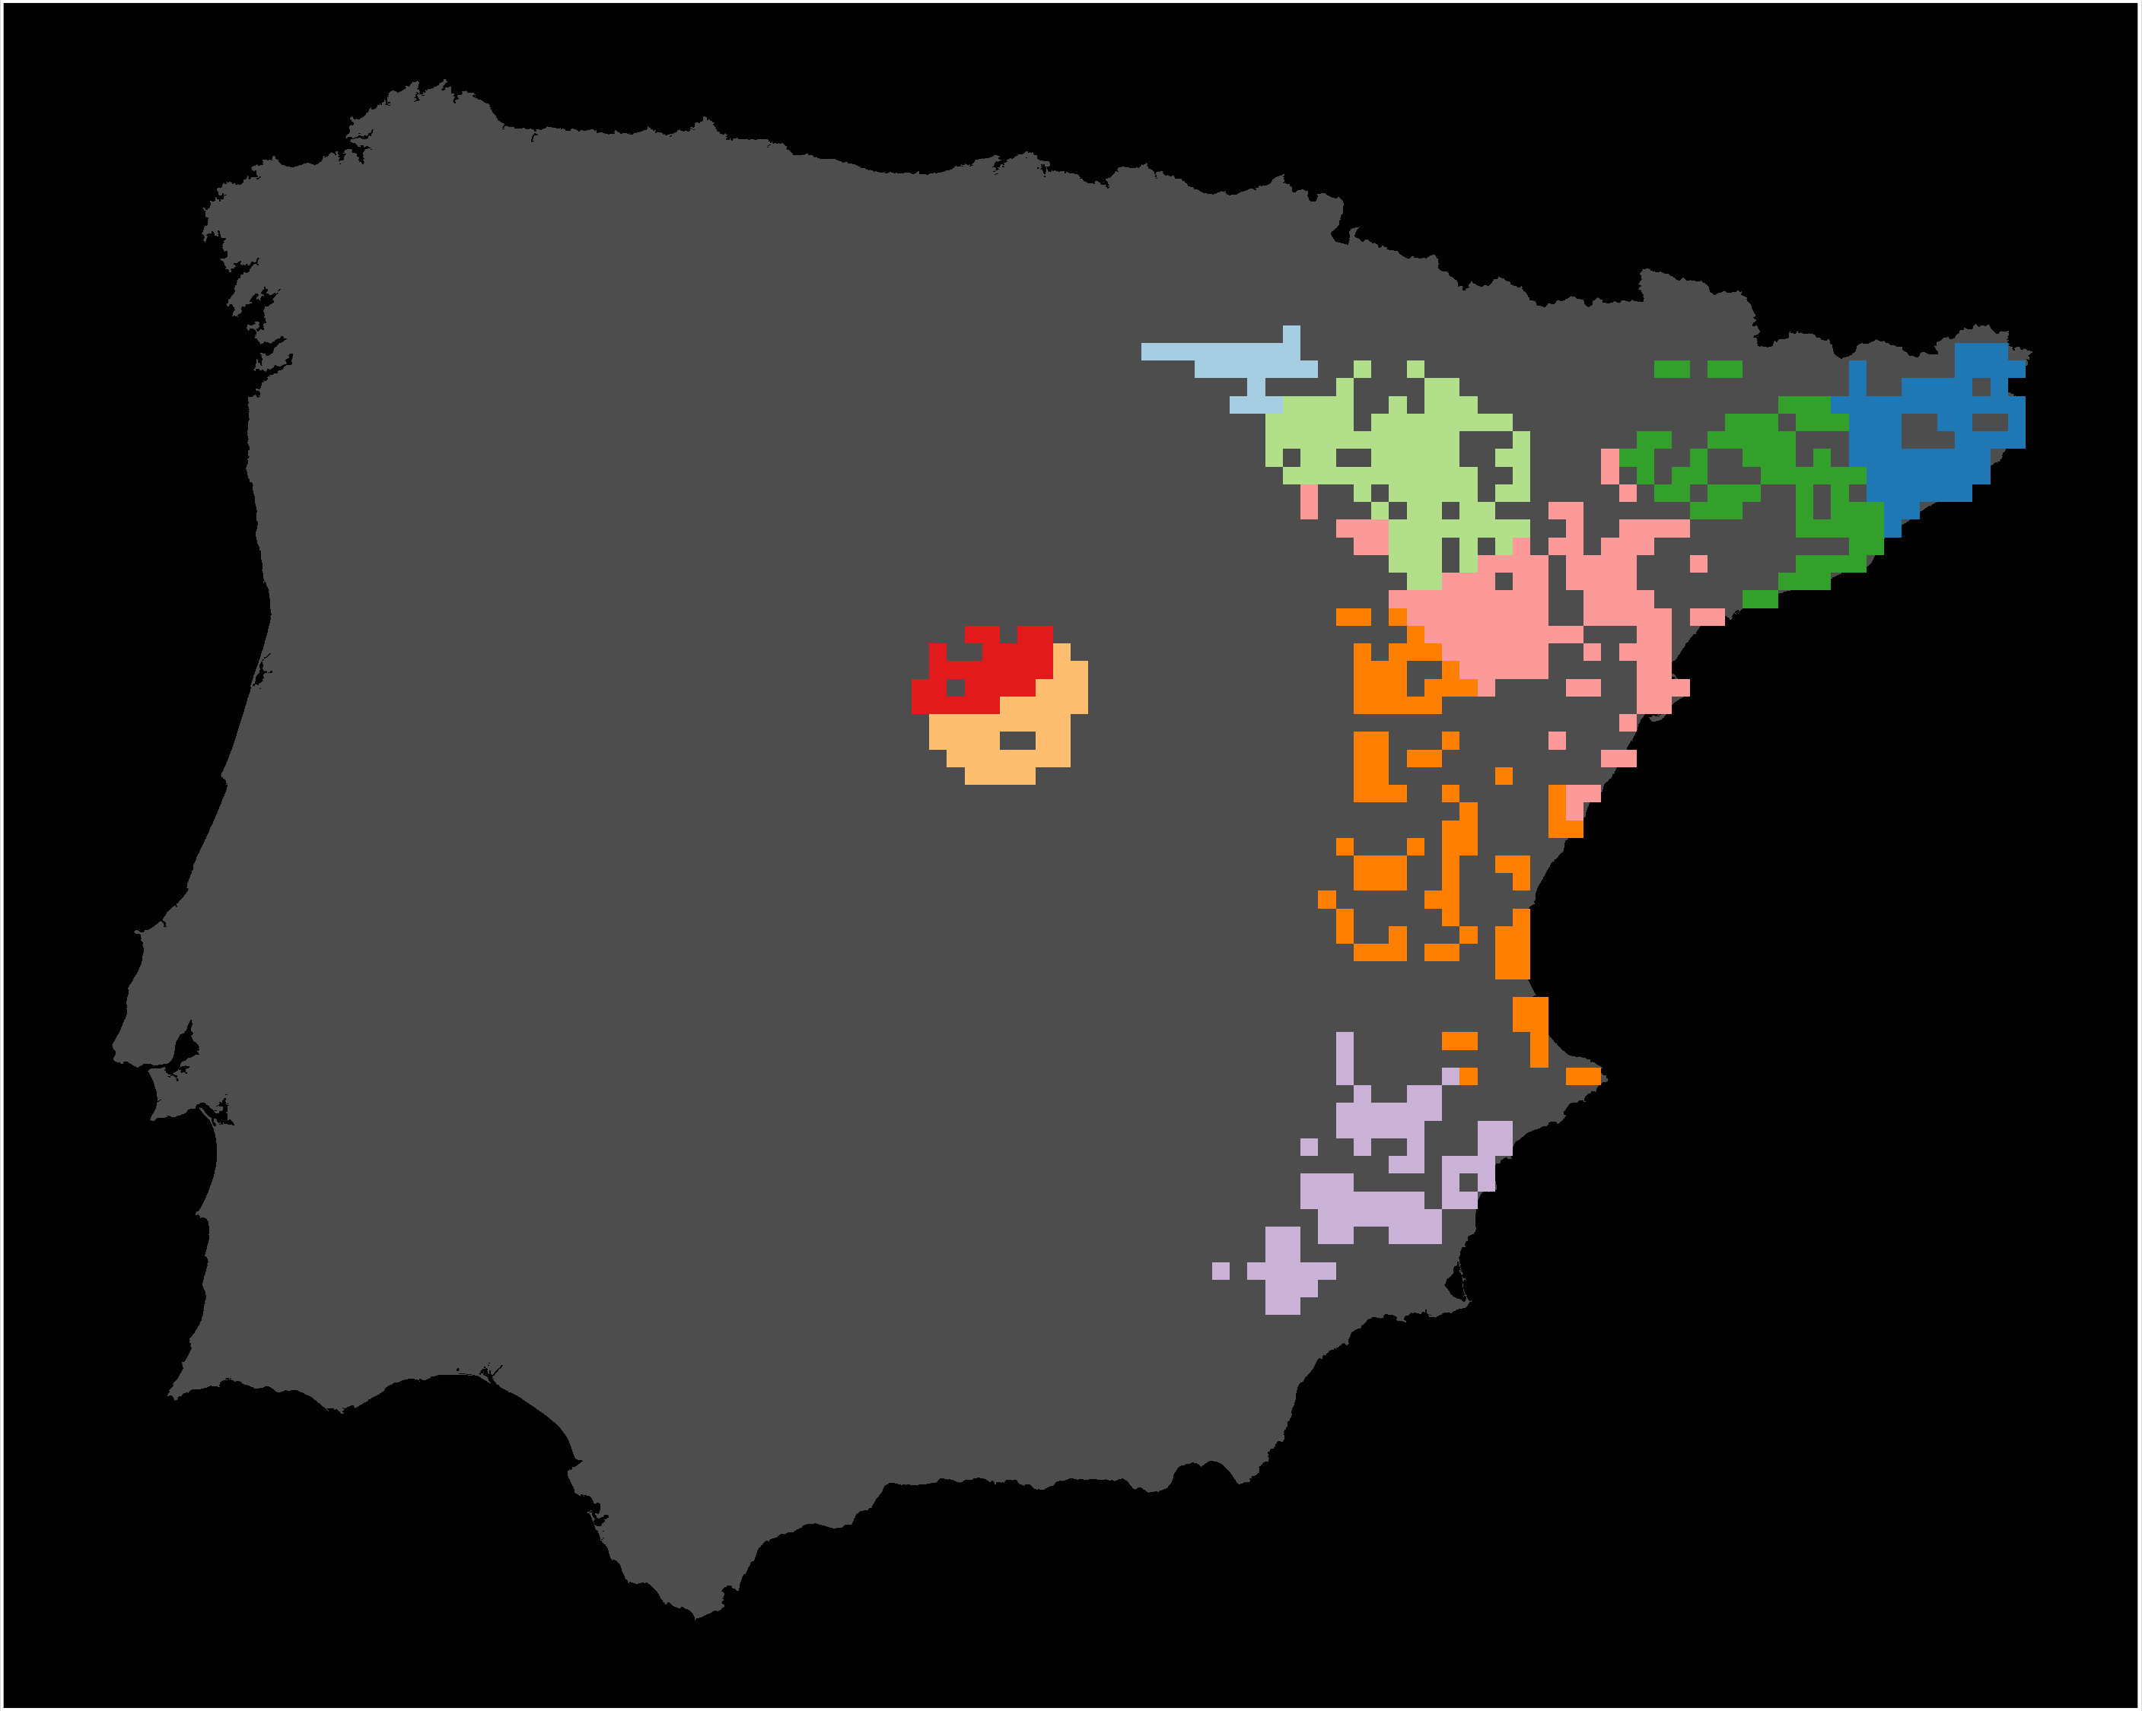
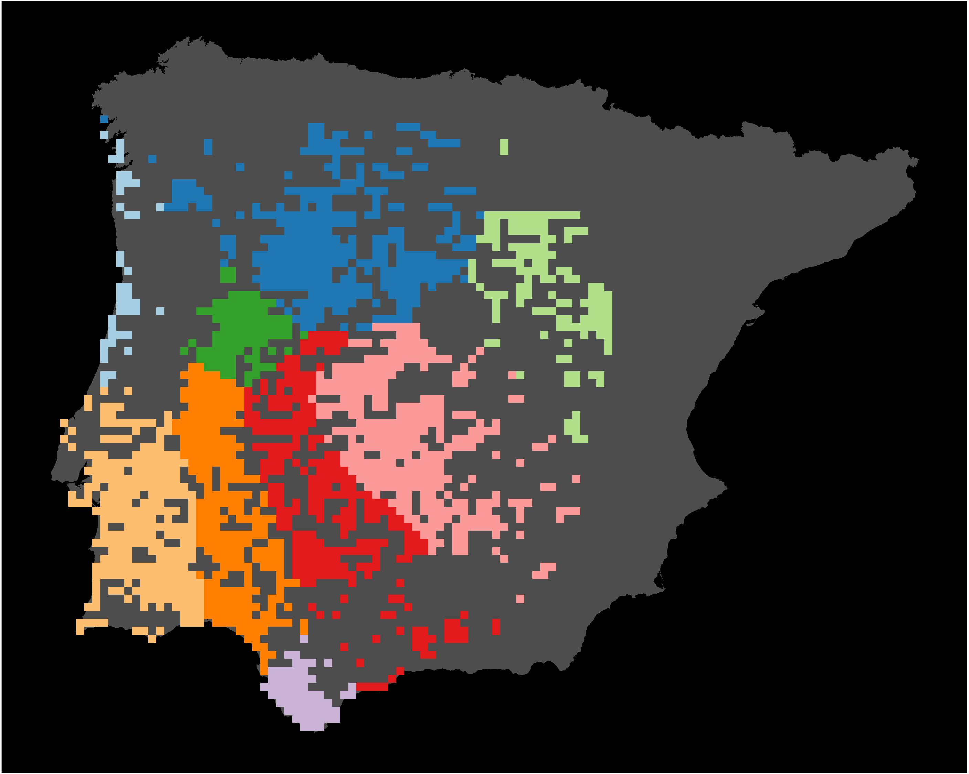
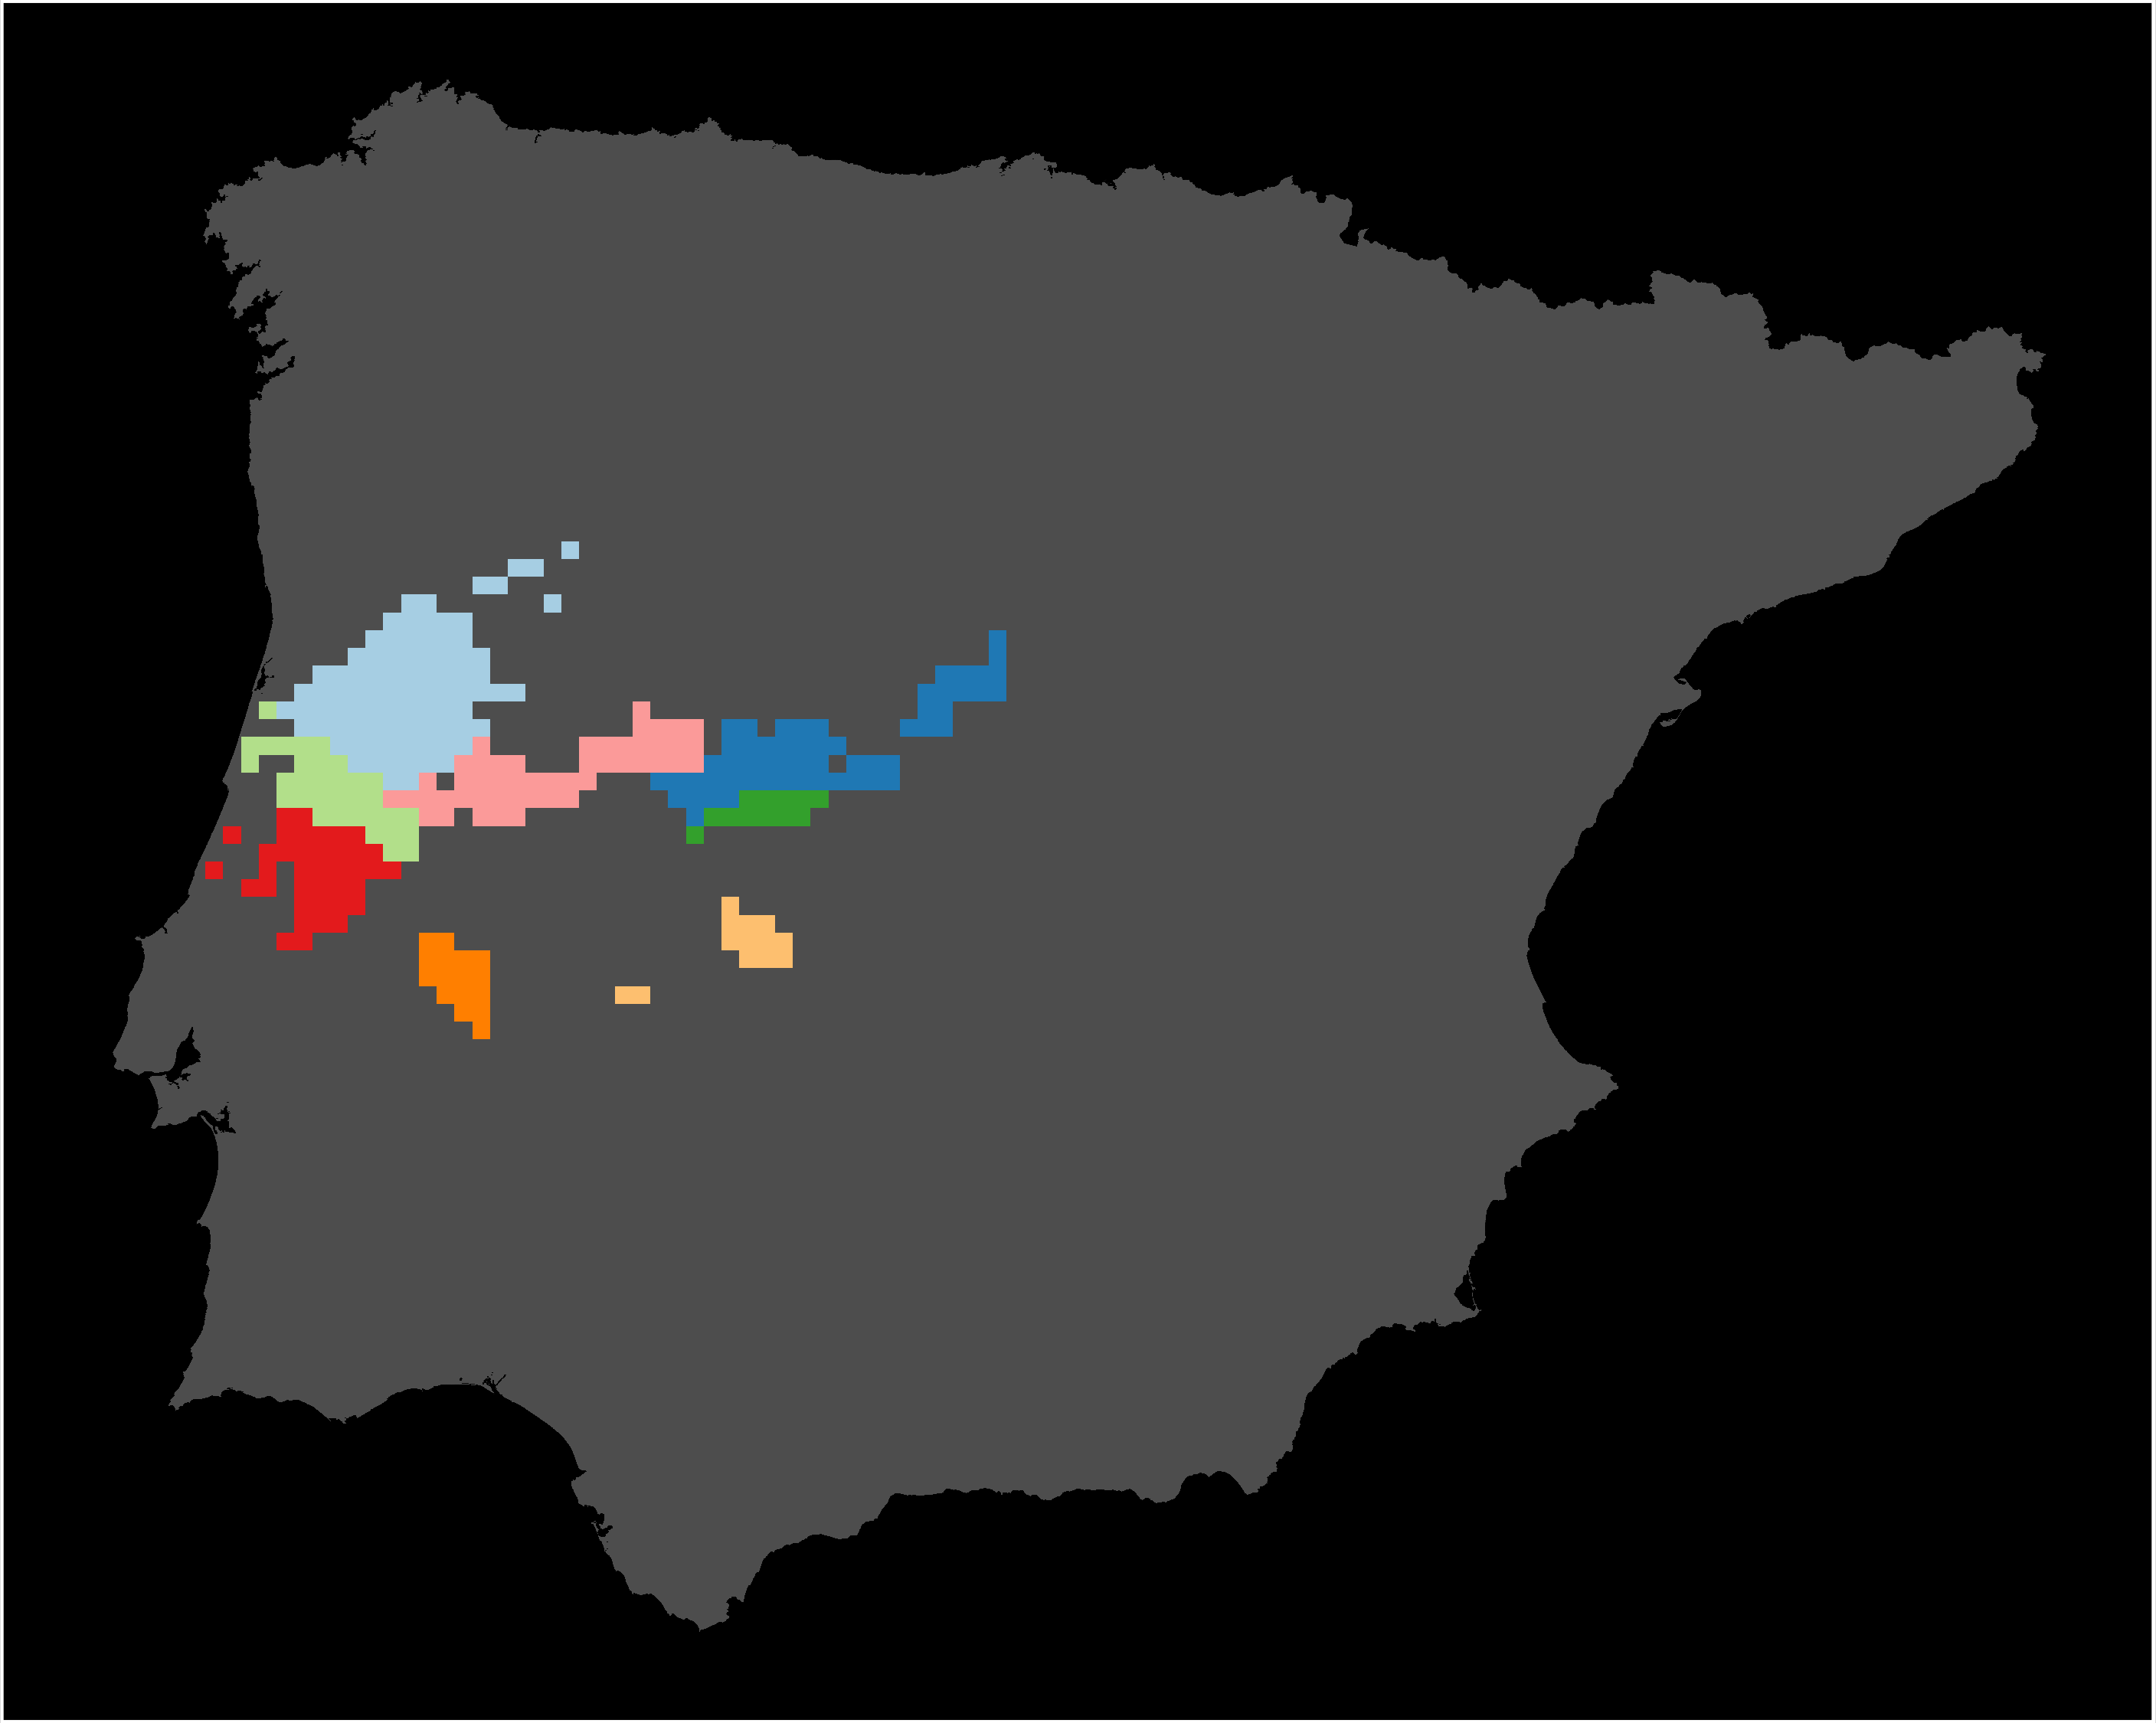
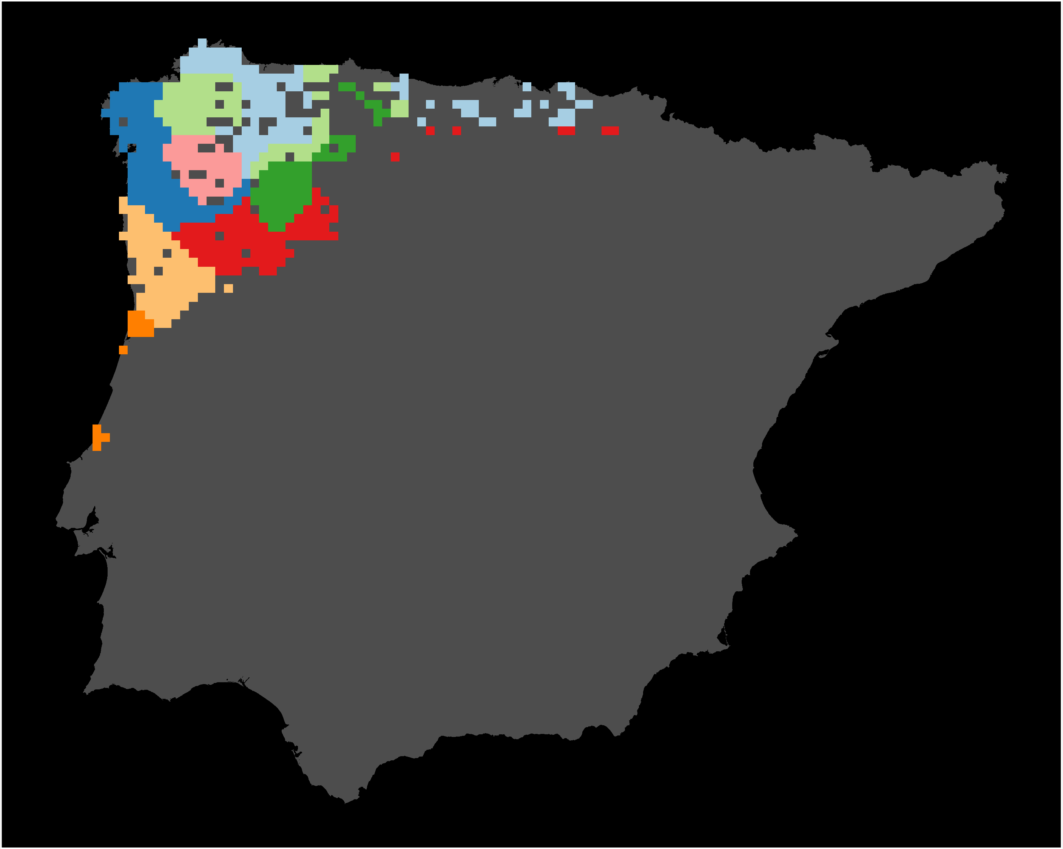
Protection of neutral genetic diversity
H. molleri
P. cultripes
R. iberica

Slide 10
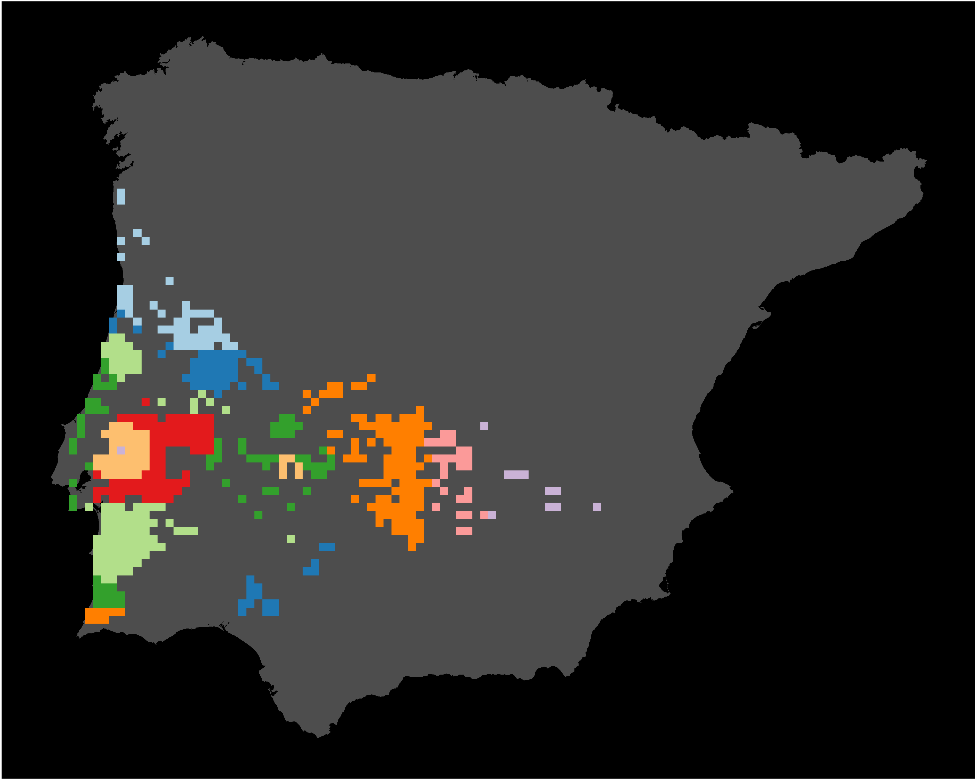
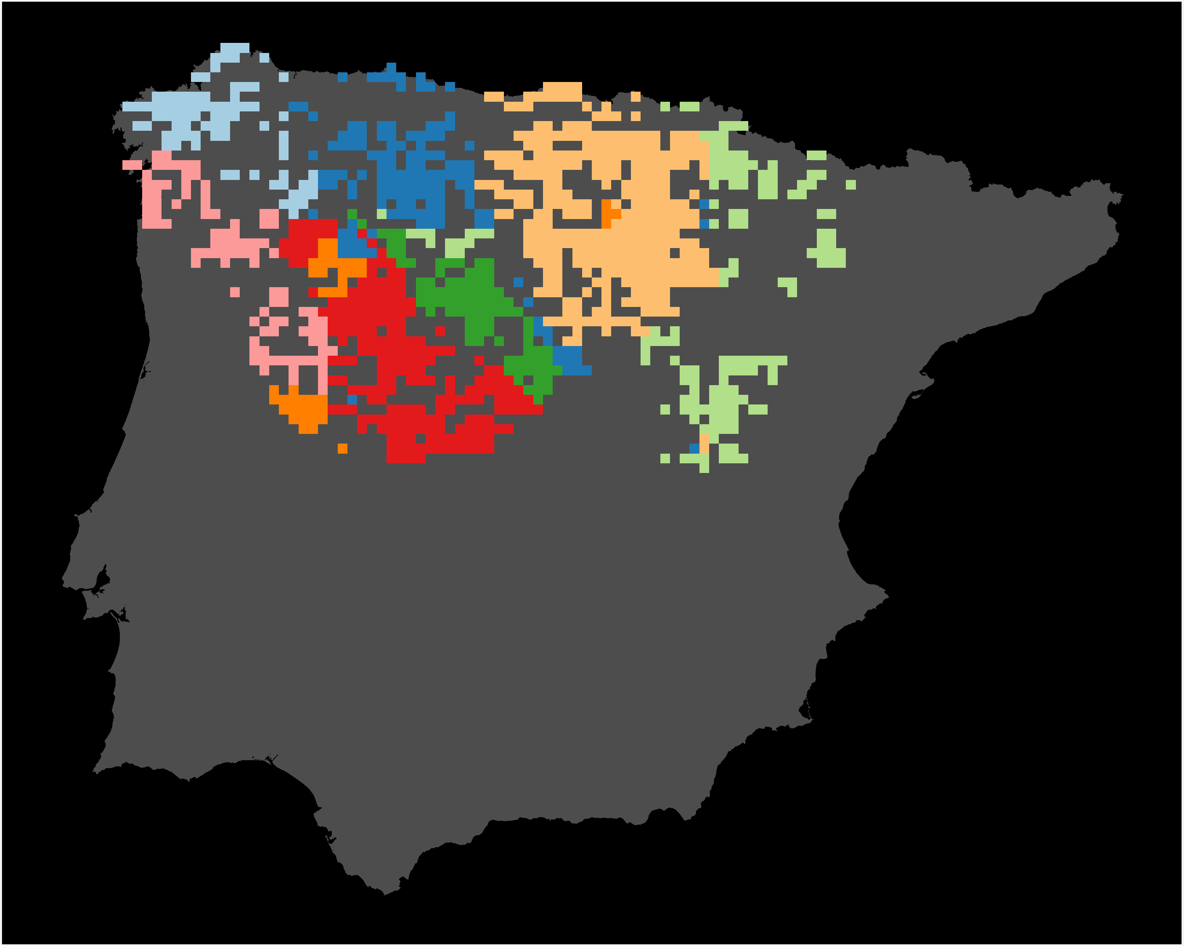
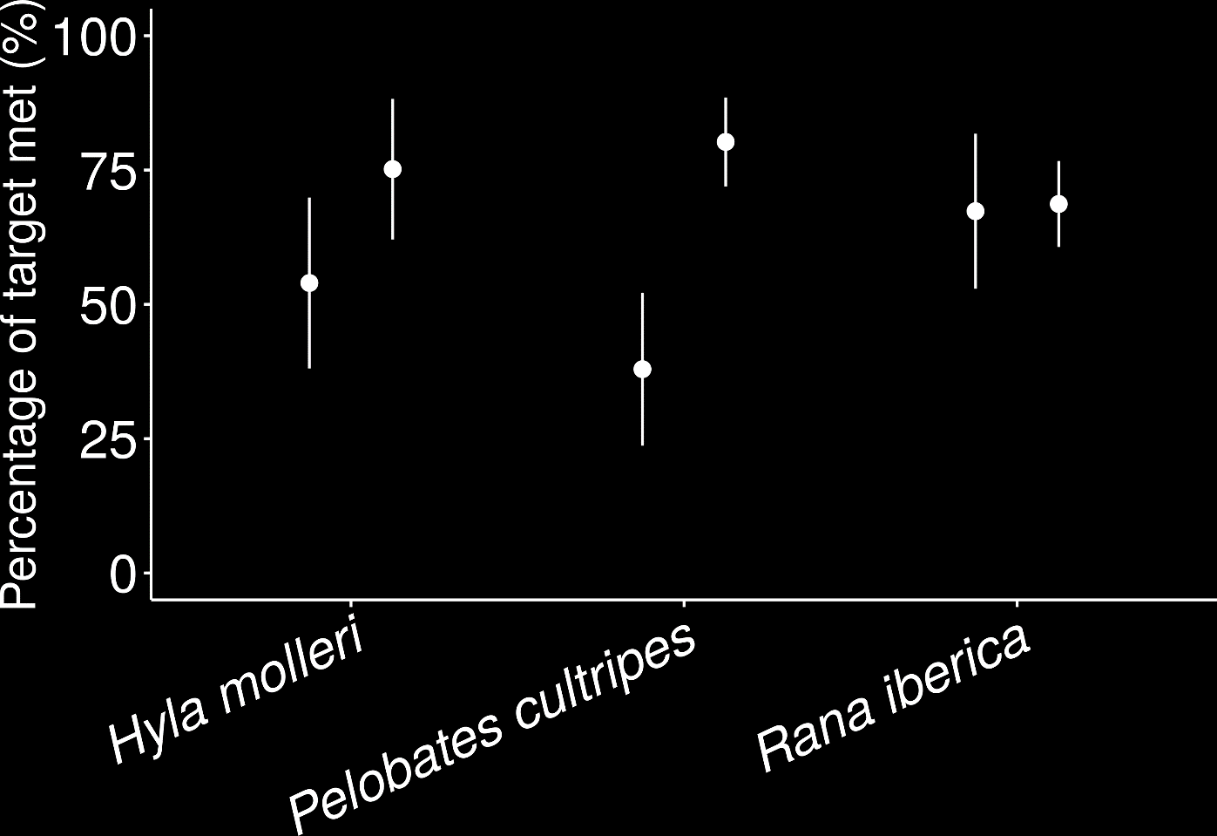
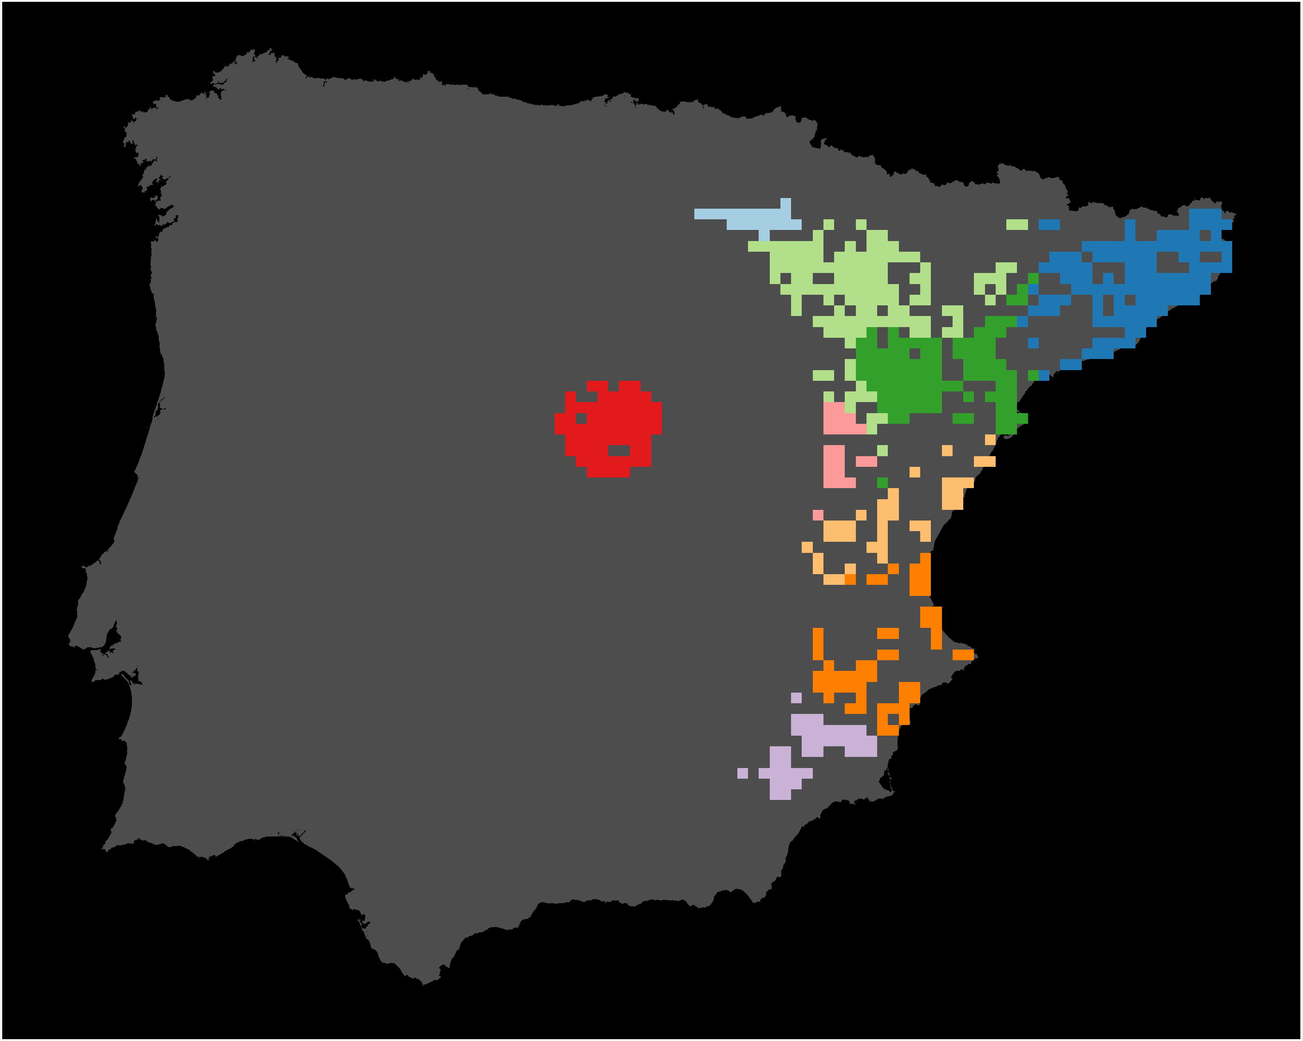
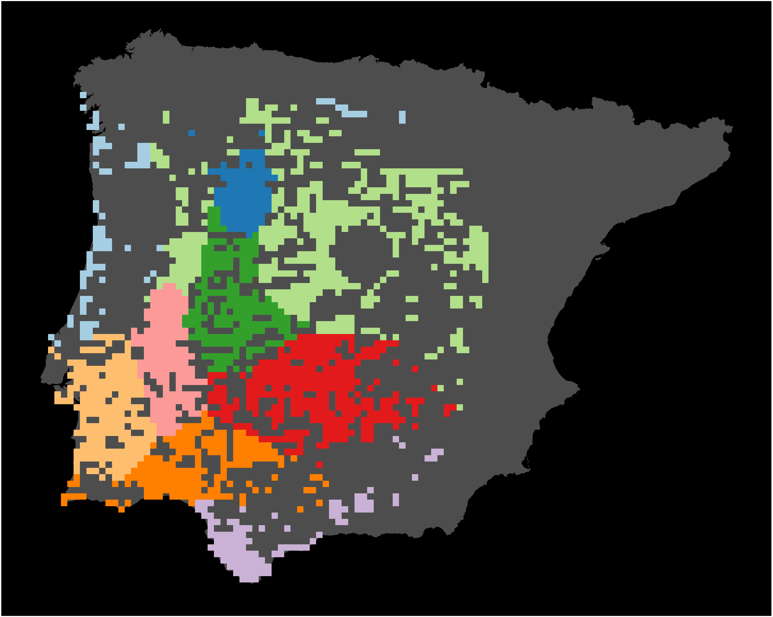
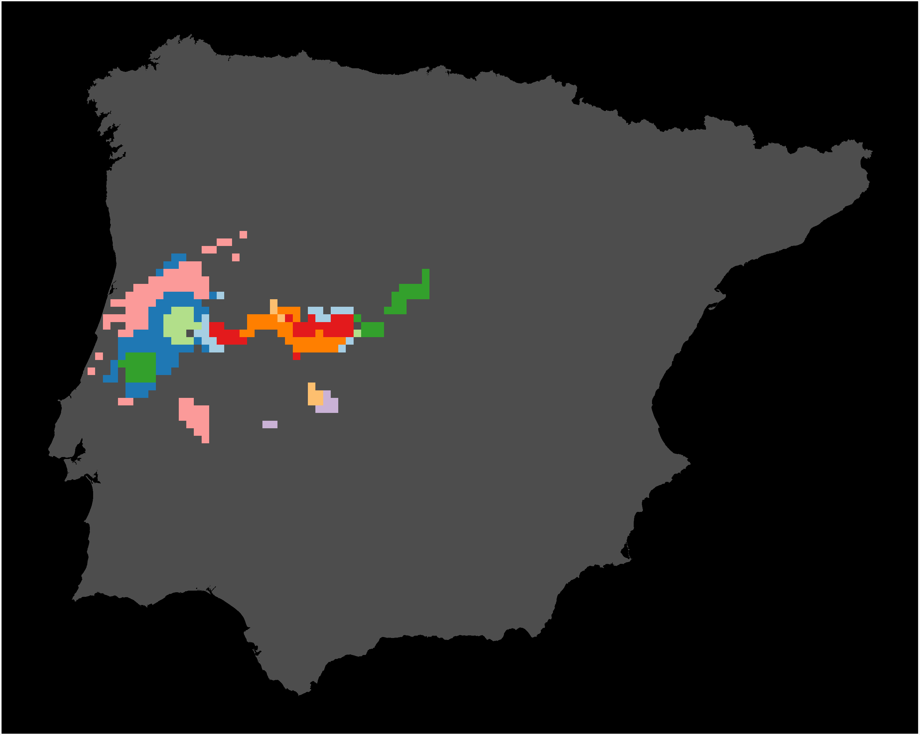
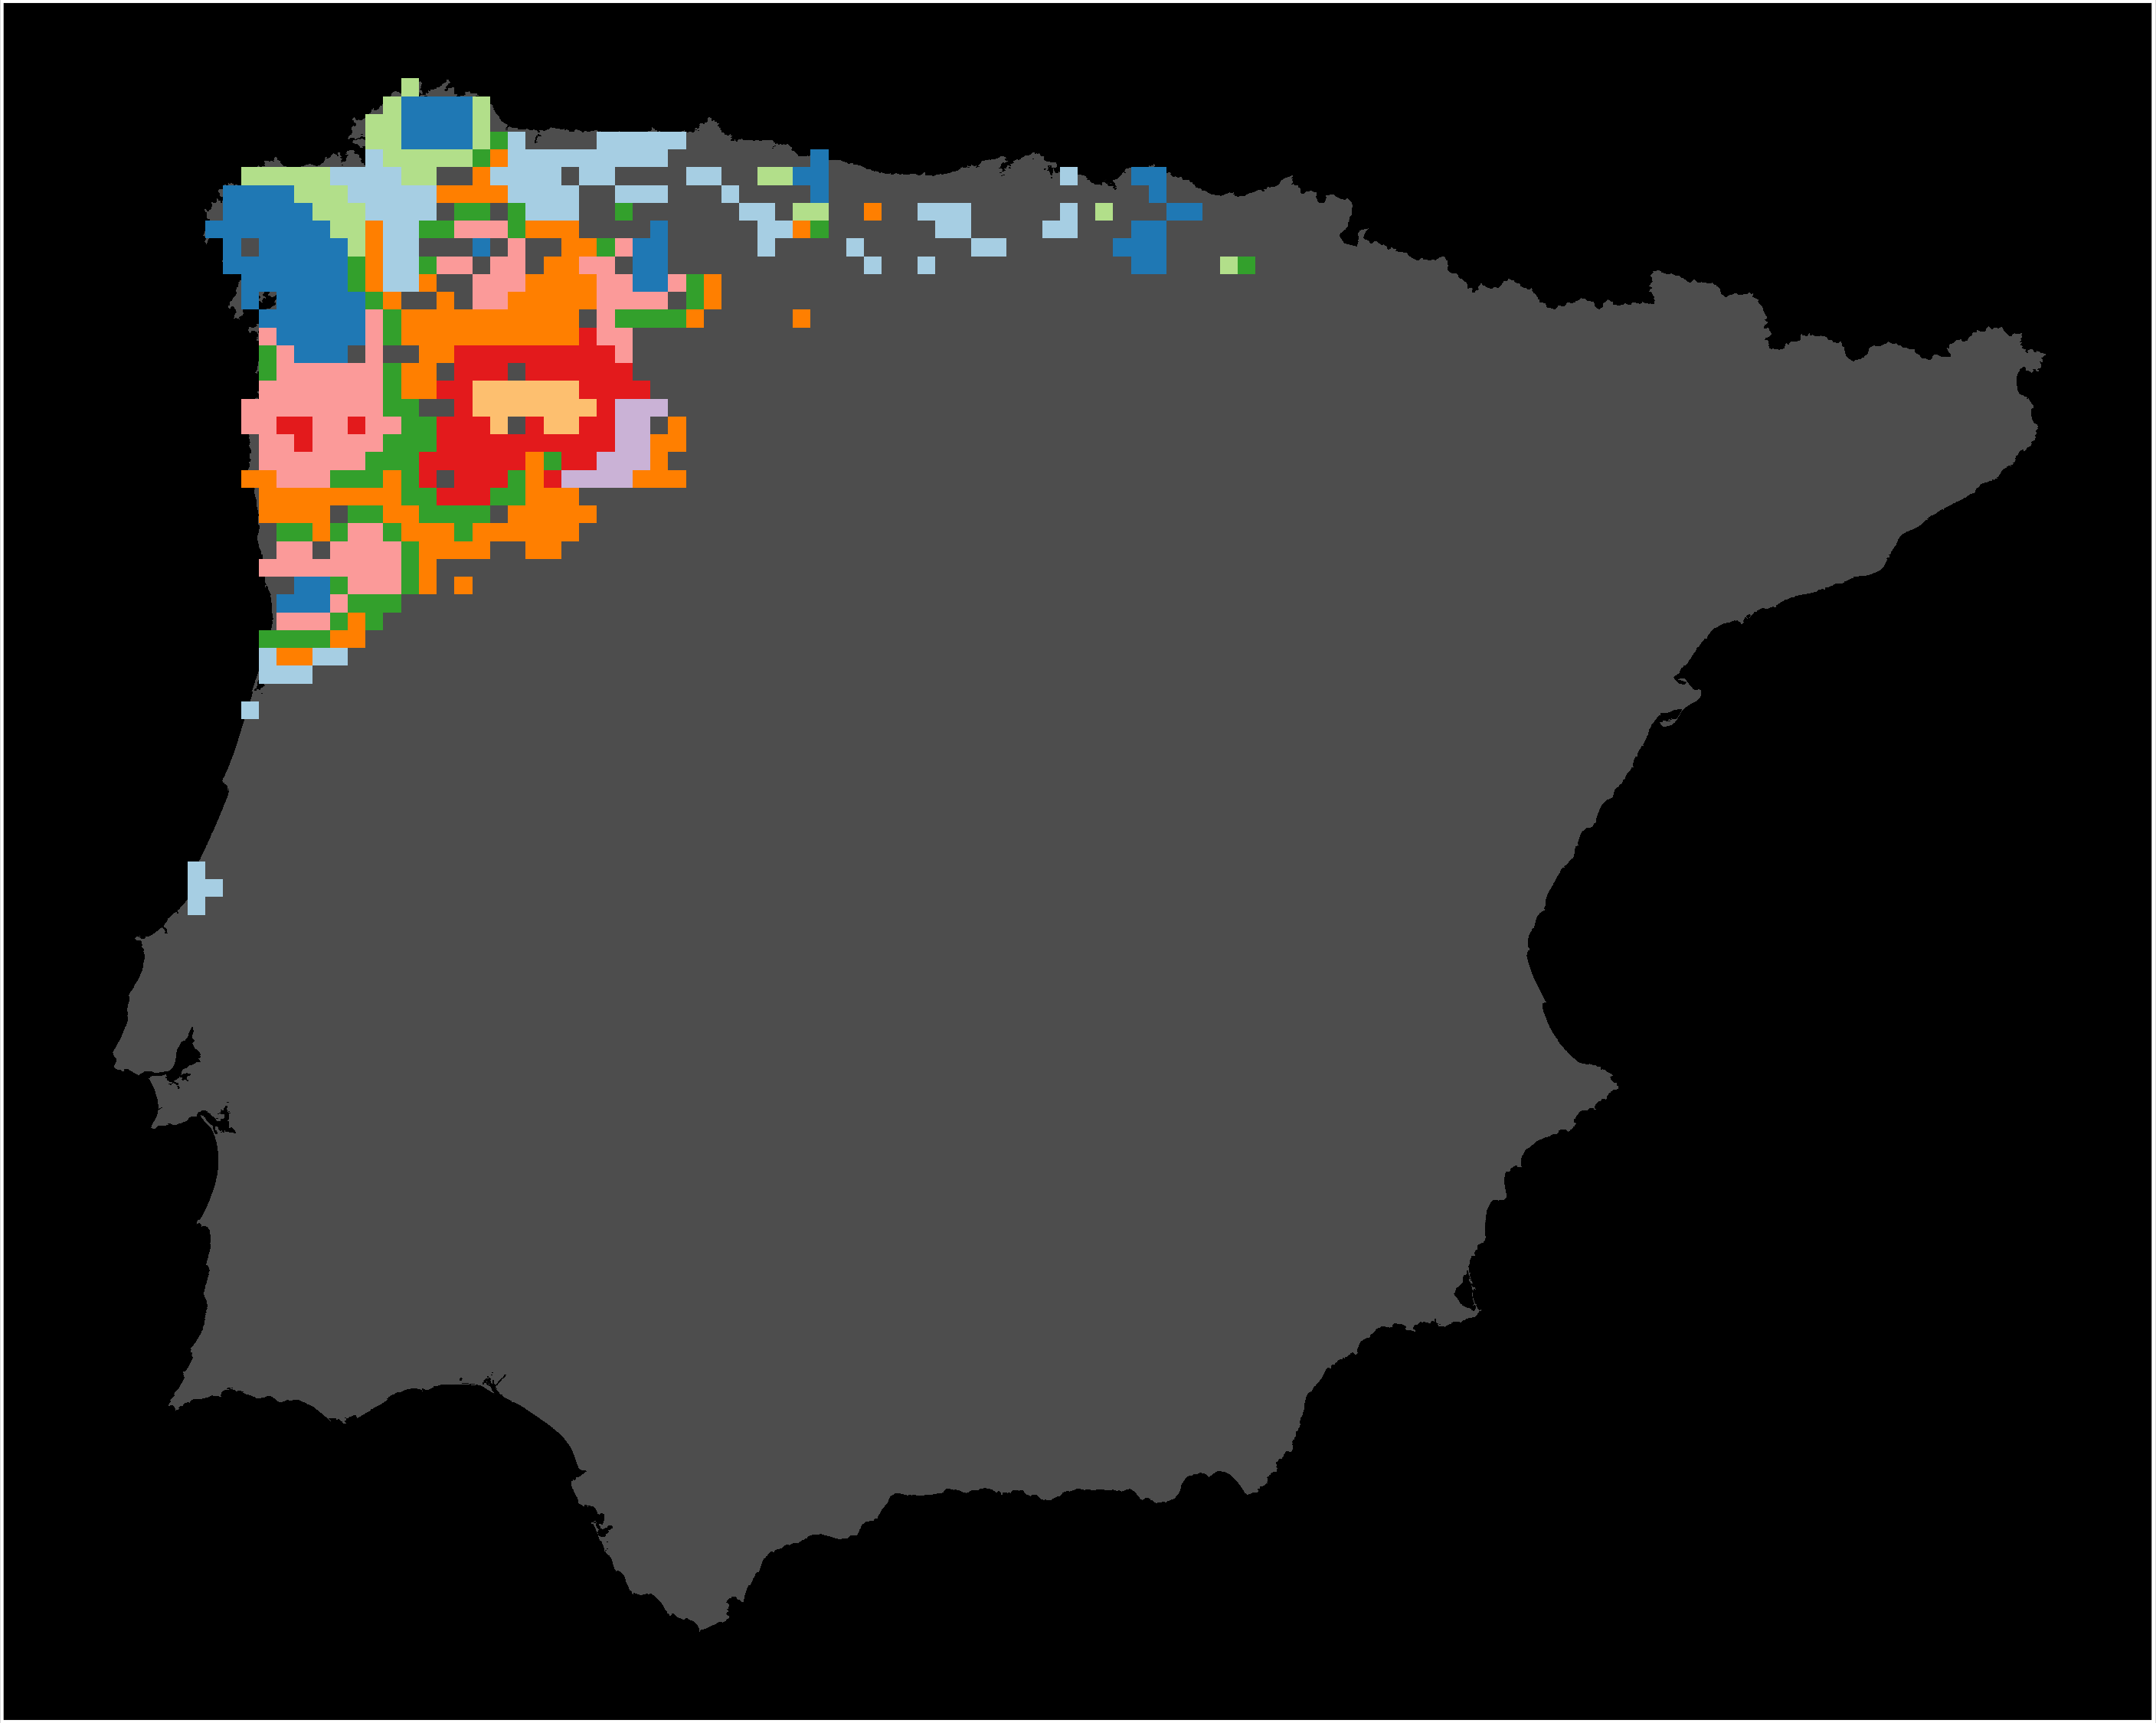
Protection of adaptive genetic diversity
H. molleri
P. cultripes
R. iberica

Slide 11
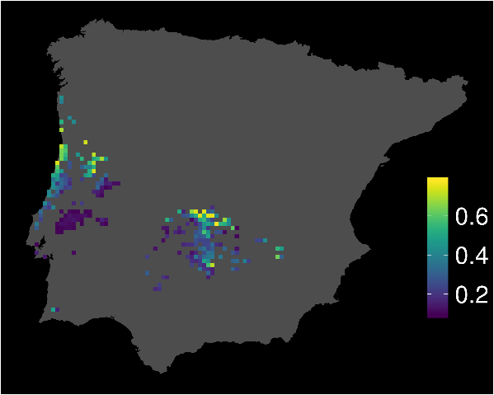
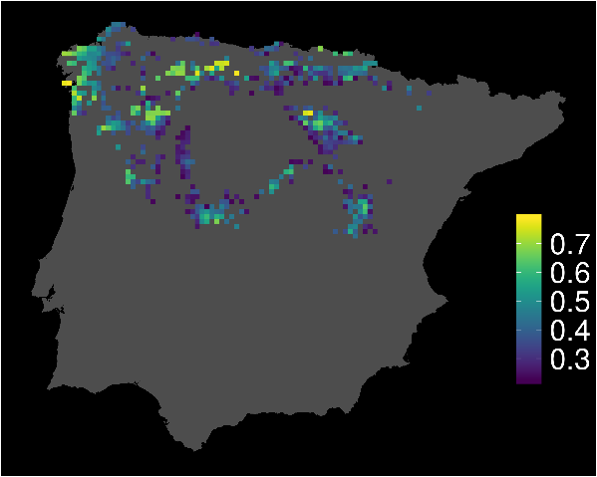
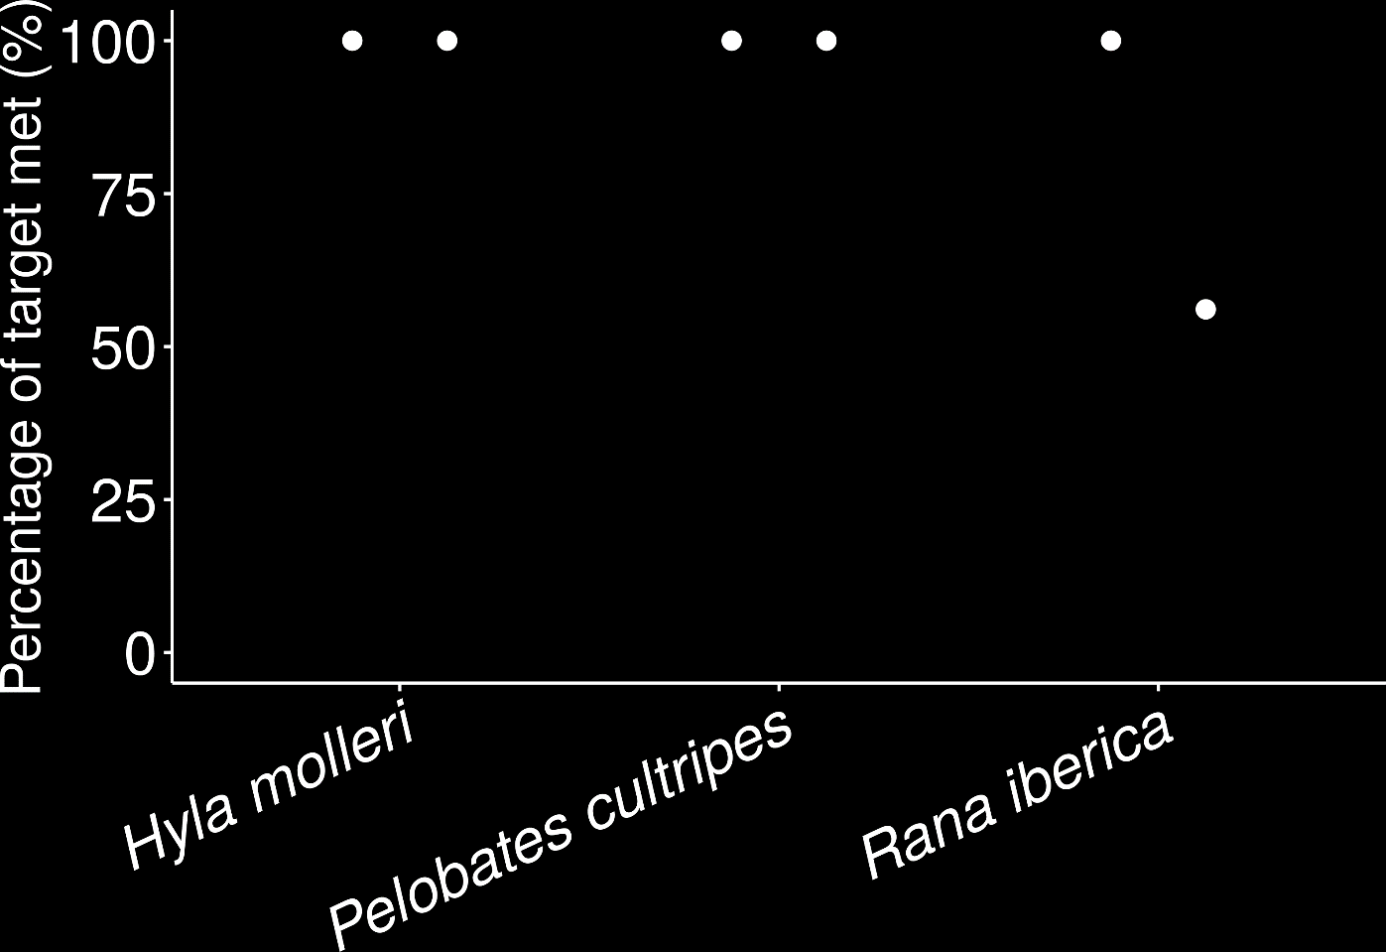




Protection of climate refugia
H. molleri
P. cultripes
R. iberica

Slide 12
Reserve selection
Notes:
- not all remaining habitat can be preserved
- achieve conservation objectives for minimal cost
- modern systematic conservation planning primarily focusses on representing species
- however, this ignores intra-specific biodiversity

Slide 13
Reserve selection

Slide 14
Reserve selection

Slide 15



Priority areas for protected areas
prioritizr
Priority areas
Protected areas

Slide 16


Planning for long-term persistence of biodiversity
Protection of genetic intra-specific diversity is insufficient
Strategic placement of new protected areas could rapidly increase protection of evolutionary processes

Slide 17



jeffrey.hanson@uqconnect.edu.au
github.com/jeffreyhanson
jeffrey-hanson.com

