Slide 1





Optimally managing threats to biodiversity across large scales
Jeffrey O. Hanson, Dobrochna M. Delsen, Allison Binley, James Allan, Martin Jung, Piero Visconti, Virgilio Hermoso, Richard Schuster, Melissa Chapman, Joseph R. Bennett
jeffrey.hanson@uqconnect.edu.au
jeffrey-hanson.com

Slide 2

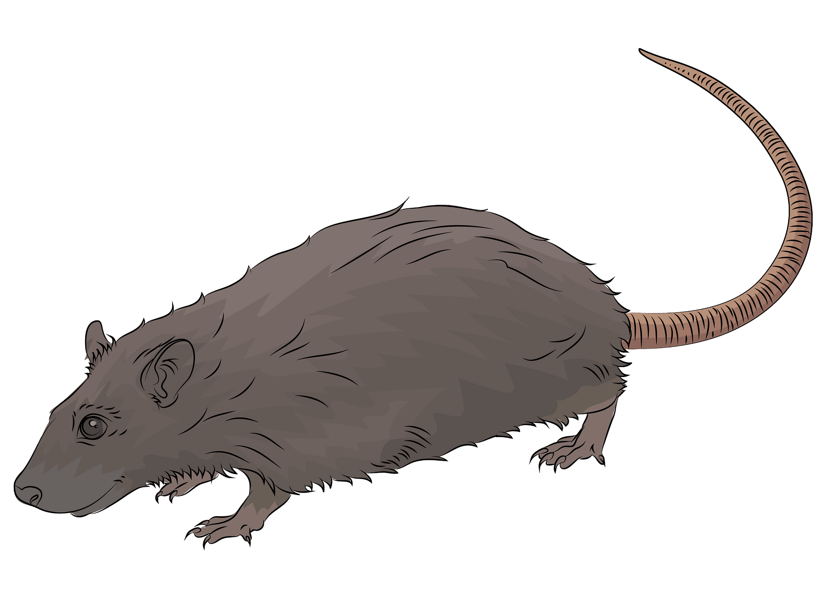
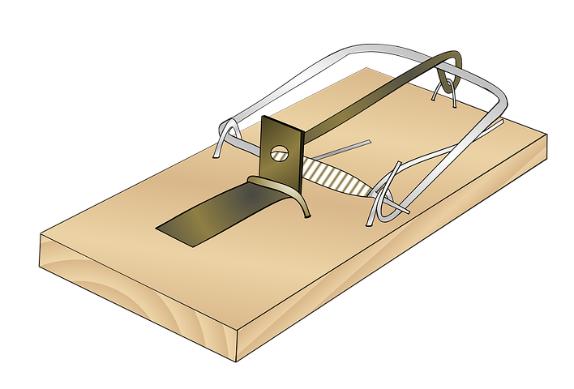
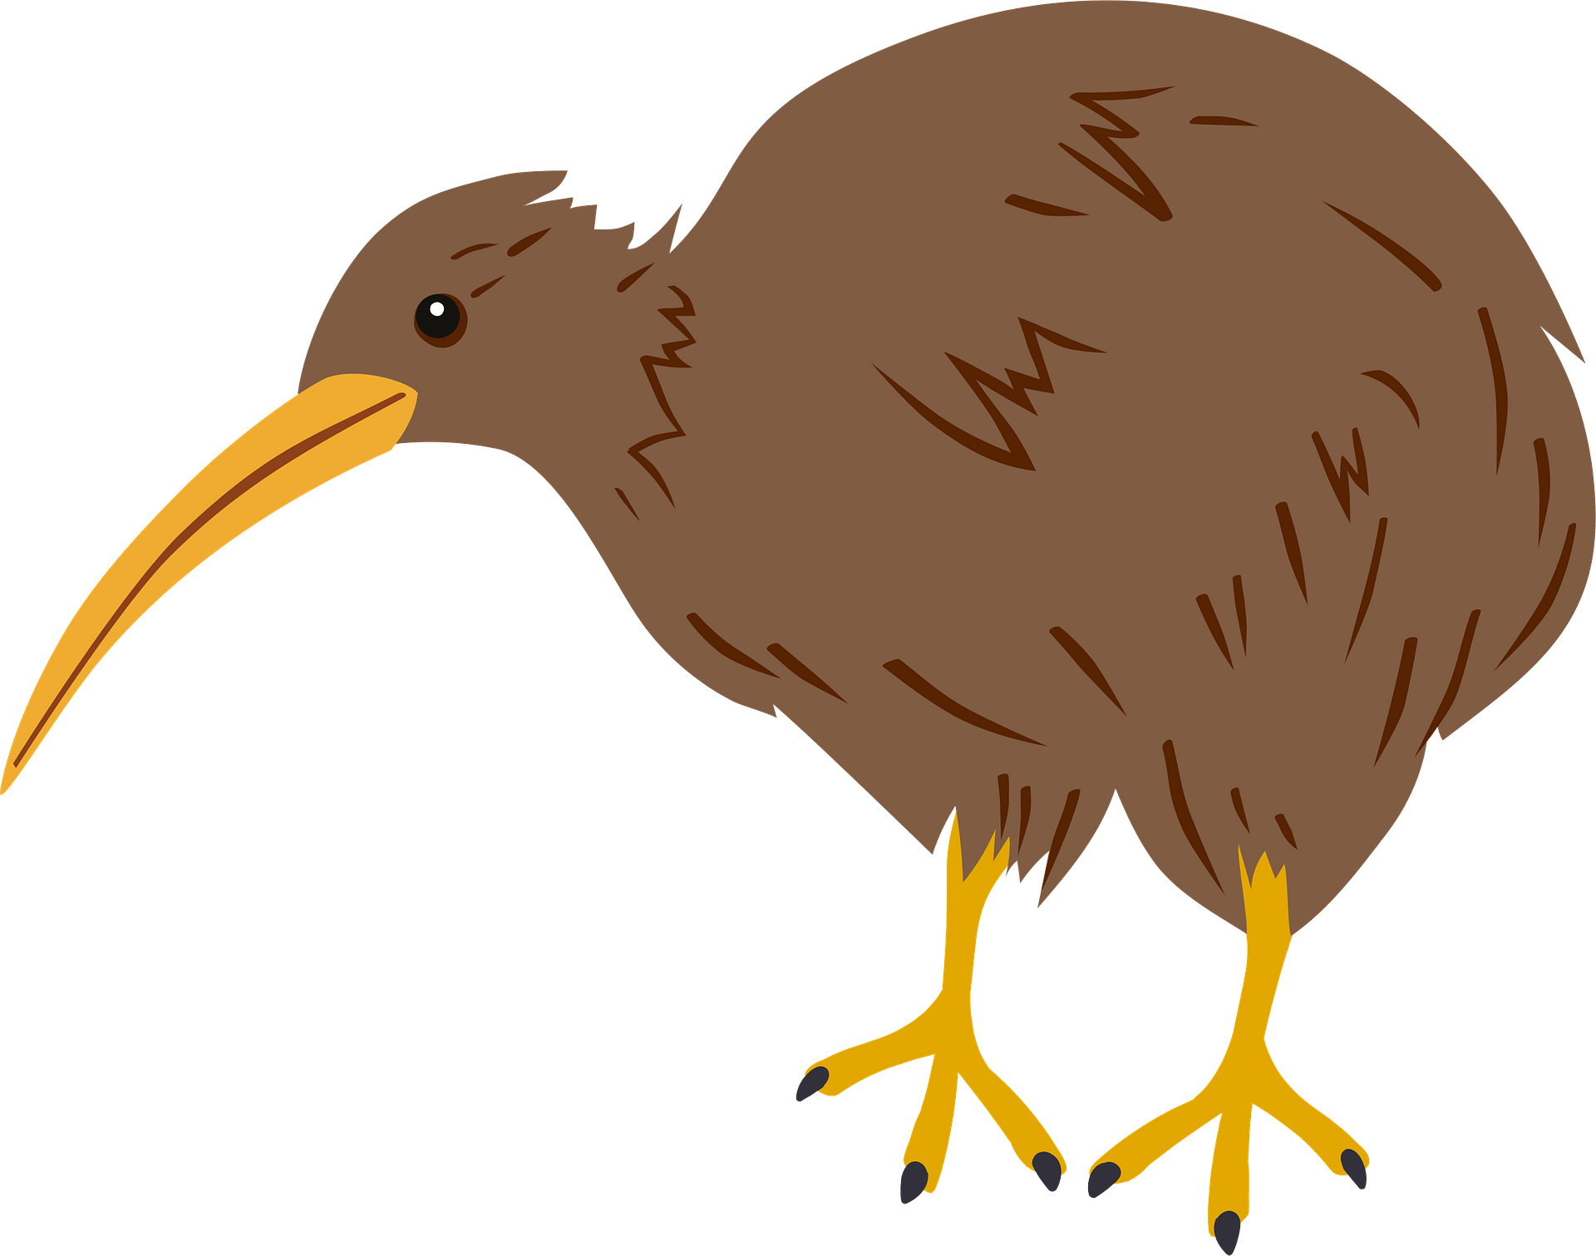
Conservation is actions in places
1. Area impacted by threat
2. Implement action to manage threat
3. Positive conservation outcome

Slide 3




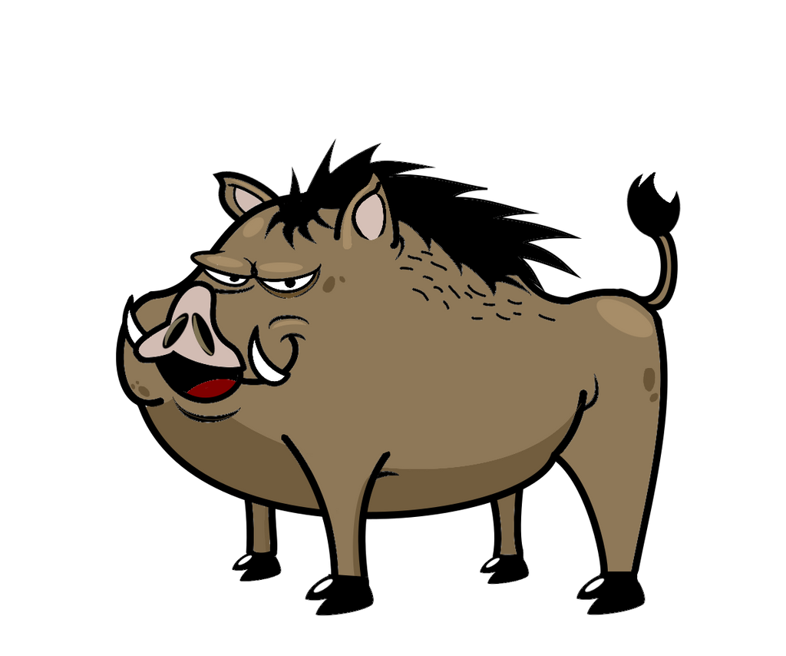

Which threats to manage, and where?
Current

Slide 4

Which threats to manage, and where?
Current
Threat impacts

Slide 5
Which threats to manage, and where?
Current
Potential
Threat impacts

Slide 6
Which threats to manage, and where?
Current
Potential
Priority
?
?
?
?
Threat impacts
Targets
= 1
= 2
= 1

Slide 7
Ensure each species has enough of “threat free” habitat
Current
Potential
Priority
Threat impacts
Targets
= 1
= 2
= 1

Slide 8
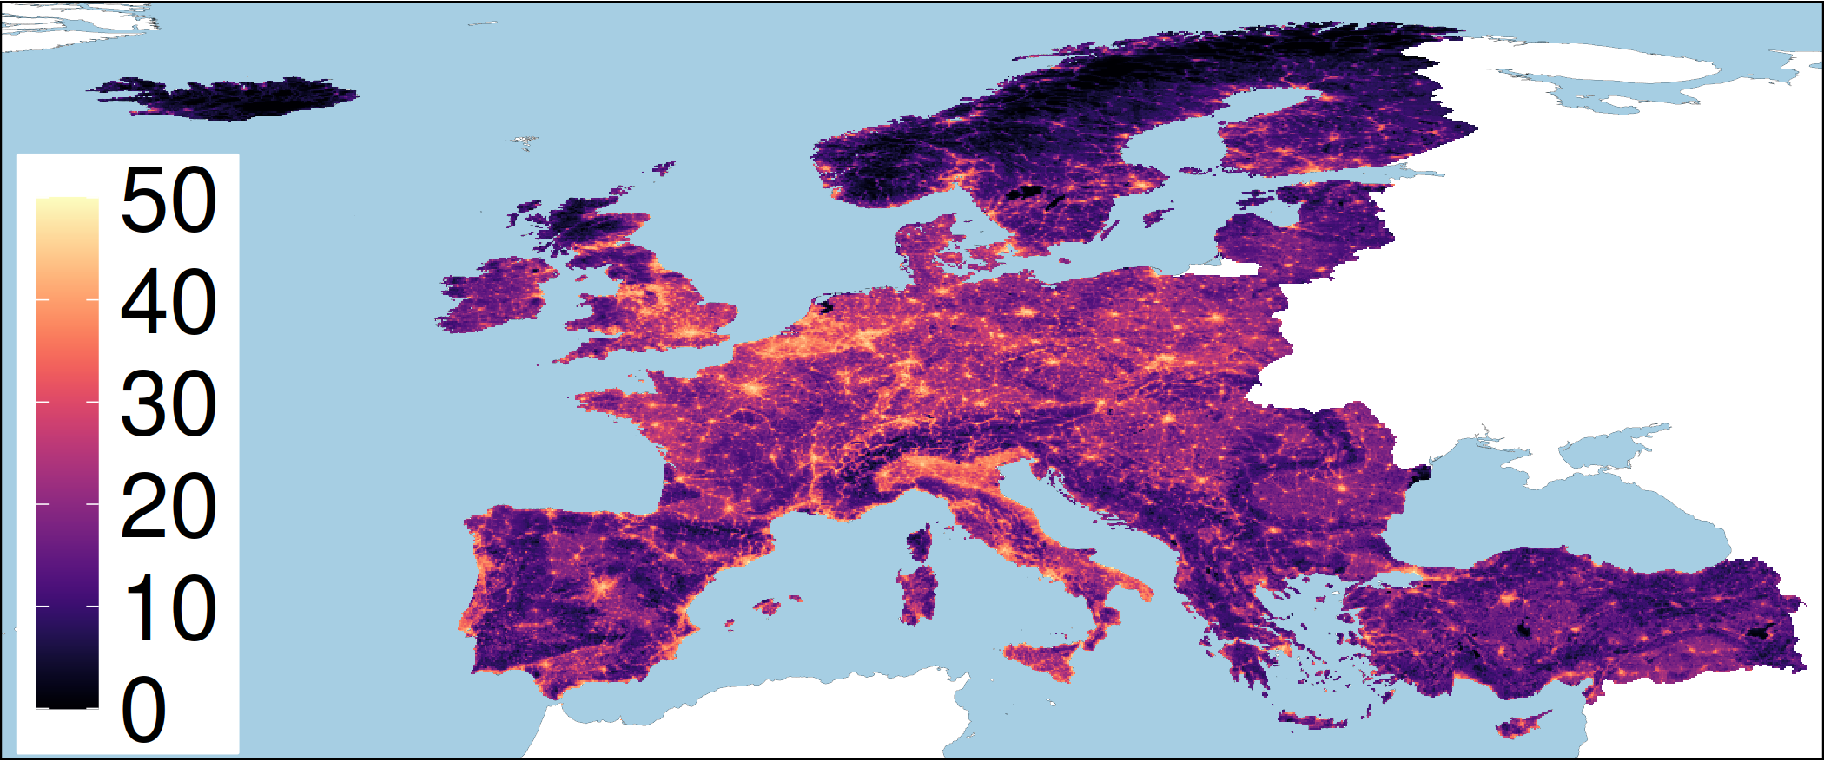
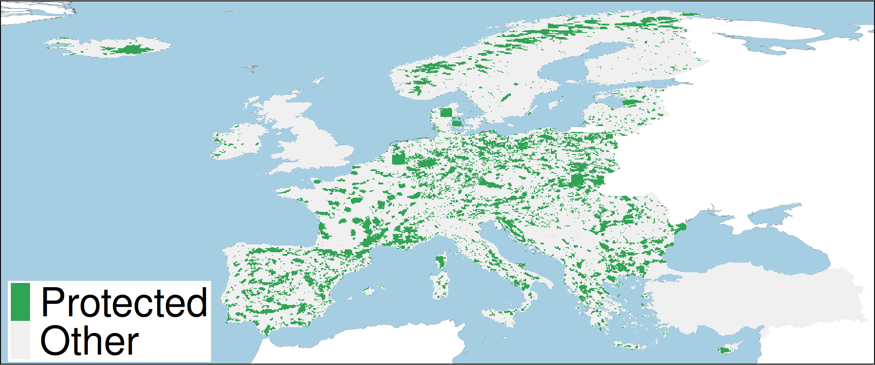
European case study
710 species: 81 amphibian, 378 birds, 156 mammal, 95 reptile species
165,000+ planning units (grid cells)
Natura 2000 network, nationally designed protected areas, OECMs
Conservation benefit for a species = amount of threat-free habitat in conservation areas
Human pressure

Slide 9
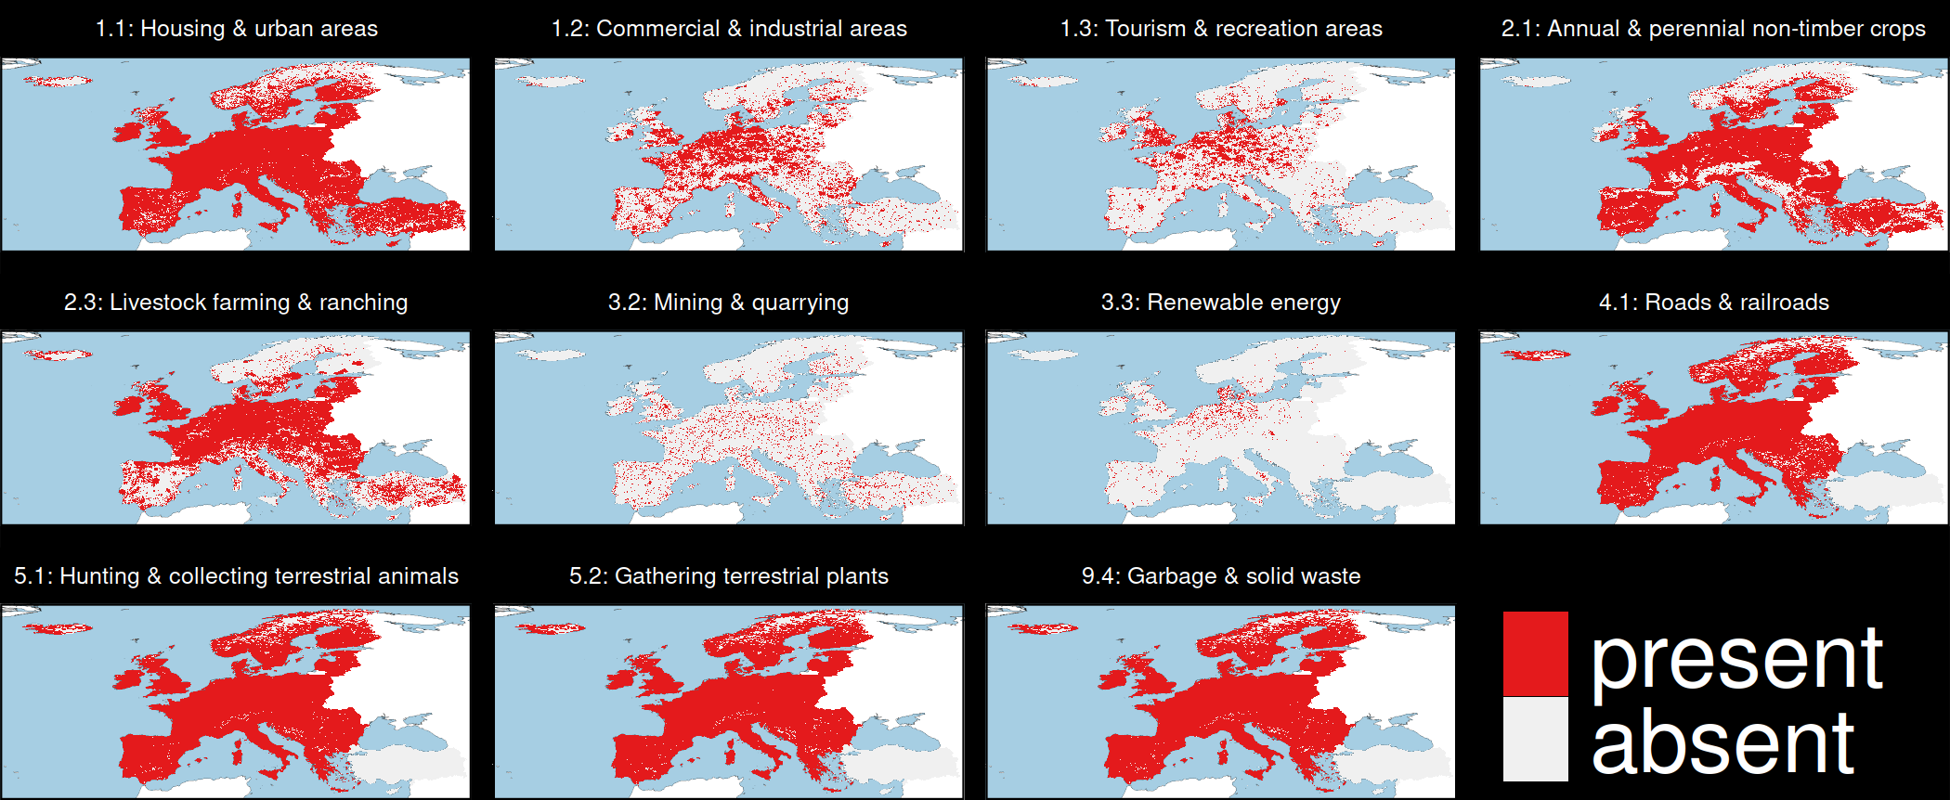
Threats to biodiversity

Slide 10
Threats to biodiversity

Slide 11
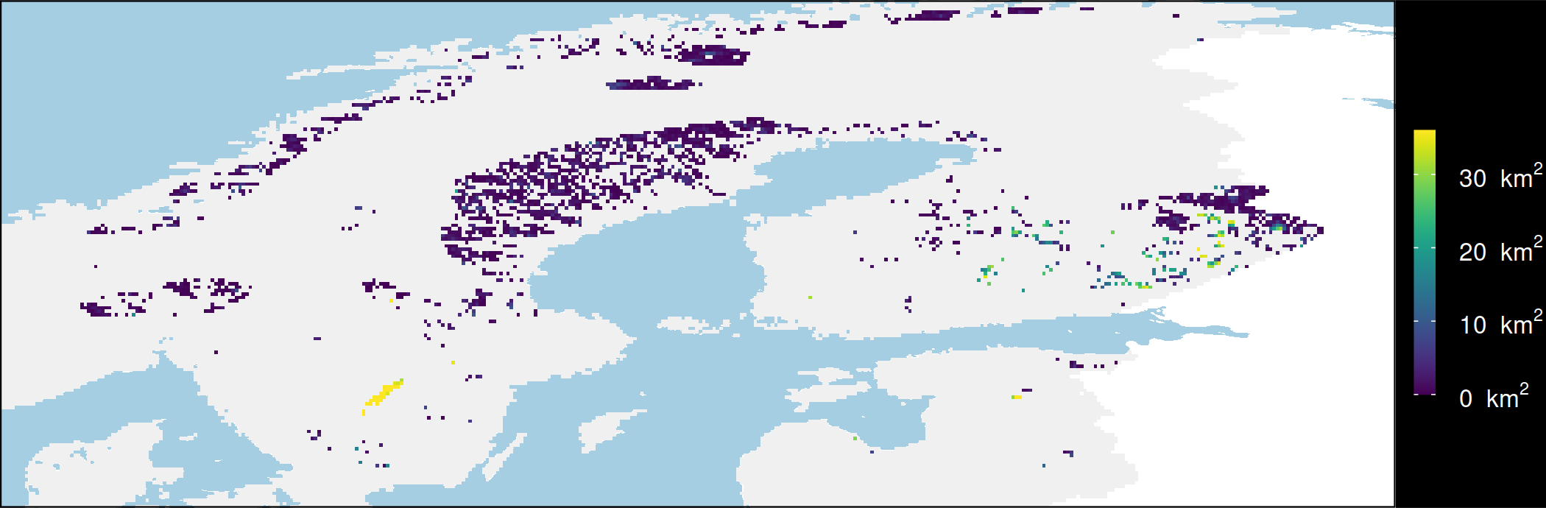

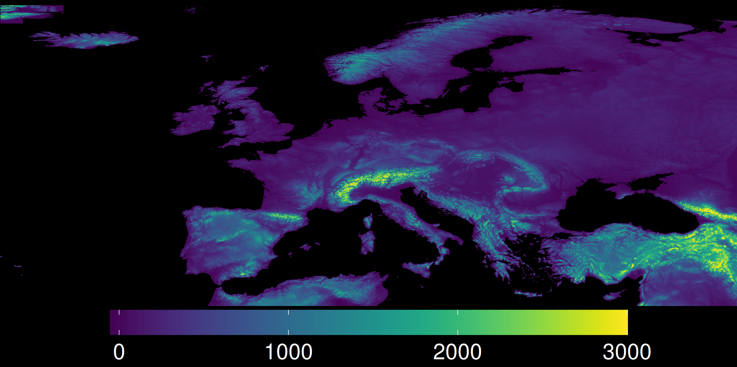
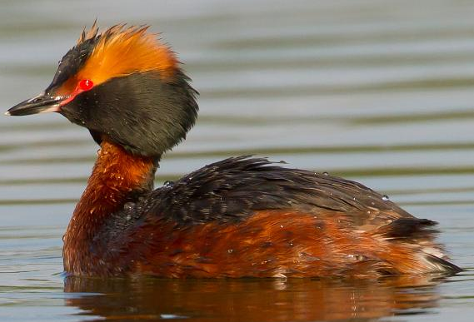
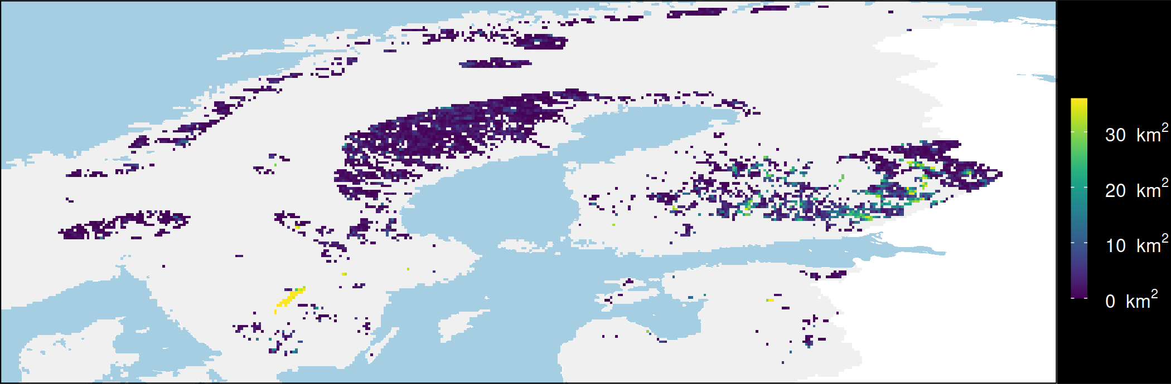
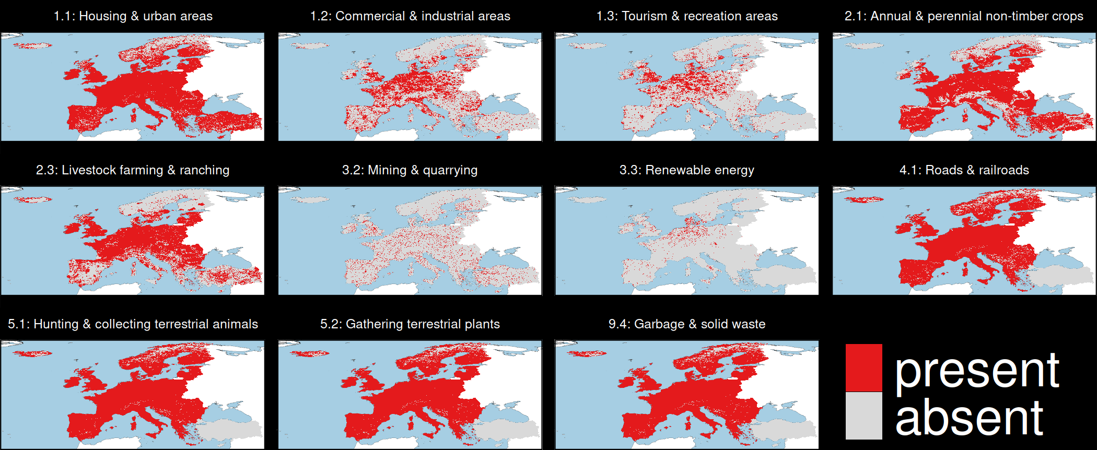
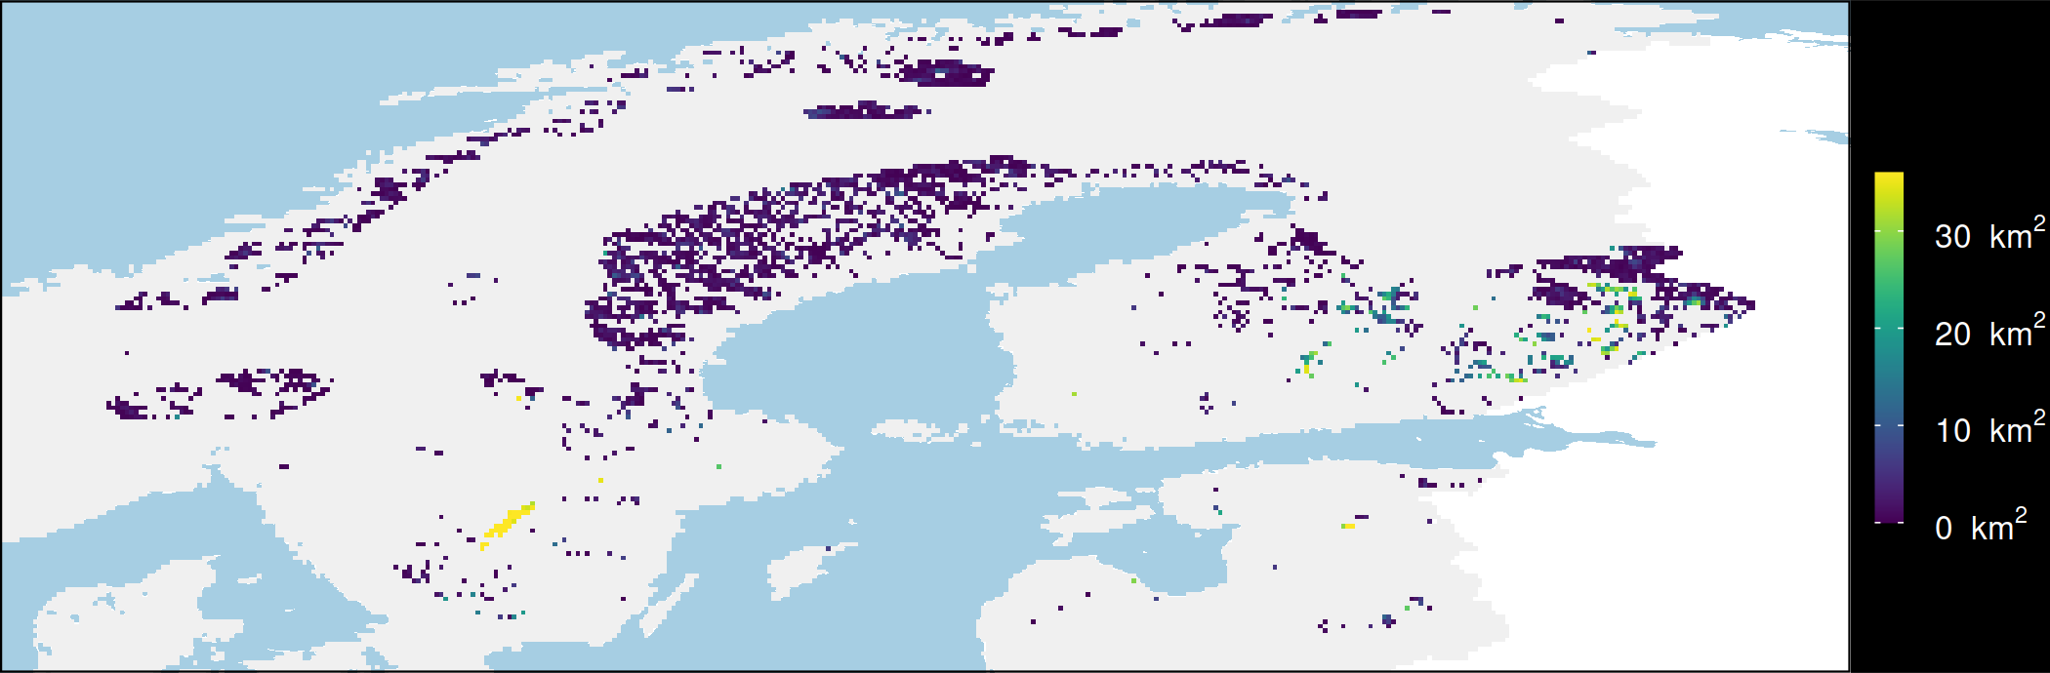
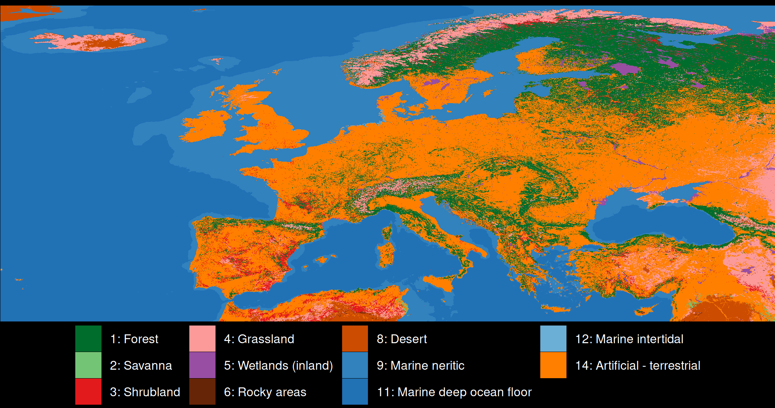
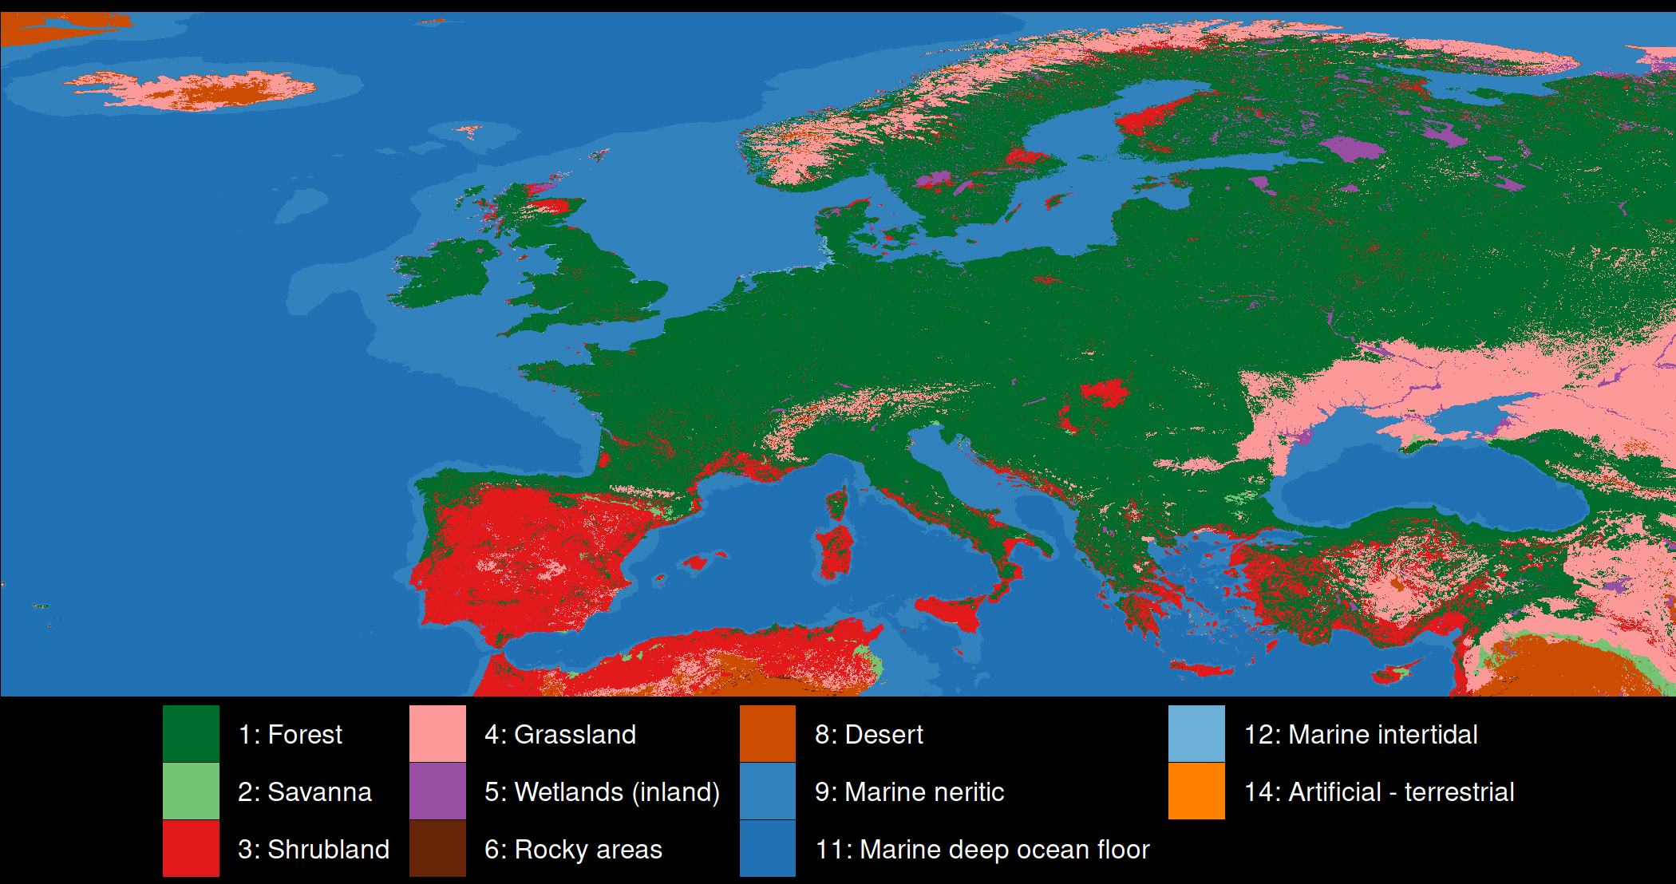
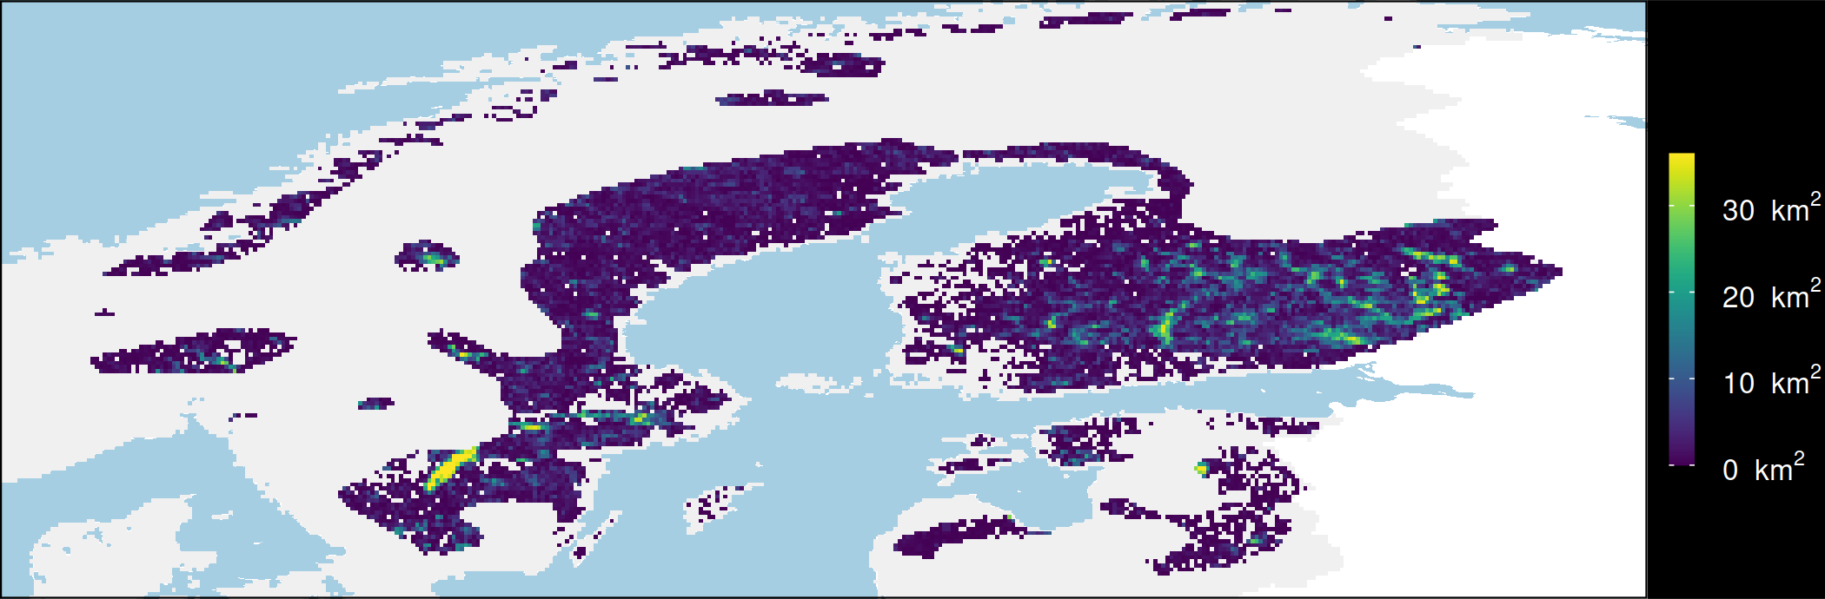
Mapping consequences
Protect existing habitat
Species
Elevation
Horned Grebe
Restore urban areas
Threats
What if?
Restore croplands
Current
land cover
Potential natural
vegetation
Restore urban & croplands

Slide 12
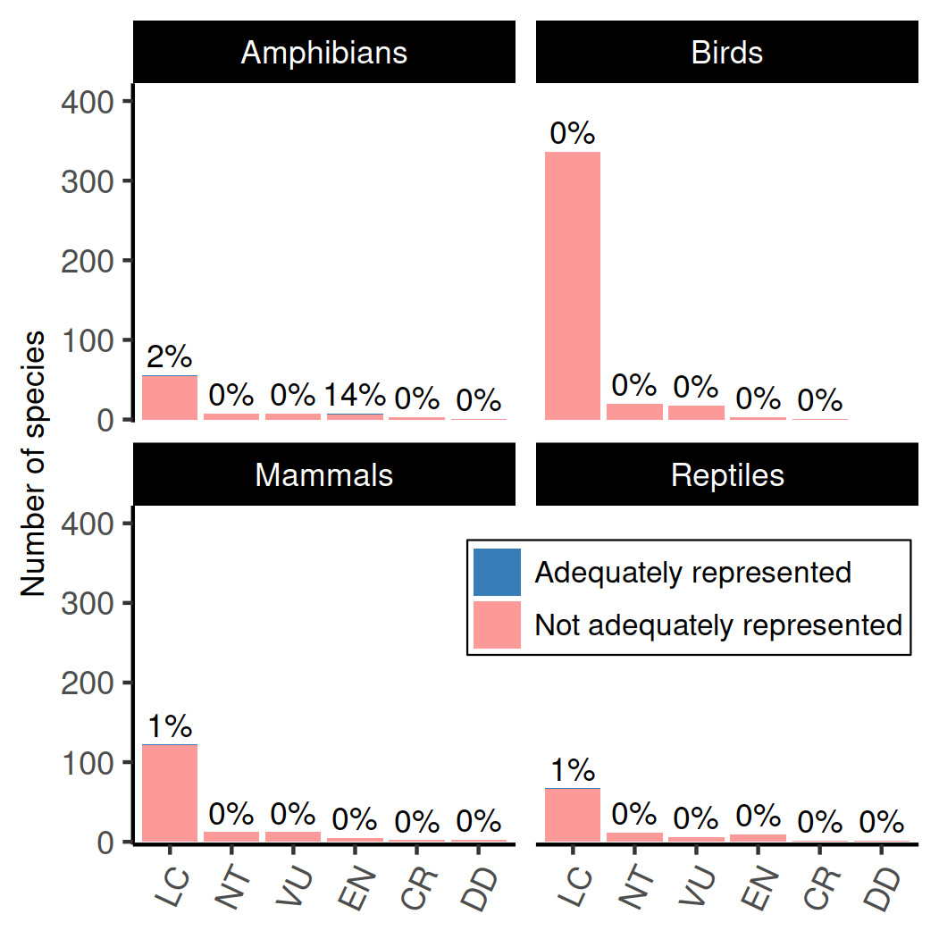
Performance of existing protected areas
Only 4 / 710 species with adequate threat-free habitat within protected areas
Only 1 / 74 imperilled species
Much worse than previous assessments which don’t account for threats

Slide 13
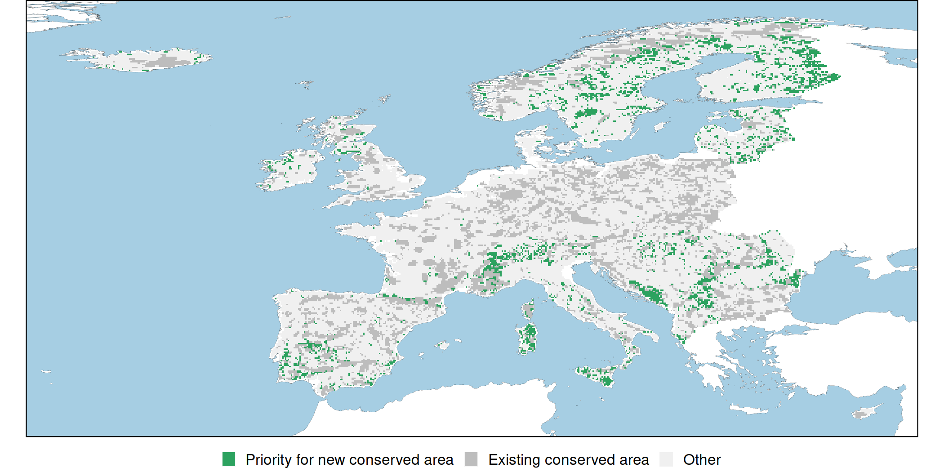
Establishing protected areas to cover 30% of Europe
Improves from 4 / 710 to 27 / 710 species with adequate threat-free habitat within protected areas

Slide 14
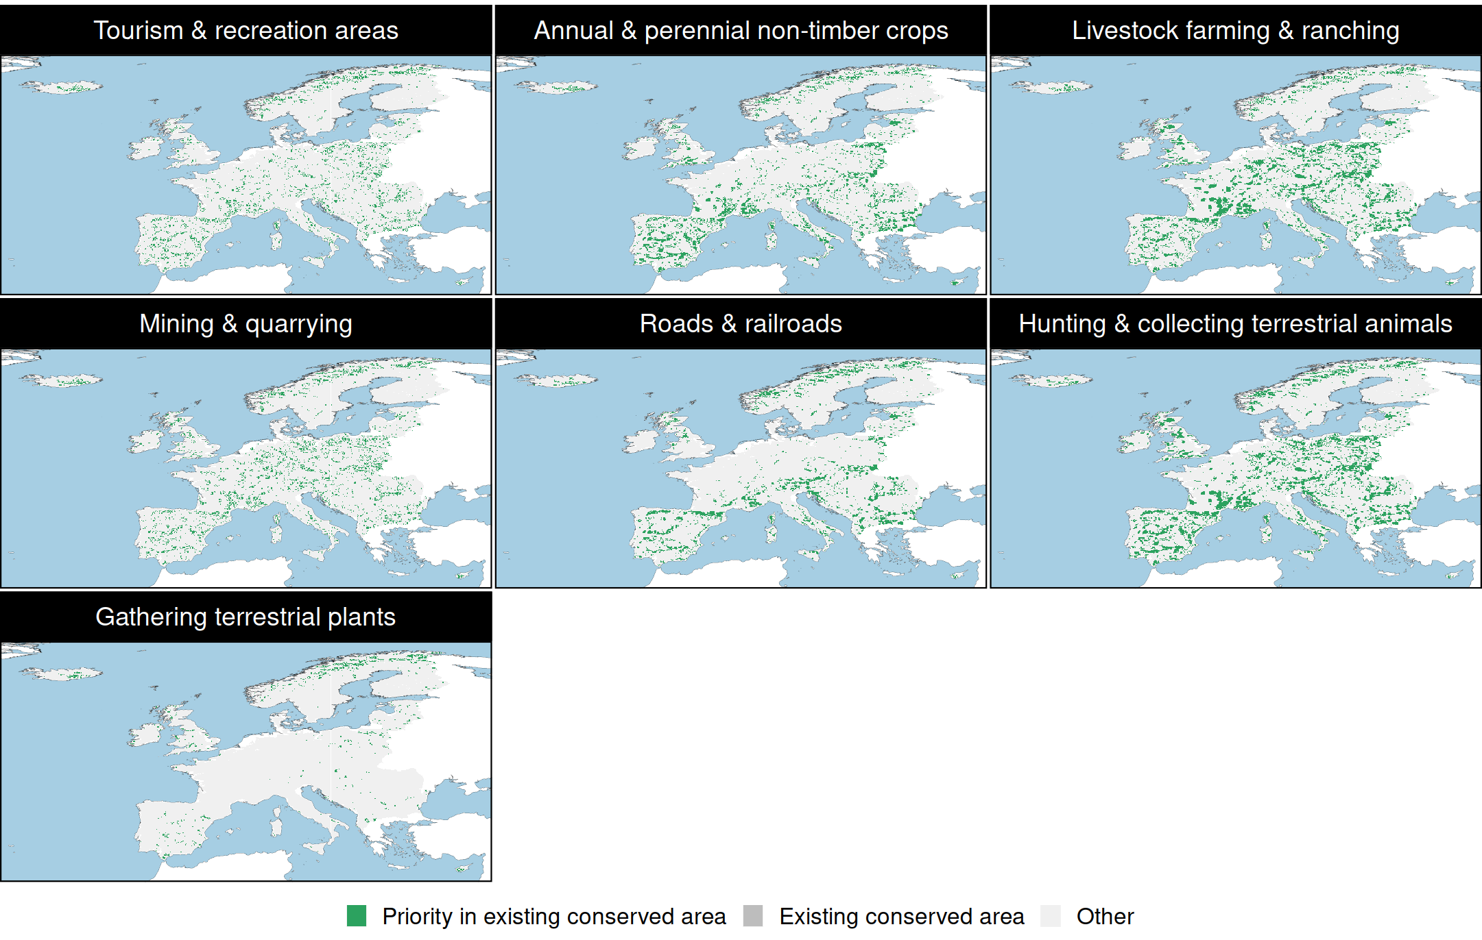
Managing threats within existing protected areas
Bigger improvement from 4 / 710 to 113 / 710 species with adequate threat-free habitat within protected areas

Slide 15
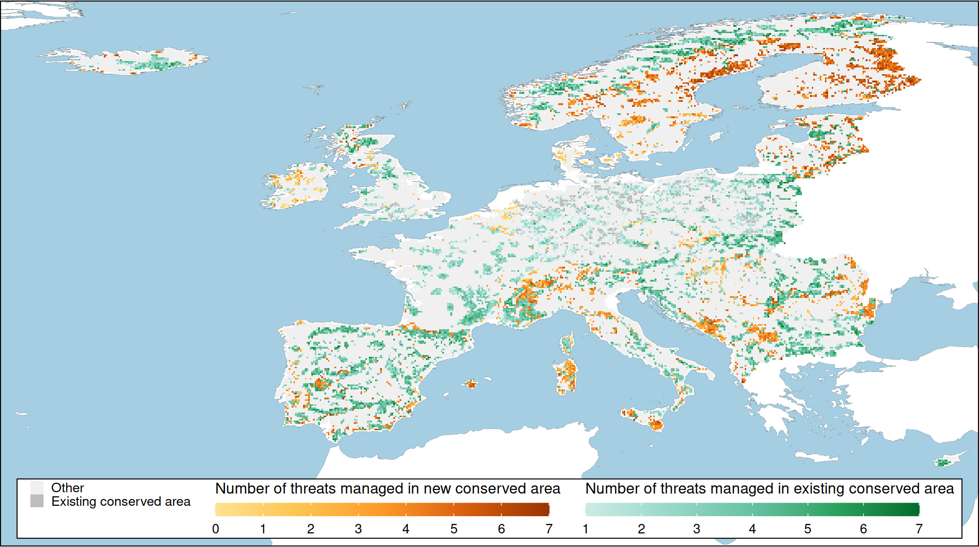
Prioritizing threat management across 30% of Europe
Massive improvement from 4 / 710 to 178 / 710 species with adequate threat-free habitat within protected areas

Slide 16
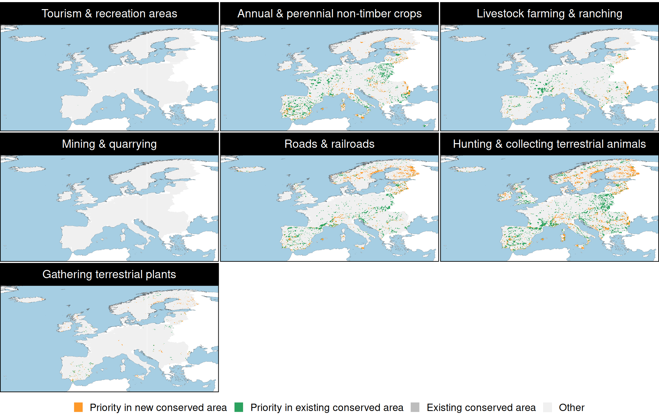
Prioritizing threat management across 30% of Europe
Most management focussed on livestock farming and ranching, hunting and collecting terrestrial animals, and annual and perennial non-timber crops

Slide 17
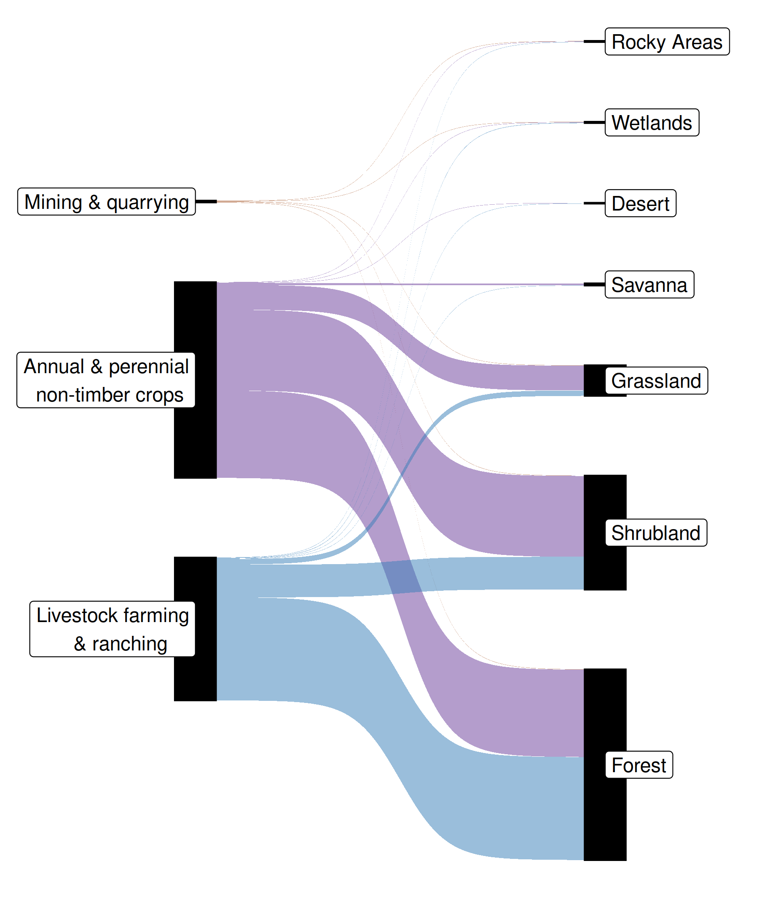
Restoration through threat management
Habitats restored within priority areas
Most of the priority areas that involved habitat restoration focussed on providing forest and shrubland areas
69% of priority areas involved restoring habitat within existing protected areas
30% of priority areas involved restoring habitat within new protected areas

Slide 18
Take home messages
Most EU species don’t have adequate habitat in protected areas that is free from threats
Improving management of existing protected areas is necessary, but insufficient, for many species
Strategically managing threats both within and beyond existing protected areas is needed
Conservation is actions in places:
you need to think about both!

Slide 19




jeffrey.hanson@uqconnect.edu.au
github.com/jeffreyhanson
jeffrey-hanson.com

