Slide 1



rapr: representative and adequate prioritisations in R
Jeffrey Hanson, Jonathon Rhodes,
Hugh Possingham & Richard Fuller
jeffrey.hanson@uqconnect.edu.au
jeffrey-hanson.com

Slide 2
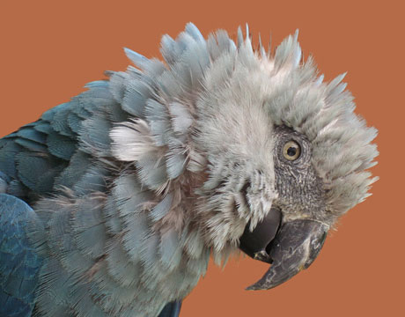
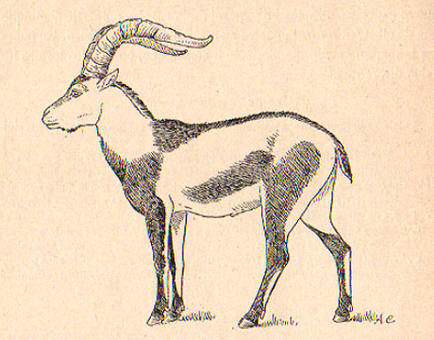
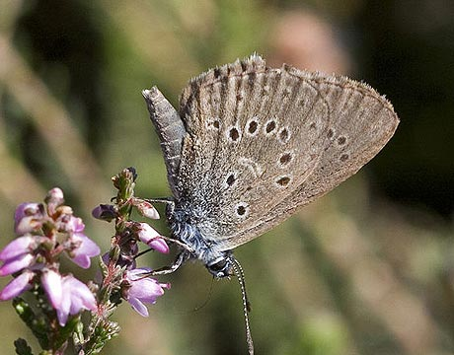
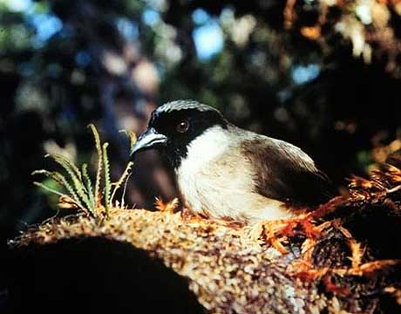
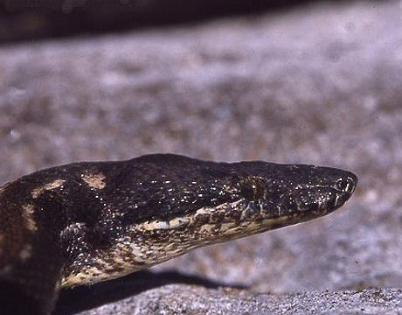
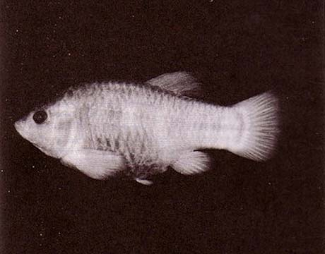
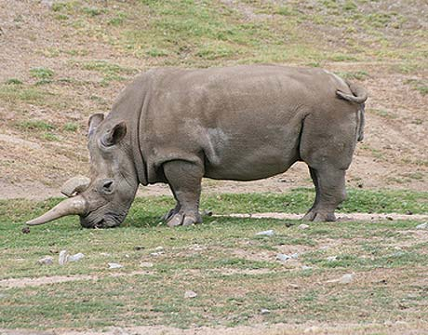
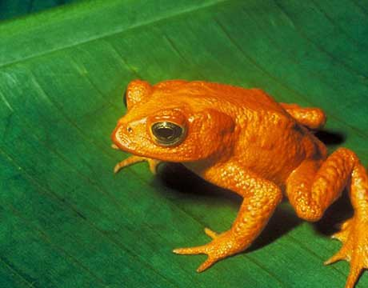
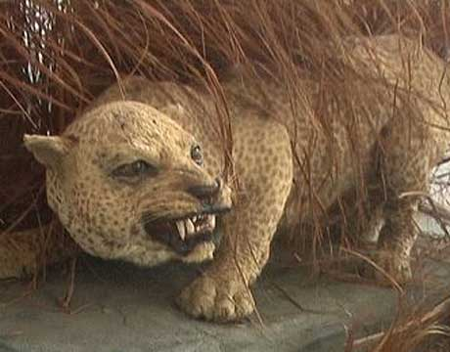
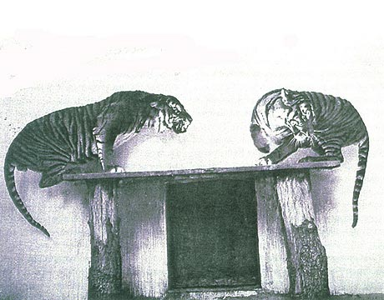
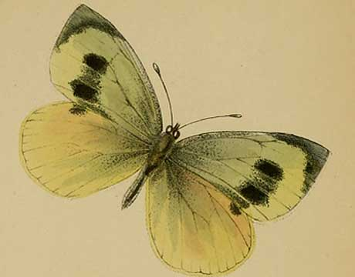
Global Biodiversity Crisis
Notes:
- high extinction rate
- conservation aims to maintain existing patterns of biodiversity and the processes that sustain them
- areas set aside to preserve biodiversity, and spearhead direct management actions

Slide 3
Reserve Selection
jeffrey-hanson.com
Notes:
- not all remaining habitat can be preserved
- achieve conservation objectives for minimal cost
- modern systematic conservation planning primarily focusses on representing species
- however, this ignores intra-specific biodiversity

Slide 4
Reserve Selection
jeffrey-hanson.com

Slide 5
Reserve Selection
jeffrey-hanson.com

Slide 6
But what about biodiversity processes?
Environmental conditions
Species range
Population
Time +
other factors
jeffrey-hanson.com

Slide 7
But what about biodiversity processes?
Environmental conditions
Species range
Population
Time +
other factors
Obtain a representative sample
jeffrey-hanson.com

Slide 8
Aims
Create a unified reserve selection problem to identify adequate and representative networks
Compare solutions generated using rapr to conventional reserve selection methods
jeffrey-hanson.com

Slide 9
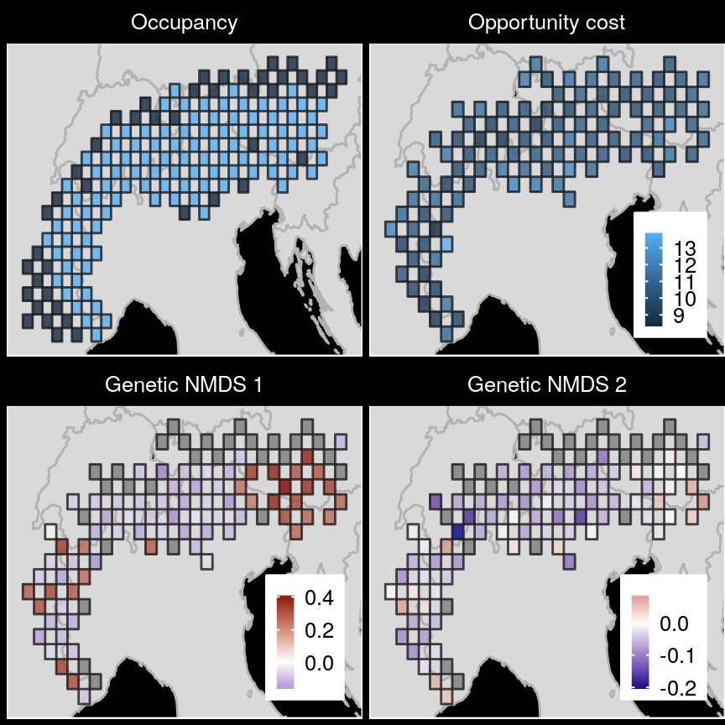
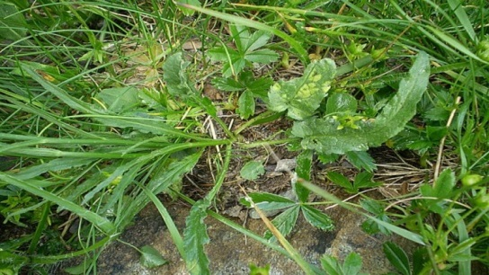
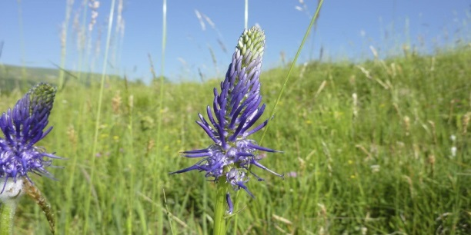
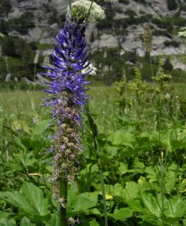
Case study
betony leaved rampion
jeffrey-hanson.com

Slide 10
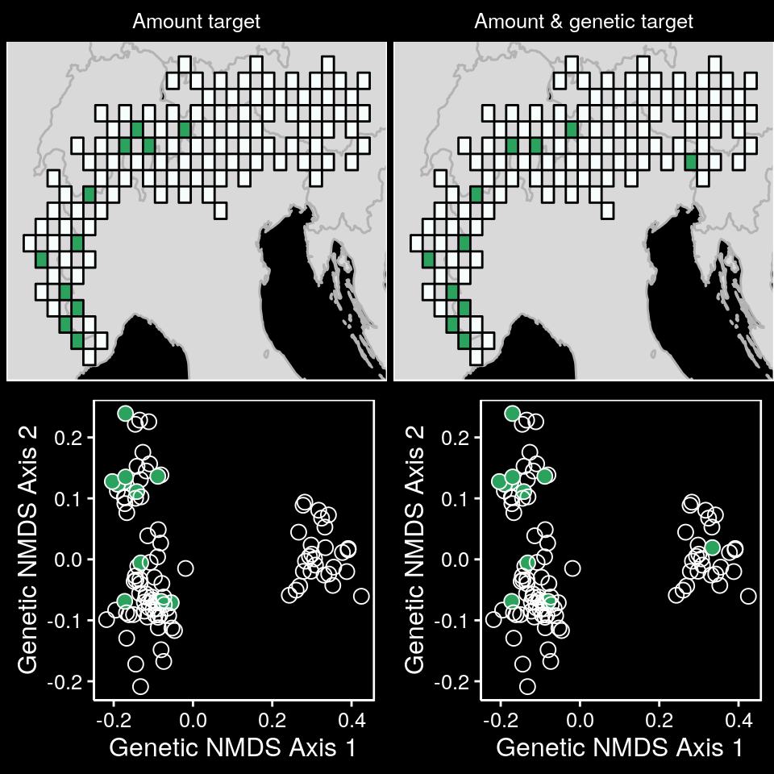
Case study
jeffrey-hanson.com

Slide 11
Case study

Slide 12
Case study
preserve neutral evolutionary processes
avoid inbreeding depression
secure existing genetic lineages

Slide 13
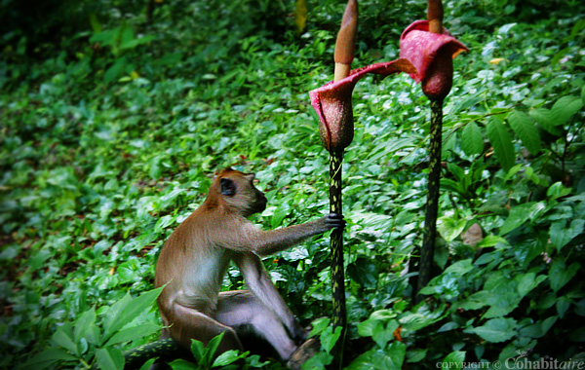
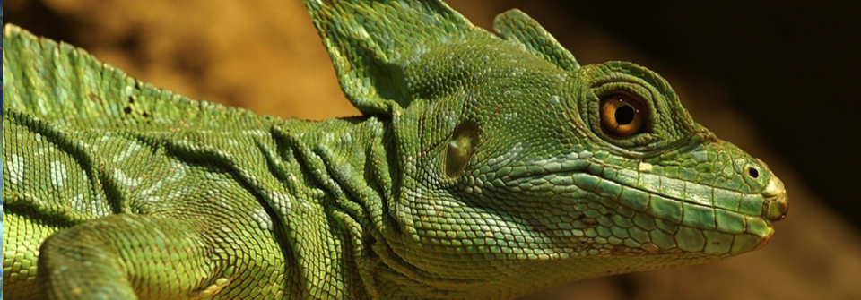
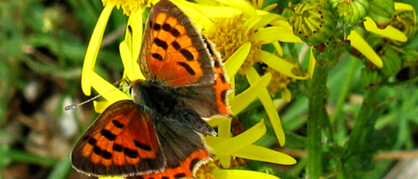
Unified reserve selection problem
new method to secure biodiversity patterns & processes
applied to any system
more effective solutions
jeffrey-hanson.com

Slide 14
Acknowledgements
Richard Fuller and the Fuller Lab
Jonathan Rhodes and the
Landscape Ecology and Conservation Group
Centre of Excellence for Environmental Decisions
jeffrey-hanson.com

Slide 15



jeffrey.hanson@uqconnect.edu.au
www.github/paleo13/rapr
jeffrey-hanson.com

Slide 16
What to preserve?
cold habitat
hot habitat
Notes:
- not all remaining habitat can be preserved
- achieve conservation objectives for minimal cost
- modern systematic conservation planning primarily focusses on representing species
- however, this ignores intra-specific biodiversity

Slide 17
Criteria: adequate sample
cold habitat
hot habitat
Notes:
- not all remaining habitat can be preserved
- achieve conservation objectives for minimal cost
- modern systematic conservation planning primarily focusses on representing species
- however, this ignores intra-specific biodiversity

Slide 18
Criteria: adequate & representative sample
cold habitat
hot habitat
Notes:
- not all remaining habitat can be preserved
- achieve conservation objectives for minimal cost
- modern systematic conservation planning primarily focusses on representing species
- however, this ignores intra-specific biodiversity

Slide 19
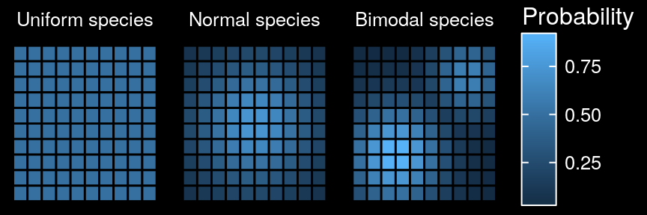
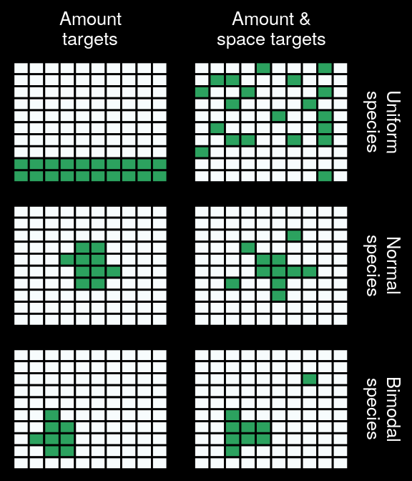
Normally distributed species
Amount
target
Amount &
space targets
Distribution
jeffrey-hanson.com

Slide 20
Normally distributed species
Amount
target
Amount &
space targets
Distribution
jeffrey-hanson.com

Slide 21
Bimodally distributed species
Amount
target
Amount &
space targets
Distribution
Amount &
space targets
Distribution
Amount targets
jeffrey-hanson.com

Slide 22
Case study

