Slide 1
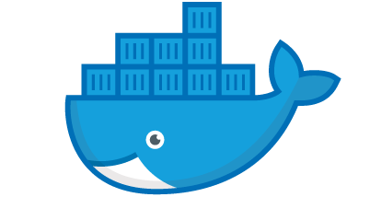

Introduction to Docker
Jeffrey Hanson
jeffrey.hanson@uqconnect.edu.au

Slide 2
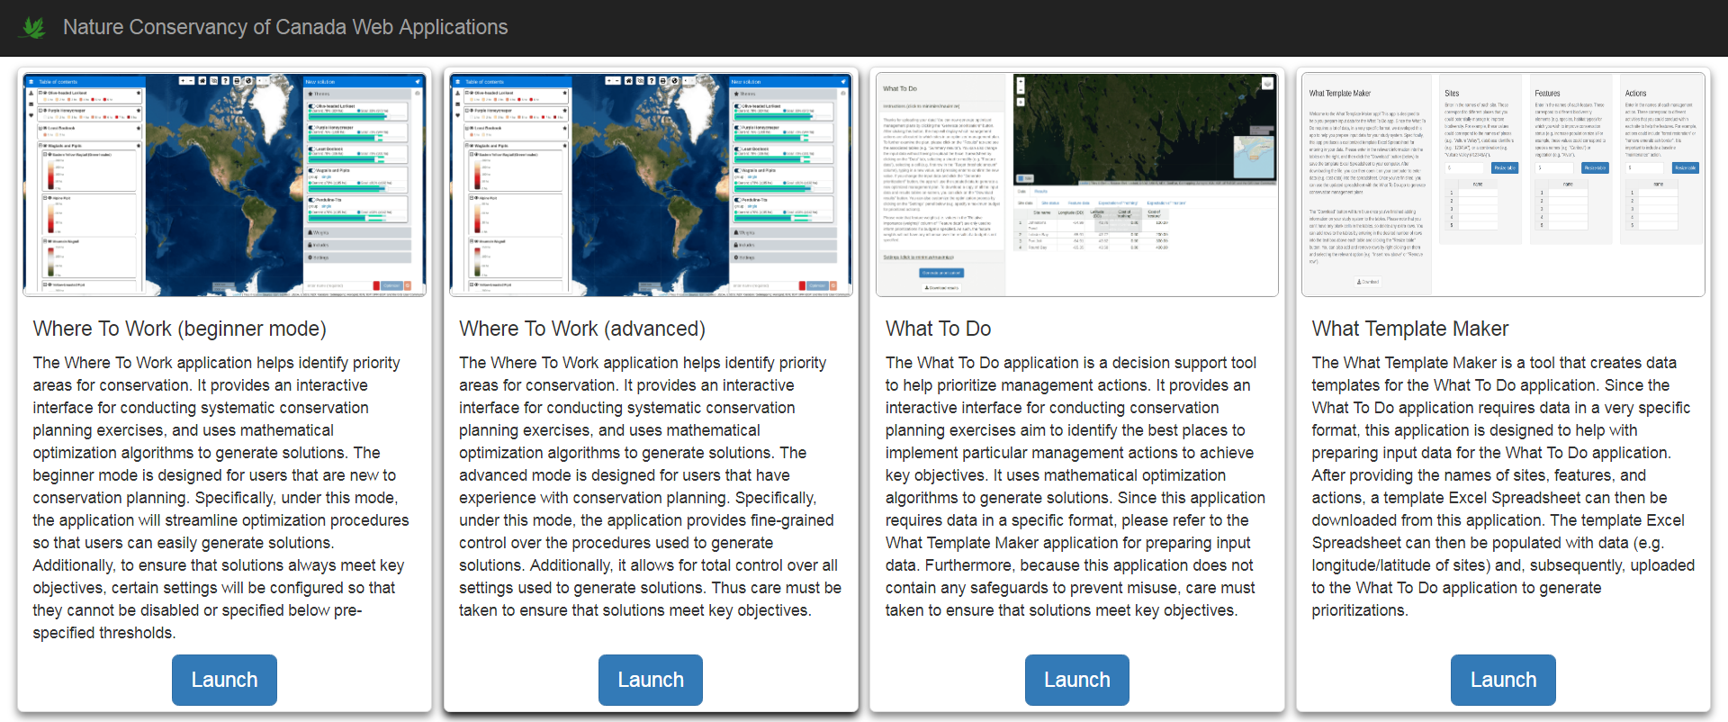
We’ve got some web applications, and they need a home

Slide 3
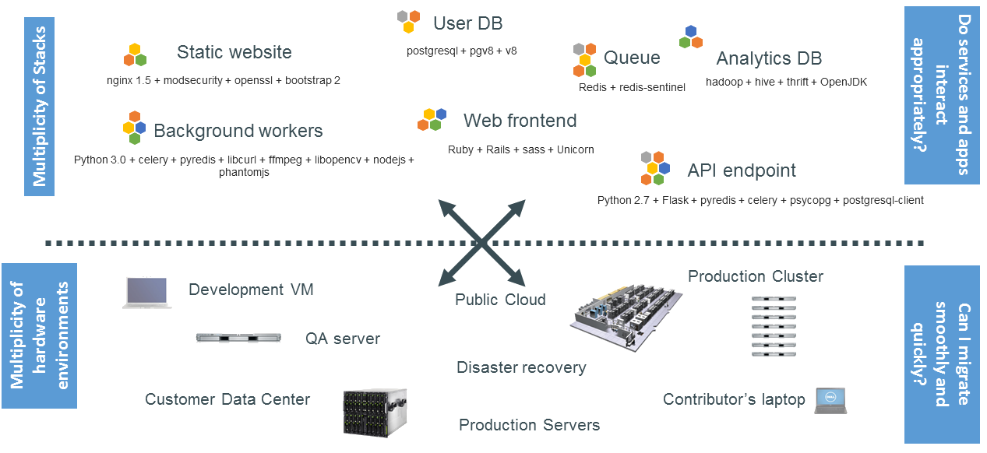
The problem…

Slide 4
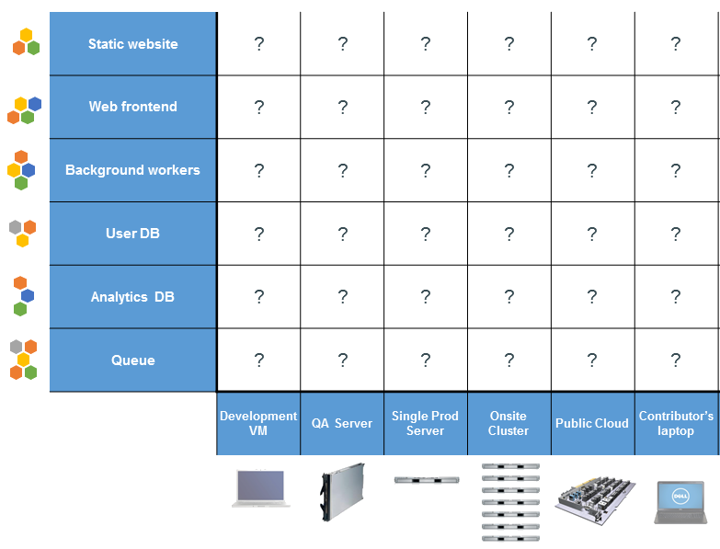
Nightmare matrix

Slide 5
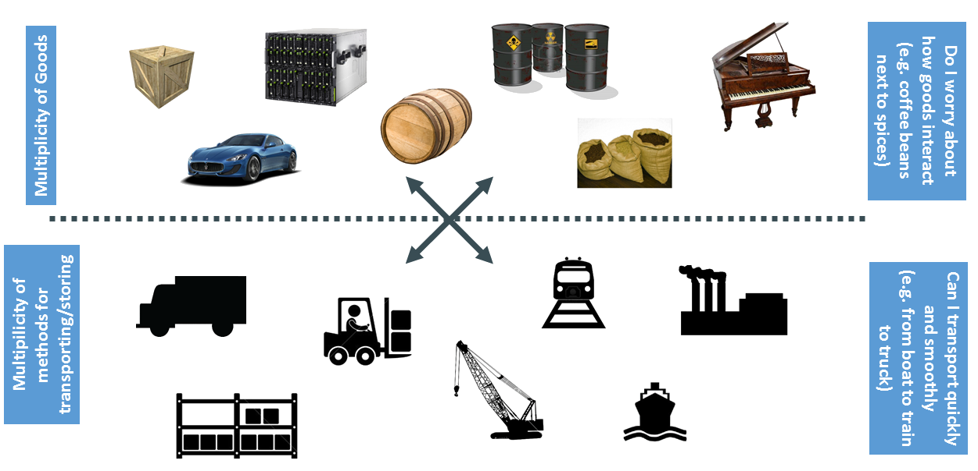
Cargo Transport Pre-1960

Slide 6
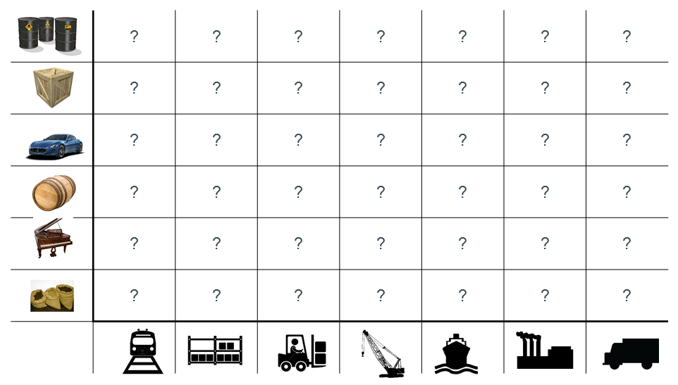
Also a nightmare matrix

Slide 7
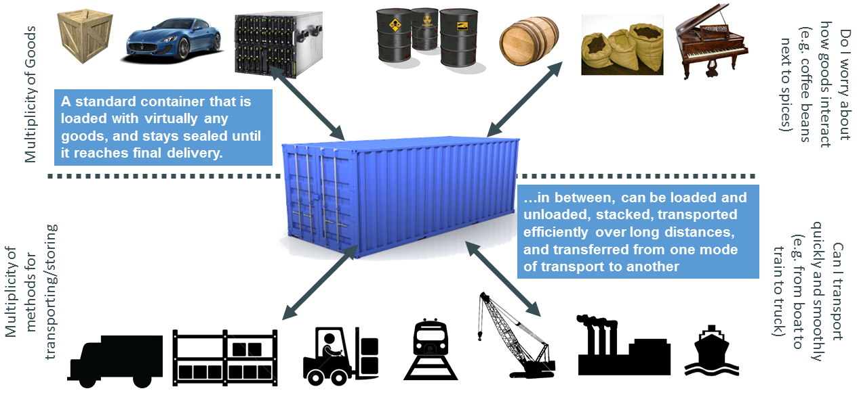
Solution: Intermodal shipping container

Slide 8
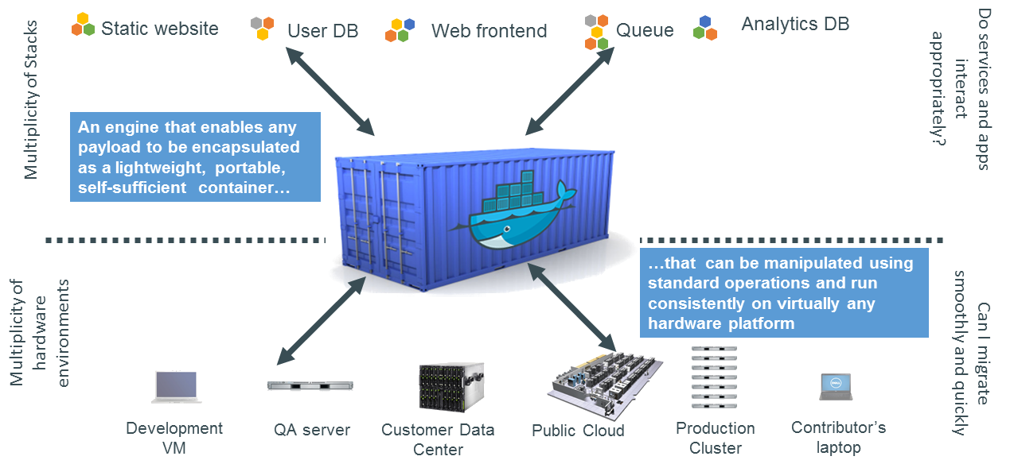
Docker is a container system for code
sort of like a virtual machine system, but more light weight and customizable

Slide 9
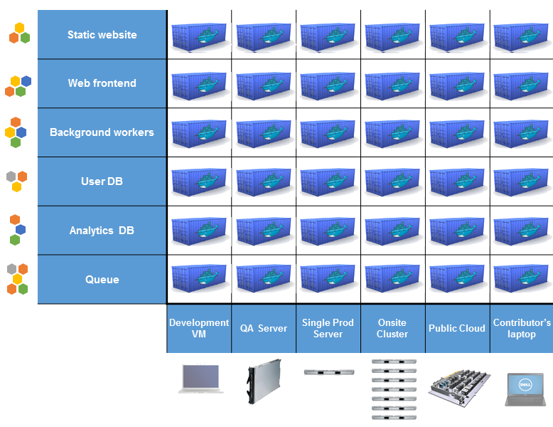
Docker eliminates the nightmare matrix

Slide 10


We want to get the app online
Where To Work app
R + shiny + cbc +
>20 R packages

Slide 11
Docker helps us do this
Where To Work app
R + shiny + cbc +
>20 R packages

Slide 12
It makes our lives easier
Developers
Build once, run anywhere
Clean, safe, portable runtime environment
No worries about missing dependencies
Automate testing, integration, packaging
Eliminate concerns about different platforms
Ops people / administrators
Configure once, run anything
Make the lifecycle more efficient, consistent, and repeatable
Eliminate inconsistencies between development and production
Improve speed and reliability of deployment and updates

Slide 13
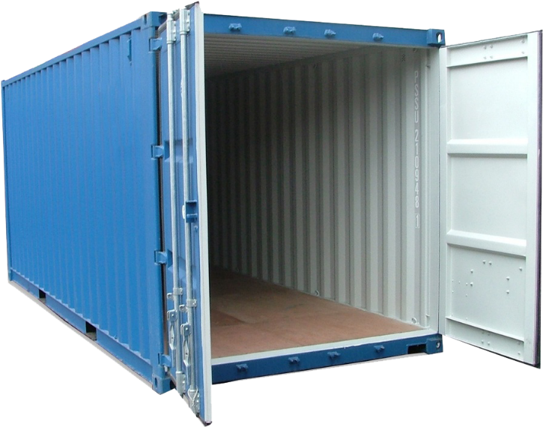
Why it works: separation of concerns
Developer
Ops Person / Admin
Worry about the
“inside” of the
container:
Code
Libraries
Package manager
Installation of dependencies
Worry about the “outside” of the container:
Logging
Access
Monitoring
Network configuration

Slide 14
Why is Docker useful for our web apps?
Software dependencies
Mounted volumes for data/logging
Automatic scaling
Continuous delivery
=
Less work for Ops/Admins

Slide 15

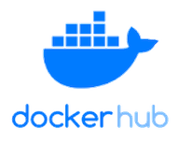
Workflow
Ops person
Developer
configures
User
creates
uploads data
accesses web app
Production server
Code
Volume
Docker file
Docker container
builds
runs instance
Docker image
pull image to
push to
Docker image

Slide 16
Demo
https://github.com/NCC-CNC/shiny-docker-demo

Slide 17








Who uses Docker?
11+ million developers
7+ million applications
13+ billion monthly image downloads

Slide 18
Where to find out more?
Docker website (www.docker.com)
Documentation (https://docs.docker.com/)
Getting started (https://www.docker.com/get-started)
Tutorials (https://www.docker.com/101-tutorial)
Other presentations (https://www.slideshare.net/dotCloud)
Many thanks to these other presentations for providing diagrams used in this presentation

Slide 19
Appendix

Slide 20
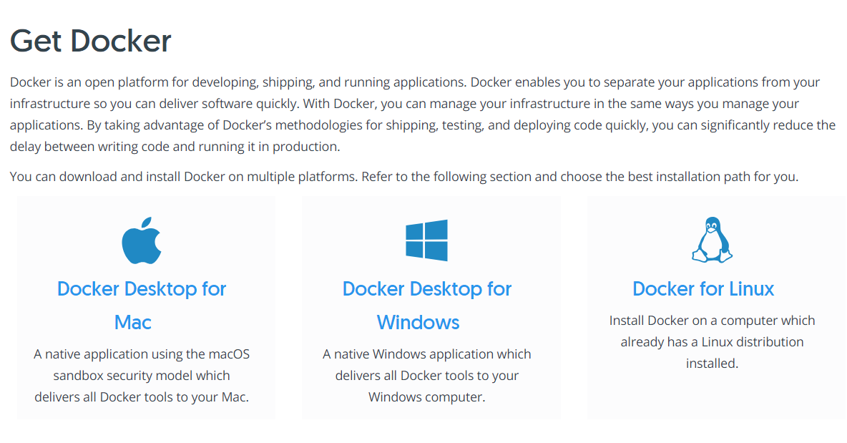
Installing Docker

Slide 21
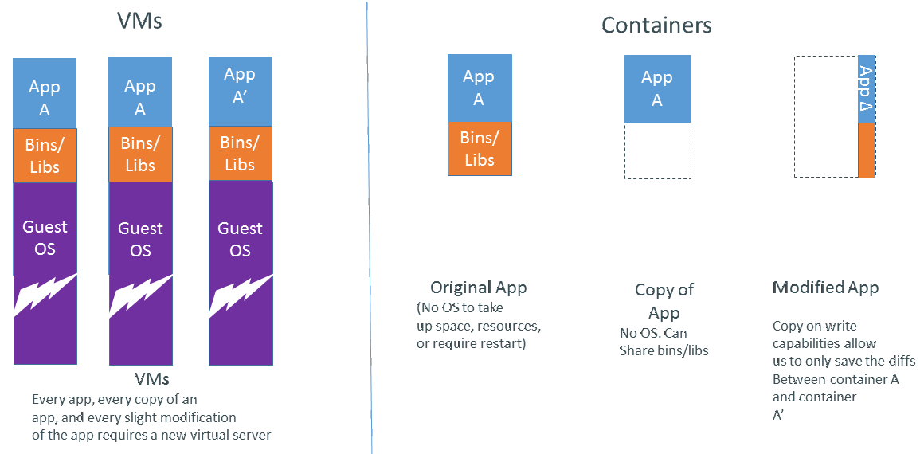
Virtual machines vs. containers

Slide 22















Yes, R is used in the industry
https://www.rstudio.com/about/customer-stories

