Slide 1
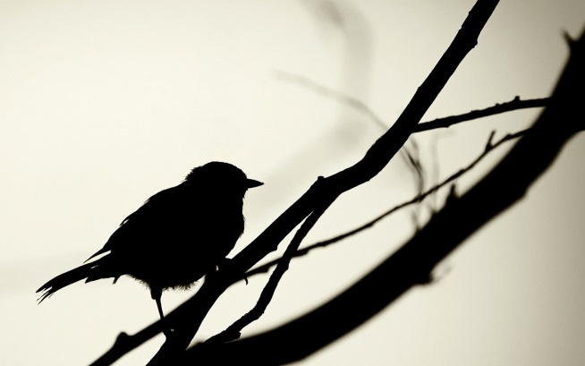

Alliance meeting (2023-05-02)
Jeffrey Hanson
jeffrey.hanson@uqconnect.edu.au

Slide 2
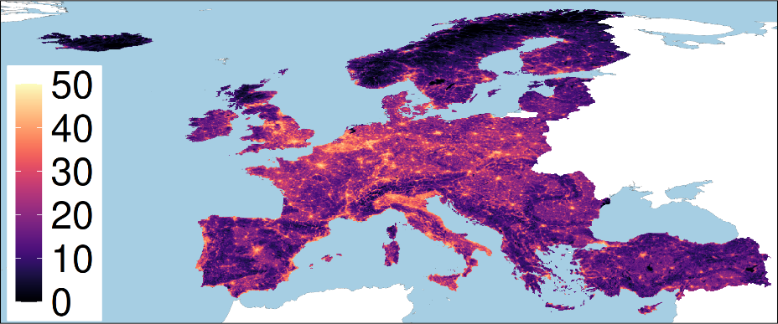
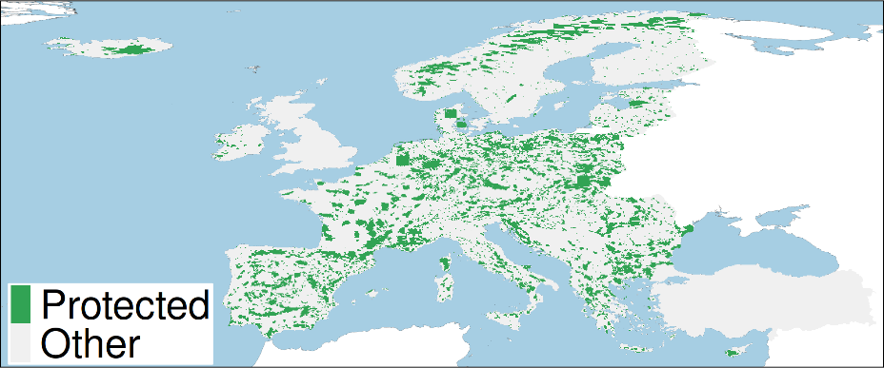
European case study
415 species: 81 amphibian, 135 birds, 79 mammal, 120 reptile species
165,000+ planning units (grid cells)
World database on protected areas
Conservation benefit for a species = amount of threat-free habitat in conservation areas
Human pressure

Slide 3
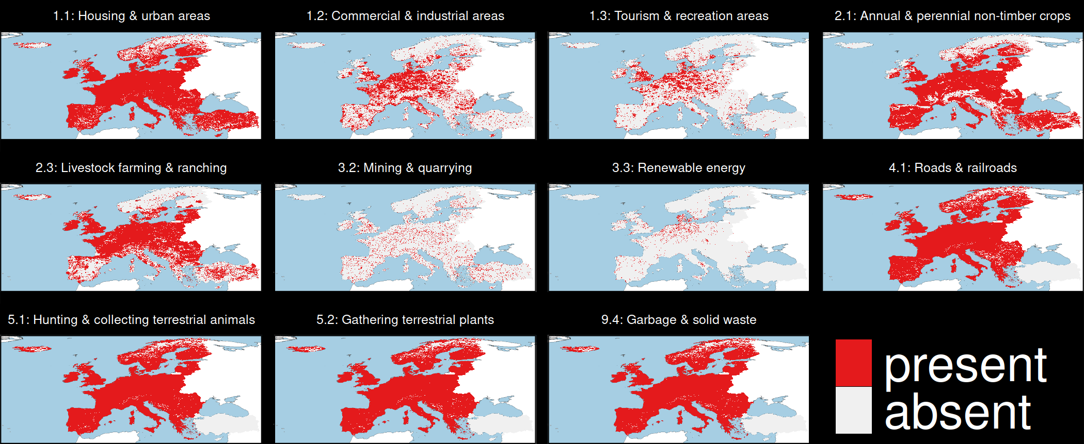
Threats to biodiversity

Slide 4
Managing threats to biodiversity
OECM
OECM
PA
PA
PA
OECM
OECM
OECM
PA
PA
PA
OECM
PA
PA
PA

Slide 5
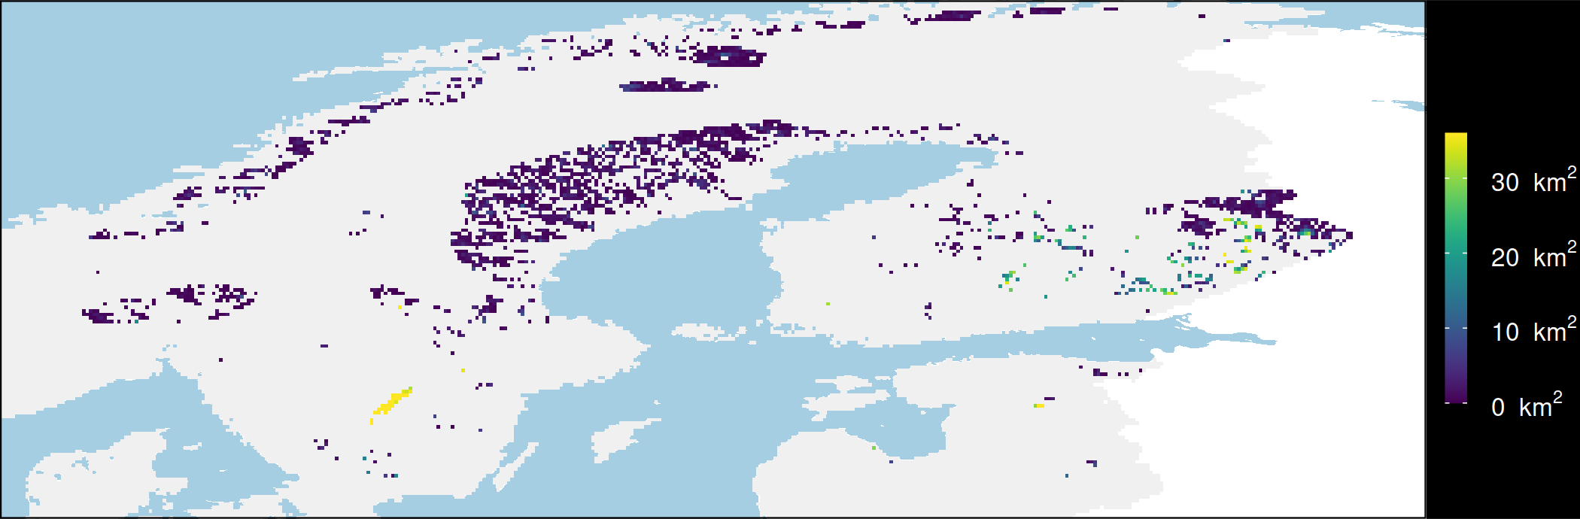

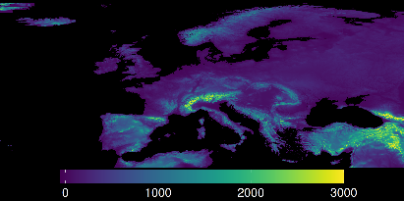
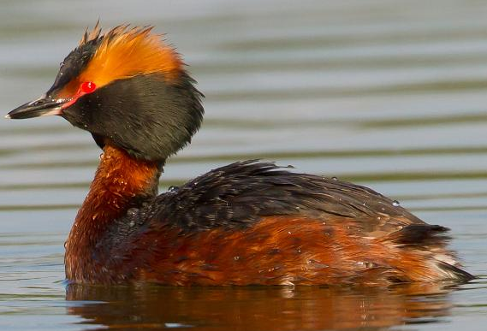
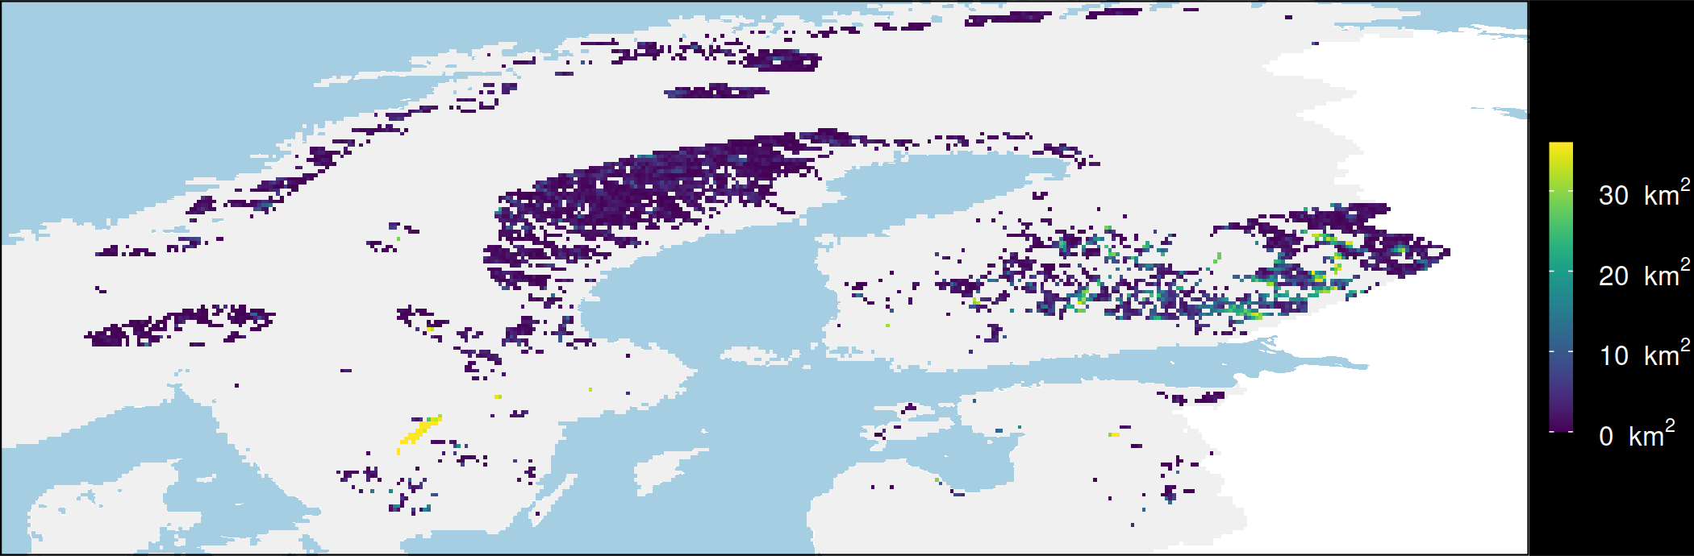
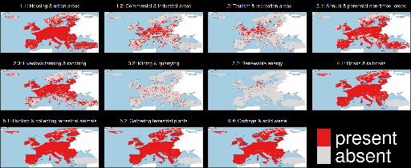
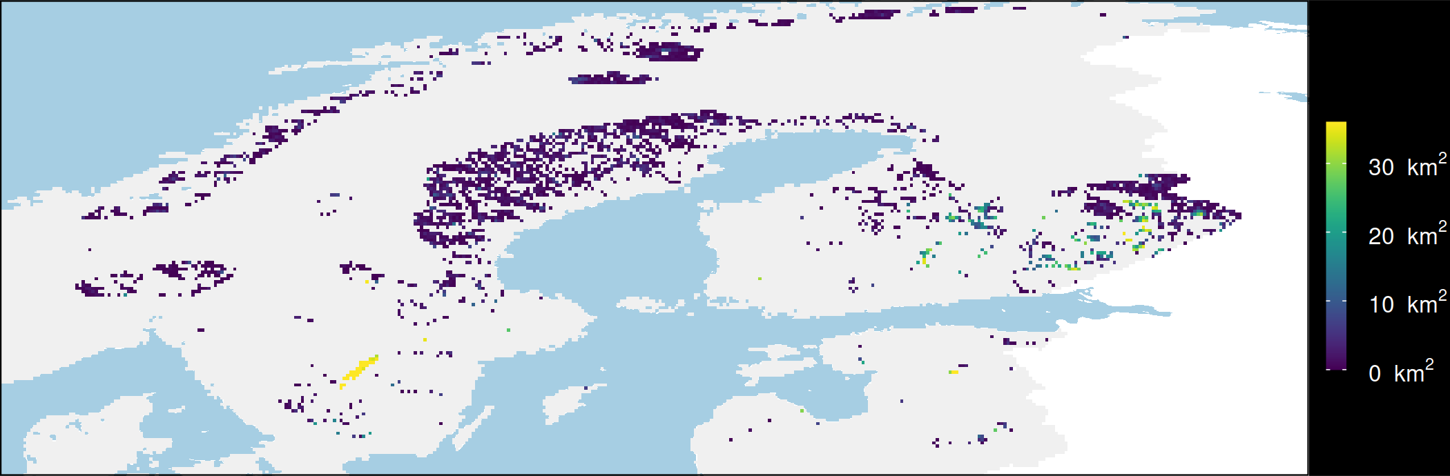
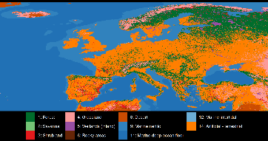
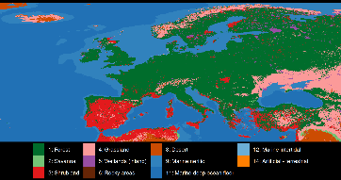
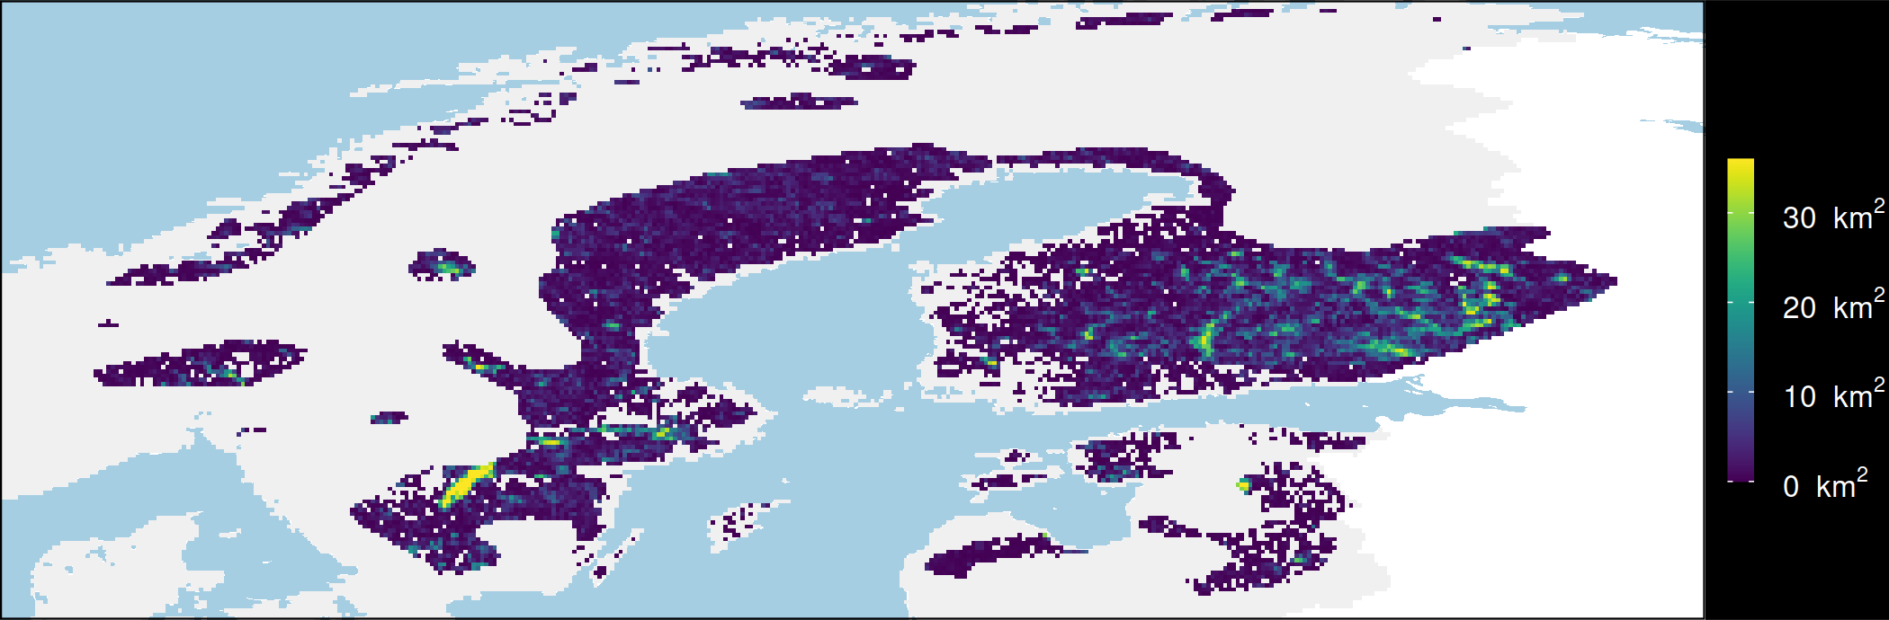
Mapping consequences
Conserve existing habitat
Species
Elevation
Horned Grebe
OECM
Restore urban areas
Threats
PA
What if?
Restore croplands
Current
land cover
Potential natural
vegetation
OECM
Restore urban & croplands
PA

Slide 6
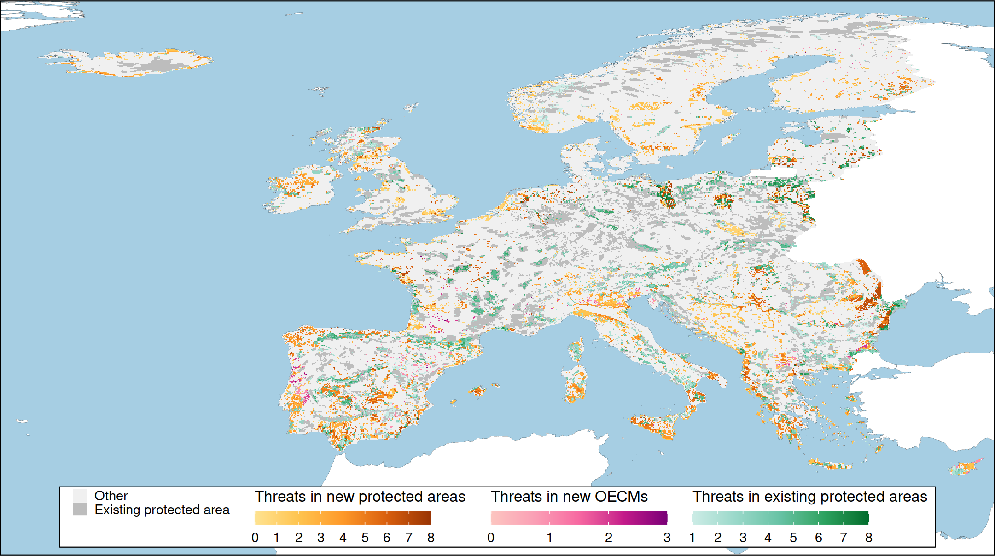
Prioritization

