Slide 1


Alliance meeting (2024-05-09)
Jeffrey Hanson
jeffrey.hanson@uqconnect.edu.au

Slide 2
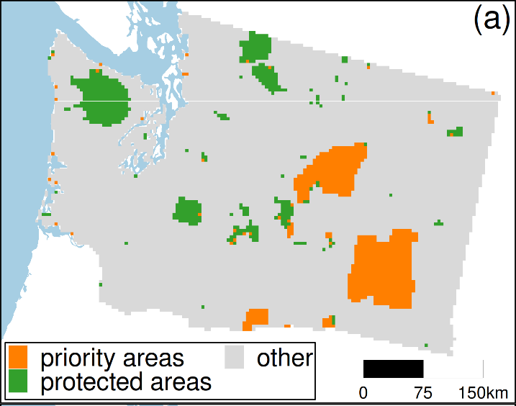
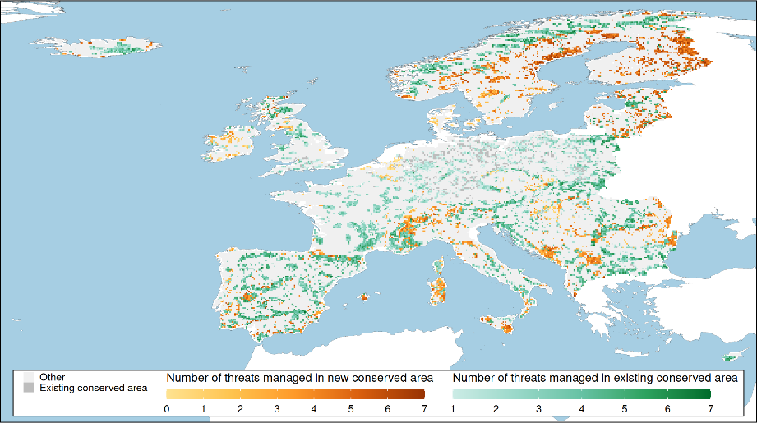

Ongoing papers
Conservation planning tool (under review)
Threat prioritization
(in prep)

Slide 3
How can community science supplement expert surveys for conservation planning
Middlesex county, ON
Multiple threatened plant species
Data from expert botanists and iNaturalist
Helps us understand when integrating community science data is worthwhile
Conservation benefit
Best plan based on expert data
Best plan based on combined dataset
Budget for conserving land ($)

Slide 4
Appendix

Slide 5
What is the value of information of community science for conservation?
Management area
Lots of potential alternative conservation plans
And many more!

Slide 6
What is the value of information of community science for conservation?
Management area
Expert ecological surveys

Slide 7
What is the value of information of community science for conservation?
Management area
Best plan based on expert data
Conservation benefit
Expert ecological surveys
Budget for conserving land ($)

Slide 8
What is the value of information of community science for conservation?
Management area
Best plan based on expert data
Conservation benefit
Best plan based on combined expert and community data
Expert ecological surveys
Community science data
Budget for conserving land ($)

Slide 9
Highest value of information for community science at lower budgets?
Or at higher budgets?
Best plan based on expert data
Conservation benefit
Best plan based on combined expert and community data
Budget for conserving land ($)
Budget for conserving land ($)

