Slide 1
Alliance meeting
Jeffrey Hanson

Slide 2
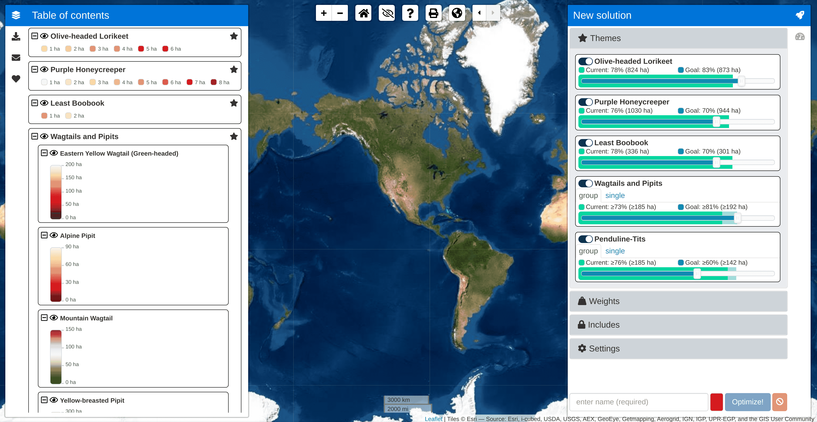
Where to Work tool
Interactive design
Multiple modes
Fast and accurate
Explore uncertainty
Solutions in near real-time

Slide 3
The team behind the tool
Bennett Lab,
Carleton University
Jeffrey Hanson
Jaimie Vincent
Joe Bennett
Nature Conservancy
of Canada (NCC)
Richard Schuster
JC Laurence
Research Software Development Team, Carleton University
Kevin Zhou
Tanvir Islam
Jazmin Romero

Slide 4
Demo with Ontario pilot
https://ncc.carleton.ca/

Slide 5
A comparison of approaches for including connectivity in systematic conservation planning
Jeffrey O. Hanson, Jaimie Vincent, Richard Schuster, Lenore Fahrig, Angela Brennan, Amanda E. Martin, Josie S. Hughes, Richard Pither, Joseph R. Bennett
In prep, authorship order not final

Slide 6
How we normally think about connectivity…
BAD
BETTER
BEST
Reserves

Slide 7
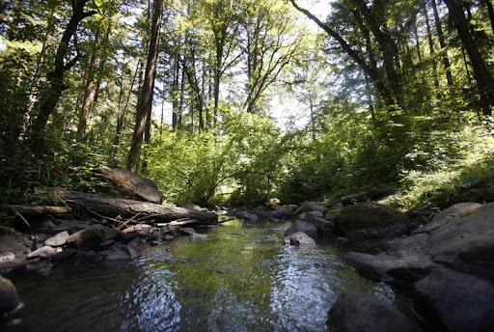

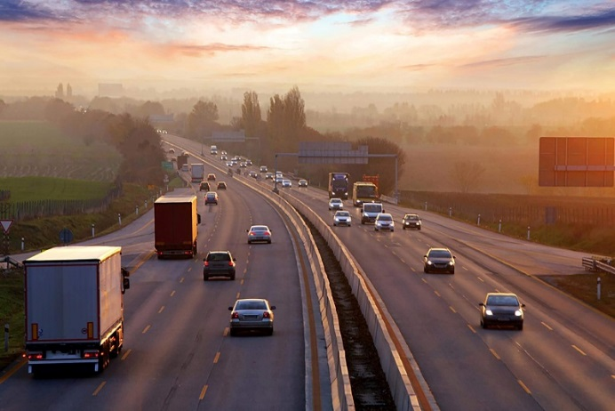
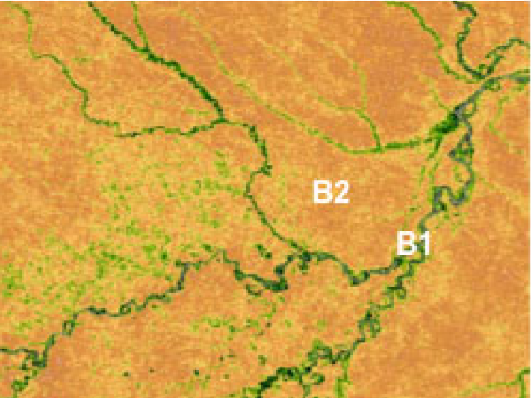
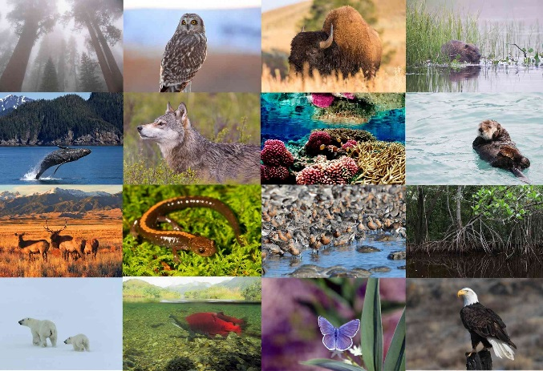

But other approaches exist too!
Total area
Human modified areas
Areas that impede movement
Spatial heterogeneity
Species representation
Environmental similarity

Slide 8
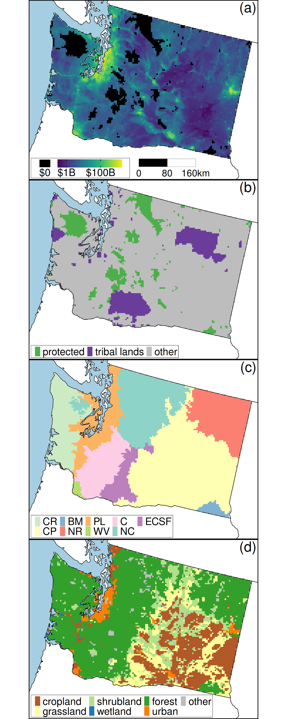

Case study in Washington, USA
Data for 261 bird species
Land acquisition costs
Account for existing land management
Compare 8 different approaches for promoting for connectivity in conservation plans

Slide 9
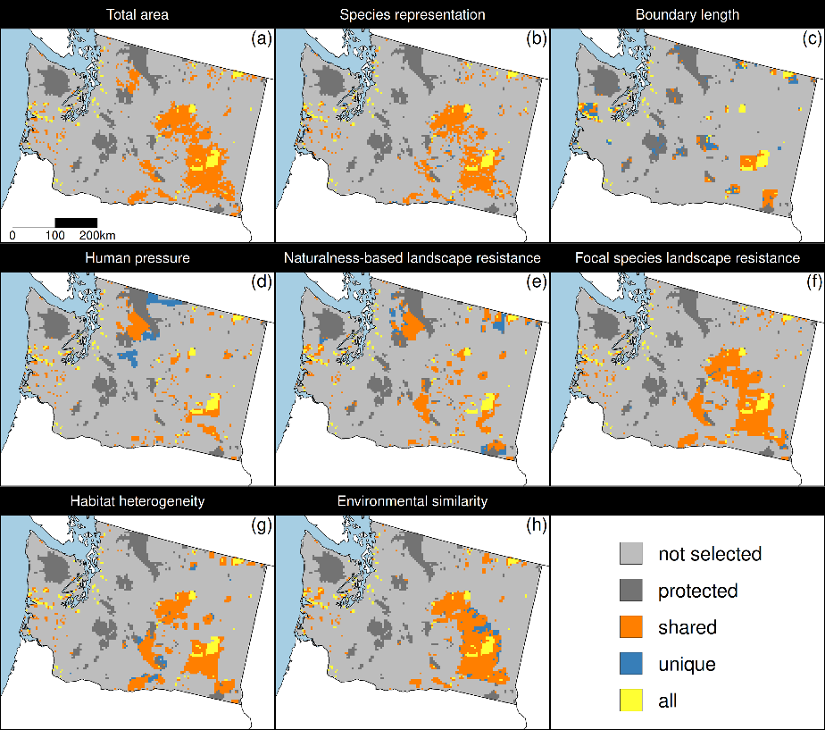
Different approaches made different plans
Some approaches made similar plans
Some places were selected under plans produced by all approaches

Slide 10
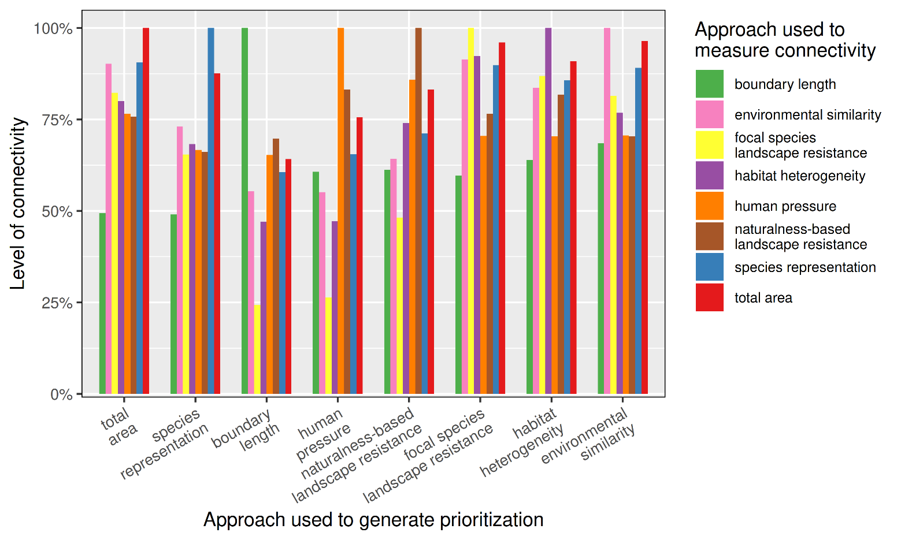
Trade-offs between connectivity approaches

