Slide 1



rapr: representative and adequate prioritisations in R
Jeffrey Hanson, Jonathon Rhodes,
Hugh Possingham & Richard Fuller
jeffrey.hanson@uqconnect.edu.au
jeffrey-hanson.com

Slide 2
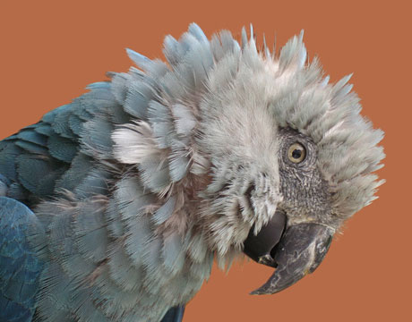
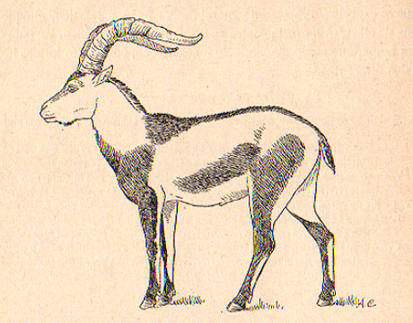
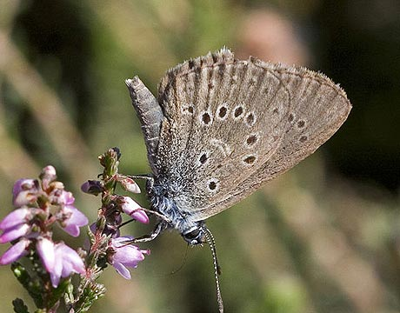
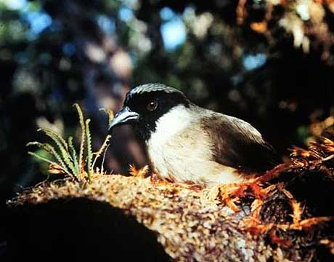
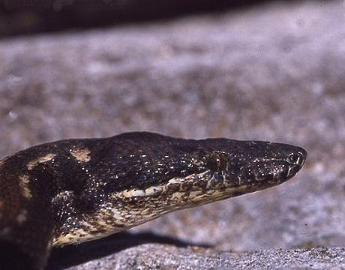
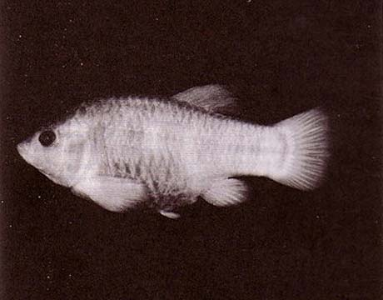
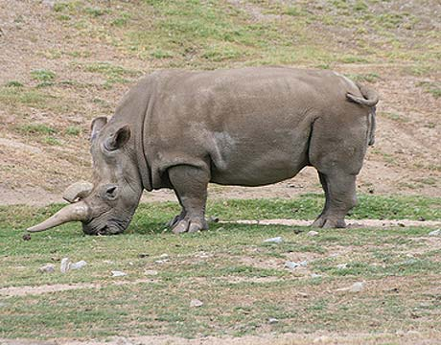
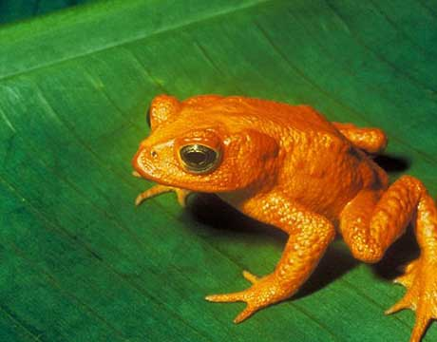
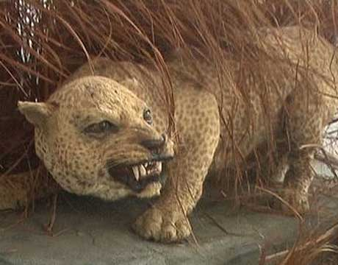
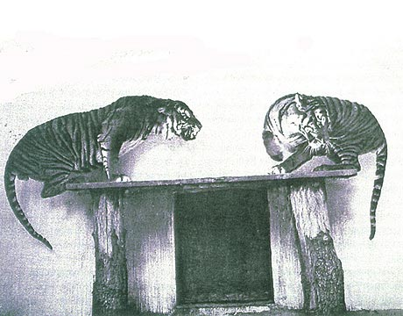
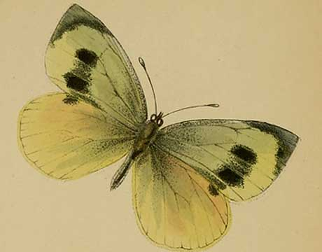
Global Biodiversity Crisis
Notes:
- high extinction rate
- conservation aims to maintain existing patterns of biodiversity and the processes that sustain them
- areas set aside to preserve biodiversity, and spearhead direct management actions

Slide 3
Reserve Selection
Notes:
- not all remaining habitat can be preserved
- achieve conservation objectives for minimal cost
- modern systematic conservation planning primarily focusses on representing species
- however, this ignores intra-specific biodiversity

Slide 4
Reserve Selection

Slide 5
Reserve Selection

Slide 6
But what about biodiversity processes?
Environmental conditions
Species range
Population
Time +
other factors

Slide 7
But what about biodiversity processes?
Environmental conditions
Species range
Population
Time +
other factors
Obtain a representative sample

Slide 8
What to preserve?
cold habitat
hot habitat
Notes:
- not all remaining habitat can be preserved
- achieve conservation objectives for minimal cost
- modern systematic conservation planning primarily focusses on representing species
- however, this ignores intra-specific biodiversity

Slide 9
Criteria: adequate sample
cold habitat
hot habitat
Notes:
- not all remaining habitat can be preserved
- achieve conservation objectives for minimal cost
- modern systematic conservation planning primarily focusses on representing species
- however, this ignores intra-specific biodiversity

Slide 10
Criteria: adequate & representative sample
cold habitat
hot habitat
Notes:
- not all remaining habitat can be preserved
- achieve conservation objectives for minimal cost
- modern systematic conservation planning primarily focusses on representing species
- however, this ignores intra-specific biodiversity

Slide 11
Aims
Create a unified reserve selection problem to identify adequate and representative networks
Compare solutions generated using rapr to conventional reserve selection methods

Slide 12
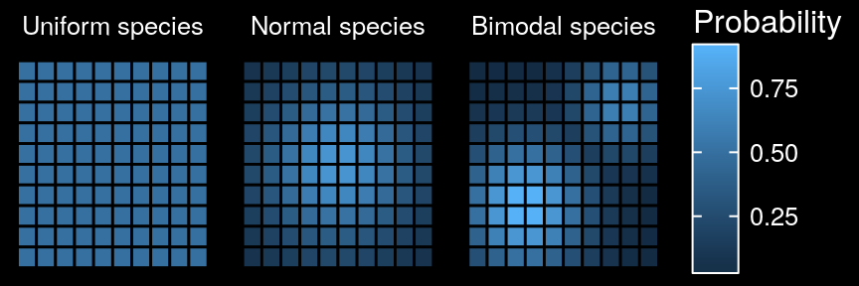
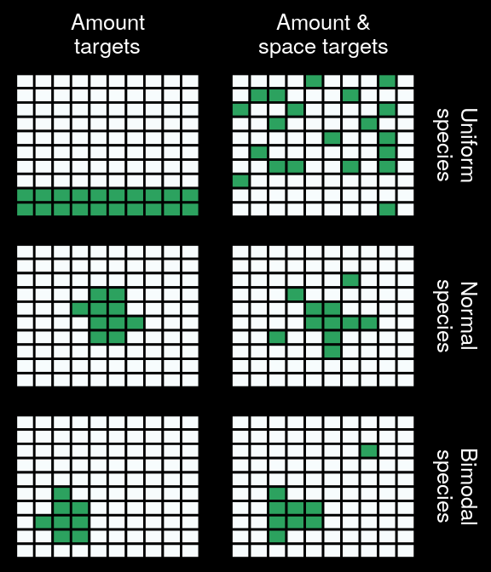
Normally distributed species
Amount
target
Amount &
space targets
Distribution

Slide 13
Normally distributed species
Amount
target
Amount &
space targets
Distribution

Slide 14
Bimodally distributed species
Amount
target
Amount &
space targets
Distribution
Amount &
space targets
Distribution
Amount targets

Slide 15
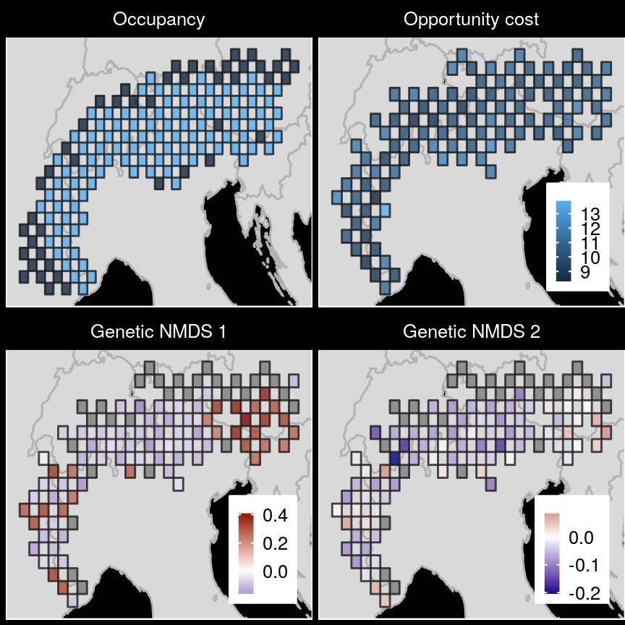
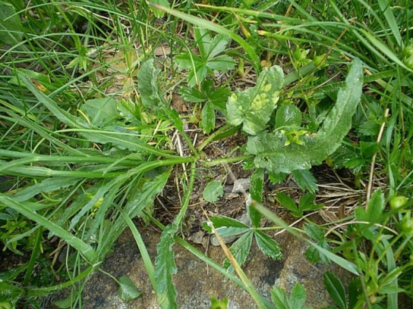
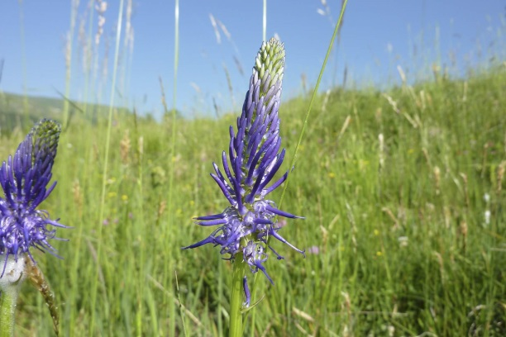
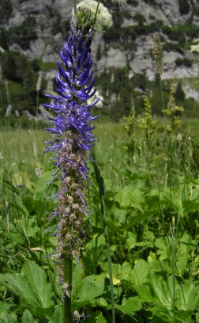
Case study
betony leaved rampion

Slide 16
Case study

Slide 17
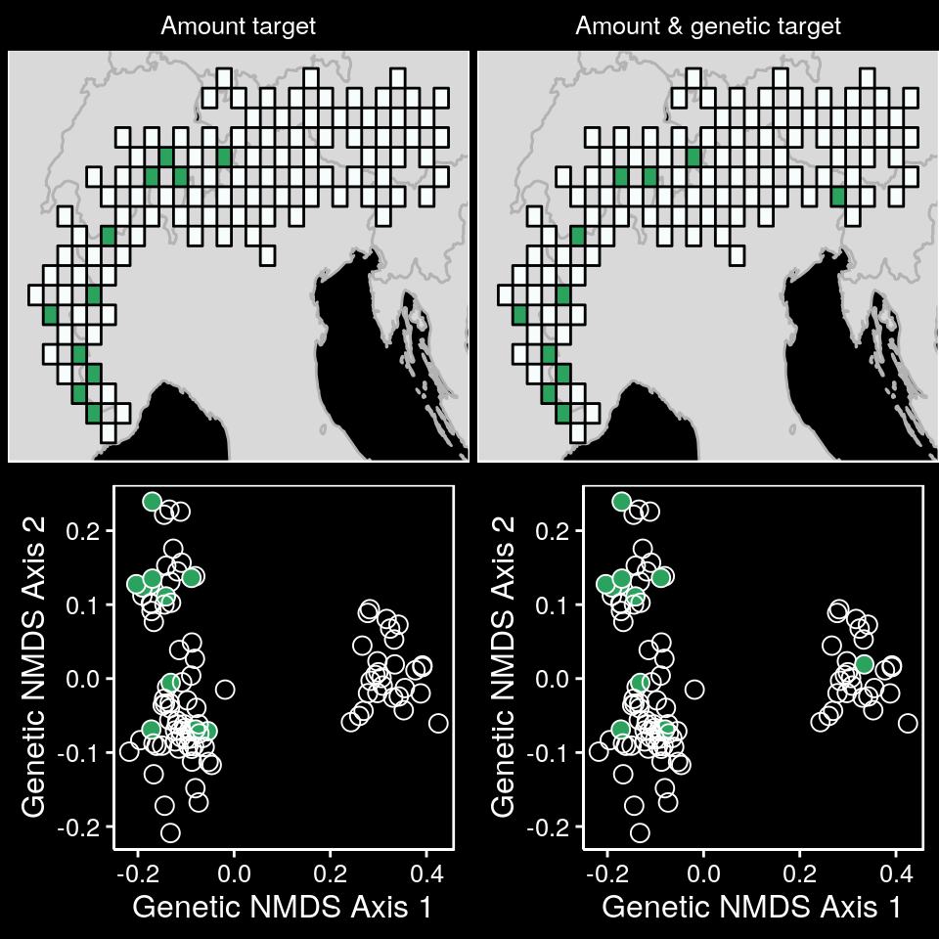
Case study

Slide 18
Case study

Slide 19
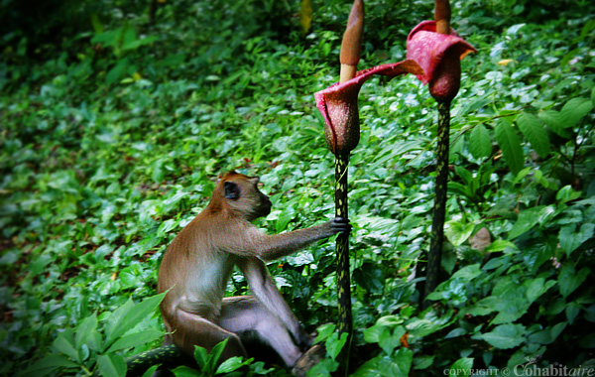
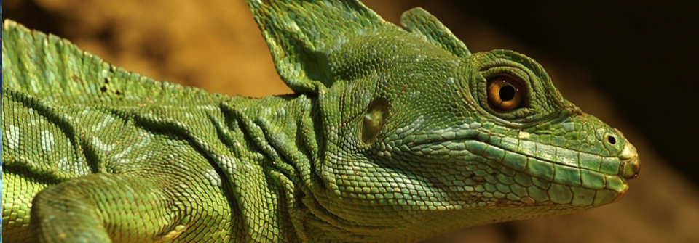
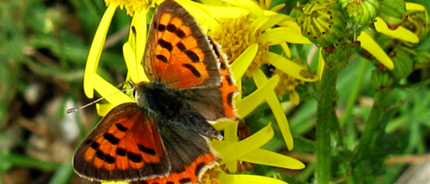
Unified reserve selection problem
new method to secure biodiversity patterns & processes
applied to any system
more effective solutions

Slide 20
Acknowledgements
Richard Fuller and the Fuller Lab
Jonathan Rhodes and the
Landscape Ecology and Conservation Group
Centre of Excellence for Environmental Decisions

Slide 21


jeffrey.hanson@uqconnect.edu.au
www.github/paleo13/rapr
jeffrey-hanson.com

