Slide 1


Conserving evolutionary processes for three amphibian species in the Iberian Peninsula
Jeffrey O. Hanson, Miguel Camacho-Sanchez, Adam Marques, Íñigo Martínez-Solano, Guillermo Velo-Antón, Ana Veríssimo, Silvia B. Carvalho
jeffrey.hanson@uqconnect.edu.au
jeffrey-hanson.com

Slide 2
Goal 15: Life on Land
“Take urgent and significant action to reduce the degradation of natural habitats, halt the loss of biodiversity and, by 2020, protect and prevent the extinction of threatened species.”
“By 2020, integrate ecosystem and biodiversity values into national and local planning, development processes, poverty reduction strategies and accounts.”

Slide 3
Reserve selection

Slide 4
Reserve selection

Slide 5
How well are existing protected areas covering important places for evolutionary processes?
Aims
Where are priority areas for conserving of evolutionary processes?

Slide 6
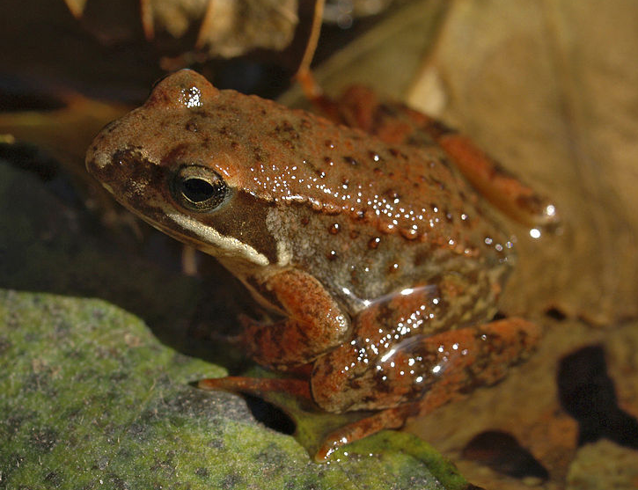
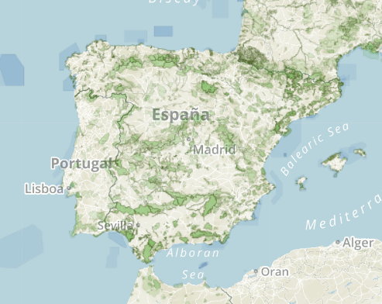
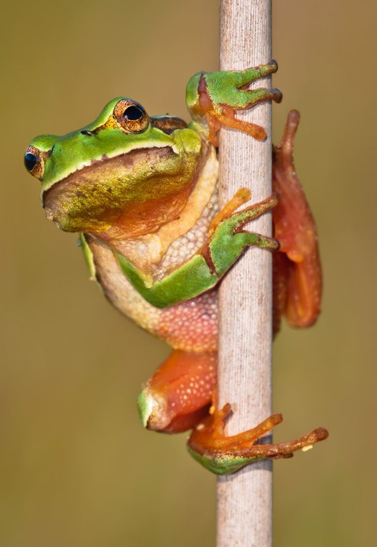


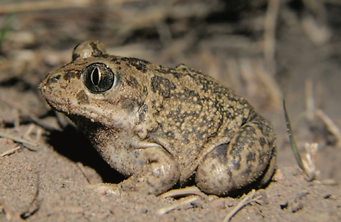
Study system
R. iberica
?
H. molleri
P. cultripes
You are here

Slide 7
Mapping spatial components of evolutionary processes for these species
Atlas data
Genetic data
Structure
Bayescan
Selestim
Pcadapt
Phylin
Maps showing spatial distribution of different lineages, which we can then use as inputs for individual heterozygosity, neutral genetic types, adaptive genetic types, and climate refugia

Slide 8
Performance of existing protected areas

Slide 9
Priority areas for improving protection of evolutionary processes for these species

Slide 10
Planning for the long-term persistence of species
If you really want it: you need to plan for it
Surrogates may work for some applications of genetic data – no guarantees!

Slide 11
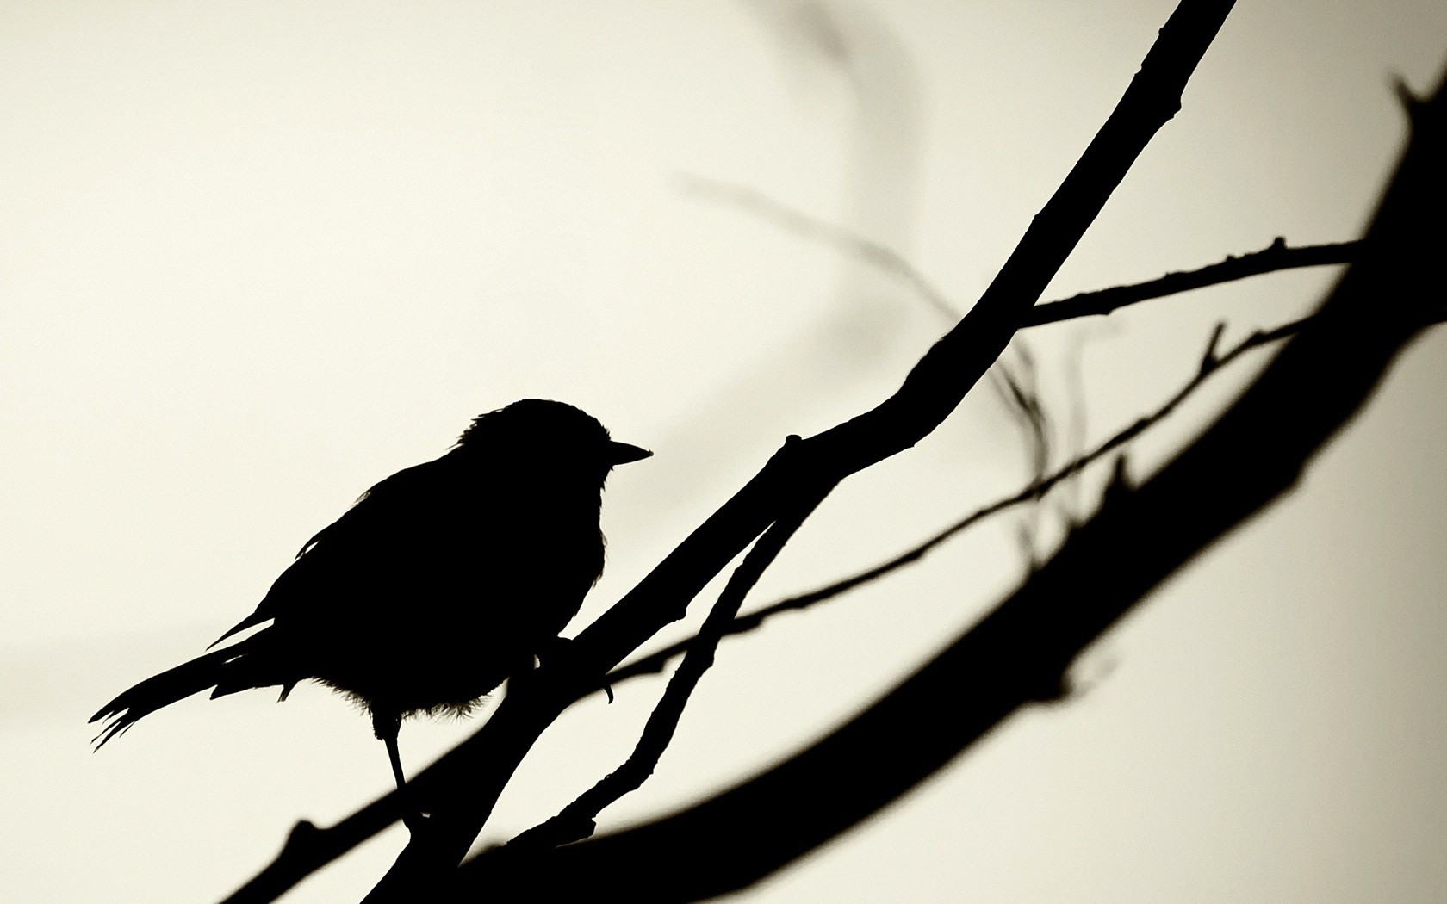


jeffrey.hanson@uqconnect.edu.au
github.com/jeffreyhanson
jeffrey-hanson.com

