Slide 1

Conservation science (196.315) Project Prioritization
Jeffrey Hanson

Slide 2
Now
Biodiversity
Status quo
2000
Future

Slide 3
Now
How do we
bend the curve ?
Biodiversity
Status quo
2000
Future

Slide 4



How do we bend the curve?
Ecological surveys
Distribution maps
Priority areas
Biodiversity
2000
Future
Data
Information
Plan
Outcome

Slide 5
How do we bend the curve?
Ecological surveys
Distribution maps
Priority areas
Biodiversity
2000
Future
Data
Information
Plan
Outcome
Prioritization

Slide 6
Systematic conservation planning
“Systematic conservation planning aims to provide a rigorous, repeatable, and structured approach for designing new protected areas that efficiently meet conservation objectives”
Schuster et al. (2020) PeerJ, DOI:10.7717/peerj.9258

Slide 7



Project prioritization
Project data
Recovery projects

Slide 8




Feature data
Phylogenetic data
Stakeholder weights
Project prioritization
Project data
Cost data
Actions
$
$$
$$$
Recovery projects
$0

Slide 9
Project prioritization
Feature data
Phylogenetic data
Stakeholder weights
Project data
Cost data
Actions
$
Success
$$
90%
$$$
20%
Recovery projects
$0
50%
100%

Slide 10
Project prioritization
Feature data
Phylogenetic data
Stakeholder weights
Project data
Cost data
Actions
Persistence (%)
$
Success
$$
90%
95%
$$$$$
20%
10%
Recovery projects
$0
50%
70%
100%
40%
9%
65%

Slide 11
Project prioritization
Feature data
Phylogenetic data
Stakeholder weights
Project data
Cost data
Actions
Persistence (%)
$
Success
$$
90%
95%
$$$
20%
10%
Recovery projects
$0
50%
70%
Budget
$$$
100%
40%
9%
65%

Slide 12
Project Prioritization vs. Reserve Selection
Project prioritization
Reserve selection
Management actions are organized into projects
Specific data requirements (i.e. detailed information on costs, budgets, species’ persistence)
Typically uses data from expert elicitation
Typically used for planning management of particular sites
Typically only one action is considered (i.e. protect or not)
Wide variety of data can be used (e.g. surrogate data for costs [human pop. density], general budget rules [≤30% of land selected], maps describing species’ presence/absence or abundance across study area)
Typically used for landscape, national, or global-level planning

Slide 13
Project prioritization protocol
“The PPP [… involved…] combine information on costs, values, benefits and likelihood of success to rank projects according to benefits per unit dollar and choose set of projects.”
Joseph et al. (2009) Cons Biol, DOI:10.1111/j.1523-1739.2008.01124.x

Slide 14
Project prioritization protocol
“The PPP [… involved…] combine information on costs, values, benefits and likelihood of success to rank projects according to benefits per unit dollar and choose set of projects.”
Better methods available now
Joseph et al. (2009) Cons Biol, DOI:10.1111/j.1523-1739.2008.01124.x

Slide 15
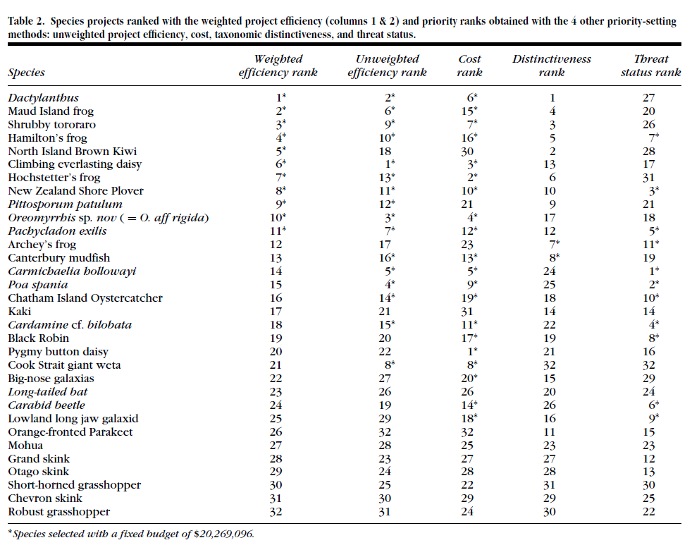
Ranking things based on overall efficiency gives very different results to cost, taxonomic distinctiveness, or threat status
Joseph et al. (2009) Cons Biol

Slide 16
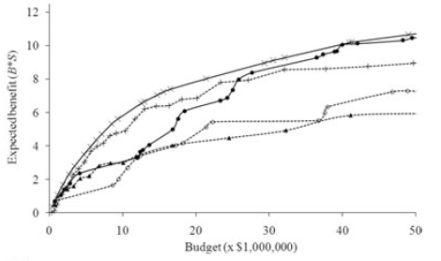
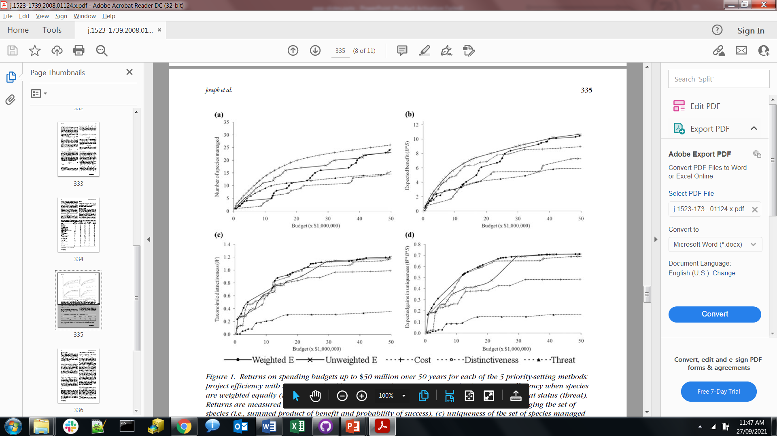
Different ranks → different biodiversity outcomes
More funding means greater benefit
Ranking by overall cost-efficiency gives better outcomes than other criteria
Joseph et al. (2009) Cons Biol, DOI:10.1111/j.1523-1739.2008.01124.x

Slide 17
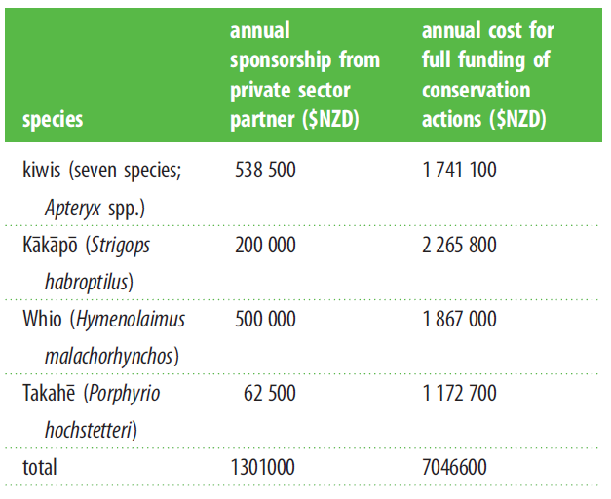
Private sponsorship for flagship species
Flagship species raise lots of $$$ for conservation
Donors want $$$ spent on projects for flagship species
If we can only spend this $$$ on flagship species, what’s the point of prioritization?
Bennett et al. (2015) Proc B, DOI:10.1098/rspb.2014.2693

Slide 18
Explored different funding scenarios
Baseline scenario: Baseline scenario: prioritization protocol assuming that no flagship species received private funding, and that flagship species were considered alongside other threatened species in the prioritization protocol.
Flagship scenario: Flagship sponsorship without considering synergies for non-flagship species. Randomly allocate funding to actions for flagship species according to funding level.
Synergistic flagship scenario: Flagship species sponsorship to maximize synergies with other non-flagship species. Allocate funding for the flagship species to the conservation actions that maximize the ratio of shared costs with other species
Bennett et al. (2015) Proc B, DOI:10.1098/rspb.2014.2693

Slide 19
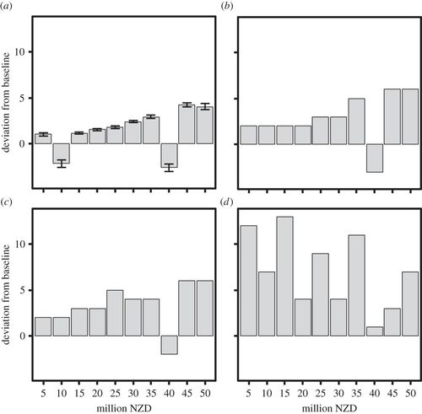
Biodiversity gains from private sponsorship for flagship species
In most cases: funding for flagship species improves overall biodiversity, even if the additional funding is focussed purely on flagship species
Increases in funding for flagship species also means greater overall benefits to biodiversity
{biodiversity under flagship scenario} – {biodiversity under baseline scenario}
Bennett et al. (2015) Proc B, DOI:10.1098/rspb.2014.2693

Slide 20
Prioritizations can help optimize funding allocation for flagship species by finding synergies with other species
{biodiversity under scenario} – {biodiversity under baseline scenario}
Bennett et al. (2015) Proc B, DOI:10.1098/rspb.2014.2693
Flagship scenario
Synergistic flagship scenario

Slide 21
Remember this?
Project data
Cost data
Actions
Persistence (%)
$
Success
$$
90%
95%
$$$$$
20%
10%
Recovery projects
$0
50%
70%
100%
40%
9%
65%

Slide 22
Remember this?
Project data
Cost data
Actions
Persistence (%)
$
Success
$$
90%
95%
$$$$$
20%
10%
Recovery projects
$0
1
50%
70%
100%
40%
9%
65%

Slide 23
What if we had multiple options?
Project data
Cost data
Actions
Persistence (%)
$
Success
$$
1
50%
95%
$$$$$
2
90%
80%
Recovery projects
$0
3
56%
45%
100%
40%
40%
40%

Slide 24
Big improvement in persistence for small investment?
Project data
Cost data
Actions
Persistence (%)
$
Success
$$
1
50%
95%
$$$$$
2
90%
85%
Recovery projects
$0
3
56%
45%
100%
40%
40%
40%

Slide 25
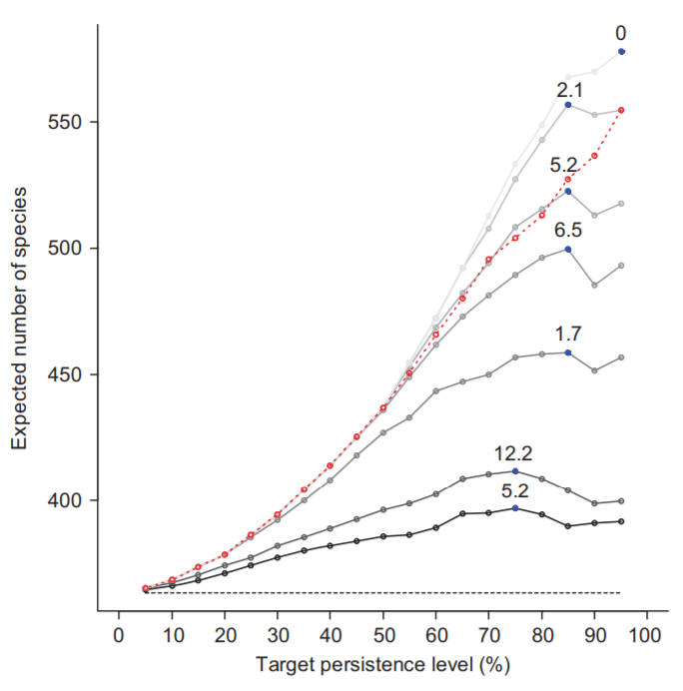
Trade-offs between persistence and expected number of species conserved
X-axis: the (target) minimum probability of persistence we want for species
Y-axis: overall number of species expected to persist given optimized project funding based on budget and target
Lines: Different budgets for funding projects (0.5, 1, 5, 10, 15, 30, and 40 M NZD per year; from darkest to lightest)
Di Fonzo et al. (2015) Cons Lett, DOI:10.1111/conl.12179

Slide 26
Trade-offs between persistence and expected number of species conserved
If target level of persistence is too low, then very few species are actually likely to persist overall
This is because funding is spread too thinly across lots of species
Di Fonzo et al. (2015) Cons Lett, DOI:10.1111/conl.12179

Slide 27
Trade-offs between persistence and expected number of species conserved
If target level of persistence is too high, then sub-optimal number of species are actually likely to persist overall
This is because funding is concentrated among just a few species
Di Fonzo et al. (2015) Cons Lett, DOI:10.1111/conl.12179

Slide 28
Trade-offs between persistence and expected number of species conserved
If target level of persistence is optimized, then we can maximize the overall expected number of species that are likely to persist
Di Fonzo et al. (2015) Cons Lett, DOI:10.1111/conl.12179

Slide 29
Trade-offs between persistence and expected number of species conserved
The target level of persistence that results in the greatest overall number of species persisting into the future depends on available funding
Di Fonzo et al. (2015) Cons Lett, DOI:10.1111/conl.12179

Slide 30
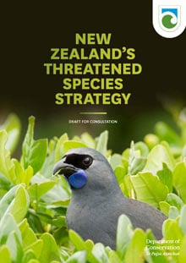
Threatened Species Strategy
“Manage 500 species for protection by 2025 – a 40% increase on today – and 600 species for protection by 2030.”
“Enhance the populations of 150 prioritised threatened and at risk species by 2025.”
“Integrate Te Ao Māori (the Māori world view) and mātauranga Māori (Māori knowledge) into species recovery programmes by 2025.”
“Support research, particularly through the National Science Challenges, that helps us to better understand data deficient species.”
https://www.doc.govt.nz/get-involved/have-your-say/all-consultations/2017/draft-threatened-species-strategy-consultation/draft-threatened-species-strategy/

Slide 31
Threatened Species Strategy
“We start by assuming that all candidate threatened species are included in the list and are therefore ‘secure’. We then deselect each species in turn, testing the effect against genera, families, and orders. Each taxon is then assigned a representative score (R) weighted by conservation status and rate of decline. The taxon with the lowest score is assigned the lowest rank and removed from the list. The process is repeated until all taxa are removed in an order that optimises taxonomic security. Socially important taxa are assigned a high weighting to ensure that they are removed last.”
https://www.doc.govt.nz/get-involved/have-your-say/all-consultations/2017/draft-threatened-species-strategy-consultation/threatened-species-strategy-algorithm/

Slide 32
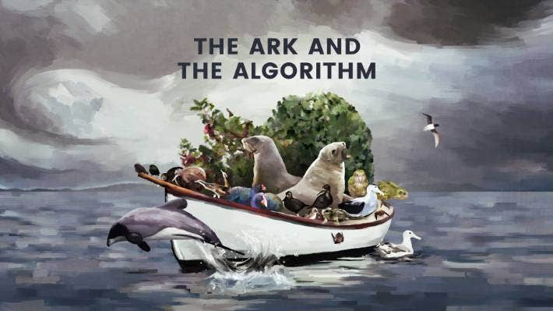
“Noah’s Ark” framing is misleading and melodramatic
Prioritizing projects is about allocating funds to implement actions to achieve objectives.
Prioritizations change depending on these factors
If available funding was high enough, then the prioritization would select all projects
“[….] New Zealand is on the forefront of making choices around a tough question that has echoes of Noah's Ark: Which species most deserve to survive?”
https://www.stuff.co.nz/environment/103568532/the-ark-the-algorithm-and-our-conservation-conundrum
https://www.stuff.co.nz/environment/105385528/how-do-we-decide-which-endangered-species-to-save

Slide 33
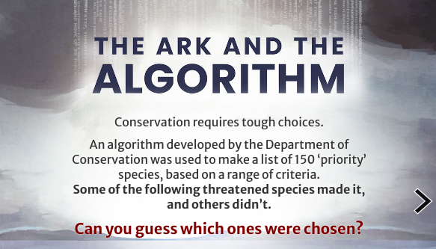
Ranking is methodologically flawed and distracts from important considerations
The overall set of projects selected by the prioritization is what is important (akin to principle of complementarity)
The rank of projects for individual species distracts from looking at the overall prioritization (unless they directly relate to the conservation objectives)
“How did a stinky, ugly plant become a higher priority for protection than the iconic Kauri tree?”
“Which one is most worthy of our protection? Someone has to decide. ”
https://www.stuff.co.nz/environment/103568532/the-ark-the-algorithm-and-our-conservation-conundrum
https://www.stuff.co.nz/environment/105385528/how-do-we-decide-which-endangered-species-to-save

Slide 34
“How did a stinky, ugly plant become a higher priority for protection than the iconic Kauri tree?”
“Which one is most worthy of our protection? Someone has to decide. ”
https://www.stuff.co.nz/environment/103568532/the-ark-the-algorithm-and-our-conservation-conundrum
https://www.stuff.co.nz/environment/105385528/how-do-we-decide-which-endangered-species-to-save

Slide 35
How did flour become a higher priority for baking than chocolate?
“Which one is most worthy of our shopping list? Someone has to decide. ”
CAKE
RECIPE
Baking
ingredients
tasty ingredients
https://www.stuff.co.nz/environment/103568532/the-ark-the-algorithm-and-our-conservation-conundrum
https://www.stuff.co.nz/environment/105385528/how-do-we-decide-which-endangered-species-to-save

Slide 36
So, what research have I done on project prioritization?
Hanson et al. (2019) Methods Ecol Evol , DOI:10.1111/2041-210X.13264

Slide 37
Remember this?
Ecological surveys
Distribution maps
Priority areas
Biodiversity
2000
Future
Data
Information
Plan
Outcome

Slide 38
Can bend the curve even further?
Ecological surveys
Distribution maps
Priority areas
Biodiversity
2000
Future
Data
Information
Plan
Outcome
Better algorithms

Slide 39
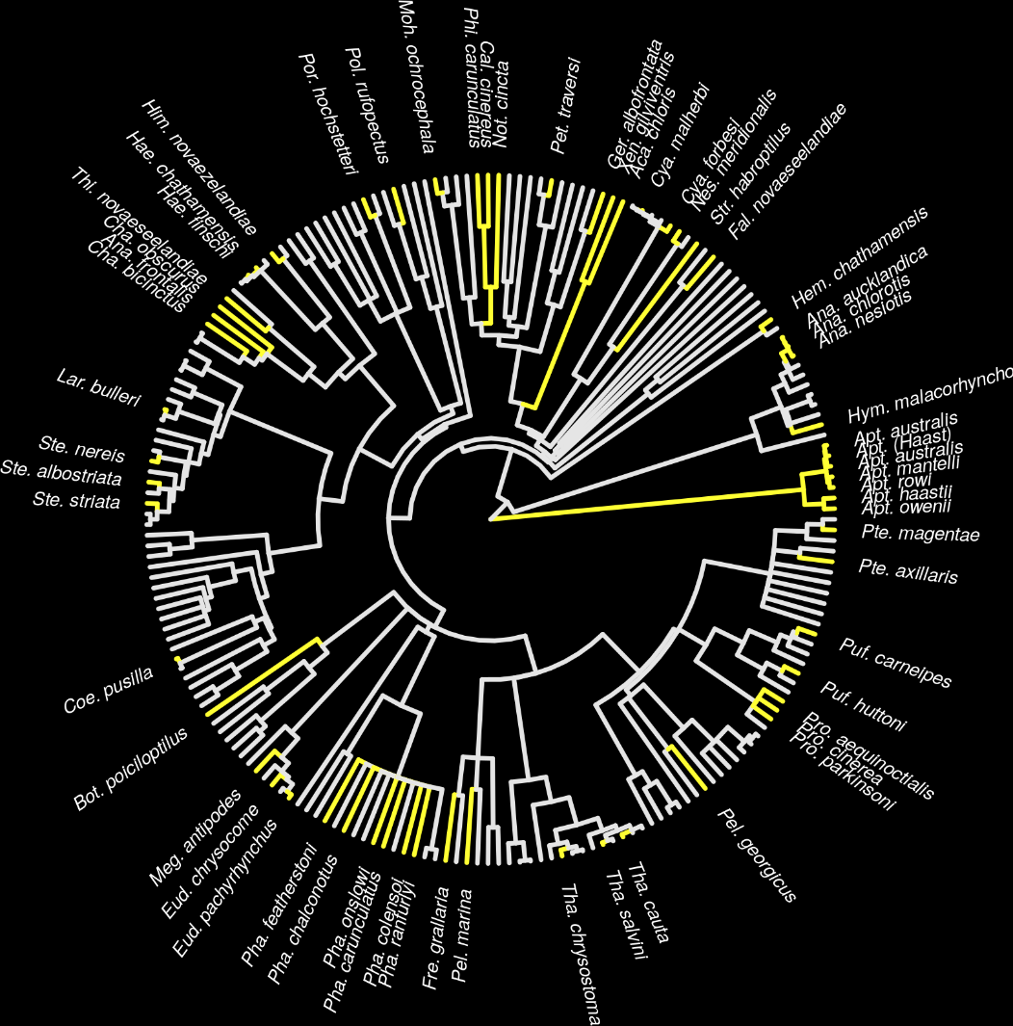
New Zealand case study
Projects for 62 imperilled bird species
1,218 different actions
Many actions shared between projects for different species
Hanson et al. (2019) Methods Ecol Evol , DOI:10.1111/2041-210X.13264

Slide 40
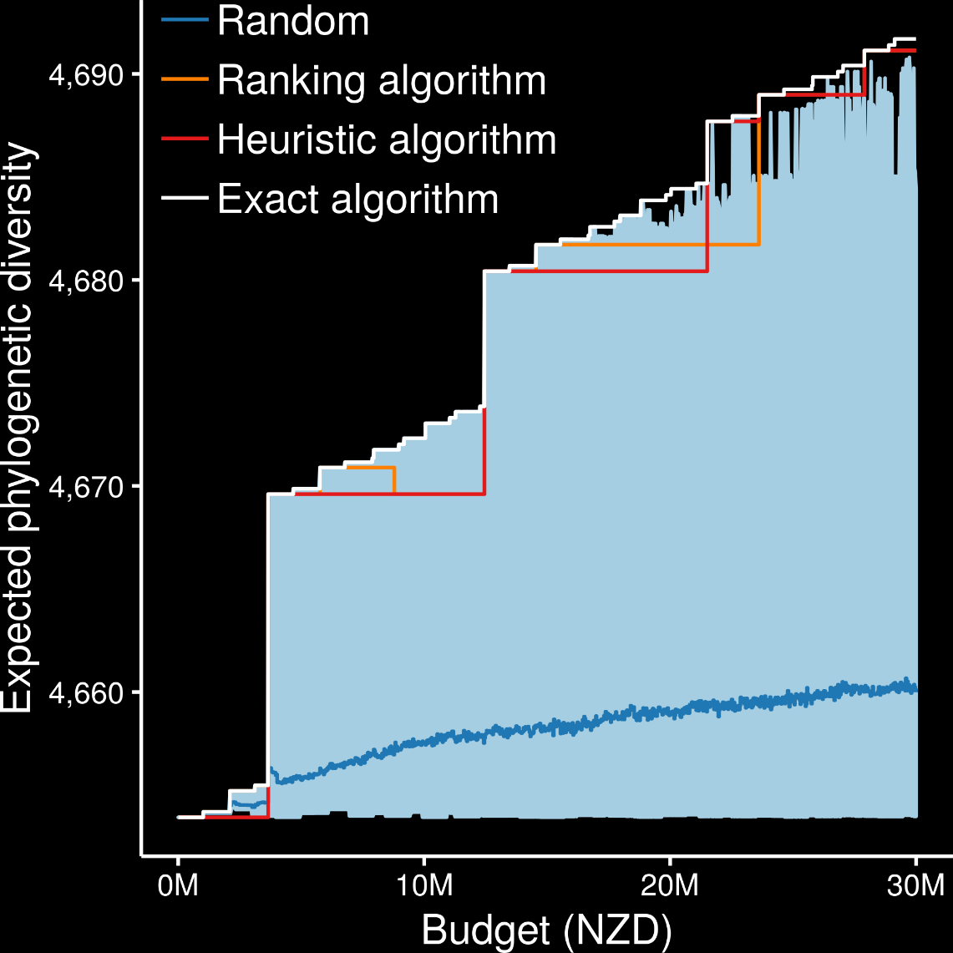
Exact algorithms always generated the best prioritizations
oppr R package,
https://prioritizr.github.io/oppr
Hanson et al. (2019) Methods Ecol Evol , DOI:10.1111/2041-210X.13264

Slide 41
Ranking and heuristic algorithms sometimes produced optimal prioritizations
Ranking and heuristic algorithm sometimes produced sub-optimal prioritizations
Hanson et al. (2019) Methods Ecol Evol , DOI:10.1111/2041-210X.13264

Slide 42
Ranking and heuristic algorithms sometimes produced worse prioritizations than randomly allocating funds
Ranking and heuristic algorithms often had large amounts of unspent funding, meaning less guidance for decision making
Hanson et al. (2019) Methods Ecol Evol , DOI:10.1111/2041-210X.13264

Slide 43
Ranking and heuristic algorithms sometimes produced worse prioritizations than randomly allocating funds
Ranking and heuristic algorithms often had large amounts of unspent funding, thus providing little guidance for decision making
Hanson et al. (2019) Methods Ecol Evol , DOI:10.1111/2041-210X.13264

Slide 44
Exact algorithms generated prioritizations within a feasible period of time
Heuristic and ranking algorithms are faster
It might be worth waiting worth ~15 seconds if it means you could potentially save millions of $$$
Table: Average run time for generating prioritizations using different algorithms
Algorithm | Average run time (seconds)
Exact | 16.2
Heuristic | 1.19
Ranking | 1.5
Hanson et al. (2019) Methods Ecol Evol , DOI:10.1111/2041-210X.13264

Slide 45

Thanks for listening!

