Slide 1

Dealing with big(gish) data
Rob S-G

Slide 2
Taking subsets
Examining/getting rid of NAs
Binding data
Merging data
Reorganizing data
Taxizing species
dplyr
tidyr

Slide 3
Subsetting
subset(d,condition)

Slide 4
Binding data
rbind(object1, object2,…)
cbind(object1, object2,…)

Slide 5
Binding data
cbind(object1, object2,…)

Slide 6
Binding data
rbind(object1, object2,…)

Slide 7
Merging data
merge(object1, object2,…)

Slide 8
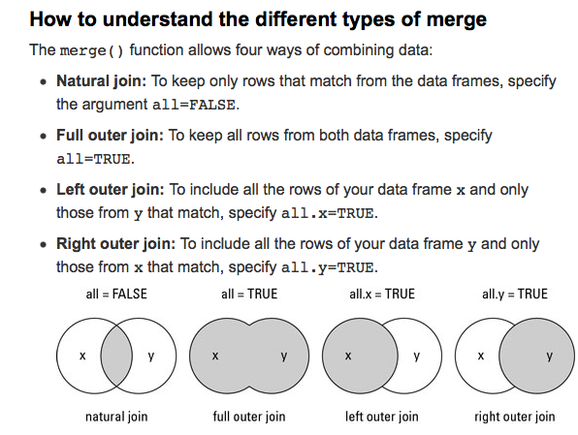
Merging data
merge(object1, object2,…)

Slide 9
Boolean conditions
Intersect(d1,d2)
setdiff(d1,d2)
union(d1,d2)

