Slide 1
ML HTGR
Prerna Joshi

Slide 2
About the Project
This project is designed to teach Machine Learning to beginners.
We deviated from the project’s original plans and ended up doing a total of 3 Machine learning Models instead of 1.
My team implemented the Random Forest, SVM, And LSTM models.
GitHub Repo: https://github.com/cppsea/ML_HTGR

Slide 3
Project Progress and Timeline
First Sprint
Cleaning up the data (Using numpy and Pandas)
Second Sprint
Splitting the data
Implementing and starting training the LSTM,SVM and Random Forest Models
Third Sprint
Training, validating and testing the dataset further on all 3 Models.
Documenting the accuracy and noting the differences between each run.
Final Sprint
Researching on LSTM,GRU,SVM And Random Forest
Comparing the 3 models and wrapping up the project.

Slide 4
General Process TO manage the project
I divided my team of 9 into teams of 3 each for mostly all tasks.
Made presentations for each meeting I conducted so that they were all documented.
Managed the project using the discord server to communicate.
Checked on my team weekly and got involved in their team meetings if needed me.

Slide 5
Random Forests
Random Forest models employ bootstrapping to choose random subsets of data (labels) and random feature sets (columns or means and medians).
This leads to the creation of multiple decision trees, forming a "random" forest.
Each tree within the Random Forest is a decision tree. These split data as they traverse down the tree through specific conditions. In our case, these conditions might involve comparing data set values, like mean acceleration, to certain thresholds.
Decision trees split the data effectively for accurate classification using concepts like entropy and information gain. Conditions in the decision tree, such as whether a data point's mean acceleration is greater or less than a certain value, contribute to the overall learning process.
While Random Forest is relatively easy to implement, it is a sophisticated model due to its ensemble of decision trees. The randomness introduced in both data and feature selection, along with the collective decision-making of multiple trees, enhances the model's complexity and predictive power.

Slide 6
SVM
SVM uses a one vs. all approach where you train a binary SVM for each class label.
The SVM algorithm decides the position and orientation of the hyperplane based on the training data and the objective of maximizing the margin between different classes.
The distance of a data point from the hyperplane is used as a measure of confidence which then makes predictions in a binary classification scenario.
Then the class with the highest confidence is the final predicted class for each instance.
If a data point is far from the hyperplane and on the correct side (correctly classified), it is considered more confident in its prediction.

Slide 7
LSTM
LSTMs are designed to process sequential data. Each instance in the sequence is typically associated with a time step.
In an LSTM, information is passed from one-time step to the next through memory cells. Each memory cell in an LSTM has three gates: input, forget, and output gates.
In our case LSTM uses the first 5 instances of data to predict what the next row should be.
At each subsequent time step, the LSTM decides what information to forget from the previous memory cell and what new information to update it with, based on the current instance in the sequence and the output from the previous memory cell. Our model uses instances 2-6 to predict what instance 7 should be. And then it keeps repeating.
LSTM then uses the updated memory cell to make a prediction for the current time step.
The LSTM's ability to capture long-term dependencies allows it to learn patterns and make predictions based on the context of the entire sequence.
LSTMs don't strictly use a fixed number of instances for prediction. Instead, they operate on a sliding window of input instances, considering a range of past instances to make predictions for the next instance.

Slide 8
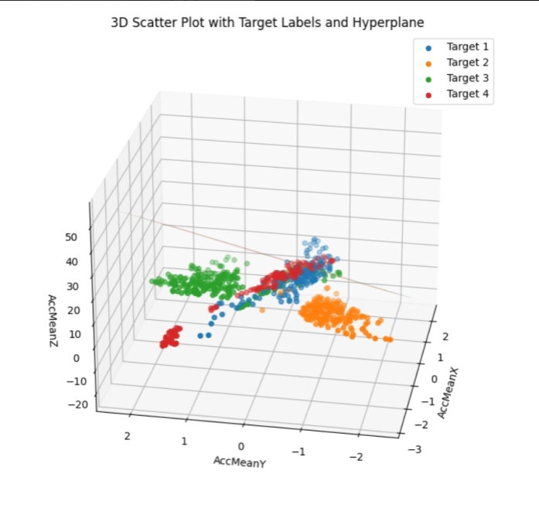
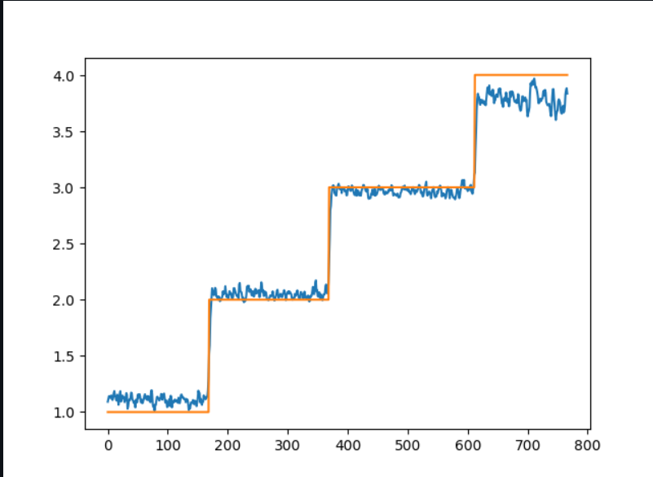
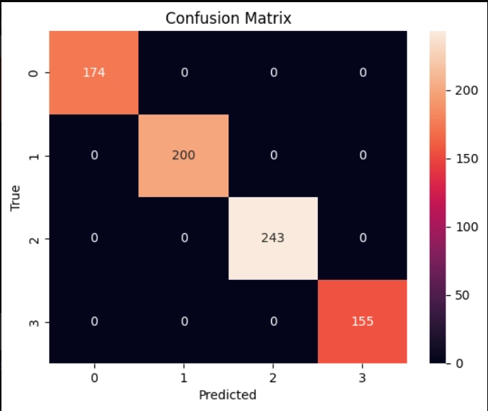
Comparison of ALL Models
Random Forest
SVM
LSTM

Slide 9
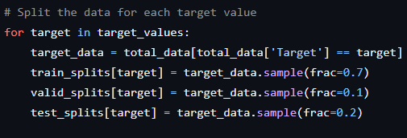

High Accuracy
The reason for the high accuracy in our results was because of how we ended up splitting our data.
We made sure that the datasets were split such that each dataset had enough values from each label even though they were randomly assigned.

Slide 10
Final Plans
Keep track of the team’s progress through the next week.
Organize the GitHub repository better.
Upload the documentation of the accuracy of various runs on all 3 models on GitHub.
Officially wrap up the project.

Slide 11
Thank You

