Slide 1
WIT COMP1000
Introduction to Computing
Notes:
WIT COMP1000 Computer Science I Course Material by Wentworth Institute of Technology (http://www.wit.edu/computer-science) is licensed under a Creative Commons Attribution-NonCommercial 4.0 International License (http://creativecommons.org/licenses/by-nc/4.0/). Based on a work at https://sites.google.com/site/witcomp128fall2014.

Slide 2
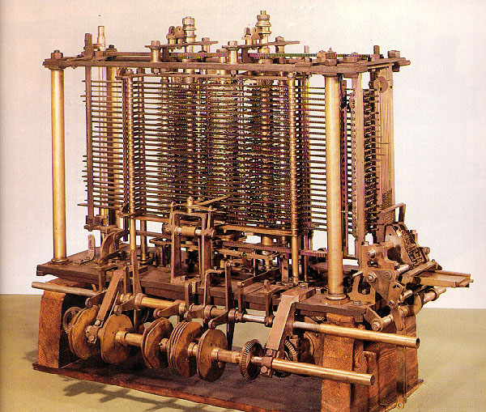
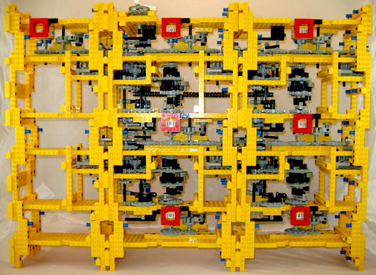
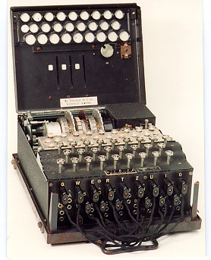
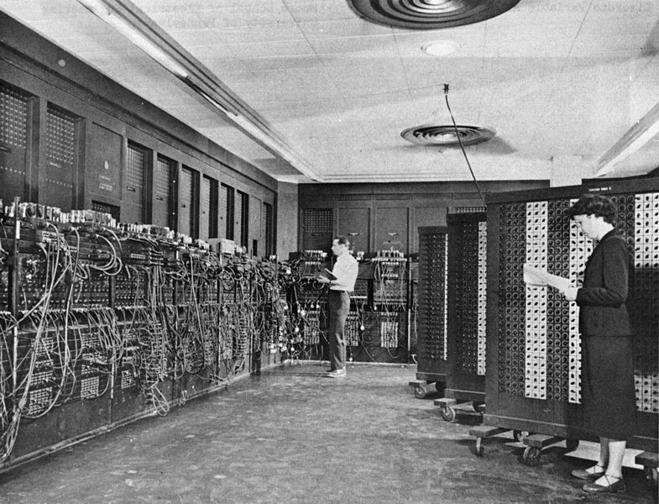
A Bit of History

Slide 3
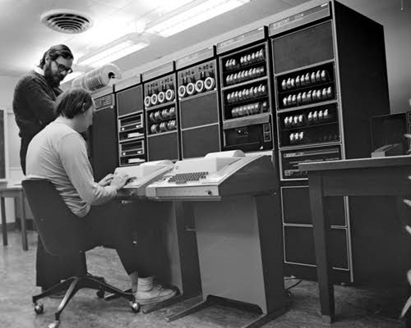
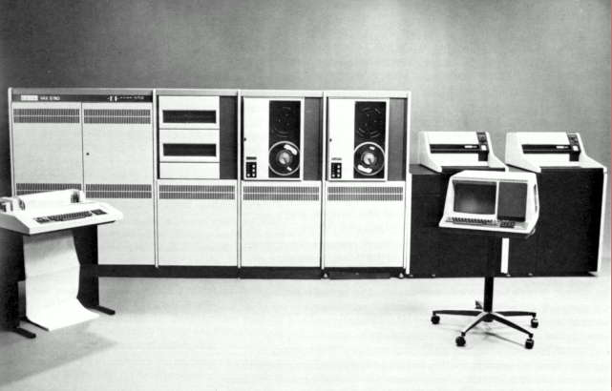
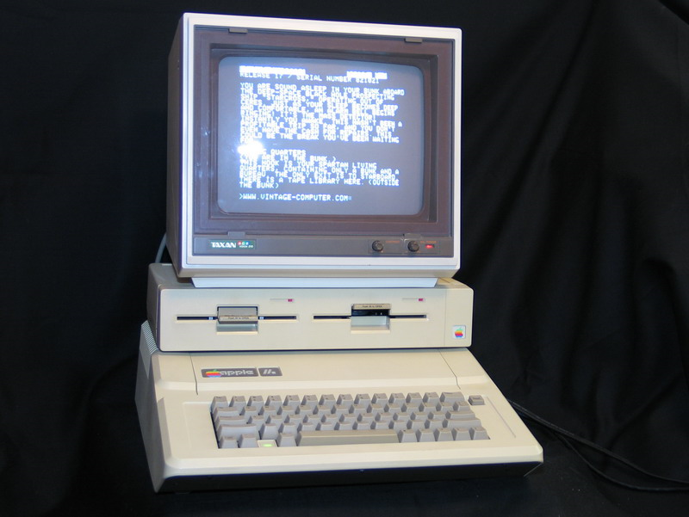
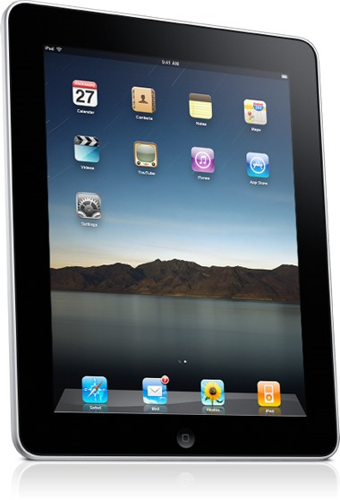
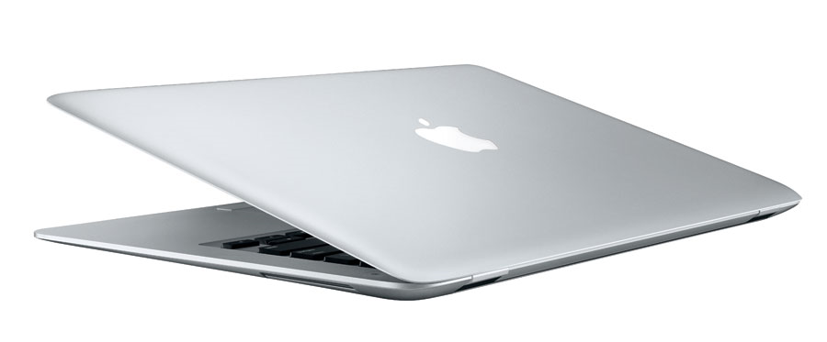
A Bit of History

Slide 4
What Makes Up a Computer?
Hardware
Physical components
Wide variety of types and manufacturers
Abstracted to a simple set of ideas for Computer Science
Software
Programs (i.e., instructions)
Wide variety of purposes
The focus of this course

Slide 5
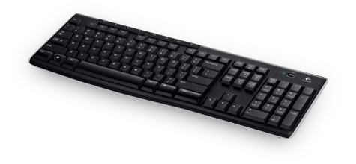

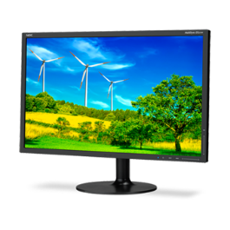
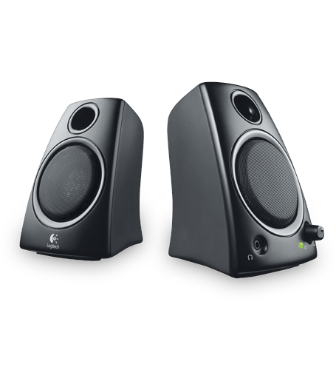
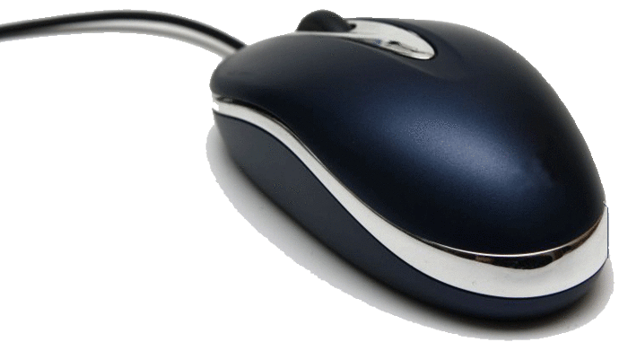
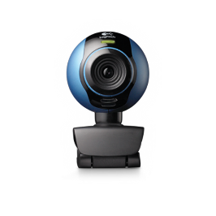
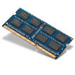
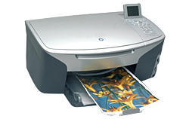
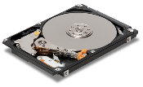

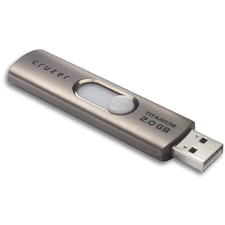
High Level Hardware View
Input Devices
Processor (CPU)
Output Devices
Main Memory (RAM)
Storage Devices
…

Slide 6
Main Memory (RAM)
byte 0
01110011
byte 1
01110100
4 bytes at address 0
byte 2
01100001
byte 3
01110010
Addresses
byte 4
01110111
2 bytes at address 4
byte 5
01100001
byte 6
01110010
2 bytes at address 6
byte 7
01110011
…

Slide 7



Running a Program
CPU doesn't understand Java directly
Processor (CPU)
Data/Input
Memory (RAM)
Output
…
Storage Device
Program

Slide 8
Compilers
Java Source Code
class HelloWorld {
public static void main(String[] args) {
System.out.println("Hello World");
}
}
Byte Code
01111010000101010100100011010001101000111110010101010010100110001010110001010000011101010101110001100110010000100110101010101001000011110001110000000111101000101010101010010001110…
Java Compiler

Slide 9
Java Virtual Machine
Java byte code also can't be executed by a CPU directly
Instead, the Java Virtual Machine (JVM) is another program that interprets the byte code and translates it into the native CPU language
Allows a program to be compiled once and run on all types of computers (that have a JVM available and installed)
Other high level languages work differently

Slide 10
Building a Java Program
Processor (CPU)
Java Source Code
Memory (RAM)
Java Byte Code
…
Storage Device
Java Compiler

Slide 11
Running a Java Program
Processor (CPU)
Program Input
Memory (RAM)
Program Output
Java Byte Code
…
Storage Device
JVM
Libraries

Slide 12
Take Home Points
Computers have 5 main components: Processor, Main Memory, Input Devices, Output Devices, Storage Devices
1 byte = 8 bits (binary digits)
Main Memory is a sequence of bytes, each with a memory address
The Java compiler turns source code into byte code
The JVM uses that byte code along with additional libraries in order to execute your program

