Slide 1
WIT COMP1000
Testing and Debugging
Notes:
WIT COMP1000 Computer Science I Course Material by Wentworth Institute of Technology (http://www.wit.edu/computer-science) is licensed under a Creative Commons Attribution-NonCommercial 4.0 International License (http://creativecommons.org/licenses/by-nc/4.0/). Based on a work at https://sites.google.com/site/witcomp128fall2014.

Slide 2
Testing Programs
When testing your code, always test a variety of input values
Never test only one or two values because those samples may not catch some errors
Always test "interesting" values
Values that show up in the code
For example, boundary values that change if/else behavior

Slide 3
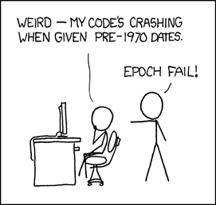
"Interesting" Values
http://xkcd.com/376/

Slide 4
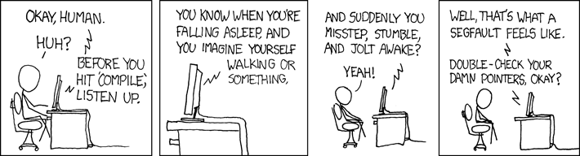
Also: Be Nice to Your Computer
CRASH
EVERYTHING
http://xkcd.com/371/

Slide 5
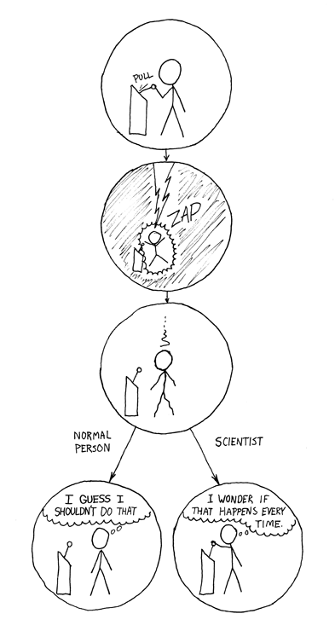
Also Also: Be Diligent!
Computer!
http://xkcd.com/242/

Slide 6
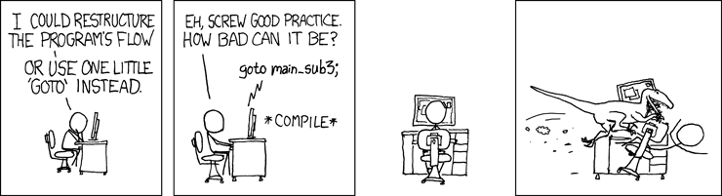
One Last Warning
http://xkcd.com/292/

Slide 7
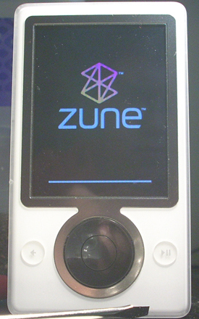
Example Bug: Microsoft, 12/31/2008
Early this morning we were alerted by our customers that there was a widespread issue affecting our 2006 model Zune 30GB devices (a large number of which are still actively being used). The technical team jumped on the problem immediately and isolated the issue: a bug in the internal clock driver related to the way the device handles a leap year. That being the case, the issue should be resolved over the next 24 hours as the time change moves to January 1, 2009. We expect the internal clock on the Zune 30GB devices will automatically reset tomorrow (noon, GMT). By tomorrow you should allow the battery to fully run out of power before the unit can restart successfully then simply ensure that your device is recharged, then turn it back on. If you’re a Zune Pass subscriber, you may need to sync your device with your PC to refresh the rights to the subscription content you have downloaded to your device.

Slide 8
Zune Bug Excerpt
// days is the number of days since 1980, e.g., 10000 or 365 or 10592
// year is the current year
if (IsLeapYear(year)) {
if (days > 366) {
days -= 366;
year += 1;
}
}
366 and 367 seem like good values to test

Slide 9
General Advice
Always check for common errors
Using = instead of ==
Using > or < instead of <= or >=
Other off-by-one errors
Integer division
Always test your code
Use lots of values to test, including ones that change the behavior of the code

Slide 10
Localize Errors
When you don't get the output you expect, DO NOT just change code randomly
Narrow down where the problem is by checking values throughout the program
Use output statements at key points to check current variable values
Also use output statements to verify which branch of if-else statements are taken

Slide 11
Example (with Errors)
import java.util.Scanner;
public class ClassExamples {
public static void main(String[] args) {
Scanner input = new Scanner(System.in);
double radius, height, volume;
System.out.print("Enter the radius of the cone: ");
radius = input.nextDouble();
System.out.print("Enter the height of the cone: ");
height = input.nextDouble();
volume = 1 / 3 * Math.PI * radius * radius * height;
System.out.println("The volume is: " + volume);
}
}

Slide 12
Error Localized
Scanner input = new Scanner(System.in);
double radius, height, volume;
System.out.print("Enter the radius of the cone: ");
radius = input.nextDouble();
System.out.print("Enter the height of the cone: ");
height = input.nextDouble();
System.out.println("radius is " + radius);
System.out.println("height is " + height);
//volume = 1 / 3 * Math.PI * radius * radius * height;
//volume = 1 / 3 * Math.PI;
volume = 1 / 3;
System.out.println("The volume is: " + volume);
Integer division!

Slide 13
Simple Testing and Debugging
When your code doesn't produce the correct output, don't just randomly change things
Localize the error by using output statements to track variable values, branch conditions, and other interesting areas of your code
Always check for common mistakes (look very hard, because they are easy to overlook)

Slide 14
Debugging Exercise
public static void main(String[] args) {
Scanner input = new Scanner(System.in);
int answer = 3;
int guess;
System.out.print("Enter a guess between 1 and 10: ");
guess = input.nextInt();
if ((guess <= 1) || (guess >= 10)) {
System.out.println("Invalid guess!");
System.exit(0);
}
if (guess == answer) {
System.out.println("Wrong! Try again.");
}
else {
System.out.println("You got it!");
}
}

Slide 15
Answer
public static void main(String[] args) {
Scanner input = new Scanner(System.in);
int answer = 3;
int guess;
System.out.print("Enter a guess between 1 and 10: ");
guess = input.nextInt();
if ((guess < 1) || (guess > 10)) { // used <= and >= instead of < and >
System.out.println("Invalid guess!");
System.exit(0);
}
if (guess == answer) {
System.out.println("You got it!"); // swapped two output messages
}
else {
System.out.println("Wrong! Try again.");
}
}

Slide 16
JUnit Testing
Another widely used type of testing is known as unit testing
The idea is to write additional code, called unit tests, that will automatically test your program with certain inputs to ensure that they produce the correct output
Of course, you must verify that your unit tests are correct!
JUnit is a very commonly used (and open source!) unit testing framework for Java
The tests you've been in running in Eclipse all semester!
Take some time to look at the test code to see that it's just more Java

Slide 17
Debugging Tools
Debuggers help you to quickly find and identify errors in your code
Allow you to:
Step through your code one line at a time
View current values of all variables as the program progresses
Set breakpoints that will stop the code at certain places in your code
Should NOT be used in place of proper testing and analysis, but rather as an assistive tool

Slide 18
Eclipse Debugger
Eclipse has a built in debugger that has all the normal debugging functionality
Set breakpoints by double clicking on the left of a line of code in the light blue vertical bar
Start the program with debugging (F11, the bug button, or go to the Run menu and click Debug)
The program will execute like normal until you come to a breakpoint
When a breakpoint is encountered, the program will stop and Eclipse will ask you to switch to the Debug perspective (which you should do)

Slide 19
Eclipse Debug Perspective
Once debugging, you can see the value of all variables in the upper right window (make sure you are looking at the Variables tab)
Use the Play/Resume (F8) and Step Over (F6) buttons to navigate through the code
Play/Resume starts the program running again, and it will continue until another breakpoint is encountered or the program ends
Step Over executes only the next line of code and then stops
There are two other options you'll use in the future
Step Into (F5) executes the next line of code, and goes into a method if that line is a method call
Step Return (F7) starts the program running again, and it continues until the current method call finishes, then stops again

Slide 20
Debugging Example
public static void main(String[] args) {
Scanner input = new Scanner(System.in);
int answer = 3;
int guess;
System.out.print("Enter a guess between 1 and 10: ");
guess = input.nextInt();
if ((guess <= 1) || (guess >= 10)) {
System.out.println("Invalid guess!");
System.exit(0);
}
if (guess == answer) {
System.out.println("Wrong! Try again.");
}
else {
System.out.println("You got it!");
}
}

Slide 21
Steps
Start by putting a breakpoint at the first if statement
Double click in the blue bar on the left of the line
It should add a blue dot to indicate that there is a breakpoint there now
You can double click on the dot to remove the breakpoint
Hit F11 to start debugging, and enter a value of 1 in the console
Eclipse will then stop automatically at the if statement
Make sure to switch do the Debug perspective
Examine the guess variable and see that it is 1
Click the Step Over (F6) button to execute the if statement

Slide 22
Steps
The program jumps into the if code block
This code should only be used when the guess was invalid, but 1 is a valid guess!
We now know to look very hard at the if condition because it must be wrong
In this case (as it often is), the problem is an off by one error cause by using <= instead of <
Fix the if statement, then stop debugging and start the program again with debugging
Next, set breakpoints at the two output statements that tell the user if their guess was correct or not
Examine the values of guess and answer
You'll see that the wrong output is printed when they are the same!

Slide 23
Debugging Exercise
public static void main(String[] args) {
Scanner input = new Scanner(System.in);
double length, width, area;
System.out.print("Enter positive rectangle length: ");
length = input.nextDouble();
System.out.print("Enter positive rectangle width: ");
width = input.nextDouble();
if ((length < 0) && (width < 0)) {
System.out.println("Invalid measurements!");
System.exit(0);
}
area = length * width;
System.out.println("The area is: " + area);
}

Slide 24
Steps
Run the program and find the following bugs:
The program does not print an error message if either measurement is zero
The program does not print an error message if only one measurement is negative
There must be something wrong around the if statement
Set a breakpoint on the if statement
Use the Step Over button to execute one statement at a time

Slide 25
Steps
You'll see that it skips the error message and return statement on several occasions when they should be executed
Verify this by looking at the values of length and width in the variables section of the debugger
That means that the error must be in the if condition
Try running with interesting boundary conditions such as -1, 0, and 1
As you test, pay attention to the conditions and change it when you note buggy behavior
In particular, both conditions should be <= instead of < and it should be || instead of &&

Slide 26
Take Home Points
Testing your code is vital, and it takes time to learn how to do it well
Use simple testing and debugging techniques such as adding output statements throughout your code
Of course, be sure to remove them once you have fixed any problems!
Use debuggers, like the Eclipse debugger, to trace through code in order to find errors
Set breakpoints near lines you want to check to skip ahead to those areas of the code

