Slide 1
WIT COMP1000
Exam 1 Review
Notes:
WIT COMP1000 Computer Science I Course Material by Wentworth Institute of Technology (http://www.wit.edu/computer-science) is licensed under a Creative Commons Attribution-NonCommercial 4.0 International License (http://creativecommons.org/licenses/by-nc/4.0/). Based on a work at https://sites.google.com/site/witcomp128fall2014.

Slide 2
Format
The exam will be 5-6 problems, with some problems having multiple sub-questions
You are allowed a single 8.5x11" piece of paper with whatever notes you want on it
Can be handwritten or computer printed
You may use both the front and back
No calculators, books, laptops, phones, or anything besides your single page of notes may be used

Slide 3
Format
Kinds of questions to expect:
Explain a program or part of a program
Translate between "normal" math expressions and their Java equivalents
Write your own code
Fix incorrect code / find bugs in code
Fill in the blank (in a program)
Short answer

Slide 4
Content
Essentially, everything we've covered so far in the semester, including:
Basic computer layout and components
Compilers and the JVM
Variables / data types
Input and output
Mathematical expressions in Java (order of operations, integer division, etc)
if-else statements

Slide 5
Review Exercises
The following slides contain exercises that will help you prepare for the exam
The exercises give you an idea of the style of questions to expect as well as the complexity

Slide 6
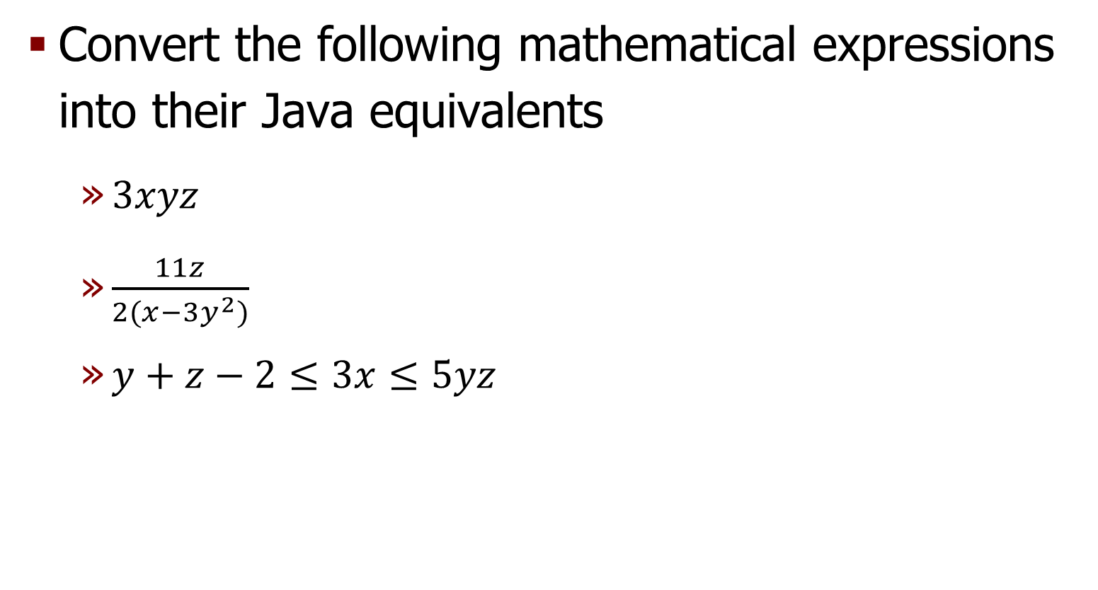
Exercise
Convert the following mathematical expressions into their Java equivalents
$3xyz$
$\frac{11z}{2(x−3y^{2})}$
$y+z−2≤3x≤5yz$

Slide 7

Answer
$3xyz$
3*x*y*z
$\frac{11z}{2(x−3y^{2})}$
(11*z) / ( 2*(x – 3*y*y) )
$y+z−2≤3x≤5yz$
(y+z-2) <= (3*x) && (3*x) <= (5*y*z)

Slide 8
Exercise
What is the output of the following program fragment?
int some_value = 99/100 + 4 + 5/2;
System.out.println(some_value);

Slide 9
Answer
6

Slide 10
Exercise
What is the output of the following program fragment?
double num = 3.75;
if (num <= 0) {
System.out.println("Less than 0!");
}
else if (num >= 1) {
System.out.println("Greater than 1!");
}
else if (num == 3.75) {
System.out.println("Equal to 3.75!");
}
else {
System.out.println("Umm... something?");
}

Slide 11
Answer
Greater than 1!

Slide 12
Exercise
What is the output of the following program fragment?
double num = 3.75;
if (num <= 0) {
System.out.println("Less than 0!");
}
if (num >= 1) {
System.out.println("Greater than 1!");
}
if (num == 3.75) {
System.out.println("Equal to 3.75!");
}
else {
System.out.println("Umm... something?");
}

Slide 13
Answer
Greater than 1!
Equal to 3.75!

Slide 14
Exercise
What are the values of x1 and x2 at the end of the program fragment below? Explain your answer.
int x1 = 14 / 4 * 3 / 2;
double x2 = 14.0 / 4 * 3 / 2;

Slide 15
Answer
int x1 = 14 / 4 * 3 / 2;
double x2 = 14.0 / 4 * 3 / 2;
x1 has value 4 due to integer division and order of operations: ((14/4) * 3) / 2 == (3 * 3) / 2 == 9/2 == 4
x2 has value 5.25, there are no integer operations: ((14.0 / 4) * 3) / 2 == (3.5 * 3) / 2 == 10.5 / 2 == 5.25

Slide 16
Exercise
Find and list all errors in the Java program fragment below
Scanner input = new Scanner(System.in);
int input_value;
System.in.print("Enter an integer between 1 and 5: ");
input_value = input.nextInt();
if (input_value < 1 && input_value > 5) {
System.out.print("That is not between 1 and 5!")
}
else if (input_value = 1) {
System.out.print("OK");
}
else (input_value > 1) {
System.out.print("GREAT");
}

Slide 17
Answer
System.in should be System.out
Scanner input = new Scanner(System.in);
int input_value;
System.in.print("Enter an integer between 1 and 5: ");
input_value = input.nextInt();
if (input_value < 1 && input_value > 5) {
System.out.print("That is not between 1 and 5!")
}
else if (input_value = 1) {
System.out.print("OK");
}
else (input_value > 1) {
System.out.print("GREAT");
}
&& should be ||
Missing ;
= should be ==
No condition after an else!

Slide 18
Exercise
Write a complete Java program that reads in three numbers from the user and prints out the maximum (largest) of the three.

Slide 19
Answer
import java.util.Scanner;
public class Max {
public static void main(String[] args) {
Scanner input = new Scanner(System.in);
double num1, num2, num3;
double max;
System.out.println("Enter three numbers: ");
num1 = input.nextDouble();
num2 = input.nextDouble();
num3 = input.nextDouble();
if (num1 >= num2 && num1 >= num3) {
max = num1;
}
else if (num2 >= num3) {
max = num2;
}
else {
max = num3;
}
System.out.println("The max was " + max);
}
}

Slide 20
Wrap Up
Review the previous slides and assignments
Work through all the examples and exercises
Check the book if you have it for additional exercises (with answers)
Use the page of notes as a study guide to help you prepare for the exam
Come see me with any questions or if you need some help understanding anything we've covered so far this semester

