Slide 1
Frequency Dynamic Convolution for Dense Image Prediction
CVPR 2025
Chen et al.
Notes:
Good afternoon, everyone. Today I’m going to present the paper “Frequency Dynamic Convolution for Dense Image Prediction,” from CVPR 2025.

Slide 2
Outline
Introduction
Related Work
Method
Experiments
Conclusion
Notes:
Here is the outline of my presentation.

Slide 3
Outline
Introduction
Related Work
Method
Experiments
Conclusion

Slide 4
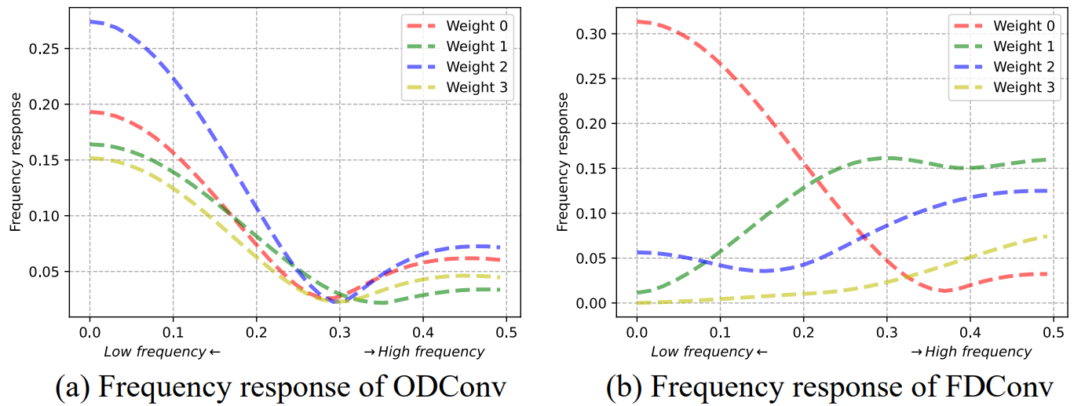
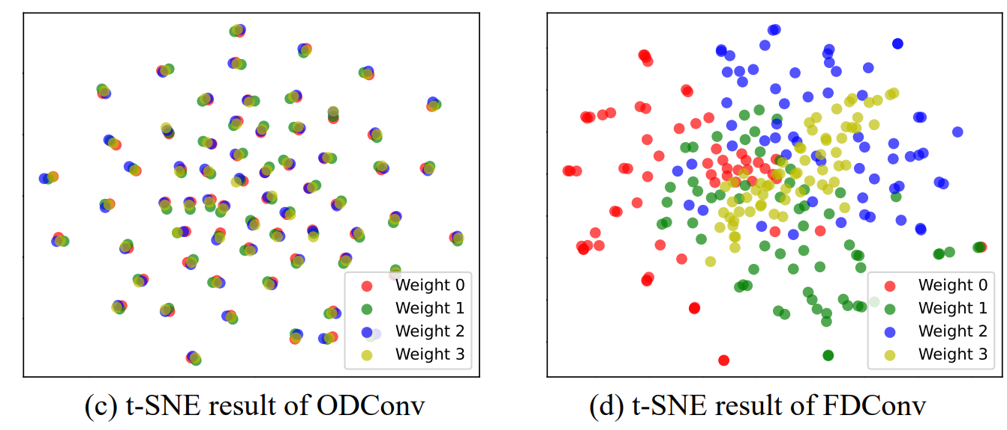
Introduction
Task
  Convolution block of dense image prediction
Problem
  Previous dynamic convolutions lack of frequency diversity in their parallel weights.
  Parallel weights of previous methods shows high similarity in parameter space.
  Despite a significant increase in parameters, the model’s ability improves little.
Contribution
  Propose FDConv, a novel dynamic convolution aim to enhance frequency adaptability.
Notes:
Dynamic convolution has become a popular way to make convolution more adaptive. Instead of using one static kernel, methods like CondConv and ODConv keep several parallel kernels and mix them with input-dependent attention. The idea is that each kernel can specialize in something different, so the network gains capacity without adding much computation.
However, the authors look at these parallel kernels from a new angle, the frequency domain, and find a problem. In figure (a), we see the frequency responses of the four parallel weights in ODConv. All four curves have almost the same shape: they all emphasize low frequencies and drop off at high frequencies. The t-SNE plot in figure (c) tells the same story. Each small group here contains one point of every color, almost on top of each other. In other words, the filters from the four weights are nearly indistinguishable, so the extra kernels are not really learning anything different.
This matters because these methods multiply the parameter count, typically by four or even eight times. If the extra kernels end up redundant, we pay a large parameter cost for very limited gains in adaptability. Frequency diversity is also especially important for dense prediction tasks like detection and segmentation. Low-frequency components help suppress noise, while high-frequency components capture edges and object boundaries.
To solve this, the authors propose Frequency Dynamic Convolution. As figures (b) and (d) show, the resulting kernels now cover different parts of the spectrum and the four weights are now easy to tell apart.
左：沒有說是Cin×Cout個k×k的平均還是kCin×kCout直接做，但應該是前者，不然FDConv會直接一塊一塊
右：同色每個點代表一個k×k×Cin的filter

Slide 5
Outline
Introduction
Related Work
Method
Experiments
Conclusion

Slide 6
Related Work
CondConv: Conditionally Parameterized Convolutions for Efficient Inference, NeurIPS 2019, Yang et al.
Omni-Dimensional Dynamic Convolution, ICLR 2022, Li et al.

Slide 7
Related Work
CondConv: Conditionally Parameterized Convolutions for Efficient Inference, NeurIPS 2019, Yang et al.
Omni-Dimensional Dynamic Convolution, ICLR 2022, Li et al.

Slide 8
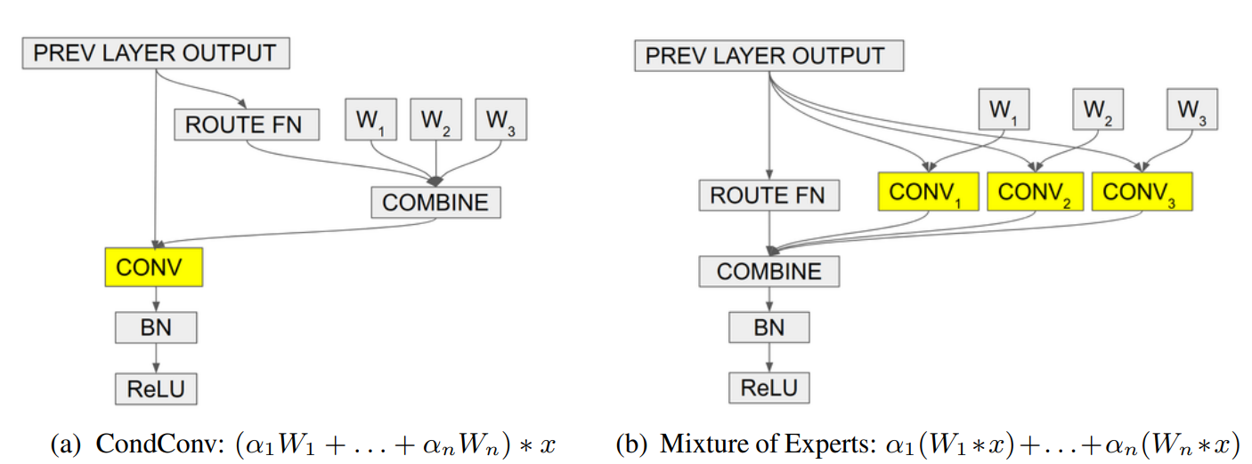
Introduction (Yang et al.)
Task
  Convolution block of image classification / object detection
Problems
  In traditional CNN, the larger capacity means more layers or larger weight tensor, causing high computational cost during inference.
Contributions
  Propose CondConv, which compute convolutional kernels as a function of the input, leverage the capacity while maintaining efficient inference.

Slide 9

Method (Yang et al.)
The final weight is linear combination of parallel weights and routing function:
The routing function is computed as linear of GAP of input followed by sigmoid:
It is mathematically equivalent to the mixture of experts approach with soft routing function.

Slide 10
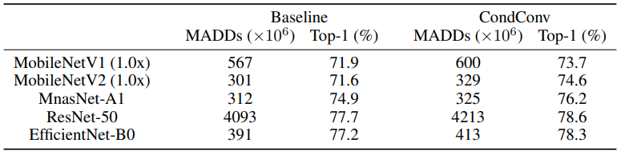
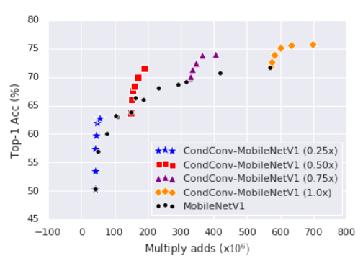
Experiments (Yang et al.)
ImageNet Classification
 | Baseline MADDs (M) | Baseline Top-1 (%) | CondConv MADDs (M) | CondConv Top-1 (%)
MobileNetV1 | 571 (1.0x) | 71.7 (1.0x) | 190 (0.5x) | 71.6 (0.5x)
MobileNetV2 | 585 (1.4x) | 74.5 (1.4x) | 329 (1.0x) | 74.6 (1.0x)
MnasNet | 340 (A2) | 75.6 (A2) | 329 (A1) | 76.2 (A1)
Notes:
左：彩色點都在baseline fronteer左上
右上：對每個backbone都在MADDs增加10%內取得進步
右下：把同類模型限縮到表現差不多時，MADDs大幅減少
模型越大增益越小

Slide 11
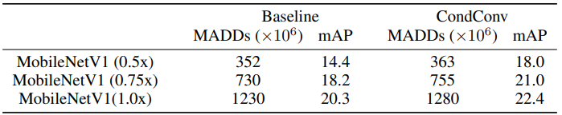
Experiments (Yang et al.)
COCO Object Detection
Notes:
對每個backbone都在MADDs增加5%內取得較大進步

Slide 12
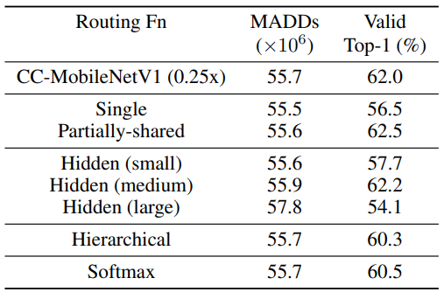
Experiments (Yang et al.)
Ablation study on Routing function
Notes:
可以看出來routing fn不能只算一次每層共用
可以看出來加hidden layer效果不大，甚至可能造成bottelneck或overfitting
routing fn只需要x，不需要前一層的routing fn輸出
sigmoid效果比較好 (可能是因為沒做退火，n=32)

Slide 13
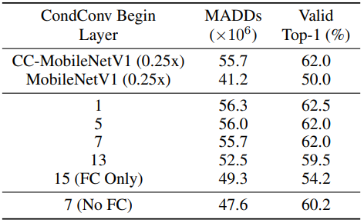
Experiments (Yang et al.)
Ablation study on CondConv Layer Depth
Notes:
用越多層效果越好
考量MADDs做經濟取捨

Slide 14
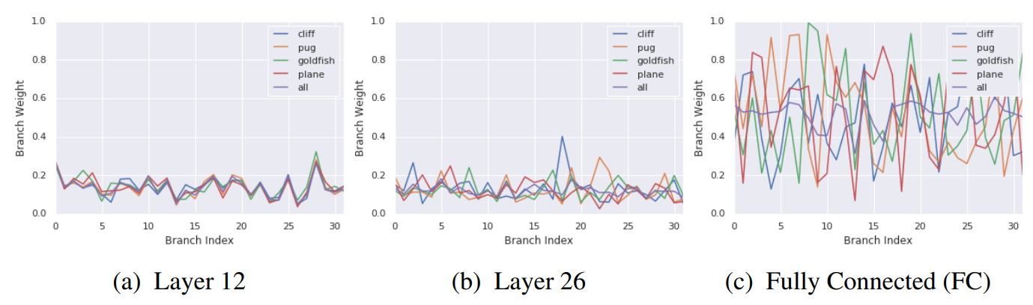
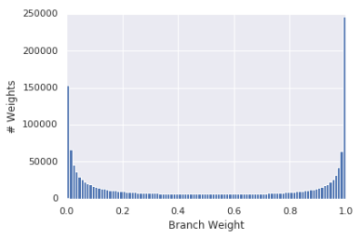
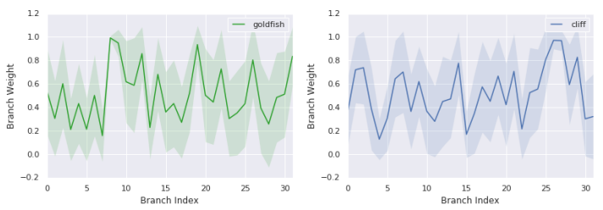
Analysis (Yang et al.)
Notes:
左：最後一層(FC)的weight分布，接近one-hot
右上：不同層之間，每個標籤的每個專家的權重平均，越深層越多樣化，值越極端
右下：同個標籤時，最後一層的每個專家的權重平均和標準差，強調同標籤樣本間權重也是多樣化

Slide 15
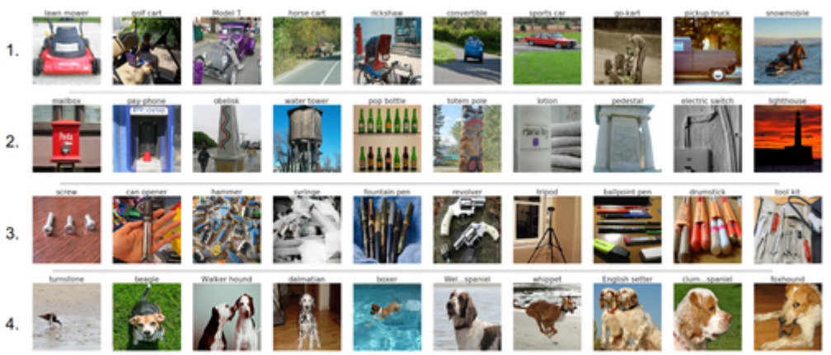
Analysis (Yang et al.)
Notes:
針對每個專家，平均權重前10名的類別，選其中權重最高的當代表
每個專家權重高的類別都有相似的視覺特性

Slide 16
Conclusion (Yang et al.)
Propose CondConv, a new direction for increasing model capacity while maintaining efficient inference (dynamic convolution).

Slide 17
Related Work
CondConv: Conditionally Parameterized Convolutions for Efficient Inference, NeurIPS 2019, Yang et al.
Omni-Dimensional Dynamic Convolution, ICLR 2022, Li et al.

Slide 18
Introduction (Li et al.)
Task
  Convolution block of image classification / object detection
Problem
  Previous dynamic convolutions are only dynamic on dimension of kernel space.
  Other dimension (spatial, in/out channel) are still static
  Previous dynamic convolutions increase parameter size by n (# of weights) times.
Contribution
  Propose ODConv, a new dynamic convolution method utilitizing spatial and in/out channel dimension.

Slide 19




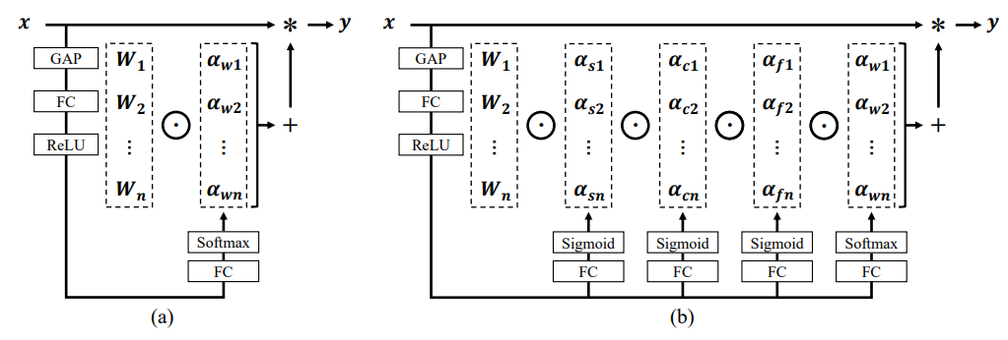
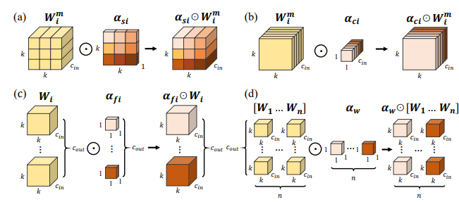
Method (Li et al.)
:weight
:output channel
:input channel
:spatial
Notes:
除了Wi的線性組合，也在捲積加上spatial, channel attention機制

Slide 20
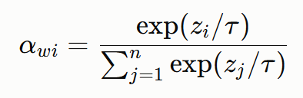
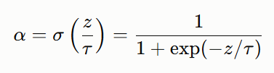
Method (Li et al.)
are shared across weights
Four share same stem
use softmax, others use sigmoid
use temperature annealing
Notes:
aw用softmax是沿用DY-Conv，原因是讓專家互相競爭，和CondConv衝突，可能是加了退火的關係

Slide 21
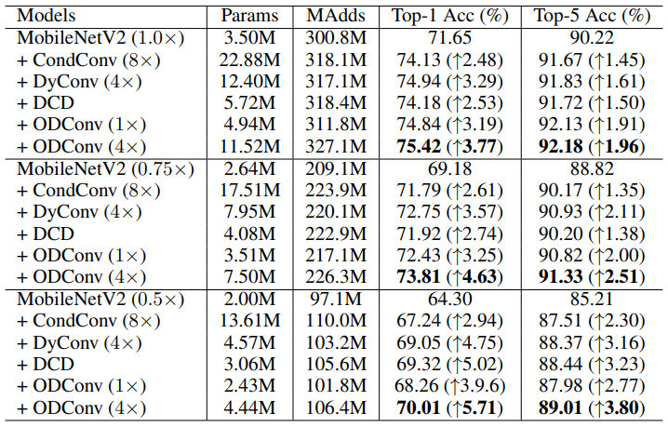
Experiments (Li et al.)
Image Classification on ImageNet — MobileNets
Notes:
ODConv (1x) 表現和前面相當，參數大幅減少
ODConv (4x) 表現大幅提高，參數和前面相當

Slide 22
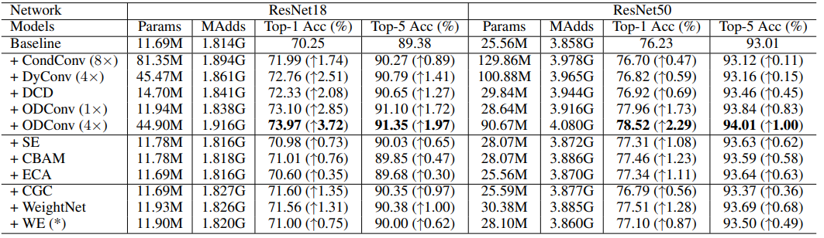
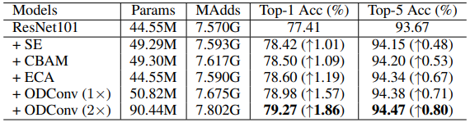
Experiments (Li et al.)
Image Classification on ImageNet — ResNets
Res101
Notes:
ODConv (1x) 表現和前面相當，參數大幅減少
ODConv (4x) 表現大幅提高，參數和前面相當
和SE等相比表現大幅提高
模型越大增益越小

Slide 23
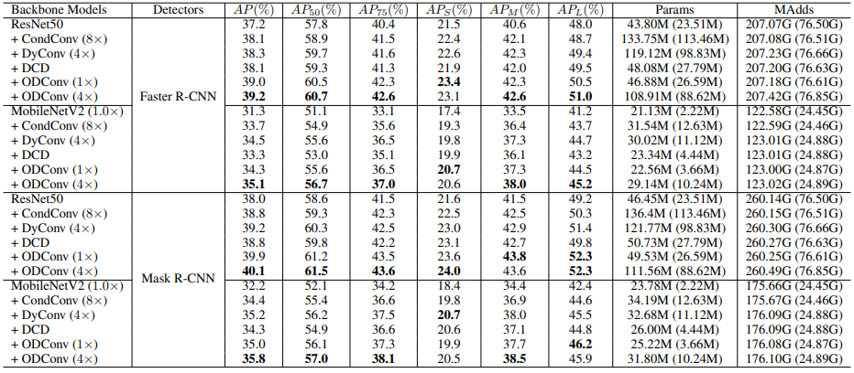
Experiments (Li et al.)
Object Detection on COCO, backbones are pretrained by ImageNet classification
Notes:
ODConv (1x) 表現和前面相當，參數大幅減少
ODConv (4x) 表現大幅提高，參數和前面相當
可遷移性，預訓練在ImageNet分類的backbone可直接接到下游任務finetune

Slide 24
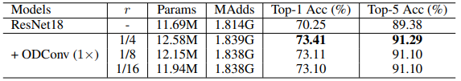
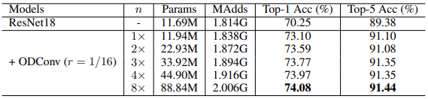
Experiments (Li et al.)
Ablation study
Notes:
r：routing fn中間層縮小比例；n：平行權重W數量
r 1/8和1/16效果差別不大，但1/16省參數
n越大效果越好，但參數線性成長，增益快速遞減

Slide 25
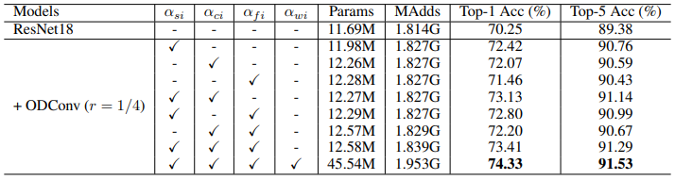
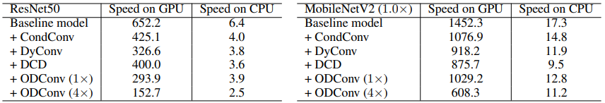
Experiments (Li et al.)
Ablation study
Notes:
上：比較各alpha的功用，spatial單獨比channel重要，但一起用有互補效果，另外最後一行加了aw的同時也從1x變成4x，並不是簡單的參數開關
下：比較個方法執行時間，在大型架構(ResNet)或GPU上特別慢，原因是加上spatial和channel attention後更不方便平行運算

Slide 26
Conclusion (Li et al.)
Propose ODConv, a new dynamic convolution method utilitizing spatial and in/out channel dimension.
Spatial attention matters more than combination of matrix and channel attention.
ODConv can surpass previous method with only one weight.

Slide 27
Outline
Introduction
Related Work
Method
Experiments
Conclusion

Slide 28
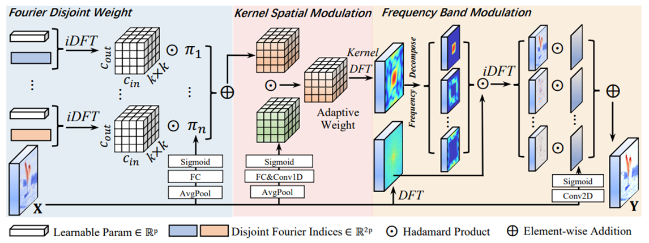
Method
Overview
  FDW followed by KSM followed by FBM

Slide 29
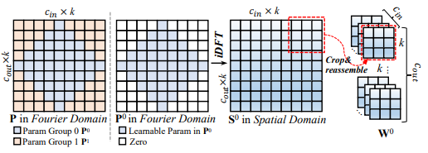
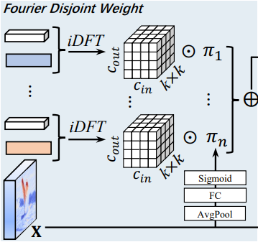
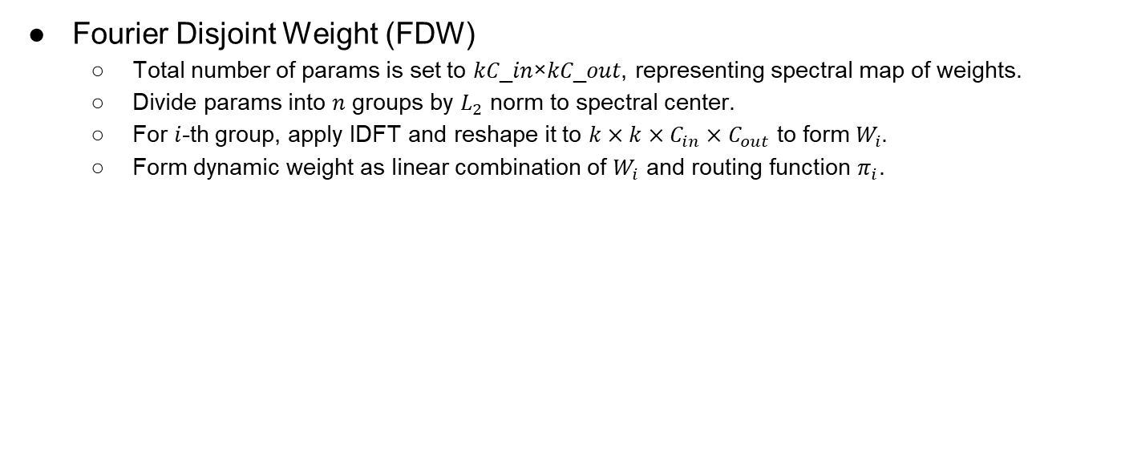
Method
Fourier Disjoint Weight (FDW)
  Total number of params is set to 𝑘𝐶_𝑖𝑛×𝑘𝐶_𝑜𝑢𝑡, representing spectral map of weights.
  Divide params into 𝑛 groups by $L_{2}$ norm to spectral center.
  For $i$-th group, apply IDFT and reshape it to $k×k×C_{in}×C_{out}$ to form $W_{i}$.
  Form dynamic weight as linear combination of $W_{i}$ and routing function $π_{i}$.

Slide 30
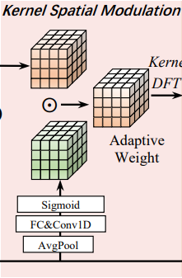
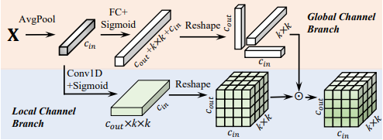
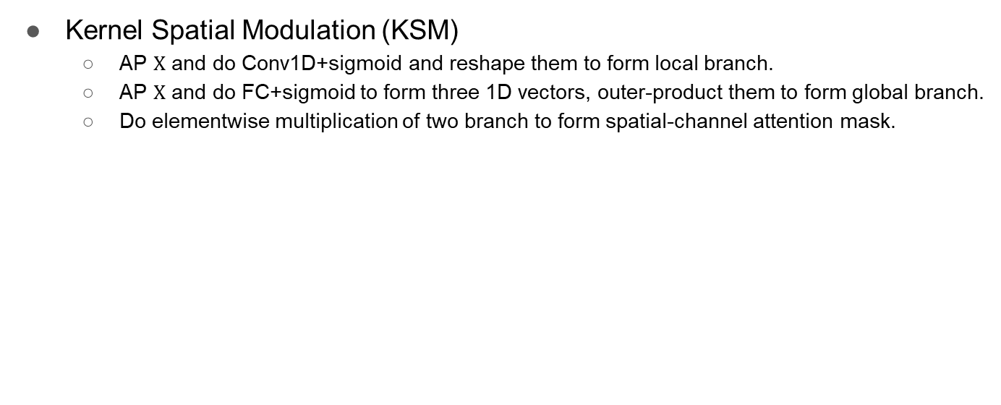
Method
Kernel Spatial Modulation (KSM)
  AP $X$ and do Conv1D+sigmoid and reshape them to form local branch.
  AP $X$ and do FC+sigmoid to form three 1D vectors, outer-product them to form global branch.
  Do elementwise multiplication of two branch to form spatial-channel attention mask.
Notes:
為什麼兩個都要？因為補足conv1d沒看到全域的問題

Slide 31
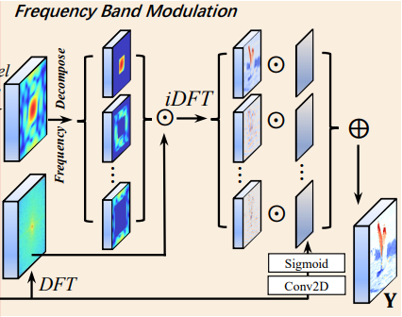


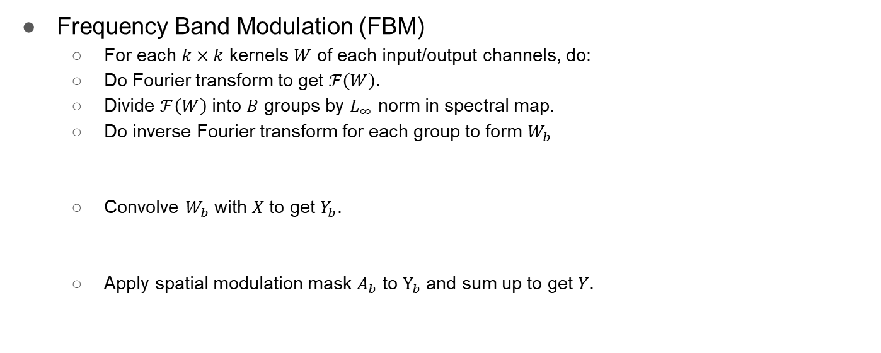
Method
Frequency Band Modulation (FBM)
  For each $k×k$ kernels $W$ of each input/output channels, do:
  Do Fourier transform to get $ℱ\left(W\right)$.
  Divide $ℱ\left(W\right)$ into $B$ groups by $L_{∞}$ norm in spectral map.
  Do inverse Fourier transform for each group to form $W_{b}$
  Convolve $W_{b}$ with $X$ to get $Y_{b}$.
  Apply spatial modulation mask $A_{b}$ to $Y_{b}$ and sum up to get $Y$.
Notes:
逐頻率逐空間位置attention

Slide 32

Method
Frequency Band Modulation (FBM)
  The process can also be rewritten as:

Slide 33
Outline
Introduction
Related Work
Method
Experiments
Conclusion

Slide 34
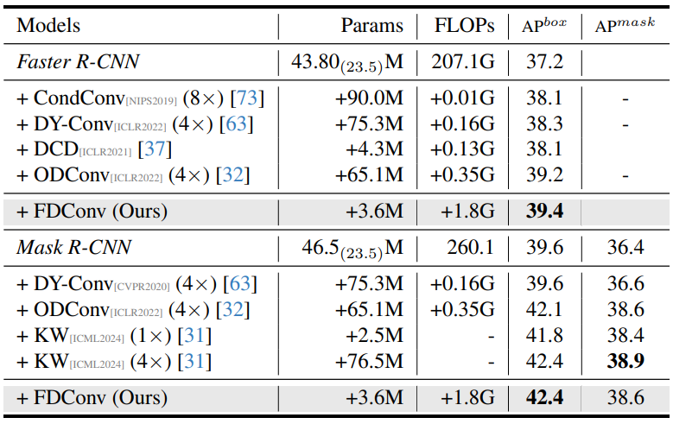
Experiments
Object Detection and segmentation on COCO with ResNet50
Notes:
花少的參數有好的效果，但很慢

Slide 35
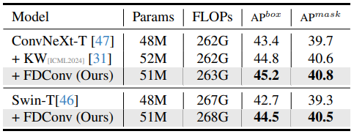
Experiments
Object Detection and segmentation on COCO with Mask R-CNN
Notes:
換到其他backbone也有效果

Slide 36
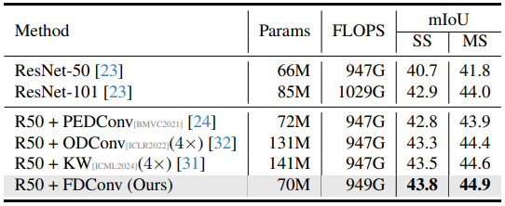
Experiments
ADE20K semantic segmentation with UPerNet
Notes:
花少的參數有好的效果，增量多但和baseline比例小

Slide 37
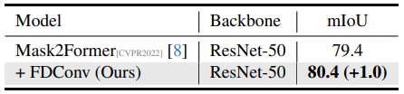
Experiments
Cityscapes semantic segmentation with Mask2Former
Notes:
在SOTA模型下也有效
照慣例會有ImageNet1K預訓練

Slide 38
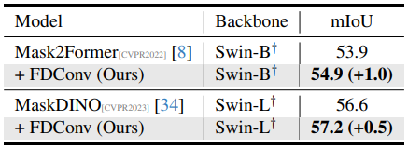
Experiments
ADE20K semantic segmentation with Mask2Former and MaskDINO
  backbones are pretrained with ImageNet-22K
Notes:
在SOTA模型下也有效

Slide 39
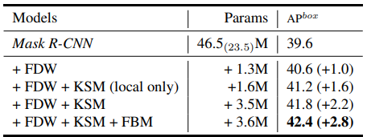

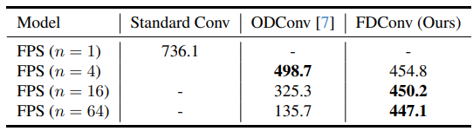
Experiments
Ablation studies
Notes:
上：每個部分都有效果，包含KSM的global branch
下：n取64最好

Slide 40
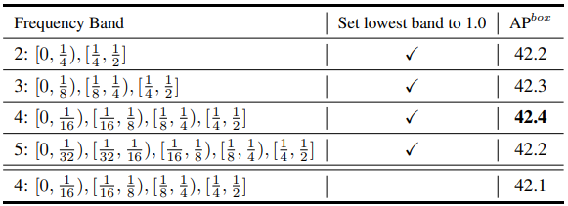
Experiments
Ablation studies
Notes:
FBM切四段最好，最低頻不要空間注意較好

Slide 41
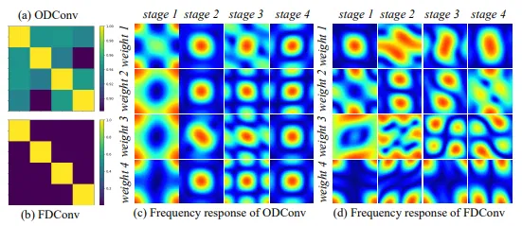
Analyses
Notes:
左：wieght之間的cosine similarity matrix
右：在每個stage的某層的權重視覺畫

Slide 42
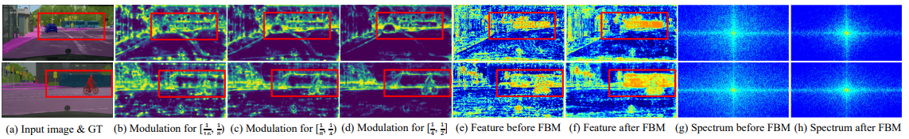
Analyses
Notes:
越接近高頻注意力越集中在物件邊緣
加完注意力後目標物件有明顯變化
在頻譜上可看到濾掉了不需要的高頻

Slide 43
Outline
Introduction
Related Work
Method
Experiments
Conclusion

Slide 44
Conclusion
Parallel kernels in existing methods have highly similar frequency responses.
Propose FDConv, learning frequency-disjoint weight and modulates frequency bands spatially.
The total number of parameter each weight is restricted to k×k×Cin×Cout.
Notes:
To conclude, this paper revisits dynamic convolution from a frequency perspective. The key finding is that the parallel kernels in existing methods have highly similar frequency responses, which wastes a large number of parameters. FDConv learns frequency-disjoint weight and modulates frequency bands spatially, makes it outperforms previous methods while having much smaller parameter size.

