Slide 1
Dissertation Outline (SSZG628T)
Jeffrey Marius
2023MT13044 M.Tech. Software Systems

Slide 2
Design, Implementation & Analysis of m-TLS Authenticated OMCI Channel in Virtualized PON Architectures

Slide 3
Problem Statement
The TR-451 standard does not impose highest security standard to protect sensitive network information when transmitted across the vOMCI architecture
In a cloud based solution, like vOMCI architecture, the modules do not authenticate each other which can allow an attacker to deploy a malicious cloned vOMCI module.
There is no proper mechanism specified to refresh the security certificates which are issued as public keys which opens up the vOMCI architecture for MITM vulnerability attacks

Slide 4
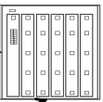
vOMCI Architecture
ONU Management Proxy
OLT
vOLT Management Function
vOMCI Function
vOMCI Proxy
Covered as part of the project work
Not Covered as part of the project work
gRPC connection via TLS

Slide 5
Solution View
Solution 1: The TR-451 standard imposes highest security measures as TL1.2. It has been found that TLS1.2 has weak ciphers and vulnerabilities.
The project work proposes to implement TLS1.3 for the vOMCI modules.
Solution 2:
As per the vOMCI architecture the connecting client validates the server using X.509 certificate as part of TLS handshake. However, it does not validate the client. The project work proposes to implement mutual TLS which ensures that both the client and server will authenticate each other during TLS handshake thus preserving integrity of the vOMCI modules.
Solution 3: There is no mechanism to refresh the X.509 certificates as per current mechanism in vOMCI architecture. The project work will perform certificate rotation automatically by monitoring the health of the certificates and the modules will be altered to establish new connection with new refreshed certificates thus avoiding MITM attacks.

Slide 6
Assumptions
→ The vOLTMF module uses Yang data modelling for pushing config request to vOMCI
function which then translates the data model to OMCI. However, for the current project
work, the Yang data modelling is not in scope and so to simulate the Yang data modelling
config push, a separate interactive CLI will be designed which will push the necessary config
command to demonstrate the transaction.
→ The vOLTMF, vOMCI Function, vOMCI Proxy will be only covered in the project work and
TLS1.3, mTLS and certificate rotation will be implemented and demonstrated via these
modules. It is understood that the solution can be extended to other modules as well.

Slide 7
Objectives & Tools
Objective: - Implement a basic framework of vOLTMF, vOMCI Function , vOMCI Proxy modules
Implement gRPC connection among the modules
Implement TLS1.3 on the gRPC
Implement mutual TLS on all modules
Implement certificate monitoring on all modules to react to certificate change
Implement a script to change the certificate automatically
Tools:
Go programming language will be used
Tcpdump & Wireshark will be used to check TLS transaction

Slide 8
Outline Architecture
CLI Interface
vOLTMF
vOLTMF also acts as client and
connects to vOMCI Function via
the client gRPC interface
vOMCI Function
vOMCI Function also acts as client and connects to vOMCI Proxy via the client gRPC interface
vOLTMF Server interface bound to
Port 8080 waiting to receive command
From CLI
vOMCI Function Server Interface bound to
Port 50051 waiting to receive gRPC calls from
vOLTMF
vOMCI Proxy
vOMCI Proxy Server Interface bound to port
50052 waiting to receive OMCI Messages via
gRPC

Slide 9
Protocol Buffers
The are 2 main interfaces to vOMCI architecture.
voltmf ←intf→ vomci Func
Vomci Func ←intf→ vomci Proxy
Each of these interfaces have specific roles. The vOLTMF aggregates all Northbound configs/data fetch from Management servers through Yang based modelling and then converts it to specific gPB based messages and relays it to vOMCI Function
The vOMCI Function now needs to convert these messages to OMCI messages and encapsulate in specific gPB based messages and relay it to vOMCI Proxy.

Slide 10
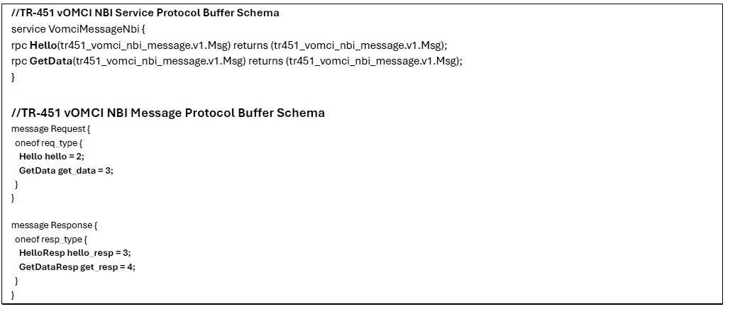
Protocol Buffers
voltmf ←intf→ vomci Func
The gPB messages is defined by standard as to what messages are to be supported. And as part of the project we will be implementing 2 types of messages to demonstrate the mTLS.

Slide 11
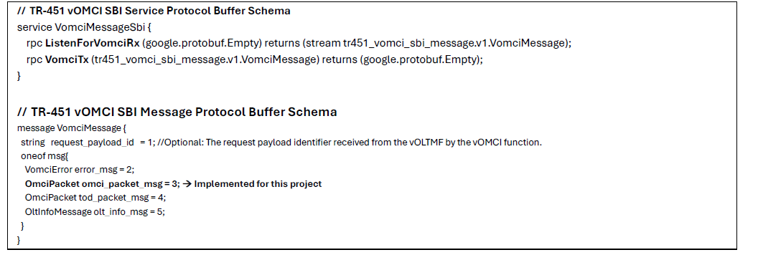
Protocol Buffers
Vomci Func ←intf→ vomci Proxy
The gPB messages is defined by standard as to what messages are to be supported. And as part of the project we will be implementing the OMCI packet message over the gPB.

Slide 12
Message Communication Design
vOLTMF
vOMCI Func
vOMCI Proxy
GetData()
Format a GET OMCI Message
Start GO Routine for listening
Streams from vomci proxy
listenforvomciRx()
vOMCITx waits for message from
listenForvomciRx() by using a
GO Channel which blocks
vOMCITx(vOMCMsg)
Streams response via vomci Proxy’s listenForvOMCIRx()
listenforvomciRx()
listenForVomcIRx() puts
The response into waiting
GO channel of vOMCITx(), which
Formulates the GET Response
GetDataResponse()

Slide 13
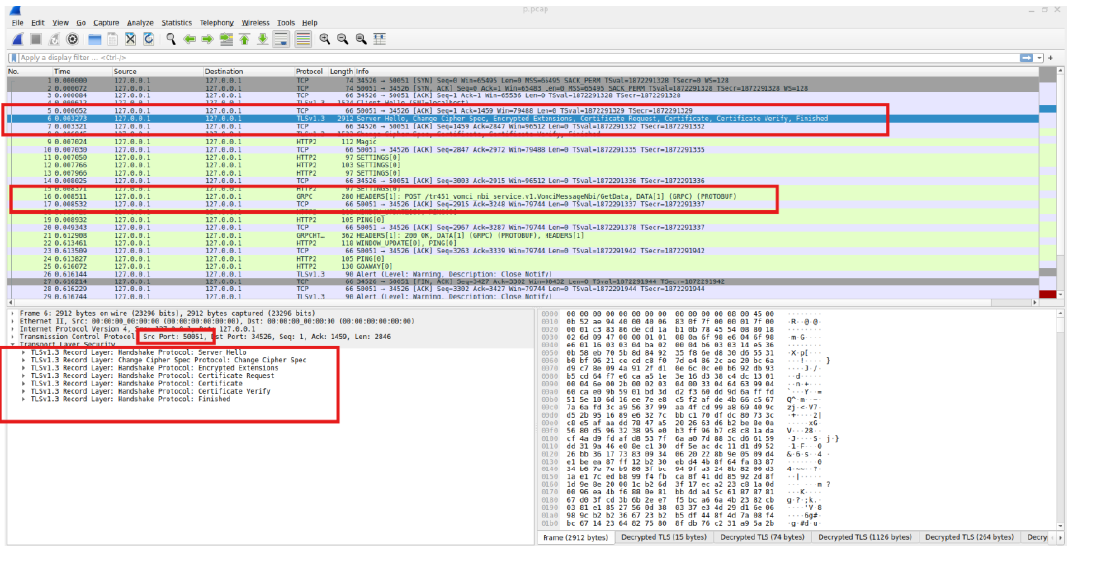
mTLS1.3 b/w vOLTMF & vOMCI Function

Slide 14
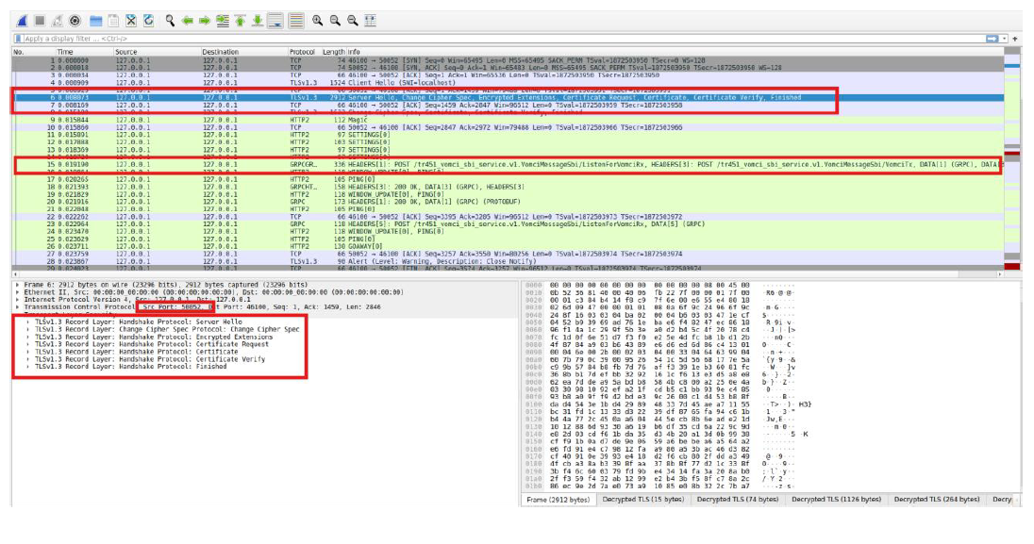
mTLS1.3 b/w vOMCI Function & vOMCI Proxy

Slide 15
Certificate Rotation Design
vOMCI Module
Load vOMCI Func
Client & Server certificate
GO Routine
Watches certificate
folder
Event of certificate
change
Re-Load vOMCI Func
Client & Server certificate

Slide 16
TLS-PSK with Machine Learning Key
A novel idea for use cases where the certificates don’t want to be used but rather if the operator decides to
use PSK in TLS, the operator needs a method to generate a random PSK.
However, any random generator can provide the unique set of PSK. But the operator needs to understand
the required randomness in the key to basically deploy in production which requires evaluation of the keys
generated through a known method.
If no benchmarks available then the key can be susceptible to attacks which can lead to compromise of
PSK key.
Thus this novel idea proposes to use the machine learning algorithm using Robust Tensor Decomposition
with neural network to generate a key sequence of high entropy, which will be used in TLS as the Pre-Shared
Key.
However, the chaotic key sequence obtained from the model is a huge data and to use the entire data as PSK
in TLS is not a feasible option, since, the OpenSSL Library used supports only 256 bytes of data. So, we introduce
a mechanism to cycle the chaotic sequence in the same order of 256 byte between client and server so that
both modules use same key at every connection making sure successful authentication is possible between
the modules also ensuring that the PSK method in TLS is achieved.

Slide 17
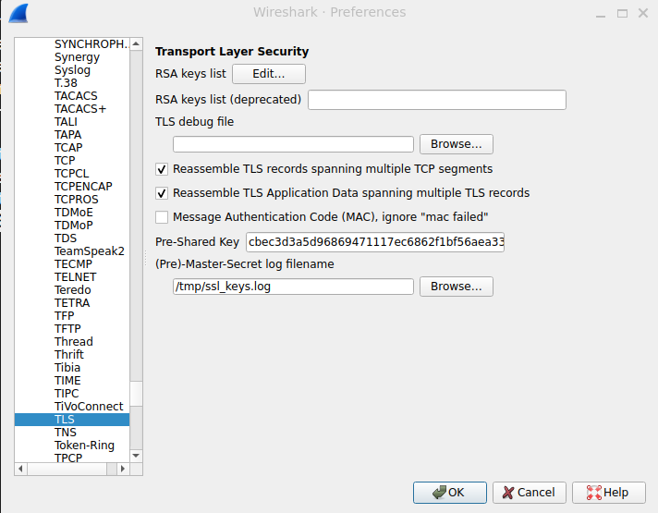
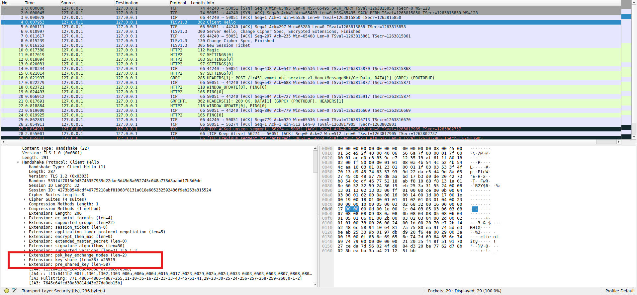
Results of TLS-PSK

Slide 18

Thank You ☺

